Slide 1

Student Behavior
&
Expectations Meeting

Slide 2
Meet Your Administrators
Dr. Dowdy- Principal
Ms. Cayton- Assistant Principal
Ms. Lind- Assistant Principal
Ms. Eshbaugh- Dean of Students

Slide 3
Major Code
Motivated: We strive to do our best
Attitude: Participate enthusiastically
Joined: Together we make ourselves better
Ownership: Accountable for our actions
Respect: Care for self, each other, and our environment
Respect ~ Responsibility ~ Ready to Learn

Slide 4
Stand Up for Your Rights
Issues that threaten your safety or your ability to not come to school and be harassed must be reported
    Counselor
    Teacher
    Dean of Students
    Assistant Principal and/or Principal
  *If you see something, say something,
  if you hear something, say something*

Slide 5
Bullying
Bullying is unwanted, aggressive behavior among school aged children that involves a real or perceived power imbalance.
  Direct Contact through hitting or shoving
  Verbal assaults such as teasing or name calling
  Socially isolating or manipulating a student
  Writing/Posting threats or harassment on the internet or through cell phone text messages

Slide 6
School-wide Expectations
Cell phones are OFF & AWAY for the day
If a student is found using their phone:
  A student’s cell phone will be confiscated and held for parent or guardian pick-up on the first offense
No electronic games, Beats, iPods, AirPods, or Smart watches
No open drinks or containers

Slide 7
Items Prohibited
Lighters/Matches
Weapons/or look a likes (water guns, Pop Its, etc.)
Vapes/Cigarettes
Offensive reading material, pictures, or music

Slide 8
Dress Code
Attire with any language or images that are vulgar, discriminatory, or obscene
Attire that promotes illegal or violent conduct (ex: weapons, drugs, alcohol)
Attire that contains threats
Clothing that exposes cleavage, private parts, the midriff, or undergarments
Sagging or low-cut pants
Head coverings/Full face masks
  We will permit & honor any religiously or ethically specific garment or head covering/hairstyle

Slide 9
Hallway Expectations
Follow the directional arrows
No looping; go directly to your class
No running, yelling, or horse play
Keep your hands and feet to yourself
No using the bathroom between classes unless it's an emergency

Slide 10
Bathroom Expectations
Must have permission from your teacher, a Hall Pass, & a physical pass
1 student out of a classroom at a time (unless of an emergency)
No more than 3 students in the bathroom at a time
No cell phones permitted in any bathroom
Use the bathroom, leave, & report back to class

Slide 11

During Class
Follow teachers’ classroom rules and expectations
Follow first ten last ten rule when using the bathroom
Must have a Hall Pass to leave/enter class
Phones are OFF and AWAY for the day
No open cups or food after breakfast unless lunch is being held in the classroom

Slide 12
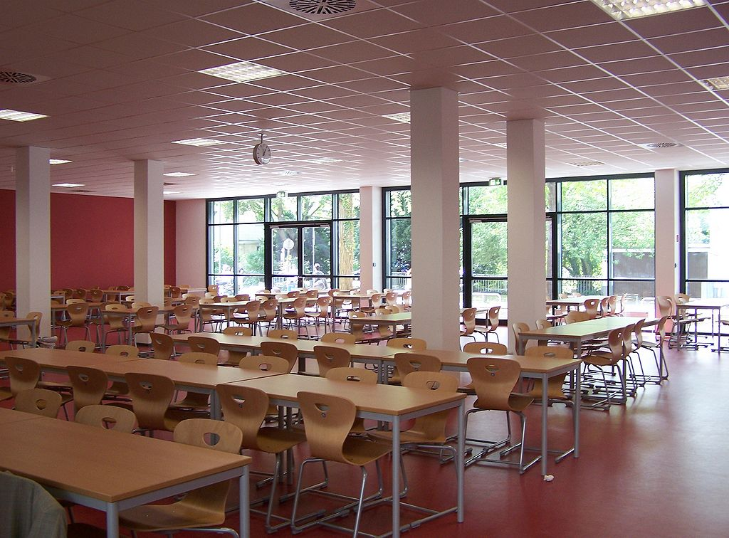
Cafeteria Expectations
Stay in your seat & with your class
Talk quietly
Only touch and eat your food
Clean and pick up after yourselves
NO PHONES & any other electric device
All trash will be thrown away on your way OUT of the cafeteria
Respect each other and all adults present in the cafeteria

Slide 13

Bus Expectations
Remain seated and facing forward
Talk quietly
Follow the directions of the driver
Exit the bus at your OWN stop
Riding the bus is a privilege, not a right
Notes are required for any daily changes (please take to the front office as soon as possible)

Slide 14
Consequences for Behavior
Any consequence given by your classroom teacher can include the following:
  Parent phone call
  Silent Lunch
  Time Out
  Discipline Referral
  After-school detention
  Any consequence given by an administrator can include the following:
  In-school suspension
  Out of school suspension
  ASD

Slide 15
Student of the Month
Follows classroom/school rules and expectations
Displays character and citizenship
Positive attitude towards others/learning
Good attendance and behavior
Shows improvement
Respectful to students/staff
Student of the Month Award
Presented to:
Your Name Here
CONGRATULATIONS ON YOUR OUTSTANDING ACHIEVEMENT AND HARD WORK

Slide 16
It is going to be a
GREAT SCHOOL YEAR! ☺

Slide 17
Any Questions?

