Slide 1
PAPER BASED ACCOMODATED TEST
ORDERING & RETURN INSTRUCTIONS
FALL/WINTER 2026

Slide 2
Eligibility
A student with a disability who has an IEP or Section 504 Plan may be eligible for paper-based accommodations (regular print, large print, braille, one-item-per-page) on computer-based statewide assessments.
Decisions regarding accommodations, including eligibility for paper-based accommodations, should be based on a student’s needs and should not be made for preferential reasons.
Students who are eligible to receive paper-based accommodations must have an IEP or Section 504 Plan that clearly indicates the reason that the computer-based test is not currently accessible or appropriate for the student.
See pages 15–16 of the 2026–2027 Accommodations Guide for additional information.
*Make sure you update Testing Indicator in TIDE to reflect Paper Based test instead of computer based (3-10) or Alternate Response Accommodation (K-2)

Slide 3
Eligible Tests for PBT
STAR Reading (K-2) * No Paper option for Star Early Literature
STAR Math (K-2)
FAST Reading Retake
FAST Reading (3-10)
FAST Math (3-8)
BEST Algebra EOC
BEST Geometry EOC
Biology 1 EOC
Civics EOC
US History EOC
FCLE

Slide 4
Where to Find Assistance
Each assessment group (K-2 & 3-10) has its own Accommodations Manual found on the FAST portal
Manuals are also linked in Google classroom
Manuals outline most allowable accommodations. * If you have a question if something is allowed, check with your school’s staffing specialist or Renae Ellsworth, ESE Program Specialist.

Slide 5
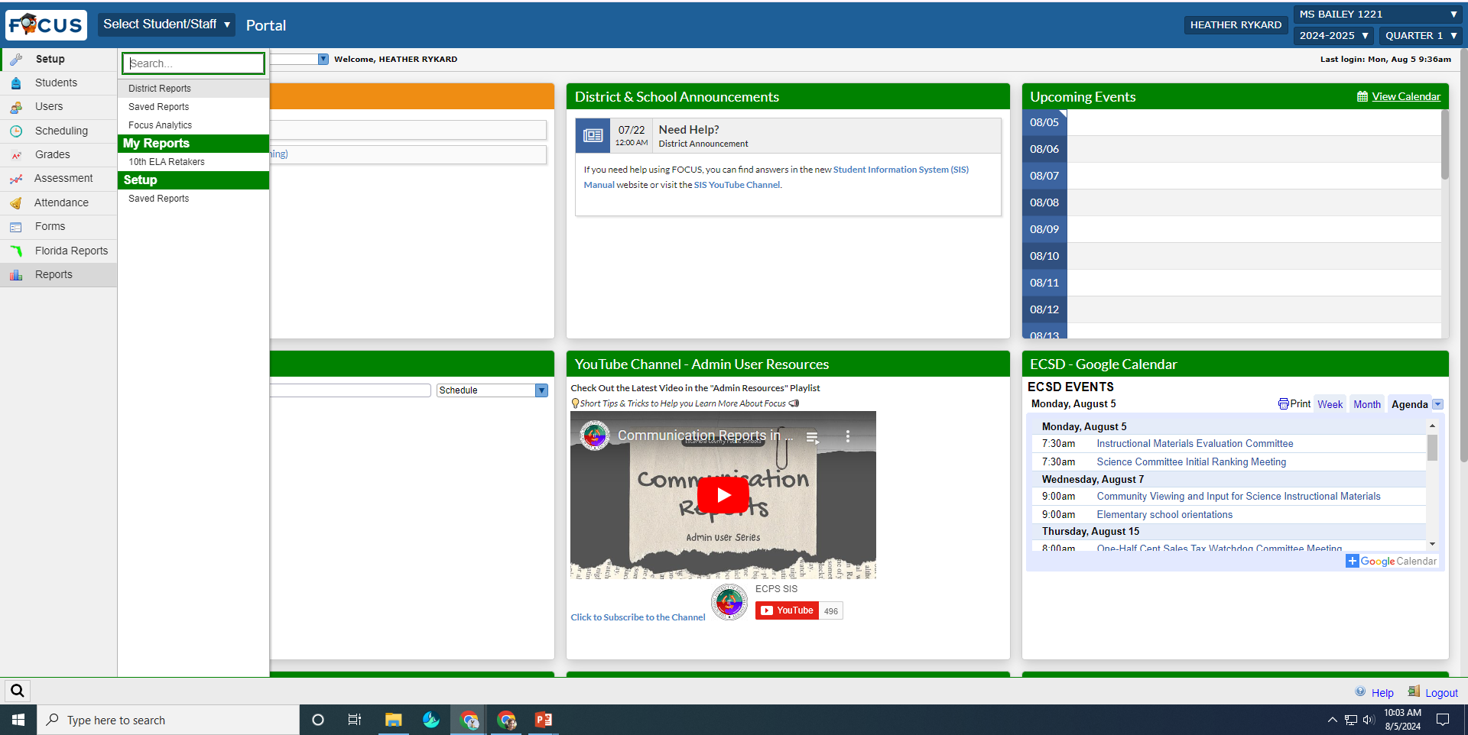
Ways to Check Who Has PBT?
For students with an IEP, easiest is to use the “ESE Testing Accommodations – School” Report found in the “Reports” menu in FOCUS

Slide 6
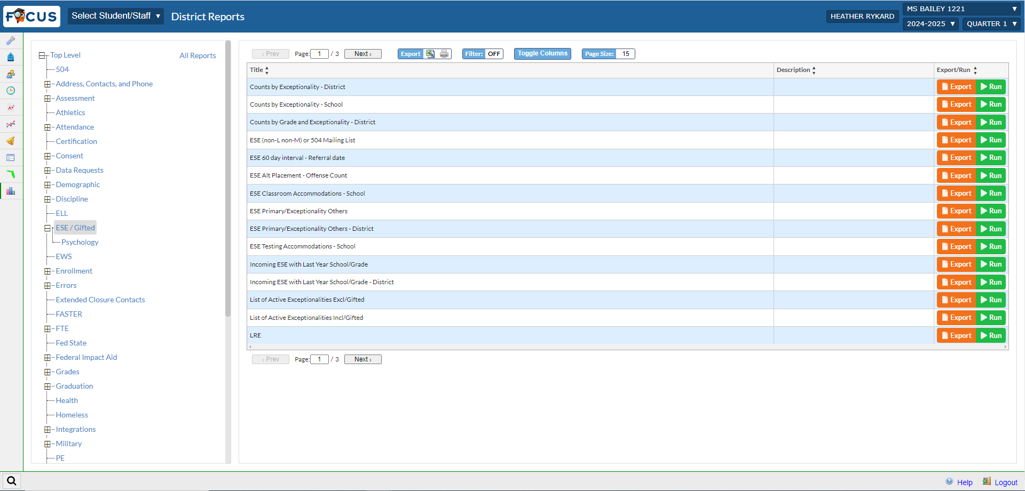
District Reports
Click on District reports then the “ESE/Gifted” option to open the ESE/Gifted reports. Select the “ESE Testing Accommodations – School”

Slide 7
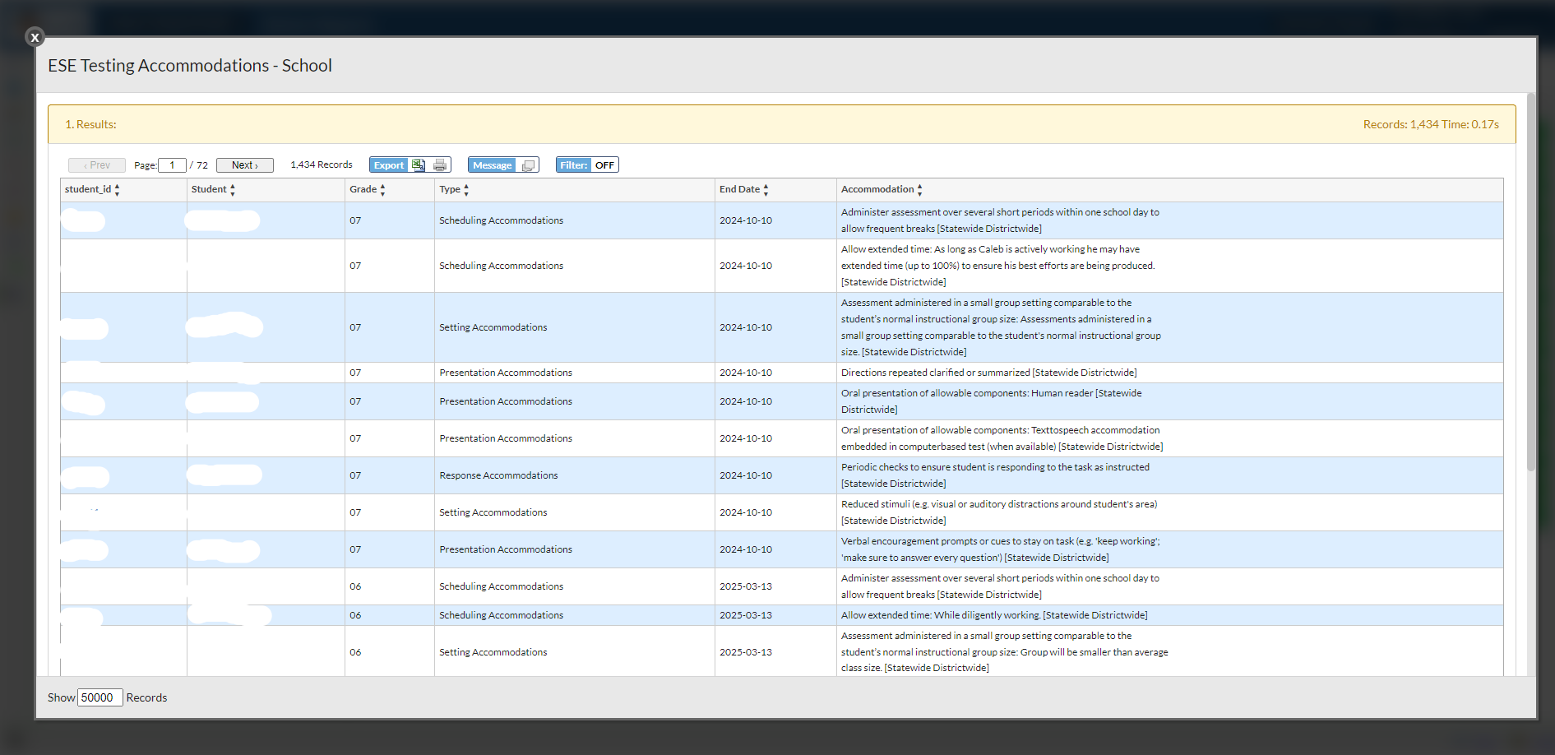
Report Results
Results will show each accommodation as a line entry. You can filter the report by a specific keyword (i.e. “paper”, “large”, or “braille”)
You can also export to excel or sheets to work with the data out of FOCUS

Slide 8
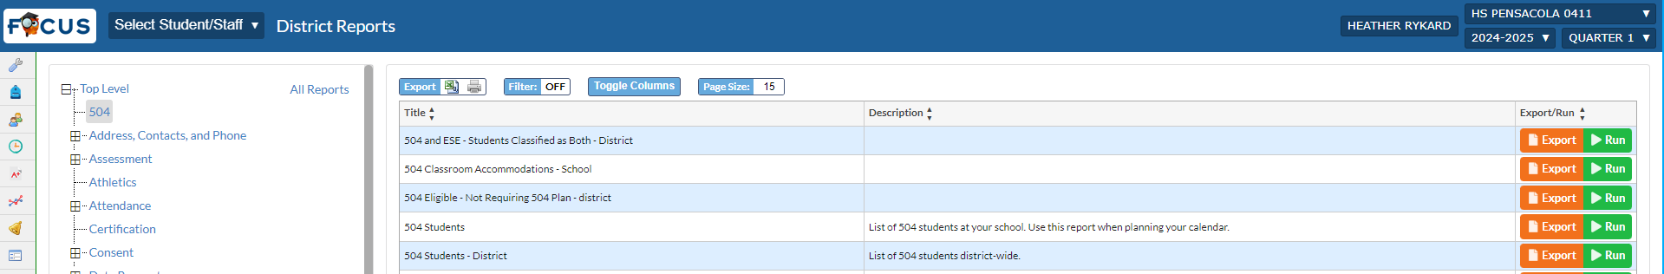
Students with a 504
For student with a 504, you will have to look at each individual 504 plan to determine if the student has a paper based accommodation.
If you have returning students, you won’t have to look these up unless the 504 has changed.
There is a report that will show you students who have an active 504
It is housed in “Reports”->”District Reports”->”504”->”504 Students”
The other reports in this menu WILL NOT show you accommodations

Slide 9
504 Students
To view the actual accommodation plan, you will need to first pull up an individual student in FOCUS
Click on the “504” tab in the student’s demographic panel
In the “504 Annual Review” section, there are uploaded files for each year’s 504 meetings. You will have to click and download the current accommodation plan
If you do not have access to see the 504 tab, check that your principal has given you the “Test Coordinator” role in FOCUS

Slide 10
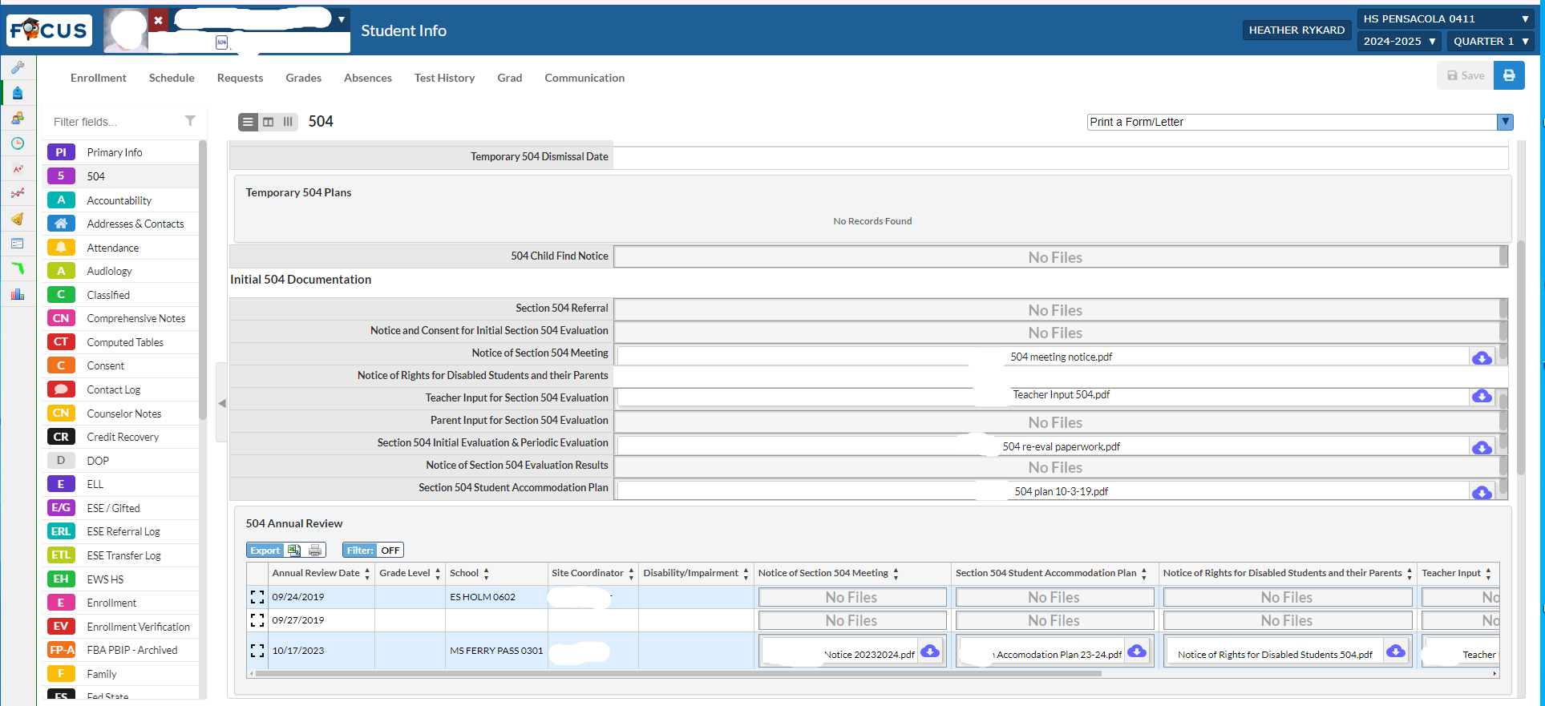
Make sure to open most current

Slide 11
Requesting a Paper Based Test
  Each school has a shared google drive -> Eval – SchoolName
  There is a folder named “Paper Based Test Requests”
  - You will have a blank template and a file for your active paper based students
  Students from last year have been updated. Please verify with your ESE/504 that plans are still active
  Eval will order tests for students and notify schools upon delivery
  ** Schools MUST update TIDE to reflect Paper Based Assessment (Change Test Indicator to requested PBT type)
    This includes BEST Writing (Gr 4-10) and Statewide Science (Gr 5/8)
  As meetings are held or updated, please ensure you communicate with your ESE and 504 Coordinators and update your file

Slide 12
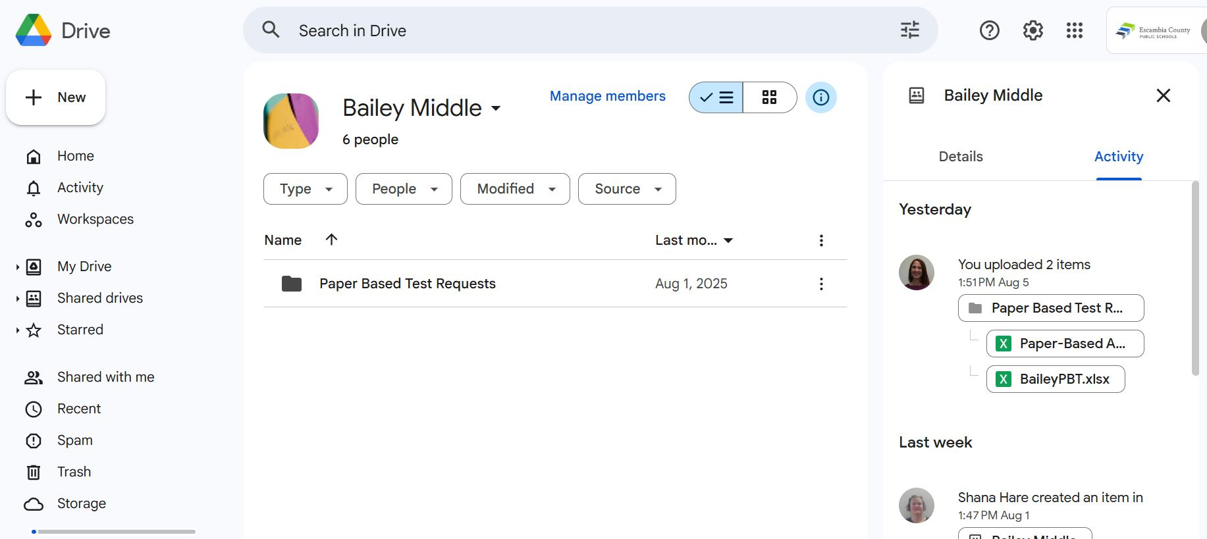

Slide 13
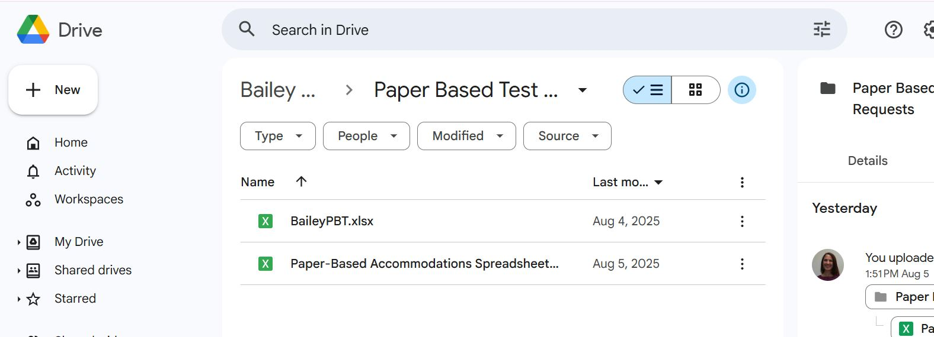
PBT Files in Drive
Data is in the school named file (BaileyPBT)
Blank template is the other file

Slide 14
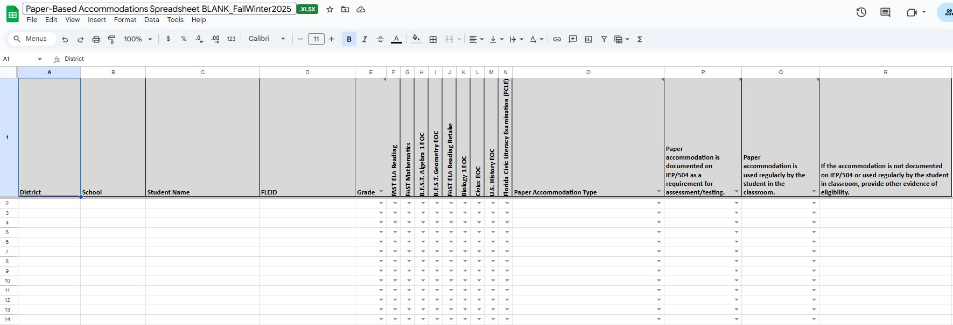
Blank Template
Blank spreadsheet is the state’s template
Data fields in Column E – Column R are drop down filled (arrow)
If you do not have access to view FLEID in FOCUS, have your school admin change your profile in FOCUS

Slide 15
Pre-Test Activities
PreID labels must be applied to all regular print test documents for Grades 3–10 FAST ELA Reading and Mathematics, FAST ELA Reading Retake, EOCs, FACT College Algebra (Spring only), and FCLE.

Slide 16
K-2 After Testing
All Grades K-2 paper based test responses are entered into the Renaissance Growth Platform (RGP) by 2 school personnel
All tests that were entered into RGP are mailed back as NOT TO BE SCORED with a WHITE label and Ground UPS return ship label
* If you have a Braille test, you may choose to enter responses into RGP or mail back to vendor as a “traditional” paper based test
* Braille manipulatives are returned to Florida Instructional Materials Center for the Visually Impaired (FIMC-VI) with the FedEx label

Slide 17
3-10 After Testing
All Grades 3-10 paper based test responses are entered into the Response Entry Interface (REI) by 2 school personnel
These personnel will also have the School Data Entry (SDE) role in TIDE to enter the student responses
The paper based test that the student wrote in will be mailed back as a “NOT TO BE SCORED” test since you have entered responses into REI (and it is now treated like a computer based test for scoring purposes)
Mail back the used test with the White “Not To Be Scored” label and Ground UPS shipping label
* If you have a Braille test, you may choose to enter responses into REI or mail back to vendor as a “traditional” paper based test
* Braille manipulatives are returned to Florida Instructional Materials Center for the Visually Impaired (FIMC-VI) with the FedEx label

Slide 18
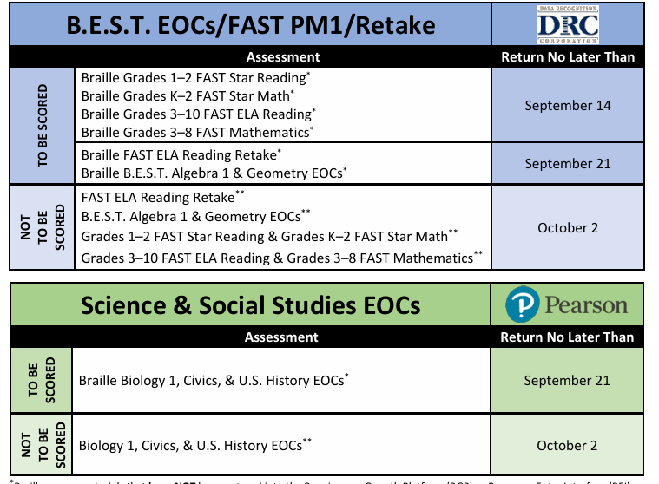
PBT Deadlines

Slide 19
Writing PBT Returns, 2026

Slide 20
PM3/EOC Returns, 2026

Slide 21
Final Reminders
Paper based tests are always Secure material. They are to stay in the Secure test storage (limited access)
Do not leave boxes for shipping out on a counter for UPS to pick up. Boxes must stay in your possession or in secure storage until UPS arrives
Administration records are still filled out for a single student in a paper based testing session. You complete a security log, seating chart and admin record/security checklist for that test.

Slide 22
Questions?
Call or Email
Heather Rykard, TSA
hrykard@ecsdfl.us
850-469-5387(Heather)/5386(Main Eval)

