Slide 1

KHS Class of 2027 Information Night
August 13, 2026

Slide 2
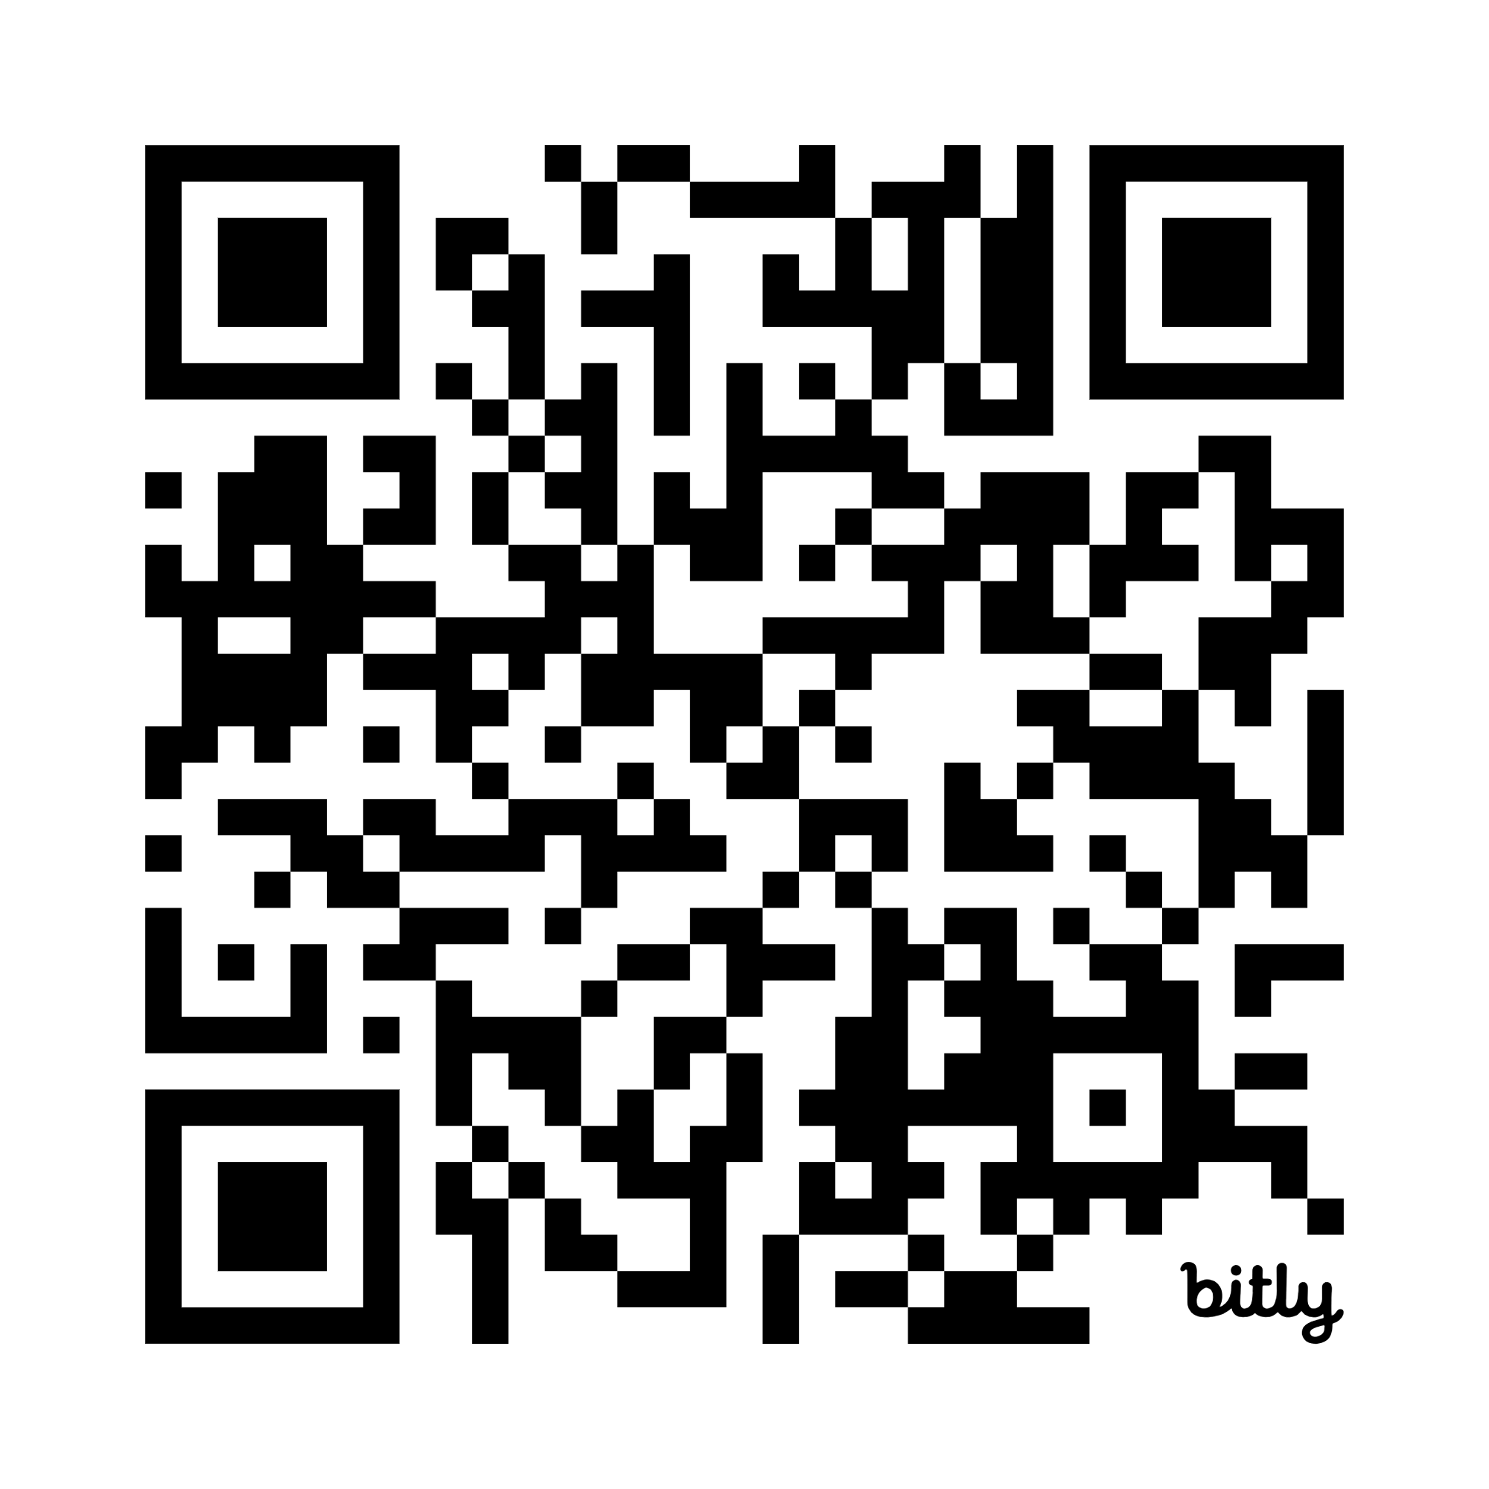
Please complete the pre survey:
bit.ly/classof27pre

Slide 3

Goals for this meeting
Introduce you to Student Services staff
Review graduation requirements
Review important information for senior year
Post-secondary planning Information
  College
  Workforce
  Military

Slide 4
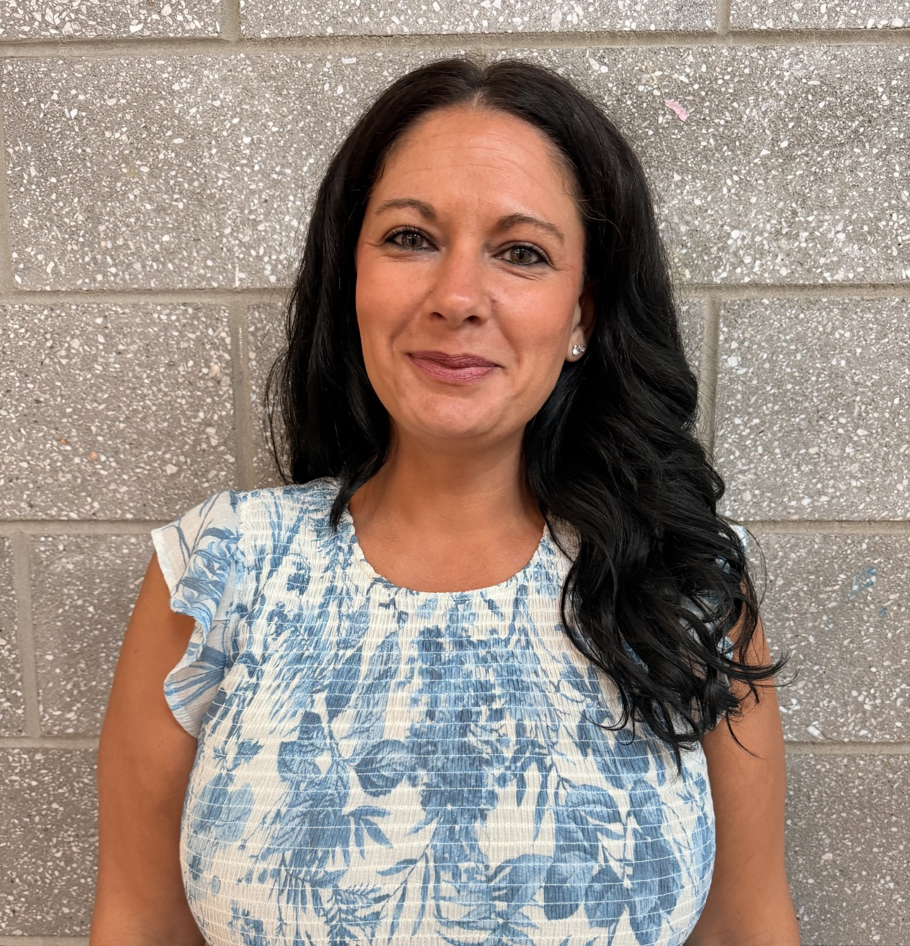
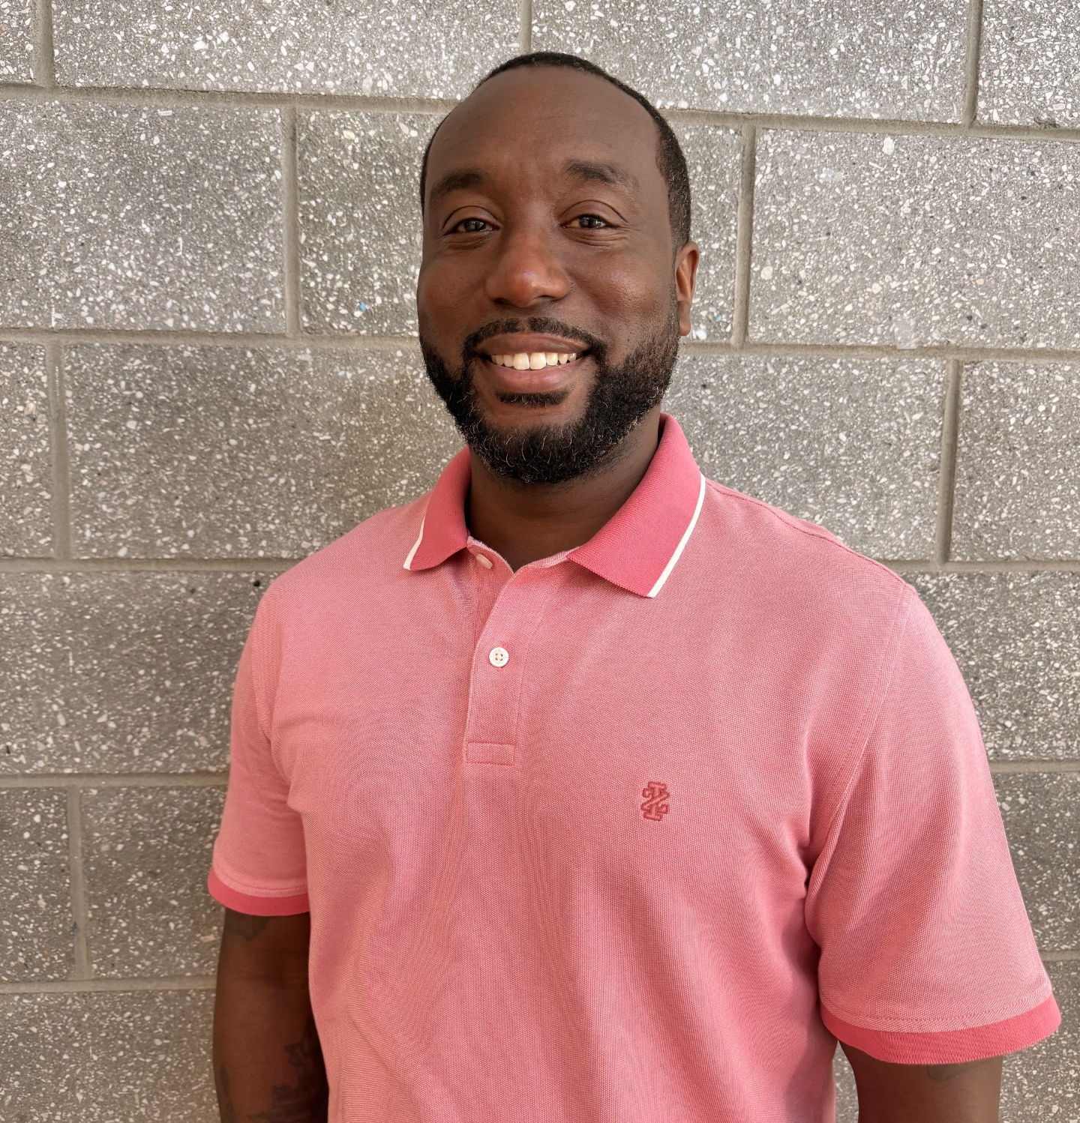
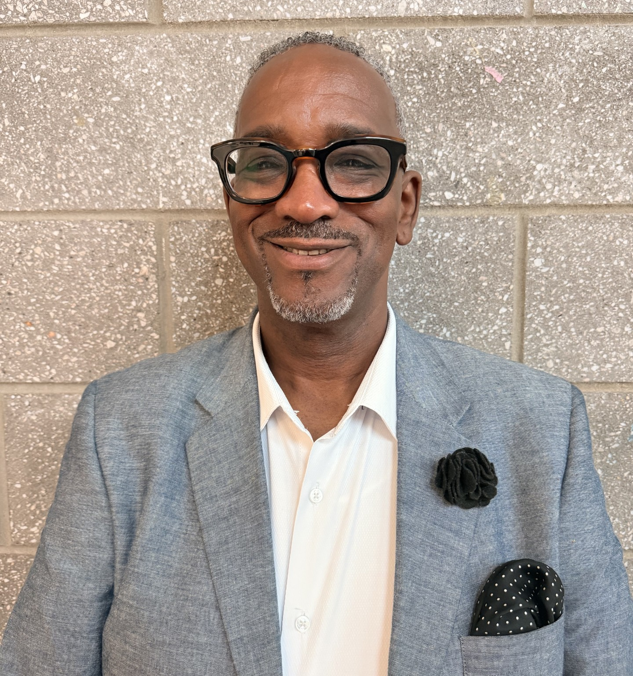
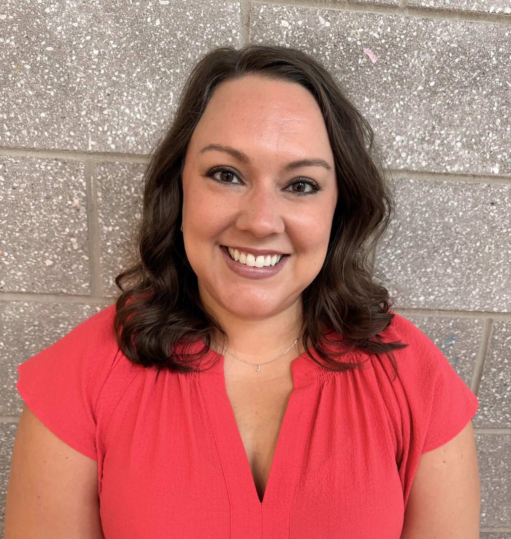
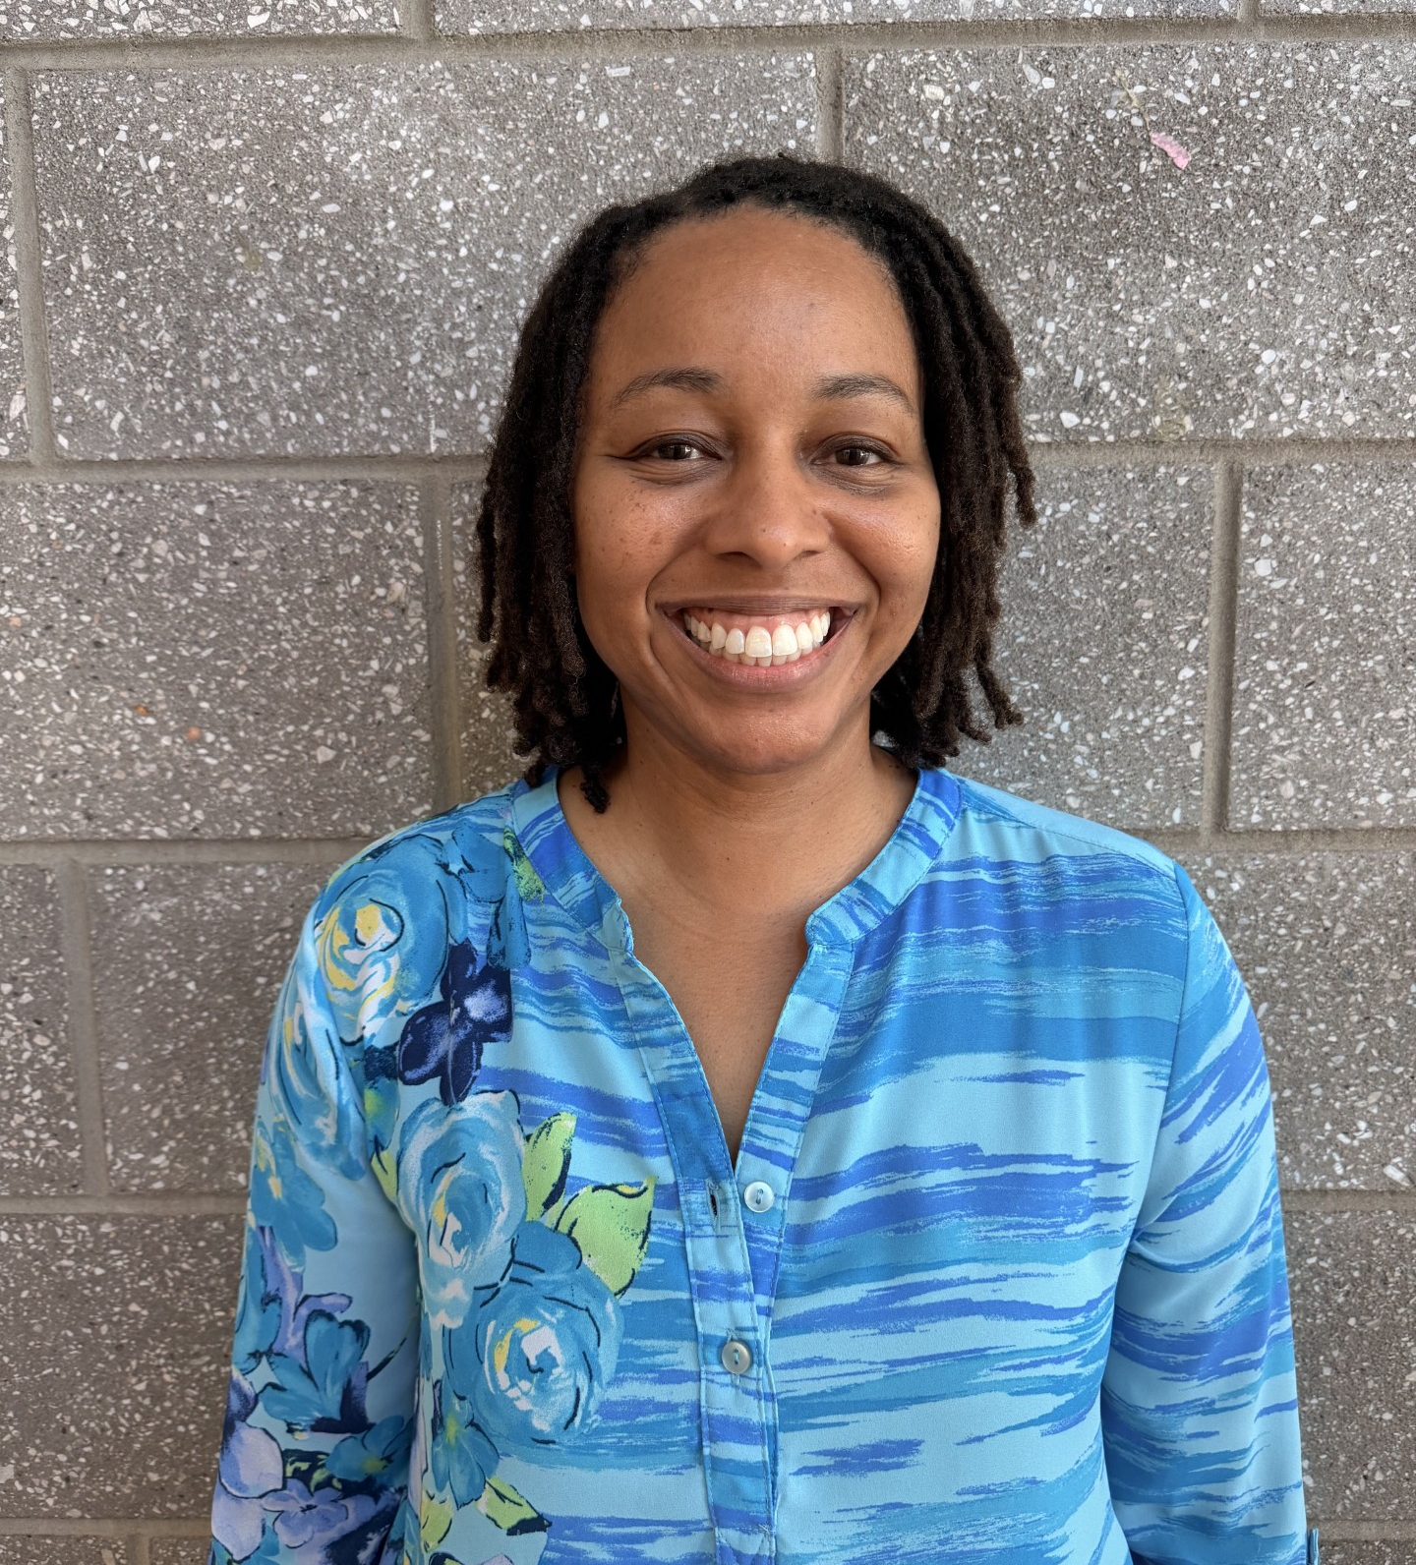
Mrs. Parker
Last Names A-D
jmparker@wcpss.net
Mr. Hutchinson
Last Names E-K
shutchinson@wcpss.net
Mr. Blackwell
Last Names L-Q
mblackwell@wcpss.net
Senior Counselors
Mrs. Strutz
Last Names R-Z
jstrutz@wcpss.net
Mrs. Thomas
OCS Students
ktthomas@wcpss.net

Slide 5
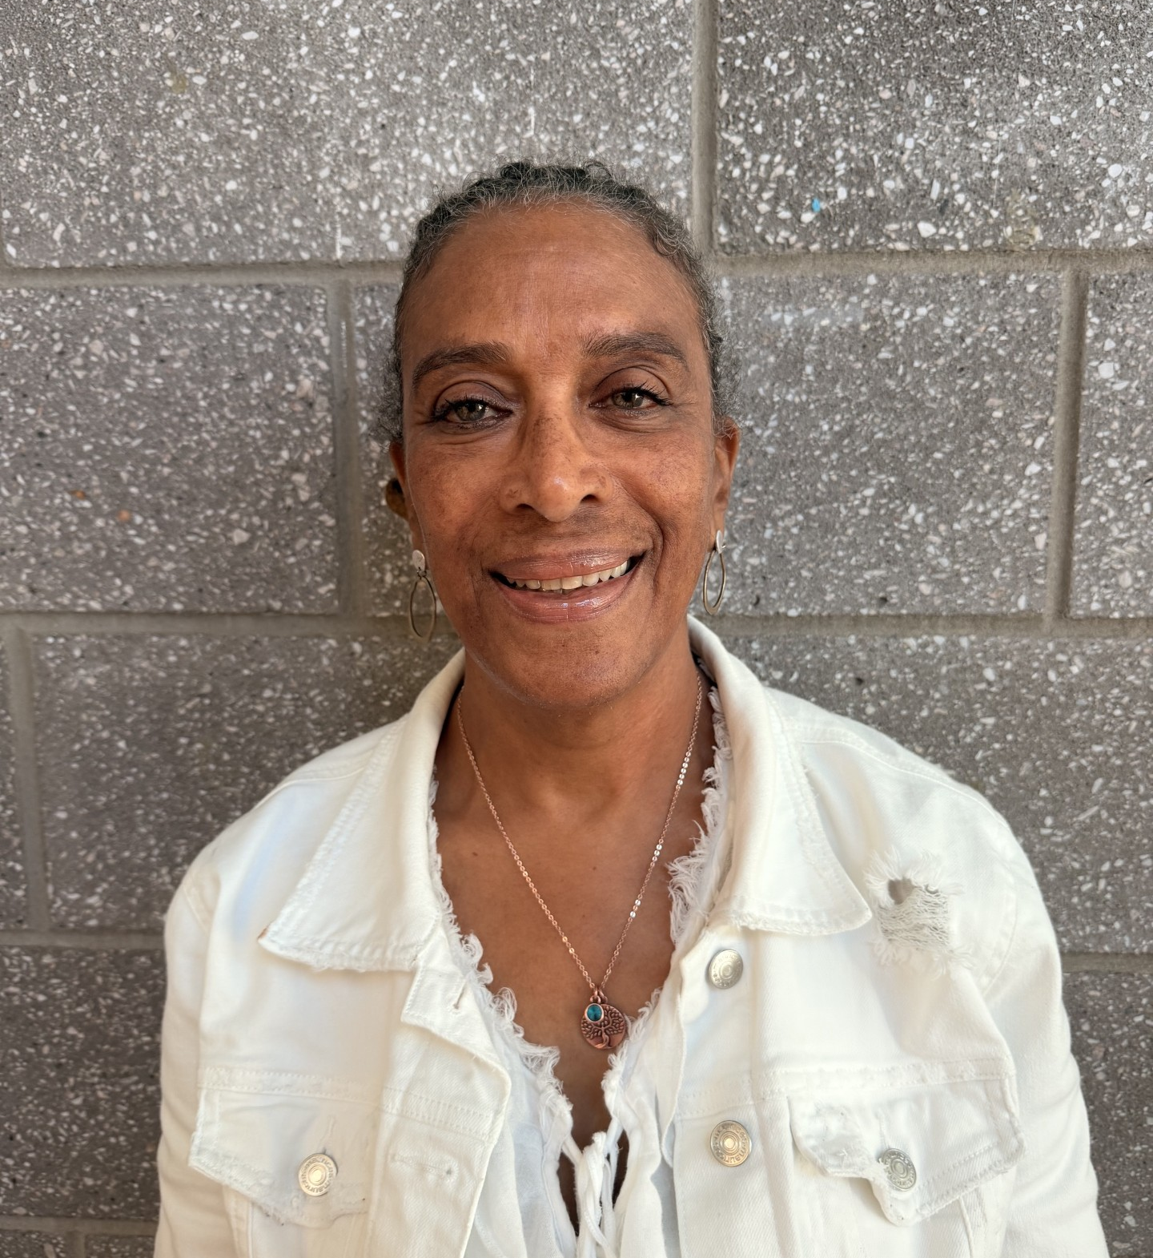
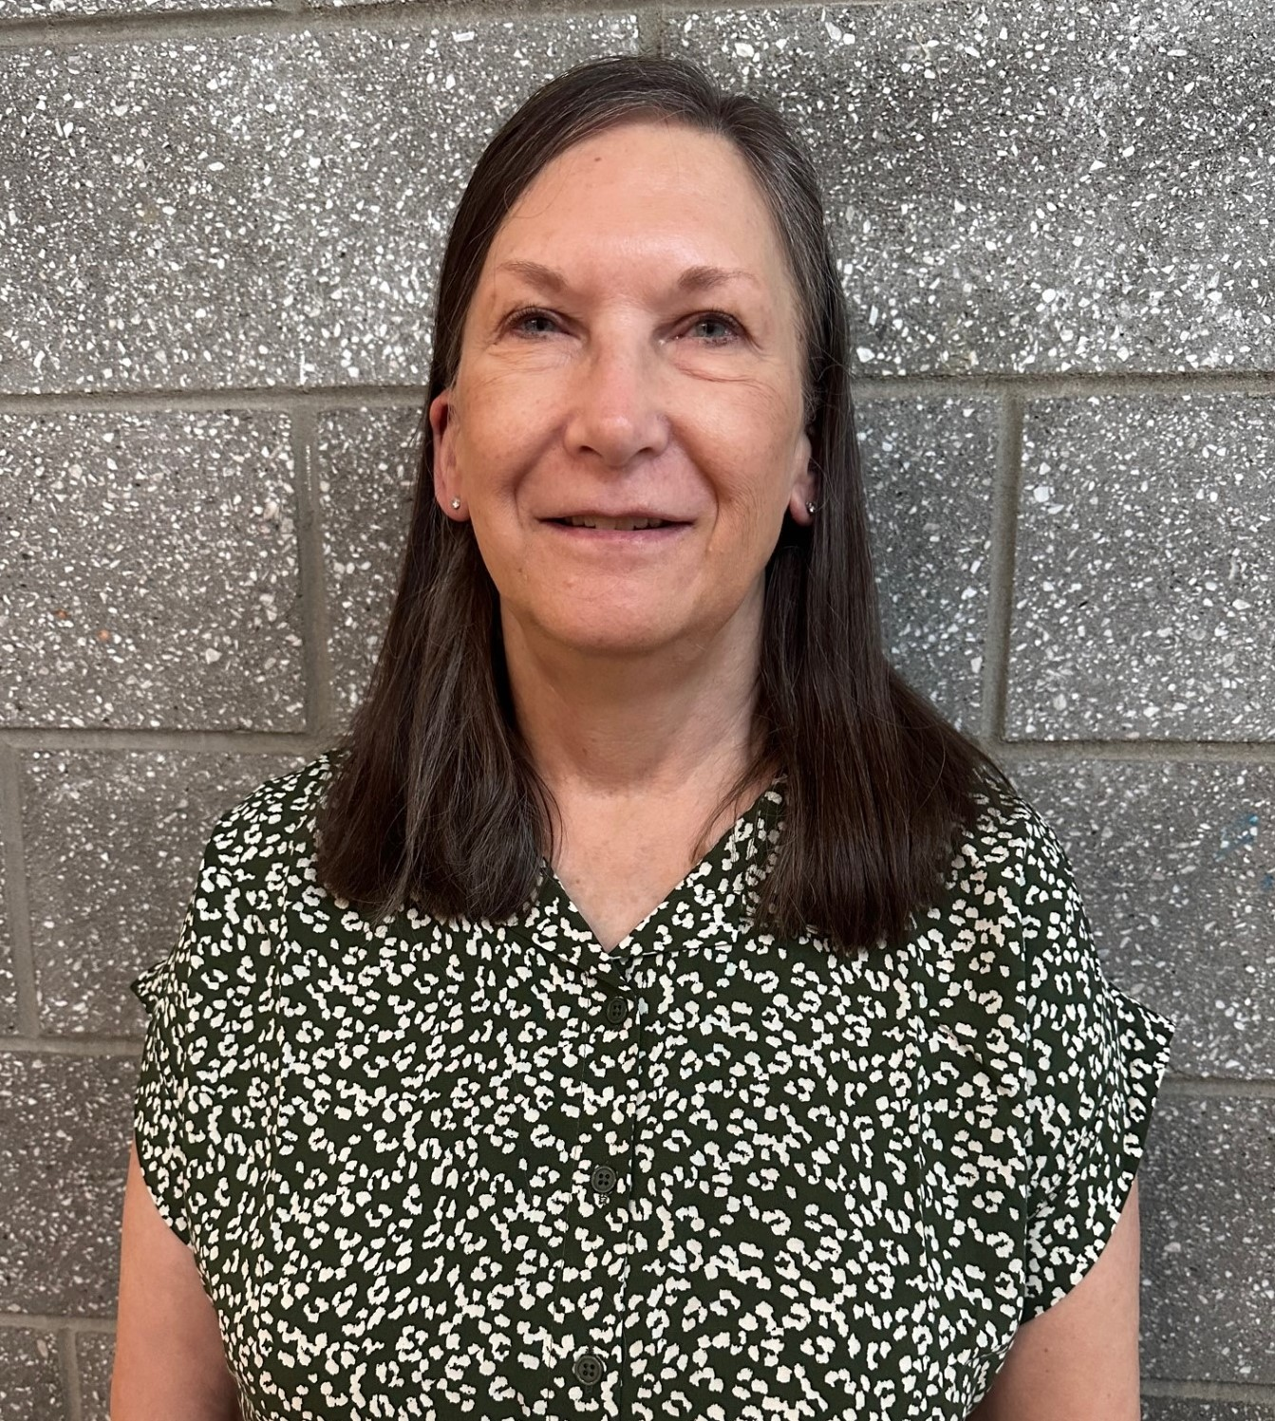

Student Services Staff - Other Staff
Mrs. Lee
SAP Counselor
alee2@wcpss.net
Ms. Klug
Guidance Secretary
lklug@wcpss.net
COMING SOON!!
College Advisor
TBD

Slide 6



Stay Connected!
Instagram: knightdalehscounselors
Student Services Website: knightdalehs.wcpss.net/student-life/student-services
Phone Messenger/Email/Talking Points: Mr. Baker sends home regular updates/info. Make sure your phone number & email are updated in our system.

Slide 7
Class of 2027 Remind Groups
Text 81010
Last Names A-D:
@khs2027ad
Last Names E-K:
@khs2027ek
Last Names L-Q:
@khs2027lq
Last Names R-Z:
@khs2027rz
Students and their parents are invited to join the Student Services Remind group to stay connect with things happening through our office.
This group will be used as a way to help remind students/families when important information goes out about various events.

Slide 8
Graduation Requirements
Graduation Requirements
Subject Area | Courses
English | 4: English I, II, III/AP Language, IV/AP Literature
Mathematics | 4: Math 1, 2, 3, & adv. math above Math 3 (Math 4, Pre-Calc, Stat)
Social Studies | 4: World History, Civic Literacy (or AP US Gov & Politics), American History (or AP US History), Economics & Personal Finance
Science | 3: Earth Science/AP Environmental Science, Biology, Chemistry or Physical Science
Health/ PE | 1: Healthful Living I
Electives | 6
Total Credits: 22

Slide 9
Additional Requirements for College Admissions
UNC System Minimum Course Requirements for admissions:
Two additional academic courses from English, mathematics, science, social studies, world languages, or computer science needed if applying to a UNC System school.
Note: these courses should be selected in alignment with a student’s academic and career objectives. Completion of two sequential world language courses is recommended.
Out of state schools:
Check for individual school’s admissions requirements.
Many school still requiring two levels of a foreign language.

Slide 10

Graduation Orders
Seniors will receive order packets from Jostens during an in school meeting on September 9.
Jostens will be on campus September 15 for students to place graduation orders during lunch.
Jostens Parent Order Night - September 15, 5:00-6:30 pm
  Families who would like to place graduation orders in person with Jostens representative
    Cap & Gown
    Graduation Announcements
    Class Rings

Slide 11

Student Name on High School Diploma
Every student will have their legal name printed on their birth certificate.
  No preferred names or nicknames
Look at Infinite Campus to check the spelling of your student’s name. If something is incorrect, please provide a new birth certificate to Student Services.

Slide 12

Final Exam Exemption Policy - NEW for 26-27
Per WCPSS policy, students may be exempt from teacher made exams based on the following criteria:
Anticipated final average of:
  An “A” (90 or above) & 3 or fewer absences
  A “B” (80-89) & up to 1 absence
  No more than 4 tardies in the course
  No violation of Policy Code: 4310 Honor Code (cheating & plagiarism)
Students are required to take all state tests (CTE & EOC) .

Slide 13
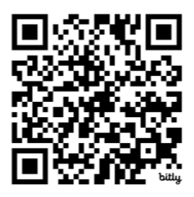
Acceptances - share your good news with us!
Please complete the form to share:
College acceptances
Scholarship awards
Military enlistments
Full-time job offers
bit.ly/acceptances27
Notes:
Students must use their WCPSS to complete.
Documentation of acceptance is required. 1 acceptance submission per form.

Slide 14
Latin Class Ranking System
Cum Laude: weighted GPA between 3.75 and 3.99
Magna Cum Laude: weighted GPA between 4.0 and 4.249
Summa Cum Laude: weighted GPA above 4.25
Class rank and all senior honors are based on
1st semester final grades.

Slide 15

Has your Senior received their Meningococcal Vaccine?
North Carolina law requires the Meningococcal vaccine
& booster for entry into 12th grade.
Parents must submit an updated immunization record to
Mrs. Barrett (lbarrett@wcpss.net), data manager, ASAP.
Students will not be able to access their classes if immunization records are not received by the 30th day of school.
Notes:
Students will be excluded after 30 days if no proof of vaccine

Slide 16

Senior Fee
PAYABLE
ON KHS WEBSITE
$40
ALL seniors must pay in order to receive their tickets for graduation & diploma.
What does it cover?
Diploma Cover
Costs associated with graduation
Senior Awards Night
Stole
etc...

Slide 17

Senior Meetings
Individual meeting with counselor to discuss credits needed for graduation, post-secondary plans, answer questions, etc.
Meetings will begin August 31
Counselors will go through English IV and Economics & Personal Finance classes. Appointments will be scheduled for students not currently enrolled in these courses.
Counselors will review the Senior Planning Guide. Students will receive access to a digital copy of the Senior Program Planning Guide.

Slide 18

How to Request a Transcript
Using
Common App?
Transcript will be sent by counselor once student adds their counselor to their Common App account
Schools in NC not
through Common App
CFNC
www.cfnc.org
(no fees & unlimited submissions)
Schools outside of NC
Scriborder
wcpss.scriborder.com
(first 3 requests are free; fee for each request thereafter)

Slide 19

FINAL Transcripts
Students are responsible for requesting their final transcript through wcpss.scriborder.com at the end of the school year.
Counselors are unable to send transcripts to schools!

Slide 20

Wake Tech Career and College Promise Program
Allows eligible high school students to earn college
credit for FREE!
Learn more about CCP on our website: knightdalehs.wcpss.net/page-detail/~board/knightdale-hs-student-life-student-services-college-and-career/post/wake-techs-college-career-promise
Wake Tech CCP website:
www.waketech.edu/admissions-aid/career-and-college-promise

Slide 21
Wake Tech CCP
Information for Spring 2027 CCP enrollment dates/deadlines will be posted on Wake Tech’s website in September.
Watching the information session is a HIGHLY ENCOURAGED first step for interested prospective students.
Notes:
*Remind seniors that they are also eligible for CCP the summer after graduating.

Slide 22
Post Secondary Planning:College Bound

Slide 23
Counselor Recommendations/Statements
Ask at least 10 school days in advance (do not wait until the last minute!)
List the correct school counselor & email on forms/applications
Fully complete the Student Brag Sheet Google Form & resume
If you do not adhere to these policies, your counselor may be unable to provide your recommendation in a timely fashion.

Slide 24
NC College Connect - www.cfnc.org/nc-college-connect
NC College Connect provides direct admission for eligible NC high school seniors to participating NC colleges and universities.
You may qualify if you:
✅ Are on track to graduate
✅ Have a 2.8+ weighted GPA
✅ Are enrolled in (or already completed) 4th-level math
✅ Meet program requirements
The higher your GPA, the more schools you may be directly admitted to!
Don't have a 2.8 GPA? If you are on track to graduate, you’ll be directly admitted to your local community college!
What Happens Next?
Seniors will receive a letter in the mail in mid-September with more information on
which school’s they have been admitted to.

Slide 25




NC Promise
What is NC Promise?
The State of North Carolina established the NC Promise Tuition Plan to increase access to a quality university education by reducing student costs. Undergraduate students at four UNC System campuses: Elizabeth City State University, the University of North Carolina at Pembroke, Fayetteville State University and Western Carolina University, pay only $500 for in-state tuition and $3,500 for out-of-state tuition each fall and spring semester.
Who is Eligible?
There are no eligibility requirements to take advantage of NC Promise.
How Do I Apply?
You only need to apply for undergraduate admission to one of the four universities that are designated as NC Promise schools. If you are accepted, you will receive the NC Promise state benefit automatically.

Slide 26

NCAA Eligibility Center - Student Athletes
Register online at www.eligibilitycenter.org
Transcripts sent end of Junior year, January, & end of Senior year automatically
If a student registers during school year or needs an updated transcript, please contact Mr. Hutchinson. (shutchinson@wcpss.net)

Slide 27

Community College - Wake Tech
Free application!
No application deadline
Open door acceptance - just need a high school diploma/GED
College Transfer Program - 2 years at WTCC & transfer to 4-year college
Associate Degree or Certificate in a trade
Apprenticeship Program through Wake Works

Slide 28

2027-2028 FAFSA
FAFSA will open on October 1, 2026.
Parents without SSNs are able to create a FSA ID.
All contributors must provide consent to have their federal tax info. transferred directly into the student’s FAFSA form via direct data exchange with the IRS. (No manual entry of data will be allowed)

Slide 29
Post Secondary Planning: Workforce/Military

Slide 30
Career Development Coordinator (CDC) - Ms. Wright
Office: Room 613
Email: lwright4@wcpss.net
Phone: 919-217-5350 Ext. 25142
Schedule an Appointment: https://calendly.com/lwright4khscdc
KHS Career Services is an on-campus career development service offered to all KHS students. It is the home for all things career-related.
​
KHS students should visit Career Services and learn about the many opportunities that are available to them. We offer job shadowing and internships. If your student has at least a 2.5 gpa and has taken Career and Technical Education (CTE) classes, please encourage students to participate before going off to college and majoring in a career they may not like.

Slide 31
WorkKeys
A job-skills assessment system that measures real-world skills employers identify as critical for workplace success.
Taken by high school students completing Career & Technical Education (CTE) courses
Successful completion can earn the National Career Readiness Certificate (NCRC)
Helps employers verify applicants have the core skills needed for a job
Thousands of U.S. employers use WorkKeys assessments alongside a high school diploma when evaluating job applicants
Seniors who qualify for WorkKeys will hear from our testing coordinator some time this year to take the assessment.

Slide 32

Resume/Mock Interviews
Ms. Wright, Career Development Coordinator, can assist with reviewing resumes and can help students prepare for the workforce by holding mock interviews.

Slide 33

Military
Branches:
Air Force
Army
Coast Guard
Marines
Navy
National Guard
KHS has military reps for each branch. They visit the school during lunch.
Speak to Ms. Wright (CDC) to schedule a meeting outside of lunches.

Slide 34

ASVAB
The Armed Services Vocational Aptitude Battery (ASVAB) is a multiple-aptitude battery that measures developed abilities and helps predict future academic and occupational success in the military. It is administered annually to more than one million military applicants, high school, and post-secondary students.
Offered in November & February each year
Notes:
November date unknown at this time per Ms. Wright

Slide 35

Upcoming Events
(Time to pull out those calendars!)

Slide 36

Financial Aid Night
Tuesday, September 15
6:30pm
KHS Auditorium
Learn more about FAFSA completion, RDS, and scholarship searches.
Representatives from CFNC will be at KHS to help provide information to families.

Slide 37

Wake County Schools
CACRAO College Fair
Sunday, September 20, 2026 1 - 4pm
McKimmon Center at NC State University
The fair will provide students and their families with an opportunity to connect with representatives from military branches, colleges, and universities from across the country and learn more about the college search and application process.

Slide 38

NC College Application Week
October 19-25, 2026
www.cfnc.org/apply-to-college/nc-countdown-to-college/
Some NC colleges/universities will waive their application fees during this week. (Participating colleges will be listed on website)
Counselors will hold events during this week for seniors to complete applications, RDS, and FAFSA.

Slide 39
Mark Your Calendars!
Make-Up Senior Pictures: September 4 & October 16 (sign up sheet to come)
Parent Graduation Meetings:
  Dates to be announced at a later time
  English and Spanish sessions will be available
Mid Year Graduation: January 14, 2027 @ 6:30pm
Senior Awards Night: Tuesday, May 18 @ 6:00 pm
Mandatory Grad Rehearsal: TBD
Graduation: TBD

Slide 40

Tips for Senior Year
Keep up the rigor - colleges consider senior year course load in decisions
Successfully complete senior year - college/military acceptances are conditional
Stay out of trouble - colleges/military recruiters can request discipline records
Check your WCPSS student email regularly - this is how we communicate various events & deadlines

Slide 41
Any Questions?

Slide 42
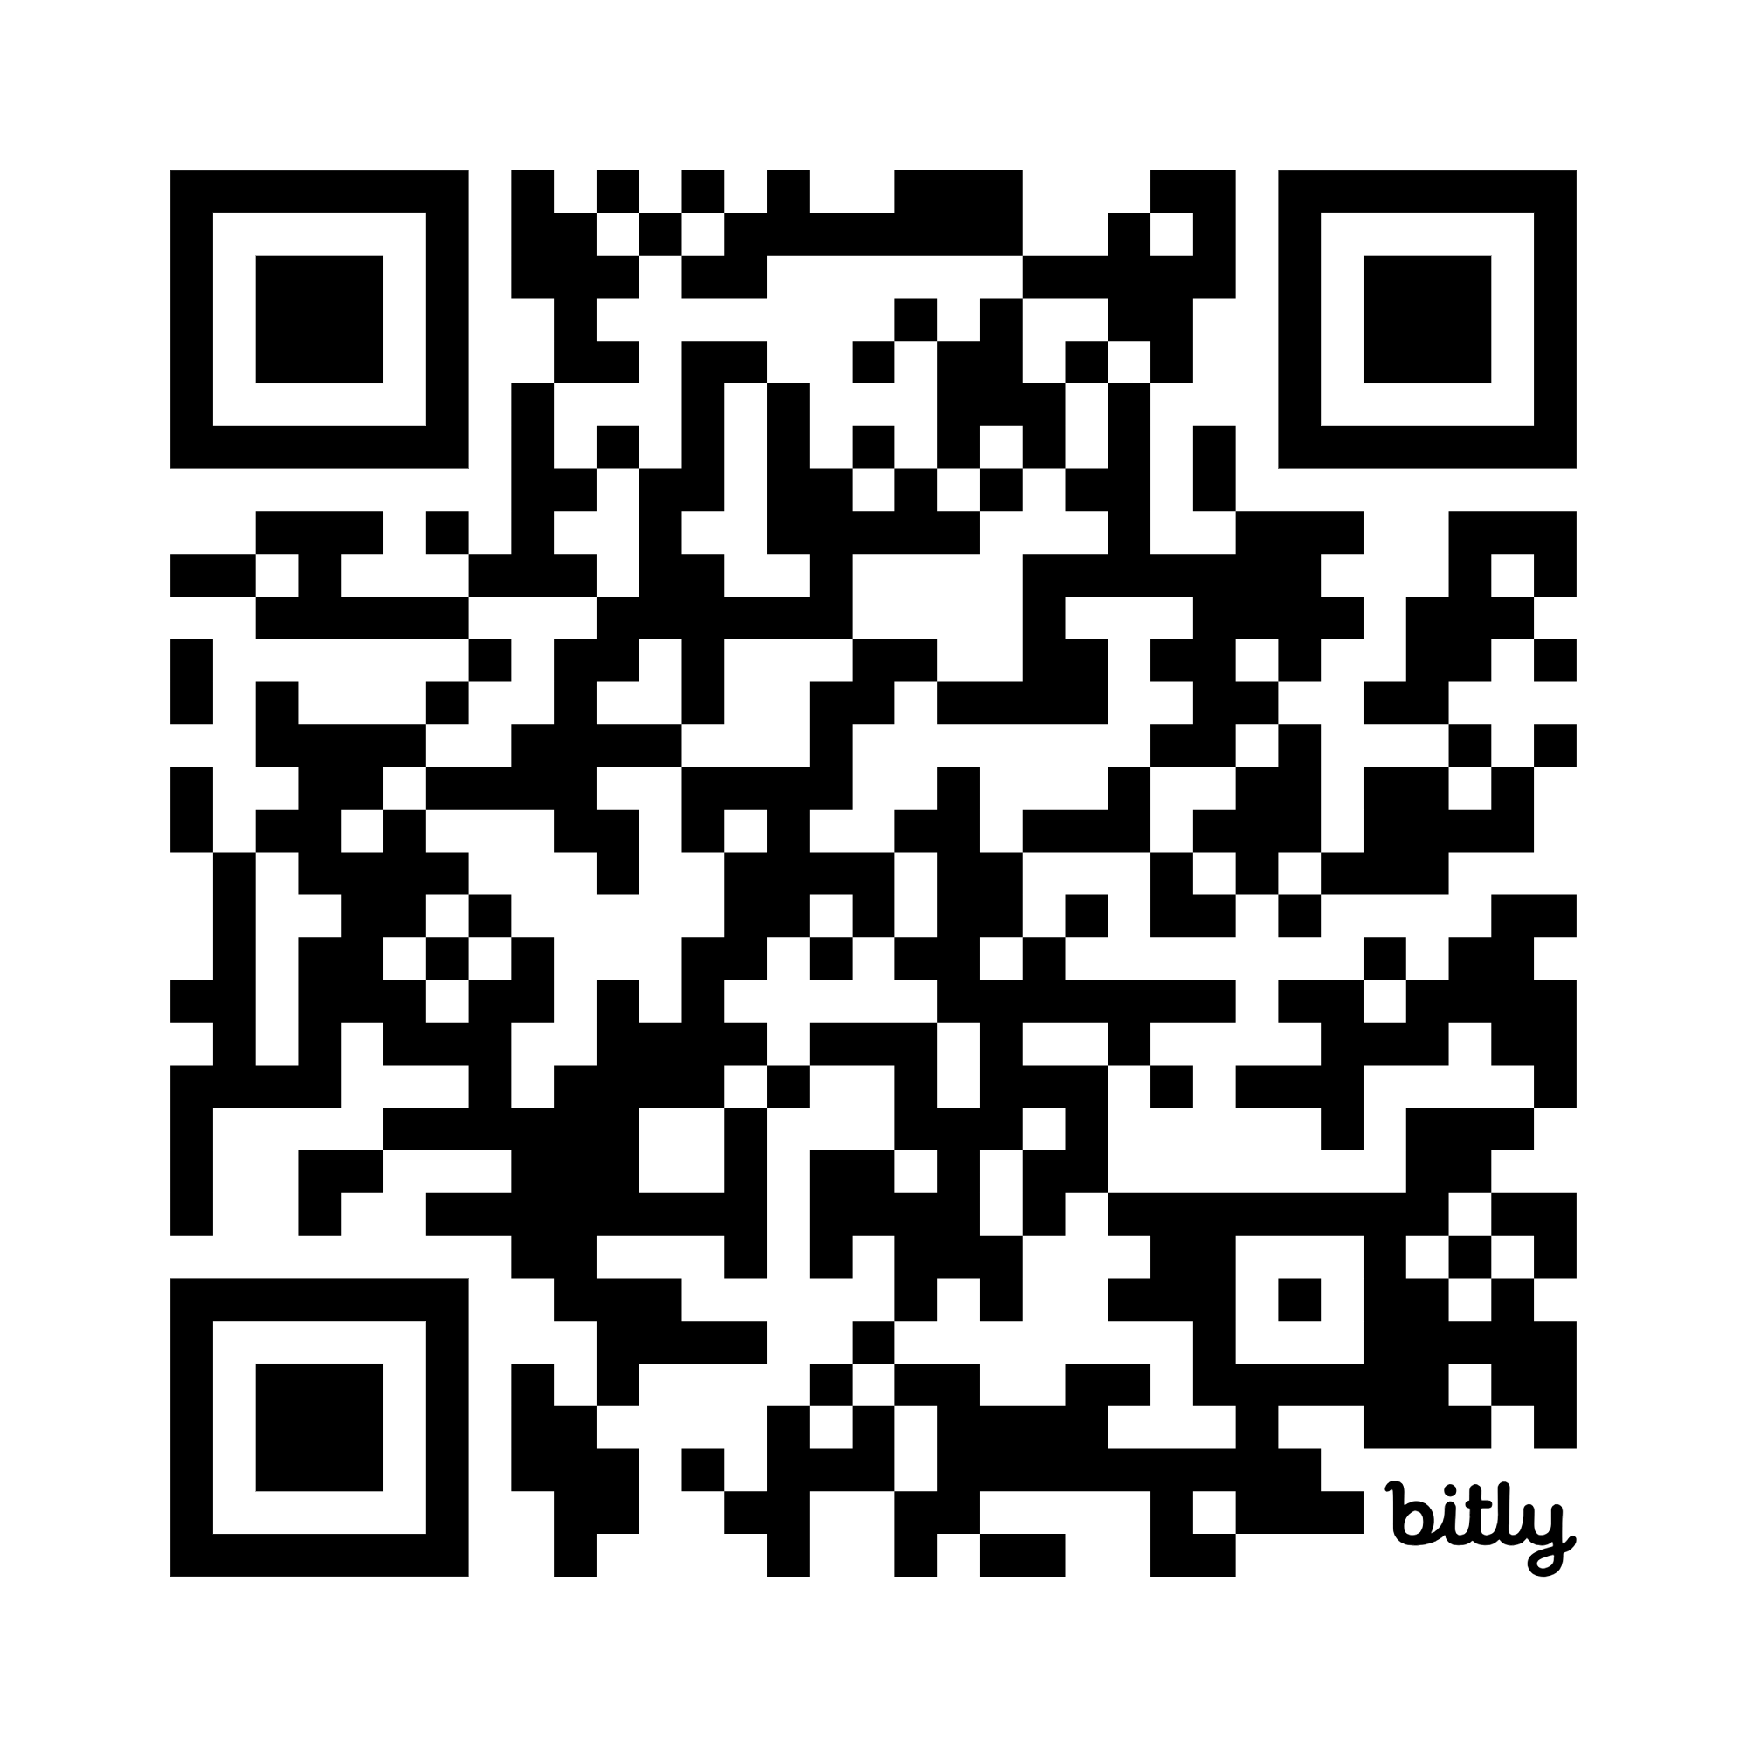
Please complete the post survey:
bit.ly/classof27post

