Slide 1
Grand PRAIRIE ISD
FINANCE 101

Slide 2


CASH MANAGEMENT procedures
Deposit funds daily.
Two people should ALWAYS count & document deposited funds.
Issue receipts for every collection and keep the pink copy in the receipt book (exception: concession sales).
Cash/Checks should ALWAYS be secured in bank bags.
No petty cash - No Cash on Campus unless it is for a deposit.

Slide 3
deposits
Use correct deposit slip (Local Maintenance or Activity).
Only use GPISD receipt books (Secretary must provide receipts to Sponsors for every deposit).
Deposit paperwork must be sent to your assigned Accounting Clerk when deposit is placed in Cafeteria vault – ACOF or Donation form is required with every deposit.
Remind your sponsors of deadlines. Deposits must clear the bank before funds are released.

Slide 4
Activity Account Overview
(ACOFs are still required for all collections such as IDs, Tech, and Library Fees)
1st ACOF with dates: 9/1/26-12/31/26
2nd ACOF with dates: 1/1/27-5/21/27
Contracts are needed prior to collection for Worlds Finest Chocolate and Picture Day / Yearbooks.
Contracts are NOT to be signed by sponsors, secretary, or principals. Contracts are to be submitted via Laserfiche*
Snack accounts are under 461 E 13 6499 SK ORG 0 99 451 (SNACKS/FOOD)
Sales-Tax Calculator needs to be attached to activity requisitions, if applicable.
ACOF OR NOTE is required on ALL activity requisitions.

Slide 5
Activity funds
Accounting clerks' responsibility
Train Principals, Secretaries, and Finance Clerks as needed.
Verify and process deposits from each campus.
Enter bank corrections and returned checks or payments.
Review and approve budget transfers and requisitions.
Approve Application Collection of Fund/Sales Tax Records.
Review accounts with Secretary/Finance Clerk at the end of the year.

Slide 6
Activity funds
PRINCIPAL responsibility
Ensure all funds are safeguarded.
Ensure all staff are following district guidelines and are properly trained.
Inform Finance office of staff changes including short- or long-term absences that will affect finances.
Approve all Application for Collection of Funds/Sales Tax Record forms, transfer and expenses.
Verify and approve all deposits.
Review balances with Secretary/Finance Clerk monthly and end of the year.

Slide 7
Activity funds secretary/finance clerks' responsibility
Train Sponsors regarding accountability and deposits.
Provide Sponsors with proper district forms and verify their accounts monthly and annually.
Process purchase order expenses and budget transfers.
Verify, complete and submit deposits daily to the bank/safe (armored service).
Submit deposit paperwork to Finance after bank bags are sealed.
Review account balances with Sponsors and Principal.

Slide 8
Activity funds
SPONSOR responsibility
Complete Application for Collection of Funds/Sales Tax Record form and the sponsor affidavit/contract.
Contact Vendor for quotes.
Ensure all funds are safeguarded.
Remit deposits daily to Secretary/Finance Clerk.
Submit Sponsor Deposit report with receipts.
Request purchase orders for invoices.
Notify Secretary/Finance Clerk of outstanding debts.
Review account(s) monthly and annually.

Slide 9
FUNDRAISERS on district premises
Campuses are allowed 6 food fundraisers per school year (after school).
Campus Sales cannot be in competition with the School Lunch Program - May not be held in serving and/or eating areas of the campus .
Approved Vendors and ACOF required.
All fundraisers are at the discretion of your principal.

Slide 10

Fundraising procedures
Fundraisers CANNOT begin without an APPROVED Application for Collection Of Funds (ACOF)
SPONSOR
&
SECRETARY
SPONSOR
SECRETARY
FINANCE
FUNDRAISE
Step 1
Step 2
Step 3
Step 4
Step 5
Sponsor submits the Application of Collection of Funds & Sponsor Affidavit/Contract to secretary.
Forms: https://www.gpisd.org/Page/37011
Secretary submits ACOF for approvals/signatures
Principal
Area Chief (Connie Baca & Amanda D. Ramirez)
Purchasing (if vendor listed) otherwise send to your activity clerk
Once approved Finance will email activity forms and approved ACOF to the sponsor and secretary.
Conduct Fundraiser within approved dates. If dates need to be revised contact campus secretary.
Deposit funds weekly.
Secretary/Finance Clerk should contact sponsor if no deposits have been made.
Close out Fundraiser.
Submit Budget Transfers/ Requisitions for approval
Sponsors & Secretaries must keep up with ledgers.

Slide 11
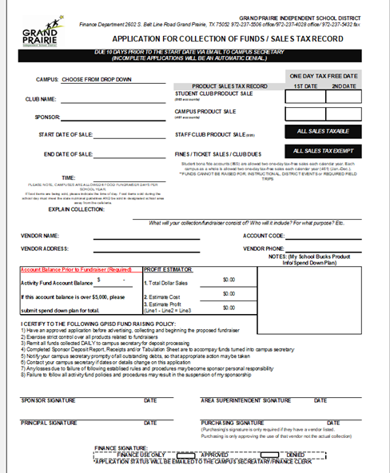
Myschoolbucks (msb)
This online payment service provides an easy way to pay for items such as Athletics, Event Tickets, Meal Accounts, Spirit Wear, Program Fees, Dues, and much more!
No deposit control sheet or receipts needed; funds are recorded into Skyward weekly, payment reports are easily accessible, and finance handles most refunds.
Submit the following for a product to be set up
Application for Collection of Funds/ Notes Section:
Product Name
  Price(s), Qty, Size, Color, etc.
  Web form/Product Image (if any)
  *High School Secretaries have access to set up products in My School Bucks

Slide 12
raffles
May not be held by the District.
May not be held by Student Activity Groups.
May ONLY be held by a Charitable Organization with 501(c)3 designation and limited to two [2] per calendar year.
Note: The district is not considered a 501(c)3 Charitable Organization.

Slide 13
DONATIONS
Submit a Donation Acknowledgment form for every donation. Forms can be found on our website (https://www.gpisd.org/Page/37011)
Donation form must be signed by the principal.
Donations of $20,000 or more will require Board Approval prior to accepting the donation.

Slide 14
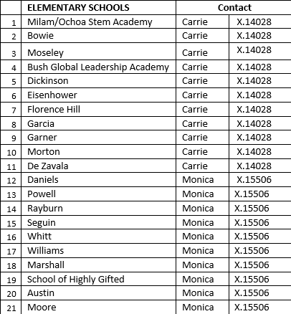
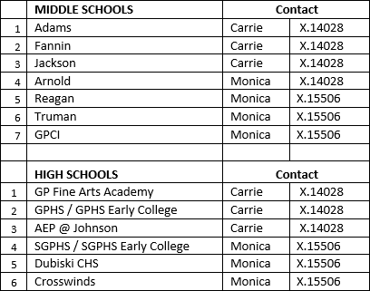
Activity account contacts
Carrie Hargrove
(972) 237-4028
Carrie.Hargrove@gpisd.org
Monica Moreno
(972) 237-5506
Monica.Moreno@gpisd.org

Slide 15
ACCOUNTS PAYABLE
All invoices must be received by Tuesday, 4:30 pm to be included in Thursday’s check run.
To pick up a physical check, please complete the check pick up form by Wednesday for a Friday AM pick-up time.
https://www.gpisd.org/cms/lib/TX01001872/Centricity/Domain/11807/CHECK%20PICK%20UP%20FORM.pdf
SCAN
ATTACH
RECEIVE
EMAIL AP
Scan your invoices. Be sure the invoice includes the PO number if it does not, please add it.
Attach invoices to the PO in Skyward.
Receive on the PO in Skyward.
Email Accounts.Payable@gpisd.org
Use “Action Required PO XXXXXX” in the subject line
In the body of the email explain. (Pay & Close, Pay & Leave Open, etc.)
Accounts Payable Contacts:
Cassie Jacinto
972-237-5519
Lawaone Young
972-237-5505

Slide 16
Contact information
Lara Brown​​
Executive Director Of Finance​​
Lara.Brown@gpisd.org​​
(972) 237-5303​
Alyssa Manellari
Accounting Manager​​
Alyssa.Manellari@gpisd.org​​
(972) 237-5412​​

Slide 17
REMINDERS
All deposits are due by Friday, August 29.​​
Please coordinate with your cafeteria manager to ensure your campus deposit is included with the Food Service deposit delivery to the Ed Center.​​
Missed the cafeteria manager?​​
Bring your deposit(s) directly to the Ed Center or call us to request a pickup.​​
Loomis Pickup Issues​​
Notify Finance immediately if Loomis does not complete a weekly pickup.​​
Need additional training?​​
Reach out to your Activity Clerk for assistance.​​
Thank you for your attention to these important procedures!​

Slide 18
Policy References
Current policy and regulations may be found at http://www.gpisd.org
Gifts & Solicitations CDC (LEGAL) (LOCAL)
Activity Funds Management CFD (LEGAL) (LOCAL)
Student Fundraising FJ (LEGAL) (LOCAL)
Parents Organizations GE (LEGAL) (LOCAL)
Advertising & Fund Raising GKB (LEGAL) (LOCAL

Slide 19
THANK YOU!
- FINANCE DEPARTMENT

