Slide 1


Board Presentation
August 5, 2026
Ramona Temporary Relocation
Updates on Timelines, Locations, and Family Support
Presentation Revised August 5, 2026

Slide 2
What is Happening?
  Ramona Elementary will not open for the start of the 2026-2027 school year.
  Students and staff will be temporarily relocated to other schools.
  This decision was made after reviewing the results of a preliminary facilities investigation.
  Based on the information we have at this time, addressing these concerns will require a comprehensive assessment, additional expertise, and the development of a detailed plan to guide next steps.

Slide 3
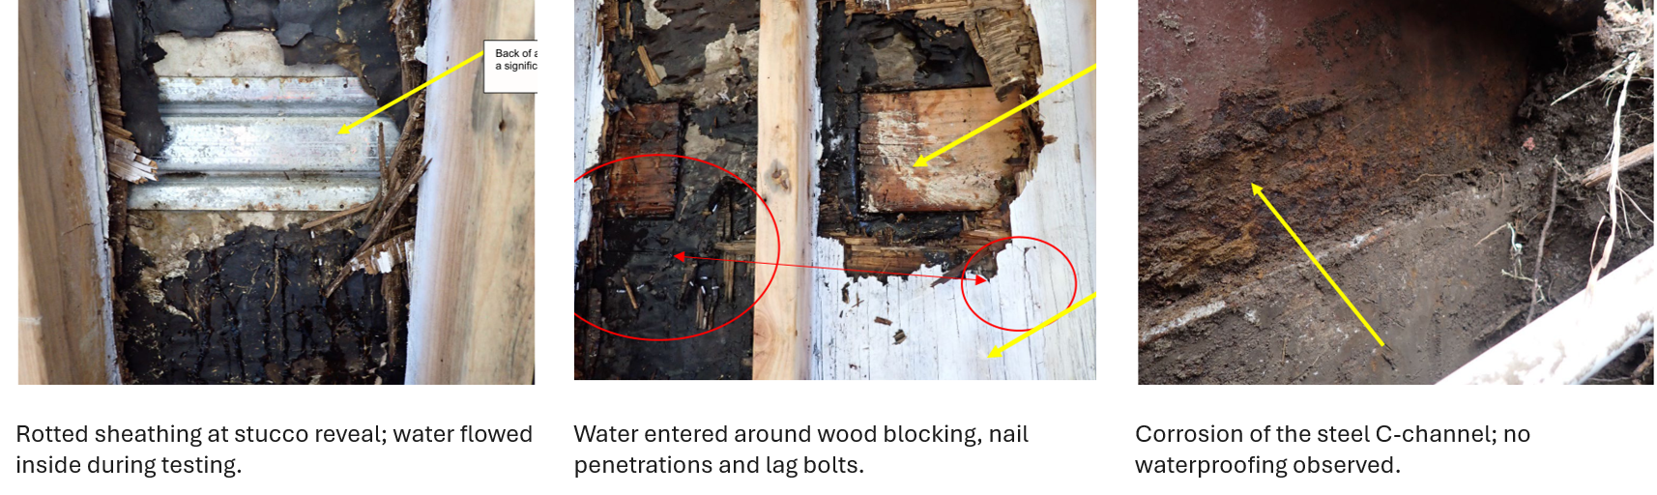
Investigation
A preliminary engineering investigation identified active water intrusion and damage to building components, including areas that require further structural review.

Slide 4
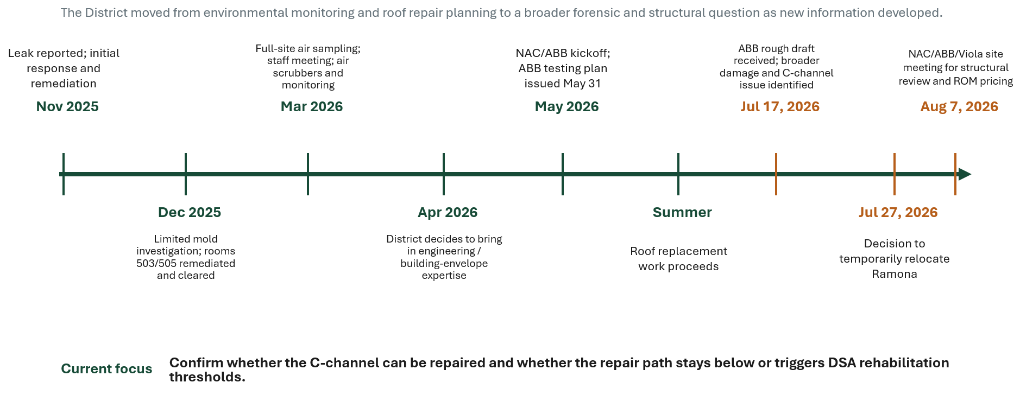
Timeline

Slide 5
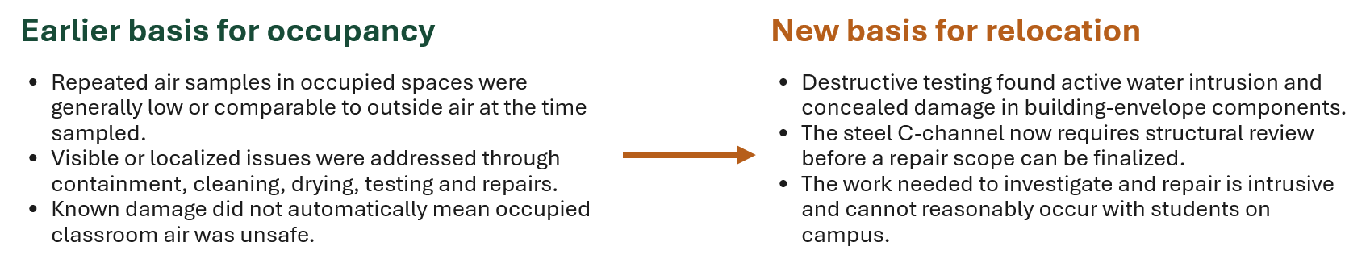
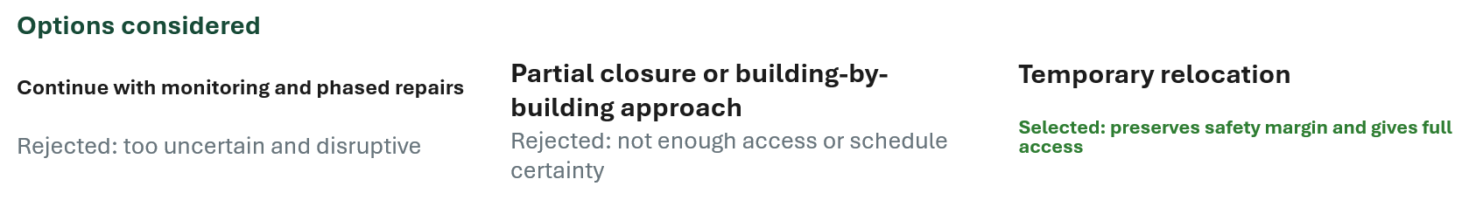
The District’s Decision

Slide 6
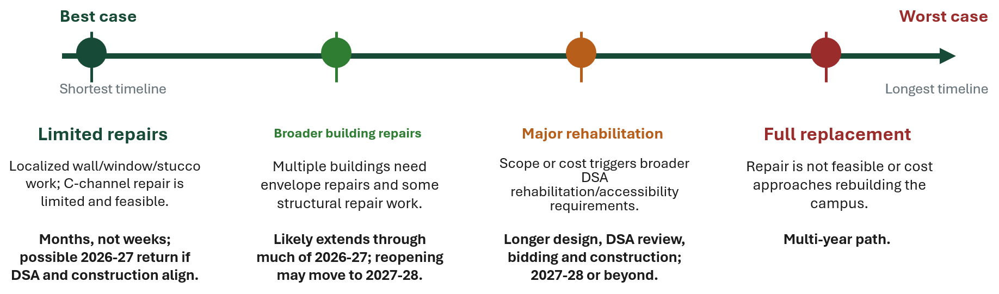
What Comes Next? Potential Outcomes
Structural review on Friday, August 7 and repair cost estimates will provide additional information to determine scope of work required.

Slide 7
Temporary Relocation Plan
Temporary School Assignments:
Lemonwood
TK
Kindergarten
Grade 1
Grades 2-3
Grades 4-5
Driffill
Lemonwood
Rose Avenue
Cesar Chavez
School Office: Ramona Administration will temporarily locate at Cesar Chavez School on the Juanita side of campus.

Slide 8
Temporary Relocation Plan
Why these schools and locations were selected:
Grade level requirements
Kinder bathrooms
Keep classes close together
Continue the biliteracy program

Slide 9
Supporting Students & Families
The District is committed to keeping the Ramona community together as much as possible.
The district is working to provide information to families on:
  Transportation
  Before- and after-school programs
  Special Education services
  Biliteracy program
  Student supports

Slide 10
School Spirit
What Will Continue for Ramona Students and Families:
Events and family gatherings
Back to school night (transportation)
Sports
After School program
Awards assemblies
School celebrations
Continued Programs: PTA, ELAC, SSC
Weekly updates will be provided from Principal Mares:
More specific information as it is being worked out.

Slide 11
Communication from the School
Text
Parent Square
Phone calls
Emails
Web Page Updates
Parent meetings
Social Media

Slide 12
School Start and Dismissal Times
School | Grade | Start | Regular Dismissal | Wednesdays
Lemonwood | TK | 8:00 AM | 2:15 PM | 12:15 PM
Lemonwood | Grade 1 | 8:00 AM | 2:20 PM | 1:20 PM
Driffill | Kindergarten | 8:15 AM | 2:30 PM | 12:30 PM
Rose Avenue | Grades 2 - 3 | 8:00 AM | 2:20 PM | 1:15 PM
Cesar Chavez | Grades 4 - 5 | 8:00 AM | 2:20 PM | 1:15 PM

Slide 13
Family Support
  Temporary Ramona Office: 224 N. Juanita Ave, Oxnard, CA 93030 (Former Cesar Chavez Office)
    Office Hours: 7:30 AM - 4:00 PM
  School Phone Number: (805) 385-1569
  Support Email: RamonaElem@oxnardsd.org
  Facilities website and FAQs:
https://www.oxnardsd.org/information
  Ongoing regular email updates

Slide 14
Looking Ahead
  The District does not yet know how long the relocation will last.
  Experts are evaluating repair options and timelines.
  Families and staff will continue to receive updates as decisions are made.

Slide 15
Our Commitment
  Safety will continue to guide every decision.
  The District will communicate openly and frequently.
  We are committed to minimizing disruption while ensuring every student receives a high-quality education and the support they need.

Slide 16


Questions
Thank you for your patience, understanding, and partnership as we navigate this unexpected transition together.
RamonaElem@oxnardsd.org
(805) 385-1569
👤
Principal Mr. Jorge Mares

