Slide 1

Teacher Incentive Allotment Overview
2026-2027

Slide 2
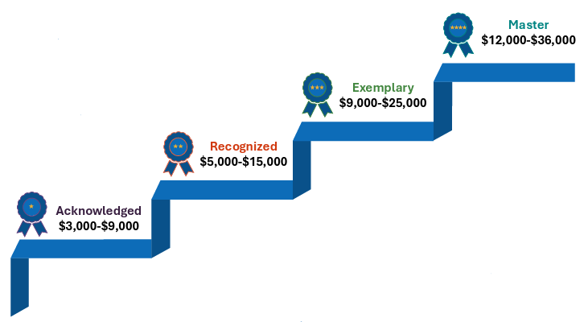

Teacher Incentive Allotment Works with the
Local Designation System
Legislation was passed to allow both certified and un-certified teachers to be designated.
The designation is added to a teacher’s SBEC certificate and is valid for five years. The allotment follows the teacher.
2
2
2

Slide 3
Overview of RYSS Teacher Incentive Allotment
Teachers are designated as Master, Exemplary, Recognized or Acknowledged based on teacher observation and student growth data.
RYSS receives $7,000 - $27,000 per year from the state for every designated teacher they employ.
National Board-Certified teachers earn a designation with funding aligned to the Acknowledged level.
The designated teacher receives 90% of the Teacher Incentive Allotment funds that RYSS receives. The remaining 10% is used by the district for teacher development.
3
3
3

Slide 4
RYSS Theory of Action and Expectations for TIA
The district’s Theory of Action is that by participating in the Teacher Incentive Allotment with a local designation system for teachers it will improve student achievement by:
  focusing on teacher impact on student growth;
  supporting teacher growth;
  increasing retention of the most effective teachers;
  strengthening our current teacher evaluation system; and
  remaining competitive to attract new teachers to our district.
Participating in the Teacher Incentive Allotment for the purposes just stated support the district's Strategic Plan Priority 2 - Strong Teams: Recruit, develop, and retain top talent to create thriving school-based and central office teams.
4
4
4

Slide 5
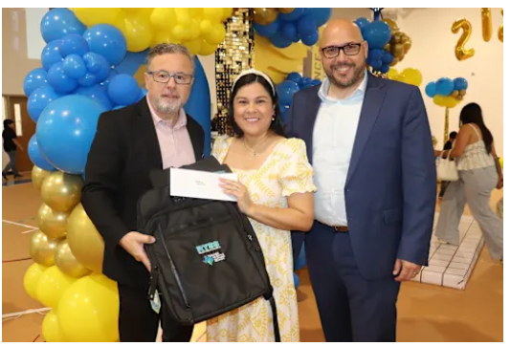
Background for RYSS TIA
Designated Teacher Breakdown (Beginning with 2023-2024 designations based on 2022-2023 data analysis)
A total of 49 teachers have earned designations through TIA:
  7 Master Teachers
  18 Exemplary Teachers
  24 Recognized Teachers
This represents:
  66% of our eligible teachers
  35% of our total teaching staff
Raul Yzaguirre Schools for Success

Slide 6

Background for RYSS TIA
Financial Impact
Since 2023-2024, RYSS has distributed a total of $1,138,390 directly to designated teachers over the past three years.
Annual payout ranges (subject to annual recalculation by TEA):
Recognized: $6,000 – $7,000
Exemplary: $12,000 – $14,000
Master: $21,000 – $25,000
Acknowledged to be added for 2026-2027 designations.
Raul Yzaguirre Schools for Success

Slide 7
RYSS TIA Model for 2026-2027 Data Collection
Weight | Component
45% | T-TESS Observation Score Average for Domains 2 & 3 across scored observations and walkthroughs (Final); no Domain 2 or 3 dimension can be less than a 3
55% | Student Growth
Student Growth for 2026-2027 Data Collection
2026-2027 Eligible Teaching Assignment/Campus | Pre-Test | Post-Test | Growth Target
Prekindergarten | Circle | Circle | Moving up a performance level or staying on track (see FAQ)
Grade K-3 Reading | I-Ready BOY | I-Ready EOY | % of students meeting >=100% typical growth target
Grade K-3 Math | I-Ready BOY | I-Ready EOY
Grade 4-8 Reading | Prior Year STAAR | Current Year STAAR | STAAR transition table
Grade 4-8 Math | Prior Year STAAR | Current Year STAAR
Algebra I, English I, and English II | Prior Year STAAR | Current Year STAAR
Grade 5 & 8 science, Grade 8 social studies, Biology, and US History | Released STAAR | Current Year STAAR | Target set using variable percentage correct method
Raul Yzaguirre Schools for Success

Slide 8
Released STAAR to STAAR Growth Expectations
To allow for growth even if the student is still in the Did Not Approach category but is moving in the right direction, the district has proposed to the state to use a variable percentage growth model.
This sets higher growth expectations for lower performing students but allows for growth at all levels.
Using the pre‐test's percent of items correct, the growth targets will be set as follows:
  0‐20% correct, 20 percentage point increase;
  21‐40% correct, 15 percentage point increase;
  41‐60% correct, 10 percentage point increase;
  61‐80% correct, 5 percentage point increase;
  81% or higher correct, maintain or >=95%.
8
8
8

Slide 9
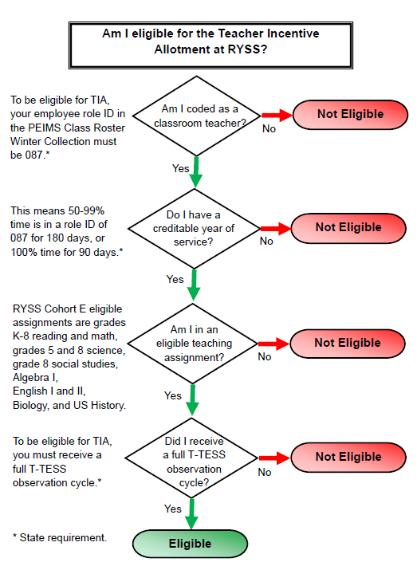
Eligibility Requirements
Must meet basic TEA eligibility requirements.
  See chart on right, eligibility is determined for year of designation which is the year after data collection.
  Must have a growth measure
  Must score “Proficient” or higher in T-TESS Domains 2 & 3 overall and on each dimension.
  Must achieve an average score of 3.48 or higher in T-TESS Domains 2 & 3, where “Proficient” =3.
9
9
9

Slide 10
STEPS 1 and 2: Determine rating for each measure.
Updated Observation Standards:
Final T-TESS rating based on all included observations and walkthroughs in DMAC: Average Score on Domains 2 & 3 with a minimum of 3 on all dimensions of Domains 2 & 3
Updated Growth Standards:
Percent of Students Meeting or Exceeding Growth Expectation as determined by assessment
Rating | District Standard
Acknowledged | 3.5
Recognized | 3.7
Exemplary | 3.9
Master | 4.5
Rating | District Standard
Acknowledged | 50%
Recognized | 55%
Exemplary | 60%
Master | 70%
Raul Yzaguirre Schools for Success

Slide 11
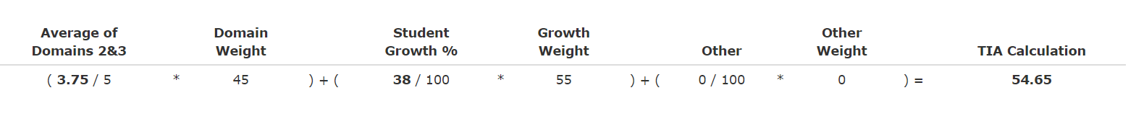
STEP 3: Weight the TTESS and Student Growth measures.
The TTESS average is normalized (score divided by 5) and weighted at 45% and the growth percent is weighted at 55%. For the weighted calculation >90=Master, 80-89=Exemplary, 70-79=Recognized, 65-69=Acknowledged.
DMAC provides these calculations once student growth is entered by the district.
Raul Yzaguirre Schools for Success

Slide 12
STEP 4: Determine overall designation.
To be designated, a teacher must receive a designation label under steps 1-3 with the final designation being the lowest of the three labels. This assures that all standards are met AND weighting was applied. (See Sample Table below.)
Designation | Weighted Score | Percentage Growth | TTESS Final D2D3Avg
Master | 96 | 92 | 5.00
Exemplary | 86 | 80 | 4.63
Acknowledged | 85 | 95 | 3.63
Recognized | 79 | 70 | 4.50
Recognized | 79 | 83 | 3.75
Acknowledged | 76 | 78 | 3.63
No Designation | 79 | 88 | 3.38
Acknowledged | 68 | 63 | 3.75
Acknowledged | 67 | 55 | 4.13
Acknowledged | 65 | 59 | 3.63
Raul Yzaguirre Schools for Success

Slide 13
Payout
Designated teacher receives 90% of allotment; 10% is maintained at the district level for professional development.
Payout is distributed in two checks: half in May and half in August.
Taxes and deductions are taken out of the checks.
Raul Yzaguirre Schools for Success

Slide 14
TIA Timeline: RYSS
Date | Item
June-August 2026 | Data collection and analysis of 2025-2026 data for 2026-2027 designations.
August/September 2026 | Preliminary 2026-2027 designations provided to administrators and scorecards to teachers for goal setting conferences
October 2026 | District provides 2025-2026 data collection to TEA for review and approval of new designations.
April 2027 | TEA verifies designated teacher eligibility from Winter Class Roster
April/May 2027 | TTU annual survey sent to teachers, administrators evaluating program
May 2027 | TEA provides district with allotment amounts; notifies teachers
May 2027 | District notifies 2023-2024, 2024-2025, 2025-2026, and 2026-2027 newly designated teachers of designations and actual payout amounts
May 2027 | Payout Part A to designated teachers
August 2027 | Payout Part B to designated teachers
14
14
14
Notes:
Part

Slide 15
What is our TIA Expansion Plan for 2027-28?
Subject​ | Grade Levels​
Algebra II​ | 9-12​
Art I​ | 9-12​
Chemistry​ | 9-12​
Economics​ | 9-12​
Geometry​ | 9-12​
Grade 5 Art​ | 5​
Music I (Jazz, Band)​ | 9-12​
Physics​ | 9-12​
Principles of Applied Engineering​ | 8-12​
Principles of Business, Marketing, and Finance​ | 8-12​
Subject​ | Grade Levels​
Science​ | 6 & 7​
Social Studies​ | 6 & 7​
Spanish I​ | 9-12​
Spanish II​ | 9-12​
World Geography​ | 9-12​
World History​ | 9-12​
Physical Education​ | K-12​
18 TEKS Ready Pre and Post-Tests administered through DMAC and Fitness Gram for P.E.
15
15
15
Notes:
Part

Slide 16
TIA Expansion Plan Timeline for 27-28
2026-2027 Year 0 pilot:
Implement TEKSReady pre-/post-tests and refine procedures.
April 2027 Expansion submission:
Submit the new grades, subjects, and growth measures.
2027–2028 Initial data collection:
Use approved procedures for designation data.
2028–2029 Expanded designations paid:
Payouts are based on the 2027–2028 data collection year
16
16
16
Notes:
Part

Slide 17
Teacher Incentive Allotment (TIA) Resources
RYSS’s TIA Sharepoint Site: https://tejanocenterorg.sharepoint.com/sites/TejanoCenter then enter “Teacher Incentive Allotment” in the search bar
RYSS Human Resources Site:
https://www.ryss.org/ryss-district/human-resources
TEA’s TIA Site (https://tiatexas.org)
Carla Stevens, TIA Project Team Lead
Carla.Stevens@Tejanocenter.org

