Slide 1

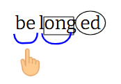
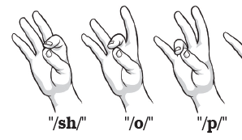
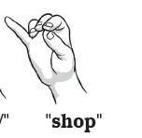

One Syllable Words |  | Two or More Syllable Words | Do I need to flex the vowel in my word? Reread. Did that make sense?
m-u-n-ch Tap | munch Blend | Scoop each syllable, look for suffixes Use what you know about syllable types to read
“munch”

Slide 2
One Syllable Words |  | Two or More Syllable Words | Do I need to flex the vowel my word? Reread. Did that make sense?
m-u-n-ch Tap | munch Blend | Scoop each syllable, look for suffixes Use what you know about syllable types to read
“munch”

