Slide 1


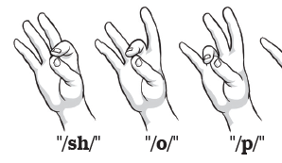
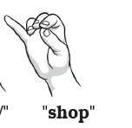
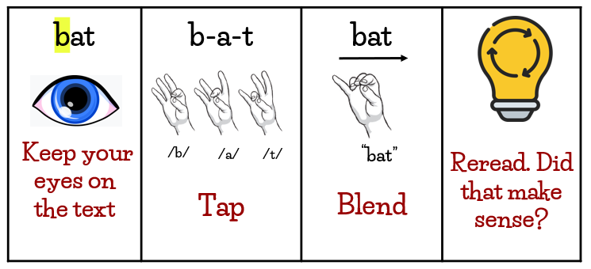
bat Keep your eyes on the text | b-a-t Tap | bat Blend | Reread. Did that make sense?
/b/
/a/
/t/
“bat”

