Slide 1
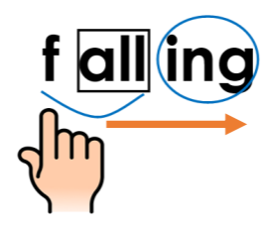


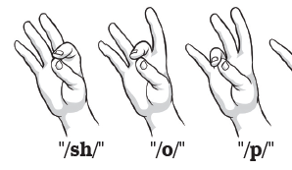
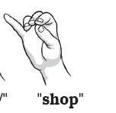

shop Keep your eyes on the text | sh-o-p Tap | shop Blend | Scoop it for parts Look through the whole word | Do I need to flex the vowel in my word? Reread. Did that make sense?
shop Keep your eyes on the text | sh-o-p Tap | shop Blend | Scoop it for parts Look through the whole word | Do I need to flex a vowel my word? Reread. Did that make sense?

Slide 2
shop Keep your eyes on the text | sh-o-p Tap | shop Blend | Scoop it for parts Look through the whole word | Do I need to flex a vowel my word? Reread. Did that make sense?

Slide 3
