Slide 1

TRAINING AND UPDATES
Procurement Services
Back to School 2026

Slide 2

Current Procurement Staff
Procurement Services
  Carolyn (Leigh) Hodges, Director of Procurement, Warehouse, and Printing Services
  Brittany Green, Construction Contracts Manager
  Vacant, Procurement Manager
  Stephanie Conrad, Procurement Specialist
  Peyton Flewelling, Procurement Specialist & P-Card Administrator
  Vacant, Procurement Specialist
  Shaniah Waden, Procurement Specialist
  Johcarla Johnson, Records Retention Specialist & Administrative Assistant
Warehouse
  Brian Albert, Warehouse Manager
Printing Services
  Paul Turner, Printing Services Manager

Slide 3

BIG CHANGE FOR FY27

Slide 4
Small Dollar Threshold $10,000.00
AS OF JULY 1, 2026:
1550. SMALL PURCHASES. (SC Code § 11-35-1550)
(1) Authority. The following small purchase procedures may be utilized only in conducting procurements that are up to the amounts specified herein. Procurement requirements must not be artificially divided by governmental bodies so as to constitute a small purchase pursuant to this section.
(2) Competition and Price Reasonableness.
(a) No Competition. Small purchases not exceeding ten thousand dollars may be accomplished without securing competitive quotations if the prices are considered reasonable. The purchasing office must annotate the purchase requisition: "Price is fair and reasonable" and sign. The purchases must be distributed equitably among qualified suppliers. When practical, a quotation must be solicited from other than the previous supplier before placing a repeat order. The administrative cost of verifying the reasonableness of the price of purchase "not in excess of" may more than offset potential savings in detecting instances of overpricing. Action to verify the reasonableness of the price need be taken only when the procurement officer of the governmental body suspects that the price may not be reasonable, comparison to previous price paid, or personal knowledge of the item involved.

Slide 5
Reminders
Never order, start production, or receive goods/services without a purchase order – this is unauthorized and will almost always require a ratification.
Do not sign vendor documents (contracts, agreements, etc.).
Buyers are final approvers – requisitions move to their queue only after all prior approvals. Check where it’s held up before contacting your buyer (instructions later).
Procurement doesn’t pay invoices – Accounts Payable handles payment to maintain separation of duties.
Purchase order terms and conditions- posted on Procurement Services website.

Slide 6
Reminders
What Procurement Does Do
What Procurement Doesn’t Do
Review and approve requisitions for accordance with Procurement Code, State Guidelines, and Federal Law
Process Change Orders
Process Ratifications
Enter and manage the MUNIS Vendor System
P-Card Administration (training, monitoring, monthly statement accounting, etc.)
Process or pay invoices
  Accounts Payable processes invoices to maintain separation of duties
Assist with technical MUNIS issues
  IT handles this, please submit a One-to-One Plus ticket
Provide guidance on budget questions
  Budget Services can assist with any questions about which budget code, including which object code within the budget code, you should use

Slide 7
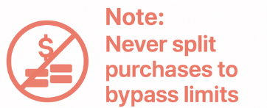
A Review of the Thresholds (as of 7/1/26)
Purchases under $10,000 (aka “small dollar” purchases)
  No “competition” required, i.e. you don’t have to solicit multiple quotes
  Must have an attached VALID quote (more on valid quotes later)
Purchases between $10,000.01 to $25,000.00
  Must obtain three written quotes OR utilize a valid contract (district, state, co-operative, etc.)
  All three quotes or the contract should be attached to the requisition
Purchases over $25,000.01+
  Require a valid contract (district, state, co-operative, etc.) otherwise, a competitive solicitation must be done
Example: A table and chairs total $11,000 (over the $10,000 limit).
Submitting two $5,500 requisitions is considered splitting and violates Procurement Code.

Slide 8
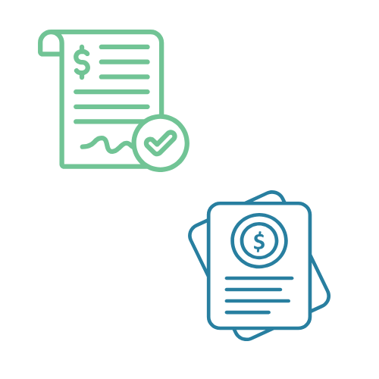
Start the right way: Quotes Part 1
What we are looking for in a quote:
Shows vendor name clearly
  Vendor name on the quote matches the vendor name in MUNIS
Quote is on a quote form or letterhead
  Not an email
  Not a shopping cart (exemptions include Staples, ODP, etc.)
  Preferably from the customer service representative for R1
Quote should be dated and include an expiration date (if applicable)
  If expiration date is past, or if it’s 30 days past the date the quote was requested (standard expiration), we will reject the requisition
  Quote clearly describes what is being purchased, a time frame for delivery, and delivery details

Slide 9
Start the right way: Quotes Part 2
Contracts & Quotes
  If using a contract, ensure the quote lists the contract number.
  Note: A vendor having a contract ≠ the items you want to order being on that contract.
Shipping and Handling
  Always add this as a line item, even if it’s $0.
Taxes
  Always include a tax line! The district is not tax exempt. We pay tax on everything except tax-exempt items (textbooks, library books, PD Services, etc.) Contact your buyer if the vendor requests a tax-exempt form.
  Quotes may omit taxes- sometimes vendors charge them later, sometimes they don’t charge them at all. Unless the items are exempt, we still owe taxes. If they don’t charge it, we remit to the state.
  Calculate tax at 8% of the total charges BEFORE SHIPPING AND HANDLING.
A clear and detailed quote + a clear and detailed requisition = a clear and detailed purchase order less change orders and ratifications!

Slide 10
General Guidelines for Requisitions
Before You Buy
  Contact your buyer BEFORE an issue arises
  Quotes must be official and valid
  Double check the vendor before you release the requisition. Once a PO is issued, the vendor cannot be changed.
IMPORTANT: MUNIS automatically emails the PO to the vendor, not your quote. This is why it’s so important to reference the quote number on the PO and to enter line items correctly.

Slide 11
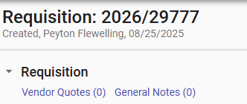
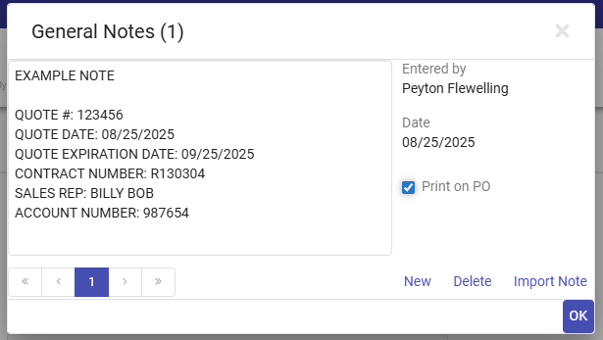
General Notes Section
The notes section of a requisition is a great place to store relevant information about the requisition and purchase order! Some of that information should be printed on the PO. Some of it should not. Because purchase orders are contracts, we only want things the vendor needs to know to be printed on the PO.
Print to PO
Don’t Print to PO
Quote number
Quote date
Quote expiration date
Contract number
Sales Rep name
Account Number
Any other relevant information listed on the quote that the vendor would potentially need to reference
Information for your buyer to know.
Teacher’s names. You can put information in the notes section to help track orders, but please do not have it print on the PO.

Slide 12
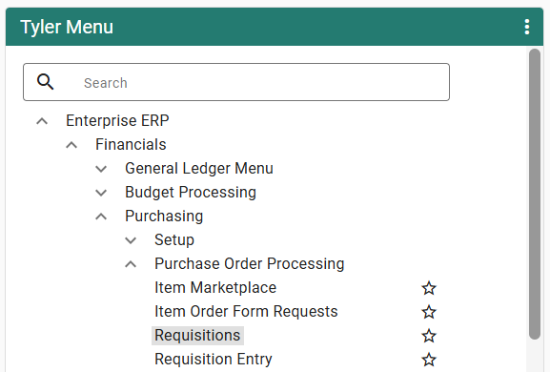
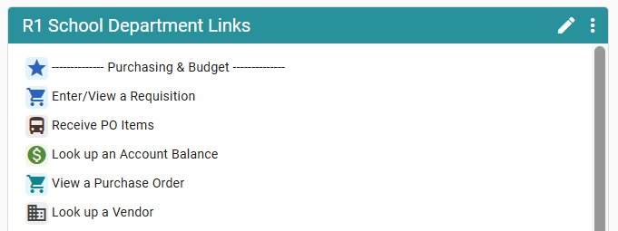
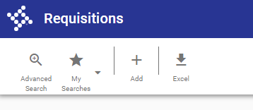
A Brief MUNIS Overview: How to Enter a New Requisition
There are two ways to enter a new requisition…
But they both bring you here!

Slide 13
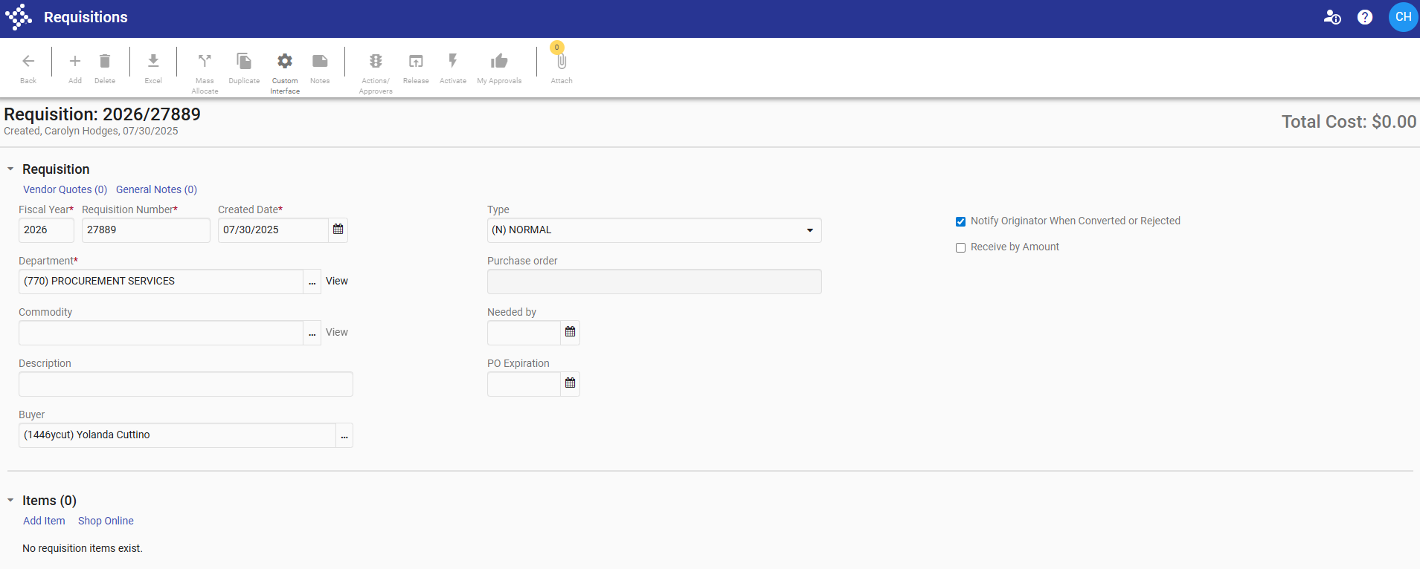
A Brief MUNIS Overview: How to Enter a New Requisition
Here is where you upload attachments.
Make sure to save them before closing out the screen!
Here is where you can enter a note, either for your buyer (do not print), for internal school/dept tracking (do not print), or quote information (print)
Did you know you can change the type of your PO? We only use “normal” and “blanket”. If you are requesting a blanket PO, please select “blanket” from the drop down menu.
Please do not submit a requisition and select the same day for “needed by”. We are not machines ☺ Please plan/expect 48 hours from the time it comes to our queue for us to process. Please consider that once you release the req, it must go through other people’s queues before it gets to us!
Here is where you “add item”.

Slide 14
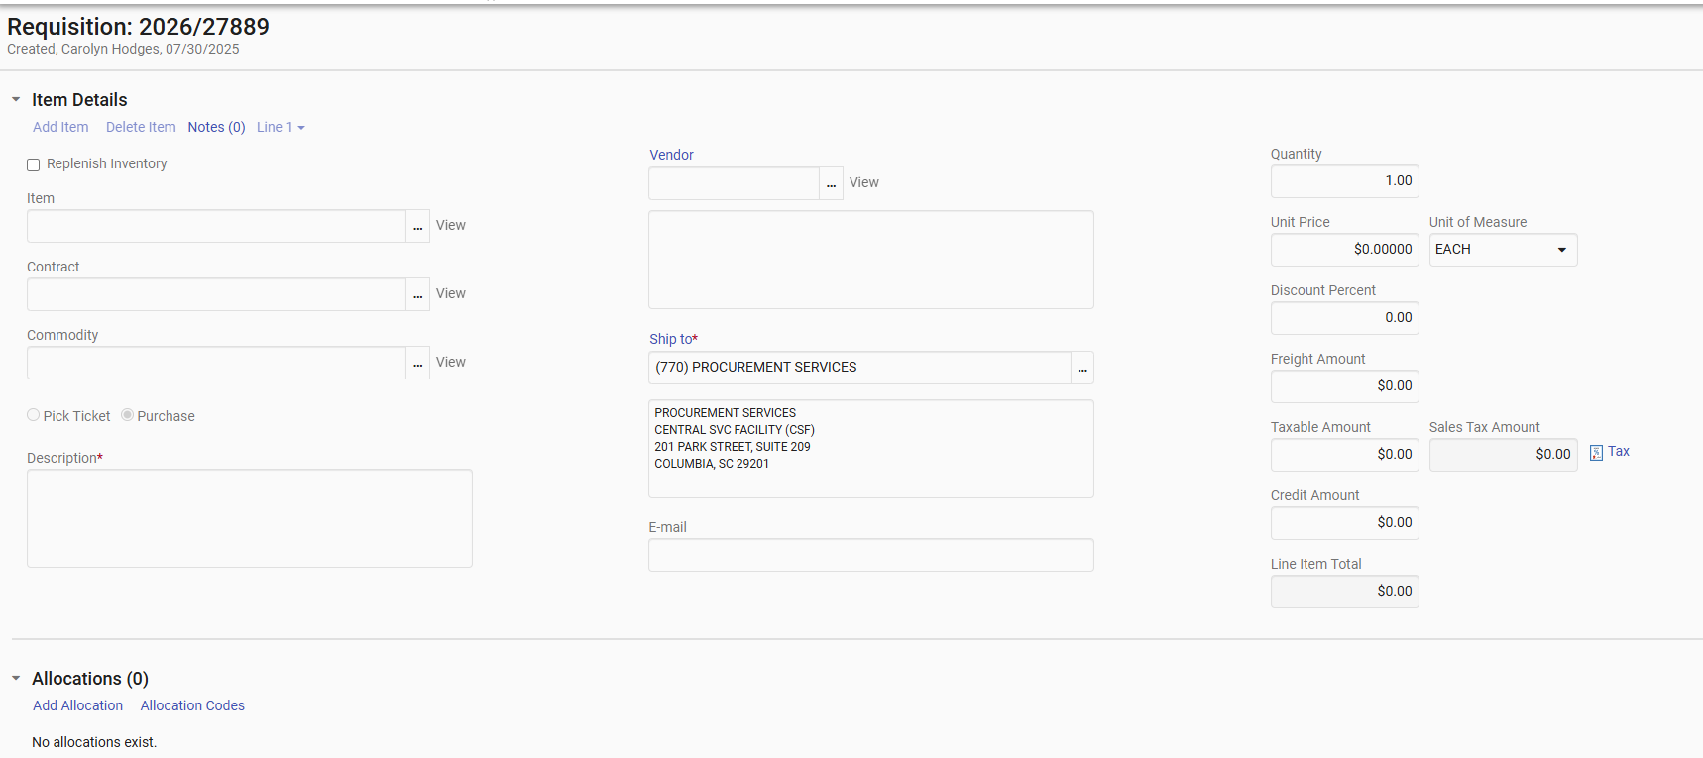
A Brief MUNIS Overview: How to Enter a New Requisition
When you have multiple line items on the quote, do not list the quantity as one and then make the unit price the total price of the multiple line items.
Only input an item number here for warehouse orders, and select “pick ticket”
Double check your vendor before submitting!
Equipment over $100? Ship to must be 750A Property Accounting
Line items should match the quote exactly!
Put your email here if it isn’t here already
Shipping/Handling (even if $0.00) and Tax (unless items are tax exempt) should always be a line item on the requisition. Use the total before shipping is added to calculate tax (8%).
Question about which budget code to use?
Call Budget Services!

Slide 15
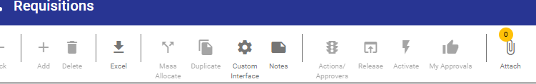
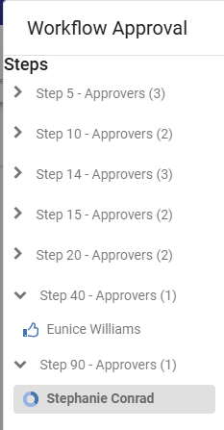
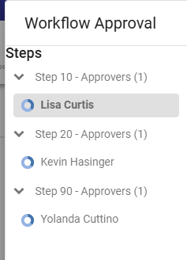
A Brief MUNIS Overview: How to Enter a New Requisition
Waiting on a purchase order? Check these things BEFORE calling your buyer:
1. Did you release it? If it’s dark grey, you haven’t. If it’s light grey, you have.
2. Click the stoplight to check the workflow.
The requisition is in whoever’s queue has the blue circle. More often than not, there are multiple approvers that all must approve before the requisition comes to the buyer.
When fully staffed, standard turn around time is 48 hours. If you are waiting on a requisition, please check to see if the requisition is in the buyer’s queue and check how long it’s been in their queue before reaching out about a status update.
Not in a buyer’s queue
In a buyer’s queue

Slide 16
A Brief MUNIS Overview: Line Items
Line Items
Budget / Object Codes for line items:
Questions about these are best addressed by Budget Services: Bobbi Jean Flowers, NaTasha Kelly, or LaShannon Wilson
We may reject if we clearly see it’s wrong (if you have office supplies and it’s a shirt)
INK = TECHNOLOGY SOFTWARE SUPPLY OBJECT CODE
Times when line item descriptions are especially important:
Certain vendors, like ODP, require one item number per line item
Any equipment that must be tagged should have a very detailed line item
Exceptions to listing line items:
Orders that are over 20 lines long- but you must make sure the quote cart reference number is on the PO

Slide 17
A Brief MUNIS Overview: Miscellaneous
Requisition Pitfalls
Why can’t I just copy the requisition that I did last time?
Duplicating a requisition leaves ample opportunity for errors to occur
Oops – I need to change the vendor or “ship to” address!
You will need to update every single line item, otherwise it could split the purchase order in two.
There are multiple vendors with the same name in Munis. Which vendor is correct?
Check with your Buyer. Check the quote – does the name and address match what’s in MUNIS? If not, we probably need an updated W-9 and vendor application from the vendor before proceeding. More about vendors later!

Slide 18
A Brief MUNIS Overview: Attachments to Requisitions
Forms To Accompany Requisitions
Requisitions for software must have an approved Technology Approval form from the current year
Requisitions for meals must have a signed meal form
  Per person meal cost is the total including all fees and taxes
Requisitions for professional development must have an approved PLA (Professional Learning Approval) form and an agenda
Requisitions for travel (flights, registration fees) must have an approved RTA (Request to Travel)

Slide 19
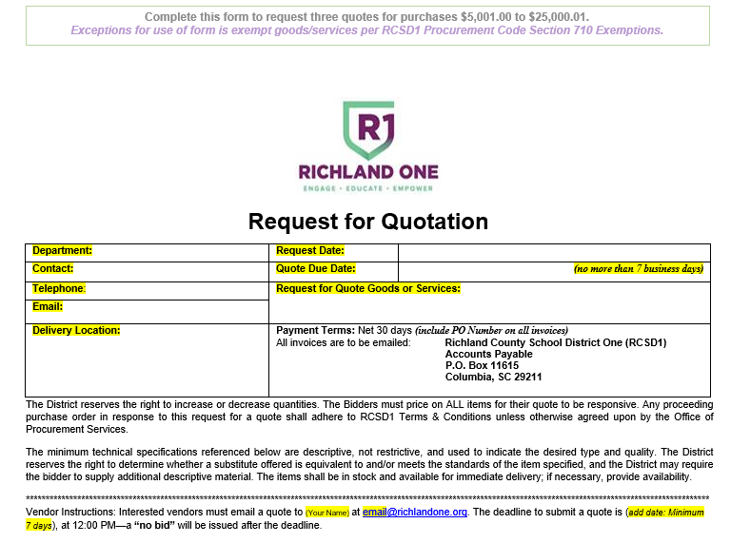
Quotes
Quotes for Purchases Between
$5,000 and $25,000
How to request quotes:
Preferred: use the form on website
Make sure to choose more than three vendors to ensure you get at least three responses (you can blind copy them all on the same email)
Important: You must ask for same thing from all three vendors to ensure the quotes are bona fide

Slide 20
Authorized Signatures on Contracts
Quotes with Contracts: Ask Up Front
If the vendor you’re working with submits their own contract/MOA with their quote, here’s what to do:
Purchase orders are contracts. They come with their own terms and conditions (available on Procurement’s webpage). Ask if they will accept our PO as contract in lieu of the district signing off on their contract/MOA.
If they will, great! We can move forward normally.
If they won’t, one of the authorized signatories in the District must sign off on the document before services begin. Enter the contract into SoftDocs / DRMS / Etrieve for signature by the appropriate signatory for your school/department.
4. Submit the document with your requisition as an attachment in MUNIS.

Slide 21
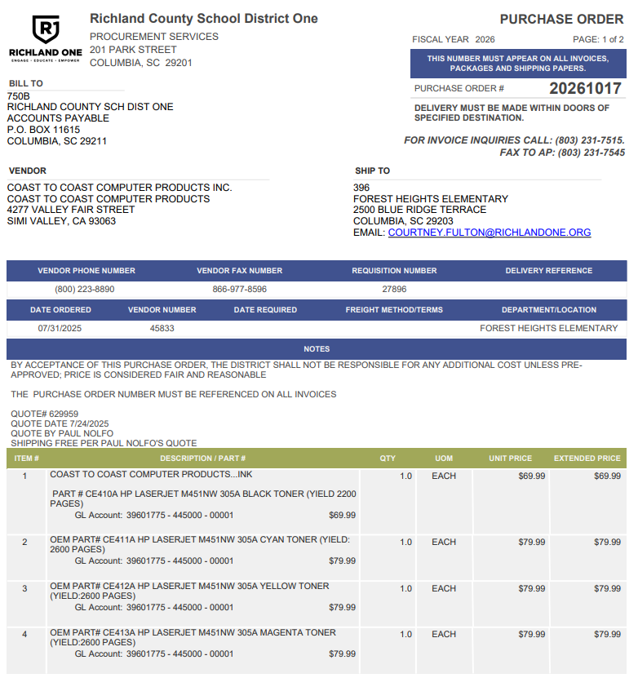
I have my purchase order. Now what?
Purchase Orders
Once a requisition is approved, a purchase order is generated. MUNIS automatically sends an email to the vendor’s email listed on their profile with the purchase order. The email comes from the buyer’s email address, but technically, MUNIS sends the email, not your buyer.
Remember: quotes are not sent with the purchase order.
If the vendor’s profile is not up to date with their current email, the vendor may not get the purchase order. There is a delicate balance the end user must strike between ensuring the vendor gets the PO, and ensuring the vendor doesn’t duplicate the order. Try reaching out to the company rep or your contact to ensure they received the PO from R1.

Slide 22

Vendor Applications
Vendors
Before requesting a vendor be added, please check for existing district vendors who provide this good/service
Vendor applications must:
    Come from a sponsoring school or department
    Have a specified good or service provided
    Have a W-9 that is live signed and less than six months old
Procurement may require additional information from certain vendors such as liability insurance, business or food handling licenses, certifications, etc.
Employees must be separated for 366 days to become a vendor
Per board policy, no vendor should be related to District employees
Make sure they are an established and responsible firm- please use good judgement and make ethical choices when choosing a vendor
Send applications to: Procurement@richlandone.org
Notes:
If all items are not met, you must resubmit with all required information/signatures and current date attached( within 6 months).

Slide 23
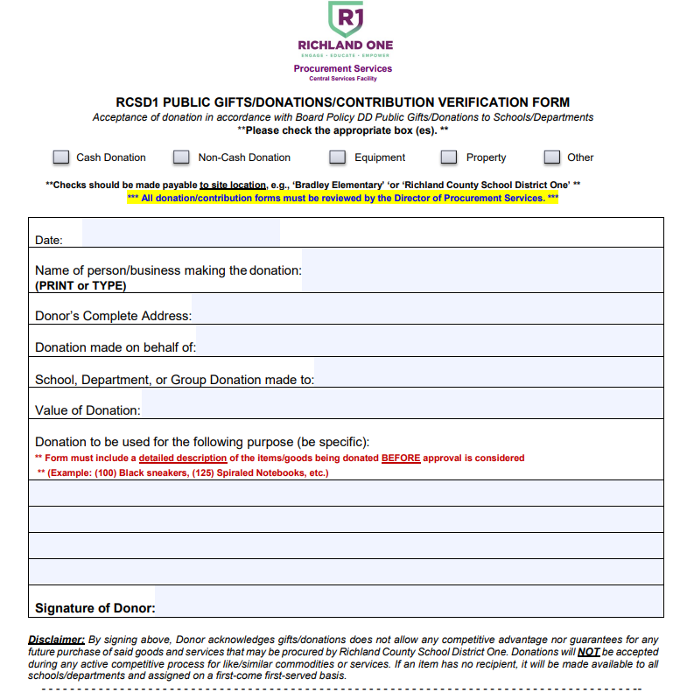
Donation Forms
Donations
Form is on the website and should be used any time someone donates anything to the school (from a box of donuts to a tv to a check)
Please be detailed in the description section. (supplies vs. instructional supplies such as pencils, erasers, scissors, and pens to be distributed evenly amongst all 1st grade teachers at Brennen Elementary School)
Have the donator sign! If they refuse, just make note of that.
Send to: Procurement@richlandone.org

Slide 24
UNAUTHORIZED PROCUREMENTS:
Ratifications
Ratifications
Ratification: An agreement, a commitment, or an order for goods or services, or changes to existing contracts by any person who does not have express written procurement authority to bind the District.
Ratification Requirements:
Letter to Director of Procurement Services
Expenditure Request
Corresponding Invoices
Approval by Procurement Director
Note:
Excessive ratifications may result in disciplinary action, loss of purchasing rights, or reimbursement to the District.
Ratifications delay payments to vendors and can result in the district being placed on a “hold” for other orders.
NEW: Quarterly reports of ratifications will be sent to Exec Directors.
Send to Procurement@richlandone.org- not your buyer!

Slide 25
Change Orders
Change Orders
Change Order: A written modification or amendment to an EXISTING contract (Remember: POs are contracts!)
Important:
If you are adding items, you need a new PO. Change orders are not to be used to add line items to your order or to increase the quantity of what you’re ordering.
When at all possible, complete the change order before you get the items, not after.
AP can close out a PO with the last invoice for the PO if you do it through PO receiving. If it’s not done then, Procurement will need a change order to close it out.
If you have to do a change order to close out a PO, please wait until the invoices have been paid before you submit it.
Purchase Orders are not automatically reprinted after change orders are completed. If a vendor requests a new PO before proceeding, contact your buyer.

Slide 26
Change Orders
Change Orders
Naming Sequence
PO Number/Vendor/Dept Code
“2026XXXX.DellComputers.770”
Budget must approve BEFORE Procurement can approve it and make the changes. Send these to R1Budget@richlandone.org. Budget will send to Procurement.
Note: Differences of Invoices +/- $300.00 do not require a written change order; approve and send to AP through PO Receiving.

Slide 27
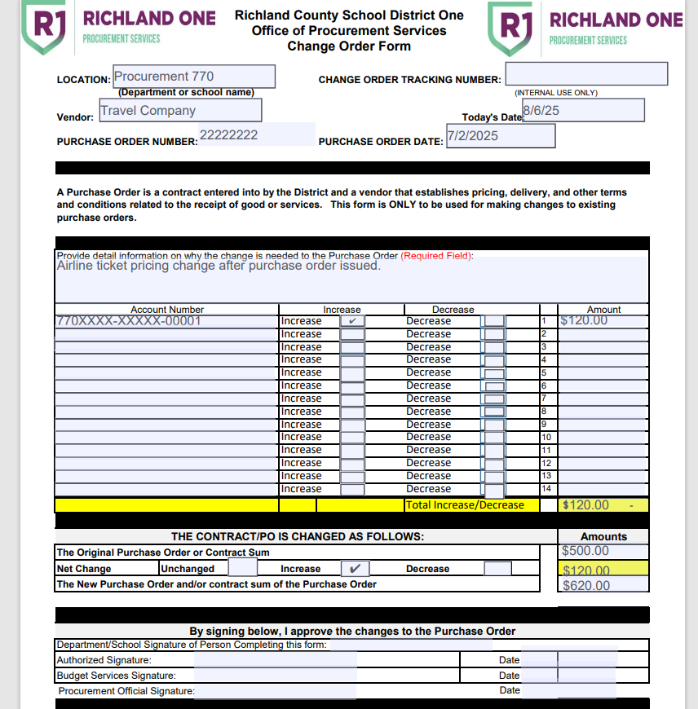
Change Orders
Our goal= Decrease changes orders & get submitters to add more detail to the description of their change order.
“Increase PO to pay invoice” vs “Airline ticket pricing change after purchase order was issued”

Slide 28
Change Order Math
Change Orders
How much you need the PO to be increased or decreased for the account number listed on the left.
The grand total of how much you need the entire PO to be increased or decreased.
How much the PO was when it was first cut.
The total amount that you want increased or decreased from the PO.
The new amount you want the PO to be (see next slide for example).

Slide 29
Change Order Math
Change Orders
The new amount you want the PO to be.
**This number should match the total of all invoices that will need to be paid out of this PO.

Slide 30
Blanket Purchase Orders
Blanket Purchase Orders
Used on a very limited/necessary basis
Only should be requested when there is a genuine need to facilitate emergency or immediate response
Approved on a case-by-case situation
Buyers retain the right to deny blanket PO requests to departments that consistently exceed their blanket PO limits or purchase orders not associated with the Budget/Object code indicated
Department MUST track spending to ensure limit is not exceeded, review monthly
In most cases, exceeding the dollar amount results in a ratification
We HIGHLY recommend tracking spending by calls/receipts, NOT by the invoices in MUNIS
All requests for blanket POs should list the following in the line item:
    Services or goods description
    Time frame PO is valid for
    Who has authority to use the PO
    Amount that should not be exceeded
    Language about gift card and electronic purchases being prohibited

Slide 31
Federal Funding
Federal Funds
Federal law requires the application of the most restrictive code to all Federal spending. Our exemptions are not the most restrictive, so we cannot use them.
A competitive solicitation is required when the cumulative total the district spends with a vendor is over $10,000 (as of 7/1/26).
TIP: Use a state contract or other valid cooperative contract that has already been competitively solicited so you don’t have to.
Questions? Reach out to State and Federal Programs for guidance.

Slide 32
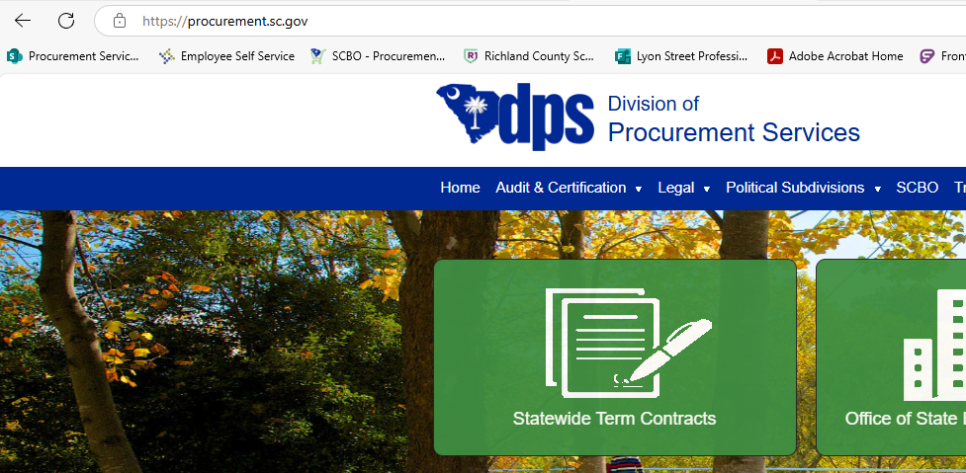
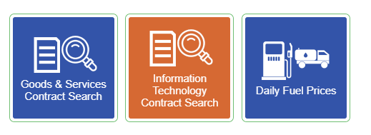
How To Find Statewide Term
Contract Resources
South Carolina Contracts
What is a statewide “term” contract? A statewide “term” contract is a contract for the indefinite delivery of an indefinite quantity of specific supplies or services to be furnished as needed and upon request during a fixed period.

Slide 33
SC State Contracts
Why Use a Statewide Term Contract?
These contracts are competitively bid by State Fiscal Accountability Authority (SFAA) which means:
The pricing is set; no negotiating or competitive quotes necessary
Terms and conditions are tailored to SC- this protects the district from risk
Can be used with Federal Funding
Vendors’ feet are held to the fire; doing bad business with us means they risk losing their contract with the state
Note: There is a different between a vendor having a contract vs. the item you want to buy from them being on that contract.

Slide 34
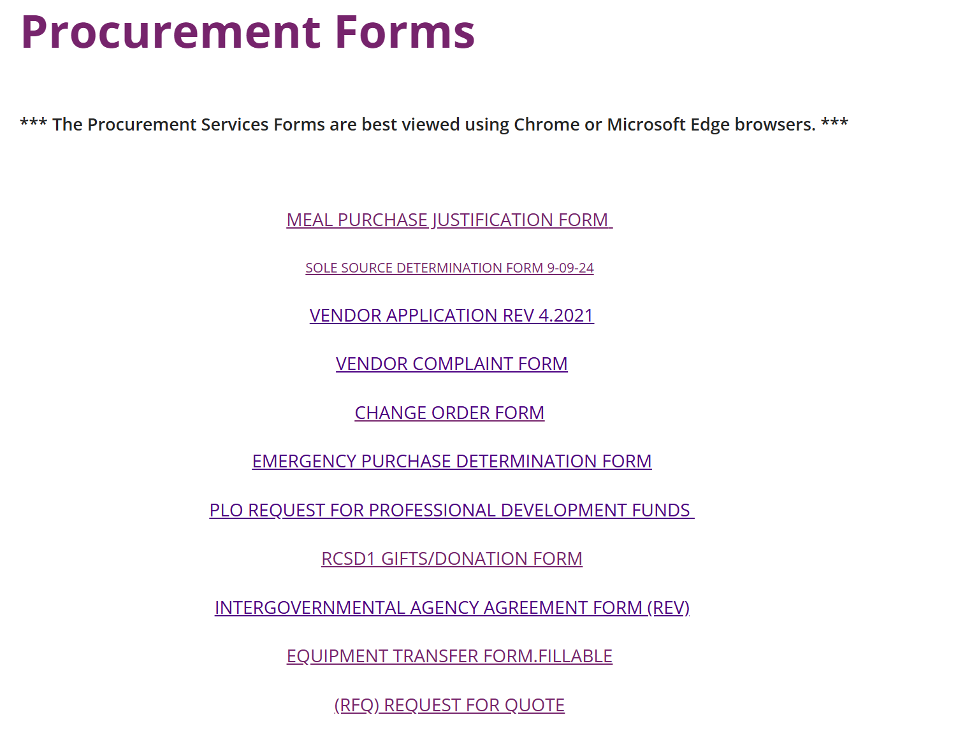
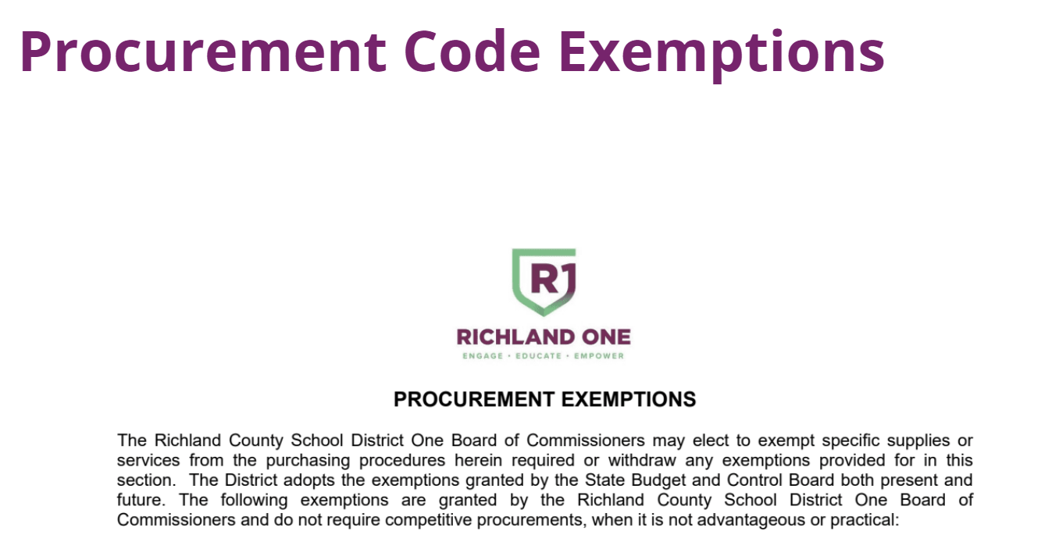

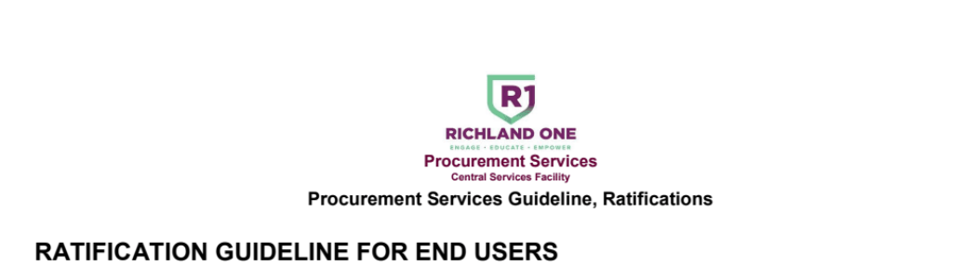
Resources – Procurement Website
Procurement Resources- Please Review!

Slide 35
Warehouse
Warehouse
School Dude is now “Brightly Asset Essentials”
Staff are still working through implementation and setup
Brian.Albert@richlandone.org is the current contact for Movement Services
Need something moved? Request it early! The schedule fills up fast
Mr. Albert can also help if you have issues with or questions about pick tickets for Warehouse fulfillment

Slide 36

Printing Services
Print Shop
Printing Services can assist with all kinds of printing needs- not just printed copies! They can do coil binding, posters, banners, yard signs, sandwich boards, business cards, letterhead, invitations, brochures, and more!
Call 803-231-6950 if you need assistance with getting an account set up for your department or have questions about their services.

Slide 37
Questions? Want more information?
Questions? You have options!
Call or email your buyer (buyer assignments on the webpage)
Call or email Procurement Services (803-231-7033, VOIP 9-1733)
Set up a time to meet with your buyer virtually or in-person
Consult the Procurement Code
Review resources and previous training materials at: https://www.richlandone.org/departments/procurement-services/home
Thank you!

