Slide 1


Leavers 101

Slide 2



Why Should PEIMS Matter to Me?
There are Serious Consequences For A Lack of Data Integrity
Consequences for inaccurate records:
Principals, administrators, PEIMS coordinators, attendance clerks, data entry clerks and counselors play an essential role in a district’s efforts to ensure that all data is timely, accurate and properly documented. In no case should paraprofessional personnel be responsible for determining students coding information for attendance, program placement or special services.
Lowering of a district’s accountability record
Lowering of a school’s accountability rating
Loss of funds which could impact jobs, salaries, and programs for students
Students may be retained inappropriately
Reprimands from the state

Slide 3

Summer PEIMS Submission | June 11, 2026 | **New submission deadline for 2025-2026 school year leaver data.
Begin School Start Window | August 18, 2026 | Any student not returning by this date from last year will be reported in Fall PEIMS if not enrolled in another Texas school or if GED (see below date).
GED/ Graduation Date | August 31, 2026 | Any student that withdrew/dropped out from 2024-2025 and has not enrolled and has earned a GED can be coded with a leaver reason GED. Students from the previous school year that finish their graduation requirements graduate on-time.
Extended Year PEIMS Final Submission | October 1, 2026 | **All corrections to leaver data from 2025-2026 for students that did not return by the PEIMS Extended Year resubmission deadline. After this date, no leaver codes may be changed for the previous school year.
Close School Start Window | September 25, 2026 | Last date for student from 2024-2025 to enroll or else he/she will be reported as leaver/dropout if not enrolled at another Texas school district, state charter or other MISD school. (excluding Migrants, Refugees/Asylees)
Fall Enrollment Snapshot Date | October 2, 2026 | LEAs will report special education and demographic data for students enrolled on the first Friday in October and for students in grade levels 7-12 enrolled at least one day on or before the first Friday in October.
Fall Enrollment Submission | October 15. 2026 | Date fall Enrollment data submission is due.
Important Dates
**PEIMS submission for leaver data changed starting with 2025-2026 school year data. Leaver Information is transmitted during Summer PEIMS instead of Fall.

Slide 4
What is a Mover?
What is a Leaver?
Movers: Students who were enrolled in the district last year, but are now enrolled in another Texas district/public school LEA, and can be located by PEIMS tracking. These students will be reported to PEIMS by another entity.
Students who have obtained a GED certificate at a Texas examination site by August 31 are Movers.
Note: The final determination of whether a student is a Mover is made by the TEA.
Leavers: Students who were enrolled in the district last year in grades 7-12, but have not enrolled in the district in the current year, or who moved to a Non-Texas Public School (charter, out of state, etc.).
Graduates and No Shows are Leavers.
Students in grades EE-6 in the prior school year are never reported as Leavers.

Slide 5
Leaver Documentation
All leaver codes, which include dropout codes and non-dropout codes, used to withdraw a student must be supported by documentation.
Documentation supporting the use of a leaver code must exist in the district at the time the leaver data is submitted. This documentation must be retained for at least five years.

Slide 6

Why Should Leaver Documentation Matter to Me?
All dropouts will have a direct impact on your TAPR data.
Dropout rates will never be completely accurate as long as we are not obtaining the proper documentation needed.
If we are ever audited by TEA, we have to have the documentation on hand that supports the codes we assigned.
I will change students to dropouts if we do not have the documentation.
Loss of
TEA is behind on reporting Federal data which could cause us to lose Title I funds and Perkins grants.
This is the reason our Leaver data reporting deadlines are changing.
Notes:
ECHS example

Slide 7
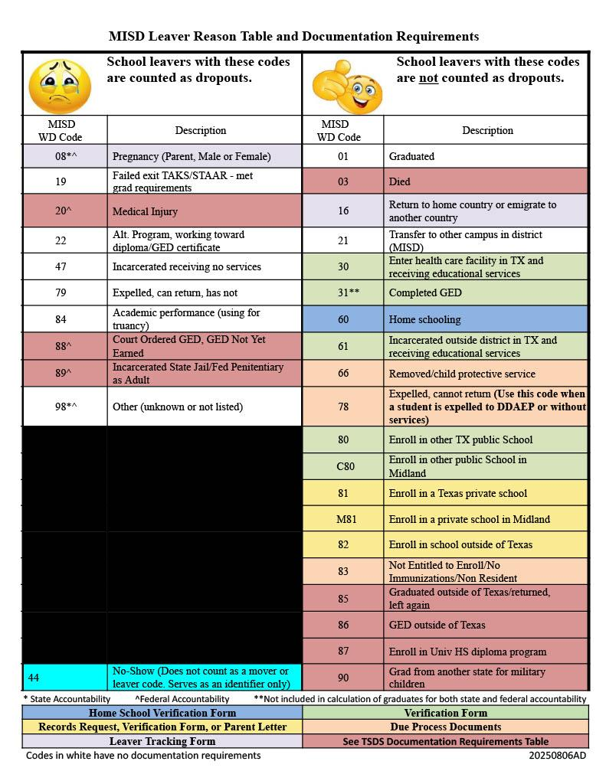
MISD Leaver/Mover Codes
(See handouts)
Codes on the left are counted as dropouts. Codes on the right are not*.
Color-coded to match documentation requirements. (matches handouts)
Notes:
*If they don’t earn a GED by 8/31 of next school year, then they are a dropout.

Slide 8
Common Withdrawal Codes
80 Moved to another Texas public school
Student Verification Form
C80 Moved to a Midland area charter school
Student Verification Form
60 Homeschooling
Parent Letter/email with date homeschooling began OR a signed Homeschool Verification Form
81/82 Private School/ Out-of-State
Student Verification Form, Records Request, or parent letter/email stating student is enrolled in a private school in Texas or a private or public school outside of Texas
16 Returned to Home Country or
Emigrated to Another Country
Leaver Tracking Form (only time verbal
conversation can be used as
documentation) or Parent/host family letter/email or parent/guardian signed
withdrawal form indicating
returning/emigrating to a foreign country
M81 Moved to a Midland area private school
Student Verification Form, Records Request, or parent letter/email stating student is enrolled in a private school in Midland
21 Transfer to other MISD campus
No documentation. Current campus withdraws the student when the receiving campus calls and asks for them to be withdrawn.
22 Getting GED
No documentation. Has to earn GED
by August 31 of the next school year
88 Court Ordered GED
Copy of court order.
Has to earn GED by August 31 of the next school year.
78 Expelled, cannot return
all students that are sent to MAP via expulsion. Students enrolling at MAP that are not expelled will be a 21 and 21 rules apply.*
84- Administrative Withdrawal
MVP Students**
98- Whereabouts Unknown
Notes:
Discuss changes to Homeschool Verification form
Honorable mention- 03
Protocol for student death
Copy of obituary

Slide 9
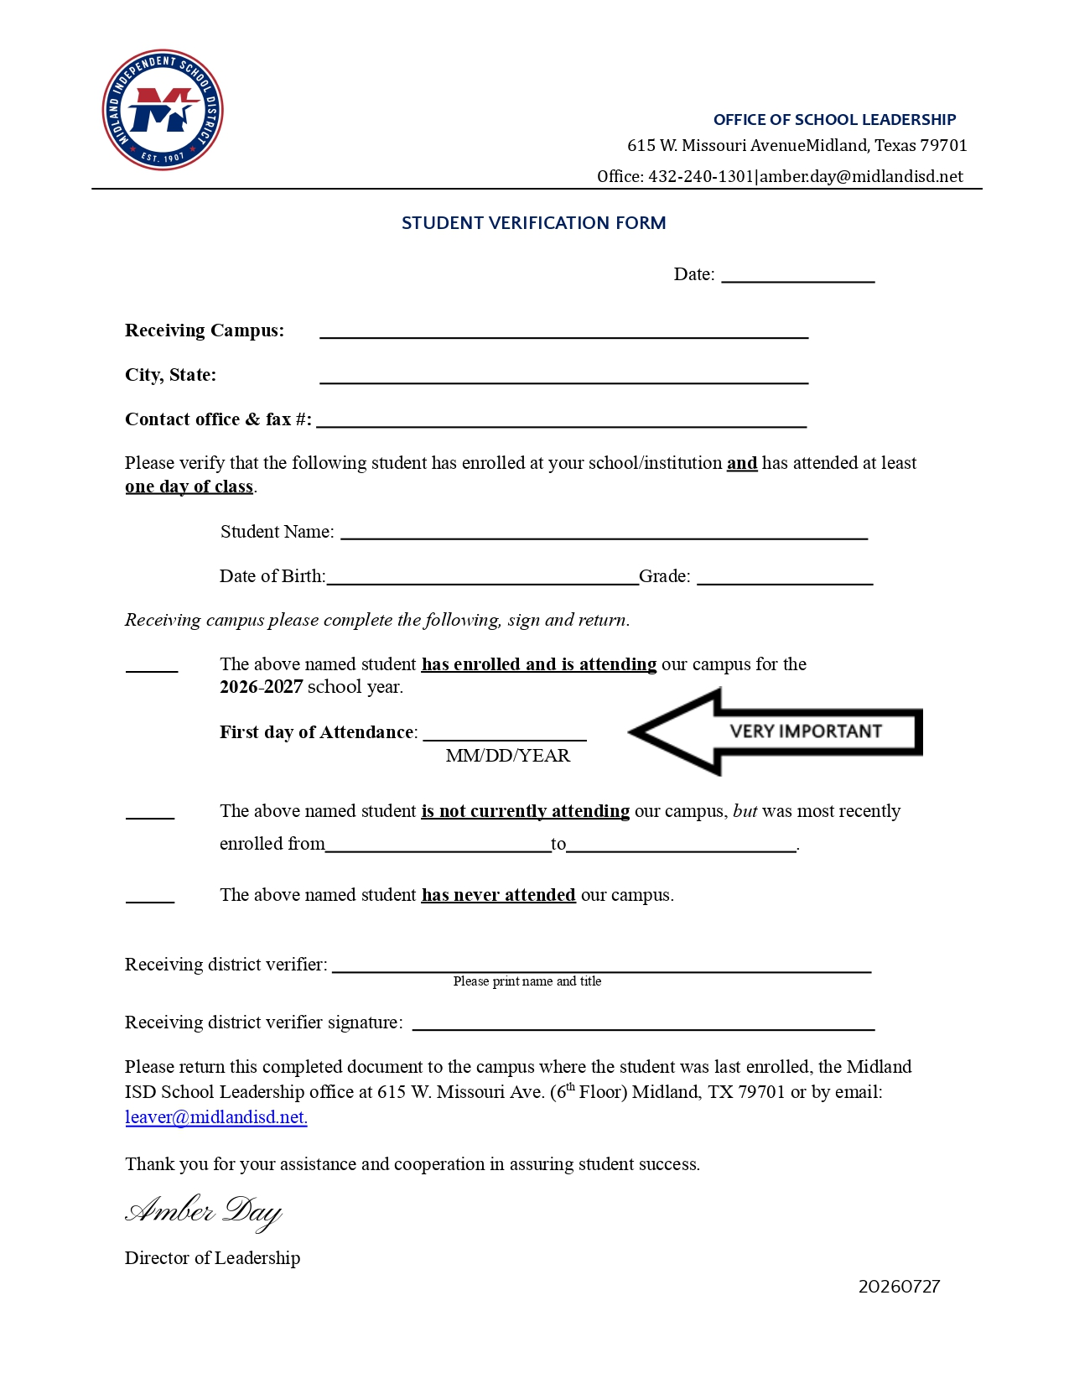
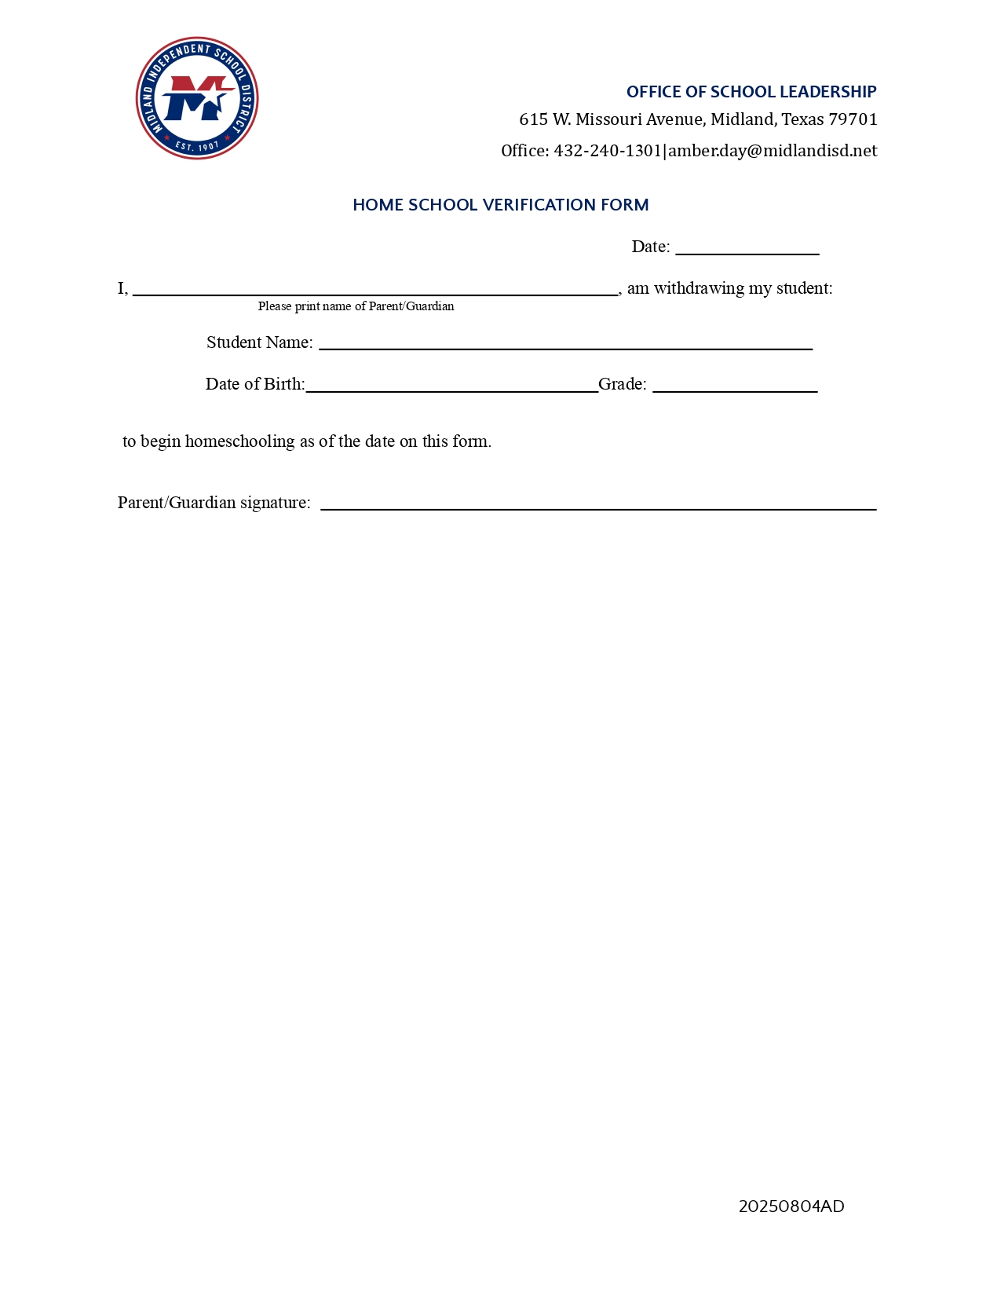
MISD Leaver Documentation forms
(See handouts)
Notes:
Discuss changes to Homeschool Verification form

Slide 10
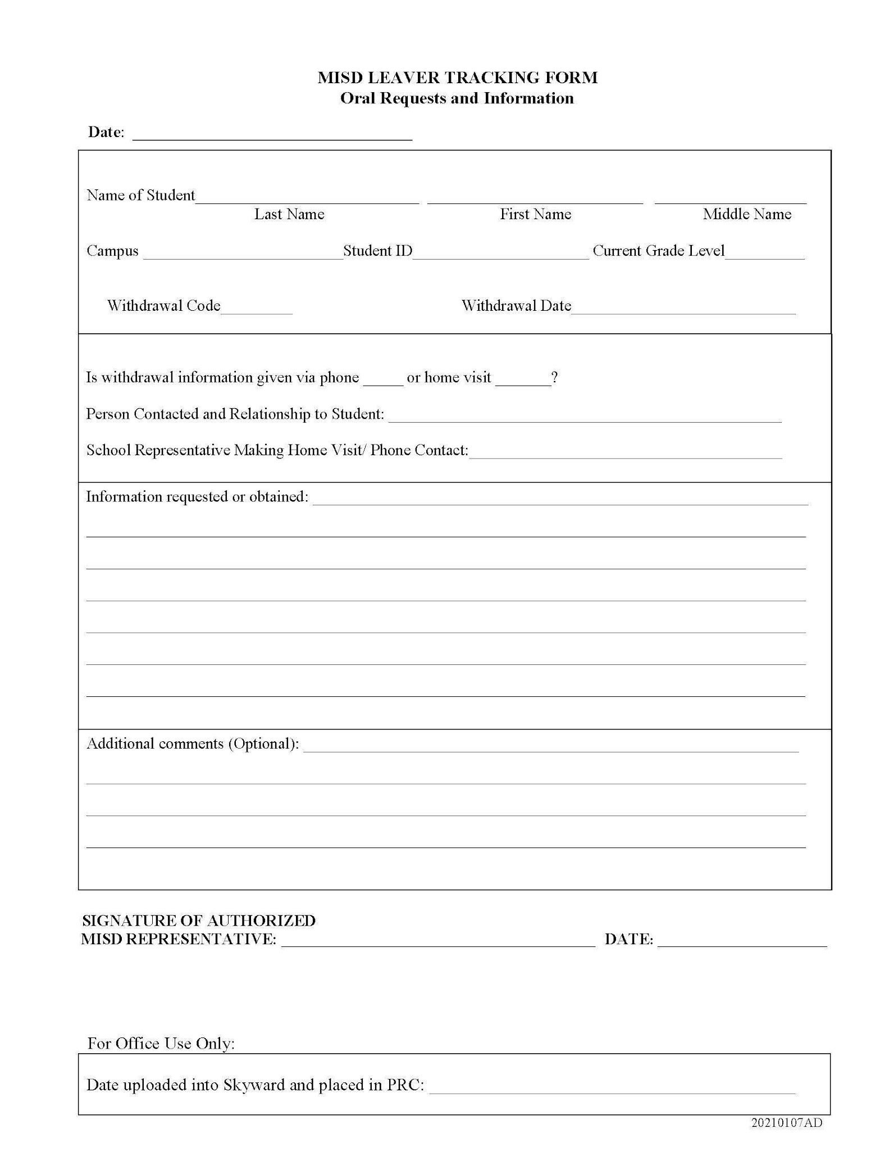
MISD Leaver Documentation forms
Dropout Prevention Webpage

Slide 11
No-Show Lists
Even though there will be no official Walk for Success, campuses will still be expected to work their student find lists that I will create after the first week of school. You will be expected to contact families and narrow down the list just as you have previously when there was a WFS.
This work is integral to our dropout and graduation rates.

Slide 12
Leaver Audits
Will be conducted at the end of each six weeks for each campus to check coding and documentation.
Leaver audits ensure that students are located in a timely manner.
The following are some of the things that will be looked at during the audit:
Leaver code discrepancies caused by not following TWEDS guidelines.
No documentation to support leaver codes.
Requests for transcripts/records and parent emails uploaded into Skyward
Code 21 was used for a student transfer in the district but the student never enrolled at the new campus.
Missing withdrawal forms in Skyward
Students had less than 10 full, consecutive days of absences
All deadlines must be adhered to
Notes:
APs, clerks, registrars, lead counselors, Directors, EDs will be copied on those emails
Students should not be withdrawn as a 21 until the new campus calls and requests the withdrawal of the student for enrollment at their campus.
Will be expected to continually look for students and work on previous 6 weeks throughout the year

Slide 13
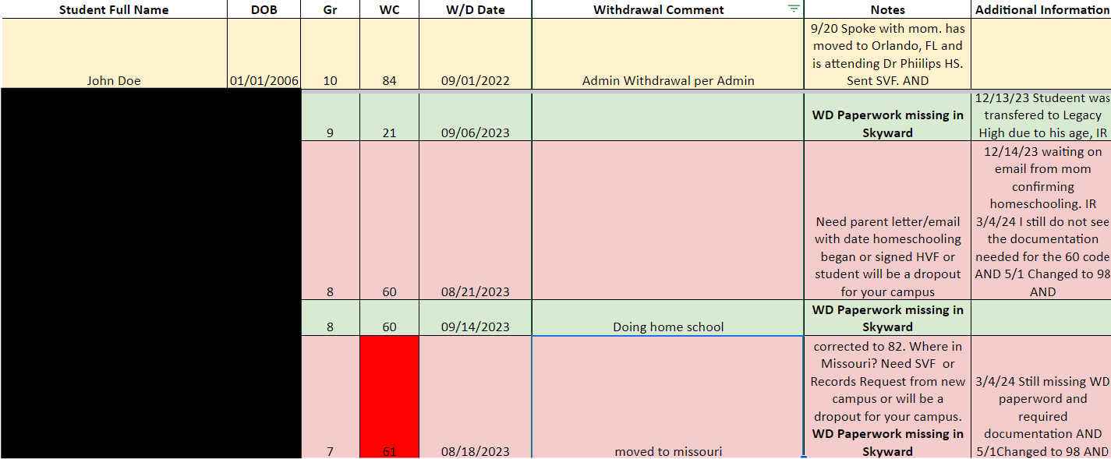
Leaver Audit Examples

Slide 14
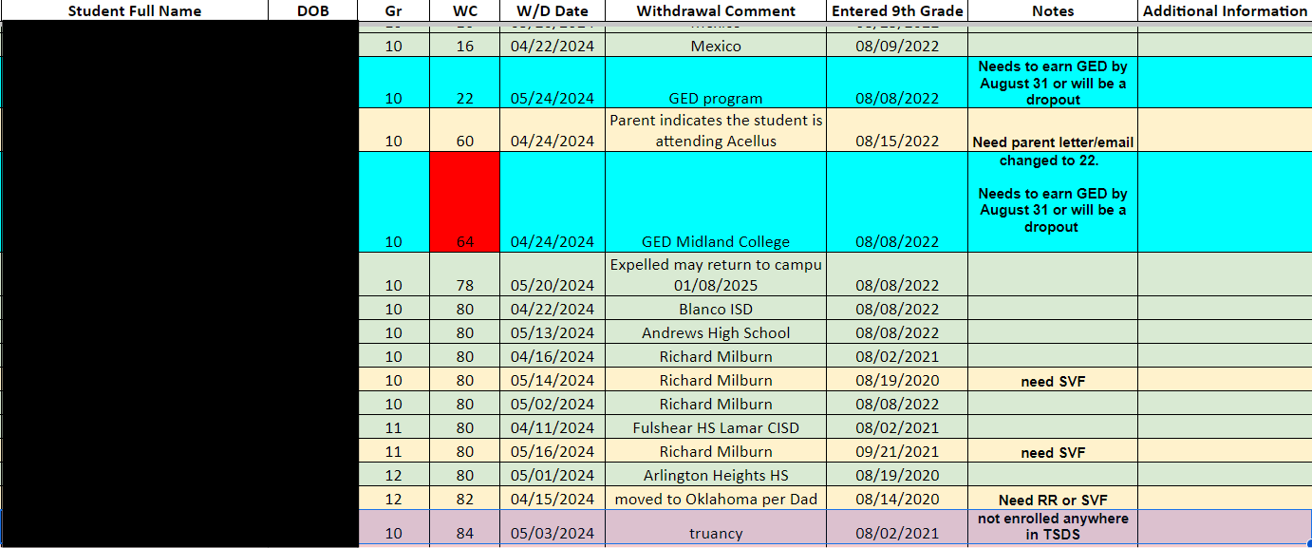
Leaver Audit Examples

Slide 15
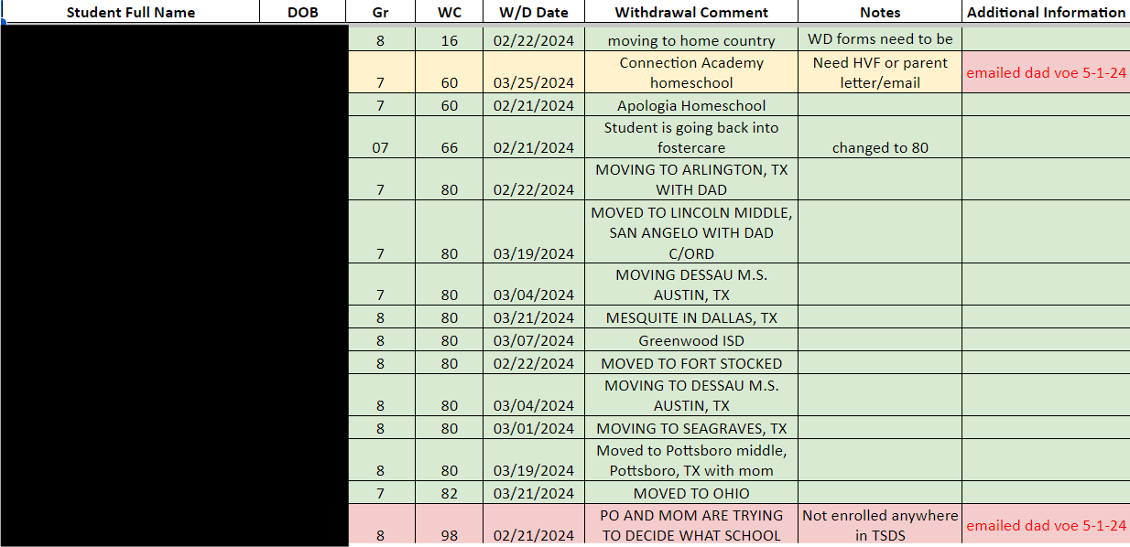
Leaver Audit Examples

Slide 16

Leaver Documentation Practice
In your group: Discuss and identify the correct leaver/mover code and what documentation is needed with each reason given for the withdrawal.
The student is being homeschooled at Texas Connections Academy, an online public school
Mom emailed student has begun homeschooling.
The family is moving back to Mexico
The family is moving to Hobbs, New Mexico.
Student 1
Student 2
Student 3
Student 4
Notes:
Start timer. Then go over answers whole group taking volunteers.

Slide 17
FAQ
While we're not required by TEA to update the leaver code for a student when additional information is received, like in this case where he withdrew to be homeschooled, but then we received the records request from a public school, it can be in our best interest to do so. As a result, we always want to upload/save the new information. Then, we need to look at the code used at the time of the withdrawal (if it is a 98­ dropout ­then we would always change it) and see if it has been audit verified meaning that we have received all necessary documentation to verify their enrollment elsewhere. In this case, we have the Homeschool Verification Form supporting the correct withdrawal code (60) and the student is not showing up on TSDS yet as being enrolled where the records were requested, so I would not change the leaver reason. If or when they do enroll in a public school (before the school start window), then I would recommend changing the student from being a leaver to a mover.
I received a records request for one of our leavers. They originally had withdrawn for homeschool. I don’t know if we need to change the leaver code in our system?

Slide 18
Important Reminders
Homeschooling
Records
1
We cannot make parents physically come up to the school to withdraw their students to homeschool them.
If they send you an email requesting withdrawal for homeschooling, please upload that email into Skyward. Be sure they have a date that homeschooling began.
3
You should be sending Student Verification Forms with records requests
Do not volunteer student records to the parent. Encourage parent to have the new school request records from us
If parent asks and still insists on taking records with them, give them a copy of the student’s records.
Documentation
4
Truancy/Excessive Absences
2
We cannot take verbal conversations with parents as documentation except when they are moving to a different country.
TREx Requests are NOT a verification of enrollment/documentation. They only indicate that a school requested records for a student who might enroll.
4
Students who are temporarily absent "as a result of illness, hospitalization, treatment for a mental health or substance abuse condition, or suspension" and are still living in the district may not be withdrawn unless a parent requests it. (SAAH 3.4.2)
McKinney-Vento students may not be withdrawn due to attendance until you can prove the absences aren’t related to their homelessness
Notes:
Fall Walk for Success is 9/14/24
Because of the upcoming changes to PEIMS due dates, the Walk for Success will be moved to June during summer school.

Slide 19
Where can you find resources?
  Dropout Prevention Webpage
  MISD Leaver Procedures Manual
  MISD Withdrawal OneNote
  amber.day@midlandisd.net
  432-240-1301
Notes:
I will email the presentation to anyone that signed in. or they can take a picture of this slide.

Slide 20
Questions?
Thank you for attending!

Slide 21


