Slide 1

One School One Book
Westport Elementary
Summer Reading
This is an 8-Week Summer Reading Journey for Grades 1-4!

Slide 2
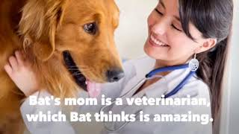
Book Trailer

Slide 3

Meet the Author !

Slide 4
🎨 Tips For Reading Across Grade Levels
💡 Parent Tip: For Grade 1 (and many Grade 2 students), this book should be a read-aloud where the parent reads and the child listens.
💡 Parent Tip: For Grades 3 and 4, students can likely read independently, or take turns reading aloud with you.

Slide 5


Summer Reading Roadmap
Week | Chapters | Focus Theme | Plot Milestone
Week 1 | 1–3 | Meet the Characters | Meeting Bat and his strict routines.
Week 2 | 4–7 | Surprise | The arrival of the mysterious baby kit.
Week 3 | 8–10 | Naming | The 30-day care agreement for "Thor".
Week 4 | 11–14 | Family | Janie's auditions and weekend at Dad's.
Week 5 | 15–17 | Science | A behind-the-scenes visit to the Vet Clinic.
Week 6 | 18–20 | Communication | Drafting the email to Dr. Jerry Jerry.
Week 7 | 21–23 | Friendship | Finding common ground with Israel at school.
Week 8 | 24–26 | Growth | Letting go and the power of responsibility.

Slide 6
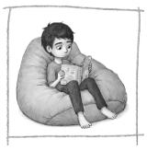
Week 1: Meet the Characters (Chapters 1-3)
Bat’s real name is Bixby Alexander Tam. Why do people call him "Bat"?
Why does Bat wear earmuffs?
What is mom’s job? What does she do?
Mom helps Bat stay calm when he gets angry. How can we keep ourselves calm when we get angry about something?

Slide 7
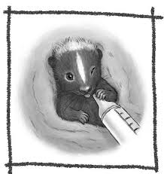
Week 2: Surprise (Chapters 4-7)
How does Bat react when he first sees the baby skunk in the box? How is his reaction different than his sister’s reaction?
Before Bat’s mom lets him hold the baby skunk, she tell him they can’t keep him and that he will go to a wildlife animal rescue center in a month. Why do you think she says this to Bat?
Why does “Every-Other Fridays” make Bat feel uncomfortable? Why was this “Every-Other Friday” going to be especially uncomfortable for Bat?

Slide 8
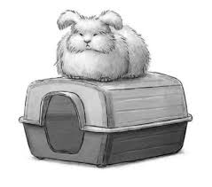
Week 3: Naming (Chapters 8-10)
Why was Luca upset?
Who is Baby Cakes?
Bat does not like group projects. Do you like collaborative projects with your peers?
Why or why not?

Slide 9
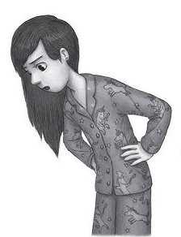
Week 4:Family (Chapters 11-14)
1. Bat predicts it is going to be a long weekend. Why does he say this?
2. What conclusions have you drawn about Mr. Grayson? How would you describe him?
3. Describe the relationship that Bat has with his sister, Janie and how he feels about her. How does she feel about Bat?
4. In Chapter 14, Bat is trying to convince his mother to let him do something she disagrees with. What strategies did Bat use to try to get his way?

Slide 10
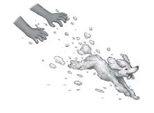
Week 5: Science (Chapters 15-17)
Why do you think Bat sneaks out of bed to read about skunks? What are your thoughts about that?
Bat is confused by Israel when he doesn’t leave. If you were there with him, what would you tell him or explain to him?
Why is Bat so much more relaxed and tolerant of sounds and flickering lights at his mom’s vet office than anywhere else?

Slide 11
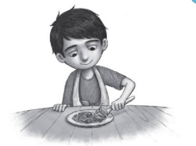
Week 6: Communication (Chapters 18-20)
1. Chapter 18 is all about Bat not understanding the effect his words have on Janie. If you were with him, what would you say to Bat to help him understand?
2. Janie didn’t like Bat’s thank-you surprise at all. What do you think of his surprise?
3. Bat is so focused on Thor that he can’t concentrate on his math. Have you ever had a time when it was hard for you to concentrate in school? If so, explain.

Slide 12
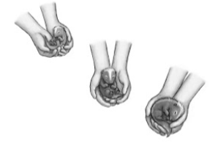
Week 7: Friendship (Chapters 21-23)
Janie explains to their dad that Bat doesn’t have any friends. Do you think this is true? Who do you think are Bat’s friends?
Bat has a nice time with his sister while watching the baseball game. How is their interaction different in this chapter? Share examples
Bat and his mom have a long conversation about eyes. What do you think his mom meant when she said, “You can tell a lot about a person by looking into their eyes.”

Slide 13
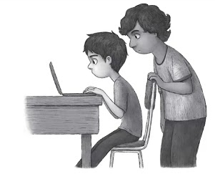
Week 8: Growth (Chapters 24-26)
1. Israel keeps talking to Bat and asks if he can go to Bat’s house. Does Israel want to be Bat’s friend? How can you tell?
2. Bat’s mom says that instead of giving Thor to the wildlife animal rescue center, Bat might be able to raise him until it is time for him to be released. Do you think this is a good idea? Why or why not?
3. It says, “Israel’s hands told Bat that Thor would be safe.” How could he know this from looking at Israel’s hands?

Slide 14
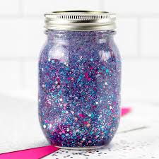
Optional Extension Activity: Social Emotional Learning
Sensory "Calm Down" Jars
Bat experiences the world very intensely and sometimes gets overwhelmed by loud noises or unexpected changes. Sensory jars are a great way to connect with how Bat manages his feelings.
What you need: Plastic water bottles or mason jars, warm water, clear glitter glue, and extra fine glitter.
How to do it: 1. Fill the jar about 80% with warm water.
2. Add a few tablespoons of glitter glue and stir until dissolved.
3. Drop in extra glitter (maybe black and white for Thor, or Bat's favorite colors).
4. Superglue the lid shut. Shake it up and watch the glitter slowly settle.
The Bat Connection: Discuss Bat’s "flapping" when he gets excited or stressed, and how having tools to calm down helps everyone.

Slide 15
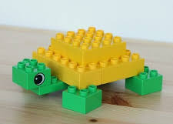
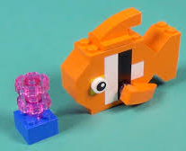
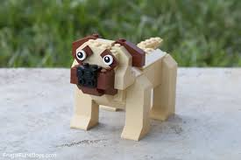
Optional Extension Activity: STEM LEGO CHALLENGE
STEM Challenge: Bat wants to keep “Thor” as his pet skunk. What is your perfect pet? Use Lego blocks that you have at home to create your own pet.
What you need: Legos and creativity!
Here are a couple of examples:
Writing Connection: Pick a writing prompt!
Descriptive Writing: Describe your perfect pet. What is it? What does it look like? How does your pet act? How does your pet move? Use colorful words to describe your pet.
Persuasive Writing: What is your perfect pet? Why would you be a good pet owner? Give 3 reasons why.
Informational Writing: What is your perfect pet? Research your perfect pet and write a report to include it’s physical description, dietary needs, exercise requirements, and ideal enclosure.

Slide 16
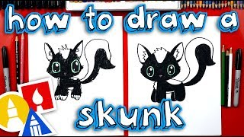
Art Hub Fun!

Slide 17
Reading a story together is one of the absolute best ways to build a child's vocabulary! When you come to one these words in the story stop and point it out. Reread the word in the sentence for context and discuss the meaning. This will help your child gain a deeper understanding of the story and build a more robust vocabulary.
Vocabulary Chapters 1-3 | Student Friendly Definition
sensitive (p. 2) | easily upset or offended by events or things that people say
unusual (p. 2) | different from what is normal or expected
trundle (p. 10) | a bed that has a space for things to be stored inside
encyclopedia (p. 10) | a book or CD, or a set of these, containing facts about many different subjects, or containing detailed facts about one subject
content (p. 11) | happy
relieved (p. 13) f | feeling happy because you are no longer worried about something
Adapted from Reading is Fundamental

Slide 18
Vocabulary Chapters 4-6 | Student Friendly Definition
orphan (p. 23) | a child whose parents are both no longer living
visible (p. 24) | able to see
misunderstood (p. 27) | used to describe someone who is not liked by other people in a way that is unfair, because they do not understand them
Vocabulary Chapters 7-9 | Student Friendly Definition
refuse (p. 36) | to say no to something that someone has told you to do
rumple (p. 45) | to make hair or clothes less neat
philosophy (p. 45) | a set of ideas that guides someone in what they do
wise (p. 46) | a good decision, usually based on experience
reluctantly (p. 56) | slow, not really wanting to do it
interject (p. 49) | to interrupt what someone else is saying with a thought
Adapted from Reading is Fundamental

Slide 19
Vocabulary Chapters 10-12 | Student Friendly Definition
threatening (p. 58) | if someone’s behavior is threatening, you believe they intend to harm you
enclosure (p. 59) | an area surrounded by a wall or fence, and used for a particular purpose
collaboration (p. 62) | when you work together with another person or group to achieve something, especially in science or art
interfere (p. 63) | to get involved in a situation where you are not wanted or needed
Vocabulary Chapters 13-16 | Student Friendly Definition
allergy (p. 80) | a medical condition in which you become ill or in which your skin becomes red and painful because you have eaten or touched something
bargaining (p. 88) | a discussion to reach an agreement about something
domestic (p. 92) | if an animal is domestic,they live in your house
expression (p. 98) | something you say, write, or do that shows what you think or feel

Slide 20
Vocabulary Chapters 17-18 | Student Friendly Definition
overwhelm (p. 105) | a feeling so strong that you cannot think clearly
symptom (p. 106) | something wrong with your body or mind which shows that you have a particular illness
marsupial (p. 110) | an animal such as a kangaroo which carries its babies in a pocket of skin on its body
compliment (p. 123) | something nice that someone says about you
Vocabulary Chapters 19-23 | Student Friendly Definition
gesture (p. 130) | a movement of part of your body, especially your hands or head, to show what you mean or how you feel
exceptional (p. 145) | very good; outstanding
inherit (p. 146) | to have the same character or appearance as your parents
nature (p. 162) | someone’s character(istics)
Adapted from Reading is Fundamental

Slide 21
Vocabulary Chapters 24-26 | Student Friendly Definition
gratification (p. 166) | to feel satisfied and happy, as though you’ve gotten an award
sincere (p. 168) | a feeling, belief, or statement that is sincere, honest,true, and based on what you really feel and believe
curious (p. 170) | wanting to know something
commitment (p. 172) | a promise
convince (p. 174) | to try and get someone to believe you
Adapted from Reading is Fundamental

