Slide 1


Full Day UPK
Herricks Union Free
School District
& the YMCA of Long Island
Meet & Greet
June 23rd, 2026

Slide 2
Welcome and Introductions

Slide 3
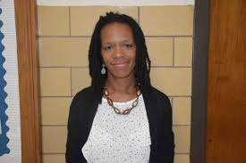
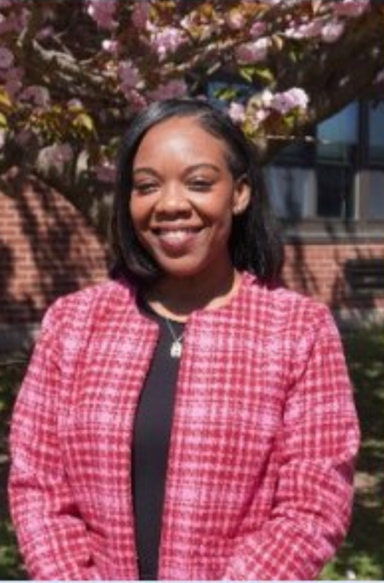
Herricks Union Free School District
Elizabeth Guercin
Assistant Superintendent for Curriculum and Instruction
Shona Beldo
Assistant Principal @ Center Street Elementary School

Slide 4
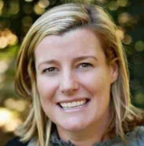
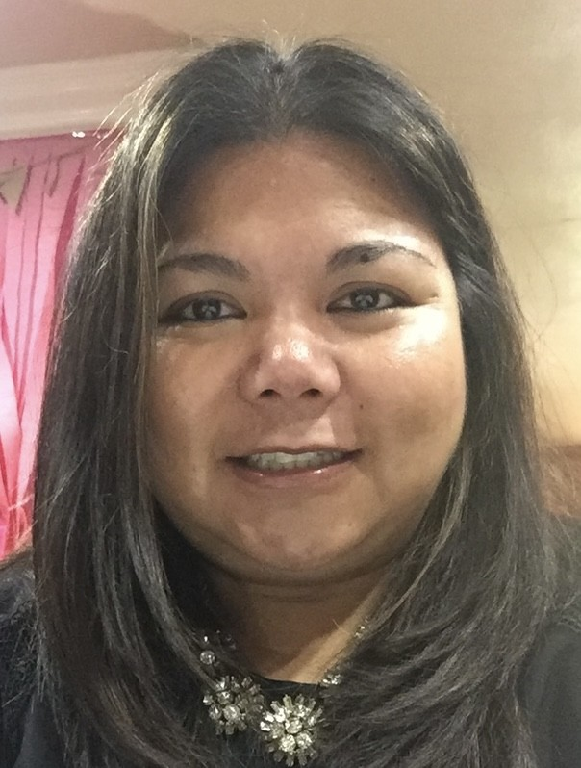
YMCA of Long Island
Shannon Cussen
Executive Director of Child Care
shannon.cussen@ymcali.org
Liberty Ledesma
Child Care Director @ YMCA at Glen Cove
Liberty.Ledesma@ymcali.org

Slide 5

Creative Curriculum
The Creative Curriculum for Pre-K focuses on nurturing curiosity and fostering whole-child development through a play-based, hands-on approach. It uses studies and investigations to spark children's natural curiosity and build confidence, creativity, and critical thinking skills. This comprehensive, research-based curriculum emphasizes project-based learning, intentional teaching, and strong family engagement.
Increased Kindergarten Readiness
Development of Critical Thinking Skills
Positive Learning Environment

Slide 6

Phonics: FUNdations Overview
Pioneered by Barbara Wilson, Fundations is grounded in the science of reading and guides teachers to provide effective instructional practices in print concepts, phonemic awareness, phonics and word study, vocabulary, automaticity/fluency, and comprehension.
The research-based approach of the Fundations program allows teachers to confidently present a carefully structured reading, spelling, and handwriting curriculum using engaging materials and multimodal techniques.

Slide 7

Phonemic Awareness: Heggerty
Overview: 35 weeks of lessons; 10 skill components in each lesson
Setting: Whole group instruction
Lesson Length: 10 minutes
What is it? Heggerty is a structured and systematic
approach to develop phonemic awareness. Students
will learn to recognize, blend, segment, and manipulate
sounds (phonemes) within words.

Slide 8
Typical Schedule
9:00 am - 9:15 am Arrival
9:15 am – 9:45 am Morning work
9:45 am – 10 :15 am Circle Time, Brain Break and Fundations
10:15 am -10:45 am Wash Hands & Snack
10:45 am -11:45am Centers/Small Group
11:45 am -12:00 pm Clean up/Bathroom
12:00 pm -12:30 pm Outdoor play
12:30 pm-12:45pm Prepare for Lunch, Bathroom & Wash Hands
12:45 pm - 1:15 pm Lunch
1:15 pm -1:35 pm Heggerty
1:35 pm - 1:50 pm Story time & Interactive Boards Activities
1:50 pm - 2:00 pm End of Day Wrap up, Pack up & Dismissal
***Schedule Subject to Change

Slide 9
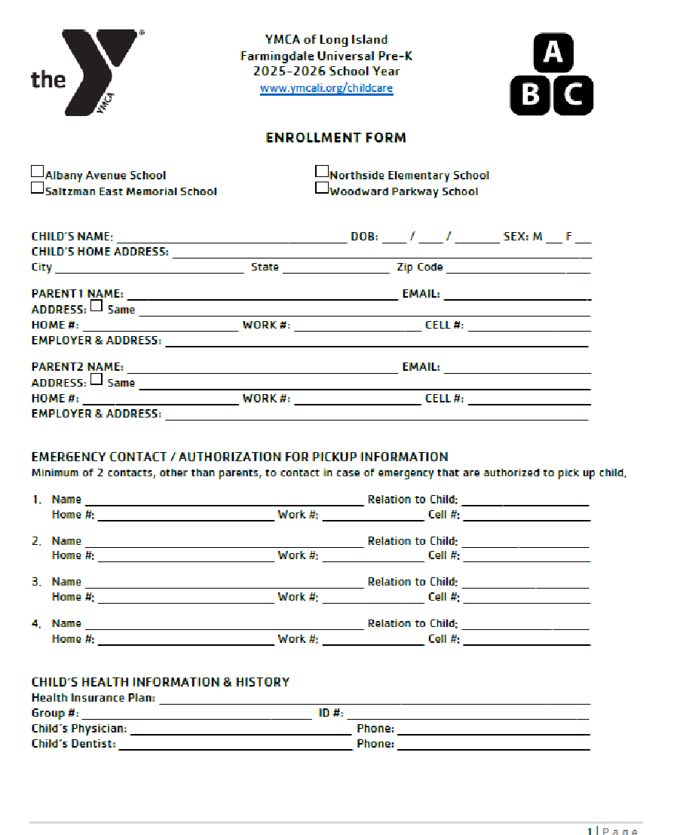
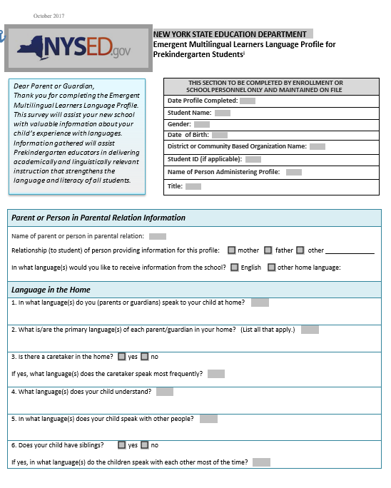
Required Forms
Please bring these forms with you on August 27th.
Enrollment Forms
Multilingual Language Survey

Slide 10
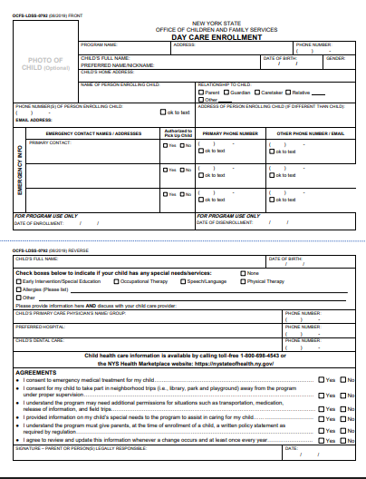
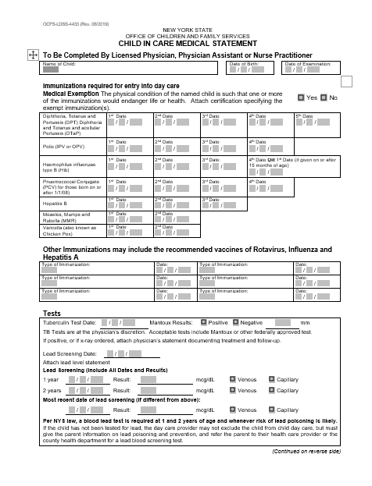
Additional Required Forms
Please bring these forms with you on August 27th
Day Care Enrollment
Child In Care Medical Statement

Slide 11
Medical Information
FOOD ALLERGIES - All Classrooms are Nut-Free
Maintain a nut aware environment by checking all food labels of items that come to class
When reading food labels look out for statements like below, these food items should not be sent to school
May contain other allergens
Processed in a facility that also processes nuts
Staff will be first aid and CPR certified
Emergency medications (epi-pen, Benadryl, and inhalers) will be given with proper medial forms.

Slide 12

Snack
Time will vary based on classroom. Your teacher will communicate with you to let you know what time is allotted for snack.
You may pack 1 small healthy snack and a refillable water bottle each day for your child.
Our classrooms are nut free, please carefully read ingredient labels when choosing snacks to be sent from home and send nut free snacks.

Slide 13
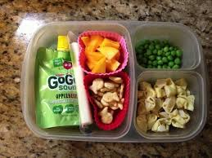
Lunch
You must provide a lunch from home in a labeled lunchbox for your child.
Please also provide a labeled reuseable water bottle. This will be fill as needed throughout the day with help of the classroom teacher.
Our classrooms are nut free, please carefully read ingredient labels when choosing lunch to be sent from home. Lunches should be nut free as well.

Slide 14
Arrival
9:00 AM – Herricks Community Center
  Parents will pull up to designated area behind the building.
  Parents will remain in their car and a staff member will take your child out of the car and bring them to their classroom teacher.
  Please follow the flow of traffic as designated.
  Please remember the first few days of school this process will take time.

Slide 15
Dismissal
2:00 PM – Herricks Community Center
All students will need to be signed out by the adult picking them up. The adult must be on the list for authorized pick up.
Changes to this list must be made in writing and in advance of dismissal.
Picture identification is required at all times, and teachers may request to see it if they do not recognize the person at the door.
This procedure takes additional time in the first few weeks of school - please be patient with our staff as we prioritize the safety of your children.

Slide 16

Birthdays
We love celebrating along with your child!
A special guest can come in and read a special story or do a craft.
  You can also film a special guest reading a story and send the video to your classroom teacher.
  Any guest entering the building must bring a photo ID to sign in at the front.
  We will send out a letter the month of your child’s birthday asking how you would like to celebrate.

Slide 17
Communication
Please feel free to contact us at any time with questions or concerns via:
A note- Please send in your child’s folder. Folders will be checked and emptied each morning.
Email- Teachers check email before and after the school day.
Remind- Send a private message through the Remind App. This app is used throughout the UPK.
  Please enjoy the pictures shared by your classroom teacher throughout the year - and do not repost on social media platforms if other children are in the photo.
Absences - If your child is going to be absent, contact the teacher directly.

Slide 18
Inclement Weather
UPK follows the school district for school closures, and it will be announced through Remind.
If the District has a delayed opening, the UPK will align with the district.
2 hour delay – Classes will begin at 11:00am

Slide 19
Parent Teacher Conference
Parent-teacher conferences are held twice a year.
UPK will have Early Dismissal on the following days:
  December 10th & 11th
  March 19th & 23rd
In order to accommodate all families, we have early dismissal on conference days.
Early Dismissal Times – 12:30pm
Your teacher will send out more information about signing up for conference times a few weeks in advance.

Slide 20
What does my child need on the first day?
Backpack
Folder
Healthy Snack/drink
Reusable/Refillable water bottle
Lunch
Rubber-soled Shoes
Extra Set of Clothing labeled with their name in a Ziploc Bag
(Pants, Shirt, 2 Pairs of Underwear, 1 Pair of Socks)
8. A SMILE!!!!
**Please clearly label all personal belongings**

Slide 21
Parent Orientation – August 27th
You can drop off any required forms, school supplies, and change of clothes at your meeting.
You will be assigned a designated time via email in early August.
You will be able to see the classroom, see the arrival and dismissal doors, and ask any questions you may have.
Please have the questionnaire filled out before the meet and greet!
Please note it is 1 adult per child.
First day of school – September 2nd

Slide 22
Thank you!
General Questions?
Classroom specific questions can be addressed during your Parent Orientation on August 27th.

