Slide 1

Freshman Parent Night
Helping families and students move confidently from middle school to high school
University High School • Auditorium • July 27, 2026
TITANS

Slide 2

Tonight’s Purpose
A shared roadmap for a strong start to ninth grade.
Know the tools
1
Parent Portal, communication, and where to find updates.
Understand expectations
2
Attendance, dress code, ID badges, and student conduct.
Protect the foundation
3
Credits, GPA, testing, and privileges begin now.
Partner early
4
Ask for support before small concerns become big barriers.

Slide 3
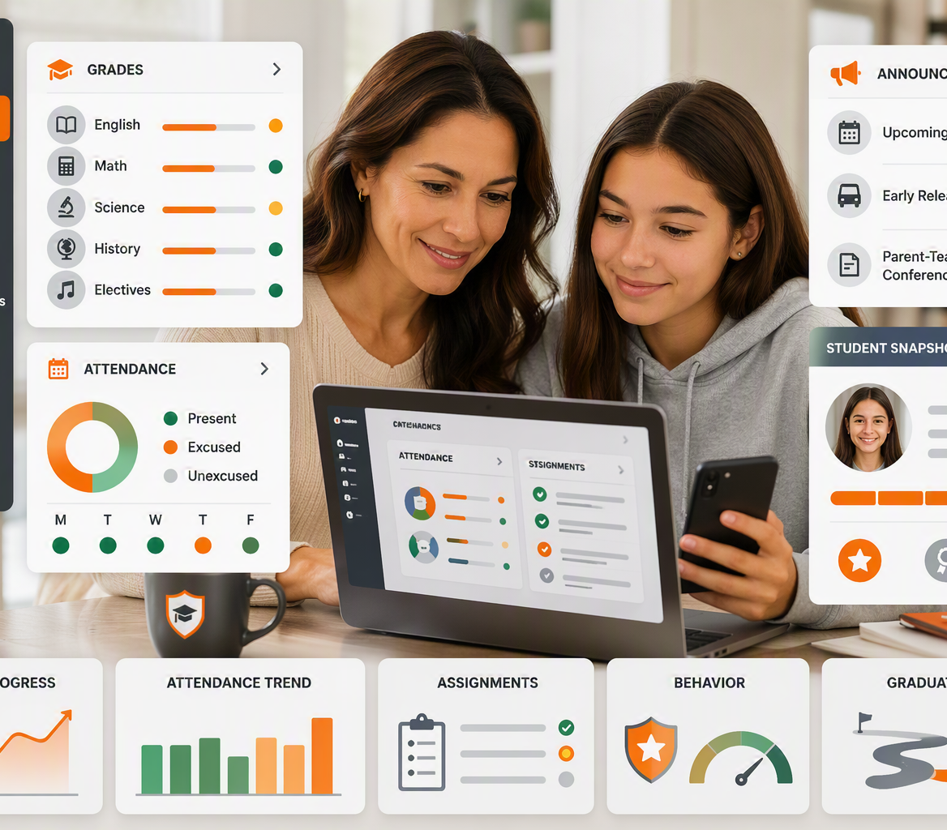
Parent Portal: Your Family Dashboard
A daily/weekly habit that helps families spot trends early.
Use it to monitor:
• Grades and missing assignments
• Attendance and tardies
• Assessments and announcements
• Discipline referral information
• Forms, fees, applications, and school items
https://www.vcsedu.org/portals
Parent Portal Tip
Set a consistent check-in rhythm with your student—look for patterns, not just one grade.

Slide 4
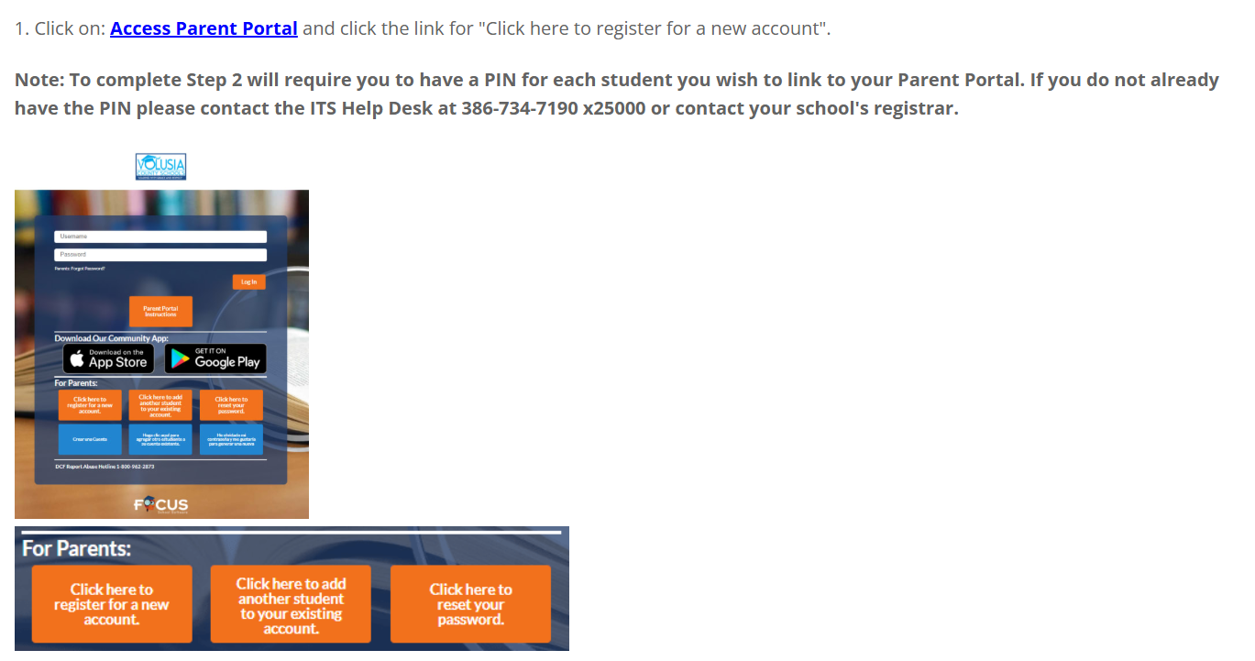

Slide 5
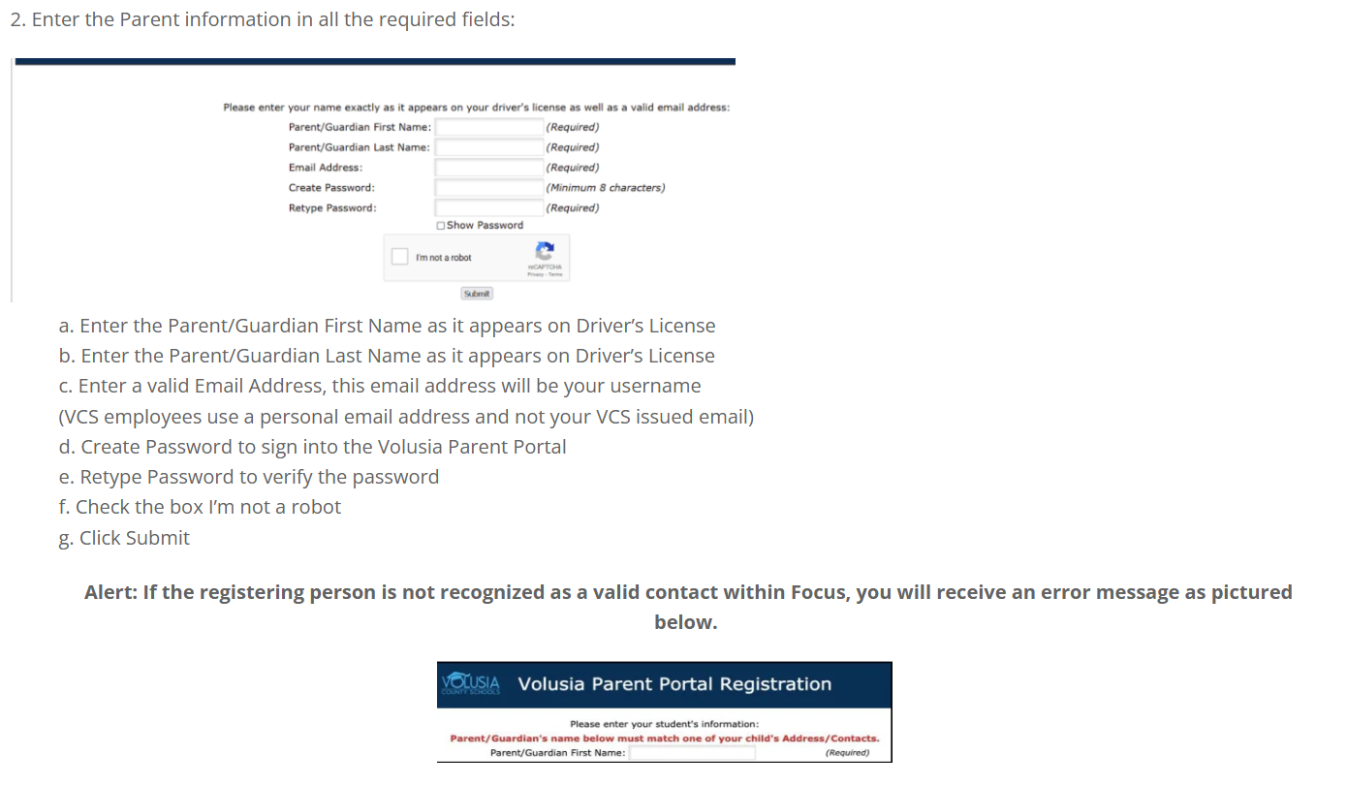

Slide 6
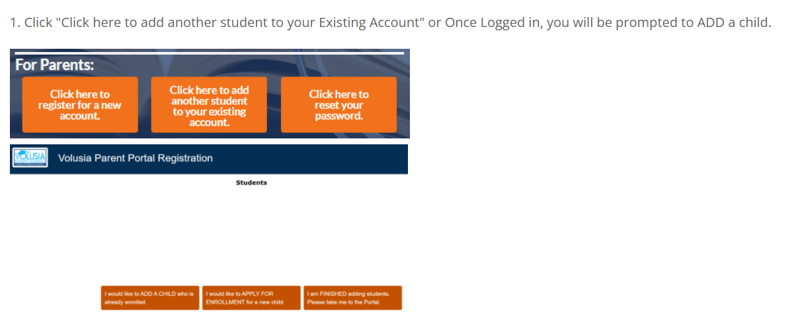

Slide 7
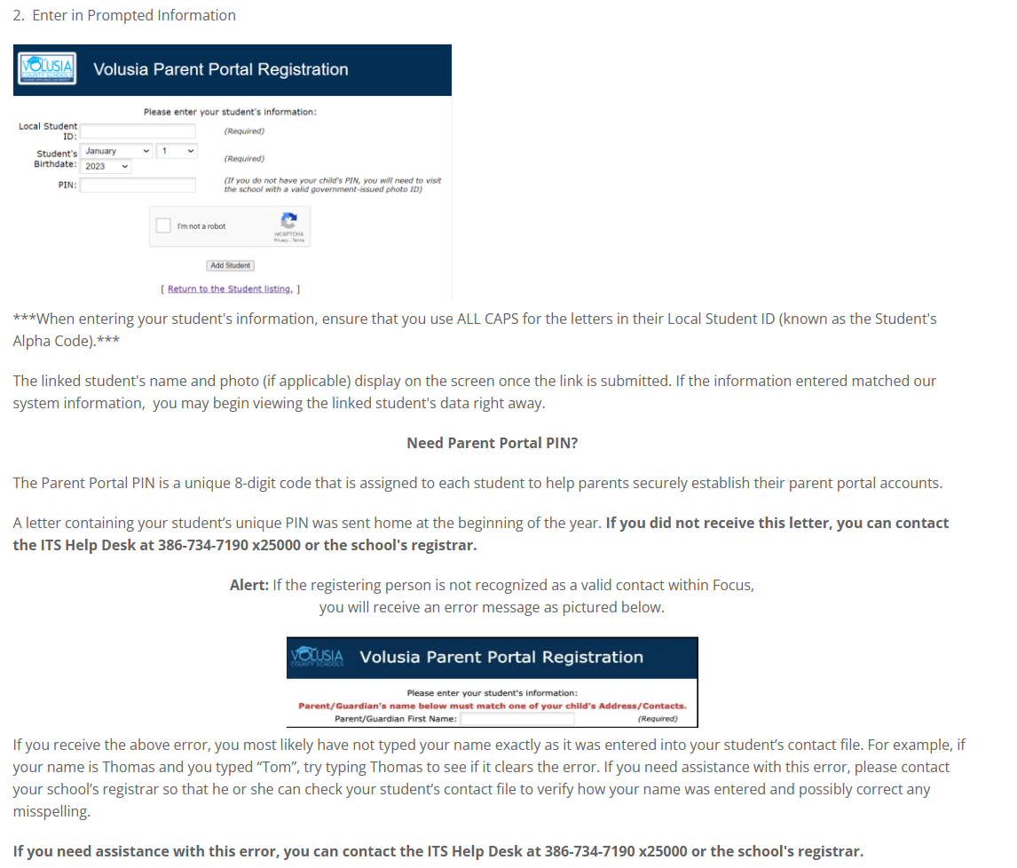

Slide 8
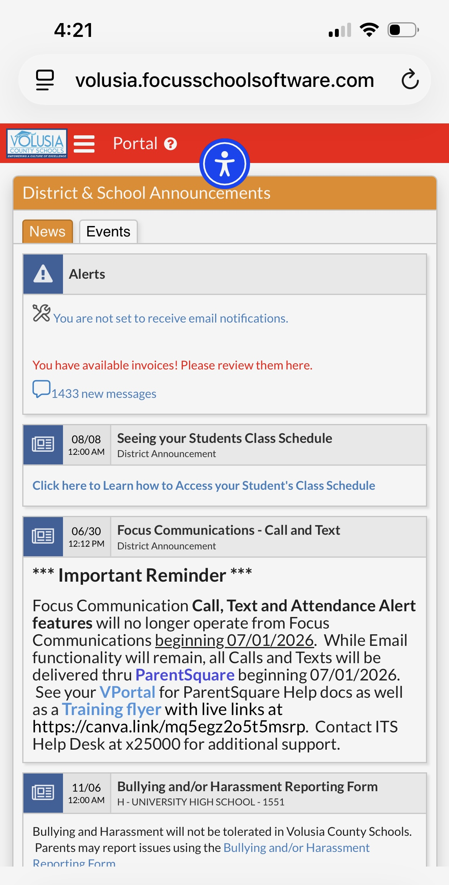

Slide 9
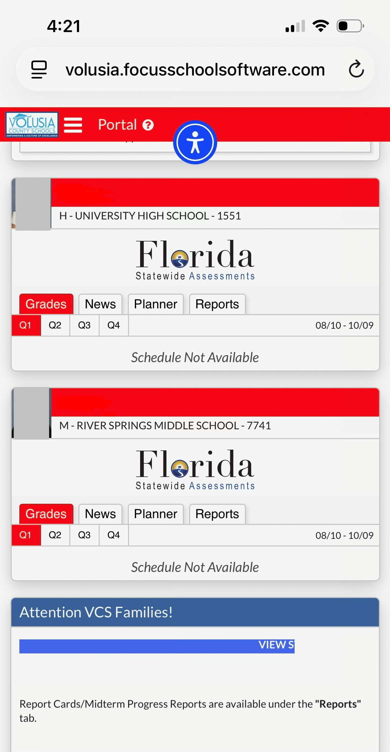

Student Name

Slide 10
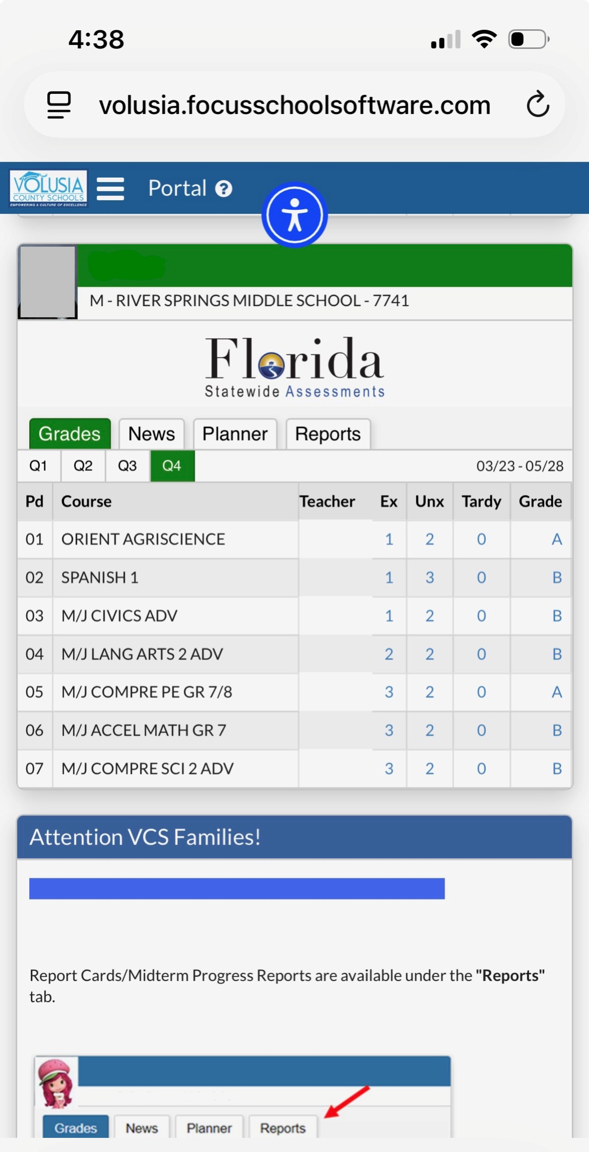

Slide 11
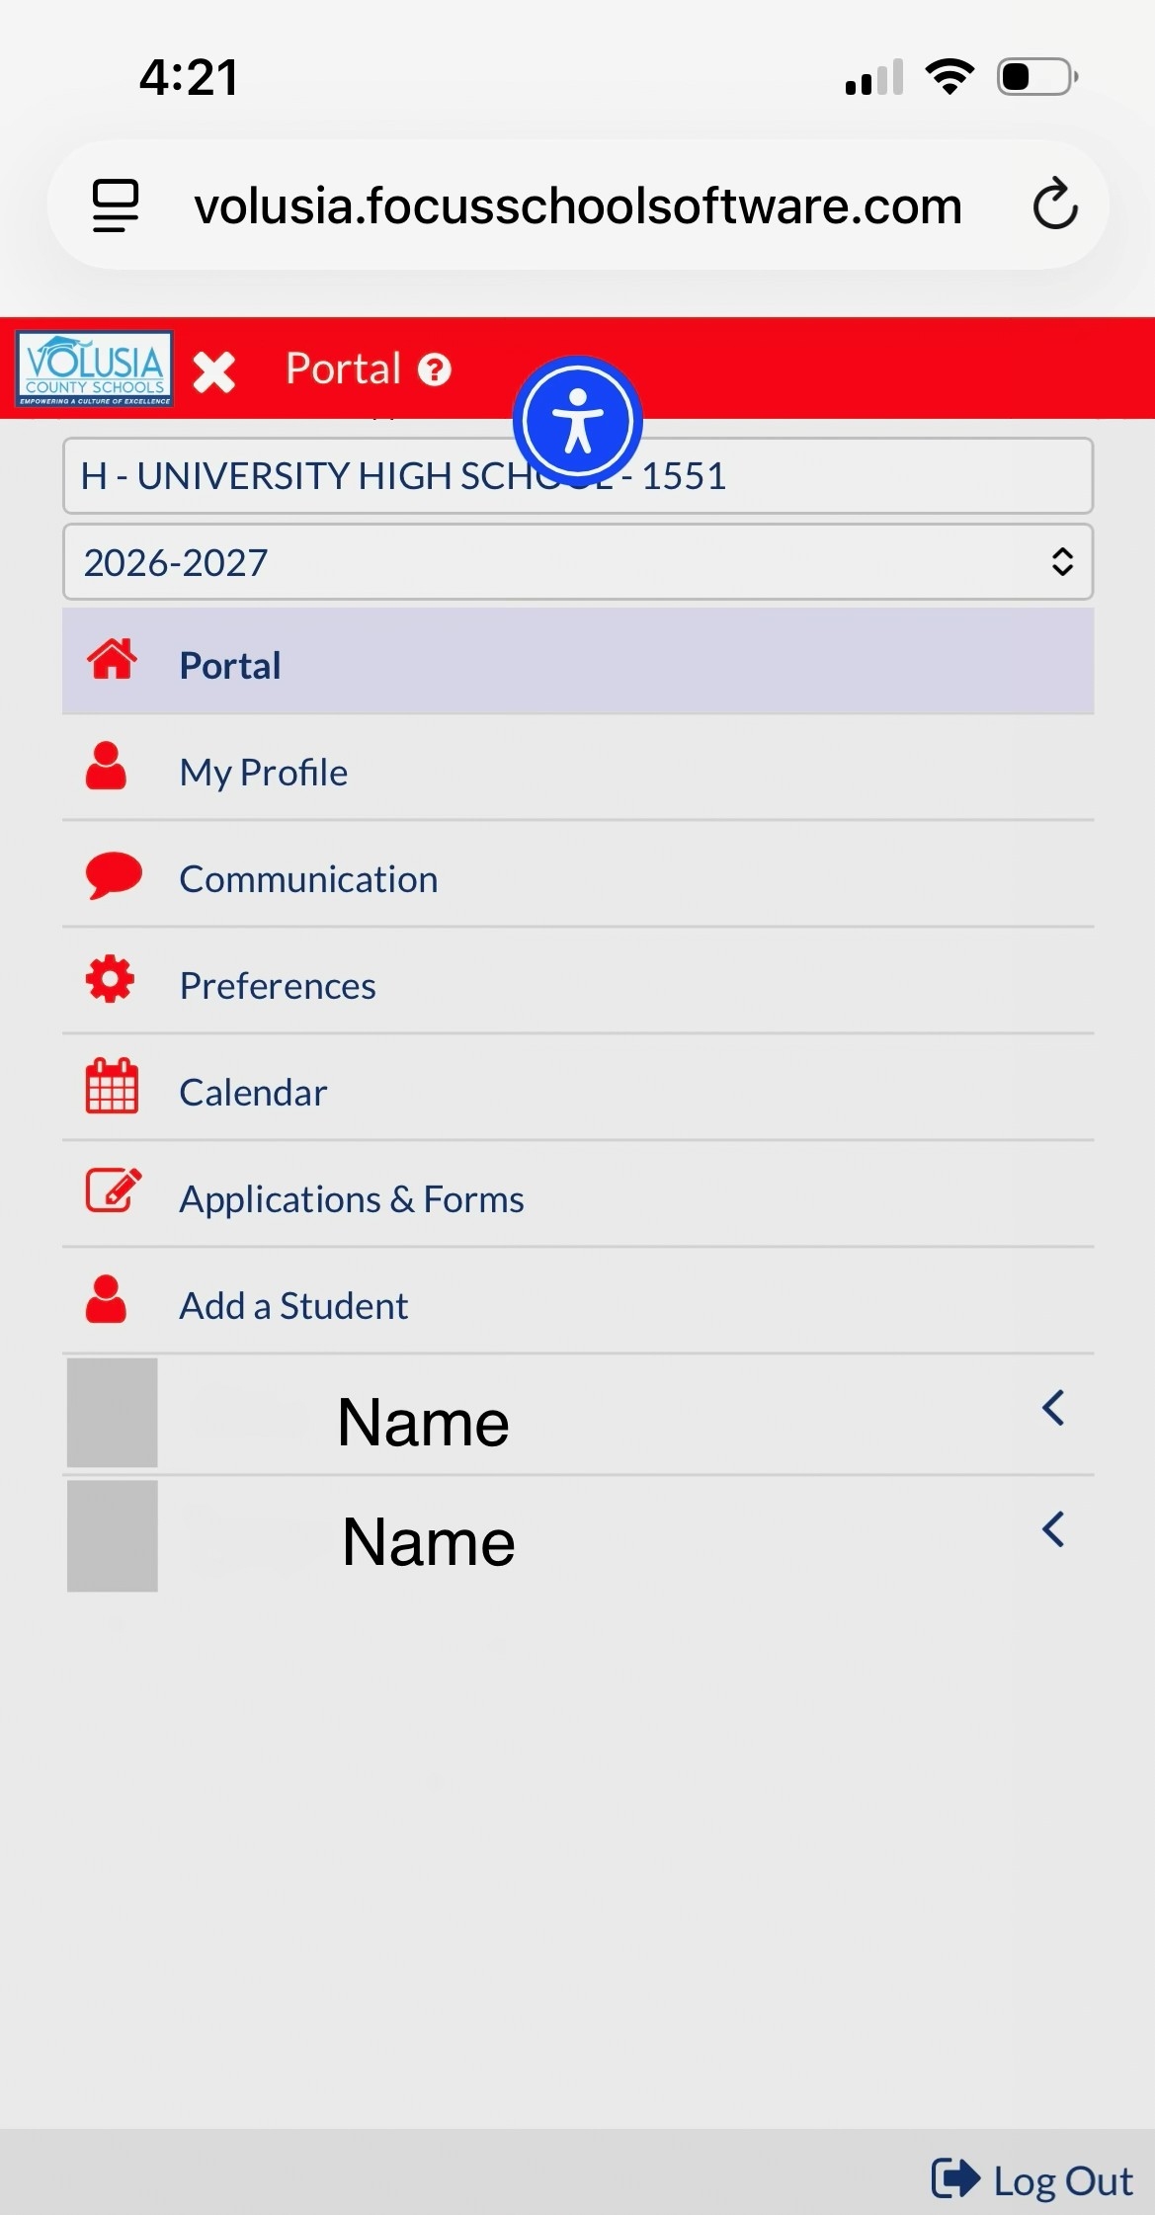

Slide 12
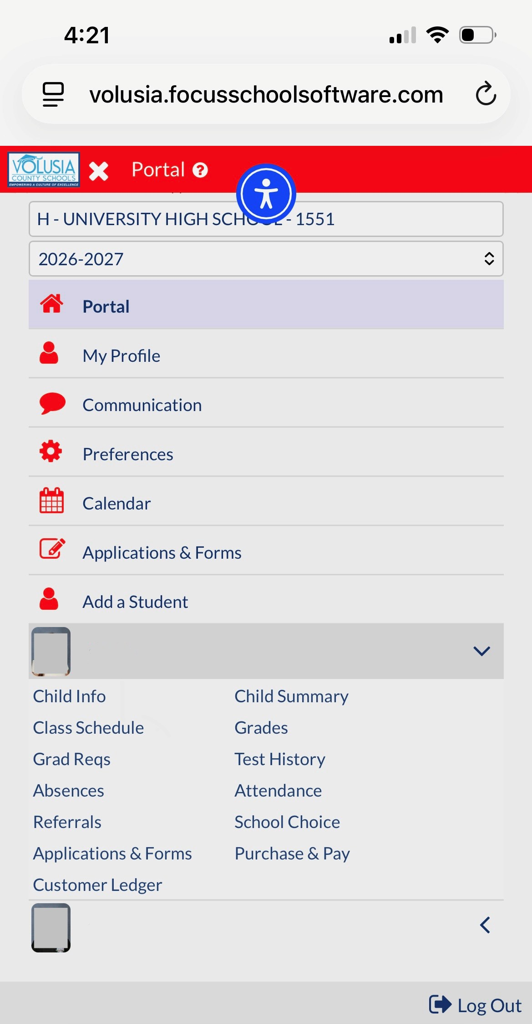
Student Name

Slide 13
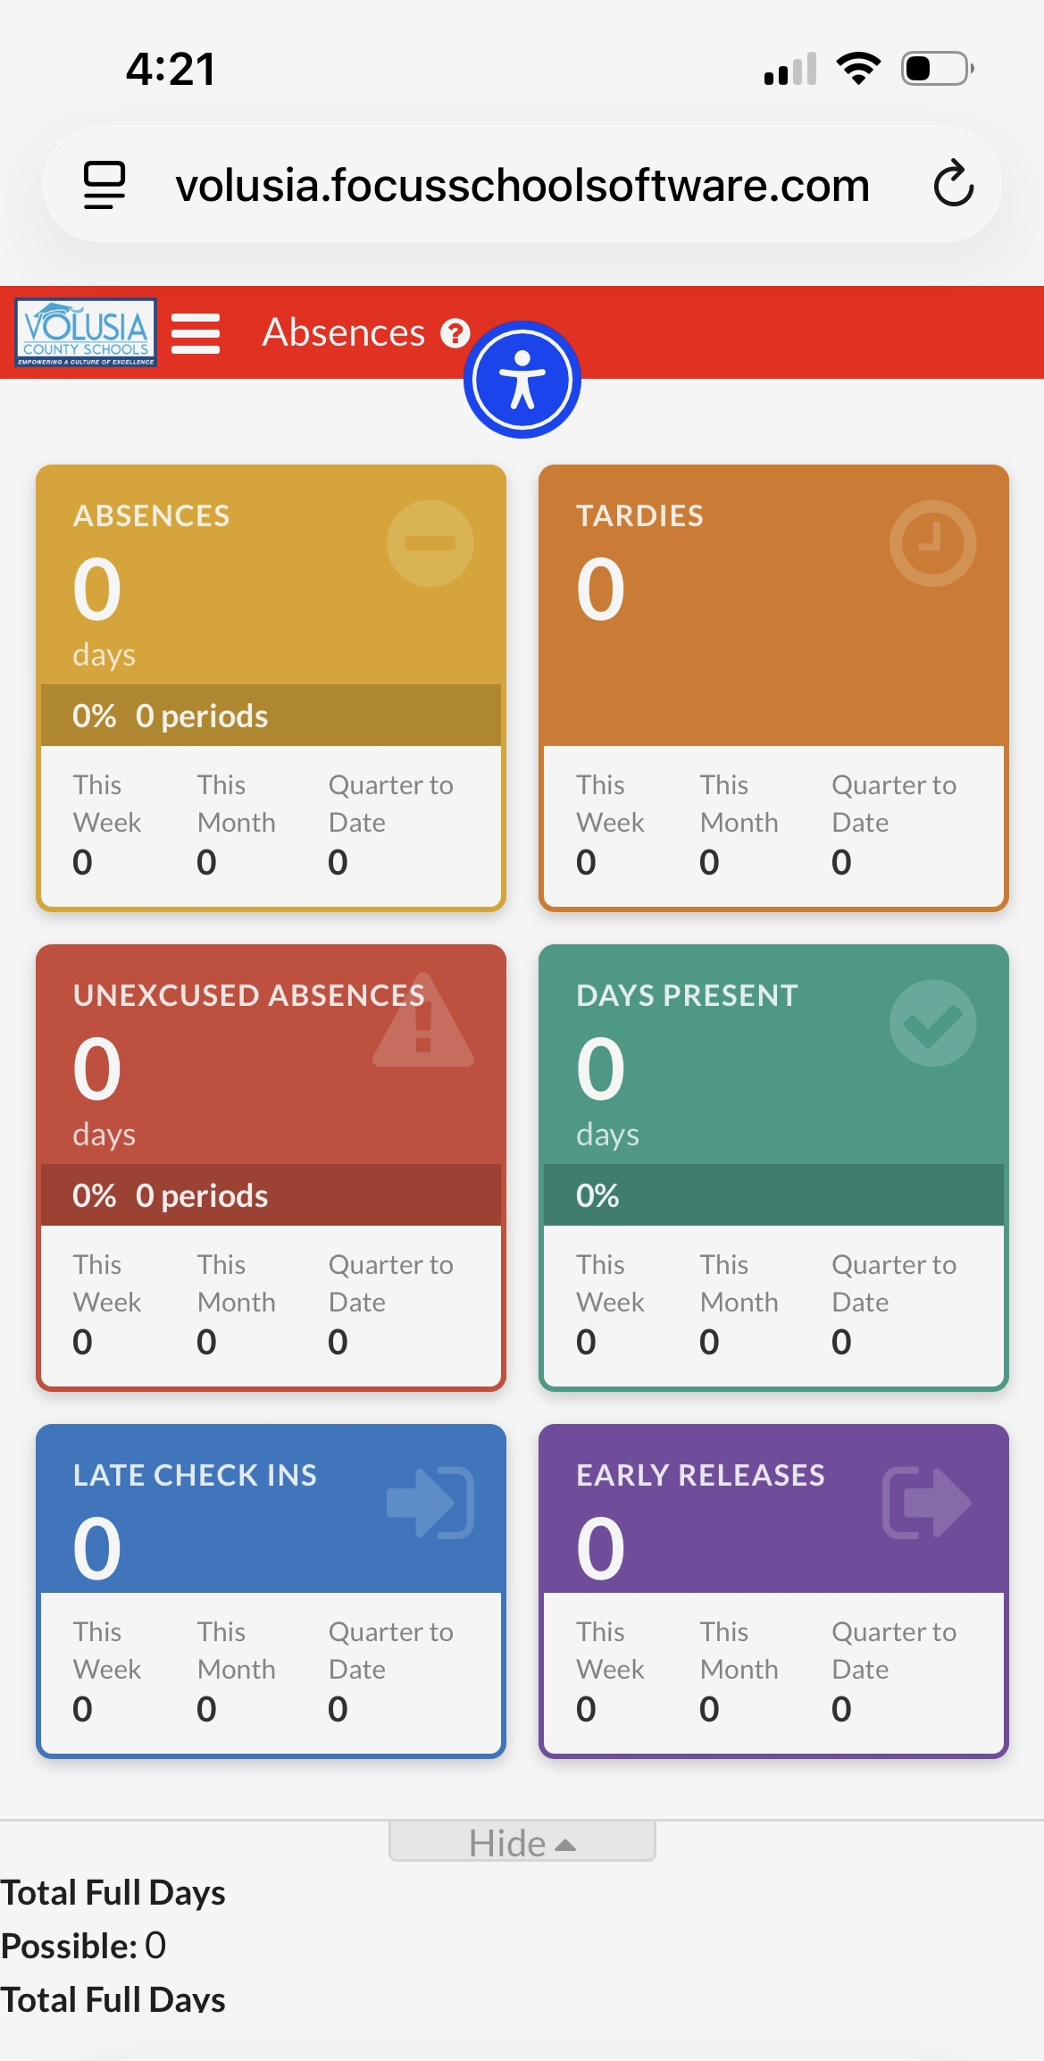

Slide 14
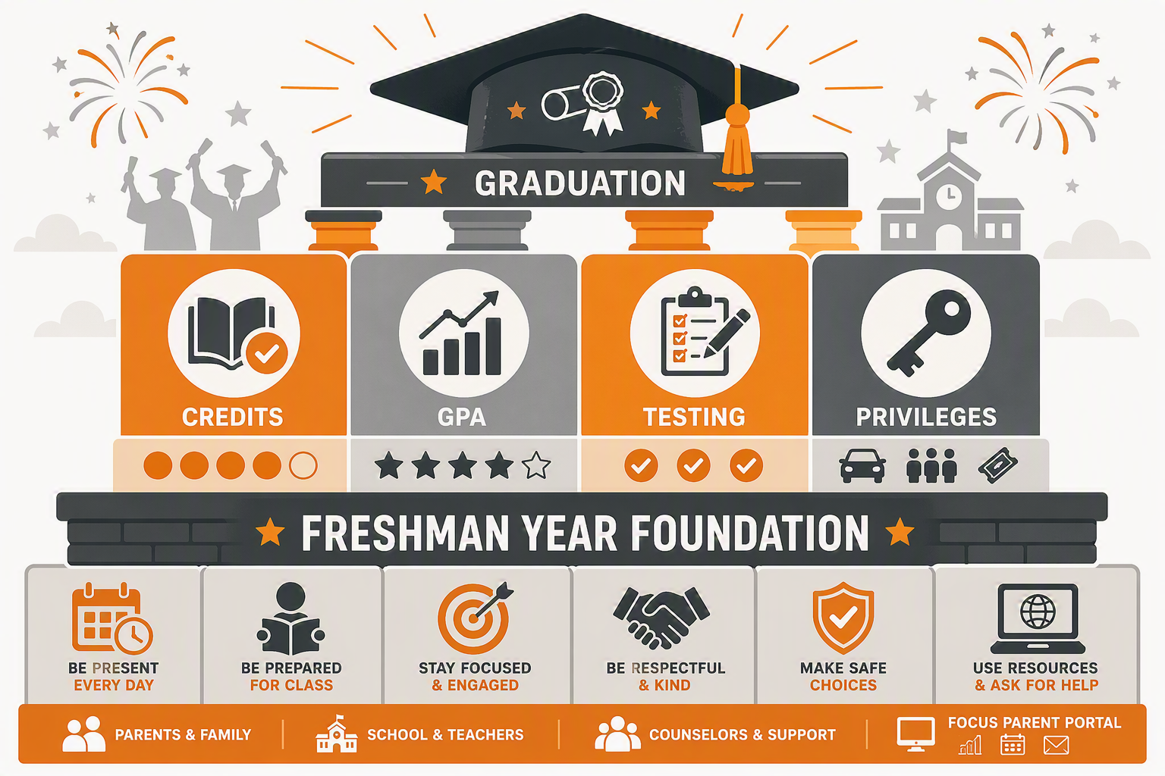
Freshman Year Sets the Foundation
Credits, GPA, and testing begin building the graduation pathway now.
Credits
GPA
Students need 24 credits to graduate High School. Students should earn 6+ credits each year to stay on track. This means passing all scheduled classes with at least a D.
Every course contributes to the cumulative GPA; a 2.0 cumulative GPA is required to graduate High School. Earning a C or better in all scheduled classes will keep students on track.
Testing
Privileges
Several courses require an EOC (end of course exam). Algebra 1, Geometry, Biology, and US History.
9th & 10th grade ELA students take the Progress Monitoring exams 3 times within the school year.
Students must pass the 10th grade PM3 and Algebra 1 exam to graduate High School.
UHS offers several privileges for students who maintain a 2.0 GPA and has good attendance, such as: parking, lunch out, and pep rallies.
The goal is not perfection—it is consistent progress and early problem-solving.

Slide 15
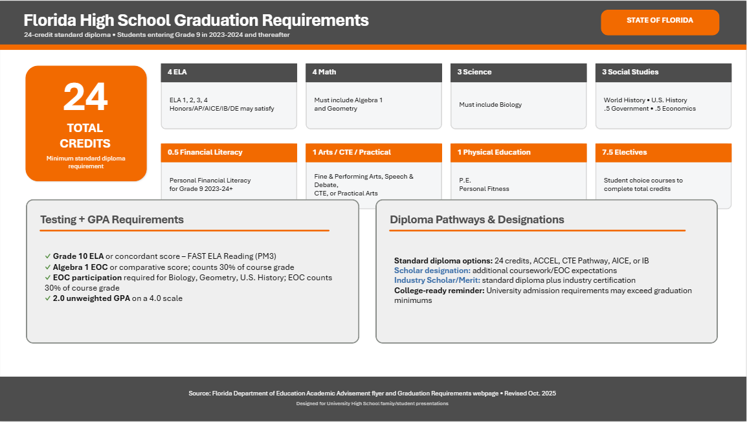

Slide 16
A Sample Freshman Year Schedule
GRADE 9
Sample Grade 9 schedule for planning purposes
Period 1 +
Period 2 +
Period 3 +
Period 4 +
English 1
Reading, writing & literature foundations for high school
Algebra I
Algebra I EOC counts 30% of grade
Biology
Biology EOC counts 30% of grade
Financial Literacy
Personal money skills • 0.5-credit semester requirement
Physical Education
Personal Fitness / PE • 0.5-credit semester requirement
Lunch
Period 5 +
Period 6 +
Period 7 +
Follows Period 4
12:06pm – 12:48pm. Students may not be checked out once lunch begins.
Elective
May include a CTE course, Fine/Performing Art, or World Language
Elective
May include a CTE course, Fine/Performing Art, or World Language
Elective
May include a CTE course, Fine/Performing Art, or World Language
Students should end the year with 6 High School credits and at least a 2.0 GPA to stay on track for graduation.
Sample Grade 9 schedule for planning purposes • Aligns to Florida 24-credit standard diploma requirements

Slide 17
What to Watch in 9th Grade
Simple checkpoints help prevent surprises.
Week 1–2
Monthly
Each Quarter
Testing Windows
Portal access, schedule, routines, ID badge
Attendance trends, missing work, grades
Credits earned, GPA impact, interventions
Preparation, attendance, device expectations
Family conversation starter: “What can we fix this week before it becomes a quarter problem?”

Slide 18

Attendance Policy: Showing Up Matters
Attendance, attachment, and achievement are connected.
Core expectations
• Be present and on time every day.
• Parents/guardians should report and explain absences promptly to our attendance clerk, Kelsie Selkgregg.
• Written documentation helps the school code attendance accurately.
• After 15 total absences, doctor verification is required to excuse additional illness-related absences under district policy.
• Attendance issues can affect academics and privileges.
Reach out to your student’s guidance counselor if attendance concerns begin.

Slide 19
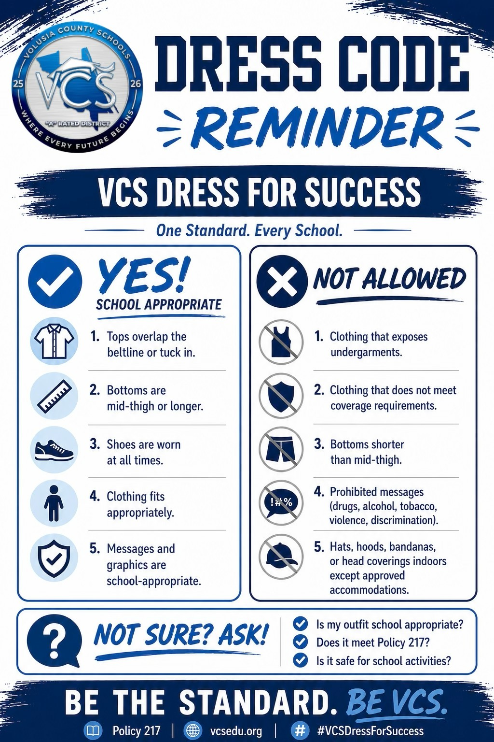
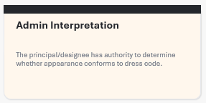
Dress Code:
Ready for the Learning Environment
Notes:
SCHOOL BOARD POLICY 217 - General Dress Code Policy Requirements
Appropriate sizes - Garments must be of a length and fit that are suitable to the build and stature of the student.
Upper garments – Upper garments must be long enough to clearly overlap the beltline or stay tucked in during the course of normal movement during the day.
Lower garments – Lower garments with visible belt loops shall be worn with a belt that is properly fastened. Exceptions will be allowed for students in grades K – 5 and in individual cases based upon the discretion of the principal or designee. The waistband of pants, shorts or skirts must be worn and secured between the hips and the waist. Undergarments and the buttocks must remain entirely covered even while seated. Jumpers, skirts and shorts must be at least mid-thigh or below in length.
Head - No hats, caps, visors, hoods, bandanas, sunglasses or other head gear may be worn on a school campus except with administrative permission (i.e. medical necessity, religious, school related events)
Shoes/Footwear - All students shall wear shoes/footwear. Students must wear shoes that are safe and appropriate for the learning environment. Students must wear athletic shoes in all physical education classes.
Outerwear – Coats, jackets, sweaters and other appropriate outer garments when necessary due to weather conditions. When outer garments with hood are worn, the hoods must be removed from the head while in school buildings. The outer garments must be of the appropriate size and shall not be overly baggy or violate any provisions of the dress code.
Unacceptable Attire
A student may not wear clothing (including bandanas), jewelry (including body piercing jewelry), buttons, haircuts, tattoos, or other attire or marking which are offensive, suggestive, disruptive or indecent, such as:
Clothing associated with gangs.
Clothing encouraging or promoting the use of tobacco, drugs, alcohol or violence.
Clothing associated with the discrimination on the basis of age, color, handicap, national origin, marital status, race, religion or sex.
Clothing exposing the torso or upper thighs, such as see-through garments, mini-skirts or mini-dresses, halters, backless shirts or dresses, tube tops or tank tops without over-blouses or shirts, spaghetti strap garments without over-blouses, bare midriff outfits, or shirts or blouses tied at the midriff.
Clothing not properly fastened or with tears.
Clothing or outer garments traditionally designed as undergarments, such as boxer shorts, underwear, tights, hosiery and sleepwear.
Clothing or footwear that is construed by the principal, or designee, as hazardous or dangerous to the health or safety of the student or others or which might reasonably lead the principal or designee to forecast substantial disruption of, or material interference with school activities.
Policy 217

Slide 20
ID Requirement: Campus Safety Is Shared
Visible IDs help staff quickly recognize students and visitors.
Visible at all times
Safety culture
ID
!
Everyone plays a role: report concerns to administration quickly, avoid spreading rumors.
Never open an exterior door. Use appropriate points of entry/exit during the school day.
ALL UHS students are issued a school ID badge and must visibly display it while on campus.
If a student loses or forgets their ID, they will be required to purchase a new one for $5 before entering campus.
Bags and events
Earbuds away
B
♪
Any person on a VCS campus may be subject to search, including all backpacks and bags.
Earbuds should be put away during the instructional day so students can hear key announcements and safety instructions.
“If you see it, don’t spread it. Report it.”

Slide 21
Discipline Policy: Fair, Progressive, and Supportive
The goal is correction, safety, and keeping students connected to learning.
Level I
Examples include class/school rule violation, minor disruption, dress code violation, tardiness.
Minor
Level II
More significant or repeated Level 1 behaviors that require a stronger school response.
Intermediate
Level III
Serious behaviors such as vaping, fighting, and major classroom disruptions or student code of conduct violations may involve suspension, restrictions, or district review.
Major I
Level IV
Most serious offenses can lead to expulsion recommendation and other required actions, such as fighting and large campus disruptions.
Major II
Parents are partners: early communication and problem-solving are part of the support system.

Slide 22

Cell Phone Policy: Protecting Instructional Time
The expectation is simple: phones away unless a teacher directs educational use.
During instructional time:
• Students may not use wireless communication devices during instructional time unless expressly directed by a teacher for educational purposes.
  Florida House Bill 1105
• Applies to phones, smart watches, tablets, and earbuds.
• Testing security expectations prohibit unauthorized devices and photos of test materials.
• Violations are handled through the Code of Student Conduct.
Family support: reinforce “away for learning.”

Slide 23
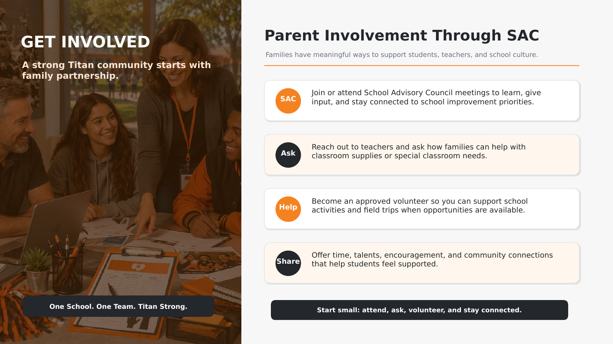

Slide 24
How Families Can Support the Transition
Small routines at home make the high school transition smoother.
Check Parent Portal together
Prioritize attendance
Build organization
Choose a weekly check-in time and focus on next steps.
Plan appointments outside school when possible and communicate absences promptly.
Use a planner, calendar, or phone reminders for assignments and events.
Practice professionalism
Protect focus
Ask for help early & Get involved
Dress code, visible ID, on-time arrival, respectful communication.
Set phone boundaries for studying and class time.
Contact teachers, counselors, or administrators before concerns grow.
Join SAC to voice your thoughts and hear from administration.
The best time to ask for support is early.

Slide 25
Welcome to the Titan Family
Freshman year is the foundation. We are partners in helping every student start strong.
Parent Portal
Counselors & Teachers
Administration
Check grades, attendance, forms, announcements, and support information.
Ask early when grades, credits, attendance, or coursework become a concern.
Questions about conduct, IDs, dress code, or campus expectations.
Thank you for partnering with us as your student begins high school.

