Slide 1

How To Do Business
Seminar
Friday, July 24, 2026
Presented by: Business and Financial Services Division
      Purchasing Department

Slide 2

Agenda
Welcome and Opening Remarks
About Henry County Schools (HCS)
Board Purchasing Policy: DJE
Purchasing Ethics and Process
Vendor Registration and supporting documentation
Current/Future Opportunities
Key Take-aways
Resource Page
Questions and Answers

Slide 3


District 1 – Dr. Pam Nutt
District 2 – Annette Edwards
District 3 – Jennifer Carter
District 4 – Sophe Pope, Board Chair
District 5 – Mackenzie McDaniel, Vice Chair
Superintendent – Dr. John Pace III
The Henry County Board of Education is composed of five members. Board members are elected by the citizens of Henry County to a four-year term of service.

Slide 4




Slide 5

Purchasing Value Statement
The purchasing department assists the school system with the provision of goods and services that support the staff and contribute to the success of every student. The purchases are made through processes that align with district policy, core beliefs and the foundational values of integrity, competition, fairness, transparency, stewardship, professionalism, and legal and regulatory compliance.

Slide 6

Purchasing Ethics
- We believe the following ethical principles should govern the behavior of everyone employed in a public sector procurement/ purchasing, or materials management role or department:
Seeks or accepts a position as head (or employee) only when fully in accord with the professional principles applicable thereto and when confident of possessing the qualifications to serve under those principles to the advantage of the employing organization.
Believes in the dignity and worth of the service rendered by the organization, and the societal responsibilities assumed as a trusted public servant.
Is governed by the highest ideals of honor and integrity in all public and personal relationships in order to merit the respect and inspire the confidence of the organization and the public being served.
Believes that personal aggrandizement or personal profit obtained through misuse of public or personal relationships is dishonest and not tolerable.
Identifies and eliminates participation of any individual in operational situations where a conflict of interest may be involved.
Believes that members of the Institute and its staff should at no time, or under any circumstances, accept directly or indirectly, gifts, gratuities, or other things of value from suppliers, which might influence or appear to influence purchasing decisions.
Keeps the governmental organization informed, through appropriate channels, on problems and progress of applicable operations by emphasizing the importance of the facts.
Resists encroachment on control of personnel in order to preserve integrity as a professional manager.
Handles all personnel matters on a merit basis, and in compliance with applicable laws prohibiting discrimination in employment on the basis of politics, religion, color, national origin, disability, gender, age, pregnancy and other protected characteristics.
Seeks or dispenses no personal favors. Handles each administrative problem objectively and empathetically, without discrimination.

Slide 7
Business and Financial Services – Purchasing Team
Greg Goins- Executive Director of Purchasing
Lynn Lewis- Purchasing Supervisor
Kesha Gossett Purchasing Assistant
Patty Nash Purchasing Assistant
Tonya Tookes-Kay Purchasing Lead

Slide 8

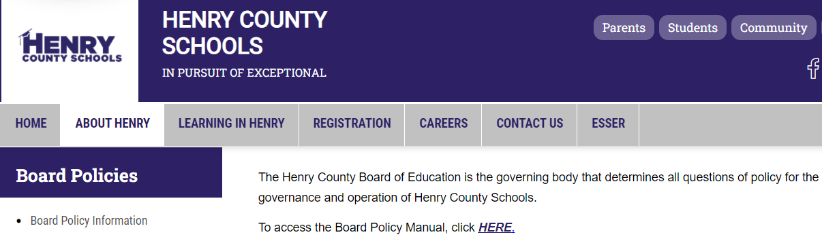
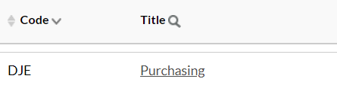
HCS’s Board Policy DJE: Purchasing
Scroll down to:

Slide 9
Purchasing Methods
Purchase Order (Items, Descriptions, Quantities, Pricing, etc.)
  Most common method of purchasing goods
Awarded Service Contract (Services, Deliverables, Schedules, and Pricing, etc.)
  Most common method for purchasing services
Purchase Card (P-card) for small dollar purchases
Utilization of cooperative agreements

Slide 10
Purchasing - Solicitations
Informal Solicitation (Quotes):
Purchases under $50,000 and not under contract are handled at the school/department level
  This process involves obtaining one or more quotes.
Formal Solicitation (Advertised to the Public):
Purchasing $50,000 and above and not under contract are handled by the Purchasing Department
    Advertise via: HCS website, HCS’s solicitation platform (Euna Solutions [formally Bonfire]), and GPR when appropriate

Slide 11
Payment Methods Offered
Check issued to supplier
ACH payment to verified banking account
Virtual/ Ghost Card payment to verified banking account
Purchase Card (P-card) for small dollar purchases
Log into your Euna (formally bonfire) account to select your preferred payment method

Slide 12
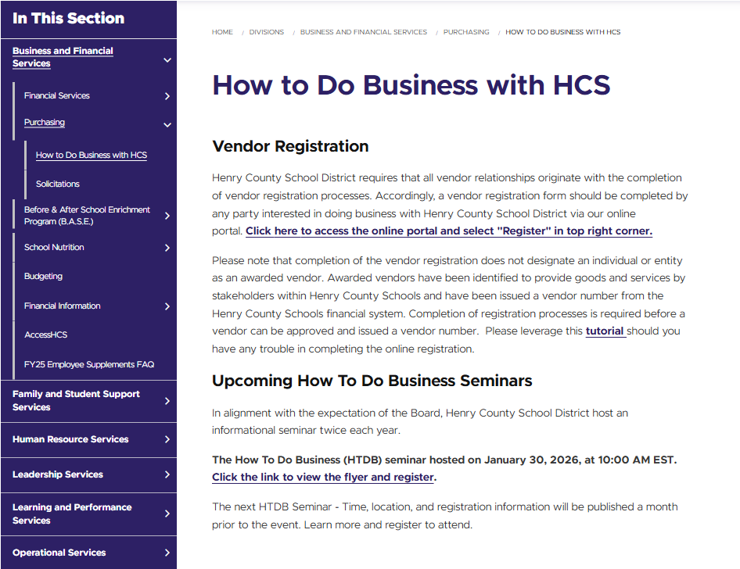
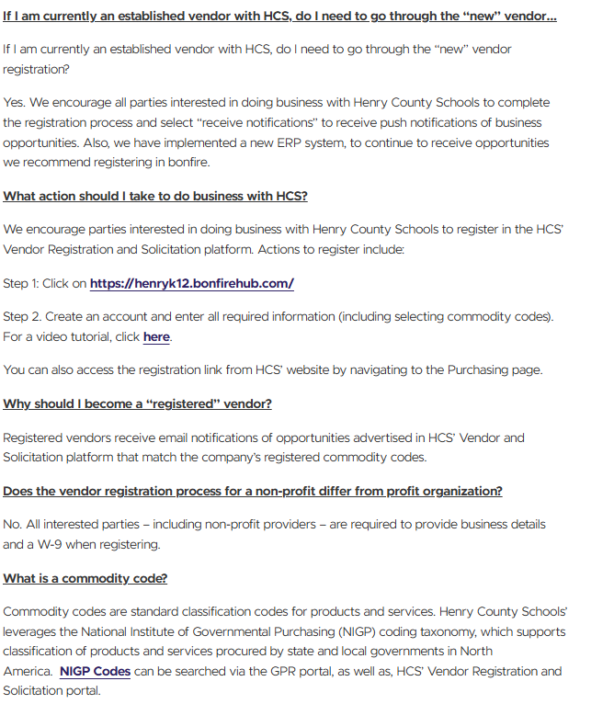

Slide 13
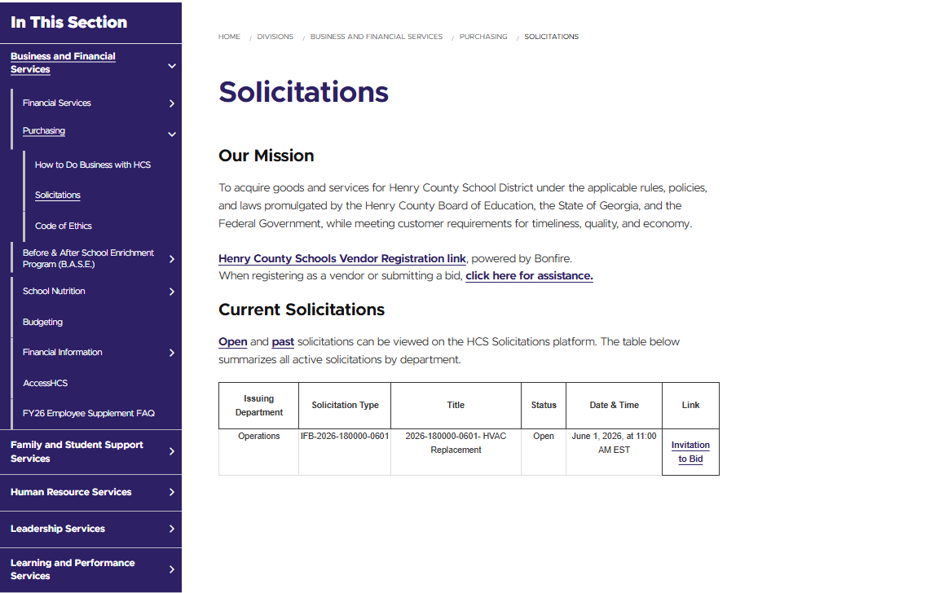


Slide 14
Types of HCS’s Vendors
  Registered Vendors – have registered in HCS’s Vendor Registration Platform to receive solicitation notifications
  Awarded Vendors – have been selected to provide goods and/or services to HCS under a vendor agreement and/or purchase order, and will be assigned a vendor number post validation of required documentation

Slide 15
AccessHCS Vendor Registration Reminders
All vendors must have a completed registration in the Henry County Schools Vendor Registration platform to be set-up in AccessHCS. This ensures the school system can (1) legally do business with the vendor and (2) meet tax and Transparency in Government Act reporting requirements.
Business transactions should not be conducted without a completed vendor registration and assigned vendor number. Schools and departments should review if the desired vendor has a profile in AccessHCS in advance of needing to conduct business.
For most suppliers to have an AccessHCS profile, the vendor is required to complete an online vendor registration via HCS Vendor Registration platform at www.henryk12.bonfirehub.com. The HCS end-user (i.e. Bookkeeper, Teacher, Athletic Director, Band Director, or other district staff) desiring to do business with the vendor is responsible for the initial outreach to the vendor. Please contact Purchasing if you are unsure if you registered your business in bonfire and do not have a record of a supplier number.
Henry County Schools strongly encourages you not to engage in any services or provide goods without a purchase order and a supplier number to prevent delayed payments.

Slide 16
AccessHCS Vendor Registration Reminders
All food vendors (food trucks; caters) will need to provide a “Food Service” permit to serve food in Henry County Schools {If you are serving food onsite}.
All Charter Buses and Inflatable Suppliers are required to meet qualifications from Risk Management in Human Resources and register in Euna (formerly bonfire) with all required documentation.
Interested and potential vendors, reporting issues with HCS Vendor registration are highly encouraged to review the tutorial posted to the Henry County Schools District web page under the “How To Do Business” link located at the very bottom of the home-page: https://www.henry.k12.ga.us/Page/151639.
Once the vendor registration has been completed, an email from the Vendor Registration Team will be issued with the assigned supplier number and other detailed information regarding Henry County Schools.

Slide 17
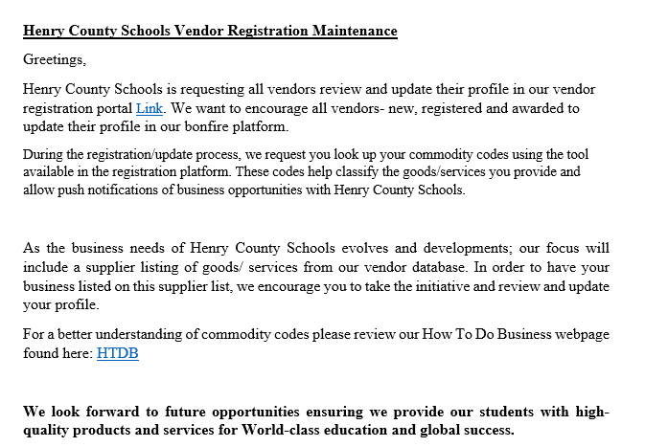

End of Year Emails were sent week of June 8
Please review your profile for missing documents
Please update your profile for expired documents
Please update your profile for business changes to phone numbers, email addresses, and contacts
Please update your payment profile we offer the following: ACH- Virtual/ Ghost Card- Check

Slide 18
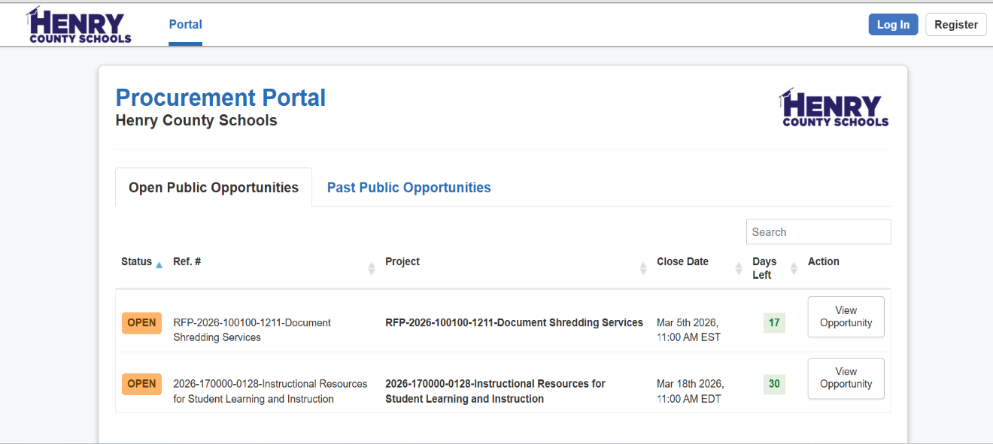
HCS Vendor Registration Portal
powered by Euna (Bonfire)
Click REGISTER to begin vendor registration by creating an account.
Click LOG IN to update your profile. Enter Username/Psswd.
VENDOR REGISTRATION ACCOUNT CREATION
Note: To Register means creating an account by submitting an email address. This launches a verification process for registration. Additional action is required by returning to your email and clicking the link that will bring you to this home screen to login.

Slide 19
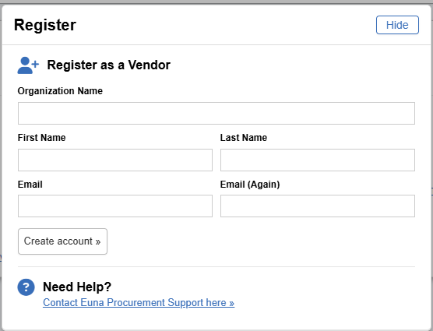
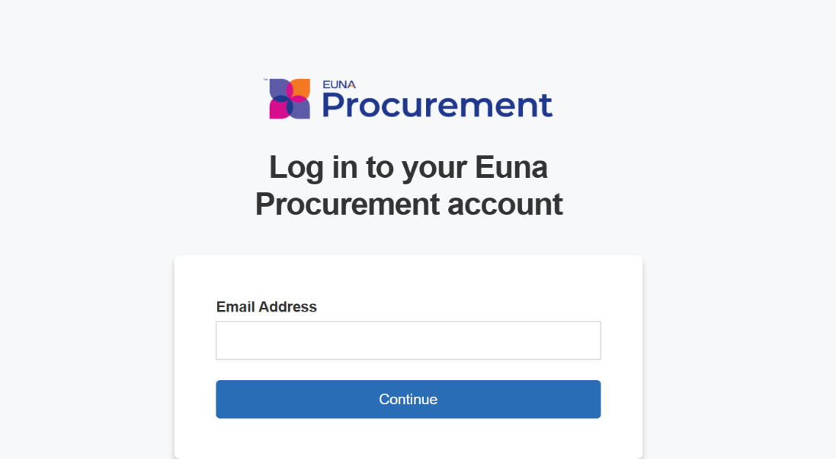
HCS Vendor Registration Portal
powered by Euna (Bonfire)
Log In Screen
(after confirming email and account is created)
Enter Commodity Codes to receive solicitation notifications:

Slide 20
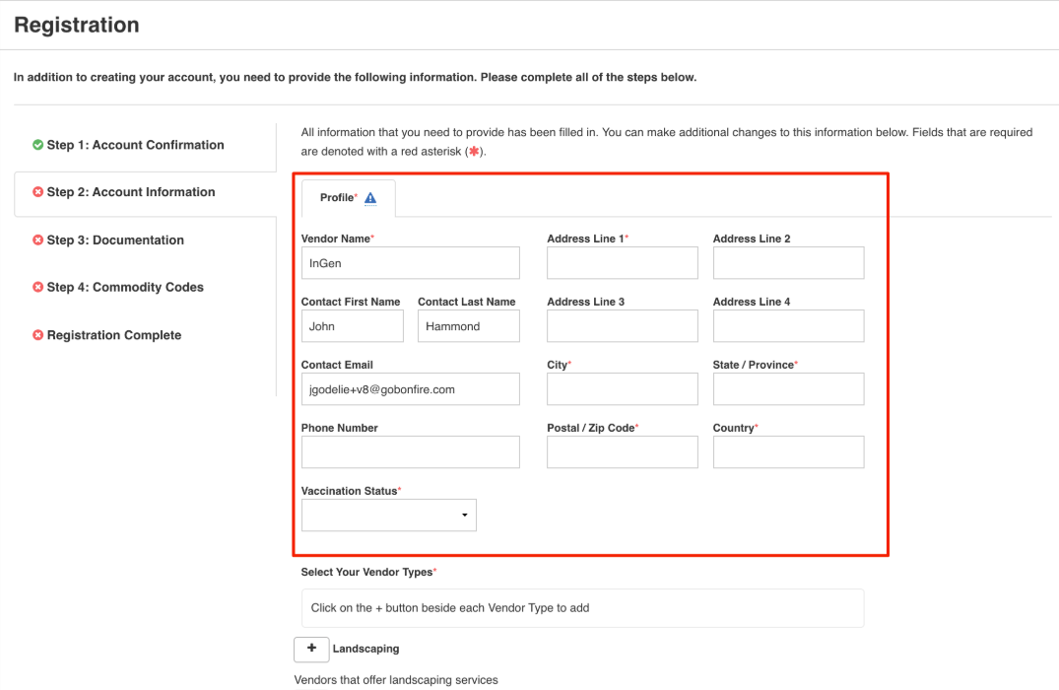
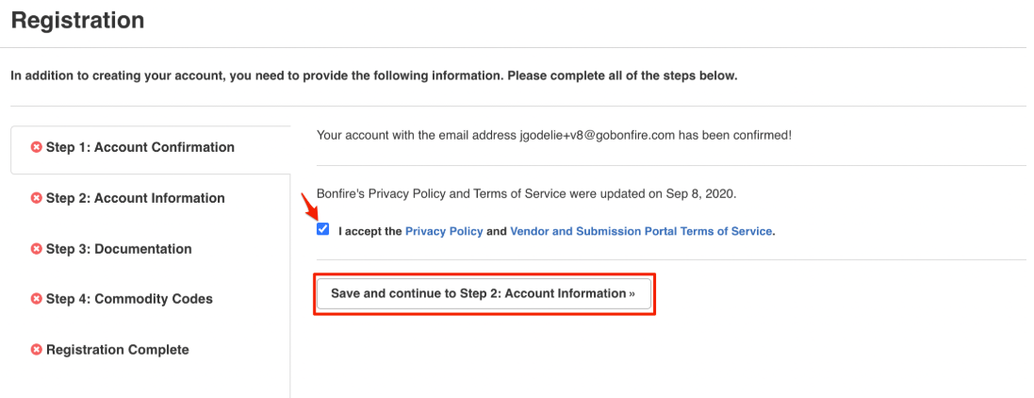
HCS Vendor Registration Portal
powered by Euna (Bonfire)
Complete information (all fields with a red*) for vendor record…

Slide 21
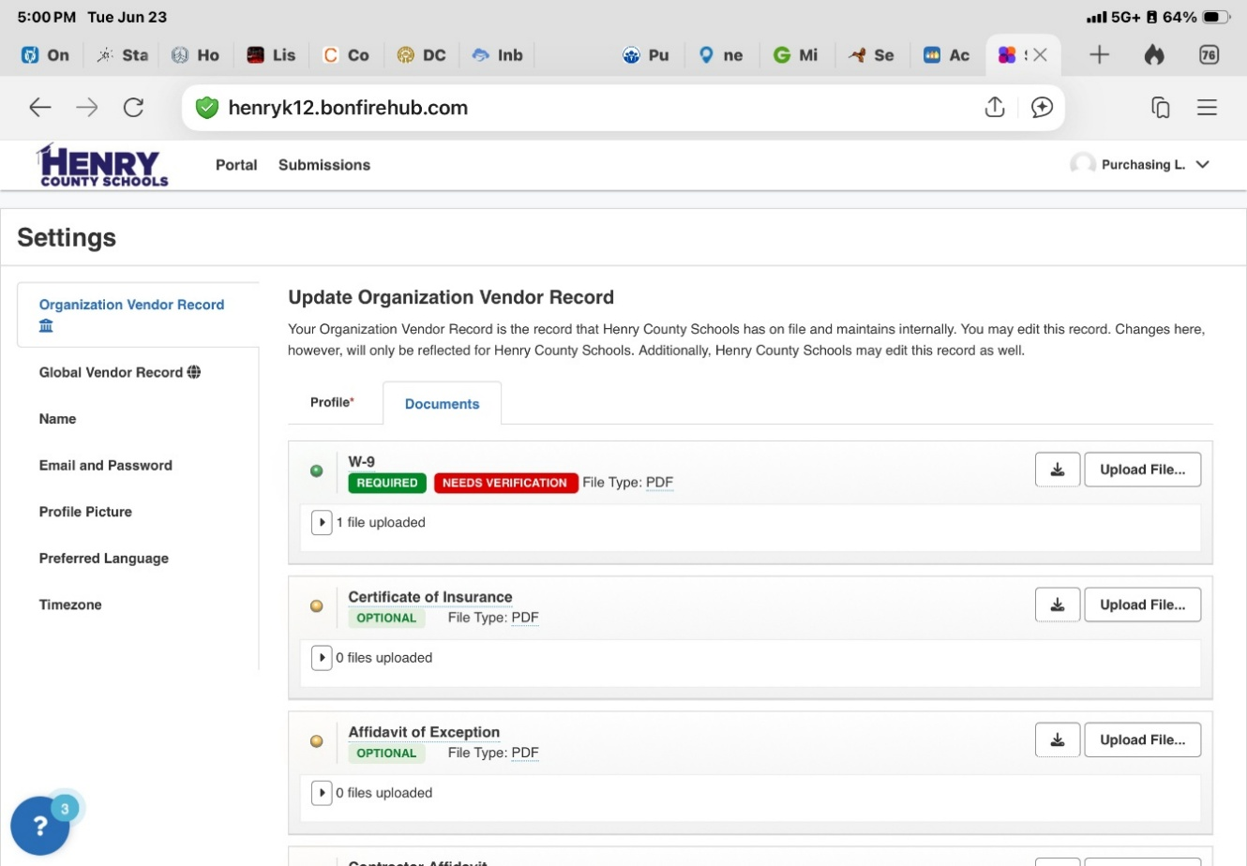
HCS Vendor Registration Portal
powered by Euna (Bonfire)
TO DOWNLOAD oe UPLOAD A DOCUMENT:
After logging in Click the small arrow for Settings.
DOCUMENTATION: Click arrow next to Username; then Settings, Profile and Documents…see screen below to upload documents. (i.e. IRS-W9 tax id)
To download blank template form
To upload completed/signed template form

Slide 22
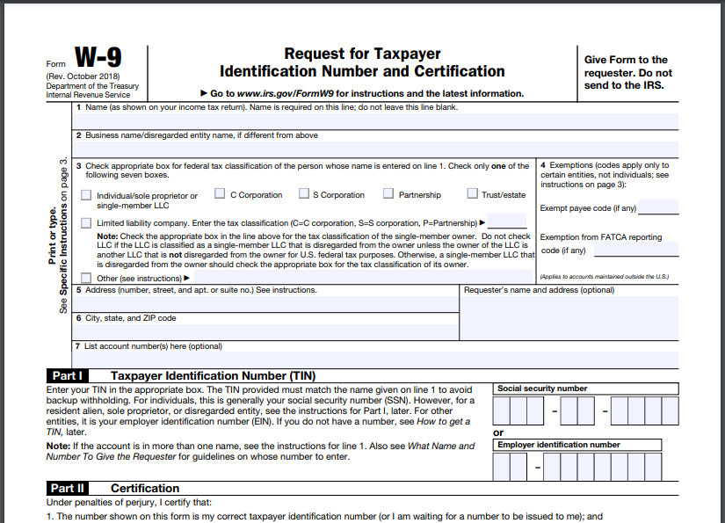
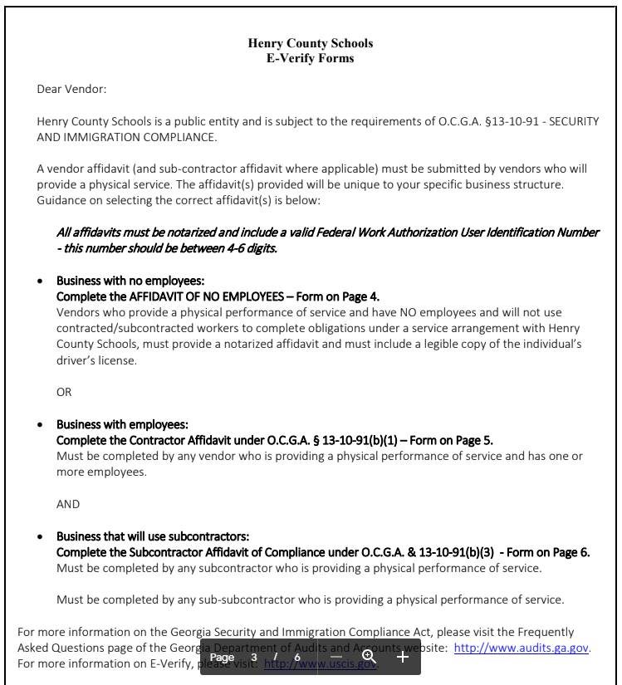
Registered Vendors: Minimum Required Documents

Slide 23
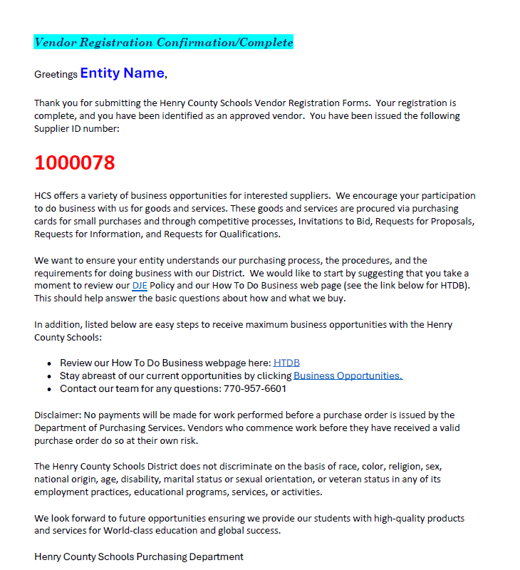
Henry County School Vendor Registration Confirmation

Slide 24

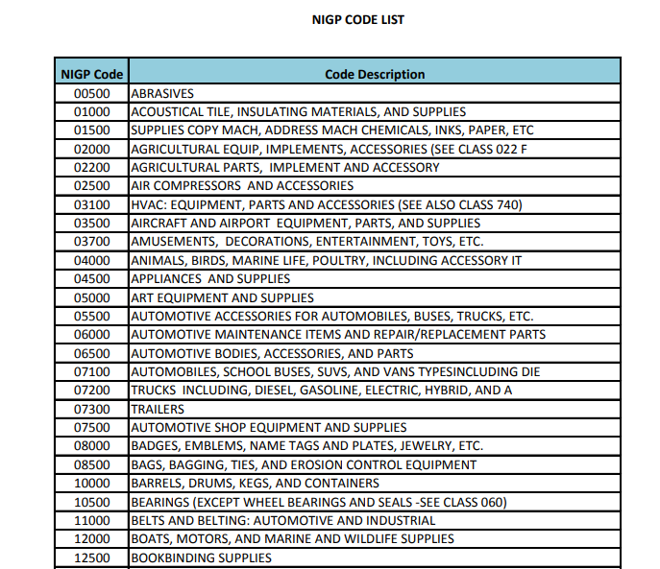
Commodity codes are standardized numerical systems used to classify goods and services.

Slide 25
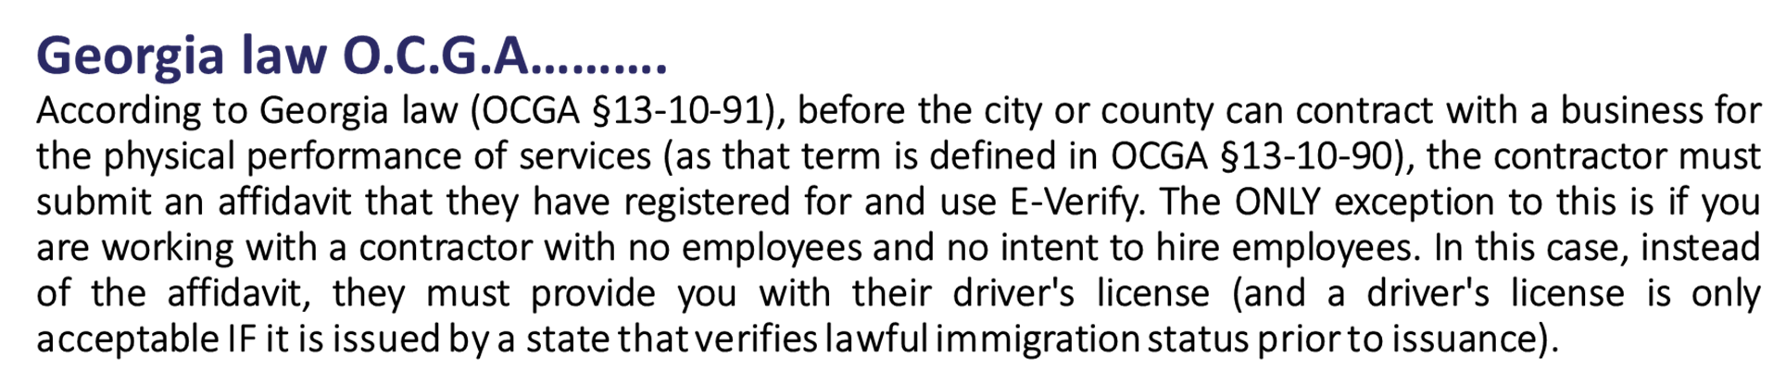
Georgia E-Verify Law
Excerpt from Georgia’s Department of Audit Guidance on E-Verify

Slide 26
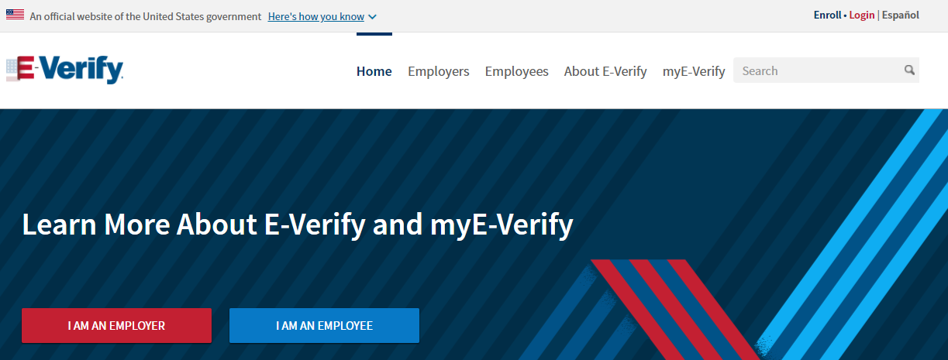
Georgia E-Verify Law: Requirements

Slide 27
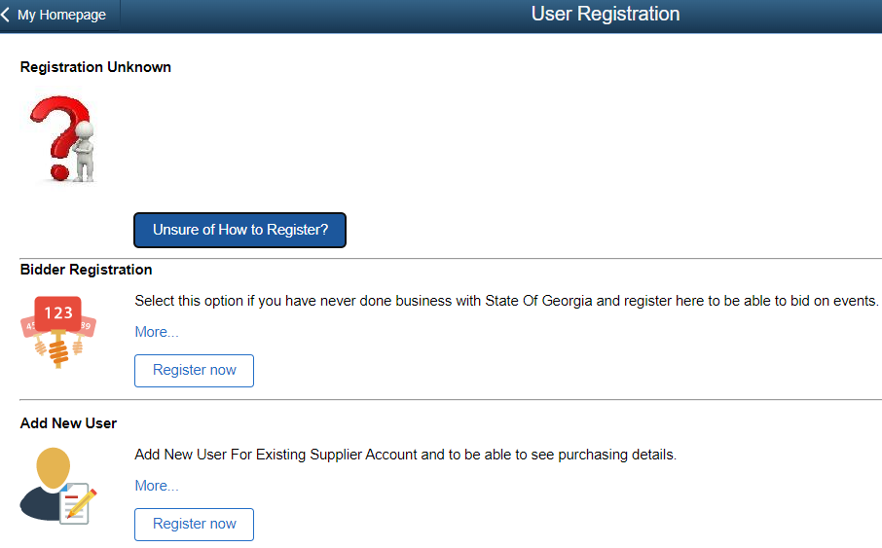
Georgia Procurement Registry – Vendors

Slide 28
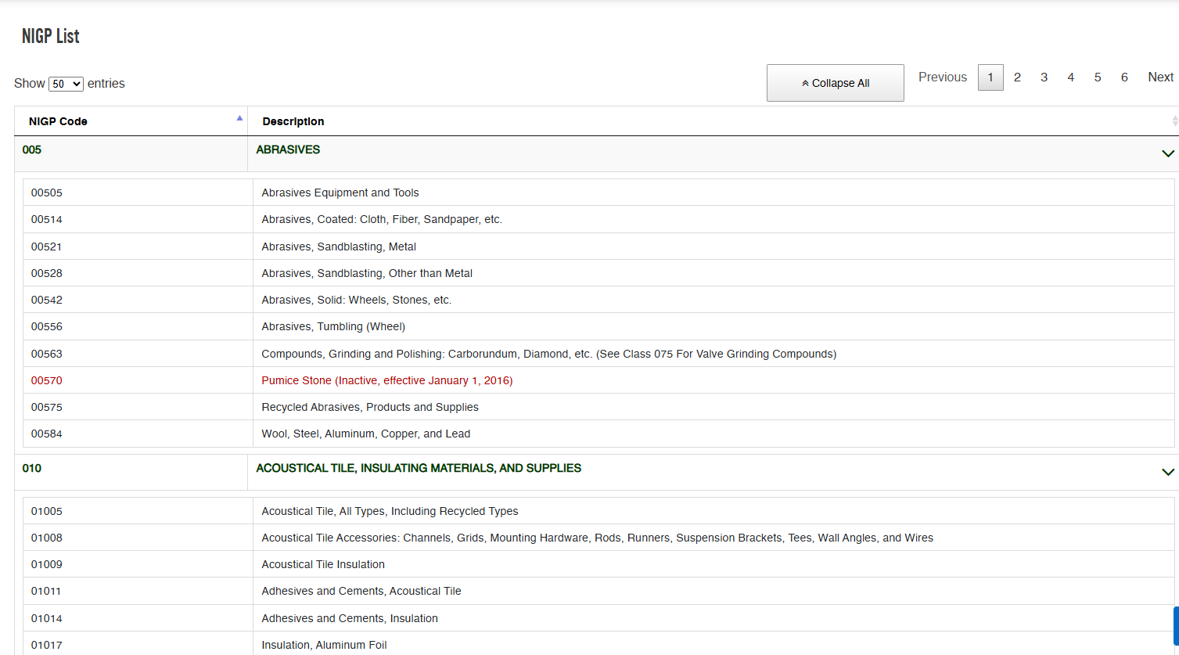
Georgia Procurement Registry – Vendors
Find National Institute of Governmental Procurement (NIGP) Codes for the State of Georgia. To search, enter a keyword or phase (up to three words) in the box and click the search button.

Slide 29
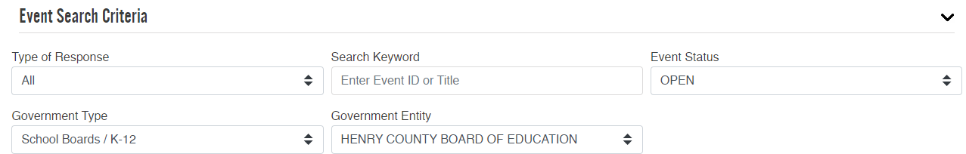
Georgia Procurement Registry – Vendors

Slide 30
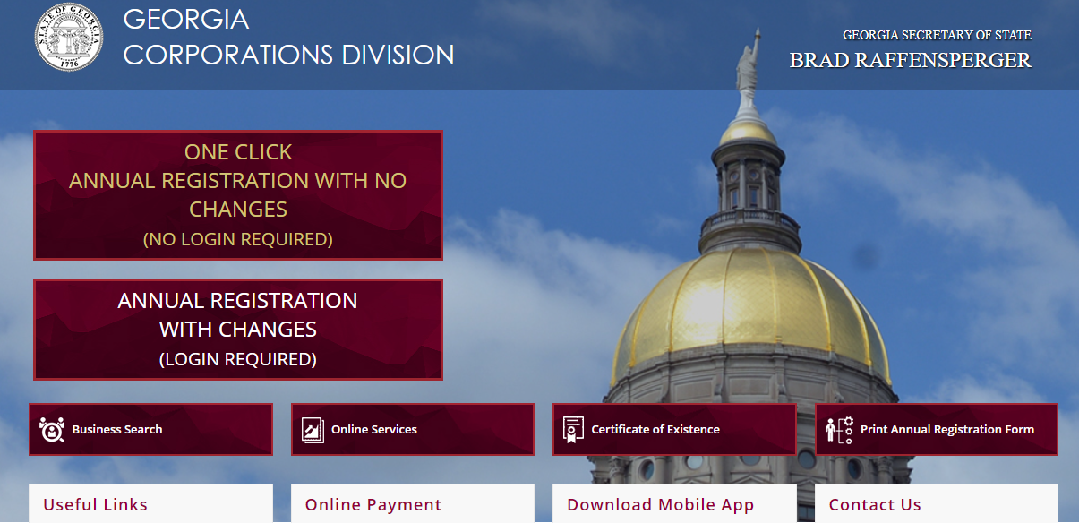

Registration with the Secretary of State of Georgia

Slide 31
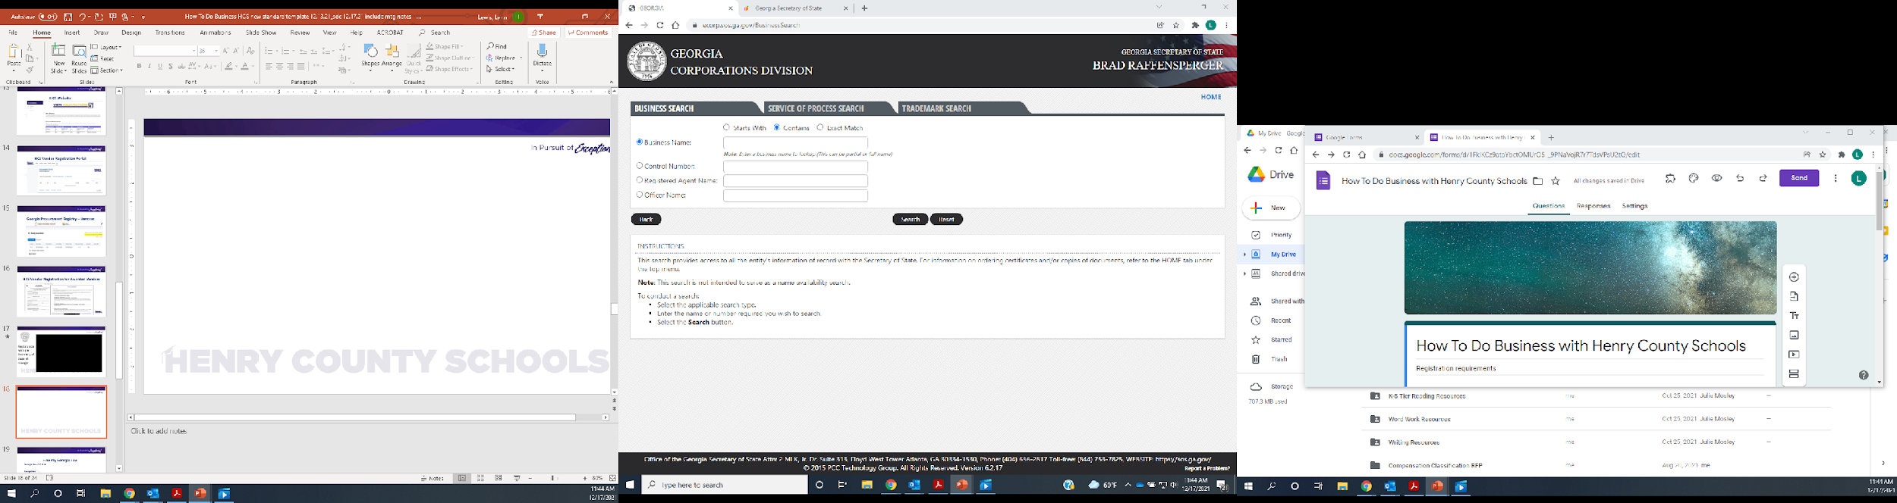

Slide 32
Take Aways
Purchasing governed by HCS BOE Policy DJE
Register in HCS’s Vendor Registration and GPR
  Include commodity codes
Purchasing Methods (official documents):
  Purchase Order, issued by Purchasing Department
  Awarded Service Contracts, fully executed by HCS
  Purchasing Card (P-card) for low dollar purchases
Purchasing Department (primary contact) for:
  Contract Management
  Formal Solicitations
  How To Do Business
  Vendor Registration

Slide 33
Resource Page
HCS Vendor Registration Help
vendorregistration@henry.k12.ga.us
HCS Vendor Registration
https://henryk12.bonfirehub.com/portal/?tab=login
Team Georgia Marketplace
https://doas.ga.gov/state-purchasing/team-georgia-marketplace/tgm-resources-for-suppliers
Secretary of State for Georgia
https://secure.sos.state.ga.us/mylicense/Login.aspx?process=app
State of Georgia Business Guide: https://sos.ga.gov/index.php/corporations/first_stop_business_guide
E-Verify
https://www.e-verify.gov/
E-Verify GA laws
https://law.justia.com/codes/georgia/2020/title-13/chapter-10/article-3/

Slide 34
Questions
      Robert.Goins@henry.k12.ga.us- Executive Director of Purchasing
      Ext. 01154
      Lynn.Lewis@henry.k12.ga.us- Purchasing Supervisor
      Ext. 01156
Tonya.tookeskay@henry.k12.ga.us- Purchasing Lead
Ext. 01170
Patricia.Nash@henry.k12.ga.us- Purchasing Assistant
Ext. 01155
Kesha.Gossett@henry.k12.ga.us- Purchasing Assistant
Ext. 01153
Contact Us: Phone: 770-957-6601
Email: Purchasing@henry.k12.ga.us

