Slide 1
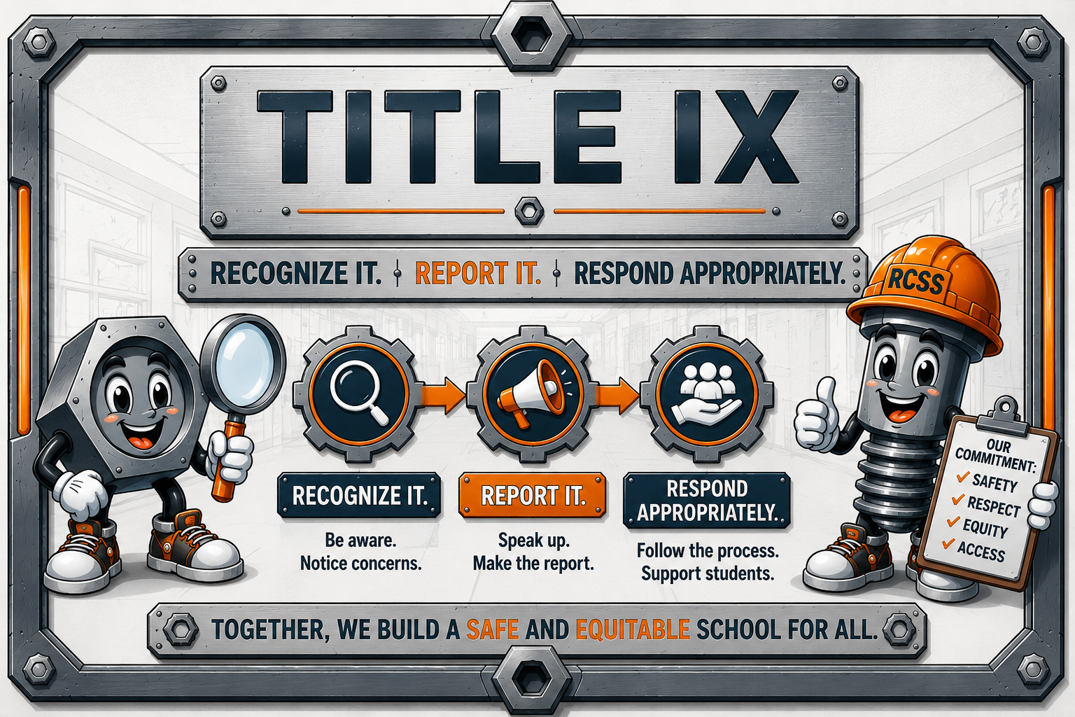

Slide 2
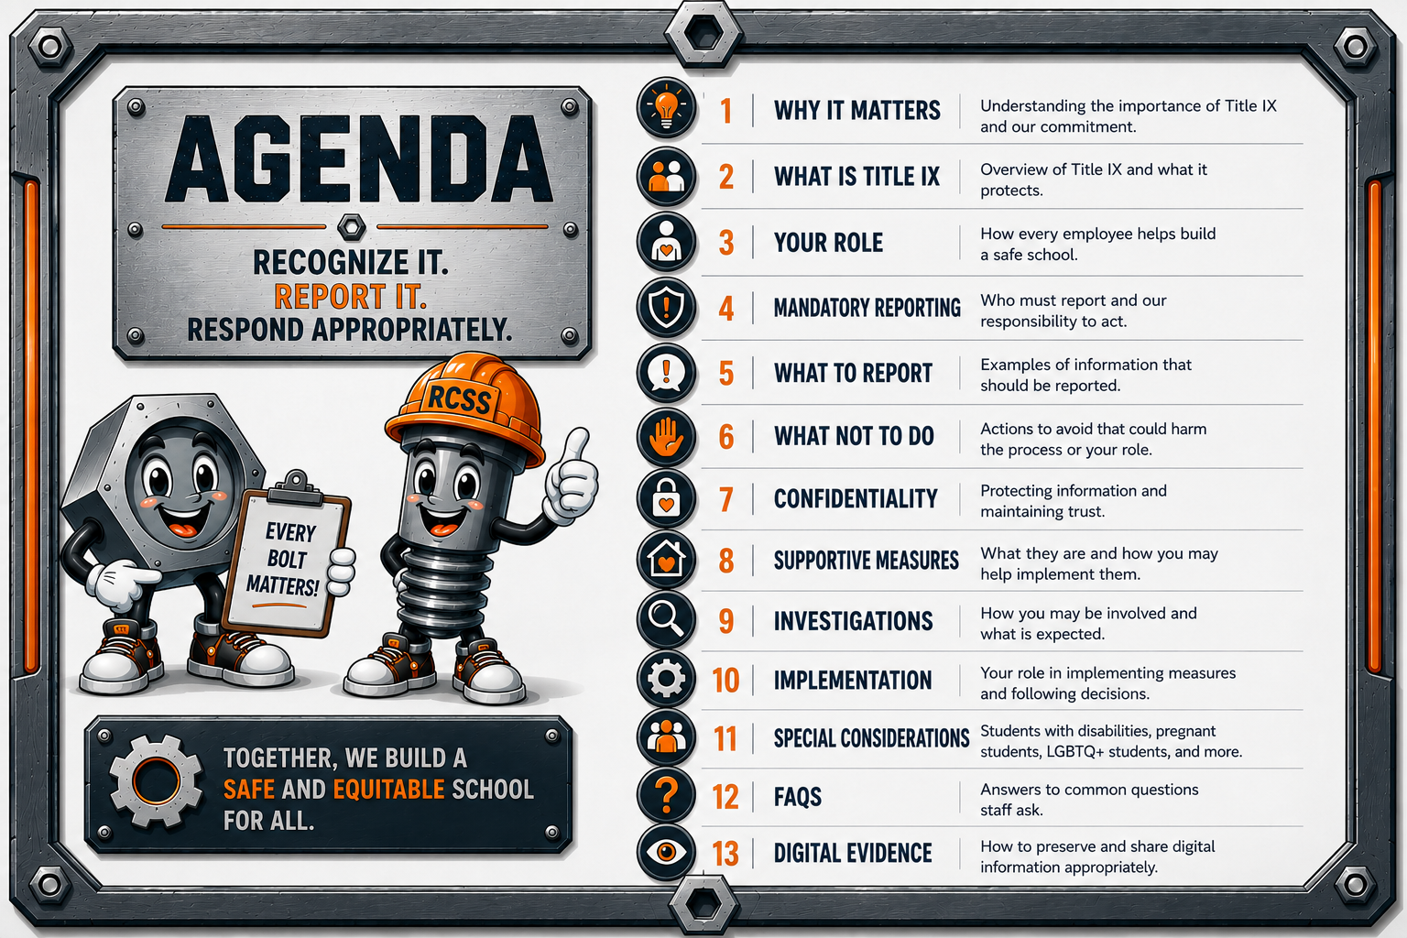

Slide 3


Slide 4

Module 1: Why Title IX Matters
This isn't about compliance first. It's about students.
Discuss:
  Every student deserves equal access to education.
  Sexual harassment and sex discrimination can interfere with learning.
  Schools have a legal obligation to respond.
  Every employee plays a role in creating a safe learning environment. know about it.
Takeaway
You don't have to solve the problem.
You just have to make sure the right people

Slide 5


Slide 6
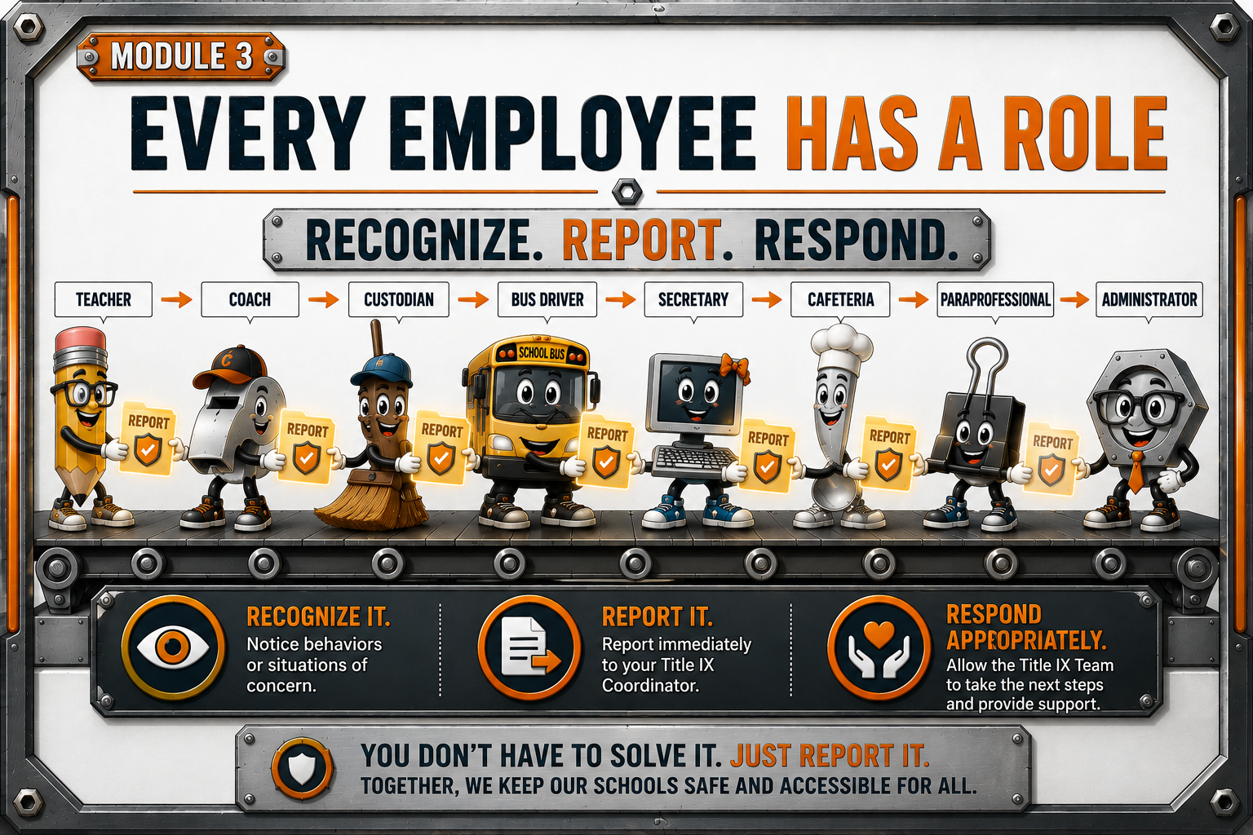

Slide 7
Examples:
A student says
"He keeps touching me.“
A student says
"I'm scared to walk to class.“
A teacher overhears
"They're sending pictures around."
parent reports
"My daughter doesn't want to go to school anymore."

Slide 8
Behavioral indicators
  sudden anxiety
  avoiding certain classes
  crying
  panic attacks
  unexplained absences
  decline in grades
  Staff need to understand
You may be the first adult who notices something.

Slide 9
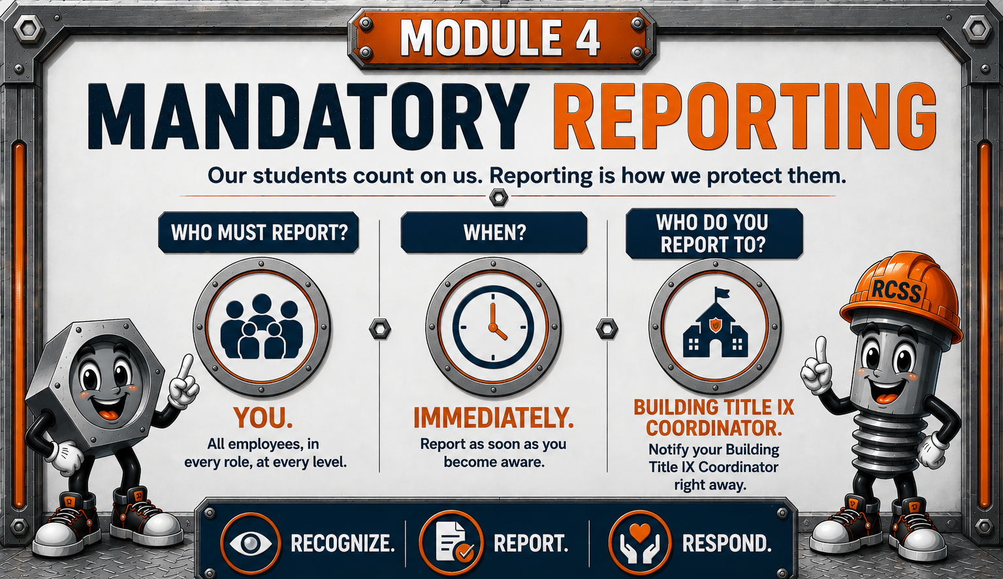

Slide 10
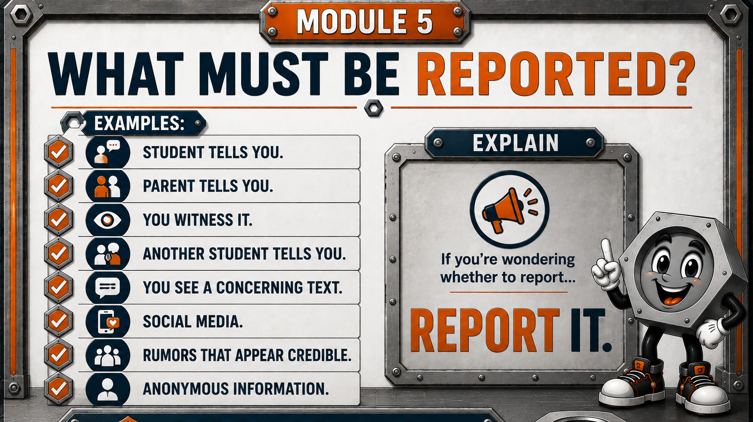

Slide 11
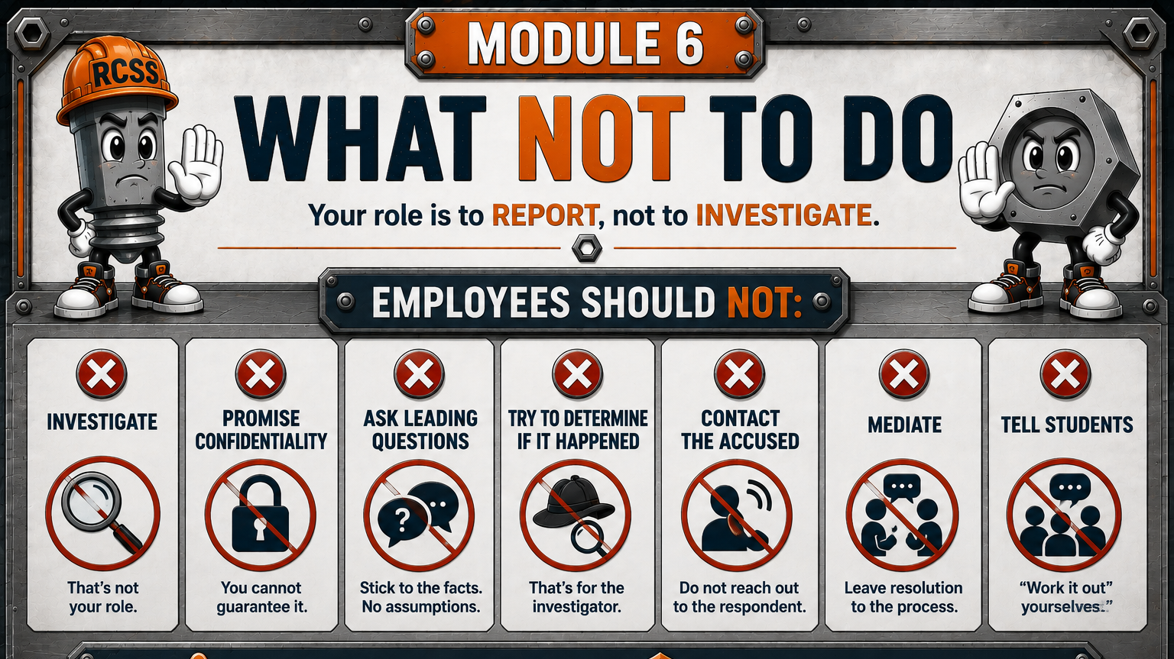

Slide 12
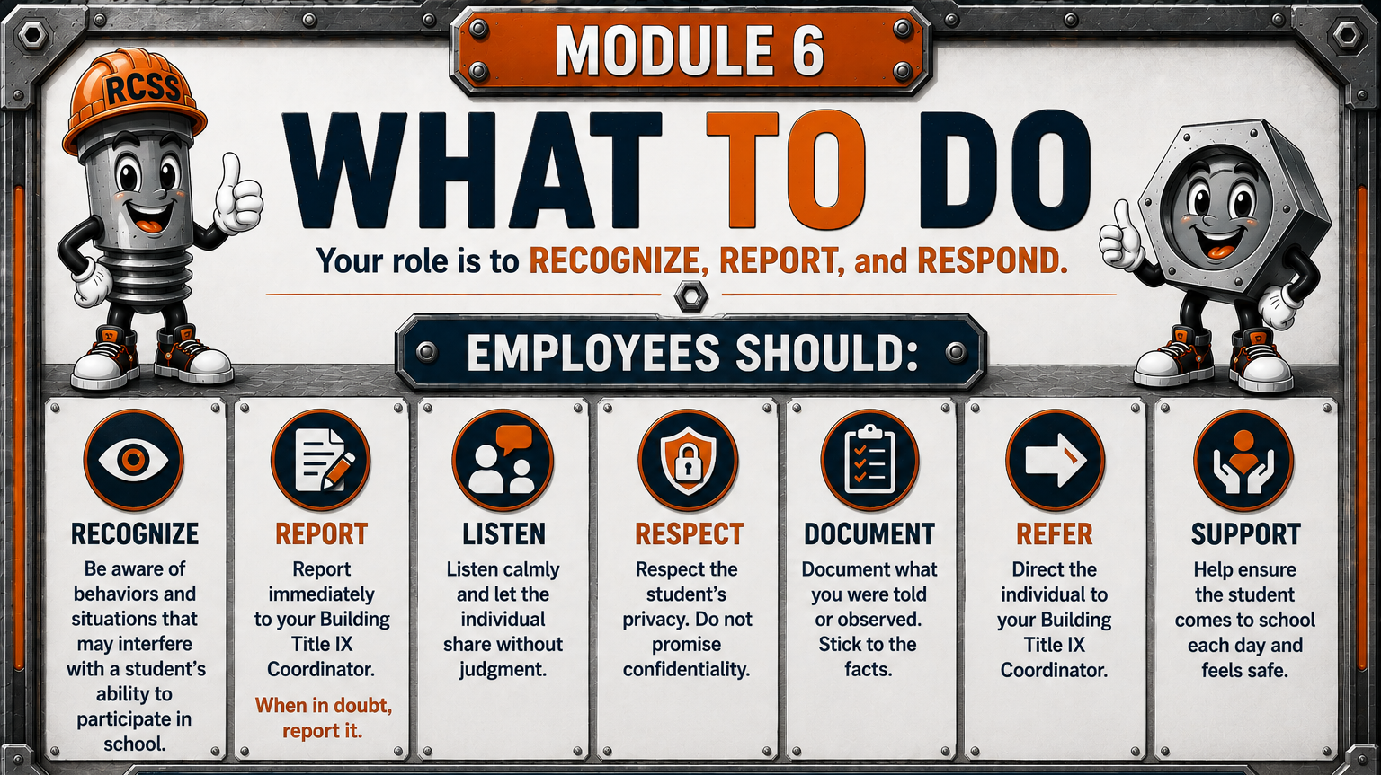

Slide 13
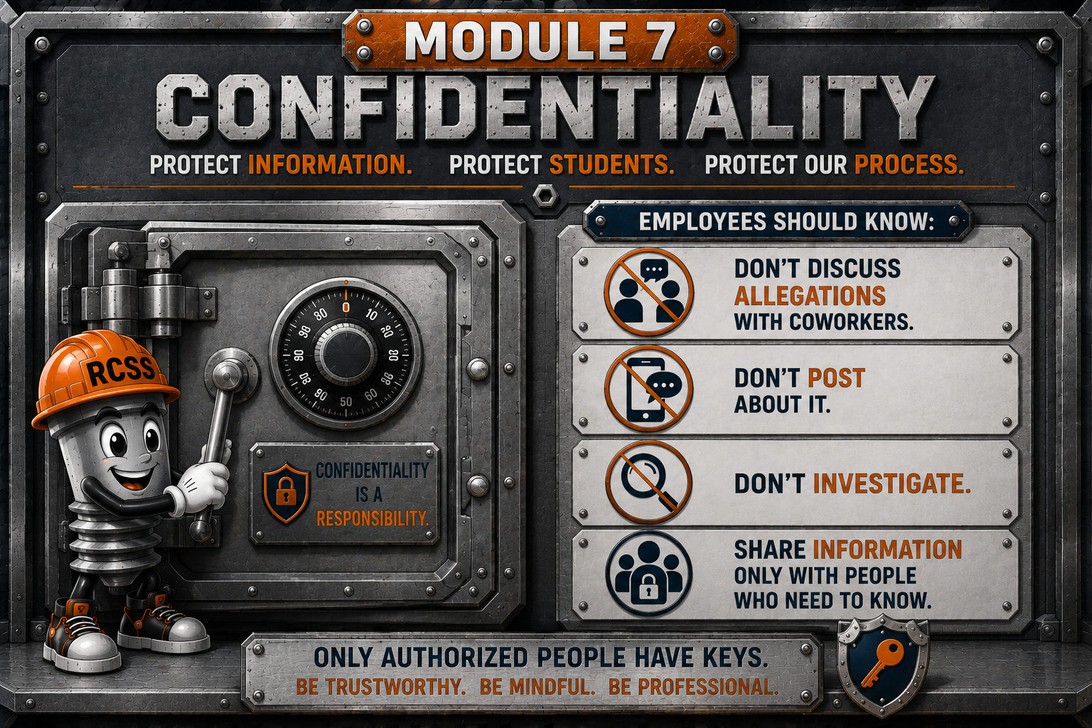

Slide 14


Slide 15


Slide 16
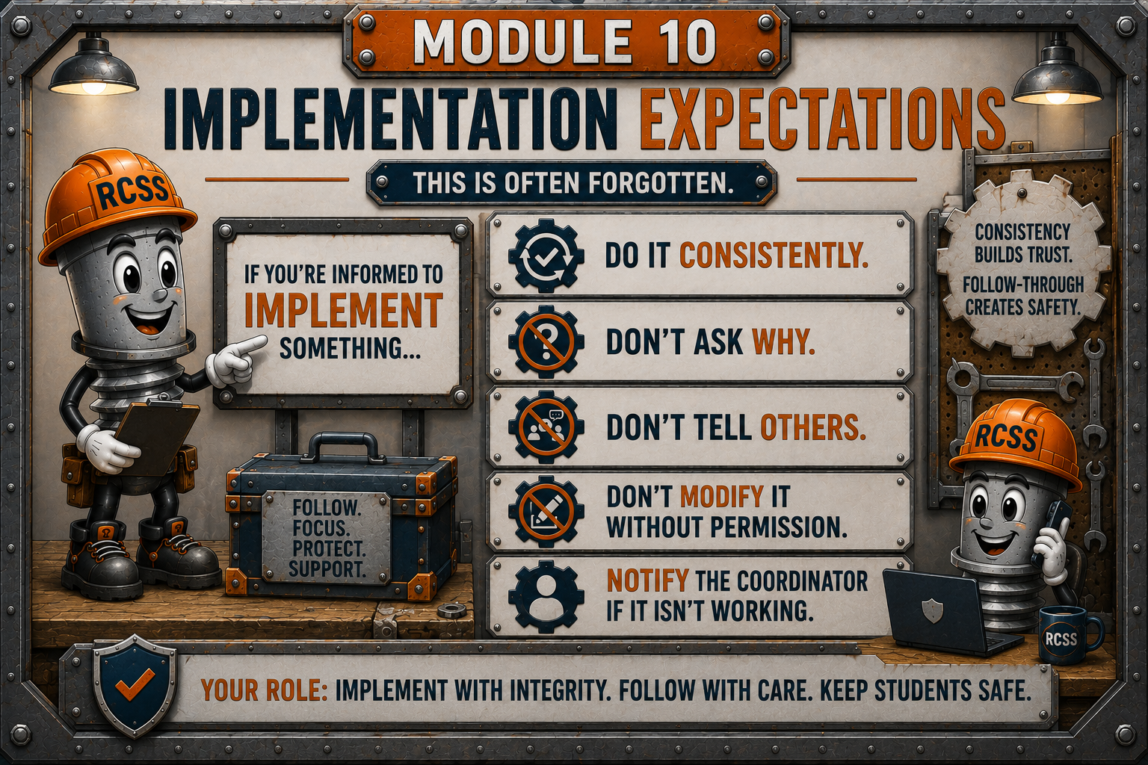

Slide 17


Slide 18

Notes:
❓What if the student asks me not to tell anyone?
Answer
Tell the student:
"I'm glad you told me. My job is to help keep you safe. I need to share this with our Title IX Coordinator so they can help."
Then report it immediately.
Remember:
You should never promise confidentiality.
❓What if it happened off campus?
Answer
Report it.
The Title IX Coordinator will determine whether Title IX, another district policy, or another process applies.
Your job isn't deciding jurisdiction.
Your job is reporting.
❓What if it happened years ago?
Answer
Report it.
Even if the conduct occurred years ago, the district still needs to evaluate the information and determine the appropriate response.
Never assume it's "too old."
❓What if I'm not sure?
Answer
When in doubt...
REPORT IT.
Never let uncertainty prevent you from reporting.
The Title IX Coordinator will determine the next steps.
❓What if both students are accusing each other?
Answer
Report both allegations.
Do not determine who is right.
Do not investigate.
Allow the Title IX process to address each allegation fairly.
❓What if it's on social media?
Answer
Report it immediately.
If possible:
Preserve screenshots.
Save texts or images before they disappear.
Do not investigate the social media account yourself.
Forward the information to the Title IX Coordinator.
I would end the slide with one final question...
❓What if I make a report and it turns out not to be Title IX?
Answer
That's okay.
The Title IX Coordinator will determine the appropriate process.
It is always better to report a concern than to miss an opportunity to protect a student.
You are not expected to know every answer.
You are expected to Recognize. Report. Respond.

Slide 19
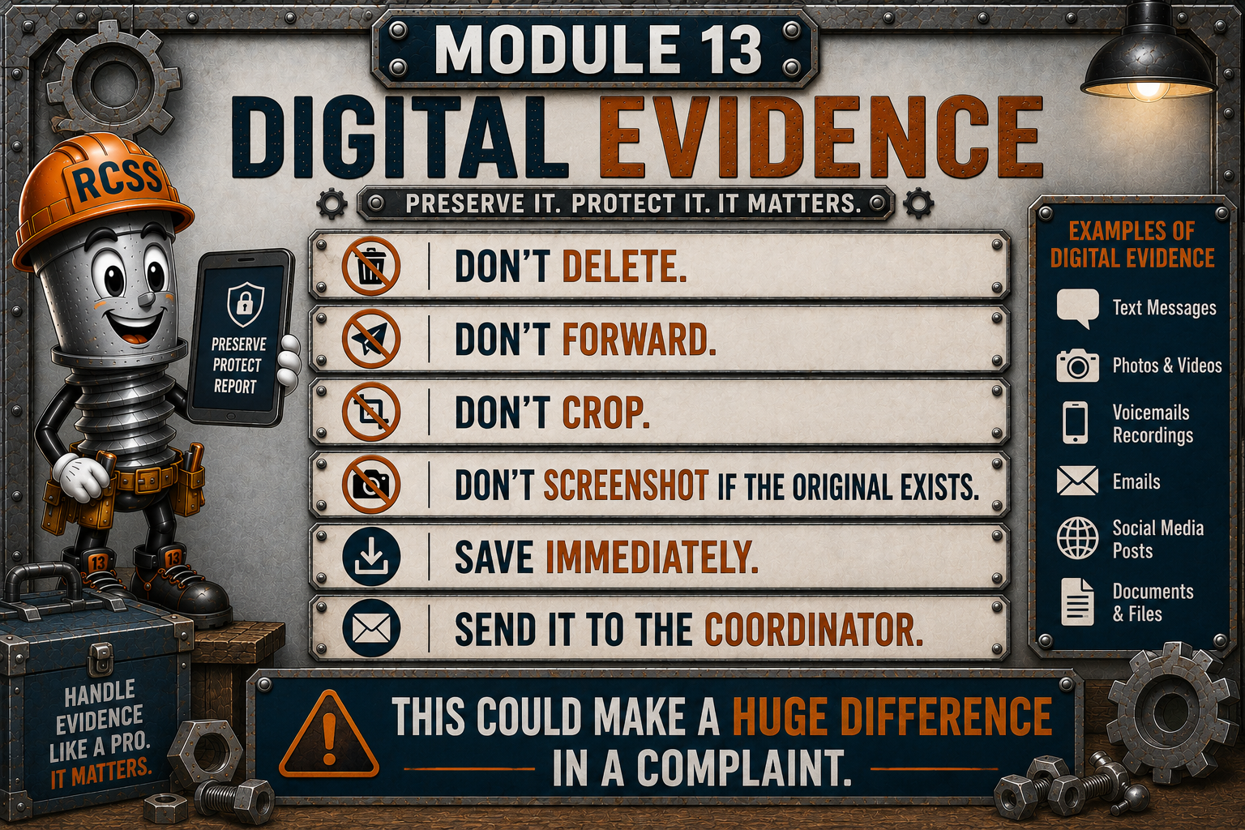
Notes:
Wait! You just asked me to not forward it. But then you said save it and send it to the coordinator. Can you please explain:
DO
Preserve the original evidence.
Save it immediately.
Upload it to the secure reporting system or provide it directly to the Title IX Coordinator.
If you don't know how to send it securely, contact the Coordinator immediately

Slide 20


Slide 21
Meet Your Title IX Coordinators
School-Based Title IX Coordinator
Name: (add your information here)
Contact:
System Title IX Coordinator
Name: Dr. Titania Singh
Compliance and Title IX Coordinator
Contact: Phone: (706) 826-1000
Email: singhti@boe.richmond.k12.ga.us

