Slide 1
Section 701 of your Task List
2.2 Compare and contrast common networking hardware devices.
Flexible Instruction Day Assignment #2
Routers
• Switches
- Managed
- Unmanaged
• Access points
• Cloud-based network controller
• Firewall
• Network interface card
• Repeater
• Hub
• Cable/DSL modem
• Bridge
• Patch panel
• Power over Ethernet (PoE)
- Injectors
- Switch
• Ethernet over Power
This material is a review of network devices
(how they work and what they are used for).
This builds on the basic network hardware
lesson by adding in additional SOHO (small
Home office) devices.

Slide 2
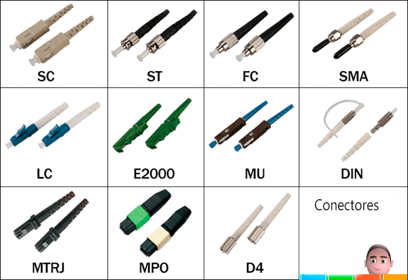
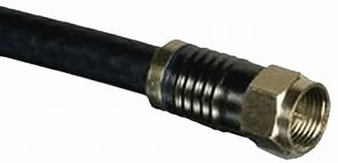
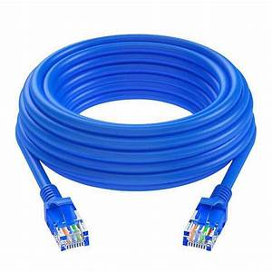
The Network Media
Network Media refers to the connections between your devices. This refers to the cables used to connect computers/equipment. They like to use the term boundless media when you are using wireless connections.
Coaxial media is common for broadband & cable TV networks as well as for cameras. This used to be common for LANs.
Twisted Pair cable
Is one of the most common media types
Fiber optic cables are very fast, go long distances, but are expensive

Slide 3
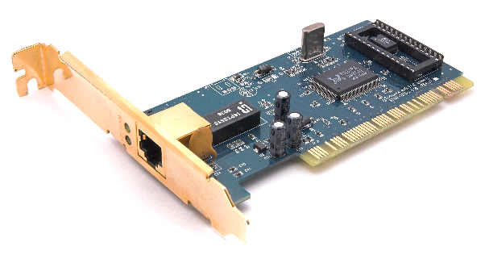
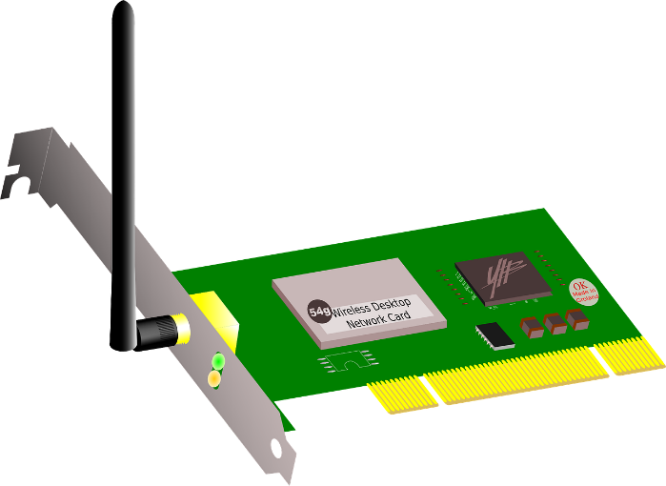
The Network Interface Card (NIC)
Your NIC (wired or wireless) is used to make your network connections. It has a physical address or MAC built into it from the factory. This is what ultimately identifies your communications/connections. Your IP address gets linked to MAC ( protocols (ARP and RARP) switch it back and forth).
Most NICs have LED indicators showing the network connectivity.

Slide 4
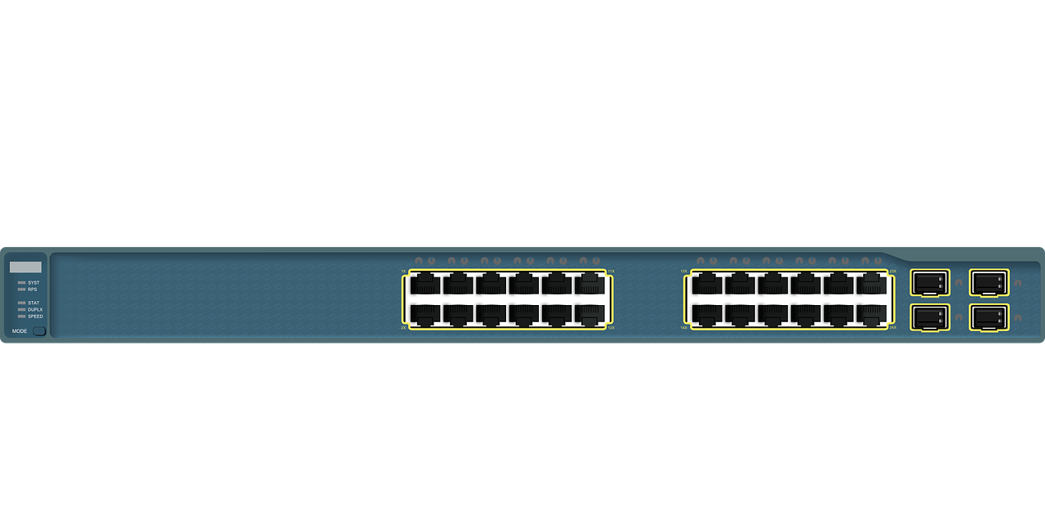
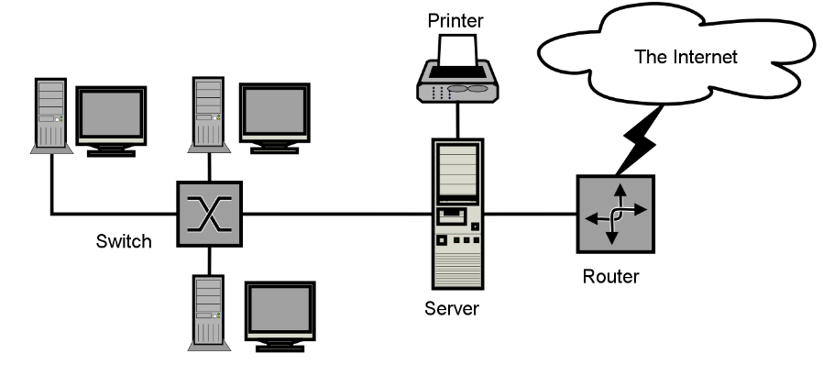
Switches and Hubs
Switches and hubs perform the same basic function (they even look the same), they are a center point to connect your cabling (media). Your PCs, servers, printers, all connect to the switch using a network cable.
Hubs repeat the signal they get to each port (they don’t know where it should go) so it is a slower device (splits your bandwidth). We used to use them more because switches were expensive.
A switch is smart and only sends the signal to the port associated with the data. It has a that it creates that has its ports and what MAC addresses are associate with it. The data has a “to and from” section (uses the MAC/physical address found in network cards) so it looks at the “to” part of the data and looks it up in the table and sends it to that port. This makes it a much faster/better option than a hub.
Managed switches let you adjust/configure the ports however you want. Unmanaged
switches are cheaper and just build their own tables which you cannot configure.

Slide 5
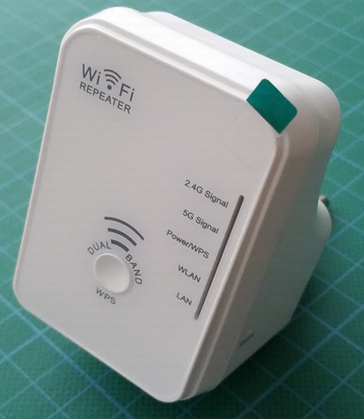
Repeaters
Signals (wired or wireless) can only travel so far before they weaken. When this happens, you will start to get errors or communication might fail altogether.
Digital signals use repeaters to extend the signals and make them go farther; they simply regenerate/repeat the signal. All of your powered network devices (switches, NICs, etc.) act as repeaters but you can buy a dedicated repeater to extend the length of a network cable.
Wireless networks have the same issue, there is a limited range for the signal. If go to the edge of where you are still receiving signal, you can install a repeater to extend the range of your network.
Repeaters are dumb devices, they do not filter or direct traffic.

Slide 6
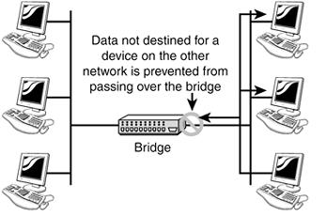
Bridges
Bridges are like repeaters in the sense that they can be used to extend your network. They can also be wireless or wired. Bridges act like repeaters because the regenerate the signals.
Bridges segment (divide it in two) a network. They build a table of MAC addresses (like switches) and associates a side/segment of the network with the addresses. It can then filter the traffic based on which side of the bridge it goes to. Traffic intended for segment A will not be passed to segment B. This makes it a much better option than a repeater.
Wireless bridges are similar but they use wireless signals to connect two network segments. This is a good option when it is to difficult or expensive to run cable. You can put them on the roof tops of buildings to connect to other buildings/networks.

Slide 7
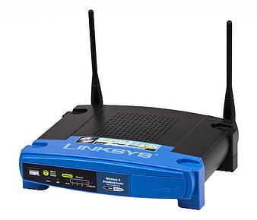
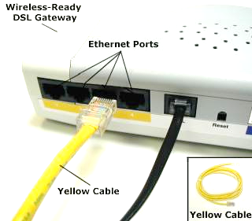
Access Points
Access points connect wireless devices into a wired network. You can think of them as wireless switches. They convert the wireless signals into wired and vice versa.
People confuse Access Points with wireless Routers (the look the same). Wireless routers can act as access points but have additional features. They are designed to attach your wireless devices to another network/the Internet. Access points are designed to connect wireless devices into an existing wired network.
Cable/DSL modems
Cable/DSL modems provide connect to your Internet service. Both cable and DSL use a different style of signaling than your traditional home or work network does. The modem converts the signal and maintains a
connection with your service provider. Your ISP will typically supply you with the needed modem.

Slide 8
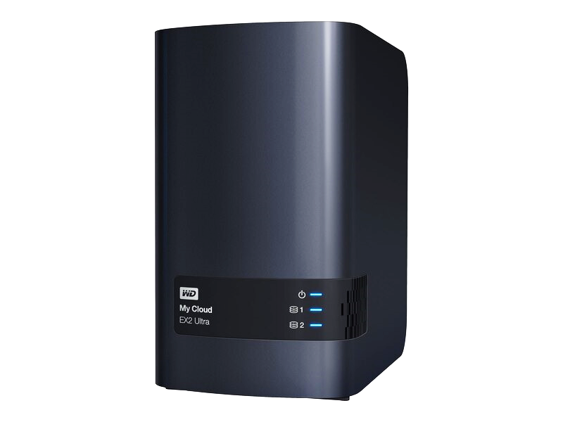
Cloud-based network controller
The cloud is used by my organizations to house storage, applications, services, even network devices/infrastructure. There are many benefits to using the cloud, especially the ability to access the resources from anywhere that has an Internet connection. My business and people create their own private clouds to store their data. A device (like the image) can be connected to your local network as NAS (network attached storage) and can give remote access to the data via the cloud. Some people use a cloud appliance to cache commonly used data and send the rest to the cloud for storage (you would need a cloud service for the cloud storage).

Slide 9
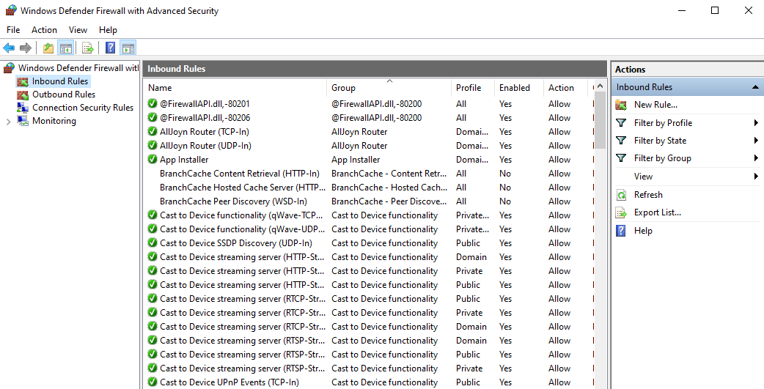
Firewalls
Firewalls can be software based (like the one in Windows) or can be a separate piece of hardware. They can be host based like the one your PC or network based (designed to protect a whole network). The purpose of a firewall is to help protect you from outside threats (they keep you sensitive communications form going out and threats from coming in). You use rules to block or allow the traffic in either direction. You can block or allow certain ports or applications depending on what your needs are. If your firewall is too restrictive, you may block the communications needed by some of your programs but if it is too weak, hackers could get access.

Slide 10

Routers
Routers are used to connect to other networks (or the Internet). These smart devices are basically little computers. These can obviously be wired or wireless. Routers use IP addresses to route (determine the path) in order to forward packets from one network to another. Routers are really designed to communicate with other routers. To explain routers in simple terms: the routers have instructions about how to handle the communications they receive and send. They look at their routing tables to determine how to send or restrict traffic.
Your home/WiFi router is a combination of devices (it is a DHCP server/gives network addresses, has a built in switch, acts as an access point, usually has a firewall and other things built in) but is really a simplistic version of the routers used in business.

Slide 11
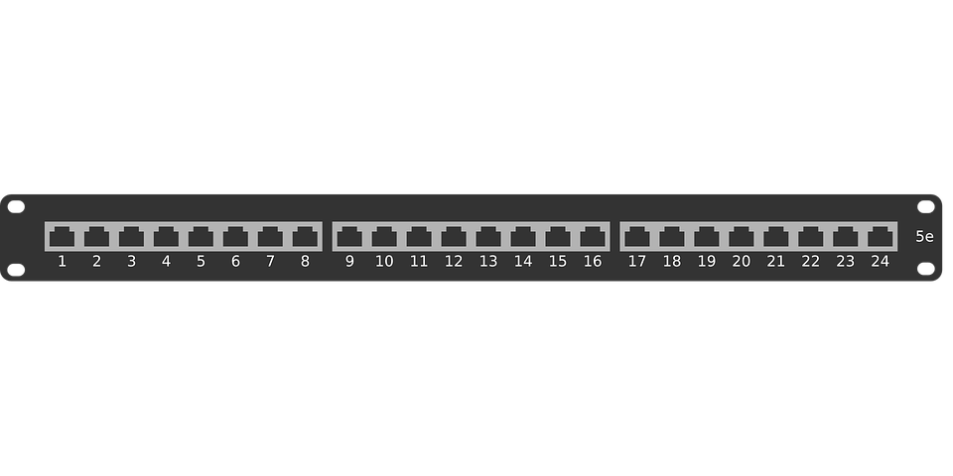
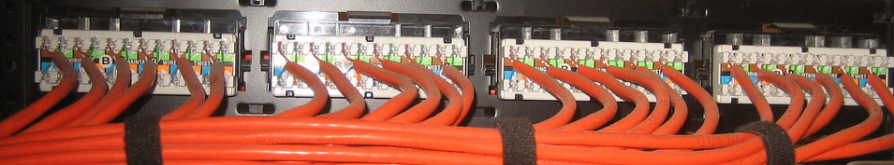
Patch panels
Patch panels are termination points for your network cabling. Your network cabling that runs through your walls and in your ceilings, collects and is punched into backs of punch panels. The panels have ports that are identical to your network wall jacks (with rj45, female ends). Your cabling goes from you all jacks through the ceiling/walls to data closet/room where they are punched into your panels. The ports on the panels are connect with Ethernet cables to switches, etc.

Slide 12
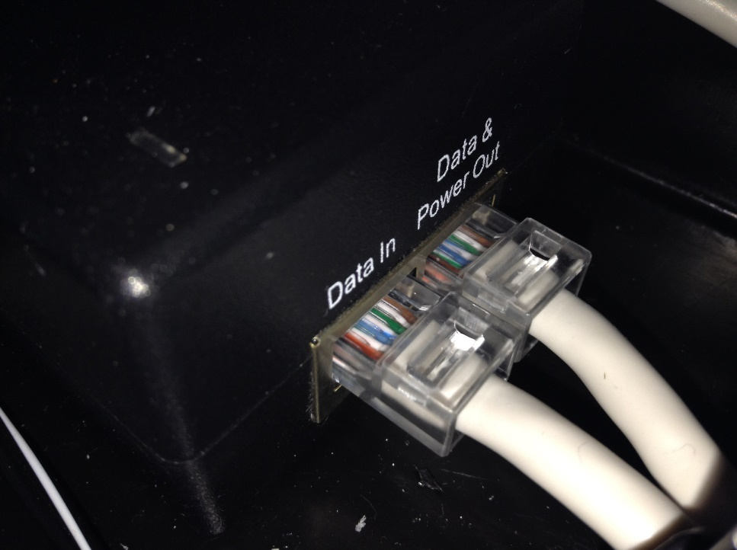
Power over Ethernet (PoE)
Sometimes you need to install a device in a location where it is difficult to place an outlet (drop ceilings etc.).
PoE uses a standard Ethernet cable to transfer data and power to a device so you don’t need an outlet to plug the device into. This is pretty commonly used with security cameras, wireless access points, and Voice over IP phones. It dedicates up to four (there are eight) wires in your standard cable to transfer power. The end device has to be PoE compatible and you need a PoE device to power the cable.
Some switches have PoE already built in (called end span device) or you can use a power injector (called a mid span device, see the picture).

Slide 13
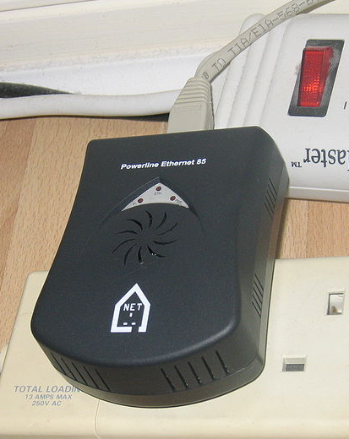
Ethernet over Power
Basically the opposite of PoE. You have difficulty running network cables and wireless isn’t a good option so you use your existing electrical wiring to transmit network signals. You plug an Ethernet over power adapter into your AC outlet and connect it to your network with a standard patch cable. The adapter converts the signal to transmit over your existing household wiring. A second adapter is plugged into an outlet where you wish to have networking; it converts the signal from the wall wiring back to original Ethernet format and you can connect to the signal with a standard patch cable.
This sounds great! Why aren’t we using it everywhere?
First, outlets need to be on the same circuit.
Second, electrical interference can cause issues with the signaling.
Third, speeds have always been slow compared to wired and wireless. The technology
has gotten a lot better recently but the manufacturers grossly over sell the speeds that
their devices can actually obtain in real world conditions.
Speeds of 20 and 200Mbps are more realistic even if the device claims 500Mb or gigabit.

Slide 14
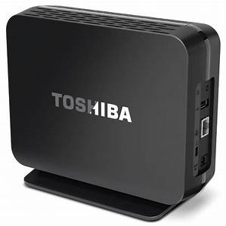
Network-Attached Storage (NAS)
Network-Attached Storage (NAS)- NAS is a device that attaches to your network to provide file sharing. NAS devices contain storage (a hard drive), a network card, and a processor (basically a simple, little computer) and are plugged into a network where they can be easily managed to provide file sharing to the network users.
NAS devices can be inexpensive ($100 to $200) or can cost thousands of dollars depending on their features/power.

Slide 15
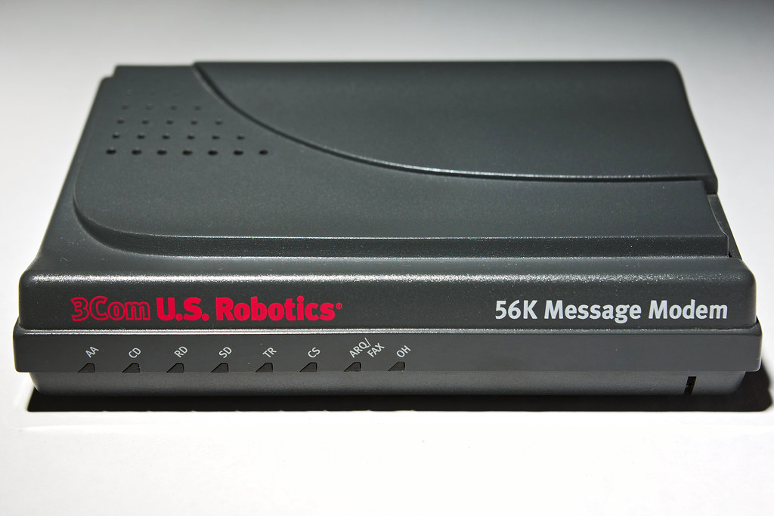
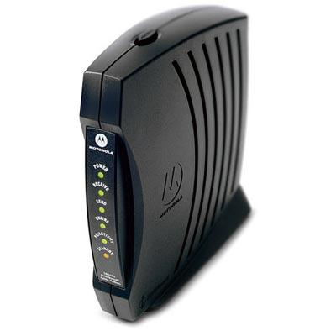
Modem
Modems were commonly used to connect your computer to a phone line so you could get dial up Internet access. They basically converted your computers digital signal to the analog signals use by phone lines. They still exist but this type of connection is very slow and unreliable; we have better options today.
The type of modem that you would be more familiar with is a cable/DSL modem. You Internet service provider probably installed one in your home. These transform the WAN data format used by cable and DSL connections to the LAN type your home network uses.

