Slide 1
Flexible Instruction Day Assignment #1
Networking Basics
This material is an review of basic networking concepts. This material is covered in 1401 Concepts & Terms but also relates to multiple second year task list sections including :1401 Concepts & Terms, 701 Network Hardware, 603 Network Topologies, 601 Network Media.
You will learn basic networking terms, types, & concepts. Network types, how they connect, and signal.

Slide 2
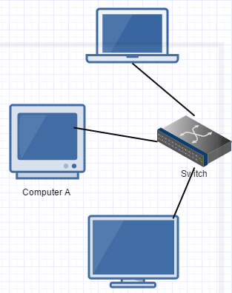
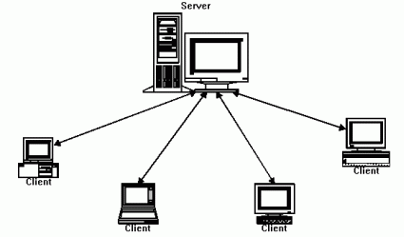
What is a network & what are the basic network types?
A network is a group of computers connected together in order to communicate and share resources. These computers can share things such as printers, files (documents, pictures, videos, etc.), an Internet connection, storage, etc.
Basic Network Types
A peer-to-peer (also called a workgroup) is a simple type of network in which the computers are connected together without having a server. The computers are connected together by connecting all of their network cables to a common switch or by using wireless connections to common wireless router/access point. This type of network is easy and cheap to install so it is often used in homes and small offices. This type of network does not work well with large numbers of computers (networking is slow) and has poor security (regular users create their own network shares and data is located on the local computers).
A server based network (also called client-server) has each computer (called clients or nodes) login into a network server in order to join the network. The network server handles security (login, rights, permissions, access) and sharing. This type of network is much more secure than a peer-to-peer, network passwords and data are stored on the server (not the clients) and sharing is managed by the server. Network management (managing accounts, software updates, shares, permissions) can all be handled from the server; making the job easier. This type of network can handle large numbers of computers much better than peer-to-peer better also. The downside of this network type is the extra cost and complexity of the installation combined with needing a trained person to manage it.

Slide 3
Network Types Continued
These network types describe network size geographically, they do not indicate how many computers are in the network.
PAN – A personal area network is limited to the area directly around a person (a couple meters). This type of network is usually created by the wireless connections made by your phones, tablets, notebooks, headsets, etc.
LAN- Local area networks are limited to the size of a building (or a couple close buildings).
MAN- Metropolitan are networks that span city.
CAN- A campus area network is limited to the size of a few blocks. CANs are found at school/college campuses or by businesses such as hospitals. They are bigger than a single LAN but smaller than a MAN.
WAN- A WAN has no geographic limitations. It is typically made by joining a number of LANs together. You can think of the Internet as the worlds biggest WAN.
WMN- A wireless mesh network combines multiple devices (mesh nodes) to share a network connection across a large area so the devices can communicate with each other. However, your wireless mesh could be confined to a smaller area as in the case with home automation systems (HVAC, lighting, etc.) or those used by companies to monitor and control their systems.

Slide 4
Network Participation (is the network private, public, internal, etc.)
Internet – The Internet is a worldwide public network. Users and organizations connect to the Internet through an internet service provider (ISP). You connect to the Internet to use publicly available network services or to share network services.
Intranet- This is a private network that is only available to people who belong to a particular organization or business. They will provide network services (uses Internet technologies) to computers (hosts) that are attached to their network.
Extranet- This type of network is private (like an intranet) but allows access to its resources by certain trusted external users. For instance, you company may host a website on its private network that they allow their partner companies to access.

Slide 5
Network Management
Network – This term indicates that the computer system (servers, clients) are being managed/controlled by a single organization.
Subnet- This term describes a subsection of a larger physical network. The computers on the subnet share the same network address but have their own unique host address. Think of the phone numbers in Butler county, they all have a 724-area code but have unique home numbers and are a subsection of the overall phone network. A large networks are often subnetted to improve security, performance, and make network management easier.
Internetwork- This term describes the connections made between different LANs to make them communicate. These networks typically use WAN connections to connect their networks to other LANs.

Slide 6
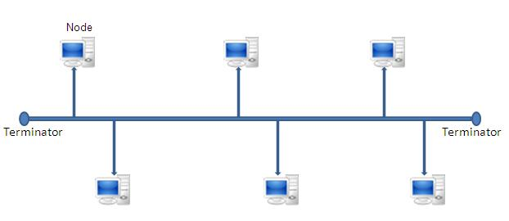
Network Topology
A Network Topology indicates the way network is wired/connected (physical topology) or the way it signals (logical topology). A network can physically be one topology and logically another. There are four main topologies.
Bus topology- In a physical bus topology all the computers are connected using a single that chains from one computer to the next. This uses coaxial cable (like the cable cable/internet providers run into your home). This used to be common in networking (it was cheap and easy to install) but is difficult to troubleshoot and slow with large numbers of computers. We still use it to connect things like security cameras but it is no longer widely used for networks. Logically, bus sends a signal out in both directions to all computers. A logical bus is very common in LAN networks.

Slide 7
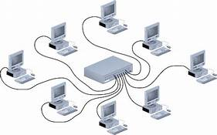
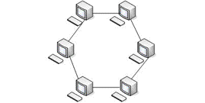
Network Topology Continued
Star topology- In a star topology all the computers have their own cable (twisted pair) which connects to a hub or switch. This is the most common LAN topology because it is reliable, cheap, easy to install and troubleshoot. You can look at the hub/switch (switches have replaced hubs in modern LANs) and it will light up each connection if they are attached properly. There is no such thing as a logical star, most star topologies are logically busses.
Ring topology- A ring topology connects each computer to its neighbor to form a ring. This is difficult to and expensive to install. This can also be difficult to work with and troubleshoot (much like a physical bus). Physical rings are not common Logically, each computer takes turns communicating and passes the signals along the network in one circular direction. It is predetermined when each computer will get its turn to communicate so data collision is not possible. This type of signaling is called token passing.

Slide 8
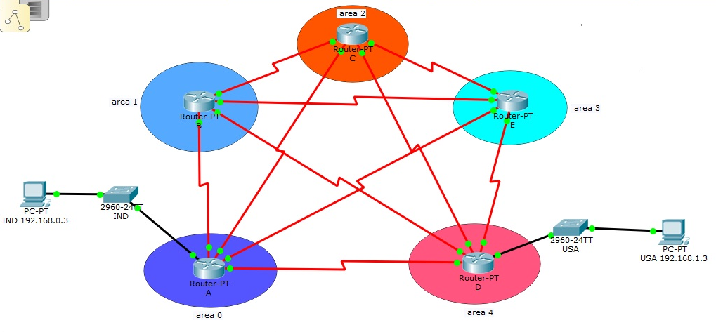
Topology Continued
Mesh topology- In a topology, each device is directly connected to every other device with its own cable. This is very expensive and difficult but if provides the most reliable (more than one connection in case one goes bad) and easiest to troubleshoot topology. This topology is not really used to connect computers in a LAN but is used to connect network devices like routers. Logically the signal travels directly from device to device unless the connection is bad/busy then it can take an alternate route. This adds reliability to your network by providing more than one path the data can take. If you have multiple paths/connections but not a direct connection between every device (full mesh), this is referred to as a partial mesh.

