Slide 1

Crosby ISD
2026-27 Benefits Overview

Slide 2
Presentation Disclaimers
GENERAL DISCLAIMER:
This presentation is intended to provide a brief overview of select employee benefit programs. It does not contain comprehensive plan details. For complete information — including coverage, costs, exclusions, limitations, and other important terms — please refer to the official plan documents, available on the Crosby ISD Benefits Website.
This presentation does not amend, modify, or replace any official plan documentation. In the event of any conflict between the information in this presentation and the official plan documents, the plan documents will govern.
Please note that all benefits and plans described are subject to change, discontinuation, or modification at any time, with or without notice.

Slide 3
HPS Call Center
Help is just a phone call away with the HPS Call Center!
Call: 833-921-0951
Available Monday-Friday 7:00 AM - 6:00 PM (CST)
Email: crosbyisd@hps.higginbotham.net
English or Spanish Representatives available to answer questions or to enroll via the phone.

Slide 4
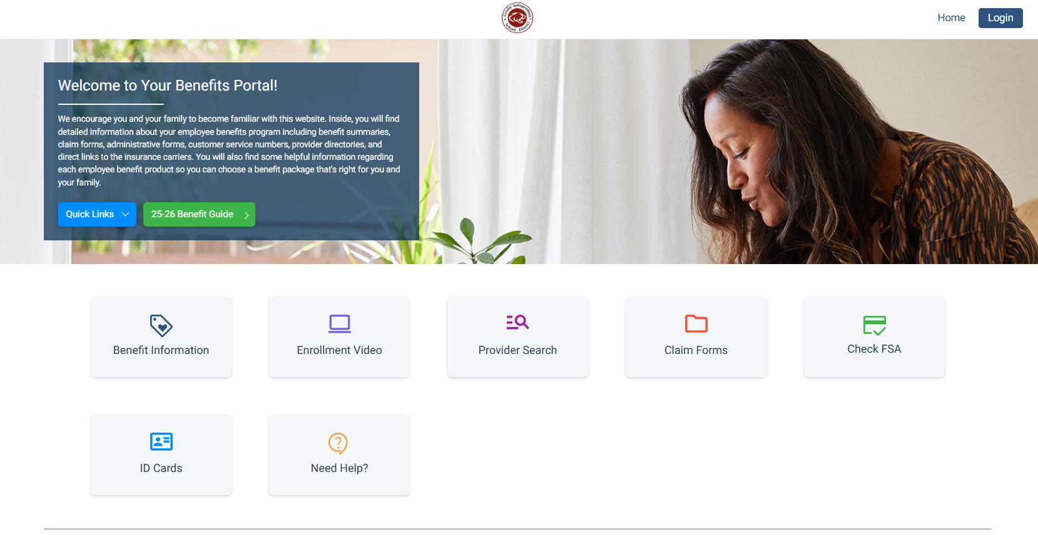
Where To Login
Click the login button
www.mybenefitshub.com/crosbyisd

Slide 5
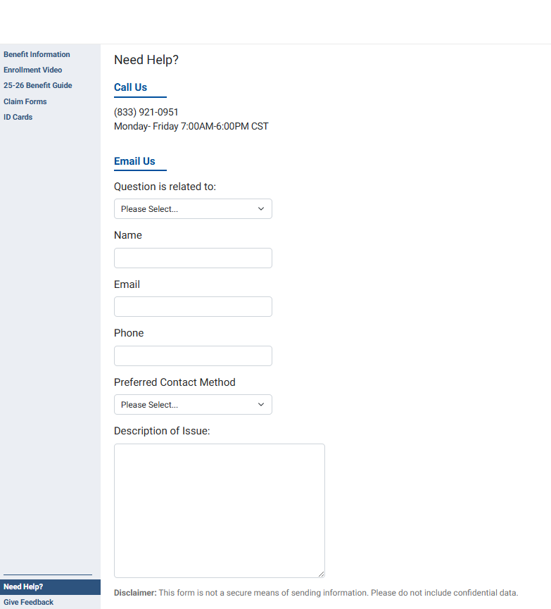
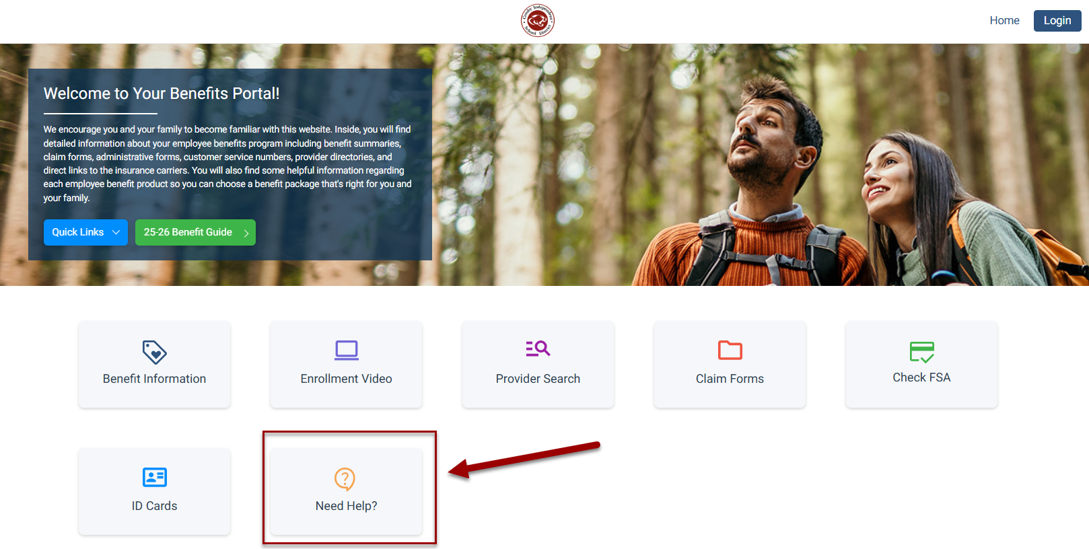
Questions or Need Help?
Use the “Need Help” link to send us your questions

Slide 6
NEW – UHC Medical
Crosby ISD medical insurance is moving to United Healthcare (UHC) for its medical insurance.
4 Plan Options to Choose From:
  Kelsey Charter H.S.A. – High deductible
  UHC H.S.A. – High Deductible
  Kelsey Charter * HMO
  Surest 8000
*Charter HMO is an in-network-only plan where employees must use Kelsey Seybold physicians. With the exception of a true emergency, benefits are only payable if an in-network physician, or facility provides services. If you use an out-of-network provider, you will be responsible for all costs. The selection of a primary care physician is not required and you do not need a referral to see a specialist. However, it is best to confirm that your doctor and all specialists are in-network before seeking care.

Slide 7
Kelsey Charter H.S.A.
Employees must use Kelsey Seybold physicians.
No Requirement to Designate a Primary Care Physician
No Referrals Needed for Specialist Visits as long as you stay within Kelsey Seybold network
No Out-of-Network Coverage
Once out of pocket maximum is reached, plan pays 100% of all charges.

Slide 8
Kelsey Charter H.S.A. Highlights
Preventative Care Visits Covered 100%
Telemedicine Covered at 100%
In-Network Deductible/Out of Pocket Maximum
  Individual - $3,500/$6,450
  Family - $7,000/$12,900
Pharmacy – Deductible $3500 must be met
  In-Network
    Tier 1 – $10
    Tier 2 – $35
    Tier 3 – $60
    Specialty – N/A
  This plan option is H.S.A. compatible

Slide 9
UHC H.S.A.
Employees can use any physician in the UHC Choice Plus network.
No Requirement to Designate a Primary Care Physician
No Referrals Needed for Specialist Visits as long as you stay within UHC Choice Plus network
Once out of pocket maximum is reached, plan pays 100% of all charges.
Out-of-Network Coverage - once deductible & out-of-pocket is met, plan pays 70% of remaining charges

Slide 10
UHC H.S.A. Highlights
Preventative Care Visits Covered 100%
In-Network Deductible/Out of Pocket Maximum
  Individual - $8,300/$8,300
  Family - $16,600/$16,600
Pharmacy – Deductible $8300 must be met
  In-Network
    Tier 1 – 0% after deductible
    Tier 2 – 0% after deductible
    Tier 3 – 0% after deductible
    Specialty – 0% after deductible
  This plan option is H.S.A. compatible

Slide 11
Kelsey Charter HMO
Must stay in Kelsey Seabold Network
No Designation of a Primary Care Physician in Kelsey network
Referrals Not Needed for Specialist Visits in Kelsey network
In-Network Coverage Only – employees can move freely within Kelsey network
Coinsurance – Once you reach your deductible, the plan pays 100% of eligible charges (emergency room $500 applies to max out-of-pocket)

Slide 12
Kelsey Charter HMO Plan Highlights
In-Network Deductible/Out of Pocket Maximum
  Individual - $6,000/$7,350
  Family - $12,000/$14,700
Preventative care covered 100%
Telemedicine covered 100%
Copays for PCP, Specialist Visits and Urgent Care
Pharmacy
    Tier 1 – $15 copay
    Tier 2 – $45 copay
    Tier 3 – $85 copay
    Specialty – $200

Slide 13
UHC Surest 8000 Plan
Nationwide Network – Surest 8000
Do Not have to Designate a Primary Care Physician
Referrals Not Needed for Specialist Visits
Preventative care covered 100%
Co-Pays ranges for all services, payment for services goes into the maximum out-of-pocket bucket
  The Surest App is necessary to use this plan and determine what your cost for services will be!

Slide 14
UHC Surest 8000 - CoPay Plan Highlights
Preventative Care Visits Covered 100%
“No” In-Network Deductible/Out of Pocket Copay Maximum
  Individual - $8,000
  Family - $16,000
Copays for PCP and specialist visits, Urgent Care, Emergency Room (freestanding and hospital), and ambulance services, Hospital Admission & Outpatient Services
Pharmacy
    Generic – $10 copay
    Preferred – $60 copay
    Non-Preferred – $90 copay
    Specialty –$10 / $150 / $300

Slide 15
Health Savings Accounts (H.S.A)
If you are enrolled in the either of the H.S.A. medical plan, you are eligible to enroll in a health savings account.
Administrator – Gulf Coast Educators Federal Credit Union
Personal savings account, stays with you even if you change jobs or retire
Balance's rollover every year, no "use it or lose it“
Unlike an FSA, funds are NOT front loaded - only the balance is available
IRS approved medical, dental and vision expenses for you and your family
Employee only : Up to $4,300/$5,300 | Family: Up to $8,550/$9,550

Slide 16
Be An Informed Consumer!
Crosby ISD’s medical plan is designed to support your health and well-being. The way we all use our benefits can impact the overall cost of coverage in the future. Here are some simple tips to help you make cost-effective choices:
Choose In-Network Providers:
Just because a provider accepts UHC insurance doesn't mean they are in-network. Always confirm network status before receiving care. Out-of-network services typically cost you and the plan significantly more.
Use Emergency Services Wisely:
Avoid free-standing emergency rooms or hospital ERs unless it's a true emergency. For non-emergencies, consider in-network Urgent Care centers or use the Recuro telehealth service for quick, affordable care.
Shop Around for Diagnostic Tests:
If your provider orders an MRI, CT scan, or other imaging services, check your Surest App for best pricing
Choose Generic Medications:
Generic drugs are safe, effective, and usually cost much less than brand-name alternatives. Ask your provider or pharmacist about generic options whenever possible.
Look for Prescription Discounts:
In addition to using your insurance benefits, check Optum Rx for potential prescription savings. It’s a free tool that can help you find lower prices on many common medications — sometimes even less than your copay.
Making smart choices helps control costs and keeps the plan affordable for everyone. Thank you for doing your part!

Slide 17
Flexible Spending Accounts (FLEX)
Flexible Spending Account (FSA)
Use pre-tax dollars to pay for eligible medical, dental, and vision expenses.
Administered by: NBS
Contribute up to $3,400 per year
Not tied to medical plan elections
Use-it-or-lose-it:
  Up to $630 rolls over (if unused by 8/31)
  Amounts over $630 are forfeited
Funds available up front on a debit card
Cannot enroll in both an FSA and an HSA
Debit Card Info:
New enrollees will new receive a card; expiring cards will be automatically replaced.
✅ Stretch your dollars — plan contributions carefully!

Slide 18
Dependent Care
Dependent Care FSA
Use pre-tax dollars to pay for eligible dependent care expenses (daycare, preschool, after-school care).
Administered by: Higginbotham
Annual Contribution Limits:
  Up to $7,500 (married filing jointly or head of household)
  Up to $3,750 (married filing separately)
Use-it-or-lose-it: Funds must be used within the plan year
No upfront funds: Only reimbursed up to current account balance
Tax rule: Cannot claim both this FSA and the childcare tax credit

Slide 19
Telehealth
Provider - Recuro
Telephone consultations with a state-licensed physician 24/7/365
No Consultation Fees
You don't have to be enrolled in a medical plan to enroll in the telehealth
Includes unlimited behavioral health consultations
May be used throughout the continental United States
Saves money AND time
Don't confuse this Recuro with telehealth through your group medical plan; they are separate benefits.

Slide 20
Hospital Indemnity
*If also enrolled in Cancer Plan, Critical Illness, and/or Accident, benefits may also be payable under those plans as well depending on the nature of the confinement!
Carrier – CHUBB
No pre-existing conditions clause
HSA Compatible
High/Low Plan Options Available
Hospital Admission Benefit - $1,500/$3,000
ICU Admission Benefit - $3000/$6000
Hospital Confinement Benefit - $100/$200 per day, 30 day max per insured
ICU Confinement Benefit - $200/$400 per day, 30 day max per insured
Newborn Nursery Benefit- $500, max 2 days per confinement
Observation Unit - $500/day, 2 day max

Slide 21
Dental – High Plan
Carrier – Cigna
$1,500 Plan Year Maximum
Out-of-Network – 90th percentile of U&C
100% Preventive & Diagnostic – 3 Cleanings
80% Basic Restorative Care
50% Major Restorative Care
50% Orthodontic Care (Adults and Children to Age 26)
  Orthodontia Benefit - $1,000 per lifetime
$50 Per Person or $150 per Family Deductible for Basic and Major Restorative Care

Slide 22
Dental – Low Plan
Carrier – Cigna
$1,000 Plan Year Maximum
Out-of-Network – MAC (Max Allowable Charge – member will owe the difference between the contract rate and the provider’s charge)
100% Preventive & Diagnostic – 3 Cleanings
80% Basic Restorative Care
25% Major Restorative Care
No Ortho
$50 per person and $150 per Family Deductible for Basic and Major Restorative Care

Slide 23
What is U & C?
    U&C is the Usual and Customary charge for a service. Charges can vary by region. The U&C charge for a root canal may be $400 in one area of the state but only $300 in another. Out-of-Network services are paid at a percentage of the U&C charge.
    How Does that Work?
      Example – Root Canal – Contract Rate is $300 and U&C for Area is $400
        Provider Out-of-Network Charges $425 for the service
          Plan at MAC will pay provider $300 and employee will owe $125 ($425-$300)
          At 90% will pay provider $360 ($400*.90) and employee will owe $65 ($425 - $360).

Slide 24
DHMO
Carrier – Cigna
In-Network Coverage Only – no out-of-network benefits
Primary Care Dentist Required
  Can change after open enrollment directly with Cigna
Fixed Fees for Services
  See DHMO fee schedule for details
Orthodontia Covered – for both adults and children

Slide 25
Vision – Platinum Plan
Carrier – Superior Vision
  Network – Superior Select Southwest
Exam/Lenses/Frames - every 12 months
Exam Copay - $5
Materials Copay - $10
Frame Allowance - $200
Contacts covered in lieu of glasses/$225 Allowance for contacts
Lens Options Covered In Full, In-Network
  Standard single vision, lined bifocal, lined trifocal
  Progressives covered to the allowance for a lined trifocal

Slide 26
Vision – Gold Plan
Carrier – Superior Vision
  Network – Superior Select Southwest
Exam/Lenses/Contact Lenses– Every 12 months
Frames - every 24 months
Exam Copay - $10
Materials Copay - $25
Frame Allowance - $150
Contacts covered in lieu of glasses/$150 Allowance for contacts
Lens Options Covered In Full, In-Network
  Standard single vision, lined bifocal, lined trifocal
  Progressives covered to the allowance of a lined trifocal

Slide 27
Long Term Disability
Carrier – Lincoln Financial
Elimination Period – 90 days – benefits will start after you have been disabled for 90 days
Max Monthly Benefit – 60% of regular earnings to a maximum of $6,000/month
Max Benefit Duration – To Normal Social Security Retirement Age if permanently disabled

Slide 28
Short Term Disability
Carrier – Lincoln Financial
Elimination Period Options – 14 days or 30 days – the number of calendar days you are out on leave waiting for your benefit to start
Benefit will last up to the time LTD benefits begin
Max Weekly Benefit – 60% of regular earnings to max of $1,500/week
1st Day Hospitalization Benefits – If you are admitted as an inpatient for at least 23 hours, elimination period is waived and benefits begin immediately.
New enrollees will be subject to pre-existing condition limitations within the first 6 months of coverage
Must be actively at work on September 1 for coverage to become effective

Slide 29
Basic Life and AD&D
Carrier –The Hartford
All full-time employees will receive $10,000 Basic Life Insurance which includes a matching amount of Accidental Death & Dismemberment
This benefit is paid for you by Crosby ISD!
The proceeds are paid to your beneficiary should you pass away while employed with Crosby ISD – must designate beneficiaries in the enrollment system

Slide 30
Voluntary Term Life
Carrier – Lincoln Financial
Voluntary Group Life Insurance Guarantee Issue (GI): $200,000 for New Hires (not to exceed 7 x annual earnings) and $50,000 for spouses (not to exceed employee election) and $10,000 for children.
Employees and spouses are eligible for up to $500,000 in $10,000 increments. Evidence of insurability (EOI) is required for amounts over GI
Employees not currently enrolled can enroll up to 4 increments of $10k ($40k total) and spouse in 2 increments of $10k ($20k total)
Employee must cover themselves to cover a spouse or dependent child.
Rates are age-banded, this means costs increase as you age
Death benefit reduces at age 70 to 50% of original amount. Spouse coverage reduces based on employee’s reduction
* New Coverage - Employees must be actively at work on September 1st for coverage to become effective. If dependent coverage is elected and dependent is hospitalized or in treatment facility on September 1st, coverage will not begin until the first of the month following discharge from facility.

Slide 31
AD&D
AD&D is coverage that pays a death benefit to the beneficiary, should death occur due to a covered accident. Dismemberment benefits are paid to you, according to the benefit level you select, if accidentally dismembered.
Carrier – Lincoln Financial
Employees can elect up to $500,000 in AD&D, $200,000 no health questions asked.
If you elect coverage, you may also cover spouses and eligible dependent children. Spouse coverage up to $500,000 but may not exceed employee coverage, $50,000. Children may be covered for an additional $10,000
Death benefit reduces at age 70 to 50% of original amount. Spouse coverage reduces based on employee’s reduction
*New Coverage - Employees must be actively at work on September 1st for coverage to become effective. If dependent coverage is elected and dependent is hospitalized or in treatment facility on September 1st, coverage will not begin until the first of the month following discharge from facility.

Slide 32
Individual Life Insurance
Carrier - 5 Star
Guarantee Issue – Employee - $100,000; Spouse - $30,000; Children to age 24 - $10,000
Rates are based on your current age and will not change simply due to a change in your age.
Guaranteed death benefit to age 121- Does not reduce with age
Quality of Life Benefit – Will pay 4% of coverage amount for LTC in facility or home for up to 18 months if permanent loss of 2 of 6 ADL’s occurs
Employees do not have to enroll to obtain coverage for dependents
Fully PORTABLE. This coverage belongs to you and can be kept into retirement

Slide 33
Cancer
Carrier – CHUBB
Guarantee Issue for Employee, Spouse, Children
High/Low Plan Options Available
First Occurrence Benefit
Daily Radiation, Chemo, Immunotherapy And Experimental Treatment
Daily hospital and ICU confinement, surgical benefits, bone marrow and stem cell transplant, travel and lodging and more
Portable (you can take it with you when you leave or retire)
Also includes heart attack or stroke
Pre-existing conditions do apply during first 12 months of coverage if you have been diagnosed with or treated for cancer during the 12 months prior to 9/1/2025.
* ICU Benefit in this plan may be used for any ICU confinement, not only cancer!

Slide 34
Accident
Carrier – The Hartford
High/Low plan options available
Pays on a schedule of benefits
  Ambulance – ground/air
  Fractures and dislocations
  Concussions
  Rehabilitation
  Hospital/ICU admission and daily confinement
Guarantee Issue
Portable
*If enrolled in the Cancer Plan and/or the Hospital Indemnity Plans and admitted into the hospital/ICU for an accident, benefits in those plans may also be payable in addition to benefits in the Accident Plan

Slide 35
Critical Illness
Carrier - CHUBB
Lump sum benefit of $10,000, $20,000 or $30,000 for employee, Spouse 100% of Employee amount. Children are automatically enrolled at 100% of employee amount for no additional cost.
Covered conditions include Heart Attack, Stroke, End Stage Renal Failure, Loss of Sight, Paralysis, Dementia including Alzheimer’s, Parkinson’s, ALS, MS (see plan summary for full list of covered conditions)
Spouse and dependent coverage available
Guarantee Issue (no health questions asked); Pre-existing exclusions may apply. Portable (you can take it with you when you leave or retire)
If enrolled in both Critical Illness and Cancer Plans, benefits will be paid under both plans. Also, if hospitalized due to Critical Illness, benefits may also be payable under the Hospital Indemnity Plan!

Slide 36
Emergency Medical Transportation
Be prepared for the unexpected, this plan provides emergency medical transport via Air or Ground to cover out of pocket costs not covered by medical insurance.
Carrier - MASA
No deductibles
Also includes non-emergent air transport and repatriation services
No provider network limitations; coverage extends to continental U.S and Canada
No health questions asked
*Depending on the cause of the medical transportation, benefits may also be paid under the Accident Plan or Cancer Plan if enrolled.

Slide 37
Legal Protection and Identity Theft
Carrier - LegalShield
Access legal services, ID theft protection or both
Legal advice/consultation on a variety of legal issues
Contract/document review
IRS assistance
Will preparation
High risk account monitoring
Social media monitoring
Credit monitoring and inquiry monitoring
Full resolution services
Added Services:
Mortgage document preparation
Uncontested separation
Uncontested divorce
Uncontested adoption
Uncontested name change

Slide 38
Employee Assistance Program (EAP)
Carrier - Lincoln Financial
Get confidential counseling and support services from licensed professionals to help with:
Relationships
Work/life balance
Stress and anxiety
Grief and loss
Childcare and eldercare resources
Substance abuse
Addiction
And more
Note: Services are available at little or no cost.

Slide 39
Thank You !!

