Slide 1

Payroll &
Time Keeper
NEW HIRE ORIENTATION
FINANCE DEPARTMENT
AUGUST 2026

Slide 2
Agenda
Payroll Contact Information
Time Keeper Log In
Clocking In
Main Menu
Missed Clock Ins
Time Sheets
Leave
Personal Information
Tax Information
Check History
Employee Reimbursements
W2s

Slide 3
Contact Information
Your School Bookkeeper, VIP
*Always your first point of contact*
Finance Department - Payroll
Ashley Jata, Chief Finance Officer ajata@duplinschools.net
Patricia Miller, Assistant Finance Officer pmiller@duplinschools.net
Samantha Powell, Payroll Services Manager spowell@duplinschools.net
Gretta Moore, Payroll Specialist grmoore@duplinschools.net
Notes:
Every school has a bookkeeper. They are a VIP! Your bookkeeper is always your first contact for any payroll question. They will work with their payroll specialist in Finance to answer any questions you have.

Slide 4
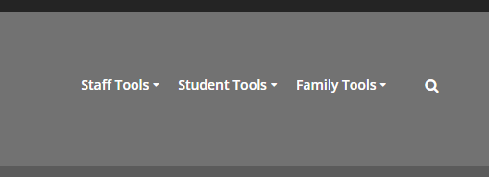
Time Keeper
Daily Log In – https://www.duplinschools.net/
Access TimeKeeper through the DCS website. Drop down Staff Tools and select TimeKeeper.
All employees are required to clock in when reporting to work for attendance purposes.
Employees may not clock each other in or out.
Notes:
Duplin County Schools uses an electronic timekeeping system for all employees. It is called Time Keeper. You can only access Time Keeper from a computer connected to the network in a Duplin County Schools building.
There are two types of employees –
Exempt employees (exempt from earning overtime) are paid the same salary every month no matter how many hours they work. They are expected to work until the job is done. There are only variations in pay for assigned extra duty pay, bonuses, leave without pay, etc. Teachers are exempt employees. Exempt employees only clock in to record their attendance for the day.
Nonexempt employees (earn overtime) are paid for every hour they work, because they earn overtime when they work over 40 hours in a week. Nonexempt employees clock in and clock out to track their hours. Teacher assistants and custodians are examples of non-exempt employees.
Each employee must clock themselves in. We are not allowed to clock each other in or out.
Access Time Keeper either through a shared computer in a common area, or from your own computer. The Time Keeper button is located near the bottom of the DCS homepage.

Slide 5
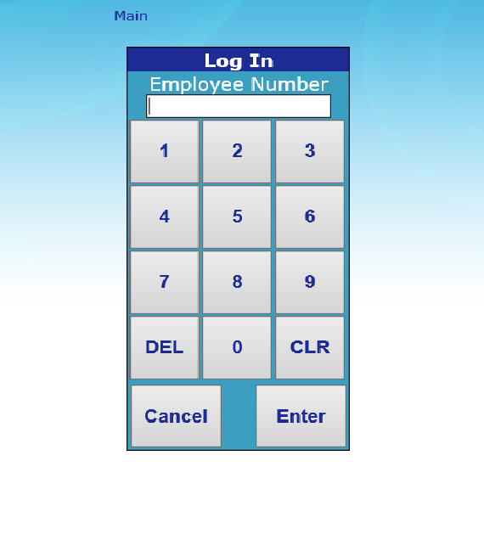
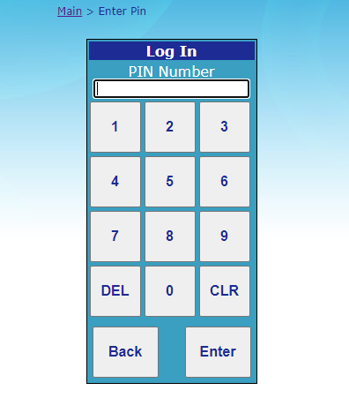
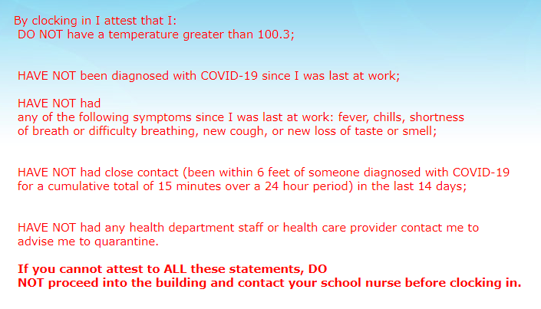

Time Keeper
Clocking In
1
Your school Bookkeeper will provide you with your employee number and PIN.
1) Key in your employee number and click “Enter”
2) Key in your PIN and click “Enter”
*Your first time pin will be your employee number. It will then prompt you to change your password. It can not start with a zero or be consecutive numbers. 1.2.3.4.
2
3

Slide 6
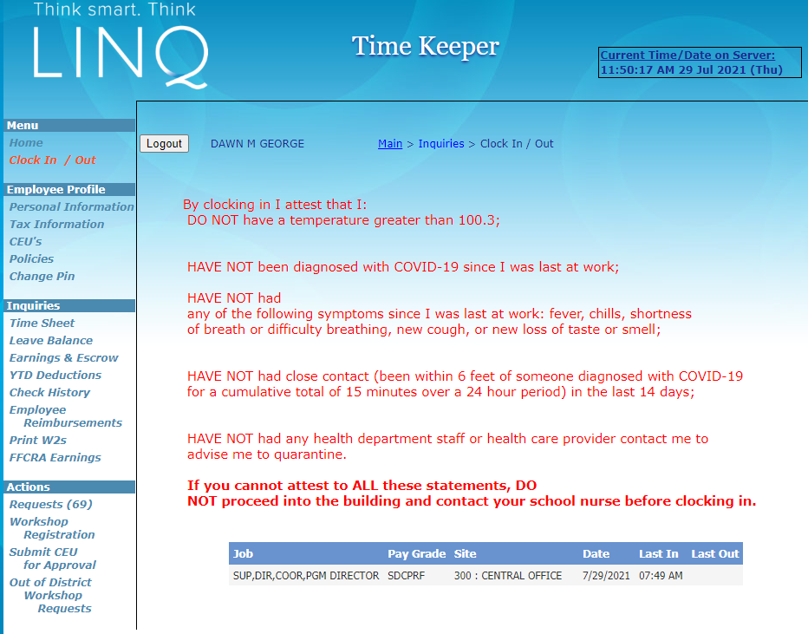
Time Keeper
Main Menu
Access the Time Keeper Main Menu by logging in with your employee number and PIN.
The Main Menu is on the left side of the screen.
Notes:
All the rest of the features we will discuss are accessed from the Time Keeper main menu. To access the main menu, you will log into Time Keeper just like you do when you are clocking in. The main menu is located on the left side of the screen.

Slide 7
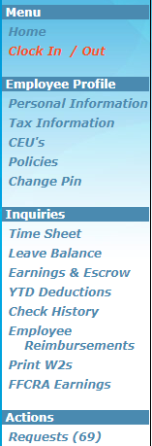
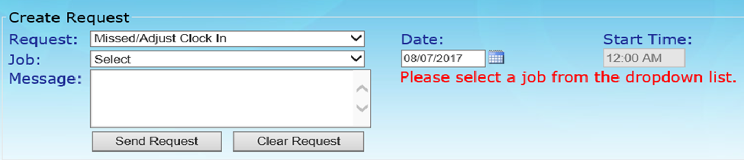



Time Keeper
Missed Clock Ins
From the Main Menu, click on “Requests” to access the Create Request screen.
Using the drop down menus, choose the type of request (Missed/Adjust Clock In) and the correct Job.
Type in or pick the correct date from the calendar.
Type in the correct start time. AM/PM
Enter a message to the Bookkeeper if needed.
Click “Send Request”
Notes:
Occasionally you may forget to clock in. To fix this, you will submit a “Missed Clock In Request” through timekeeper.
The request is routed to your school bookkeeper who will adjust your clock in.

Slide 8
Time Keeper
Time Sheets
Employees should review time sheets weekly to ensure no clock ins are missing and confirm that the appropriate leave (if any) has been entered for you.
Click on “Time Sheet” to bring up the current week’s time sheet.
Notes:
You can also review your time sheet through Time Keeper. You should review your timesheet weekly to make sure you haven’t missed any clock ins. Also, if you have submitted a leave request, you should check your timesheet to make sure the request has been entered correctly.

Slide 9
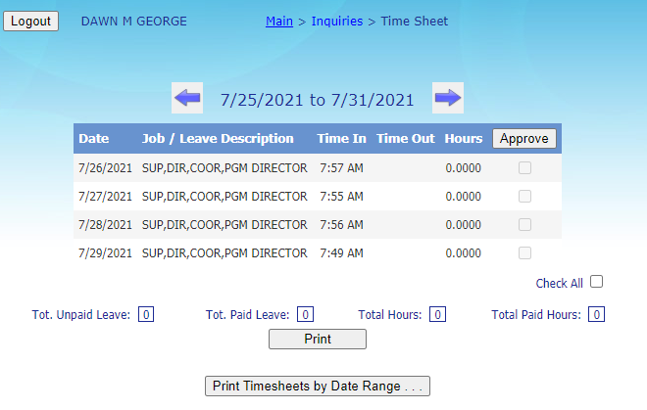

Time Keeper
Time Sheets (continued)
Use the arrows next to the dates at the top to change the week displayed on the screen.
Use the “Print” button to print the current displayed timesheet.
Click the “Print Timesheets by Date Range” button to run a report for a specific date range.
Your Bookkeeper can assist you with any questions you may have related to your time sheet.

Slide 10
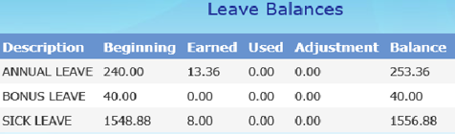
Time Keeper
Leave Balance
From the Main Menu, click on “Leave Balance” to view your leave information.
Leave is displayed in HOURS.
Annual and Sick Leave can only be taken in half and whole day increments. Other restrictions on leave use apply. Check with your Bookkeeper or for more information.
Notes:
You can check your leave balances through Time Keeper. Remember that leave balances are displayed in HOURS. If you are a Teacher, to determine how many days you have, divide your leave balance by 7.5, which is the standard number of hours Teacher per day for a Teacher.
There are restrictions on how and when leave can be taken.
Annual and Sick Leave can only be taken in half or whole day increments.
Annual Leave for 10 month employees can only be taken when students are not in session. 10 Annual Leave days are built into the school calendar and you can only take them on these days.
If you receive any other type of Leave, be sure to check with your school Bookkeeper for any restrictions on using the Leave before you schedule it.

Slide 11
Time Keeper
Leave Accrual Rates
Vacation (annual) leave accrual rates depend on years of service. To calculate, use your normal number of hours worked per day x monthly accrual rate. For new Teachers, this is 7.5 hours worked per day x 1.17 monthly accrual rate = 8.77 leave hours accrued per month.
A new 10 month employee earns about 10 vacation (annual) leave days a year which are built into the school calendar.
Sick leave accrual rate is 1 day per month.
Teachers who require substitutes also earn 2 personal days a year (.20 day each month).
Notes:
Most types of leave are accrued on a monthly basis.
Vacation (or Annual) Leave accrual rates depend on years of service. The chart shown below is the standard chart from the State of North Carolina. It is a little confusing for Teachers because it is based on the State standard which is an 8 hour workday but Teacher pay is calculated on 7.5 hours per day.
A new 10-month employee hired at the beginning of the school year earns about 10 days a year, which are built into the school calendar.
Teachers also earn 2 Personal Leave days each year at an accrual rate of .20 days per month. Be sure to schedule your personal leave days in advance.
This year, our Board of Education has also granted each employee who is hired at the beginning of the school year 4 days of Wellness Leave which follow the same use rules as Annual Leave. Wellness Leave cannot be used when students are in session, but can be used on Optional Teacher Workdays. (Employees who are hired later in the year will earn a prorated number of Wellness Leave days.)

Slide 12
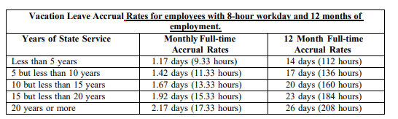
Time Keeper
Leave Accrual Rates
Years of State Service | Monthly Accrual at 7.5 hours | 10 Month Full-time
Less than 5 years | 1.17 days (8.78 hours) | 11.71 days (87.80 hours)
5 but less than 10 years | 1.42 days (10.65 hours) | 14.20 days (106.50 hours)
10 but less than 15 years | 1.67 days (12.53 hours) | 16.71 days (125.30 hours)
15 but less than 20 years | 1.92 days (14.40 hours) | 19.20 days (144.00 hours)
20 years or more | 2.17 days (16.28 hours) | 21.71 days (162.80 hours)
Notes:
Most types of leave are accrued on a monthly basis.
Vacation (or Annual) Leave accrual rates depend on years of service. The chart shown below is the standard chart from the State of North Carolina. It is a little confusing for Teachers because it is based on the State standard which is an 8 hour workday but Teacher pay is calculated on 7.5 hours per day.
A new 10-month employee hired at the beginning of the school year earns about 10 days a year, which are built into the school calendar.
Teachers also earn 2 Personal Leave days each year at an accrual rate of .20 days per month. Be sure to schedule your personal leave days in advance.
This year, our Board of Education has also granted each employee who is hired at the beginning of the school year 4 days of Wellness Leave which follow the same use rules as Annual Leave. Wellness Leave cannot be used when students are in session, but can be used on Optional Teacher Workdays. (Employees who are hired later in the year will earn a prorated number of Wellness Leave days.)

Slide 13

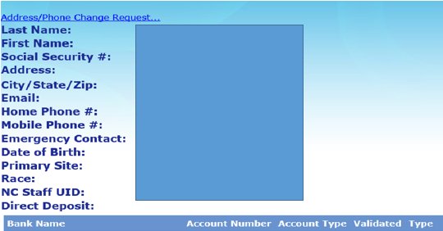
Time Keeper
Personal Information
From the Main Menu, click on “Personal Information” to view your information.
Employees can easily submit a change of address or phone number by clicking on the link at the top of the Personal Information screen.

Slide 14
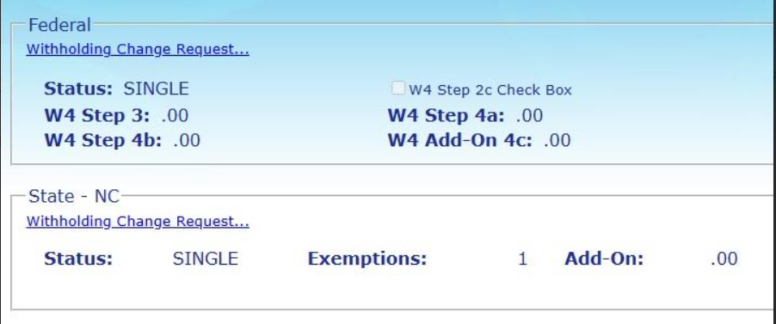

Time Keeper
Tax Information
From the Main Menu, click on “Tax Information” to view your information.
Tax Information displayed is the most recent information on file in payroll. Please review and if you would like to make any changes the “Withholding Change Request” link can be used to submit a request.
Bookkeepers and Payroll specialists can not provide tax advice.
Notes:
Your initial tax information will be entered into Payroll based on the forms you fill out as part of your new hire process. If you need to make any changes later, you will use the Tax Information feature of Time Keeper.
The Time Keeper system doesn’t have the complete form but will only ask you for the information contained in certain boxes of the W-4 or NC-4. Tax forms can be complicated so I would advise you, before you log in to make this change, pull down a W-4 or NC-4 from the internet and complete it. It will make this process go much smoother!

Slide 15
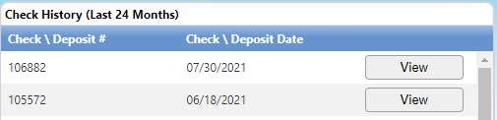
Time Keeper
Check History
From the Main Menu, click on “Check History” to view the last 24 months of checks.
You may have more than one check in the same month if it is a supplement month, you worked extra duty, etc.
Checks are usually available for viewing 3 to 4 days prior to pay day. If you see an error or have a question please contact your Bookkeeper.
Remember if you are a 10 month employee you are prepaid.
Your first check on Aug 31st will cover Aug 10th thru Sept 8^{th at noon}.
Your last check on May 28th will cover May 6^{th at noon} thru June 4TH.
Notes:
Time Keeper can also be used to view your check stubs prior to payday. 24 months of checks are visible in the system.
Usually, checks become visible 3 days prior to payday. We encourage everyone to look at their checks prior to payday. If there are any errors, or if you have any questions, please ask your school bookkeeper for help. The earlier we know of errors, the easier it is to fix them.
Very important to remember that 10 month employees are prepaid. Your first check on August 31st will pay you for August 6th through September 6th. Your last check on May 31st will pay you from Jay 5th to June 3rd. You will receive 10 paychecks each school year.
This means you will not receive a check in June or July. Please plan ahead! The State has discontinued the installment pay system which allowed us to spread 10 month paychecks over 12 months, but we are still allowed to work with banking institutions to set up payroll deductions for employees who have savings accounts. If you are interested in this option, contact your banking institution to see if they offer this service. If so, the bank will need to submit a form to us requesting a payroll deduction be set up. We will then automatically take the deduction each month and send the funds directly to the banking institution.

Slide 16
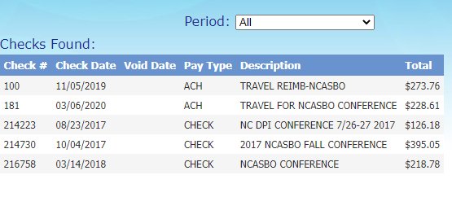
Time Keeper
Employee Reimbursements (Accounts Payable)
From the Main Menu, click on “Employee Reimbursements” to view information about any employee expense reimbursements you have received.
Notes:
Employee expense reimbursements are also visible through Time Keeper. Employee expense reimbursements are processed through either ACH or check. If you don’t specify a preference on the reimbursement form, we will default to check.

Slide 17
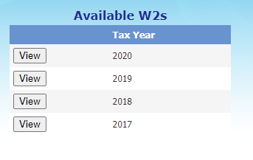
Time Keeper
W2s
From the Main Menu, click on “Print W2s” to view previous year W2s.
W2s are produced each January for the previous calendar year.
Notes:
W2s are also available through Time Keeper. You will receive a paper copy of your W2 from your school bookkeeper, but you can also print a copy from the Time Keeper system. This feature is very useful if you ever need a duplicate W2 for a loan or any other reason.

Slide 18
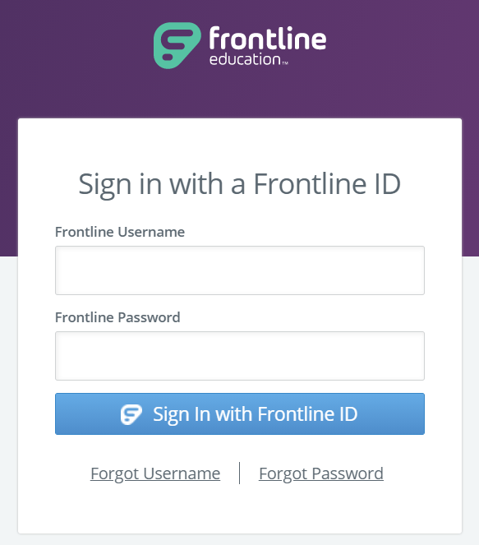
NOT Time Keeper
Leave Requests
Certified Employees use Frontline Professional Growth to request leave and schedule substitutes.
Leave is routed electronically for approval.
You will receive additional training on how to access and use the Frontline system.

Slide 19
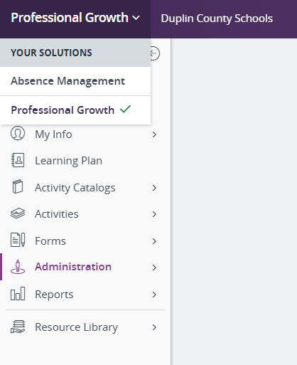
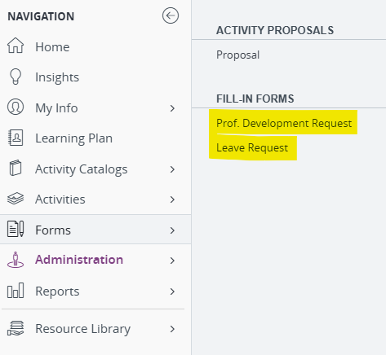
Frontline – Professional Growth
Leave Requests
Professional Growth Leave Requests are MANDATORY for all Certified staff when requesting any type of Leave.
Professional Growth Professional Development Requests when required must be completed on the correct form. (You will receive further training)

Slide 20

Questions?

