Slide 1


Welcome
MSBSD Migrant Education Program
Parent Advisory Council Meeting
2026 Comprehensive Needs Assessment
"Your voice helps shape our Migrant Education Program"

Slide 2

Why We’re Here
Your Voice Shapes Our Program
We are here to listen. As parents and family members, you know your children best, and your feedback helps us make informed decisions about the services and supports we provide.
Together, we can identify priorities, build on our strengths, and ensure the Migrant Education Program continues to meet the unique needs of our students and families.

Slide 3
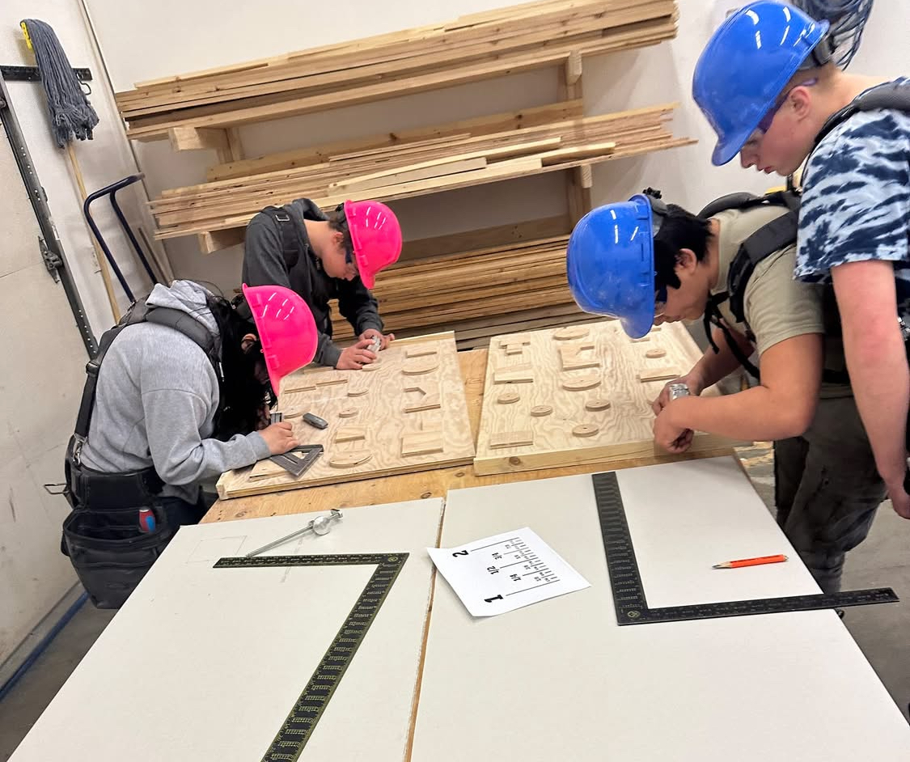
Program Goals
Fostering Academic Excellence
Provide migratory students with supplemental high-quality educational services.
starIncrease Academic Achievement
trending_upPromote Consistent Progress & Success (even after graduation)

Slide 4
What is the
Migrant Education Program?
Serves eligible migratory children birth through age 20
Supports academic success
Helps reduce the impact of educational interruptions
Works with families to remove barriers to success

Slide 5
Eligibility
Children birth to 20 years old who have not graduated from high school.
They travel or move with a parent for commercial fishing, subsistence fishing, berry picking, logging, or farming.
The move or travel is minimum of 7 nights & 8 days over the course of a year.
In MSBSD, must be a minimum of 20 miles from the child’s home.

Slide 6
Services for Approximately 2,800 eligible migrant students
High School Success Coaching
Summer Program Opportunities
Educational Resources
Swimming Lessons
Free Breakfast & Lunch
Preschool
Before or After School Tutoring
Nutrition, Health & Safety Education
Small Group Supplemental Support
Notes:
Tammy

Slide 7

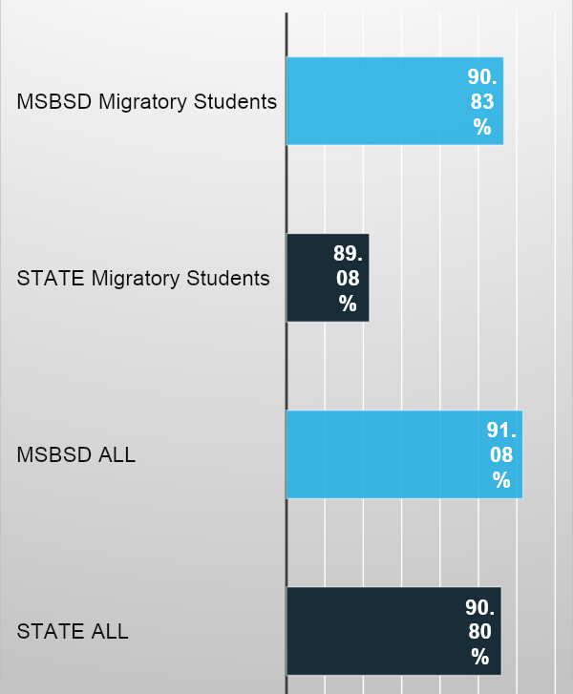



Performance Metric
Migrant
Attendance
Comparative analysis of student attendance rates across MSBSD and State levels.

Slide 8
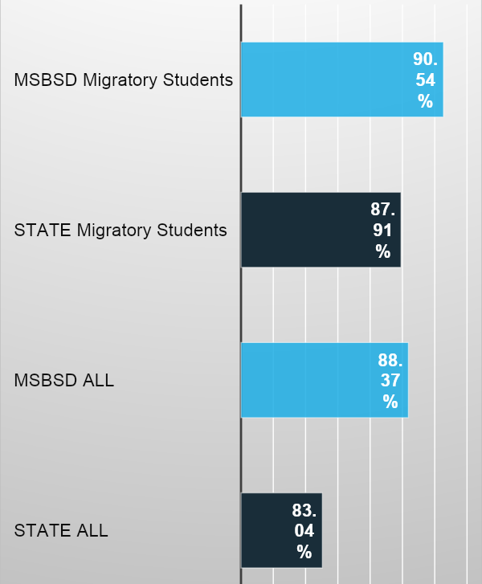
Performance Metric
Migrant
Graduation
Comparative analysis of student graduation rates across MSBSD and State levels.

Slide 9

Title I, Part C Needs Assessment Survey Results

Slide 10
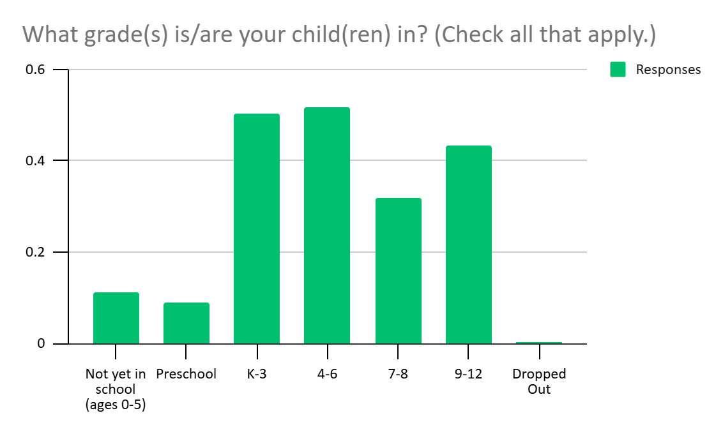
2025 State Needs Assessment 257 Participants
Notes:
https://www2.ed.gov/policy/elsec/leg/esea02/pg21.html
(2) STATE ALLOTMENTS-
(A) HOLD HARMLESS-
(i) IN GENERAL- Subject to subparagraph (B), from the funds appropriated under section 2103(a) for any fiscal year and not reserved under paragraph (1), the Secretary shall allot to each of the 50 States, the District of Columbia, and the Commonwealth of Puerto Rico an amount equal to the total amount that such State received for fiscal year 2001 under —
(I) section 2202(b) of this Act (as in effect on the day before the date of enactment of the No Child Left Behind Act of 2001); and
(II) section 306 of the Department of Education Appropriations Act, 2001 (as enacted into law by section 1(a)(1) of Public Law 106-554).
(ii) RATABLE REDUCTION- If the funds described in clause (i) are insufficient to pay the full amounts that all States are eligible to receive under clause (i) for any fiscal year, the Secretary shall ratably reduce those amounts for the fiscal year.

Slide 11
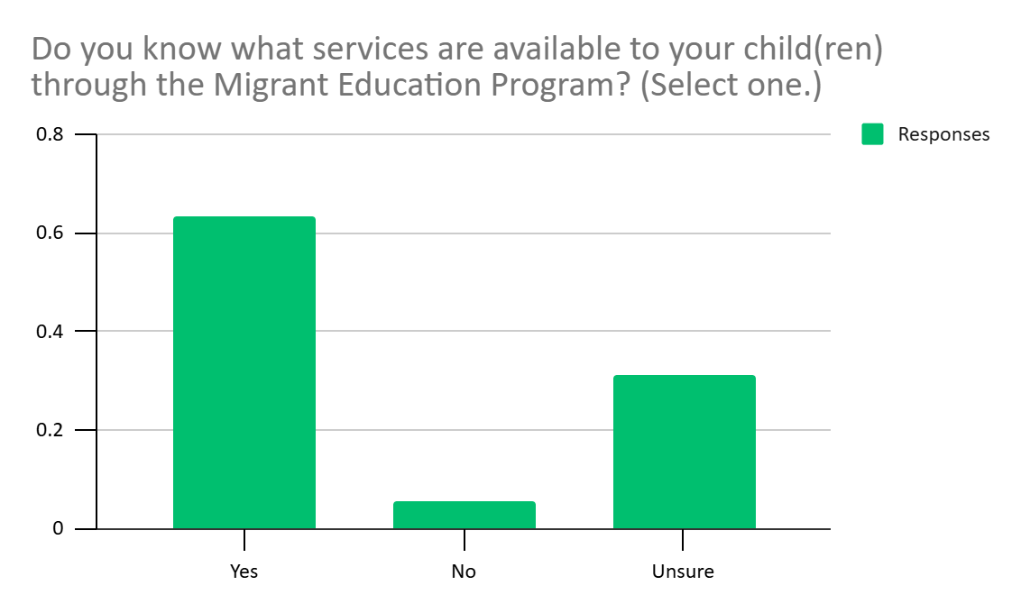
2025 State Needs Assessment 257 Participants
Notes:
https://www2.ed.gov/policy/elsec/leg/esea02/pg21.html
(2) STATE ALLOTMENTS-
(A) HOLD HARMLESS-
(i) IN GENERAL- Subject to subparagraph (B), from the funds appropriated under section 2103(a) for any fiscal year and not reserved under paragraph (1), the Secretary shall allot to each of the 50 States, the District of Columbia, and the Commonwealth of Puerto Rico an amount equal to the total amount that such State received for fiscal year 2001 under —
(I) section 2202(b) of this Act (as in effect on the day before the date of enactment of the No Child Left Behind Act of 2001); and
(II) section 306 of the Department of Education Appropriations Act, 2001 (as enacted into law by section 1(a)(1) of Public Law 106-554).
(ii) RATABLE REDUCTION- If the funds described in clause (i) are insufficient to pay the full amounts that all States are eligible to receive under clause (i) for any fiscal year, the Secretary shall ratably reduce those amounts for the fiscal year.

Slide 12


What Families Value Most About Migrant Education
Parent Survey Highlights (Spring 2025)
Parents shared that the Migrant Education Program makes a meaningful difference by providing:
Academic Support
Tutoring, books, literacy events, Success Coaches, and summer learning opportunities.
📚
Basic Needs Assistance
Free/reduced meals, school supplies, backpacks, winter gear, and reduced activity/sports fees.
🍎
Safety & Life Skills
Swimming lessons, life jackets, CPR/First Aid, babysitting certification, hunter education, and outdoor safety.
🌊
Support for Alaska's Subsistence Lifestyle
Fishing, foraging, food preservation, canning, and subsistence equipment/resources.
🐟
Family Engagement
Family nights, book fairs, enrichment activities, and caring staff who support both students and families.
👨‍👩‍👧‍👦
Notes:
https://www2.ed.gov/policy/elsec/leg/esea02/pg21.html
(2) STATE ALLOTMENTS-
(A) HOLD HARMLESS-
(i) IN GENERAL- Subject to subparagraph (B), from the funds appropriated under section 2103(a) for any fiscal year and not reserved under paragraph (1), the Secretary shall allot to each of the 50 States, the District of Columbia, and the Commonwealth of Puerto Rico an amount equal to the total amount that such State received for fiscal year 2001 under —
(I) section 2202(b) of this Act (as in effect on the day before the date of enactment of the No Child Left Behind Act of 2001); and
(II) section 306 of the Department of Education Appropriations Act, 2001 (as enacted into law by section 1(a)(1) of Public Law 106-554).
(ii) RATABLE REDUCTION- If the funds described in clause (i) are insufficient to pay the full amounts that all States are eligible to receive under clause (i) for any fiscal year, the Secretary shall ratably reduce those amounts for the fiscal year.

Slide 13
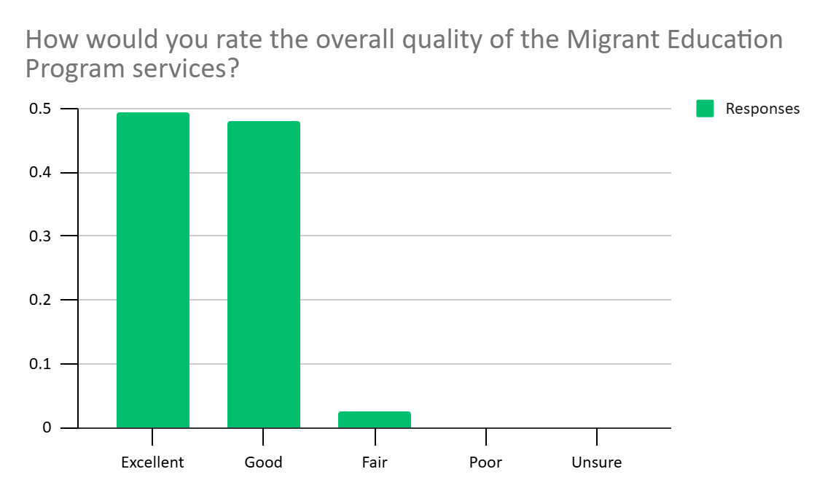
2025 State Needs Assessment 257 Participants
Notes:
https://www2.ed.gov/policy/elsec/leg/esea02/pg21.html
(2) STATE ALLOTMENTS-
(A) HOLD HARMLESS-
(i) IN GENERAL- Subject to subparagraph (B), from the funds appropriated under section 2103(a) for any fiscal year and not reserved under paragraph (1), the Secretary shall allot to each of the 50 States, the District of Columbia, and the Commonwealth of Puerto Rico an amount equal to the total amount that such State received for fiscal year 2001 under —
(I) section 2202(b) of this Act (as in effect on the day before the date of enactment of the No Child Left Behind Act of 2001); and
(II) section 306 of the Department of Education Appropriations Act, 2001 (as enacted into law by section 1(a)(1) of Public Law 106-554).
(ii) RATABLE REDUCTION- If the funds described in clause (i) are insufficient to pay the full amounts that all States are eligible to receive under clause (i) for any fiscal year, the Secretary shall ratably reduce those amounts for the fiscal year.

Slide 14
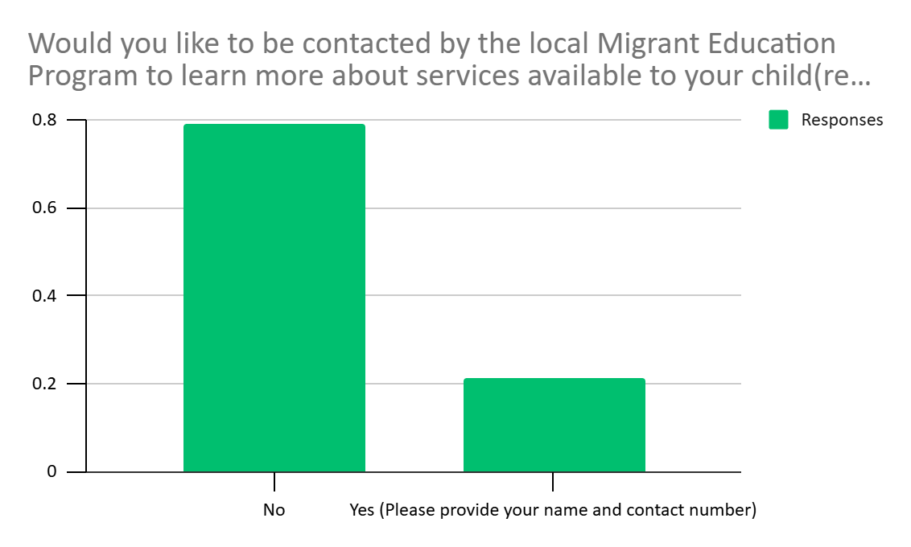
2025 State Needs Assessment 257 Participants
Notes:
https://www2.ed.gov/policy/elsec/leg/esea02/pg21.html
(2) STATE ALLOTMENTS-
(A) HOLD HARMLESS-
(i) IN GENERAL- Subject to subparagraph (B), from the funds appropriated under section 2103(a) for any fiscal year and not reserved under paragraph (1), the Secretary shall allot to each of the 50 States, the District of Columbia, and the Commonwealth of Puerto Rico an amount equal to the total amount that such State received for fiscal year 2001 under —
(I) section 2202(b) of this Act (as in effect on the day before the date of enactment of the No Child Left Behind Act of 2001); and
(II) section 306 of the Department of Education Appropriations Act, 2001 (as enacted into law by section 1(a)(1) of Public Law 106-554).
(ii) RATABLE REDUCTION- If the funds described in clause (i) are insufficient to pay the full amounts that all States are eligible to receive under clause (i) for any fiscal year, the Secretary shall ratably reduce those amounts for the fiscal year.

Slide 15
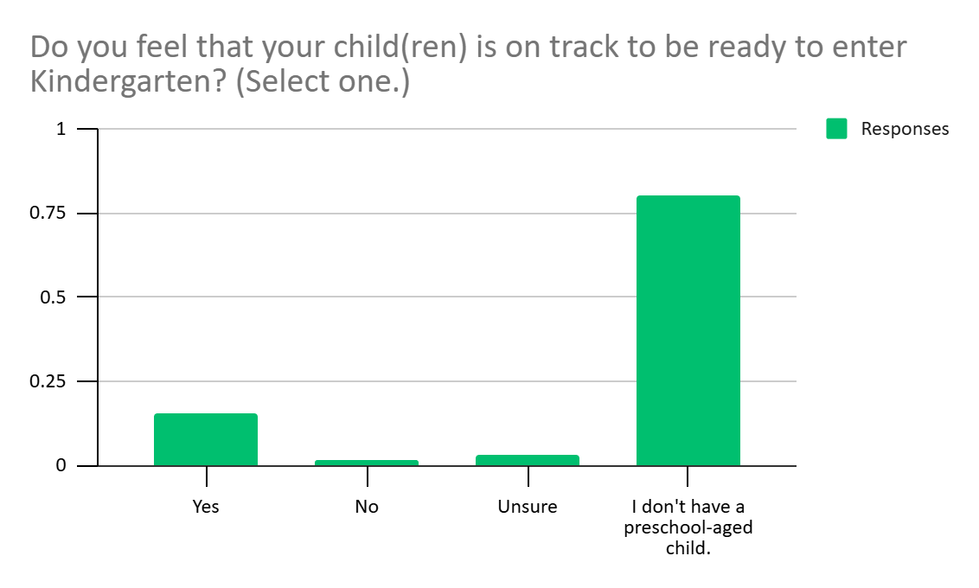
2025 State Needs Assessment 257 Participants
Notes:
https://www2.ed.gov/policy/elsec/leg/esea02/pg21.html
(2) STATE ALLOTMENTS-
(A) HOLD HARMLESS-
(i) IN GENERAL- Subject to subparagraph (B), from the funds appropriated under section 2103(a) for any fiscal year and not reserved under paragraph (1), the Secretary shall allot to each of the 50 States, the District of Columbia, and the Commonwealth of Puerto Rico an amount equal to the total amount that such State received for fiscal year 2001 under —
(I) section 2202(b) of this Act (as in effect on the day before the date of enactment of the No Child Left Behind Act of 2001); and
(II) section 306 of the Department of Education Appropriations Act, 2001 (as enacted into law by section 1(a)(1) of Public Law 106-554).
(ii) RATABLE REDUCTION- If the funds described in clause (i) are insufficient to pay the full amounts that all States are eligible to receive under clause (i) for any fiscal year, the Secretary shall ratably reduce those amounts for the fiscal year.

Slide 16
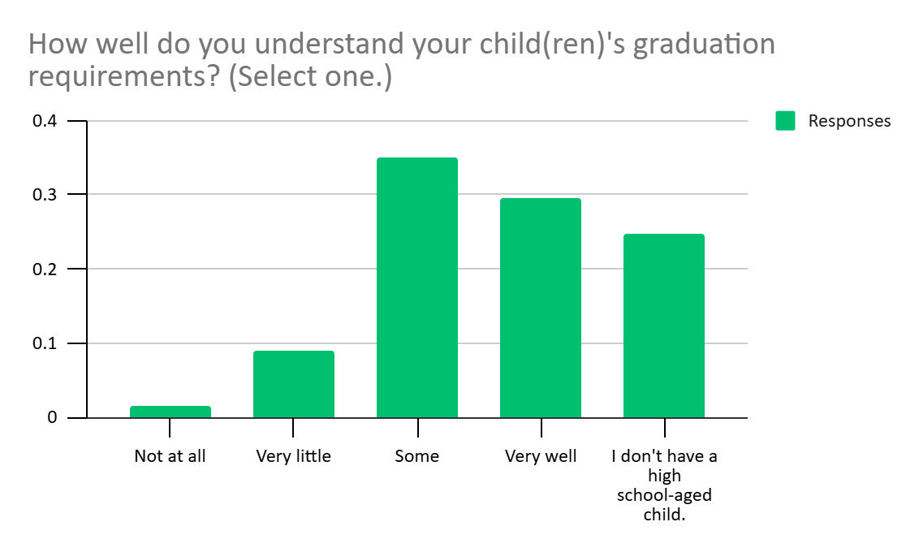
2025 State Needs Assessment 257 Participants
Notes:
https://www2.ed.gov/policy/elsec/leg/esea02/pg21.html
(2) STATE ALLOTMENTS-
(A) HOLD HARMLESS-
(i) IN GENERAL- Subject to subparagraph (B), from the funds appropriated under section 2103(a) for any fiscal year and not reserved under paragraph (1), the Secretary shall allot to each of the 50 States, the District of Columbia, and the Commonwealth of Puerto Rico an amount equal to the total amount that such State received for fiscal year 2001 under —
(I) section 2202(b) of this Act (as in effect on the day before the date of enactment of the No Child Left Behind Act of 2001); and
(II) section 306 of the Department of Education Appropriations Act, 2001 (as enacted into law by section 1(a)(1) of Public Law 106-554).
(ii) RATABLE REDUCTION- If the funds described in clause (i) are insufficient to pay the full amounts that all States are eligible to receive under clause (i) for any fiscal year, the Secretary shall ratably reduce those amounts for the fiscal year.

Slide 17

What Families Value Most About Migrant Education
Parent Survey Highlights (Spring 2025)
Families identified these as their greatest concerns:
📖 Academic Success
Reading, math, writing, tutoring, and ensuring students receive the support they need to stay on track.
🎓 Graduation & Readiness
Meeting graduation requirements, preparing for college/careers, and accessing postsecondary opportunities.
❤️ Student Well-Being
Motivation, attendance, mental health, bullying, and maintaining a positive, safe learning environment.
👩‍🏫 School Support
Access to quality teachers, manageable class sizes, one-on-one support, and unique learning needs services.
🚌 Access & Resources
Transportation, school supplies, technology, meals, and opportunities for extracurricular involvement.
🐟 School & Family Life
Managing absences for subsistence activities while helping students keep up with coursework.
Key Takeaway: Parents want strong academic support, caring school environments, and equitable access to resources so every student can succeed in school and be prepared for life after graduation.
Notes:
https://www2.ed.gov/policy/elsec/leg/esea02/pg21.html
(2) STATE ALLOTMENTS-
(A) HOLD HARMLESS-
(i) IN GENERAL- Subject to subparagraph (B), from the funds appropriated under section 2103(a) for any fiscal year and not reserved under paragraph (1), the Secretary shall allot to each of the 50 States, the District of Columbia, and the Commonwealth of Puerto Rico an amount equal to the total amount that such State received for fiscal year 2001 under —
(I) section 2202(b) of this Act (as in effect on the day before the date of enactment of the No Child Left Behind Act of 2001); and
(II) section 306 of the Department of Education Appropriations Act, 2001 (as enacted into law by section 1(a)(1) of Public Law 106-554).
(ii) RATABLE REDUCTION- If the funds described in clause (i) are insufficient to pay the full amounts that all States are eligible to receive under clause (i) for any fiscal year, the Secretary shall ratably reduce those amounts for the fiscal year.

Slide 18
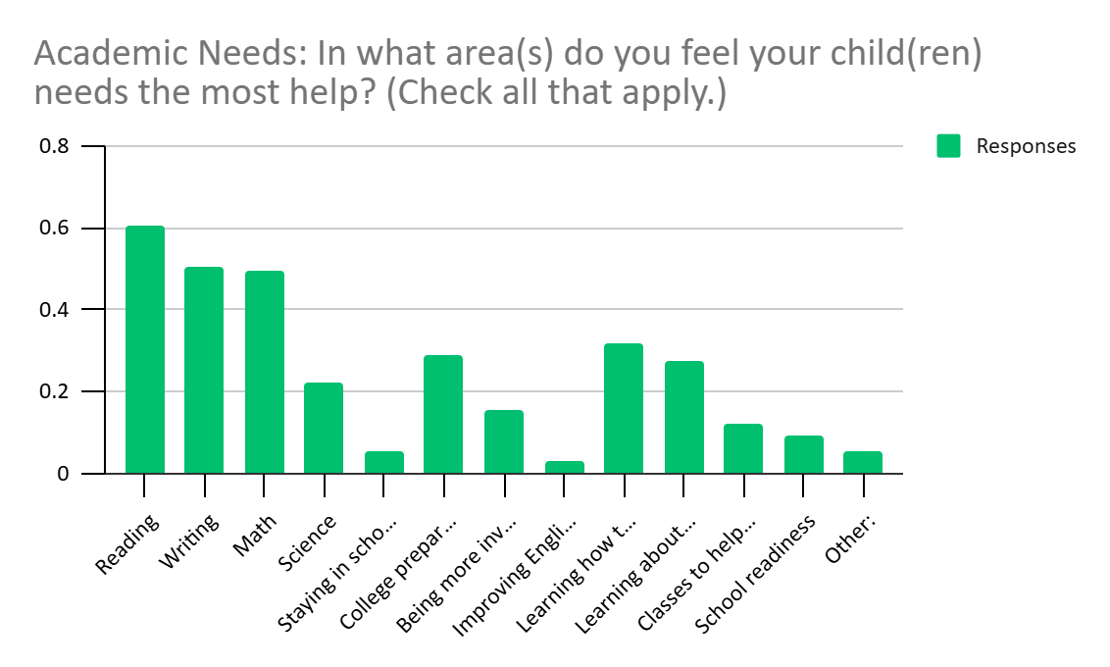
2025 State Needs Assessment 257 Participants
Notes:
https://www2.ed.gov/policy/elsec/leg/esea02/pg21.html
(2) STATE ALLOTMENTS-
(A) HOLD HARMLESS-
(i) IN GENERAL- Subject to subparagraph (B), from the funds appropriated under section 2103(a) for any fiscal year and not reserved under paragraph (1), the Secretary shall allot to each of the 50 States, the District of Columbia, and the Commonwealth of Puerto Rico an amount equal to the total amount that such State received for fiscal year 2001 under —
(I) section 2202(b) of this Act (as in effect on the day before the date of enactment of the No Child Left Behind Act of 2001); and
(II) section 306 of the Department of Education Appropriations Act, 2001 (as enacted into law by section 1(a)(1) of Public Law 106-554).
(ii) RATABLE REDUCTION- If the funds described in clause (i) are insufficient to pay the full amounts that all States are eligible to receive under clause (i) for any fiscal year, the Secretary shall ratably reduce those amounts for the fiscal year.

Slide 19
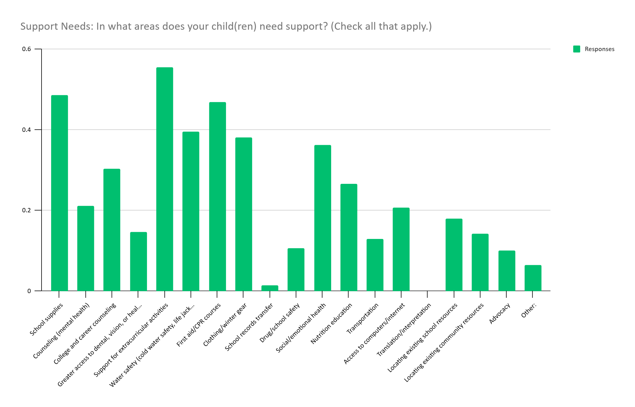
2025 State Needs Assessment 257 Participants
Notes:
https://www2.ed.gov/policy/elsec/leg/esea02/pg21.html
(2) STATE ALLOTMENTS-
(A) HOLD HARMLESS-
(i) IN GENERAL- Subject to subparagraph (B), from the funds appropriated under section 2103(a) for any fiscal year and not reserved under paragraph (1), the Secretary shall allot to each of the 50 States, the District of Columbia, and the Commonwealth of Puerto Rico an amount equal to the total amount that such State received for fiscal year 2001 under —
(I) section 2202(b) of this Act (as in effect on the day before the date of enactment of the No Child Left Behind Act of 2001); and
(II) section 306 of the Department of Education Appropriations Act, 2001 (as enacted into law by section 1(a)(1) of Public Law 106-554).
(ii) RATABLE REDUCTION- If the funds described in clause (i) are insufficient to pay the full amounts that all States are eligible to receive under clause (i) for any fiscal year, the Secretary shall ratably reduce those amounts for the fiscal year.

Slide 20
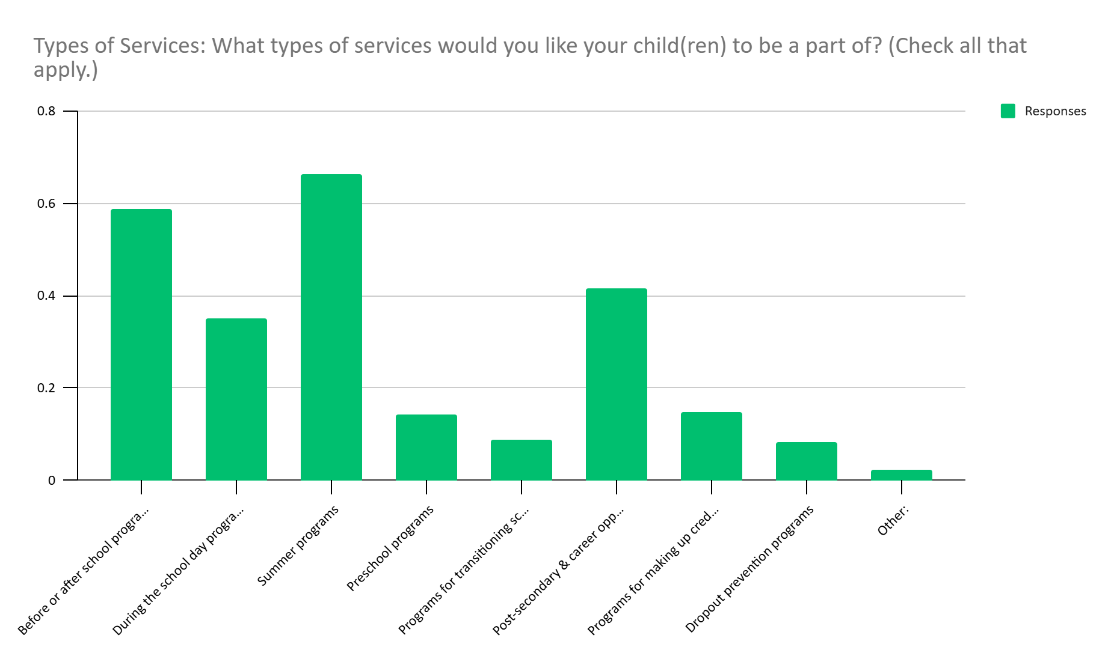
2025 State Needs Assessment 257 Participants
Notes:
https://www2.ed.gov/policy/elsec/leg/esea02/pg21.html
(2) STATE ALLOTMENTS-
(A) HOLD HARMLESS-
(i) IN GENERAL- Subject to subparagraph (B), from the funds appropriated under section 2103(a) for any fiscal year and not reserved under paragraph (1), the Secretary shall allot to each of the 50 States, the District of Columbia, and the Commonwealth of Puerto Rico an amount equal to the total amount that such State received for fiscal year 2001 under —
(I) section 2202(b) of this Act (as in effect on the day before the date of enactment of the No Child Left Behind Act of 2001); and
(II) section 306 of the Department of Education Appropriations Act, 2001 (as enacted into law by section 1(a)(1) of Public Law 106-554).
(ii) RATABLE REDUCTION- If the funds described in clause (i) are insufficient to pay the full amounts that all States are eligible to receive under clause (i) for any fiscal year, the Secretary shall ratably reduce those amounts for the fiscal year.

Slide 21
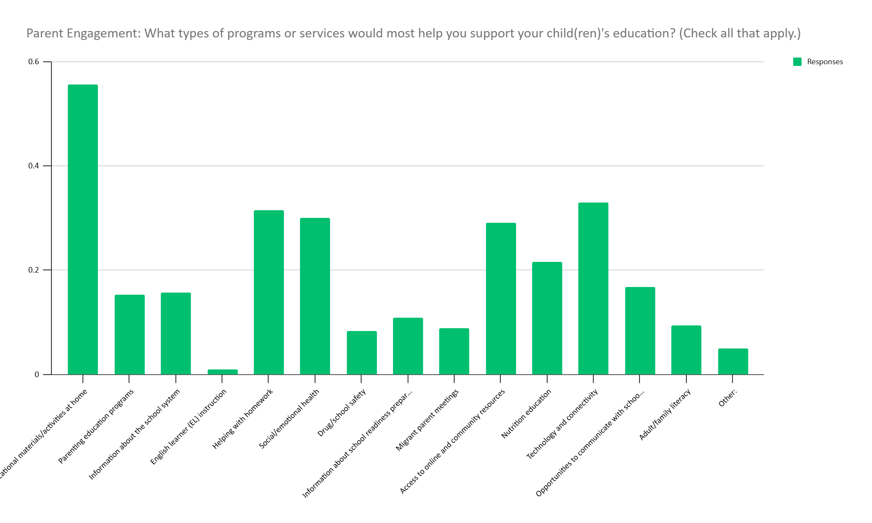
2025 State Needs Assessment 257 Participants
Notes:
https://www2.ed.gov/policy/elsec/leg/esea02/pg21.html
(2) STATE ALLOTMENTS-
(A) HOLD HARMLESS-
(i) IN GENERAL- Subject to subparagraph (B), from the funds appropriated under section 2103(a) for any fiscal year and not reserved under paragraph (1), the Secretary shall allot to each of the 50 States, the District of Columbia, and the Commonwealth of Puerto Rico an amount equal to the total amount that such State received for fiscal year 2001 under —
(I) section 2202(b) of this Act (as in effect on the day before the date of enactment of the No Child Left Behind Act of 2001); and
(II) section 306 of the Department of Education Appropriations Act, 2001 (as enacted into law by section 1(a)(1) of Public Law 106-554).
(ii) RATABLE REDUCTION- If the funds described in clause (i) are insufficient to pay the full amounts that all States are eligible to receive under clause (i) for any fiscal year, the Secretary shall ratably reduce those amounts for the fiscal year.

Slide 22



Parent Survey Results: Feedback for the Migrant Education Program
Parent Survey Highlights (Spring 2025)
Families shared appreciation for the program while offering ideas for continued growth.
🌟 What Families Appreciate
Strong academic, social, and family support
Caring staff and Success Coaches
Book programs, literacy events, winter gear, and swim lessons
Summer learning opportunities and enrichment activities
Overall gratitude for the positive impact on students and families
Post graduation planning and connections
💡 Suggestions for Improvement
Expand tutoring and before/after-school learning opportunities
Increase communication and outreach about available services
Offer more summer programs, outdoor learning, and cultural experiences
Increase opportunities for students to connect through field trips
Continue expanding access to resources across all schools
Key Takeaway
Parents overwhelmingly value the Migrant Education Program and encourage continued investment in academic support, communication, and enriching opportunities that help students succeed.
Notes:
https://www2.ed.gov/policy/elsec/leg/esea02/pg21.html
(2) STATE ALLOTMENTS-
(A) HOLD HARMLESS-
(i) IN GENERAL- Subject to subparagraph (B), from the funds appropriated under section 2103(a) for any fiscal year and not reserved under paragraph (1), the Secretary shall allot to each of the 50 States, the District of Columbia, and the Commonwealth of Puerto Rico an amount equal to the total amount that such State received for fiscal year 2001 under —
(I) section 2202(b) of this Act (as in effect on the day before the date of enactment of the No Child Left Behind Act of 2001); and
(II) section 306 of the Department of Education Appropriations Act, 2001 (as enacted into law by section 1(a)(1) of Public Law 106-554).
(ii) RATABLE REDUCTION- If the funds described in clause (i) are insufficient to pay the full amounts that all States are eligible to receive under clause (i) for any fiscal year, the Secretary shall ratably reduce those amounts for the fiscal year.

Slide 23
What Does the MEP Alaska State Service Delivery Plan Focus On
Academic Success
Reading
Writing
Math
School Engagement
Attendance
Graduation
Credit completion
Educational Continuity
Students moving between schools
Summer learning
Preschool transitions
College & Career Readiness
Career exploration
Postsecondary planning
Scholarships
CTE
Family Engagement
Communication
Parent training
Family events
Notes:
https://www2.ed.gov/policy/elsec/leg/esea02/pg21.html
(2) STATE ALLOTMENTS-
(A) HOLD HARMLESS-
(i) IN GENERAL- Subject to subparagraph (B), from the funds appropriated under section 2103(a) for any fiscal year and not reserved under paragraph (1), the Secretary shall allot to each of the 50 States, the District of Columbia, and the Commonwealth of Puerto Rico an amount equal to the total amount that such State received for fiscal year 2001 under —
(I) section 2202(b) of this Act (as in effect on the day before the date of enactment of the No Child Left Behind Act of 2001); and
(II) section 306 of the Department of Education Appropriations Act, 2001 (as enacted into law by section 1(a)(1) of Public Law 106-554).
(ii) RATABLE REDUCTION- If the funds described in clause (i) are insufficient to pay the full amounts that all States are eligible to receive under clause (i) for any fiscal year, the Secretary shall ratably reduce those amounts for the fiscal year.

Slide 24
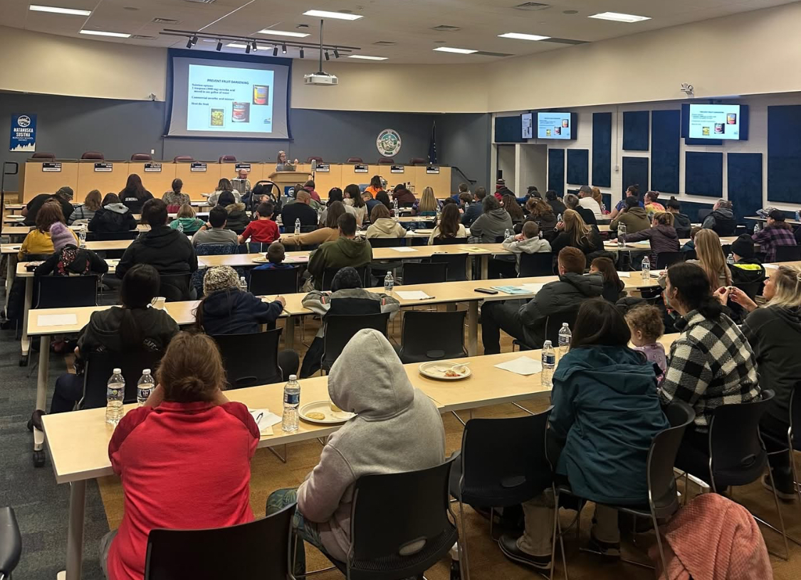
Collaboration Activity
Notes:
https://www2.ed.gov/policy/elsec/leg/esea02/pg21.html
(2) STATE ALLOTMENTS-
(A) HOLD HARMLESS-
(i) IN GENERAL- Subject to subparagraph (B), from the funds appropriated under section 2103(a) for any fiscal year and not reserved under paragraph (1), the Secretary shall allot to each of the 50 States, the District of Columbia, and the Commonwealth of Puerto Rico an amount equal to the total amount that such State received for fiscal year 2001 under —
(I) section 2202(b) of this Act (as in effect on the day before the date of enactment of the No Child Left Behind Act of 2001); and
(II) section 306 of the Department of Education Appropriations Act, 2001 (as enacted into law by section 1(a)(1) of Public Law 106-554).
(ii) RATABLE REDUCTION- If the funds described in clause (i) are insufficient to pay the full amounts that all States are eligible to receive under clause (i) for any fiscal year, the Secretary shall ratably reduce those amounts for the fiscal year.

Slide 25
Looking Ahead
Your feedback tonight will be used to:
✔ Update the Comprehensive Needs Assessment
✔ Update the Service Delivery Plan
✔ Determine priorities for funding
✔ Design future Migrant Education services

Slide 26
Thank You!
Federal Programs Overview
Chasitie Wilkes
Director of Federal Programs
📞 907-761-4037
✉️ Chasitie.cork@matsuk12.us
Michael Evans
Director-Success Coach Administrator
📞 907-761-4080
✉️ Michael.Evans@matsuk12.us
Holly Peters
Administrative Assistant / Title 1 Coordinator
📞 907-746-9276
✉️ Holly.peters@matsuk12.us
Mary Graham
Migrant and Indian Education Coordinator
📞 907-746-9236
✉️ Mary.graham@matsuk12.us

