Slide 1
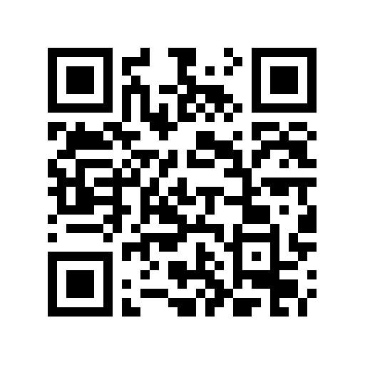
Welcome to
Coles School Kindergarten Orientation
2026!
While you’re waiting, Use the QR code to join the PTA

Slide 2
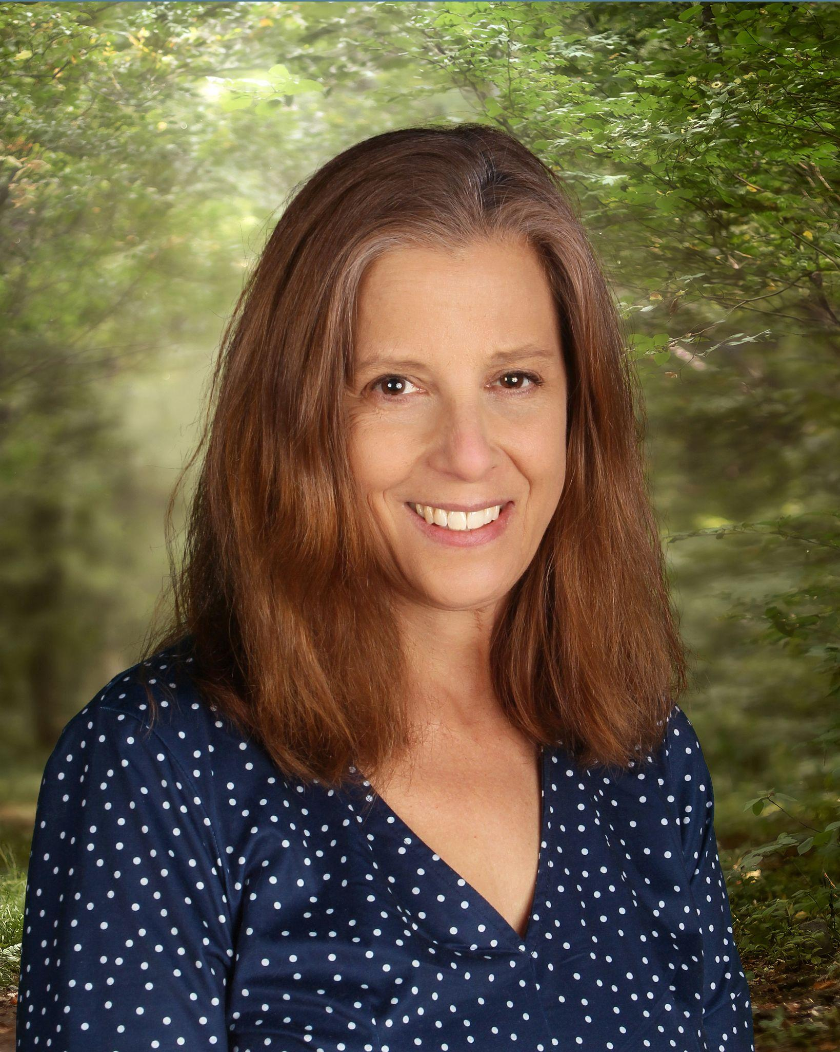
Principal- Sandy Fehte

Slide 3

Important people to know:
Melissa Chichester – Secretary
Trish Compierchio- Secretary
Chris Cappadoccia – Nurse
Chaandanie Ramnarace - SAS
Mr. George – Head Custodian

Slide 4
Meet our Teachers!
Kindergarten Team
Mrs. Hall
Mrs. Dimiceli
Mrs. Hercel
Mrs. Tamase
Miss Travers
Miss Liang
Support Staff
Ms. Ramnarace- Student Assistance Specialist/ Counselor
Mrs. Mehl- Basic Skills
Mrs. Chin- Basic Skills
Mrs. Ciemniecki- Basic Skills
Ms. Medley- Social Worker

Slide 5
Join the PTA
  PTA President: Mrs. Stephanie Taeschler- 25-26
To opt-in to the PTA emails:
colesptamail@gmail.com
Subject: Register
Scan the QR code to access the Coles PTA website

Slide 6

Getting to Know You
Raise Your Hand if…
This is your first child entering kindergarten
You have other children who went to Coles
You remember your kindergarten teacher’s name
You are still friends with someone you went to kindergarten with
Your child is REALLY excited to come to kindergarten!

Slide 7
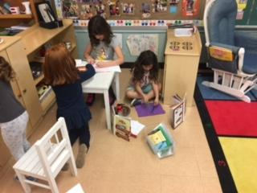
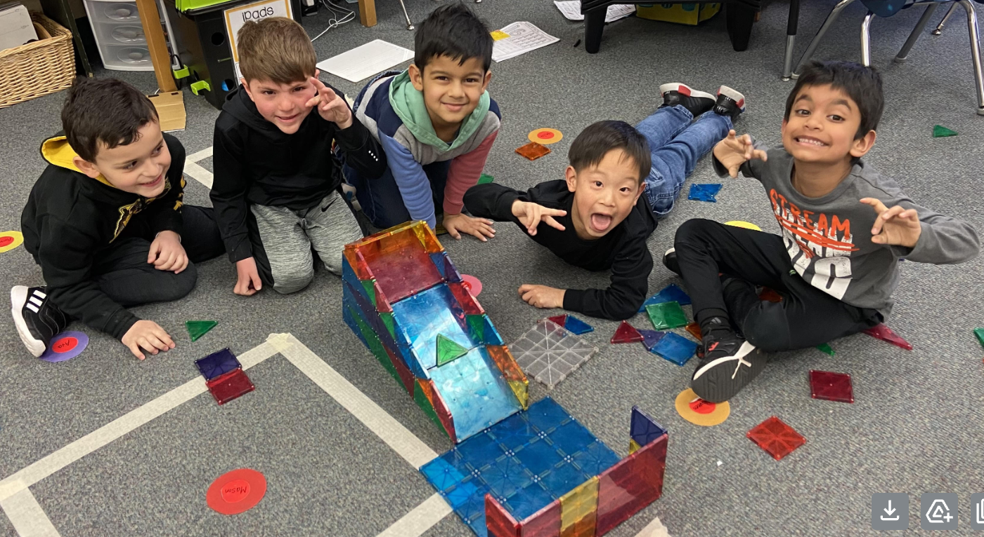
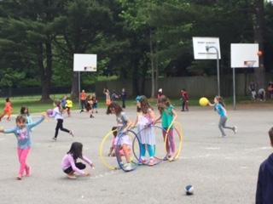
The Kindergarten Experience
Children spend time in whole group, small group and independent activities throughout the day
Children learn through hands-on experiences, making choices and practicing skills at learning centers
Children develop social skills throughout the day, both inside and outside the classroom
Building independence and practicing self-help skills are as important as academic learning

Slide 8
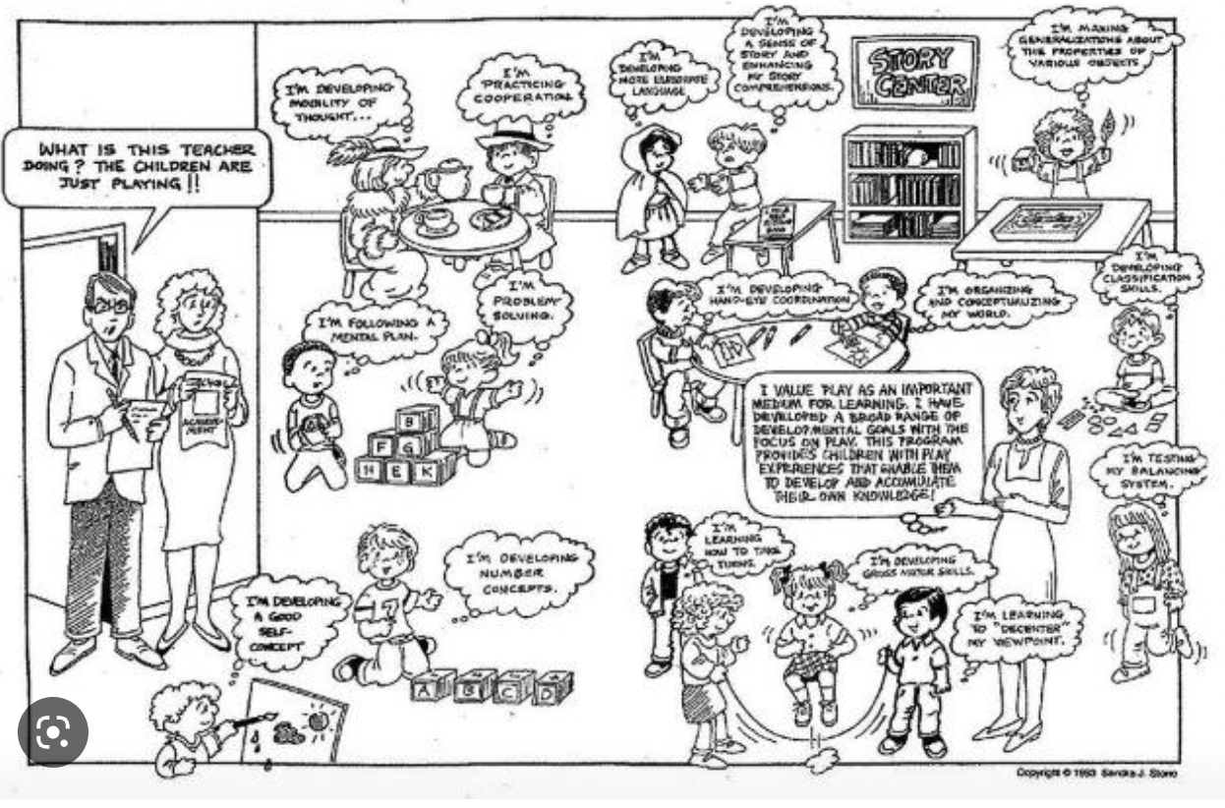
The Kindergarten Experience

Slide 9
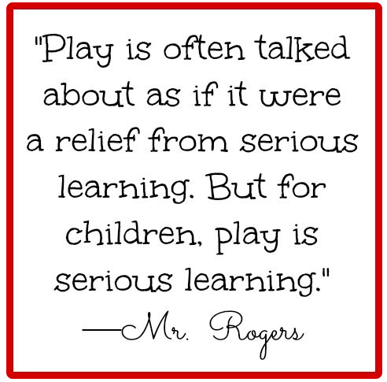

Slide 10
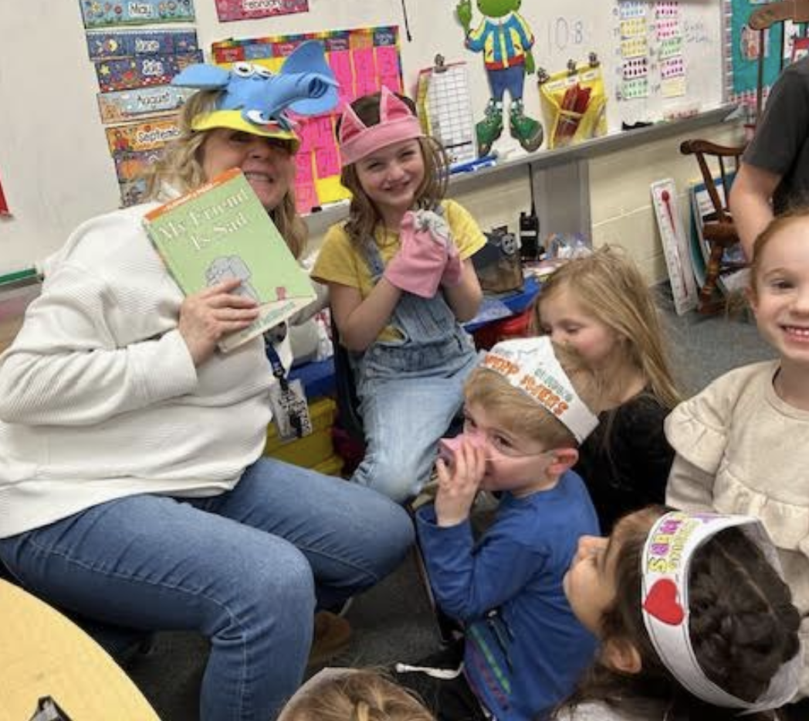
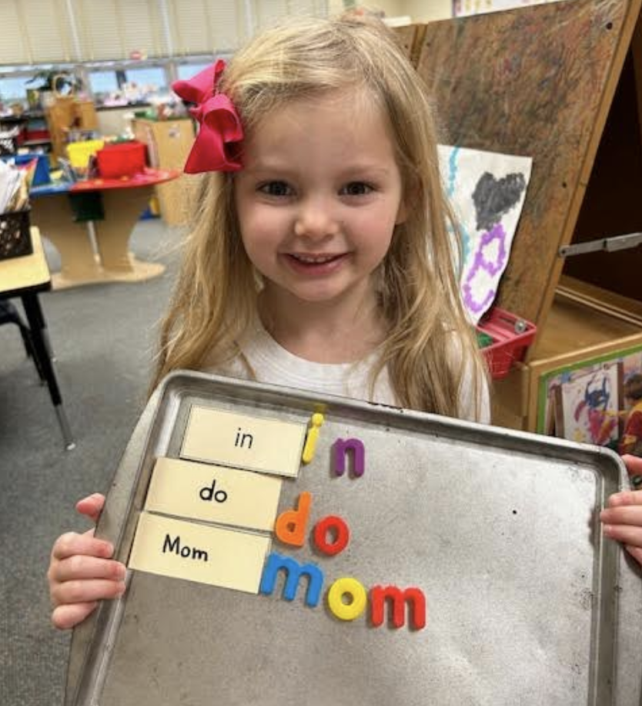
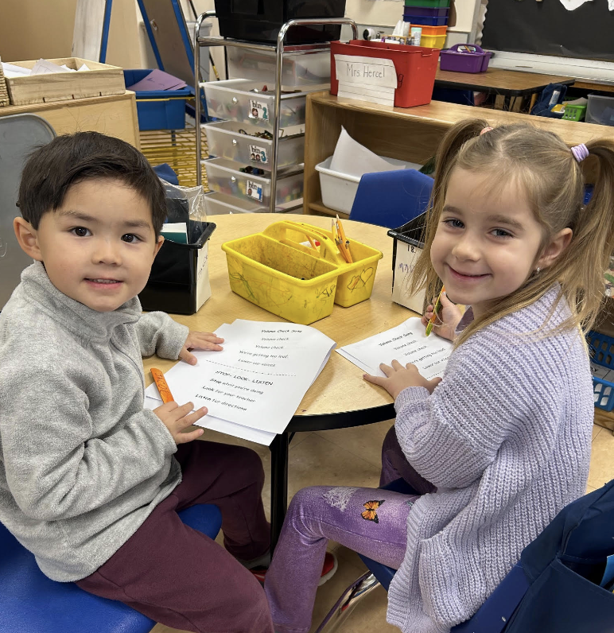
What we Teach…
All Kindergarten Instruction is based on NJSLS
(NJ Student Learning Standards)
Language Arts Literacy
  Advancing Literacy Program- Writing and Reading
    Whole Group, Small Group and Independent work
  Fundations- phonics
  Students are grouped based on where they are in their learning process and what skills they are working on.

Slide 11
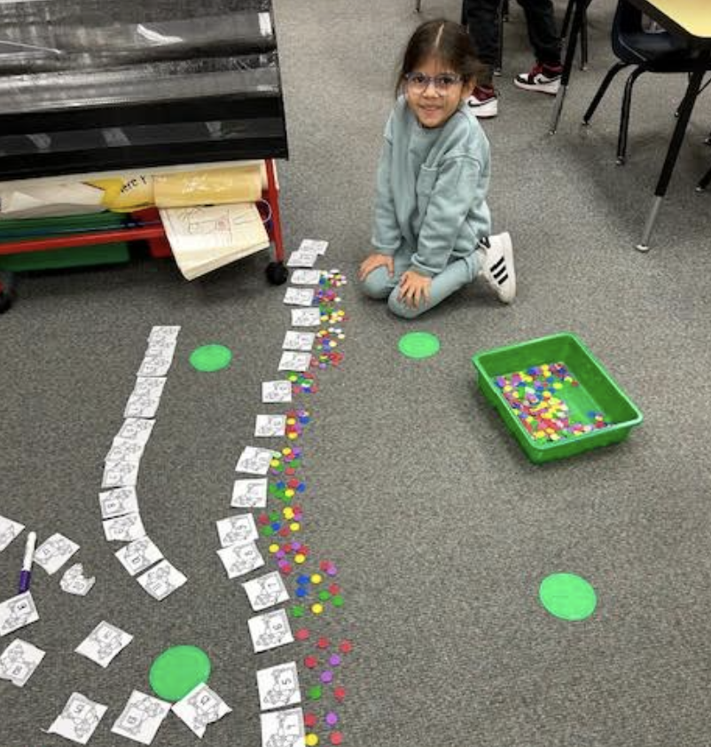
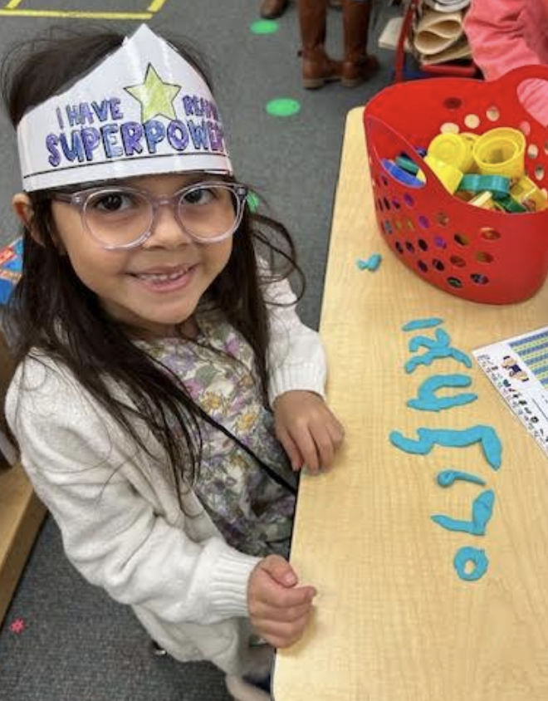
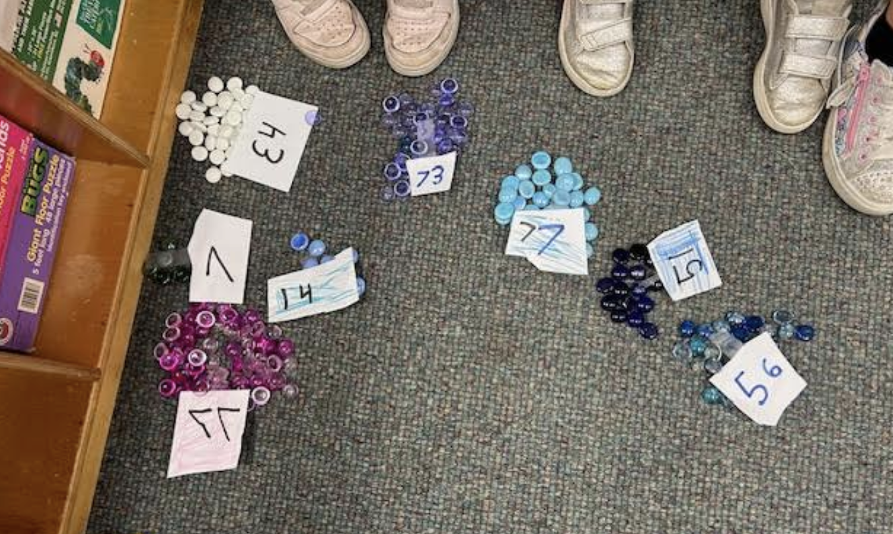
What we Teach…
Math: Everyday Math Program
  includes number sense, independent problem solving
  differentiation is evident
  hands-on activities
  asking students to explain their thinking
  Spiraling of instruction- concepts are taught, then repeated throughout the year

Slide 12
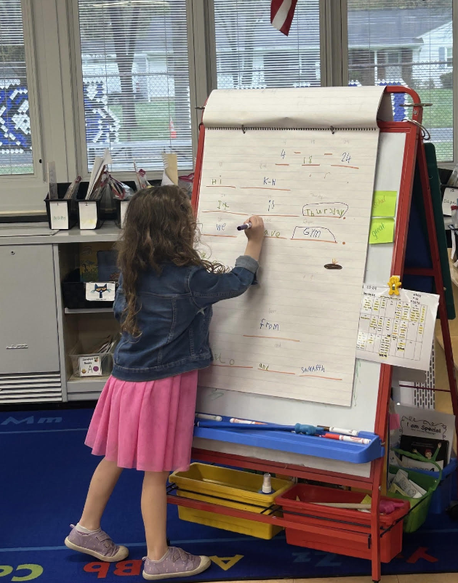
What we Teach…
Social/Emotional and other Skills
  Morning Meeting – Calendar, weather, morning message, social-emotional learning
  Socialization and play through Choice Time
    Take turns
    Accept “No”
    Be a gracious loser/winner
    Be polite to friends and adults
  Fine motor and gross motor skills

Slide 13
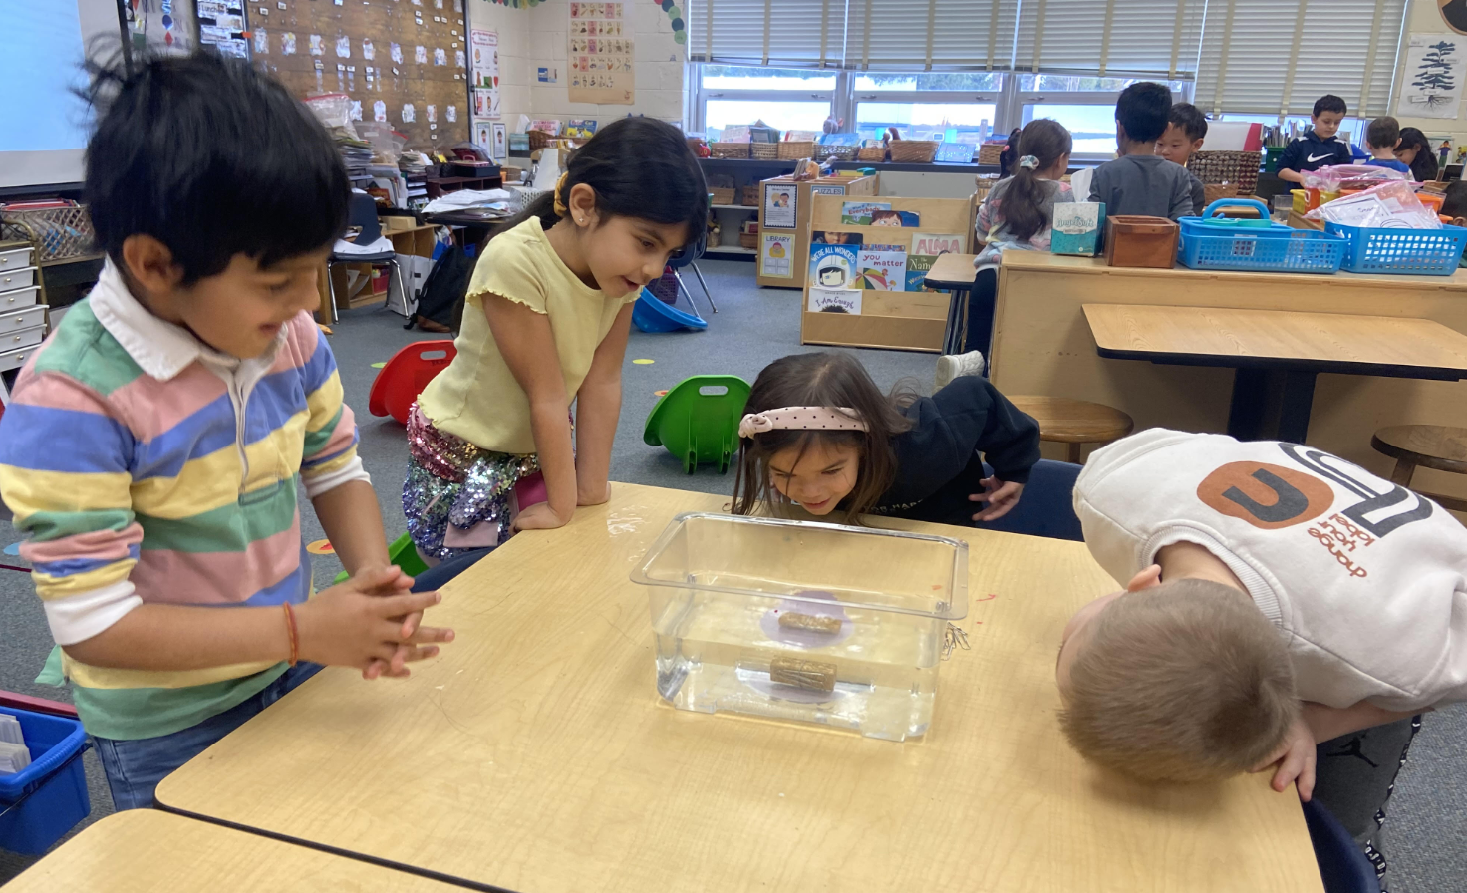
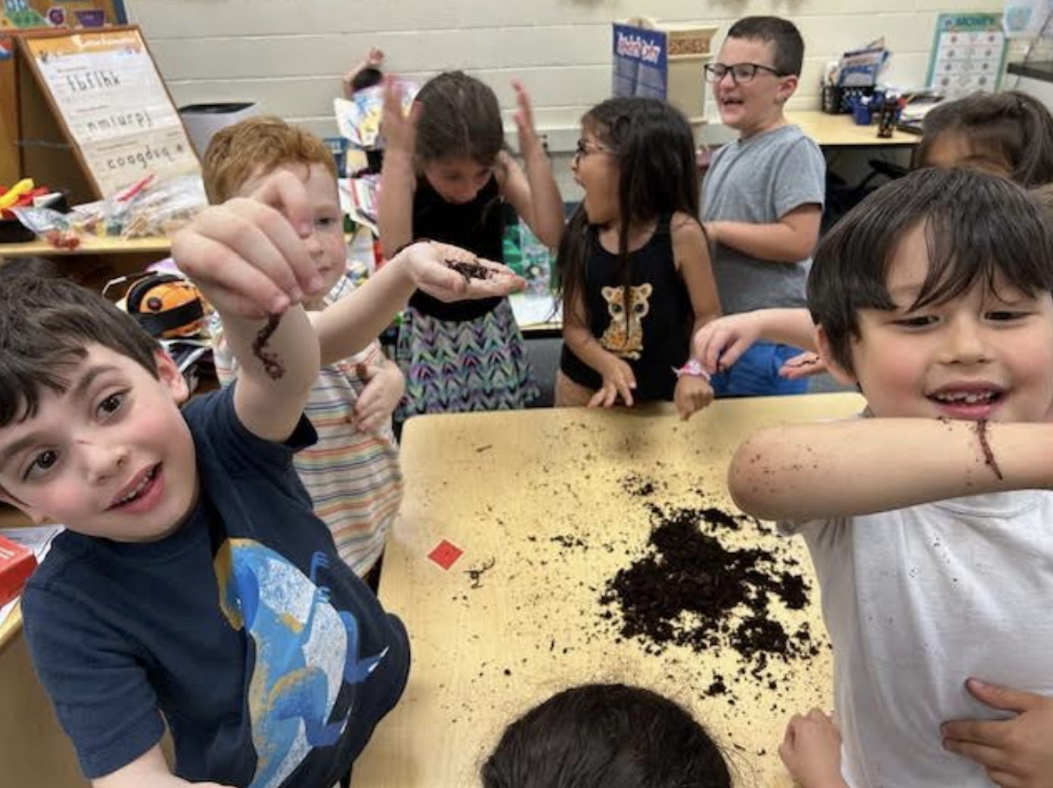
What we Teach…
Science:
-Exploration, Observation, Hands-on experiences
-Investigating the World Around Us
Social Studies:
-Who am I
-How can I be a good friend
-Conflict resolution
Notes:
redworms and nightcrawlers

Slide 14
What we Teach…
Specials
  Art, PE, Music, Library
  Specials help support the whole-child
    Physical/Gross Motor Skills
    Fine Motor Skills
    Reading/Writing
    Artistic Expressions
    Exposure to music and art

Slide 15
Our Students:
Children enter school with varied abilities and skills
  Health and physical development
  Social and emotional development
  Language and communication
  Cognition and general knowledge
  Approaches toward learning
Teachers meet them where they are and help them reach challenging, yet achievable, goals

Slide 16
Current Kindergarten Classrooms

Slide 17
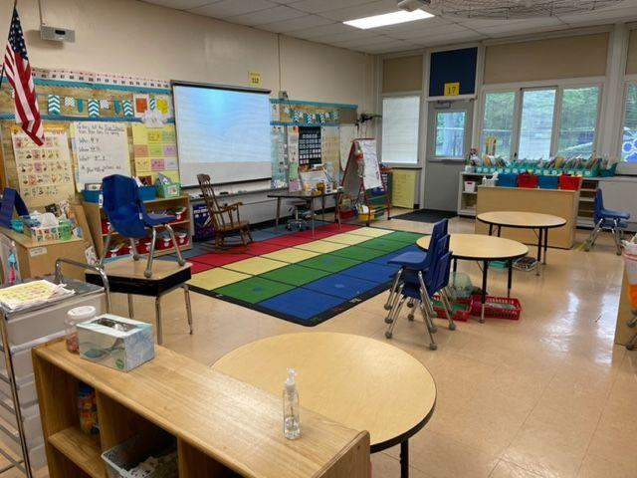
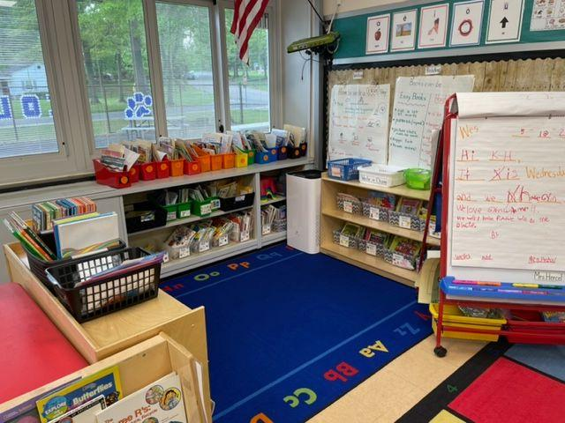
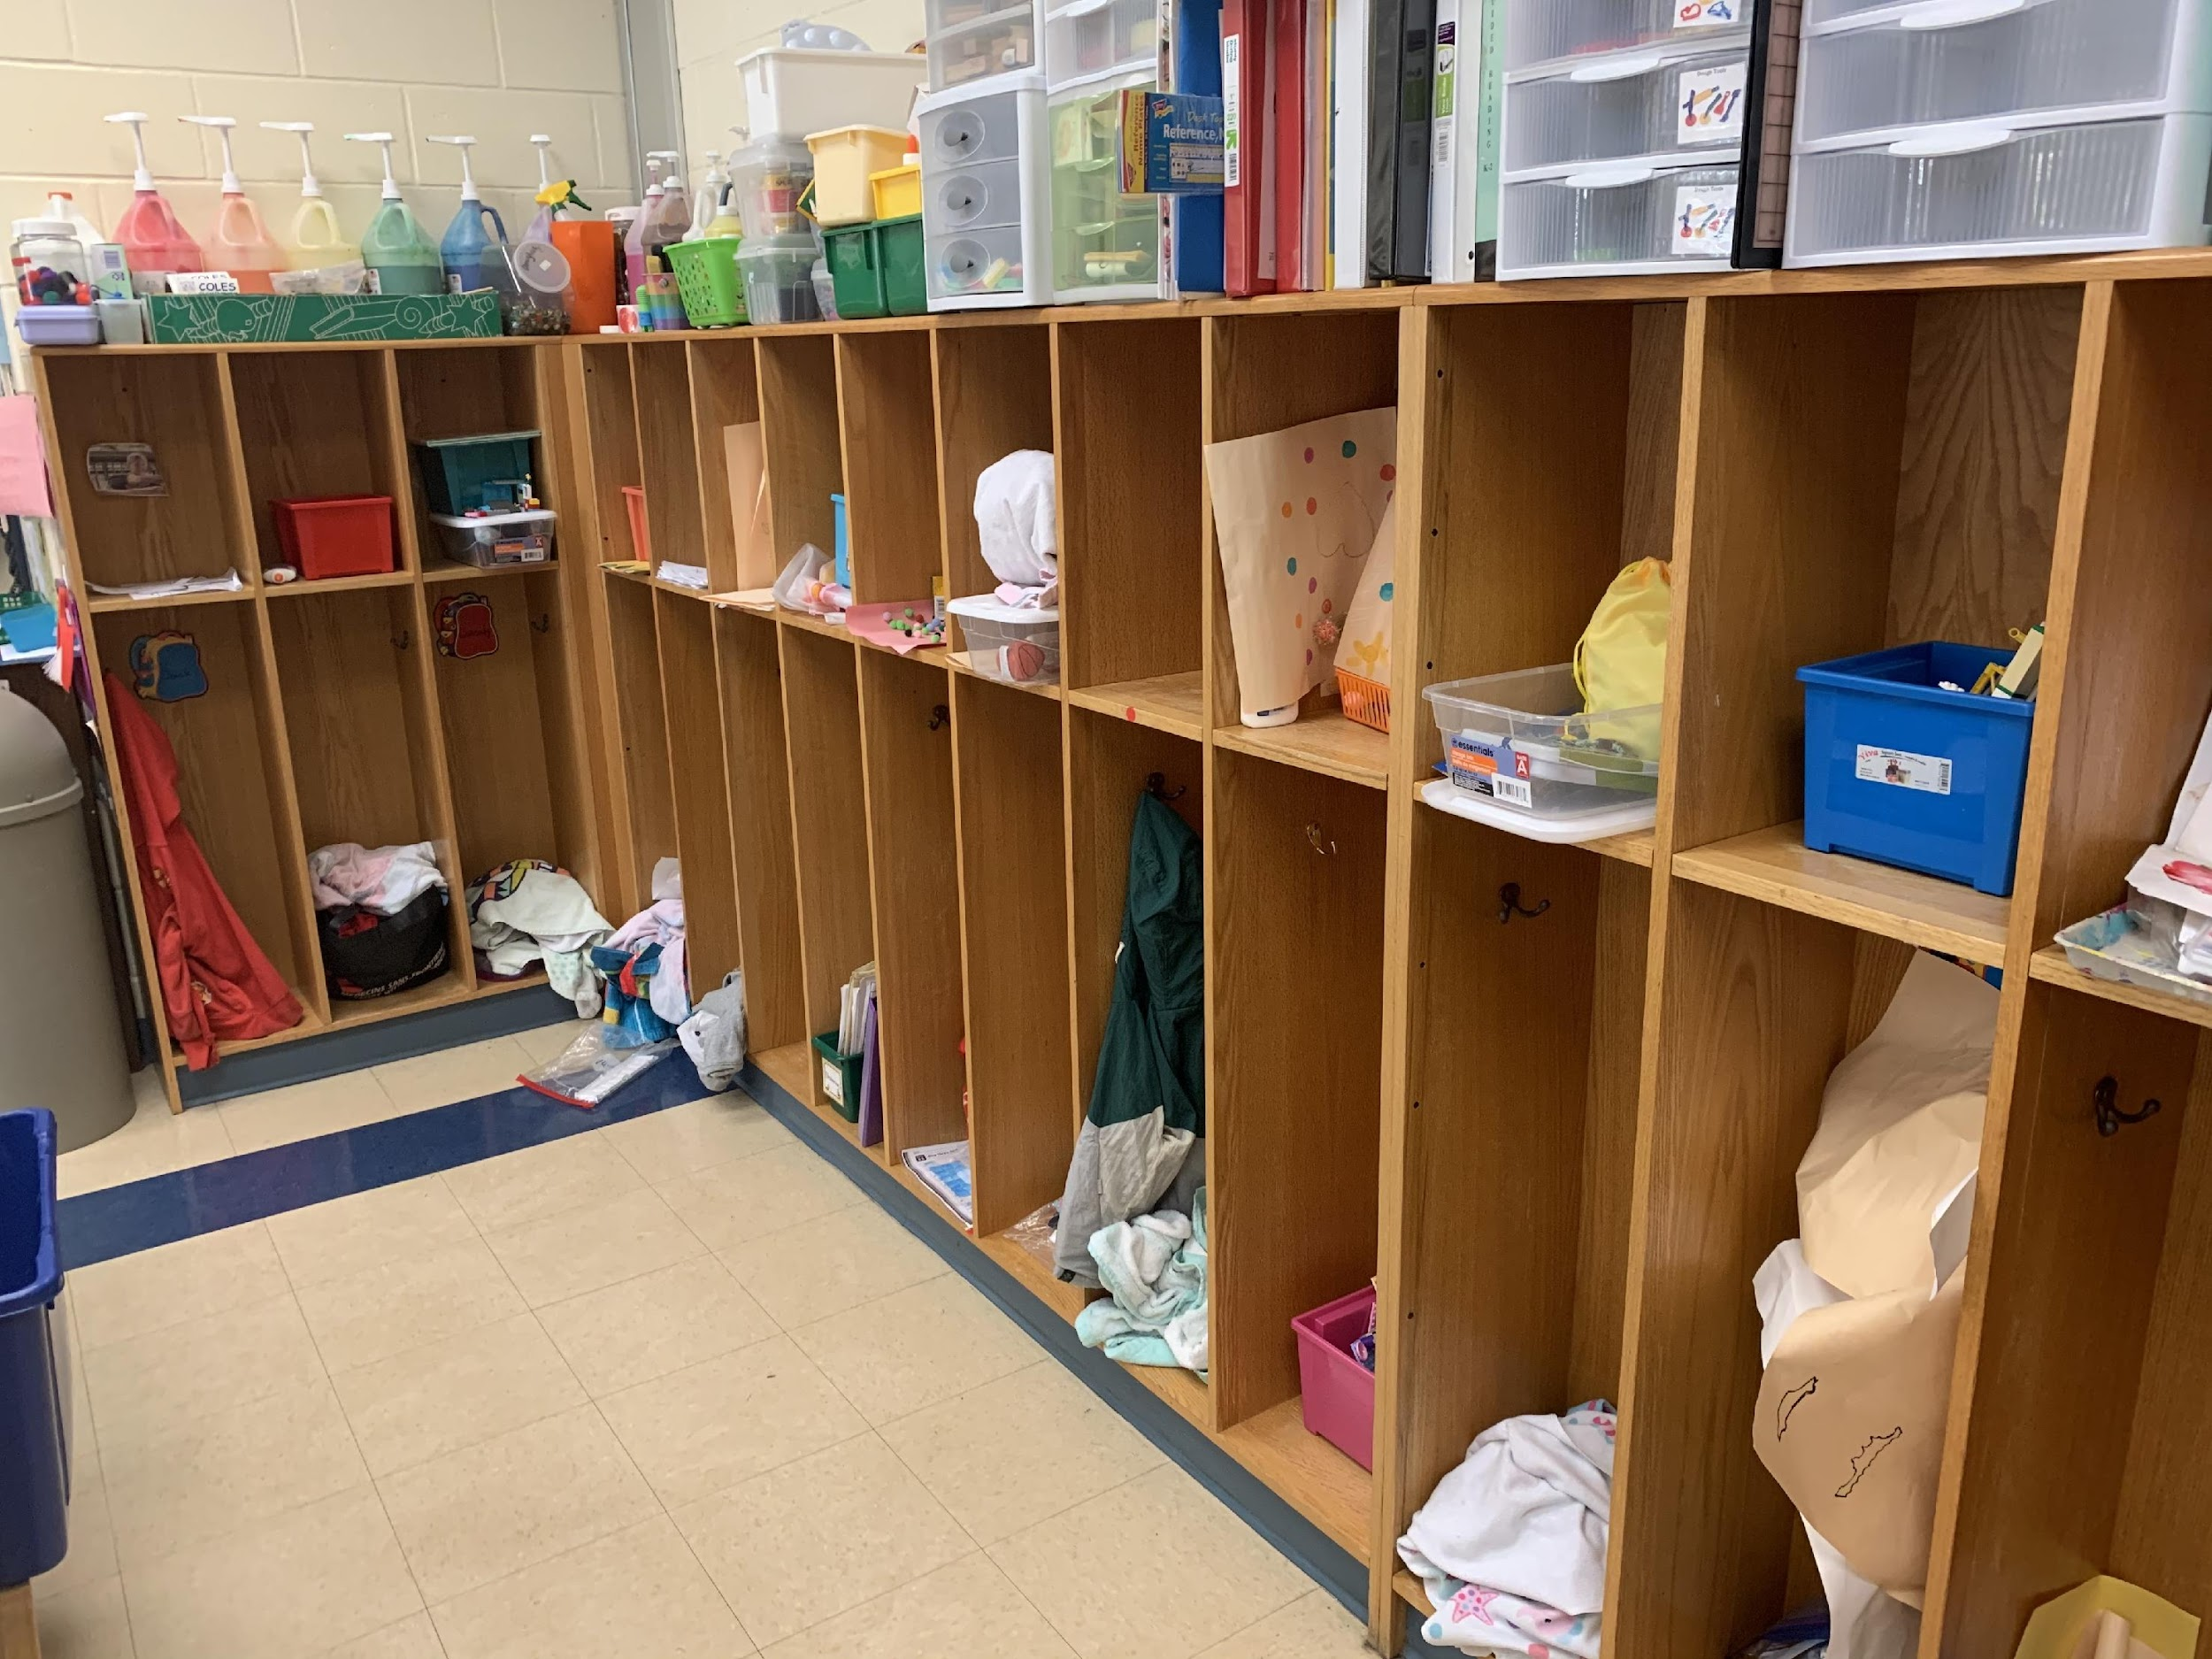
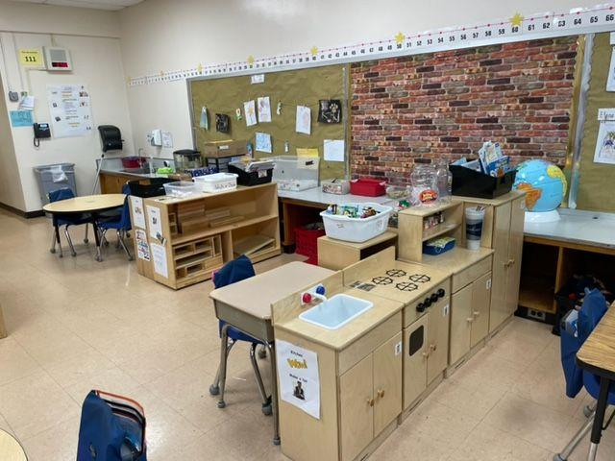
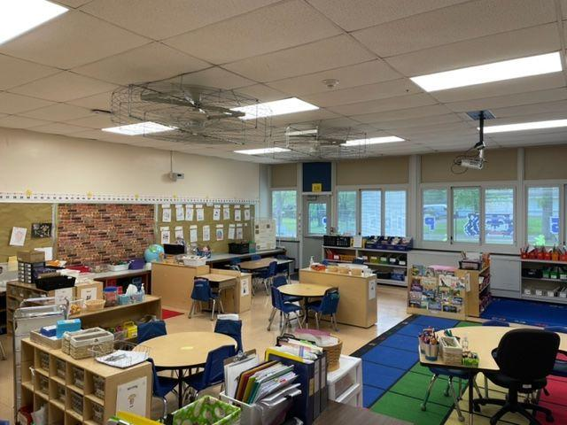

Slide 18
Sample Day Schedule
8:25 – 8:35 Arrival
9:10 Morning Meeting/Shared Reading
9:10 – 10:10 Choice Time/Project Work/ Guided Reading
10:10 – 10:20 Sharing
10:20 – 10:30 Snack
10:30 – 11:00 Writing Workshop
11:00 – 12:00 Lunch/Recess

Slide 19
12:00-12:20 Quiet Time/ Read aloud
12:20 – 1:20 Math/Science/Social Studies Exploration
1:20 – 2:00 Choice Time with Ongoing Investigations/Project Work
2:00 – 2:40 Specials(Music, PE, Library, Art)
2:40 – 3:00 Sharing, Review, and Closing

Slide 20
The Kindergarten Community
Children with special needs are included and supported based on their IEPs
Language-rich experiences support English Language Learners
Diversity is embraced and celebrated

Slide 21
Recess/Lunch
11:00 – 11:30 AM – Lunch
  One aide per class
  Eat at assigned tables in MPR
  Can bring or buy lunch
    Pomptonian is our food service provider
    Vegetarian and non-vegetarian options available
    All meals are peanut and tree-nut tree
    Any dietary concerns can be addressed directly with Pomptonian
11:30 AM – 12:00 PM – Recess
  Rotate between blacktop and playground areas

Slide 22
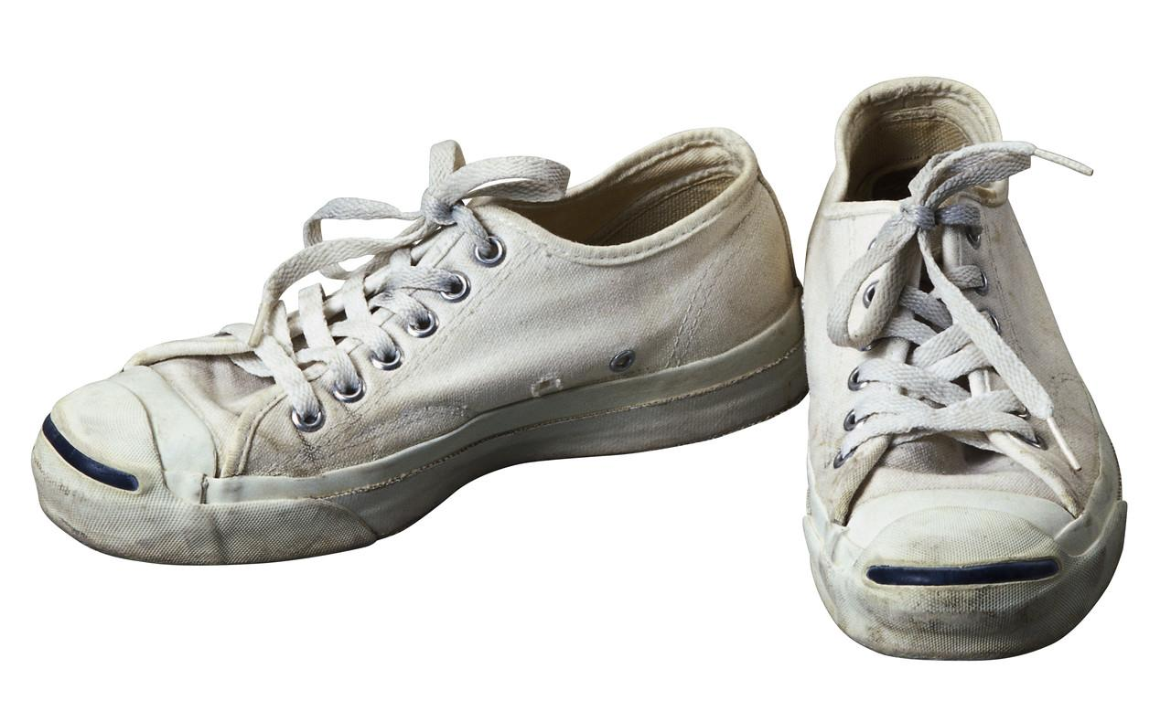
CLOTHING
Comfortable
Able to zipper, button and snap independently
Safe

Slide 23
Safety
All doors locked all day
Visitors enter through the front door and must ring the bell to be admitted
Please do not hold the door for anyone
Security Drills monthly

Slide 24

Communication
We are always here to help, and call us should any urgent concern or issue occur.
Weekly Parent Newsletter
Report Cards in February and June
Conferences in November and as needed
Notifications through PowerSchool – you are automatically signed up

Slide 25

Ways to Prepare Your Child for School:
Practice saying name when asked
Read stories
Draw pictures – shapes
Cut with scissors
Play with rhymes, sounds
Identify letters and numbers
Count
Recognize Environmental print (Pizza, STOP)
Explore nature
Give your child access to books, pencils, etc.

Slide 26

Ways to Prepare Your Child for School:
Be interested in school
Follow rules
Recognize authority- listen to the adults
Separate from parents
Dress independently- put on jacket, pull up pants
Use bathroom independently, including wiping
Eat independently- use utensils, clean up after themselves
Share play interactively
Sort items
Speak in complete sentences

Slide 27
First Day of School
What to bring:
Snack – Peanut and Tree Nut free!
Refillable plastic water bottle
Seasonal change of clothes (including socks and underwear) in a labeled, ziploc bag
Lunch/plans to buy lunch
Backpack
Smile

Slide 28

Arrival
If you want to walk your child to the door:
  Park on a side street
  Doors open at 8:25 AM and students walk directly to the classroom
Drop off Lane On Kevin Road, parent volunteers assist
Bus Students –
  Enter through the main entrance or Door 2
  PLEASE – PLEASE –PLEASE –
  Do Not enter or park in the parking lot – all spaces are numbered and assigned to staff!

Slide 29
Dismissal
Bus students are walked to the MPR by an adult and line up by bus.
Bus students will have a color-coded tag
Children will also wear identification stickers for a few weeks. (Distributed by teacher)
Kindergarten walkers and car riders are dismissed at 3:10 by the Kindergarten playground (Door 4) or Doors outside classrooms (Doors 17, 18, and 19).

Slide 30
Before and After Care
Right at School offers Before and After Care at Coles School
The JCC offers after care at the JCC – students are bussed to the JCC
The YMCA also offers after care at the YMCA- students are busses there.
Please contact the JCC, YMCA, or Right at School for more information.

Slide 31
Notification of Teacher –
Late August
Kindergarten Meet and Greet –
Tuesday, September 1 (tentative)
First Day of School –
Wednesday, September 2
Grade Level Supply Lists are located on the school website

Slide 32

!
Questions?

