Slide 1
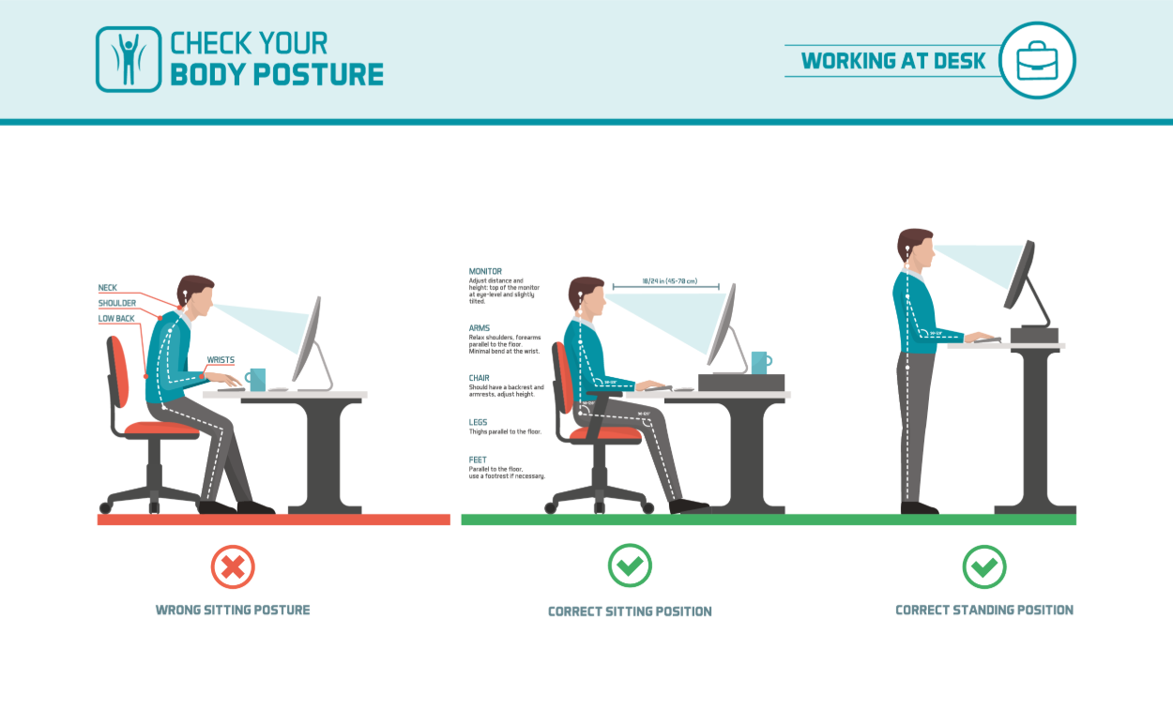

Slide 2
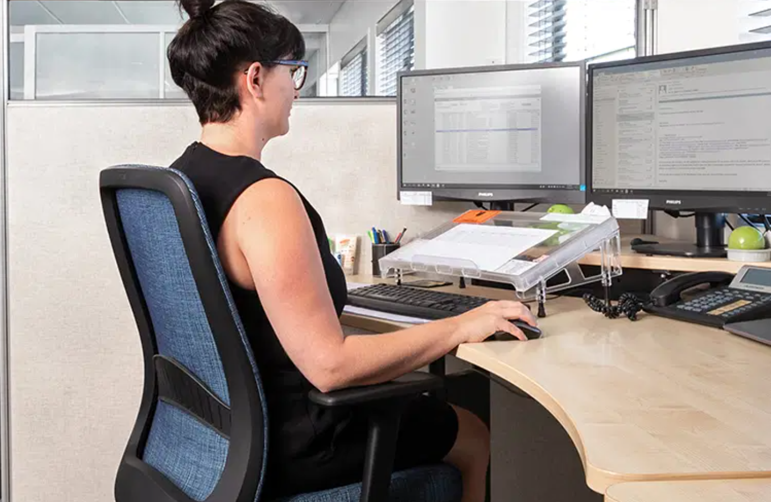
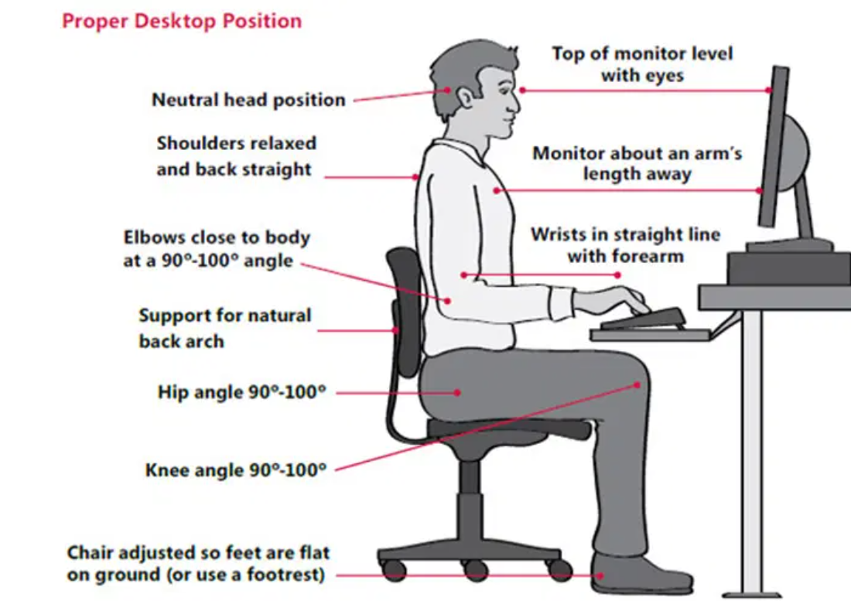

Desktop Safety

Slide 3
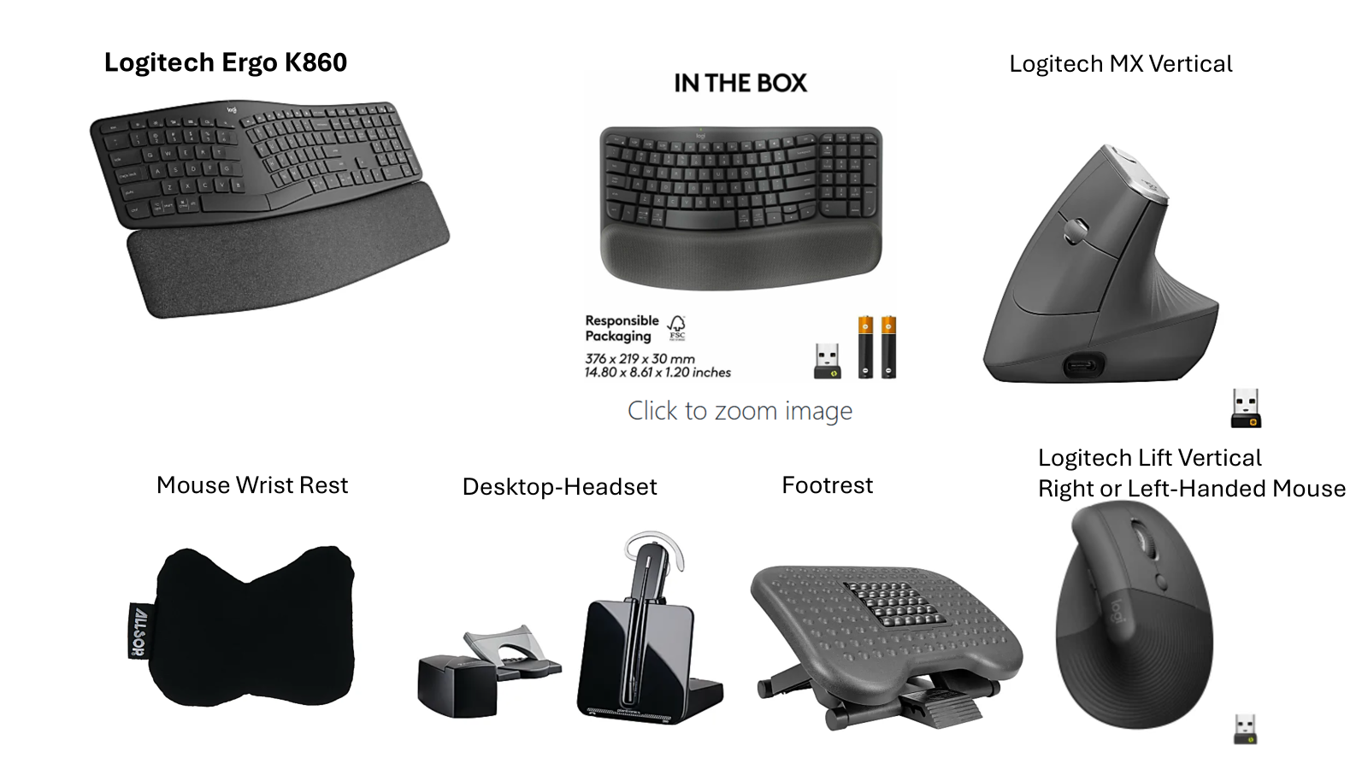

Slide 4
If you need an Ergonomic Evaluation
GO to the MCOE.org website:
On the MCOE website, go to the department.
Human Resources
Employee Safety
Scroll down to Ergonomic Evaluation and fill out the form. It’s best to upload a picture of your current workstation.

