Slide 1
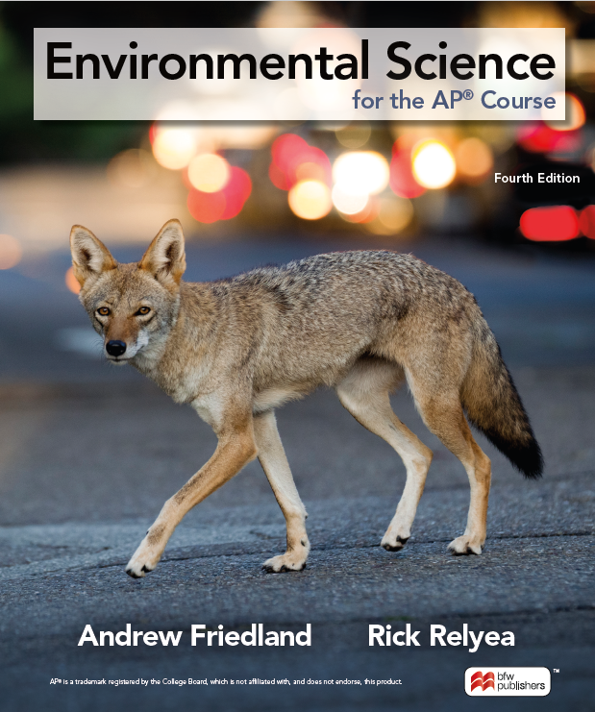
Lecture Slides
to accompany
Note that this presentation contains copyrighted material. This slide deck is only intended for use in class or on a secure, password-protected classroom site.

Slide 2

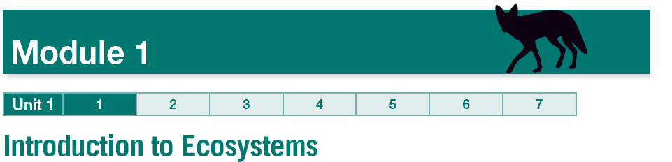

Slide 3
Learning Goals
LG 1-1
LG 1-2
LG 1-3
LG 1-4
LG 1-5
Explain how we define ecosystem boundaries.
Describe how competing species respond to limited resources.
Identify which species interactions involve one species consuming another species.
Describe which species interactions cause neutral or positive effects on both species.
Explain how invasive species represent novel species interactions.

Slide 4
LG 1-1 Describe how populations can evolve adaptations in response to environmental changes.
In environmental science we examine community ecology, which is the study of interactions among species.
Those species interact in different ways, through consumption, competition, and symbiosis.
Ecosystem boundaries are determined by abiotic and biotic factors, such as temperature, salinity, soil, etc.

Slide 5
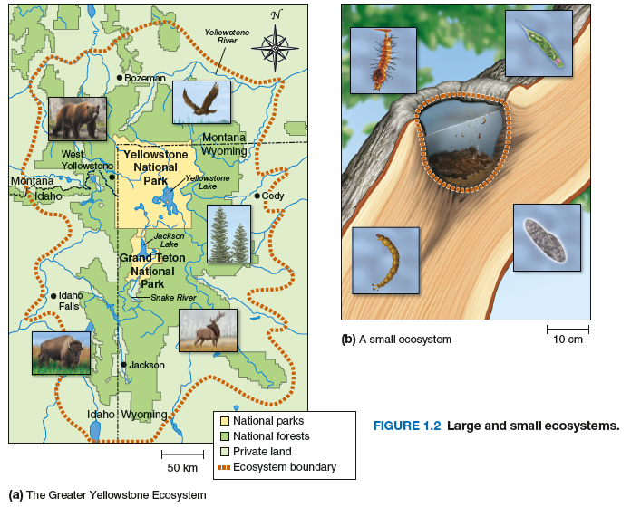
LG 1-1 Describe how populations can evolve adaptations in response to environmental changes.
Ecosystems can vary in size as in the example below.

Slide 6
LG 1-1 Describe how populations can evolve adaptations in response to environmental changes.
Division of ecosystems is helpful for study, but all ecosystems on Earth are interconnected in the biosphere.

Slide 7
LG 1-2 Describe how competing species respond to limited resources.
When there is limited resources for individuals, this results in competition.
A classic experiment by Gause demonstrated how species thrive in absence of competition, and how they respond.
This has led to the competitive exclusion principle – that two species competing for the same resource cannot coexist.

Slide 8
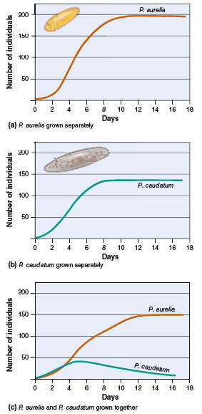
LG 1-2 Describe how competing species respond to limited resources.

Slide 9
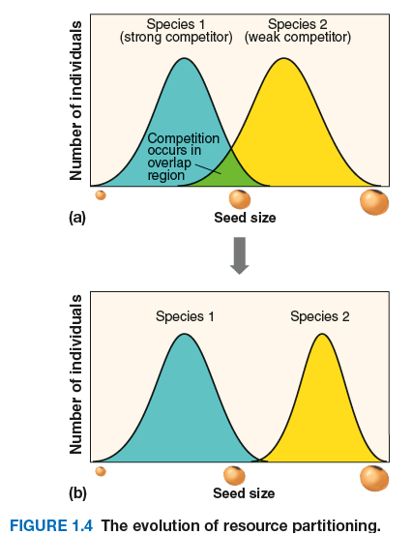
LG 1-2 Describe how competing species respond to limited resources.
Another way that species would respond in order to remain successful is the process of resource partitioning, wherein two species evolve to divide a resource through behavior or morphology in order to avoid competition.

Slide 10
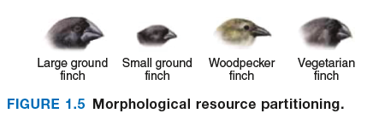
LG 1-2 Describe how competing species respond to limited resources.
Resource partitioning can be behavior as in the previous slide, or through evolution of morphology as in Darwin’s finches.

Slide 11
LG 1-3 Identify which species interactions involve one species consuming another species.
Predation occurs when one animal kills and consumes another animal, in order to consume their energy.
  Example: wolves hunting moose
Besides typical predation, a parasitoid also consumes its prey by laying its eggs inside another organism, which then hatch and slowly consume it from the inside.
  Example: parasitic wasps laying eggs inside aphids
Prey tend to evolve morphological defenses to avoid predation, such as with camouflage, sharp spines, or chemical defenses (like that of a poison dart frog).
Other species can even mimic these defenses to avoid predation.

Slide 12
LG 1-3 Identify which species interactions involve one species consuming another species.
Parasitism is another interaction, where an organism lives on another organism, consuming a small fraction of the host in order to keep it alive.
Those organisms that cause disease, like viruses, bacteria, fungi, protists, and wormlike organisms known as helminths, are known as pathogens.
Consumption of plants by animals is known as herbivory. An increase in herbivores can lead to collapse of ecosystems, so predation can sometimes keep them under control.

Slide 13
LG 1-4 Describe which species interactions cause neutral or positive effects on both species.
Some species’ interactions are not always negative, as is the case of mutualism, where both species benefit from the interaction.
  Example: plants and pollinators such as birds, bats, and insects
Other famous examples are those of coral reefs and lichens.
In coral reefs, algae provide the coral with sugars through photosynthesis:
6CO₂(g) + 6H₂O (l) → C₆H₁₂O₆ (s) + 6O₂ (g)

Slide 14
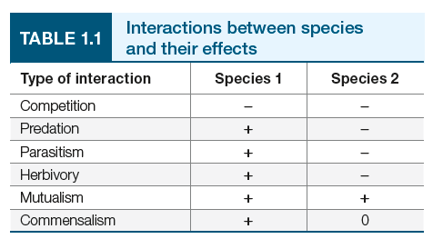
LG 1-4 Describe which species interactions cause neutral or positive effects on both species.
Sometimes species interact where one benefits and another is unaffected, known as commensalism.
  Example: Fish species use coral reefs as shelter from predators. This benefits the fish, but has no effect on the coral reef.
Summary of interactions:

Slide 15
LG 1-5 Explain how invasive species represent novel species interactions.
Species evolve to their ecosystems over time, leading to some species being native species.
Exotic/alien species are those that are out of their historical range and can have an impact on those native species.
Movement of species through human behavior has led to many exotic or alien species affecting natives. Examples:
  Honeybees in North America
  Red foxes in Australia
Species that spread quickly and cause harm to native ecosystems are considered invasive species.

