Slide 1

Lecture Slides
to accompany
Note that this presentation contains copyrighted material. This slide deck is only intended for use in class or on a secure, password-protected classroom site.

Slide 2


Slide 3
Learning Goals
LG 0-1
LG 0-2
LG 0-3
LG 0-4
Describe the field of environmental science and discuss its importance.
Identify ways in which humans have altered and continue to alter our environment.
Explain the four “Big Ideas” in environmental science.
Describe the scientific method and justify how it is used to design and evaluate information in environmental science.

Slide 4
LG 0-1 Describe the field of environmental science and discuss its importance.
The sum of all the conditions surrounding us that influence life is known as the environment.
The environment is composed of living and nonliving components, and humans have influence on these components.
Environmental science is the field of study that looks at interactions among human systems and those found in nature.
Ecosystems can be natural or completely human-made, but are always composed of abiotic (nonliving) and biotic (living) factors.

Slide 5
LG 0-1 Describe the field of environmental science and discuss its importance.
Environmental science should not be confused with environmentalism, which is a social movement that seeks to protect the environment through lobbying, activism, and education.
Example: a person protesting the removal of a nature park for development of human homes is engaging in environmentalism.
A scientist researching the population numbers of a native species of woodpecker before the decision to remove a nature park is practicing environmental science.

Slide 6
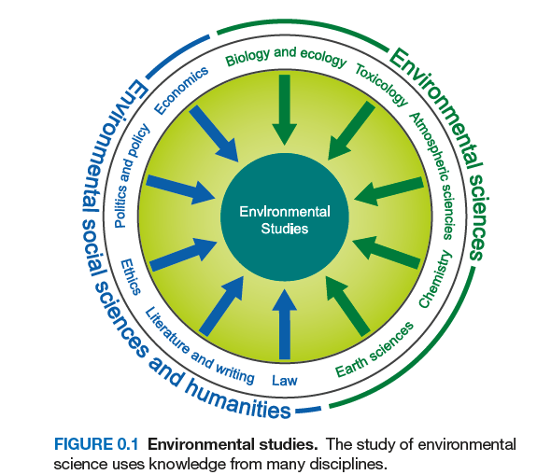
LG 0-1 Describe the field of environmental science and discuss its importance.
Environmental science is a subset of environmental studies, a field of study that includes policy, economics, literature, and ethics as well.

Slide 7
LG 0-2 Identify ways in which humans have altered and continue to alter our environment.
Living factors interact with nonliving factors to influence ecosystems.
Systems vary in size, with larger systems likely comprised of smaller systems.

Slide 8
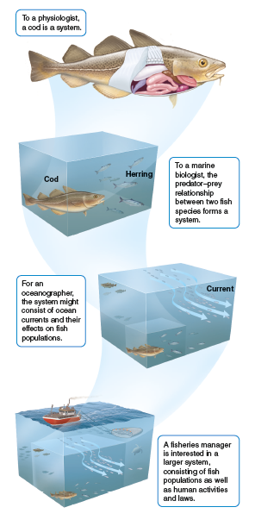
LG 0-2 Identify ways in which humans have altered and continue to alter our environment.

Slide 9
LG 0-2 Identify ways in which humans have altered and continue to alter our environment.
Humans manipulate systems more profoundly than any other species.
Examples:
  Converting land into urban, suburban, agricultural areas
  Evolution of humans led to extinctions of mammoths, mastodons, giant ground sloths, and many bird species
Humans have also created opportunities for some species and ecosystems, such as the restoration of the Giant Panda and the expansion of the Great Plains.
Global population growth and advancement of technology have been increasing these impacts.

Slide 10
LG 0-3 Explain the four “Big Ideas” in environmental science.
AP environmental science contains four “Big Ideas”:
  1 – Energy Transfer: understanding conversion and transfer of energy among different components of systems (whether natural or created by humans) is integral in environmental science.
  2 – Interactions between Earth’s systems: humans and natural factors influence Earth’s systems.
  3 – Interactions between different species and the environment: species on Earth have existed for 4.5 billion years, with humans and their ancestors for the last 2.5 million. Advancements in technology and population growth have substantially impacted resources and terrestrial and aquatic pollution.
  4 – Sustainability: using Earth’s resources in a way that does not jeopardize future generations from engaging in similar activities. Considered the unifying theme, this big idea is weaved throughout the course.

Slide 11
LG 0-4 Describe the scientific method and justify how it is used to design and evaluate information in environmental science.
Scientific inquiry has provided great insights into challenges we are facing and has suggested ways to address those challenges
Scientists use the scientific method, an objective method to explore the natural world, draw inferences from it, and predict the outcome of certain events, processes, or changes

Slide 12
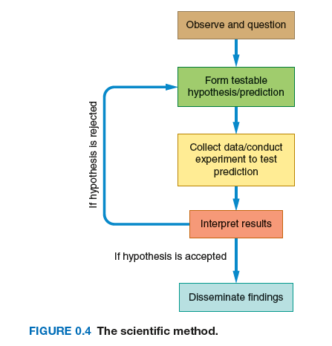
LG 0-4 Describe the scientific method and justify how it is used to design and evaluate information in environmental science.
The scientific method begins with observation, then leads to a hypothesis: a testable conjecture about how something works, typically using previous knowledge.

Slide 13
LG 0-4 Describe the scientific method and justify how it is used to design and evaluate information in environmental science.
Every experiment has variables, which are factors that differ in the experiment/natural world.
These experiments can have dependent variables, factors which are being measured, and independent variables, factors which are not being measured.
When experiments are designed, a control group should be used in order to compare to the experimental group.
Environmental science is unique, because events being studied can sometimes occur as a natural experiment. In this situation, it is best to compare the studied natural event and its environment to a similar system, or to the environment before the natural event occurred.

Slide 14
LG 0-4 Describe the scientific method and justify how it is used to design and evaluate information in environmental science.
Experiments need to have replication, or repeated measurements, in order to be valid.
The sample size (n), allows for more replication in data collection, to improve the accuracy (true value) of the experiment.
Repeated measurements that are close to each other are considered precise.
Once all measurements have been taken, the uncertainty, or estimate of how much a measured or calculated value differs from the true value, can be calculated.

Slide 15
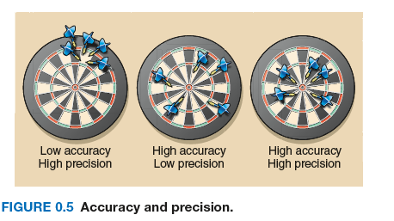
LG 0-4 Describe the scientific method and justify how it is used to design and evaluate information in environmental science.

Slide 16
LG 0-4 Describe the scientific method and justify how it is used to design and evaluate information in environmental science.
Once all data has been taken, the process of interpreting results begins.
In order to interpret results of an experiment or data collection, two types of reasoning can be used:
  Inductive reasoning –making general statements from specific facts or examples
  Deductive reasoning – applying general statements to specific facts or situations
Once hypotheses are confirmed by multiple experiments, peer review allows other scientists in related fields to repeat, verify, or challenge the results.
Once a hypothesis is repeatedly tested and confirmed, it can become a theory, or a widely accepted belief.

Slide 17
LG 0-4 Describe the scientific method and justify how it is used to design and evaluate information in environmental science.
Some theories have no exceptions, such as the laws of thermodynamics.
The first law of thermodynamics is that energy is neither created or destroyed, merely changing from one form or another.
The second law of thermodynamics is that energy transformed loses the ability to do work.
Example: all the energy generated at a powerplant remains in the same quantity, but becomes heat and noise through conversion.

