Slide 1

PAYROLL AND BENEFITS

Slide 2
PAYROLL - AGENDA
Payroll Calendars
Exception Dashboard
Tasks Prior to Payroll Reports Due Date
Direct Deposit - NEW INFO
Frontline
Substitute Reminders
General Fund Payroll Reimbursements (PRC 509)
Work Week and Work Day Reminders
  Fair Labor Standards Act
Comp Time
Leave Benefits
  Non-FMLA
  FMLA
  Parental Leave
Workers’ Compensation

Slide 3
PAYROLL CALENDARS (Hourly)
Pay Groups: #06 Hourly Employees
Pay Period | Pay Date | Date Range in Pay Period | # of Days Paid | Absence Date Range and Timesheet Date Range | Payroll (Submit) Reports Due by 5 pm | PR Process Days
1 | 31-Jul | JUNE 8 - JULY 10 | 25 | JUNE 8 - JULY 10 | 13-Jul | 9
2 | 31-Aug | JULY 13 - AUG 7 | 20 | JULY 13 - AUG 7 | 10-Aug | 10
3 | 30-Sep | AUG 10 - SEPT 11 | 25 | AUG 10 - SEPT 11 | 14-Sep | 7
4 | 30-Oct | SEPT 14 - OCT 9 | 20 | SEPT 14 - OCT 9 | 12-Oct | 9
5 | 30-Nov | OCT 12 - NOV 6 | 20 | OCT 12 - NOV 6 | 9-Nov | 8
6 | 31-Dec | NOV 9 - DEC 4 | 20 | NOV 9 - DEC 4 | 7-Dec | 9
7 | 29-Jan | DEC 7 - JAN 8 | 25 | DEC 7 - JAN 8 | 11-Jan | 9
8 | 26-Feb | JAN 11 - FEB 5 | 20 | JAN 11 - FEB 5 | 8-Feb | 9
9 | 31-Mar | FEB 8 - MARCH 5 | 20 | FEB 8 - MARCH 5 | 8-Mar | 10
10 | 30-Apr | MARCH 8 - APRIL 9 | 25 | MARCH 8 - APRIL 9 | 12-Apr | 9
11 | 28-May | APRIL 12 - MAY 7 | 20 | APRIL 12 - MAY 7 | 10-May | 9
12 | 30-Jun | MAY 10 - JUNE 4 | 20 | MAY 10 - JUNE 4 | 7-Jun | 12

Slide 4
PAYROLL CALENDARS (Pre-Paid)
Pay Period | Pay Date | Date Range in Pay Period | # of Days Paid | Absence Date Range and Timesheet Date Range | Payroll (Submit) Reports Due by 5 pm | PR Process Days
Pay Groups: #01 & #06 10 mo - (ALL 10-month PRE PAID staff excluding Early College plus hourly employees)
1 | 31-Jul | Districk Flexible Learning | 21.5 | JUNE 8 - JULY 10 | 13-Jul | 9
2 | 31-Aug | AUG 10 - SEPT 8 NOON | 21.5 | JULY 13 - AUG 7 | 10-Aug | 10
3 | 30-Sep | SEPT 8 NOON - OCT 7 | 21.5 | AUG 10 - SEPT 11 | 14-Sep | 7
4 | 30-Oct | OCT 8 - NOV 6 NOON | 21.5 | SEPT 14 - OCT 9 | 12-Oct | 9
5 | 30-Nov | NOV 6 NOON - DEC 7 | 21.5 | OCT 12 - NOV 6 | 9-Nov | 8
6 | 31-Dec | DEC 8 - JAN 6 NOON | 21.5 | NOV 9 - DEC 4 | 7-Dec | 9
7 | 29-Jan | JAN 6 NOON - FEB 4 | 21.5 | DEC 7 - JAN 8 | 11-Jan | 9
8 | 26-Feb | FEB 5 - MARCH 8 NOON | 21.5 | JAN 11 - FEB 5 | 8-Feb | 9
9 | 31-Mar | MARCH 8 NOON - APRIL 6 | 21.5 | FEB 8 - MARCH 5 | 8-Mar | 10
10 | 30-Apr | APRIL 7 - MAY 6 NOON | 21.5 | MARCH 8 - APRIL 9 | 12-Apr | 9
11 | 28-May | MAY 6 NOON - JUNE 4 | 21.5 | APRIL 12 - MAY 7 | 10-May | 9
12 | 30-Jun | *Sub Pay Only* |  | MAY 10 - JUNE 4 | 7-Jun | 12

Slide 5

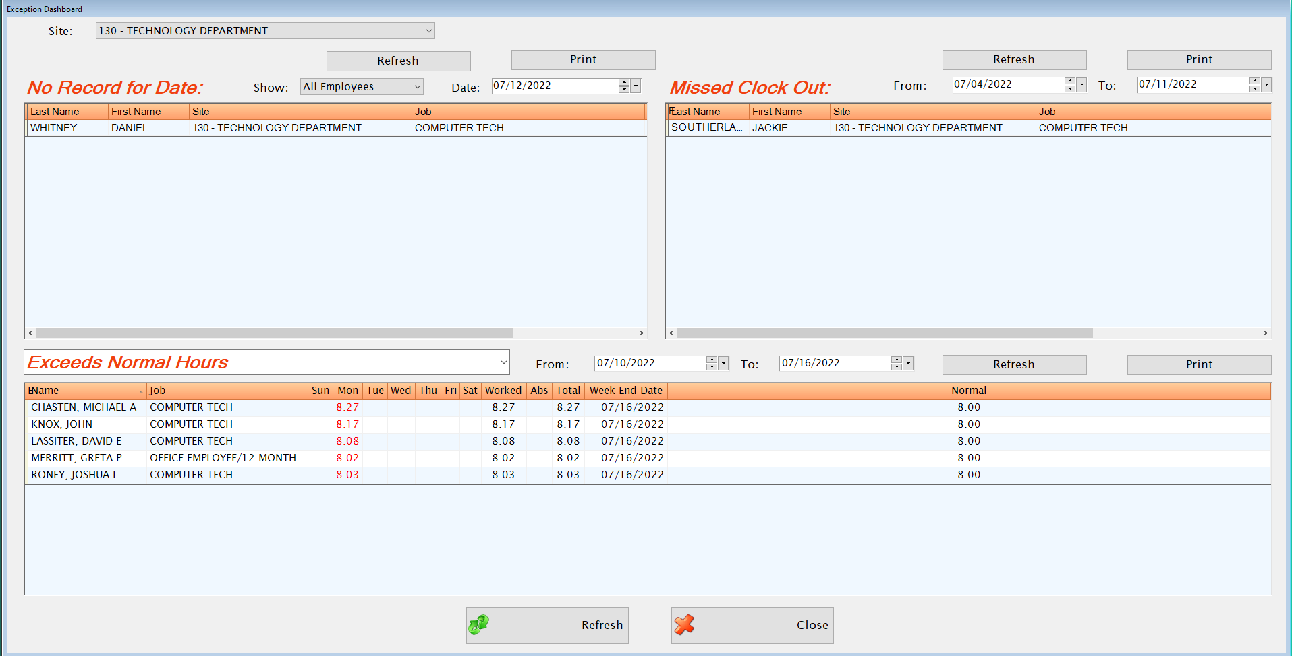
EXCEPTION DASHBOARD + YOU =
Timekeeper Exception Dashboard
  LINQ Payroll -> Timekeeper Menu -> Exception Dashboard
ALWAYS CHECK YOUR EXCEPTION DASHBOARD BEFORE YOU TURN IN YOUR PAYROLL EACH MONTH.

Slide 6

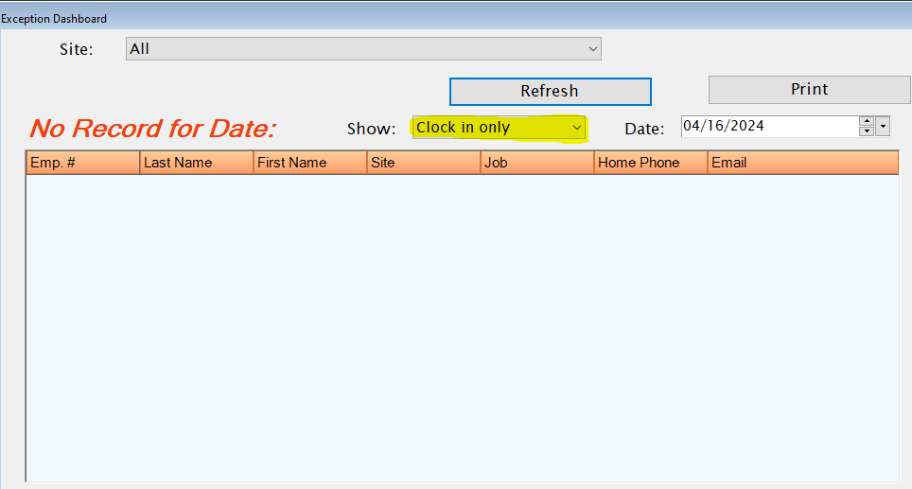
QUICK QUIZ!
CLOCK IN/ OUT ONLY employees are okay to have on the dashboard as long as they are ________?
EXAMPLES ARE:
*BUS DRIVER/TA *CERT/EXT *CHILD NUTRI/HRLY SUB
*TUTOR *BUS/MONITOR *BUS/DRIVER
*BUS/SUB *EXTRA DUTIES
CLOCK IN ONLY employees should NOT be on your dashboard unless they are less than %100 employed.

Slide 7
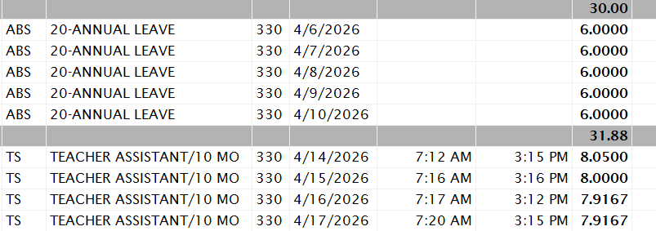
LESS THAN 100% EMPLOYED
A 37.5 HOUR EMPLOYEE AT 80% EMPLOYED. THE EMPLOYEE WORKS 4 DAYS PER WEEK FOR A TOTAL OF 30 HOURS.
LINQ ONLY FACTORS IN A 5 DAY WORK WEEK. THE EMPLOYEE SHOULD BE WORKING 7.5 HOURS PER DAY FOR 4 DAYS BUT THE SYSTEM THINKS THE EMPLOYEE IS WORKING 6 HOURS PER DAY.
YOU MUST CALCULATE THE TOTAL MISSED HOURS WHEN THE EMPLOYEE TAKES A DAY OF LEAVE.

Slide 8
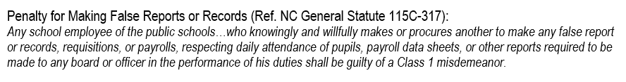
TOP 3 TASK PRIOR TO PAYROLL DUE
Time Approval and Change Documentation
1.Administrators are required to review and approve the Absence History Report and Substitute Listing Report prior to the Payroll Reports Due Date.
2. Document, document, document!
3. All changes to an employee’s timesheet must have appropriate backup documentation. *When staff is allowed to leave early their clock out time MUST be the time they leave campus not their normal clock out time*

Slide 9
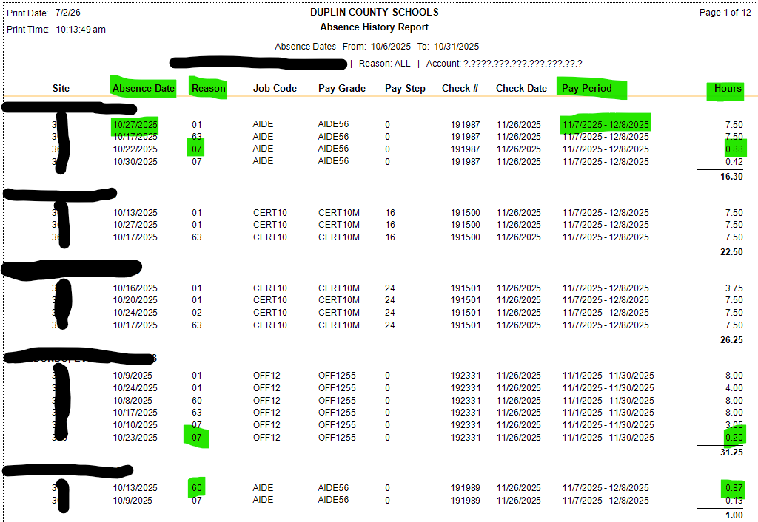
What to look for when reviewing Absence History Report
Absence Date Range matches Payroll Schedule Dates
Absent Code is correct and increment of hours keyed is correct for that absence code
Verify Pay Period
WHAT 3 LEAVE TYPES CAN BE USED IN ANY INCREMENTS?
*07-ABSENCE WITHOUT PAY
*04-ABSENCE WITHOUT DEDUCTION
*60-COMP TIME

Slide 10
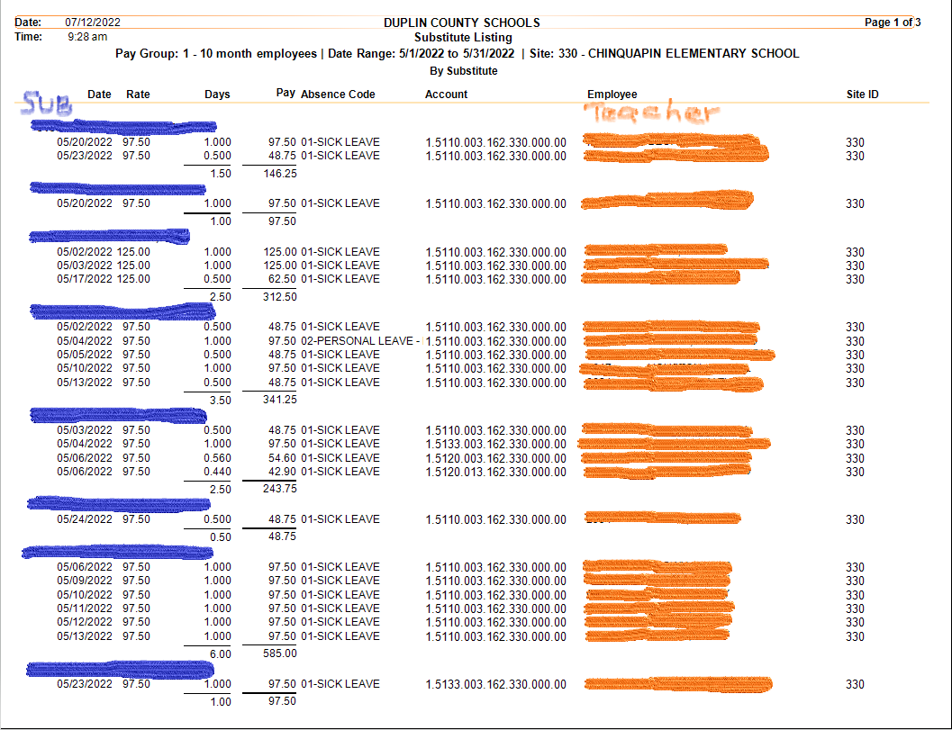
What to look for when reviewing Substitute Listing Report
Date Range matches Payroll Schedule
Days should either be .50 or 1.00. Substitutes are paid in ½ or whole day increments.
Absence code is correct
Account codes are correct (see next slide)
Account code site is assigned to your site number
When you are keying a sub in for an absence, what year should they end in?
*2099

Slide 11
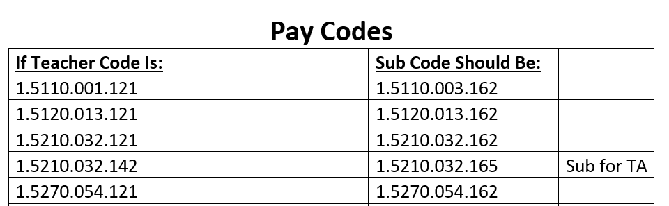
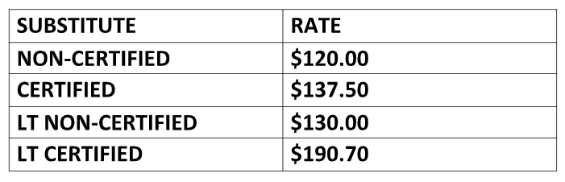
SUB BUDGET CODE/SUB PAY RATE

Slide 12
Substitute Codes
04 -Absence W.O Deduction:
Should most often be coded to 163. Make sure that you are checking the Professional Development form for Sub Codes.
It will be helpful to you to copy the Sub code for the PD and paste it into the notes section of the leave request. By doing this you will have the code available for when you attach the sub.
All other leave types:
Teachers should be coded to 162 unless you are using school funds to cover the sub and in this case you would use 509.
Teacher Assistants should be coded to 165 unless you are using school funds to cover the sub and in this case you would use 509.

Slide 13
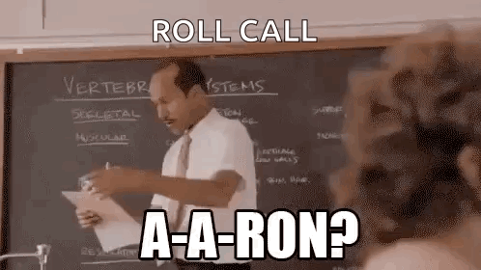
SUBSTITUTE REMINDERS
Daily Subs
  Only allowed to be paid for by DCS budgeted funds for substitutes filling in for a teacher who is on paid leave
  The sub is paid from the same source of funds from which the regular teacher is paid
  Subs for Teacher Assistants are only allowed to be paid for with DCS budgeted funds if they are EC TAs or special situations approved in advance through Human Resources
Long Term Subs
  Requests for LT Subs need to be sent to Human Resources
  LT Subs must work at least 21 consecutive days for the same teacher
509 Subs
When using School Funds to pay a sub make sure you have keyed the correct budget code in timekeeper as well as providing an approved 509 form

Slide 14
Long Term Substitute Spreadsheet
*Substitute spreadsheets will be required going forward when turning in payroll.
*Spreadsheets must be typed and completely filled out.
*Full Name of Teacher & Sub
*Employee ID #
*Teacher/ Sub Code
*Spreadsheet MUST be kept up with by the Bookkeeper to verify accuracy and that substitutes are paid
*It is Mandatory that Subs sign in daily. It can be a paper sign in sheet or by Identakid as a Sub.
Long Term Sub Spreadsheet

Slide 15
Use of 509 Forms
Field Trips
When a outside agency such as NC State, ECU, Rural Teacher Leadership are covering sub expense. (Bookkeeper will submit for reimbursement through agency)
Principal approved PD that is NOT covered by a department such as CTE & EC.
*BETA Convention
Sporting Event-Competition/Playoffs
509 FORM

Slide 16
PAYROLL - DIRECT DEPOSIT
If an employee submits a new form, please have them only submit their employee ID, not their entire SSN for security reasons.
Due to continued, aggressive fraud attempts, Bookeepers must initial and date the change form to confirm they have received the form directly from the employee.
If an employee needs their direct deposit changed immediately, please call your payroll contact person so it can be turned off and no additional checks are sent via direct deposit to their account. They will receive paper checks instead.
First paycheck after direct deposit is set up or changed will be a paper check. This allows us to test the account before we send the entire paycheck there. It also helps detect and prevent fraud.
*** Starting in August 2026, all DCS employees will be required to complete a direct deposit form. ***
Direct Deposit Form

Slide 17
PAYROLL - FRONTLINE
All absences for certified staff must be entered into Frontline by the employee requesting the absence. This is MANDATORY.
Leave must be keyed under Leave Request - GREEN FORM
Professional Development must be keyed under Prof. Development Request - YELLOW FORM
When a substitute is needed, whenever possible, the employee should also request the sub through Frontline. ABSENCE MANAGEMENT
  Not always possible when absences are unplanned

Slide 18
LEAVE - REMINDERS
Be sure to key leave on the correct payroll assignment.
  Keying leave on an assignment that does not accrue leave causes system errors when processing payroll.
Be sure the employee has enough leave to cover what is being keyed. Do not key leave in the negative.
  Exception: With Principal approval, NEWLY HIRED 10 MONTH EMPLOYEES may borrow annual leave up to the amount they will accrue by the last day of school to use during the built-in annual leave days in the school calendar.
If an employee plans to be out for an extended amount of time, immediately contact Ms. Lanier and the payroll person assigned to the site.
  Potentially protects the employee’s position when there is leave they can apply for
  May prevent overpayment
  Allows DCS to explain how their benefits may be continued – NO SURPRISES!

Slide 19
QUICK QUIZ
Mr. Jones (AD) became ill and could not drive the girls soccer team to their game. Ms. Powell, who is a volunteer for the soccer team stated she had bus license. Mr. Jones told Ms. Powell she can drive the bus and the bookkeeper will reimburse her from the athletic account the next day. Ms. Powell drove the team to their game and returned back to school. It is the next day and Ms. Powell is looking for her compensation.
What should you do in this situation?

Slide 20

SCHOOL GENERAL FUND PAYROLL REIMBURSEMENTS
Never, ever, (ever) pay an employee through school general funds
All Local School Forms must be approved by the Principal
Substitutes that are not allowed to be paid through budgeted funds and extra duty that the school will pay for are coded to program 509.
  ex: 6.5110.509.162.SCH.000.00 for a school paid sub
Extra duty activities and extended employment must be approved through Human Resources BEFORE it occurs. No employee should be working in a position that is not assigned to them. Ex: If an employee can’t clock in on a position, they should not be working in that capacity.
Manual timesheets and/or Local Schools pay form is submitted with payroll documentation
Pay is processed through payroll, and schools are billed for these expenses.

Slide 21
WORK WEEK AND WORK DAY REMINDERS - EXEMPT
Exempt jobs are excluded from earning overtime/comp time
Examples of exempt jobs are Teacher, Nurse, Director, Principal, Assistant Principal
The workweek for certified teachers and certified instructional support is a minimum of 37.5 hours, and will continue until the professional responsibilities to the student and school are complete.
The workweek for other exempt professional staff will be a minimum of 40 hours, and will continue until the professional responsibilities to the student and district are complete.
Supervisors may assign extra duties within the employee’s regular job scope beyond the normal workday without pay as long as the assignments are distributed equitably and are reasonable in the amount of time.
Payment for extra duties considered beyond the scope of an employee’s regular job must be pre-approved by Human Resources.

Slide 22
WORK WEEK AND WORK DAY REMINDERS- NON-EXEMPT
Non-exempt jobs are not excluded from earning overtime/comp time
Examples of non-exempt jobs are bus driver, mechanic, teacher assistant, bookkeeper, custodian
The workweek for full-time classified non-exempt employees is 40 hours except for TAs who have a workweek of 37.5 hours.
Non-exempt employees must be compensated for all hours worked.
No working “off the clock”
“Flexing” time within the same workweek is a supervisor decision.
Earning rate for overtime/comp time:
  If workweek is 37.5, earns straight time for extra hours worked up to 40
  Earns time and a half for all hours worked over 40
  Comp Time is the default for our school system
  Comp Time is discouraged by policy (See Board Policy 7500) and must be approved by the Superintendent or his designee

Slide 23
What do you think the top Payroll mistakes are?
*Sub codes
*Sub job (picking 2026 instead of 2099)
*Choosing the wrong pay period
*Turning in payroll later than the scheduled due date
*Missing frontline request
*Subs not signing in
Now, how can we fix it?
* Review Sub Listing report very carefully. This will catch sub codes, pay period, & sub pay
*Communication with all parties; employees, subs, Payroll specialists
*Work daily on payroll so you can accurately turn in payroll on the assigned date
*If you have a question; PLEASE CALL OR EMAIL AND ASK US
We are here to help, when you are on task so are we. Let’s help each other!

Slide 24

New & Improved for YOU!
Google Calendar - PAYROLL
We created this calendar specifically for Payroll deadlines. In the event you need it at the tips of your fingers.
Annual Leave Cheat Sheet
Annual leave can be tricky, which is why we made a one page cheat sheet.
If you think of anything else that would help, please let us know and we will see what we can do!

Slide 25
FMLA NON-FMLA
The purpose of medical leave under the Family and Medical Leave Act is to protect an employee’s job while on medical leave for 10 or more consecutive days for either his/herself or their spouse, child, or parents.
The employee must have worked for the employer for at least 12 months on the date the FMLA leave is to start or the employee must have at least 1,250 hours of service for the employer during the 12-month period immediately before the date the FMLA leave is to start.
Employees eligible for FMLA must provide their supervisor and Ms.Lanier with a request for medical leave indicating the reason for requesting leave, the date their leave will begin, and the date they expect to return to work. Once the request is submitted, Ms. Lanier will send the employee all the forms necessary for review of their request.
Employees wishing to be off work for more than 10 days who do not have accrued leave of the correct type, or it is for a reason not covered by a leave type, or they are not eligible for FMLA must:
  Obtain Supervisor approval to apply for a leave of absence AND
  Apply for a leave of absence through Human Resources.
  The Board of Education must approve all absences that are longer than 10 days.

Slide 26
WORKERS’ COMPENSATION
What is Workers Compensation?
Workers’ compensation insurance is a type of business insurance that provides benefits to employees who suffer work-related injuries or illnesses. Specifically, this insurance helps pay for medical care, wages from lost work time and more.
Employees who miss work due to a work related injury must use their own leave the first seven days. Any absences beyond seven days due to work related injuries will be paid through workers’ compensation and their accrued leave should not be used.
Employees who are injured on the job must follow these steps:
Employee reports injury right away to their supervisor
Administrator or bookkeeper completes form and forwards it to the benefits administrator as soon as possible
  The injured employee must never complete the injury report themselves!
Benefits administrator keys and submits claim
Adjuster is assigned to employee by workers’ compensation
Employees that need to be seen by a doctor must go to a Goshen Medical in Duplin County or ECU Health Duplin Hospital if they want workers compensation to cover those services.

Slide 27

STATE HEALTH PLAN OPEN ENROLLMENT
New employees have 30 days from their date of hire to enroll for benefits. If they miss enrolling for benefits, they will have to wait until open enrollment to enroll for benefits in 2026.
New employees who enrolled for benefits when hired still have to take action during open enrollment if they want to continue their SHP benefits in 2027!
Open enrollment will take place from October 12th through October 30th.

Slide 28
LEAVE BENEFITS - PARENTAL LEAVE
Existing Benefits for Parents
Sick Leave
  Up to 30 days of earned sick leave may be used to care for a child placed with an employee for adoption or foster care. May be taken any time within 12 months of placement and is available to either parent.
  For the birth of a child, there is a presumptive recuperation period of 30 days (or longer by order of medical professional) for which sick leave may be used. Must immediately follow the birth of the child and is only available to the birthing parent.
FMLA
  Allows eligible employees to take 12 work weeks of unpaid, job-protected leave during a qualifying event.
  Employee may use accrued annual leave or personal leave during this time. Sick leave may be used if indicated by a medical professional.
  Parents who are employed by same employer are limited to a total of 12 weeks of FMLA leave.
Unpaid Parental Leave
  Unpaid leave of absence for up to one calendar year from the date of birth, adoption, or foster placement.
  Annual leave (or sick leave by order of medical professional) may be used to maintain payroll status
  Parents who are both employed are limited to a combined total of 12 months.

Slide 29
LEAVE BENEFITS - PARENTAL LEAVE
Paid Parental Leave
8 weeks of paid leave for birthing parent; 4 weeks for all other qualifying events. Part-time limited to 4 weeks for birthing parent and 2 weeks for other qualifying events.
  Parent – the legal guardian or custodian of a child through birth, adoption, foster care, or other legal placement.
  Child – a newborn biological child or newly place adopted, foster, or otherwise legally placed child under the age of 18.
  Qualifying Event – when an eligible employee becomes a parent to a child.
Effective October 1st, 2026 changes will take place regarding paid parental leave, we will provide more information as it becomes available.

Slide 30
LEAVE BENEFITS - PARENTAL LEAVE
  Eligible employee
    A permanent, full-time employee who becomes a parent to a child under the age of 18 years.
    Time-limited and probationary employees are eligible for paid parental leave.
    Prorated benefit for eligible, part-time employees.
    Eligible employee must be employed by a PSU for the immediate twelve months without a break in service preceding the qualifying event.
      At least 1,040 hours in payroll in that 12-month period
      Temporary employees and independent contractors are not eligible for paid parental leave
      Each PSU is separate employer for meeting 12-month employment requirement.

Slide 31
LEAVE BENEFITS - PARENTAL LEAVE
  Usage
  Leave is limited to the twelve months following the qualifying event.
  Multiple births (or placements) do not increase the total amount of the leave.
  Unused paid parental leave is forfeited twelve months from the date of qualifying event.
  Parental paid leave shall not be counted against or deducted from the employee’s leave balances
  Employees shall not be paid out for this leave upon separation from employer.
  Paid parental leave may not be donated to another employee.
  May be used intermittently
  Paid parental leave may be used only once by an eligible employee within a rolling 12-month period.

Slide 32
LEAVE BENEFITS - PARENTAL LEAVE
  Other Considerations
  Paid parental leave is in addition to all other parental benefits offered by the State.
  Paid parental leave runs concurrently with FMLA provided the employer notifies the employee that the leave qualifies for FMLA leave in accordance with Section 8.2.10 of the Benefits Manual.
  Employee may take paid parental leave after exhausting FMLA.
  Employees may take parental leave benefits in any order provided they meet the requirements for using the leave at the time of request.
  Regardless of the order of leave options, parental leave is a FMLA qualifying event and will count against the employee’s FMLA benefit entitlement.
  This policy is effective for qualifying events occurring on or after July 1, 2023.

Slide 33

LEAVE BENEFITS - BENEFITS WEBPAGE
Be sure to visit the Benefits Webpage for additional information on these and all employee benefits!
Click the image below to access employee benefits information.

Slide 34
TAKEAWAYS
Please work with staff to verify Address & Phone number is correct in Linq. If it is not they will need to submit a personnel change request through Timekeeper. *This is important for Open Enrollment.
All employees should submit a Direct Deposit form if they do not already have Direct Deposit set up.

Slide 35

THANK YOU!

