Slide 1
FCS
Assessment
Department
New Teacher Celebration
2026-2027
Overview of Assessment Elementary
Notes:
sweigart

Slide 2
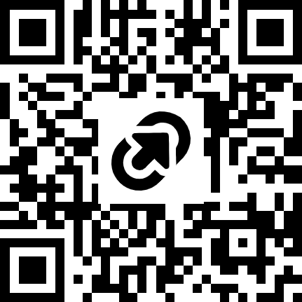
New Teacher Celebration Resources
Access the program and session resources by going to https://tinyurl.com/FCSNTC2026 or scanning the QR code:

Slide 3
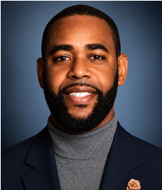

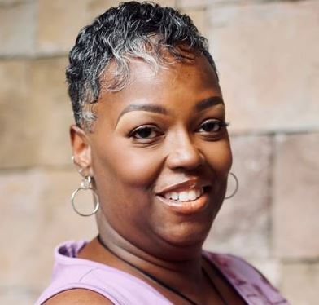


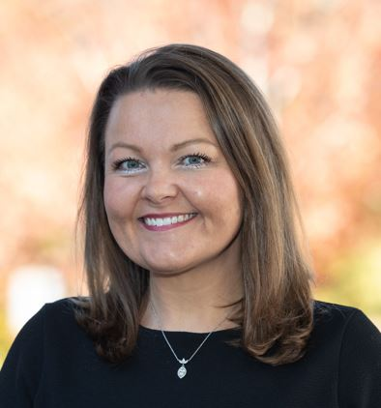

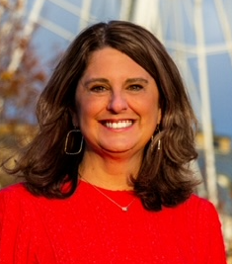

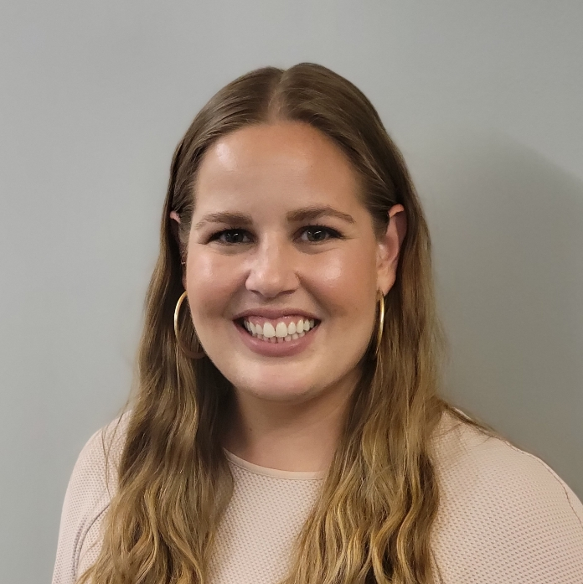
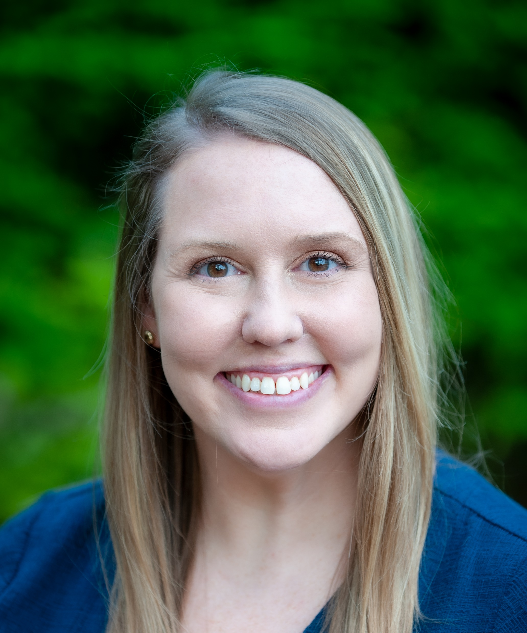
INTRODUCTION TO THE ASSESSMENT TEAM
Charles Chester
Director, Assessment
@fultonschools.org
Shonda Madison
Professional Assistant III
madisons@fultonschools.org
Data-Driven Instruction
Erin Collins Stone
Coordinator, Assessment
stonee4@fultonschools.org
Andrew Simmons
Program Specialist
simmonsa1@fultonschools.org
Zone 2 Schools
LaWanda Knight
Program Specialist
knightl@fultonschools.org
Zone 4 Schools
Sarah Boltz
Program Specialist
boltz@fultonschools.org
Zone 6 Schools
Corissa Worthy
Program Specialist
worthyc@fultonschools.org
Zone 3 Schools
Jennifer Sweigart
Program Specialist
sweigartj@fultonschools.org
Zone 5 Schools
Jennifer Edmonds
Program Specialist
edmondsj@fultonschools.org
Zones 7 Schools
State and National Assessment
Whitney Jankovic
Coordinator, Assessment
jankovicw@fultonschools.org
Ryan Haire
Program Specialist
hairer@fultonschools.org

Slide 4
GOALS FOR TODAY’S SESSION
Participants will learn about the different assessments administered in Fulton County. We will:
  Share assessment board policy
  Discuss Fulton assessments and purpose
  Show how to access various assessment platforms
  Review Fulton's assessment calendar
  Discuss data-driven instructional practices
Notes:
Add in "The Goal of today is to understand the Assessment Portfolio for FCS! You may not know all of this, but will at least have heard most of this information."

Slide 5
GOALS FOR TODAY’S SESSION
Participants will learn about the different assessments administered in Fulton County. We will:
  Share assessment board policy

Slide 6
BOARD POLICY
Board policy II governs assessment administration for FCS.
How does policy define the purpose of each assessment type?
Universal Screening & Diagnostic Assessment
determine a student’s overall academic performance level and their strengths/weaknesses
identify students who may benefit from additional services or supports
Pinpoint learning needs to guide curricular and instructional decisions
used at intervals throughout the year to monitor student growth
Standards-based Assessment
used in the classroom before, during, and after instruction
monitor and evaluate student progress towards mastery of grade level standards
inform instruction and respond to students’ needs
teachers reflect on the effectiveness of their instructional strategies
State and National
Assessment
evaluate learning at the end of a long-term instructional period
determine whether each student has achieved proficiency on a set of required skills and concepts
classify or rank students on a continuum of achievement compared to their peers
Notes:
sweigart

Slide 7
GOALS FOR TODAY’S SESSION
Participants will learn about the different assessments administered in Fulton County. We will:
  Discuss Fulton assessments and purpose
Notes:
edmonds

Slide 8
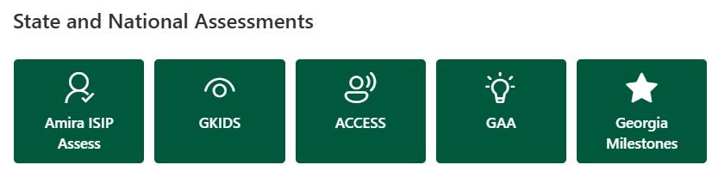


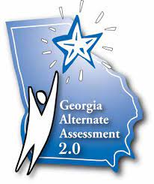


FCS ASSESSMENTS: STATE AND NATIONAL
State and National
Assessment
evaluate learning at the end of a long-term instructional period
determine whether each student has achieved proficiency on a set of required skills and concepts
classify or rank students on a continuum of achievement compared to their peers
Read more about state and national assessments on the Assessment Hub!
Notes:
Add QR code to link board policy and our website. Add a table to for assessments and notes
Purpose of standardized assessments is to evaluate learning at the end of the instruction (end of year or program) to determine if a student has achieved proficiency on required skills and concepts

Slide 9


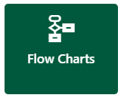

FCS ASSESSMENTS: UNIVERSAL SCREENER & DIAGNOSTIC ASSESSMENT
Universal Screening & Diagnostic Assessment
determine a student’s overall academic performance level and their strengths/weaknesses
identify students who may benefit from additional services or supports
Pinpoint learning needs to guide curricular and instructional decisions
used at intervals throughout the year to monitor student growth
Notes:
Purpose of universal screening and diagnostic assessments is to …..

Slide 10
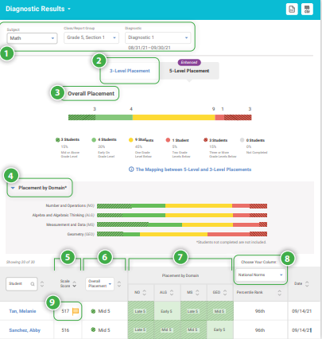
UNIVERSAL SCREENER & DIAGNOSTIC i-READY INFORM
Who? | When? | Why?
Grades K-5 | Fall: Grades K-5 Winter: Grades K-5 Spring: Grades K-2 (Math) Grades: K-3 (Reading) *Grades 4-5 optional* | Computer adaptive test that measures skills in Reading and Math Helps determine students' overall academic performance levels Identifies students who may benefit from additional services or supports to meet their learning needs
Read more about i-Ready on the Assessment Hub!
Notes:
Purpose of universal screening and diagnostic assessments is to …..

Slide 11
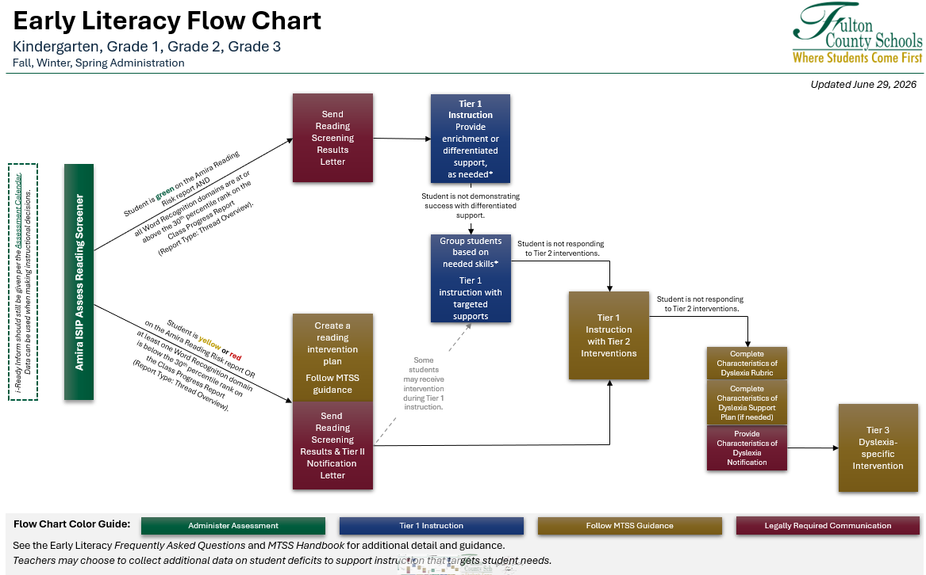
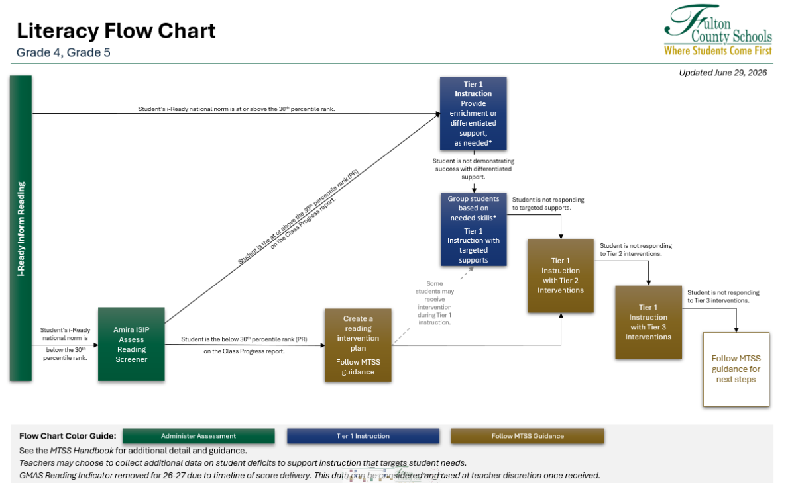
MTSS EARLY LITERACY FLOWCHARTS
Who? | When? | Why?
Grades K-5 *Teachers will learn more about the criteria at the pre-planning PD | Fall: Grades K-3 (required) Grades 4-5 (see chart) Winter: Grades K-3 (required) Grades 4-5 (optional) Spring: Grades K-3 (required) Grades 4-5 (optional) | Helps teachers gain additional information on students’ phonics skills Allows teachers to identify specific gaps in phonological awareness, phonics, and oral reading fluency Identifies students who may benefit from additional services or supports to meet their learning needs
Read more about Flow Charts on the Assessment Hub!

Slide 12

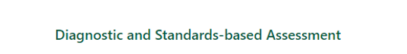
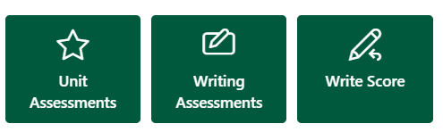


FCS ASSESSMENTS:
STANDARDS-BASED ASSESSMENTS
Standards-based Assessment
used in the classroom before, during, and after instruction
monitor and evaluate student progress towards mastery of grade level standards
inform instruction and respond to students’ needs
teachers reflect on the effectiveness of their instructional strategies

Slide 13
STANDARDS-BASED ASSESSMENTS
UNIT ASSESSMENTS
Who? | When? | Why?
Grades K-5 | At the end of each instructional unit. | Used to monitor student progress towards mastery of grade-level standards Administered at the end of an instructional unit Unpacking assessment items and blueprints facilitates understanding of student expectations Results should be analyzed and used to inform instruction
Content | Grade
Math | Grades K-5 Unit Assessments
ELA | Grades 3-5 Unit Assessments
Science | Grade 5 Unit Assessments
Social Studies | Grade 5 Unit Assessments (optional)
Read more about Unit Assessments on the Assessment Hub!

Slide 14

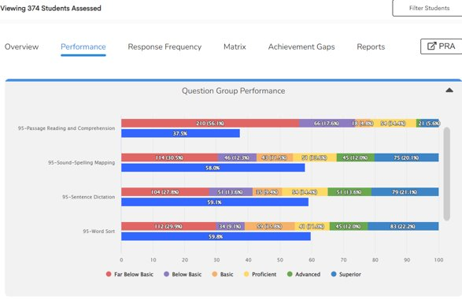
STANDARDS-BASED ASSESSMENTS
95 PHONICS CORE PROGRAM (PCP)
Who? | When? | Why?
Grades K-2 (required) Grade 3 (optional by zone) Grades 4 & 5 (required at some schools) | At the end of each 95 Phonics Core (PCP) unit | Used to monitor student progress towards mastery of 95 PCP skills taught Administered at the end of an instructional unit Unpacking assessment items facilitates understanding of student expectations Results should be analyzed and used to inform instruction K-2 administration is required in all schools. K-2 Reading/ELA teachers will enter student data in Illuminate for each assessment.

Slide 15
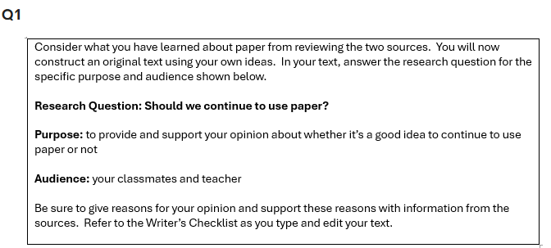

STANDARDS-BASED ASSESSMENTS:
WRITING ASSESSMENTS BENCHMARK 1
Who? | When? | Why?
Grades 3-5 | October 5-9 (Benchmark 1 on the calendar) | Provides district-wide assessment and data point on students’ writing skills so that schools can use the data to tailor further writing instruction Offers data analysis and reporting (needs to be teacher scored using GADOE rubric)
Read more about Writing Assessments on the Assessment Hub!

Slide 16
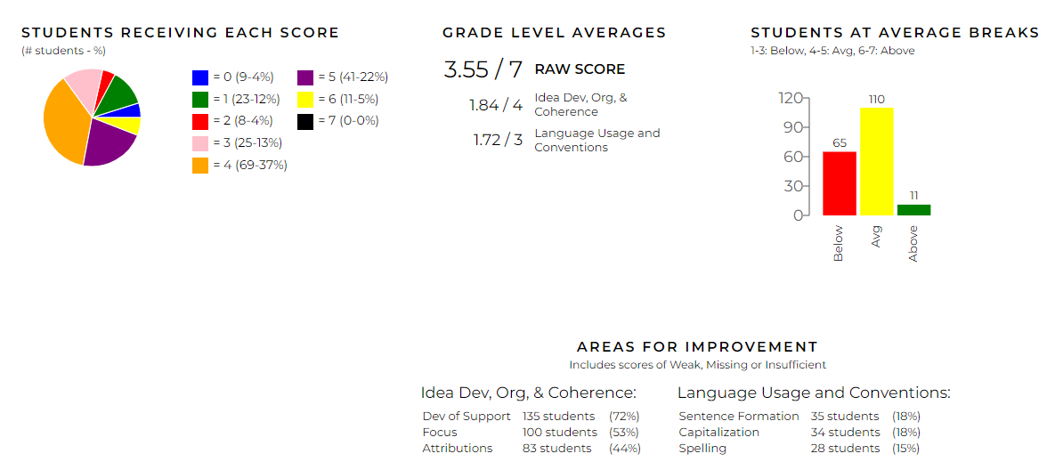
STANDARDS-BASED ASSESSMENTS:
WRITE SCORE BENCHMARK 2
Who? | When? | Why?
Grades 3-5 | February 1-5 (Benchmark 2 on the calendar) | Provides hand-scored extended writing task and peer revision tasks assessments that are formatted and aligned to Georgia Milestones (ELA Section 1) *Grades 3 & 5 will complete an extended writing task *Grade 4 will complete a Peer Revision Task Offers data analysis and reporting, as well as lesson plans, professional development, and resources
Read more about Write Score on the Assessment Hub!

Slide 17

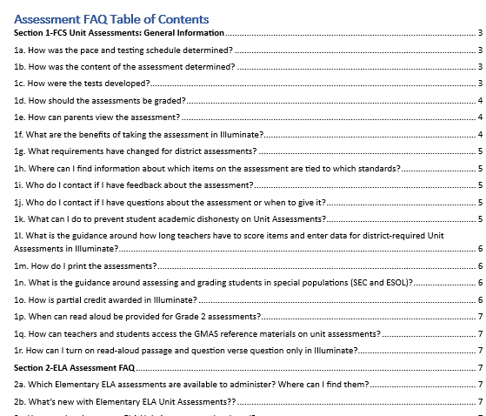
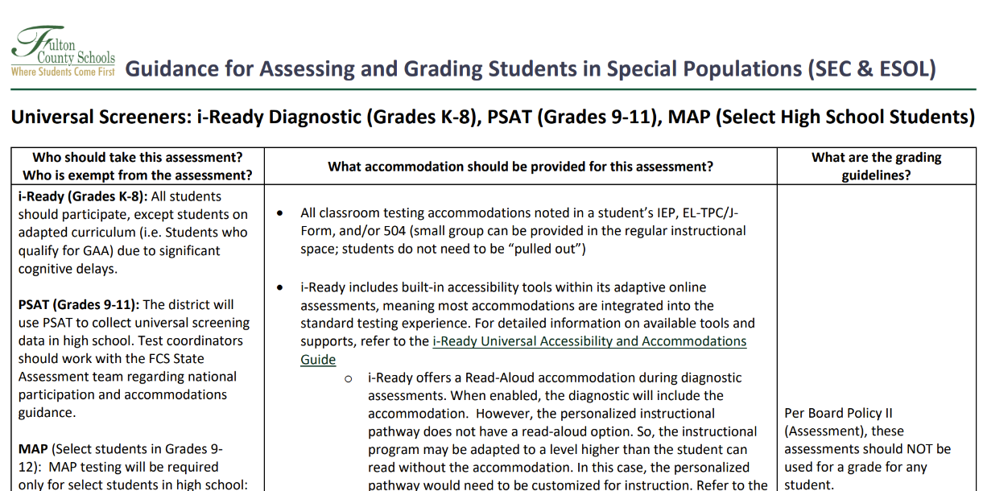
FAQ and SPECIAL POPULATIONS GUIDANCE
Assessment FAQ
Special Populations Guidance

Slide 18

Turn and Talk...
Name one assessment you have learned about in FCS and share its purpose.
Notes:
edmonds

Slide 19
GOALS FOR TODAY’S SESSION
Participants will learn about the different assessments administered in Fulton County. We will:
  Show how to access various assessment platforms
Notes:
worthy

Slide 20
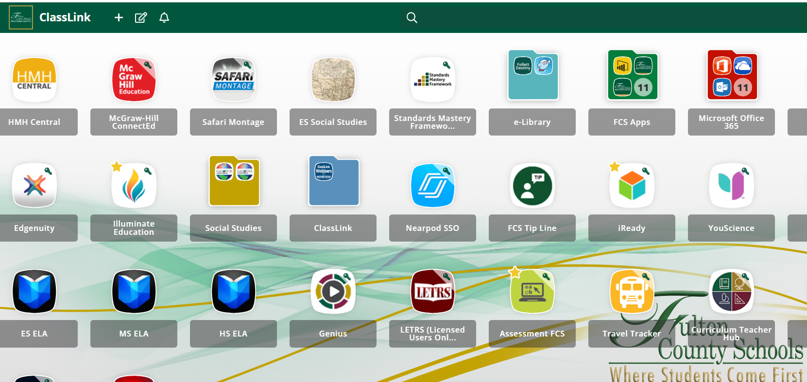
FCS ASSESSMENT PLATFORMS
Notes:
Give one minutes to log in to ClassLink and find/access Illuminate app
Share uses of Illuminate
Access and administer district created unit assessments (summative assessments) for specific grades/contents
Create additional assessments (summatives and formatives) for use throughout the year

Slide 21
GOALS FOR TODAY’S SESSION
Participants will learn about the different assessments administered in Fulton County. We will:
  Review Fulton's assessment calendar
Notes:
worthy

Slide 22
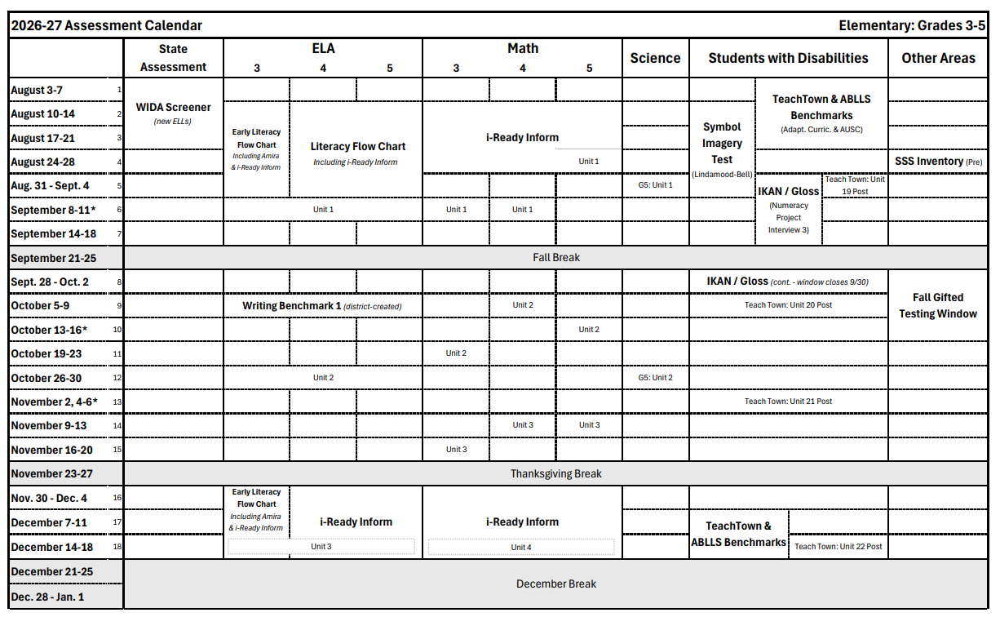
FCS ASSESSMENT CALENDAR
Notes:
Explain how calendar is divided by content/student groups and organized by weeks
Explain testing window, can administer assessment before window if students are ready, must test by Friday of the assessment window week
Calendar for each content matches the content pacing guides
IF ON THE CALENDAR IT IS REQUIRED. Other assessments that can be given as options but these are REQUIRED
Print out assessment
ES- K-2 and 3-5
Bring highlighters

Slide 23
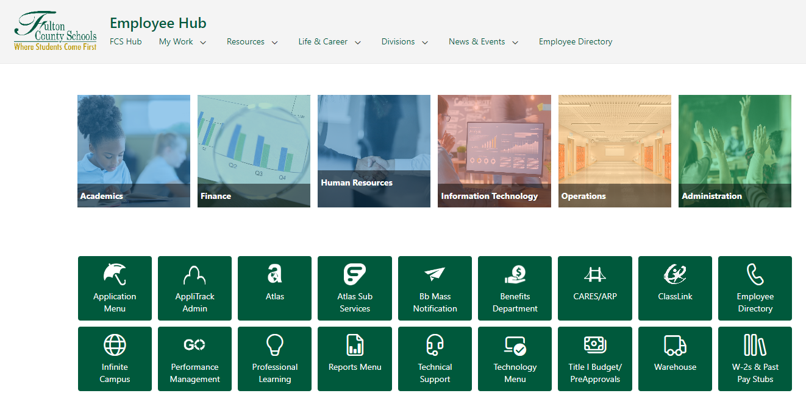

FCS ASSESSMENT CALENDAR: ACCESS
To access the Assessment Hub…
Log into the Employee Hub-> Click the Academics app-> Choose Assessment
Notes:
Walk through steps and give a minute to navigate to Employee Hub

Slide 24
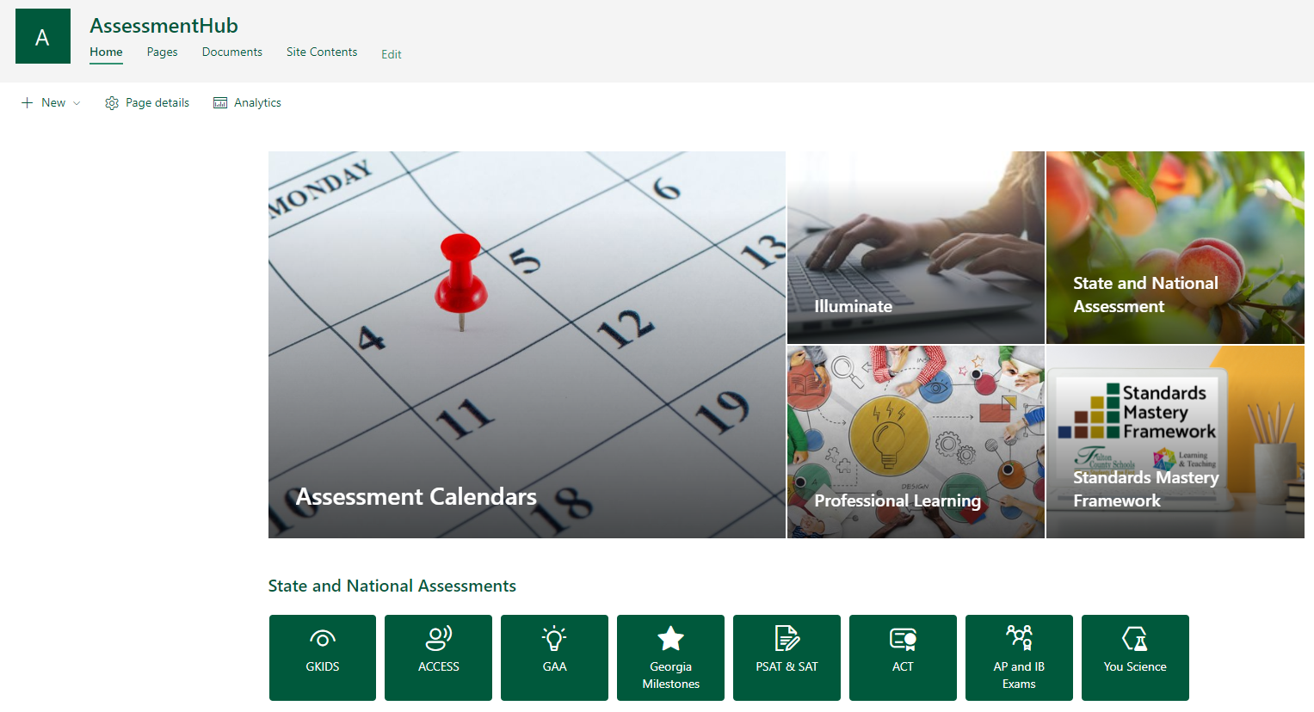
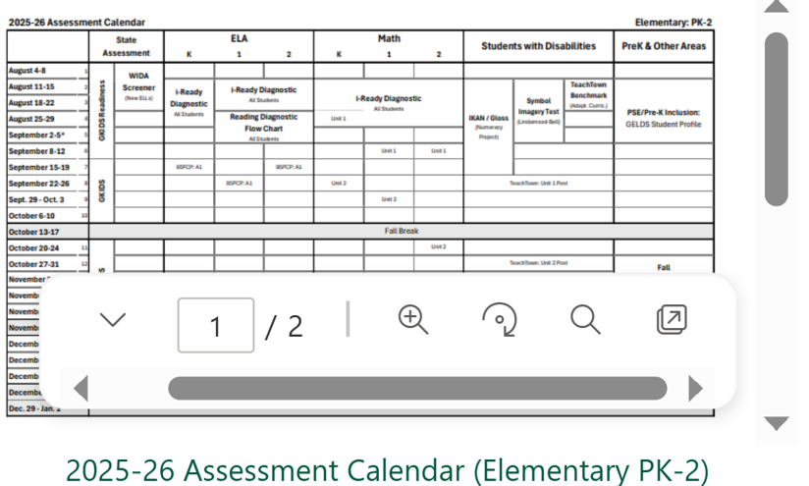
FCS ASSESSMENT CALENDAR: VIEWING
Place your clicker over the PK-5 Assessment Calendar-> Click “Open in new window” box
Choose "Assessment Calendars"
Notes:
Walk through steps and give a minute to navigate to

Slide 25
FCS ASSESSMENT CALENDAR
Share ONE thing you notice on the Assessment Calendar you’re viewing.
Notes:
Worthy
Give a few minutes to look at the assessment calendar
Share one thing they notice Ask any questions

Slide 26
GOALS FOR TODAY’S SESSION
Participants will learn about the different assessments administered in Fulton County. We will:
  Discuss data-driven instructional practices
Notes:
Sweigart

Slide 27
DATA-DRIVEN INSTRUCTION IN FCS
Initial Unit Plan
Unpack summative assessment(s)
Plan for learning
What is the plan for initial learning?
What do students need to know?
Data Analysis & Action (Summative)
Analyze summative assessment data
Plan for reteaching & reassessing
Balanced Assessment Plan (Calendarize)
- Plan and implement common formative assessments & checks for understanding
Data Analysis & Action (Formative)
Analyze formative assessment data
Plan for learning & reteaching (if needed)
What do we do if they don’t know it?
How do we know that they know it?
What do we do if they already know it?
Resources to support with Data-Driven Instruction on the Assessment Hub!

Slide 28
WHO DO I CONTACT FOR SUPPORT?
PLC-Based Support
Grade Level Chair
PLC Team Member or Mentor
School-Based Support
Curriculum Support Teacher (CST)
Coach(es)
ELA Coach
Math Coach
Administrative Assistant (AA)
SDI Coach
District-Based Support
Assessment Program Specialist

Slide 29

QUESTIONS

Slide 30

And welcome to Fulton County Schools!
Notes:
sweigart

