Slide 1

Moving Banker Boxes

Slide 2
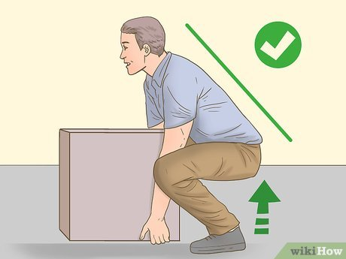
Pre-Move Preparation
The safest way to move banker boxes in an office is to keep the total weight under 30–40 pounds per box, reinforce bottoms with heavy-duty packing tape, and use a wheeled cart or dolly whenever possible. Lift ergonomically using your legs—not your back—and avoid twisting your torso while carrying.

Slide 3
Limit the Weight: Aim for a maximum of 30 lbs. to 35 lbs. per box to prevent lifting strain and avoid bottom blowouts.
Secure the Boxes: Seal the bottom and top seams completely using 2-inch-wide heavy-duty packing tape.
Use the Right Equipment: Never carry tall stacks by hand. Utilize a four-wheel flatbed cart or an upright hand truck (dolly) with stair climbers if you are navigating between floors.
Secure the Load: Strap the boxes to the dolly or hand truck using bungee cords or load straps to prevent shifting while in transit.

Slide 4
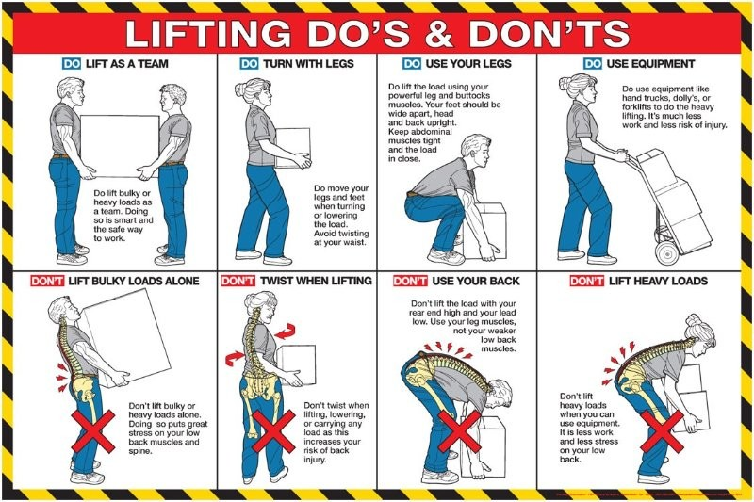

Slide 5
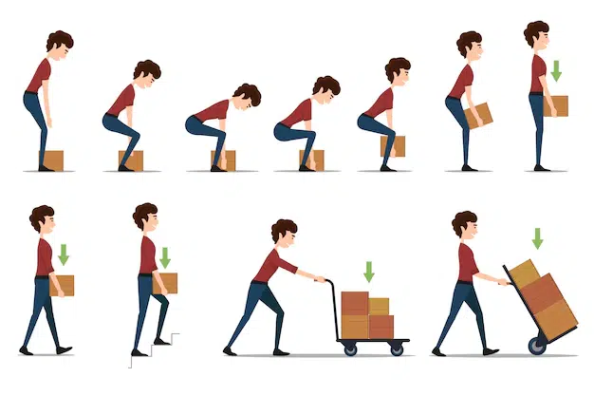
Conclusion
Planning the lift and knowing where you are going is the most critical step in manual handling. Before moving an object, size up the load, ensure your path is clear of obstacles, and know exactly where you are placing the item to prevent back strain and avoid tripping hazards.

