Slide 1
Things To Defuse Violence

Slide 2
OVERVIEW
To quickly defuse violence or aggression, prioritize physical distance, stay calm, and control your non-verbal cues. Practice active listening, offer simple choices instead of ultimatums, and remove audiences to prevent the conflict from escalating further.

Slide 3
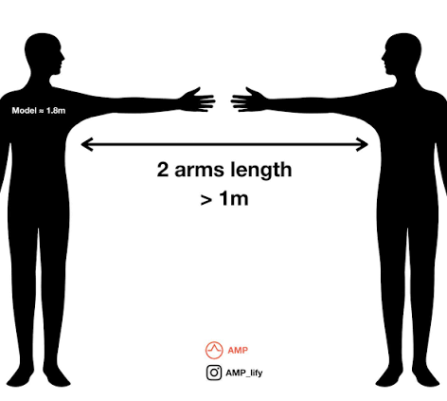
Maintain a safe,
Non-confrontational stance: Keep a distance of at least two arms' lengths. Angle your body to the side rather than facing them directly, and keep your hands visible, open, and relaxed

Slide 4
1. Situational awareness
First, check yourself: your emotional state is your choice. Emotional self-control is key, so make sure you project calmness.
Then check out your surroundings. Where are the exits? Who else is around? Is your risk for personal harm high?
Observe the other person’s verbal and physical behavior. Note how far they have escalated.
Finally, plan your approach and how you might exit, if needed. Remember, safety is paramount.

Slide 5
2. Take care with your words
Resist the urge to say: ”Calm down.” Think about how you’d feel if you were upset. Remember your emotions affect your words, and if you’re fearful, this will show up when you speak. Watch your tone and your volume; if you appear bureaucratic, argumentative, or directive, this will likely trigger an escalation. Speaking calmly and slowly will often prompt the other person to do the same.

Slide 6
3. Acknowledge the problem
You can’t avoid the elephant in the room, so name it and deal with it. Acknowledge the emotion and ask open-ended questions to seek understanding. “Wow, you’re upset; how can I help out?” “You’re clearly angry; what’s going on?” Caution: asking a person if they’re upset, when they clearly are, will lessen your credibility and likely earn you a rude response.
Listen actively and validate feelings: Give the person your full attention. Acknowledge their emotions with neutral phrases like, "I can see you are very upset," which shows you hear them without necessarily agreeing with their actions.

Slide 7
4. Be Empathetic
Dealing with their emotions first is an effective defusing technique. Be empathic and explore their feelings by using non-judgmental questions. Express your goal to try to comprehend where they are coming from. Ask open-ended questions that help you understand their situation. “I’d like to hear more about how you’re feeling.” Use their name if possible and express that “we” will get this sorted out together.

Slide 8
5. Use silence
Silence in a normal conversation is often awkward, yet it can be very helpful in angry confrontations. Using silence helps a person slow down their thinking and regain composure, buying you some time. Lead into a silence break by putting the onus on yourself: “That’s an important point; give me a minute to think about that.” “We’ve covered a lot of ground; I need a moment to collect my thoughts on what we’ve talked about.”

Slide 9
6.Give choices
People often become angry or violent because they feel they have lost control of a situation. They feel someone has either done something to them or is not doing something for them.
Providing them with choices helps them regain control of themselves. Refocus the individual on their issue and, if possible, offer them choices: “I can take down your complaint in writing, or would you rather write it out in your own words?” “Do you want to tell me what happened first or how this made you feel?” ” We can fill out the application together, or you can do it on your own.”

Slide 10
In conclusion
Your overall goal is to respond to these situations confidently, effectively, and safely. There is no “one size fits all” approach to managing aggressive and abusive conduct but being prepared is critical to successfully defusing a situation. Remember: “Failing to prepare is preparing to fail.” So, take some time to think about your more common conflict situations. Visualize how you will act when responding positively. And finally, practice, practice, practice!

