Slide 1

Carl Junction Schools Allergy and Anaphylaxis Annual Training
For School Personnel
2026

Slide 2

Learning Outcomes
  Learner will gain knowledge of allergy basics (food, latex, and insect) and how to respond to anaphylaxis.
  The learner will gain knowledge of the importance of collaboration with staff and families in responding to anaphylaxis.
  Learner will gain knowledge of resources for policy and practice.

Slide 3
Prevalence of Food Allergy in Children
Allergic conditions affect about 50 million children and adults living in the United States (American Academy of Allergy Asthma & Immunology, 2020).
Data from the National Health Interview Survey in 2021 revealed 5.8% of children between the ages of 1-17 years had a food allergy. (Centers for Disease Control and Prevention, 2023).
Non-Hispanic Black children were more likely than non-Hispanic White and Hispanic children to have a food allergy. (Zablotsky et al., 2023).
One third of children/youth with food allergies also has asthma. (Centers for Disease Control and Prevention, 2008).

Slide 4
Food Intolerance
A food intolerance response occurs in the digestive system, not the immune system.
Causes: enzyme deficiencies, sensitivity to food additives, or chemicals in the foods.
With food intolerance, some people can tolerate eating small amounts of the food.
(American Academy of Allergy, Asthma, & Immunology, n.d.).

Slide 5
Food Allergy can be a Life-Threatening Immune Response
A food allergy response occurs in the immune system when eating or coming in contact with certain foods or food additives.
When your immune system identifies a food protein as dangerous, your immune system overreacts.
To protect your body, substances such as histamine and IgE are released into the blood which produces an allergic reaction.
The allergic reaction causes symptoms in the nose, lungs, throat, or on the skin.
(American Academy of Allergy, Asthma, & Immunology, n.d.).

Slide 6

Allergic Reactions to Food
Can range from mild to life threatening… both may vary in type and severity over time.
Early recognition and treatment (without delay) can prevent serious health problems or death.
(Centers for Disease Control and Prevention, n.d.).

Slide 7
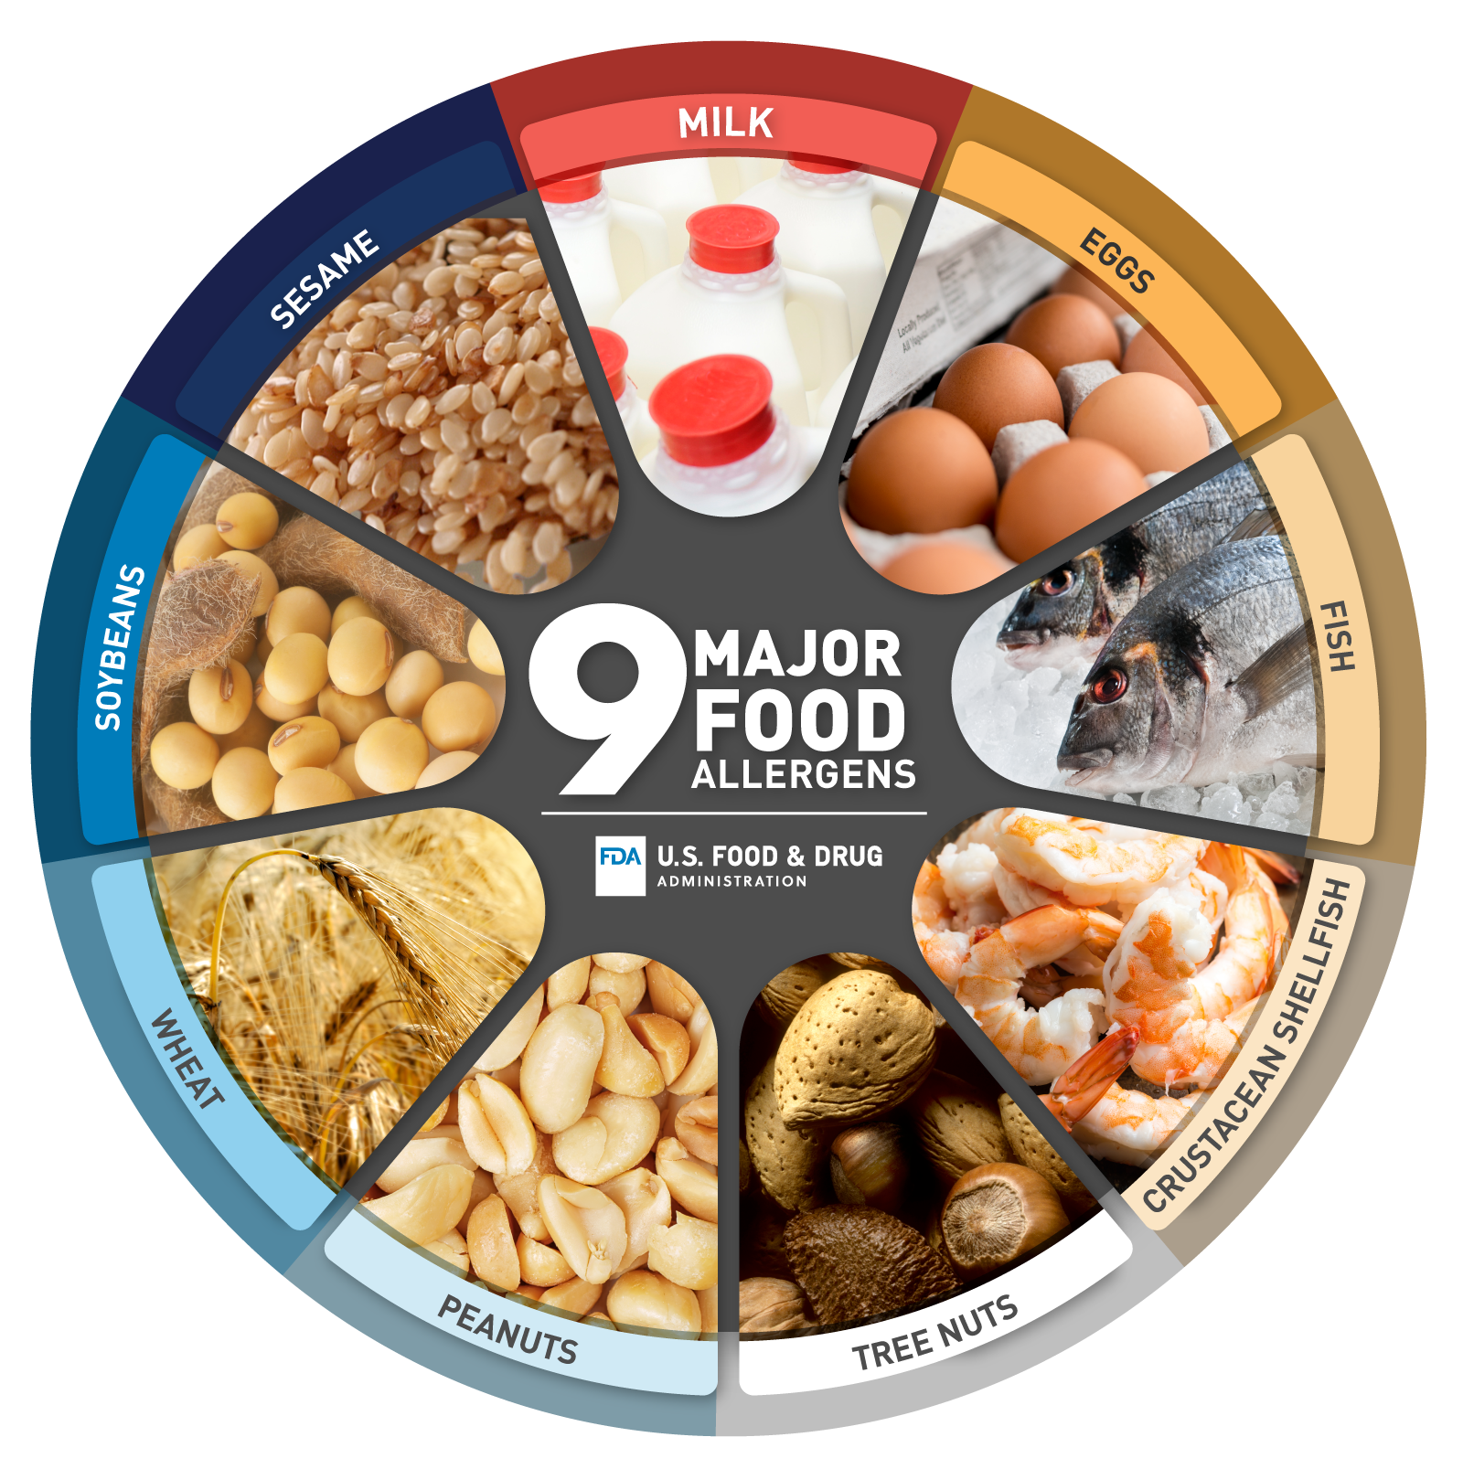
Top Food Allergens
9 foods account for 90% of all reactions in the United States. These are:
Cow’s milk
Eggs
Peanuts
Tree nuts
Wheat
Soy
Fish
Shellfish
Sesame
(Food & Drug Administration, 2023).
Notes:
Avoiding foods known to cause food allergy is the only way to prevent an allergic reaction. These nine are responsible for most severe allergic reactions.

Slide 8
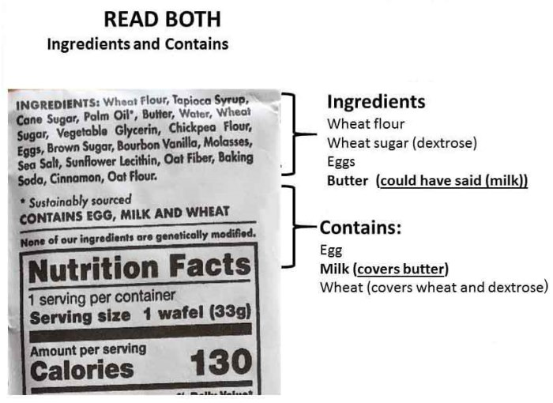
Learn to Read Food Labels
Manufacturers are required to list the ingredients on the label… this does not guarantee that all ingredients are listed. Cross contamination is still possible. Look for “may contain” or “processed with” statements. If in doubt, do not eat it and check with the school nurse or parent.
Did you know?
Tree nuts and coconut are in many skin and haircare products.
Different brands of Play-Doh may contain wheat.
Casein, sodium caseinate, and whey are all milk proteins.
(Food & Drug Administration, 2023).

Slide 9

Latex Allergies
    Safer buildings: Identify possible sources and opportunities for exposure
    Use non-latex gloves for healthcare delivery, food prep, housekeeping, etc.
    Remove healthcare supplies containing latex (bandages, gloves, medical tape, catheters, etc.). CJ health office uses latex free band aids and gloves.
    Remove supplies with latex from classroom such as erasers, rubber bands, art supplies, balloons, etc. Don’t let those products come in contact with child with allergies.
      Remove playground/gym equipment with latex such as rubber mats, balls, etc.
      Avoid foods that are cross-reactive with latex such as banana, kiwi, avocado, chestnut, white potato, and tomato.
      More common in children with frequent hospital stays as an infant/child such as students with spina bifida.
      Post signage.

Slide 10

Insect Stings - Prevention
      Notify custodians if and where they are seen on playground so insecticides can be used and nests can be removed.
      Take measures to limit exposure while eating and drinking outside, especially near trash cans.
      Take measures to prevent stinging insects from entering school (e.g., intact window screen, closed doors).
      Take Walkie-Talkie/phone to recess/outdoors- if suspect allergic reaction, call for nurse. Say “Someone is having a possible allergic reaction, I need a nurse and an Epipen”.

Slide 11
Anaphylaxis
“Anaphylaxis is distinguished from a mild or moderate allergic reaction by the sudden involvement of two or more organ systems manifesting with a variety of symptoms such as difficulty breathing, swelling of the tongue, swelling or tightness in the throat, wheezing, sudden persistent cough, abdominal pain, vomiting, and hypotension” (Sampson et al., 2006; Pflipsen & Vega Colon, 2020).
The onset of anaphylaxis can occur within seconds of exposure to the allergen or can be delayed up to an hour or more (Turner et al., 2019).

Slide 12
An allergic reaction is considered severe or anaphylaxis if there are mild symptoms in more than one body system present or if any of the following severe signs or symptoms are present (FARE, n.d):
Signs and symptoms of anaphylaxis may include:
Shortness of breath
Wheezing
Repetitive cough
Cyanosis
Pallor
Dizziness
Weak pulse
Fainting
Throat tightness
Throat hoarseness
Trouble swallowing
Trouble breathing
Swelling of tongue or lips
Many hives all over the body or widespread flushing
Repetitive vomiting
Severe diarrhea
Feeling something bad is about to happen, anxiety, or confusion

Slide 13
Treatment for Anaphylaxis
Epinephrine by injection and call 911 or EMS.
Administration of epinephrine without delay is key to saving a life.
Repeat epinephrine injection if symptoms are not better in 5 minutes.
Followed by observation in the emergency room for 4-6 hours
A biphasic reactions (if/when anaphylaxis returns) occurs about 20% of the time, within 72 hours.
A biphasic reaction can be worse than the first reaction.
(Shaker et al., 2020).

Slide 14
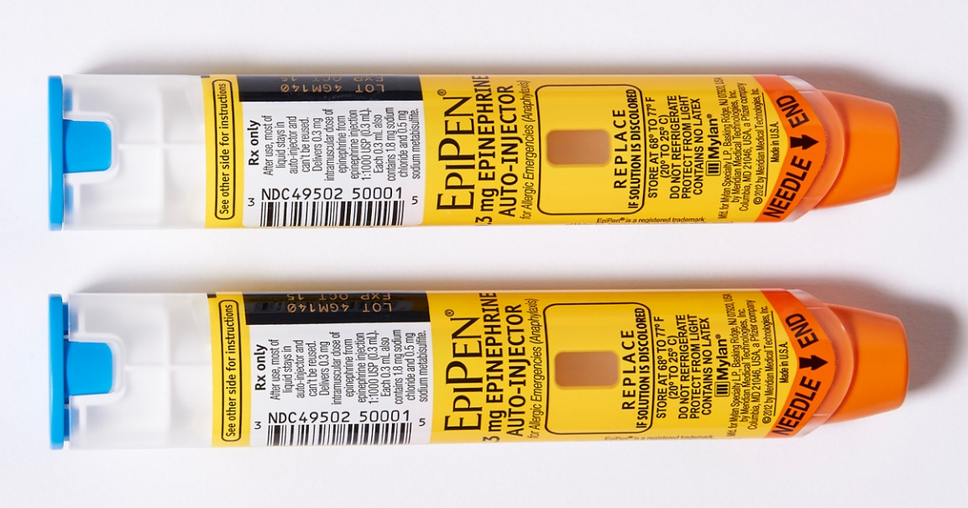
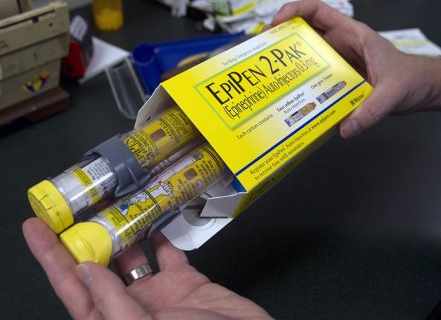
How to use an EPIPEN
How to use an Epipen video
Blue end up
Orange end down
“Blue to the sky, orange to the thigh”
Push and hold in place, count to 10 (we count fast in emergencies)
Call 911
Be sure to visit your building nurse to sign off on demonstrating use of the Epipen.

Slide 15
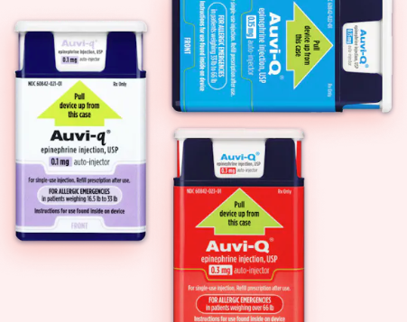
How to use an Auvi-Q
How to use an Auvi-Q video
Students who self-carry often have Auvi-Q brand epinephrine.
Be sure to let the school nurse know if self-carry. Self-carry forms must be renewed each school year and on file with the nurse for students who carry medications on themselves.
DISTRICT POLICY JHCF STUDENT ALLERGY PREVENTION AND RESPONSE

Slide 16

H.R. 2468, School-Based Allergies and Asthma Management Program Act was Signed into Law 1-5-2021
States can earn financial rewards for putting the following in place:
Methods to identify all students who have allergies or asthma
Create individual student action plans
Require school nurses or on-site trained staff during operating hours to administer medicines for both asthma and allergies
Asthma and allergy training education for school staff
Efforts to reduce indoor asthma and allergy triggers
Coordinate management of care with families and health care providers
(H.R. 2468, School-Based Allergies and Asthma Management Program Act, 2021).
Notes:
Here is a recent law of interest.

Slide 17

Legal Considerations
Life-threatening food allergy can be considered a disability under federal laws:
  Rehabilitation Act of 1973, Section 504
  The Individuals with Disabilities Education Act (IDEA)
  The Americans with Disabilities Act (ADA), along with the ADA Amendments of 2008 (ADA)
Privacy and confidentiality assurance laws:
  Family Educational Rights and Privacy Act (FERPA)
  Health Insurance Portability and Accountability Act of 1996 (HIPAA)

Slide 18

ADA, Section 504, IEP, IHP and Diet Rx form
Section 504 eligibility under Section 504 is determined on a case-by-case basis by a licensed healthcare provider (e.g., PCP or allergist).
A life-threatening food allergy alone is not considered condition warranting protection under IDEA. Some students may have comorbid condition that impacts learning, such as a hearing impairment. For such students, IDEA coverage generally applies, and an individual education plan (IEP) is developed.
Not all students with food allergy require a 504 plan (or IEP). Accommodations may be documented in an individual healthcare plan (IHP or IHCP) or emergency action plan (EAP).
A diet prescription form, completed by a licensed healthcare provider, needs to be included in the 504 plan or the IHP. Your school nutrition staff is provided a list by the school nurse to make appropriate accommodations. Look for medical alert “tray changes” or “dr note” followed by foods to avoid.
The nurse, parent, and student will determine if a Dr note for tray changes is needed based on the student’s allergy. Refer any questions about school lunches and allergies to the nurse.
(Texas Education Agency, 2020).
Notes:
Parent/guardians can file a civil rights claim with the U.S. Department of Education Office of Civil Rights on behalf of the student if the governing laws are not followed.

Slide 19
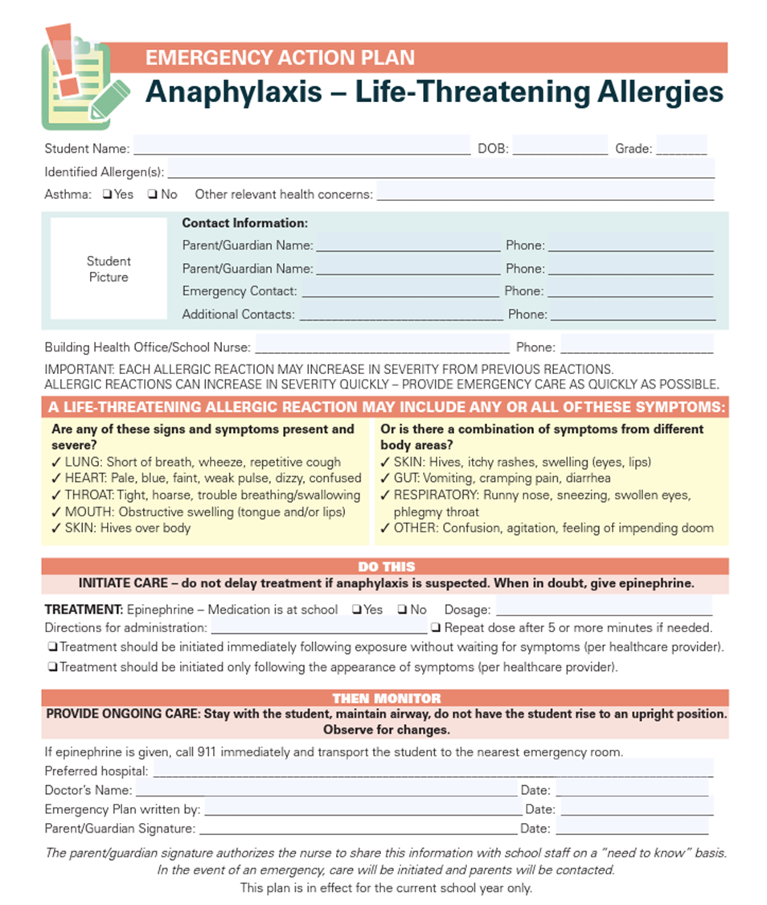
Emergency Action Plan (EAP)
EAP kept with epinephrine.
Be aware of where epinephrine is stored in your building.
If student has life-threatening allergies, bring epinephrine on all trips off campus.
If needed, nurse may provide copy for sub folder.

Slide 20

Mental Health and Food Allergies
It is understandable that parent(s)/guardians as well as the child/youth may feel anxious due to concerns around their food allergy/allergies… fear of a life-threatening reaction, fear that their child/youth will be socially excluded…
What can schools do?
Create and maintain a safe, supportive, equitable school environment for all students.
Schools can promote efforts to support all students by building a positive school climate.
Reinforce the school’s rules against bullying and discrimination.
Address all reports of bullying or harassment of a student with a food allergy to school administrators
Inform parents if their child has been bullied.
(National Association of School Nurses, 2018).

Slide 21
Risk Reduction Strategies for Anaphylaxis with a Care Coordination Approach
School Staff: Allergy and Anaphylaxis training for all school staff.
In the Classroom: Reduce the presence of identified allergens in classrooms, promote hand washing hygiene, and follow cleaning protocols. Communicate expected behavior to all students. There is no way to guarantee an allergen-free classroom. Post signs. Notify other parents if appropriate and requested (for celebrations/parties).
In the Cafeteria: Enforce responsibilities of school nutrition staff and contracted food service staff to take a food allergy safety training each year and clean each table before each lunch to “allergen-safe.” Take care to avoid cross-contamination. Making children with food allergies sit at separate tables is not inclusive or equitable. Allergy-free table is provided if requested by parent.
(Centers for Disease Control and Prevention, 2013).

Slide 22
Mitigating Risk for Anaphylaxis with a Coordinated Approach (continued)
On the Bus: Encourage a no-eating protocol, require bus companies and personnel to be familiar with local EMS procedures, and to equip all school vehicles with functional two-way communication devices.
On Field Trips: All staff attending a field trip must be trained to recognize and treat anaphylaxis. Promote hand washing hygiene and discourage trading of food or drink. Consider allowing parents (schools can not require parents) to attend the field trip/activity as an extra precaution. A parent may only give medication to their child/youth. The student’s personal EAI must accompany the student on the field trip.
(Centers for Disease Control and Prevention, 2013).

Slide 23
Administration and Storage of Emergency Medication Protocol
The school nurse obtains the appropriate forms and documentation for medication.
In accordance with your state/local laws and school districts policies, train authorized personnel to administer medications and determine where medication will be stored safely allowing for quick access.
Any medication that is administered should be documented in the student health record, whether the medication is administered at school or during offsite, school-related activities (such as field trips). Notify the school nurse when a medicine is given offsite.
Protect the safety of students and the medications.
Follow state laws for storage, access, and administration of medication. Check with your building nurse if you have questions on how a medicine should be stored.

Slide 24
Students who Self-Carry and/or Self-Administer Epinephrine to Stop Anaphylaxis
All self-carry medicines require a specific form on file in the nurse’s office. Please let the nurse know if a student is carrying medication on themselves.
Considerations:
There is no specific age when a child is ready to self-carry or self-administer epinephrine.
Readiness should be determined by the child’s primary healthcare provider.
Does the child have the ability to recognize symptoms of a severe allergic reaction/anaphylaxis?
Can the child demonstrate with an epinephrine trainer, how to use an epinephrine auto-injector?
What is the child’s comfort level with self-carrying and self-administering?
Previous history of anaphylaxis.
Are there comorbid conditions such as developmental delay, ADHD, autism spectrum disorder, and depression?
(American Academy of Allergy, Asthma, & Immunology, n.d.).

Slide 25
Develop Appropriate Plans Using Care Coordination
Care coordination is key in the development of these plans. Collaborate with the school nurse or designee, student’s parents, district or school nutrition staff, and licensed healthcare providers to create the plan.
The school nurse should develop and maintain an individualized healthcare plan (IHP) and an emergency action plan (EAP), also called a food allergy action plan (FAAP) to address the student’s medical needs and any special accommodations.
Set date to evaluate plans and revised as needed for student’s age/developmental level and consistency with state/federal laws.
The school nurse or designate is responsible for establishing and monitoring the individual written management plans.
Develop medication storage protocols and allergy incident reports.
When the student’s diagnosis indicates a disability because of the food allergy, a 504 plan and/or an IEP determination should take place.
(Kids with Food Allergies, 2021).
Notes:
The IHP is a nursing document and responds to the day-to-day management of food allergy.
The EAP is aligned with the IHP and written in terms for use by non-licensed school personnel that are a part of the food allergy management team.

Slide 26
Supporting Students with Food Allergies in School-Based Out of School Time (OST) Programs
Many schools/school districts offer or sponsor organizations that have OST programs located on school grounds.
Students with allergies (food, insect, latex) or other chronic health conditions may require either emergency or ongoing management in the OST setting.
Currently, no federal legislation exists that mandates information sharing between schools and OST programs.
Federal laws governing health information and privacy include the Family Educational Rights and Privacy Act (FERPA) and the Health Insurance Portability and Accountability Act of 1996 (HIPAA), and can help guide considerations for schools, OST staff, and families about confidentiality.
(Centers for Disease Control and Prevention, 2022).
Notes:
According to the CDC more than 40% of school-aged children and adolescents in the US have at least one chronic health condition. https://www.cdc.gov/healthyschools/chronicconditions

Slide 27
Training to Support the Needs of Students with Food Allergies in School-Based Out of School Time (OST) Programs
All students deserve to participate in OST programs.
The school nurse is uniquely positioned to provide these trainings.
Provide training to OST staff/volunteers on the chronic health conditions of the students in their care.
Training OST staff/volunteers may include (but are not limited to) the basics of the health condition(s), an understanding of the EAP, and delegation of emergency medicine administration (if permitted by local, state, and school district).
(Centers for Disease Control and Prevention, 2022).

Slide 28

Transition Planning - Communication
Family Educational Rights and Privacy Act (FERPA) allows the sharing of a child/youth record to school officials with a legitimate educational interest.
Transition planning should be considered when developing plans for preventing an allergic reaction and responding to a food allergy emergency.
The school nurse or designee (as assigned by school administrator) communicates “need to know” healthcare needs (ECP or FAAP, IHP, and if the students has a 504, or IEP) when progressing to a new teacher, the next grade, or new school. (Centers for Disease Control and Prevention, n.d.).

Slide 29
Additional Resources
CDC Field Trip checklist: Managing Food Allergies in Schools: https://www.cdc.gov/healthyschools/foodallergies/pdf/teachers_508_tagged.pdf
8 Tips to Help Teachers and School Staff Read Food Labels for Food Allergies (Kids with Food Allergies is a division of the Asthma & Allergy Foundation of America): https://community.kidswithfoodallergies.org/blog/8-tips-to-help-teachers-and-school-staff-read-food-labels-for-food-allergies
Medical Statement for Student Requiring Special Meals Due to Food Allergy or Intolerance: http://www.usd261.com/Foods/Special_Dietary_Forms/Form_19D.docMedical_Statement_for_Student_Requiring_Special_Meals_Due_to_Food_Allergy_or_Intolerance.pdf
Sample Student Epinephrine Autoinjector Self Carry Authorization Form: https://odh.ohio.gov/know-our-programs/school-nursing-program/media/sample_school_epinephrine_autoinjector_authorization

Slide 30
NASN Position Statements that Apply to the Care and Support of Students with Food Allergies
Bullying and Cyberbullying, Prevention in Schools: https://www.nasn.org/nasn-resources/professional-practice-documents/position-statements/ps-bullying
IDEIA and Section 504 Teams, The School Nurse as an Essential Member: https://www.nasn.org/nasn-resources/professional-practice-documents/position-statements/ps-ideia
Use of Individualized Healthcare Plans to Support School Health Services: https://www.nasn.org/nasn-resources/professional-practice-documents/position-statements/ps-ihps
School-Sponsored Before, After, and Extended School Year Programs: https://www.nasn.org/nasn-resources/professional-practice-documents/position-statements/ps-before-after-programs
School-Sponsored Trips: https://www.nasn.org/nasn-resources/professional-practice-documents/position-statements/ps-trips
Transition Planning for Students with Healthcare Needs: https://www.nasn.org/nasn-resources/professional-practice-documents/position-statements/ps-transition

Slide 31
References
American Academy of Allergy, Asthma, & Immunology. (n.d.). Immunoglobulin E (IgE) defined. https://www.aaaai.org/tools-for-the-public/allergy,-asthma-immunology-glossary/immunoglobulin-e-(ige)-defined
American Academy of Allergy, Asthma, & Immunology. (n.d.). Food intolerance versus food allergy. https://www.aaaai.org/tools-for-the-public/conditions-library/allergies/food-intolerance
American Academy of Allergy, Asthma, & Immunology. (n.d.). When should children and adolescents assume responsibility for self-treatment of anaphylaxis? https://www.aaaai.org/Tools-for-the-Public/Conditions-Library/Allergies/children-epinephrine
Butler, S. M., Boucher, E. A., Tobison, J., & Phan, H. (2020). Medication use in schools: Current trends, challenges, and best practices. The journal of pediatric pharmacology and therapeutics : JPPT : the official journal of PPAG, 25(1), 7–24. https://doi.org/10.5863/1551-6776-25.1.7
Centers for Disease Control and Prevention. (n.d.). Food allergies. https://www.cdc.gov/healthyschools/foodallergies/index.htm
Centers for Disease Control and Prevention. (2013). Voluntary guidelines for managing food allergies in schools and early care and education programs. Washington, DC: US Department of Health & Human Services. https://www.cdc.gov/healthyschools/foodallergies/pdf/20_316712-A_FA_guide_508tag.pdf
Centers for Disease Control and Prevention. (2022). Supporting students with chronic health conditions in school-based OST programs. https://www.cdc.gov/healthyschools/managing_CHC_OST.htm
Family Educational Rights and Privacy Act (FERPA). U.S. Department of Education. https://www2.ed.gov/policy/gen/guid/fpco/ferpa/index.html
Food & Drug Administration. (2023), Food allergies. https://www.fda.gov/food/food-labeling-nutrition/food-allergies
Food & Drug Administration. (2023). Have food allergies? Read the label. https://www.fda.gov/consumers/consumer-updates/have-food-allergies-read-label
H.R. 2468, School-Based Allergies and Asthma Management Program Act. (2021). https://www.congress.gov/bill/116th-congress/house-bill/2468/text
Kids with Food Allergies. (2021). School health care plans for your child with food allergies. https://kidswithfoodallergies.org/living-with-food-allergies/planning-for-school/school-health-care-plans/
Lee, S., Bellolio, M. F., Hess, E. P., & Campbell, R. L. (2014). Predictors of biphasic reactions in the emergency department for patients with anaphylaxis. The journal of allergy and clinical immunology. In practice, 2(3), 281–287. https://doi.org/10.1016/j.jaip.2014.01.012

Slide 32
References
National Association of School Nurses. (2021). School nursing evidence-based clinical practice guideline: Medication administration in schools implementation toolkit. https://learn.nasn.org/courses/36927
National Association of School Nurses. (2018). Bullying and cyberbullying – Prevention in schools. https://www.nasn.org/nasn-resources/professional-practice-documents/position-statements/ps-bullying
National School Boards Association. (2012). Safe at school and ready to learn: A comprehensive policy guide for protecting students with life-threatening food allergies. https://cdn-files.nsba.org/s3fs-public/reports/Safe-at-School-and-Ready-to-Learn.pdf
Pflipsen, M. C., & Vega Colon, K. M. (2020, September 15) Anaphylaxis: Recognition and management. American Family Physician, 102(6), 355-362. https://www.aafp.org/pubs/afp/issues/2020/0915/p355.html
Polloni, L., & Muraro, A. (2020). Anxiety and food allergy: a review of the last two decades. Clinical & Experimental Allergy, 50(4), 420-441.
Sampson, H. A., Muñoz-Furlong, A., Campbell, R. L., Adkinson Jr., N. F., Bock, S. A., Branum, A., Brown, S. G. A., Camargo Jr., C. A., Cydulka, R., Galli, S. J., Gidudu, J., Gruchalla, R. S., Harlor Jr., A. D., Hepner, D. L., Lewis, L. M., Lieberman, P. L., Metcalfe, D. D., O’Connor, R., Muraro, A., Rudman, A., Schmitt, C., Scherrer, D., Simons, F. E. R., Thomas, S., Wood, J. P., & Decker, W. W. (2006). Second symposium of the definition and management of anaphylaxis: Summary report- Second National Institute of Allergy and Infectious Disease/Food Allergy and Anaphylaxis Network symposium. Journal of Allergy and Clinical Immunology, 117(2), 391-397. https://doi.org/10.1016/j.jaci.2005.12.1303
Shaker, M. S., Wallace, D. V., Golden, D. B., Oppenheimer, J., Bernstein, J. A., Campbell, R. L., ... & Contributors, W. (2020). Anaphylaxis—a 2020 practice parameter update, systematic review, and Grading of Recommendations, Assessment, Development and Evaluation (GRADE) analysis. Journal of Allergy and Clinical Immunology, 145(4), 1082-1123.
Texas Education Agency. (2020). Technical assistance: Section 504. https://tea.texas.gov/sites/default/files/504_guide.pdf
Turner, P. J., Worm, M., Ansotegui, I. J., El-Gamal, Y., Rivas, M. F., Fineman, S., Geller, M., Gonzalez-Estrada, A., Greenberger, P. A., Tanno, L. K., Borges, M. S., Senna, G., Sheikh, A., Thong, B. Y., Ebisawa, M., Cardona, V., & WAO Anaphylaxis Committee (2019). Time to revisit the definition and clinical criteria for anaphylaxis? The World Allergy Organization Journal, 12(10), 100066. https://doi.org/10.1016/j.waojou.2019.100066
Zablotsky, B., Black, L. I., & Akinbami, L. J. (2023). Diagnosed allergic conditions in children aged 0–17 years: United States, 2021.

