Slide 1
July 21, 2026
K-12 science: connecting our district’s resources across grades
FCS Science Team

Slide 2
AGENDA
Introductions​
Strategic Alignment​
Vertical Alignment Engagement​
3D Science​
K-12 Core District Resources​
Supplemental Resources
Upcoming PD Schedule​
Q & A

Slide 3

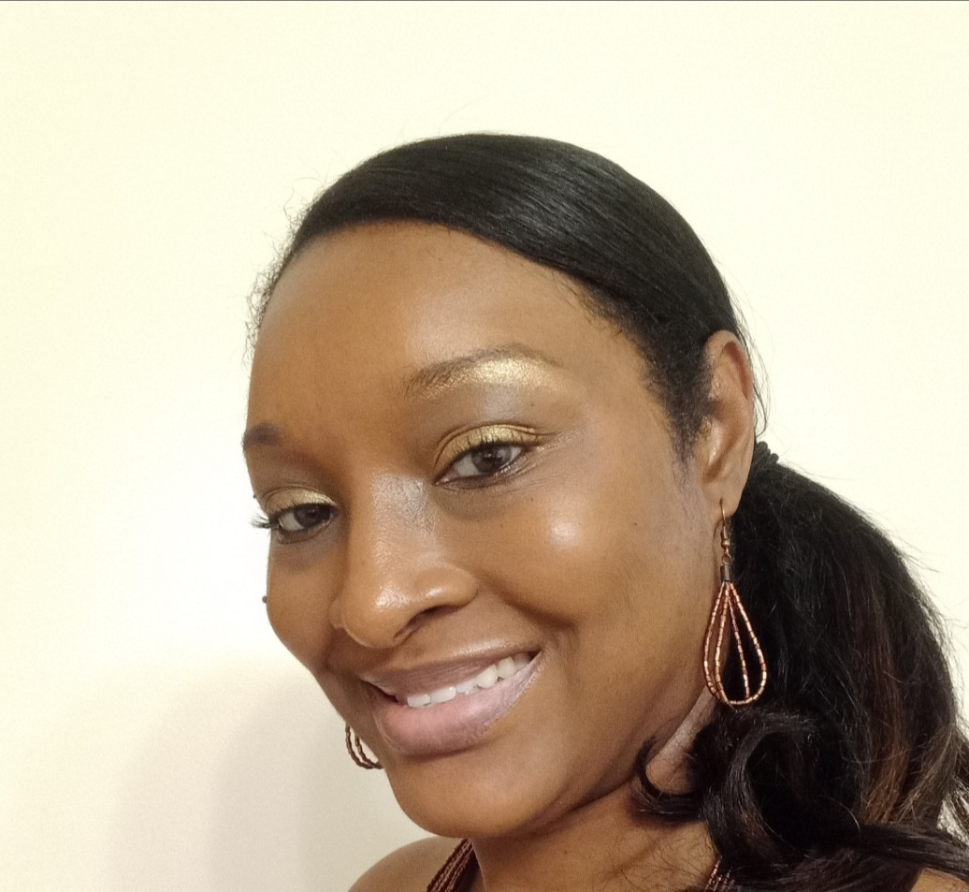
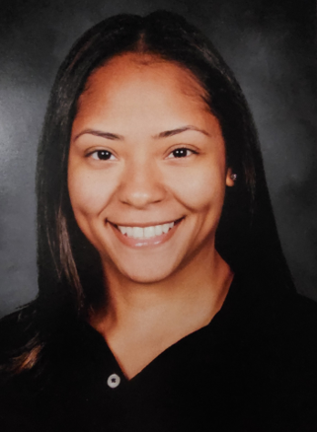
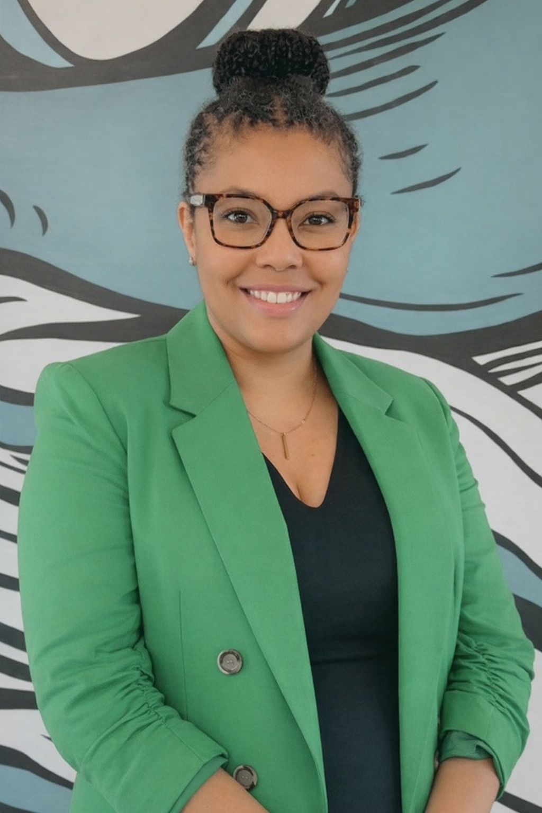
MEET THE TEAM
Adero Carter
K – 5 Program Specialist
Nabulungi Bolton
6 – 12 Program Specialist
LaTonya Davis
Director of Science

Slide 4
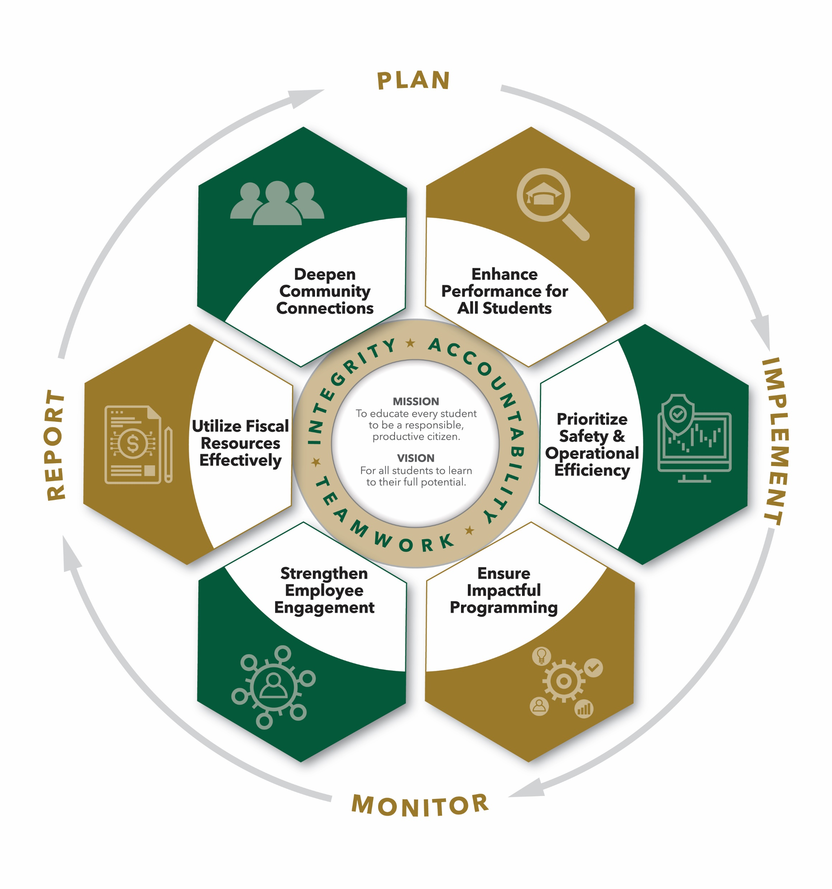
Connection to the FCS Strategic Plan
Support teachers in implementing the science curriculum
Foster a love of learning for three-dimensional science instruction

Slide 5
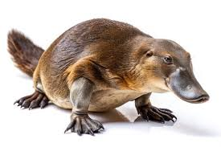

PHENOMENA
Observe the picture of the Platypus.
  What do you notice?
  What do you wonder?
  A Platypus is an animal that is difficult for scientists to classify. Scientists had to determine which characteristics were important for classification.
You are going to determine the characteristics that will be used to classify a group of objects.
Notes:
Ask teachers to share what they notice <Capture responses>
Ask teachers what do you wonder about this pile of candy? <Capture responses?
Say: “Scientists often need a way to organize and describe items so that other people can identify them the same way every time. Today, you’re going to design a system that helps someone else figure out what they’re looking at based only on descriptions.”

Slide 6
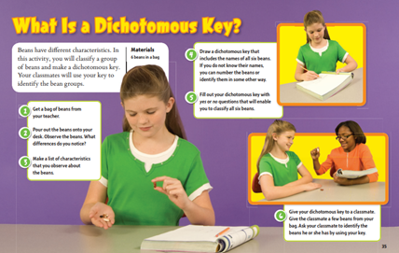
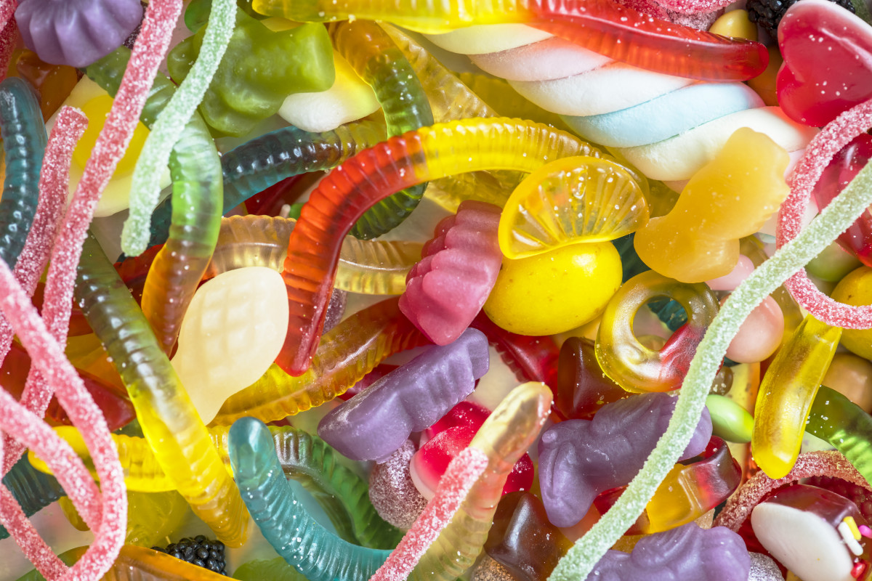
ENGAGE – CANDY CLASSIFICATION
Teacher Activity (Groups of 4):
Make a list of your observations of the candy.
Describe some of the characteristics of your candy.
Work in groups to sort the candy into groups based on your observations.

Slide 7

How did the phenomena and activity prime student learning?

Slide 8
THE BIG PICTURE
Engaging Phenomenon
  The platypus activity sparks curiosity by showcasing an organism with unusual traits, prompting observation and wonder.
Classification Challenge
  This activity demonstrates the complexity of classifying organisms based on shared characteristics and traits.
Evidence-Based Reasoning
  Participants are encouraged to phrase observations as data, emphasizing evidence-based scientific reasoning.
Sensemaking in Learning
  Using phenomena like the platypus creates meaningful learning experiences that anchor classification standards.
Notes:
All members

Slide 9
LET’S DEBRIEF…
Students use observable characteristics to sort the candy.
Students are introduced to structured classification systems.
Standard | Connection
S5L1.a | Grouping organisms based on observable traits
S7L1.a | Identifying characteristics to organized organisms
SB4.b | Identifying traits used in evolutionary comparisons
Notes:
Highlight vertical alignment

Slide 10
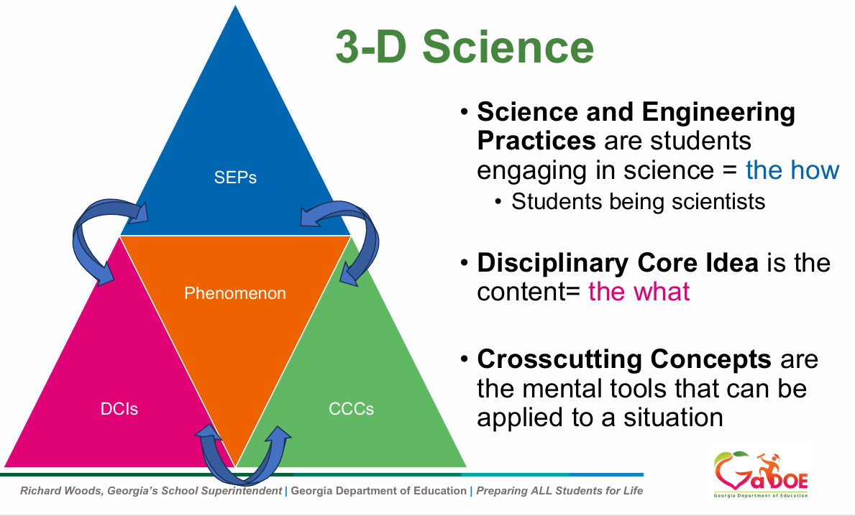
WHAT IS 3D SCIENCE?
Notes:
Add a transition statement

Slide 11

Preparing for Success in Science

Slide 12
K-12 CORE DISTRICT RESOURCES
Grade-level standards
Curriculum maps
GADOE Teacher notes
Textbook resources
Unit planning documents
Unit assessments for tested and grade levels
Notes:
LD

Slide 13

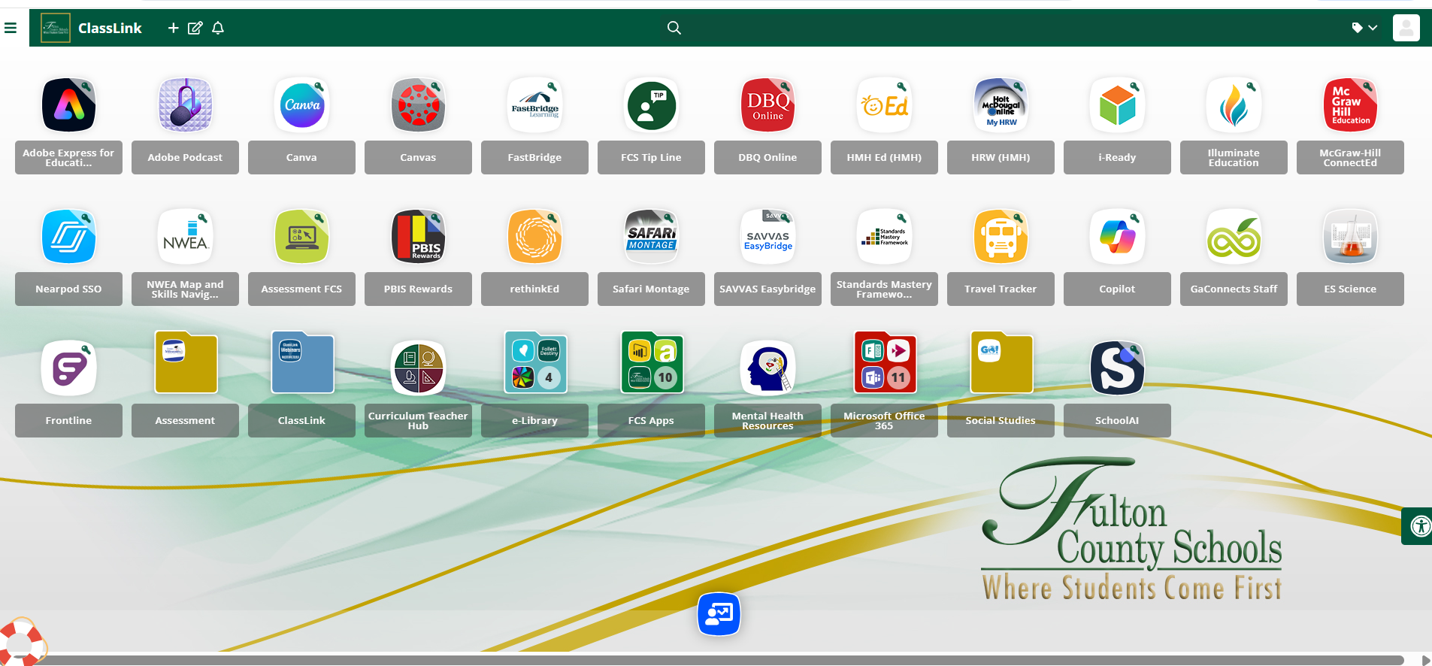

CURRICULUM HUB
Notes:
AC starts

Slide 14

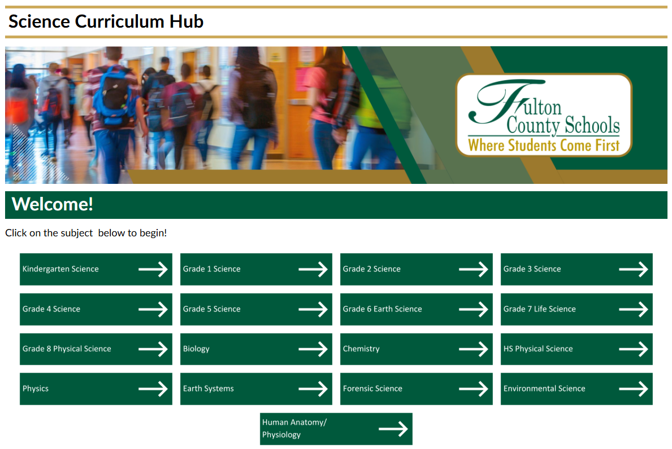
CANVAS

Slide 15
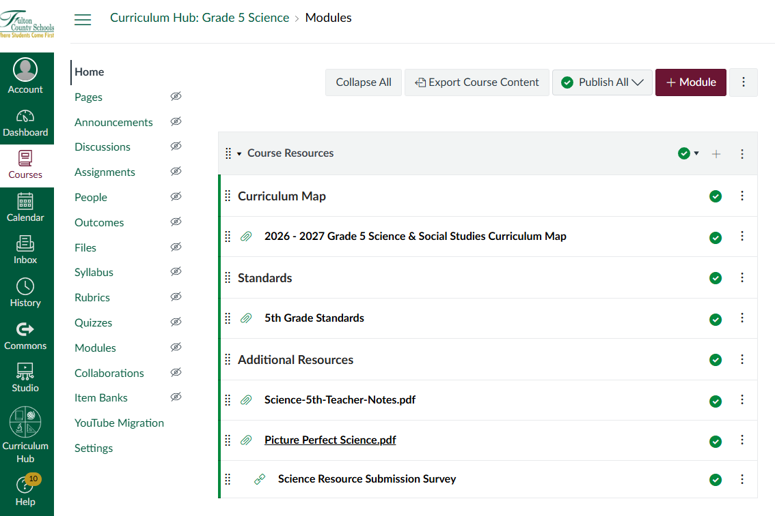
CURRICULUM MAPS

Slide 16

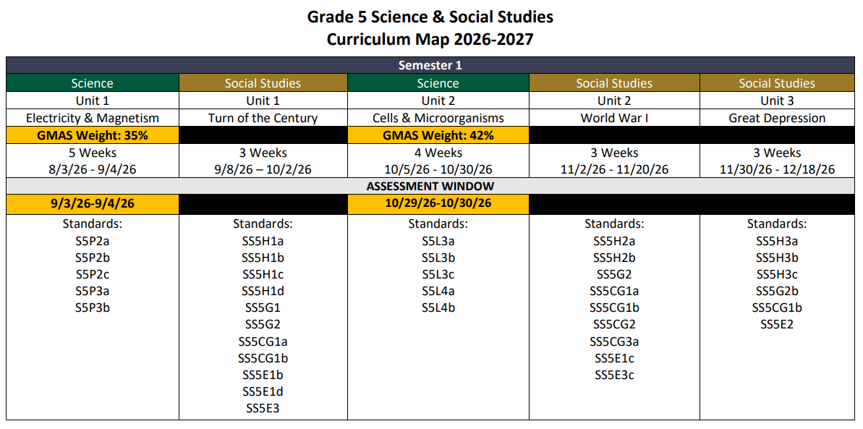
CURRICULUM MAPS

Slide 17
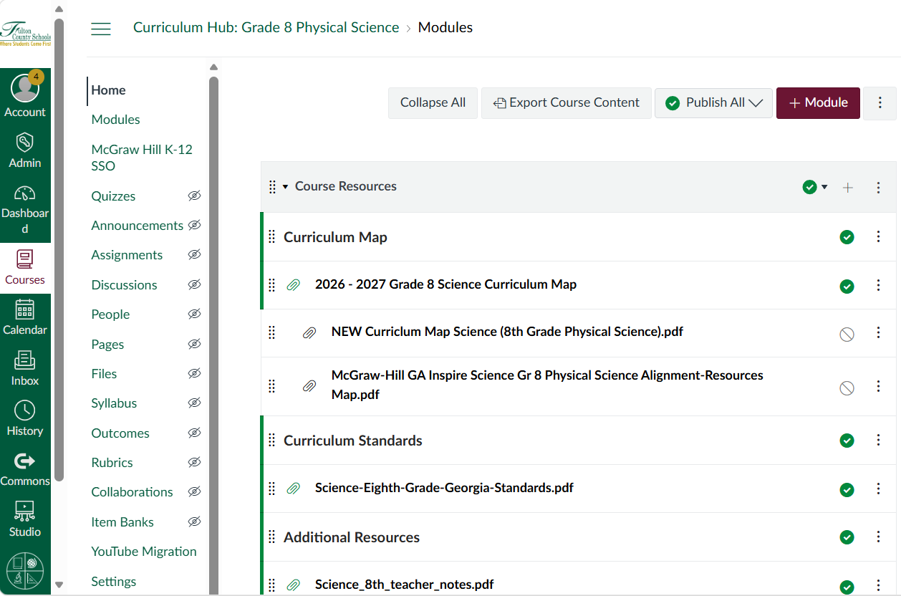
CURRICULUM MAPS

Slide 18
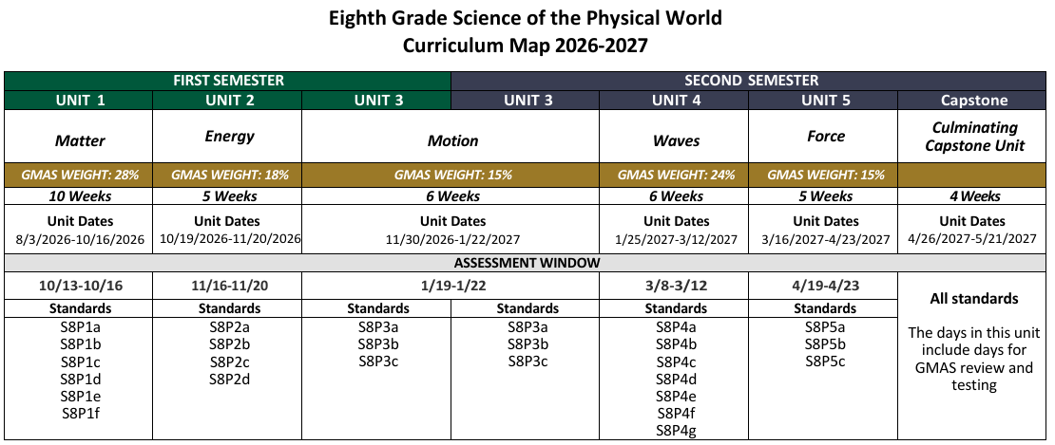
CURRICULUM MAPS
Notes:
NB

Slide 19
TEACHER NOTES AND STANDARDS
Teacher Notes were developed to help deepen educators’ understanding of the Georgia Science Standards. They serve as a resource for instructional support and enrichment. They are designed to support teacher knowledge building up to and beyond the standard.
Notes:
AC

Slide 20
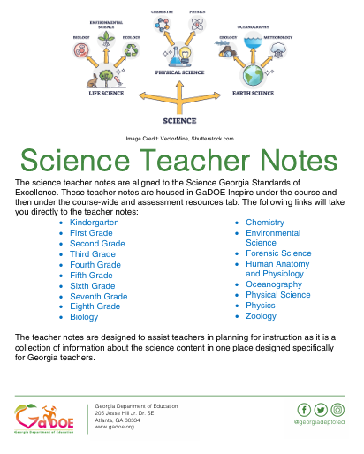
TEACHER NOTES AND STANDARDS
Overview of the standard
Academic language
Per element
  Background information (DCI)
  Misconceptions
  SEP
  CCC
  Suggested Phenomenon
Notes:
NB

Slide 21
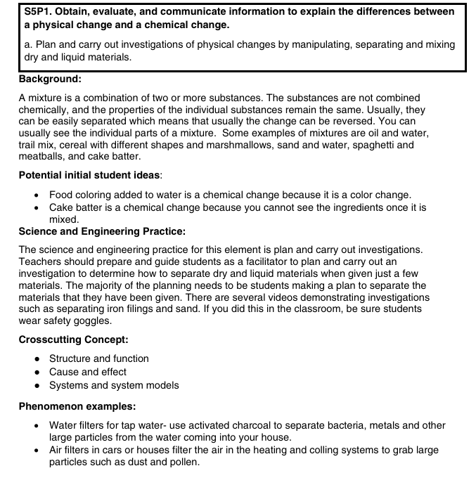
TEACHER NOTES AND STANDARDS

Slide 22
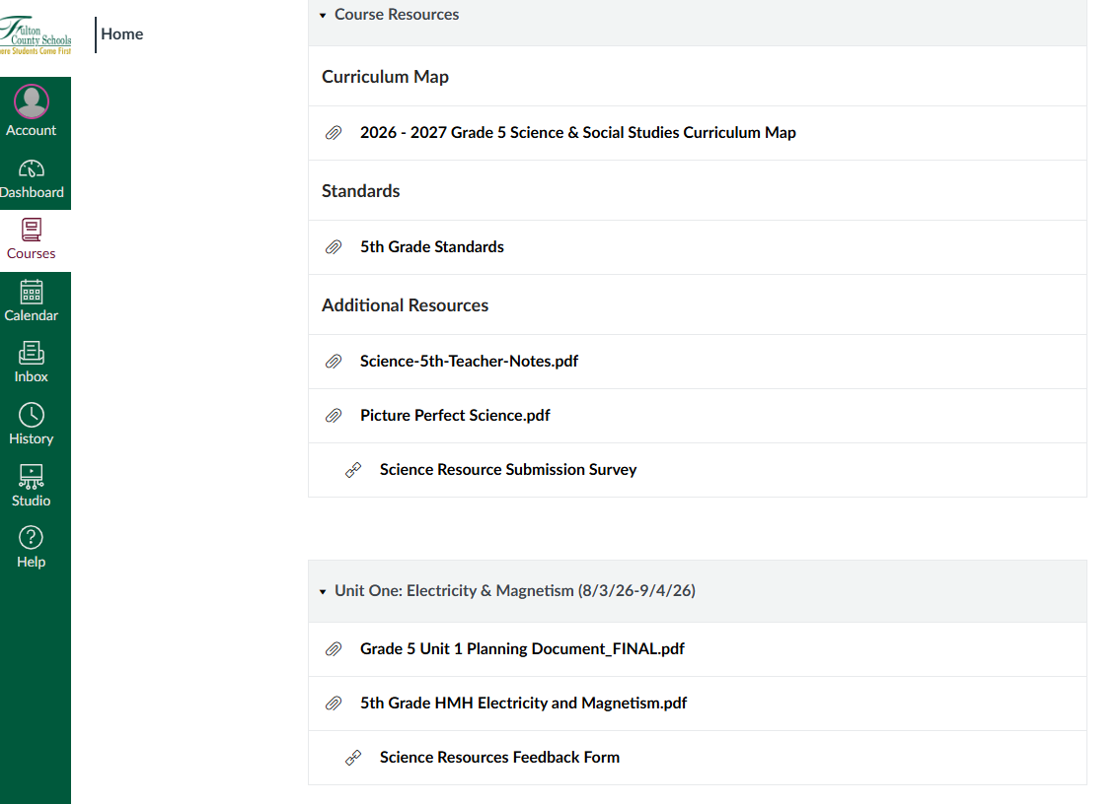
UNIT PLANNING GUIDES: CURRICULUM HUB
Planning guides are available for Grades 4 and 5
Notes:
AC

Slide 23
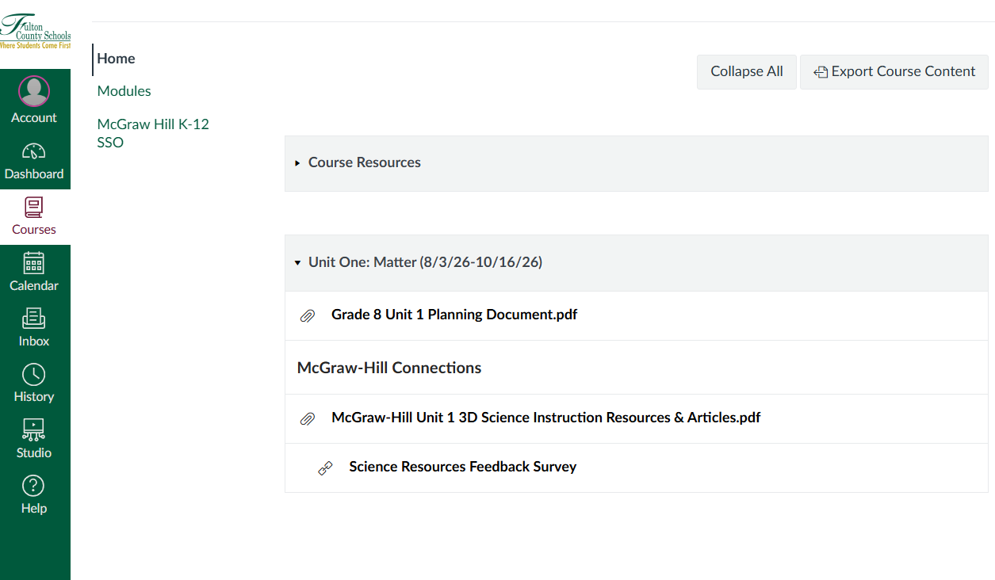

UNIT PLANNING GUIDES: CURRICULUM HUB
Planning guides are available for Grades 6, 7, 8, Physical Science, and Biology

Slide 24

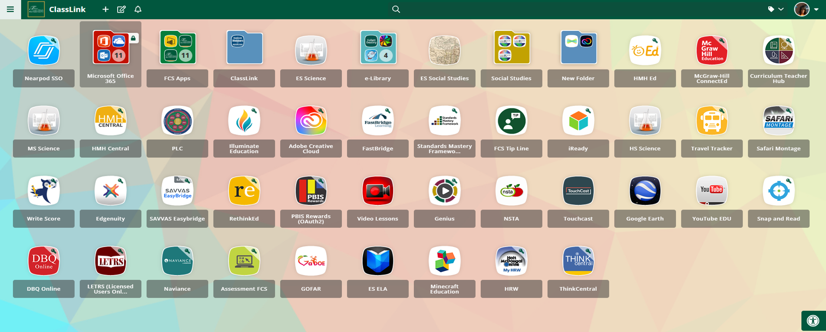

TEXTBOOK RESOURCES

Slide 25
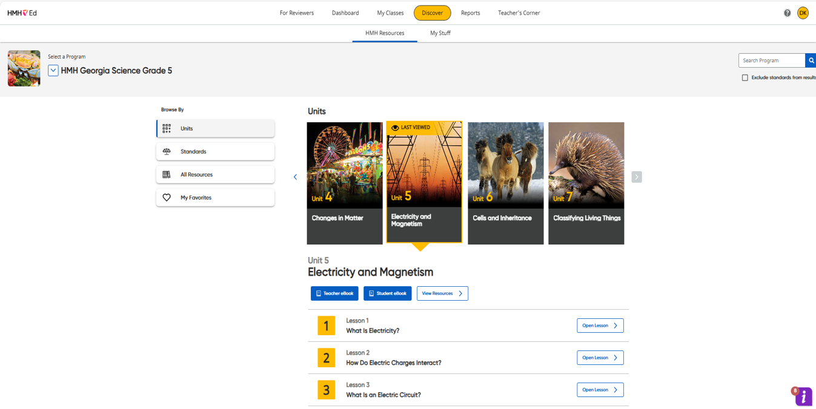
TEXTBOOK RESOURCES
Houghton Mifflin (HMH) Science

Slide 26
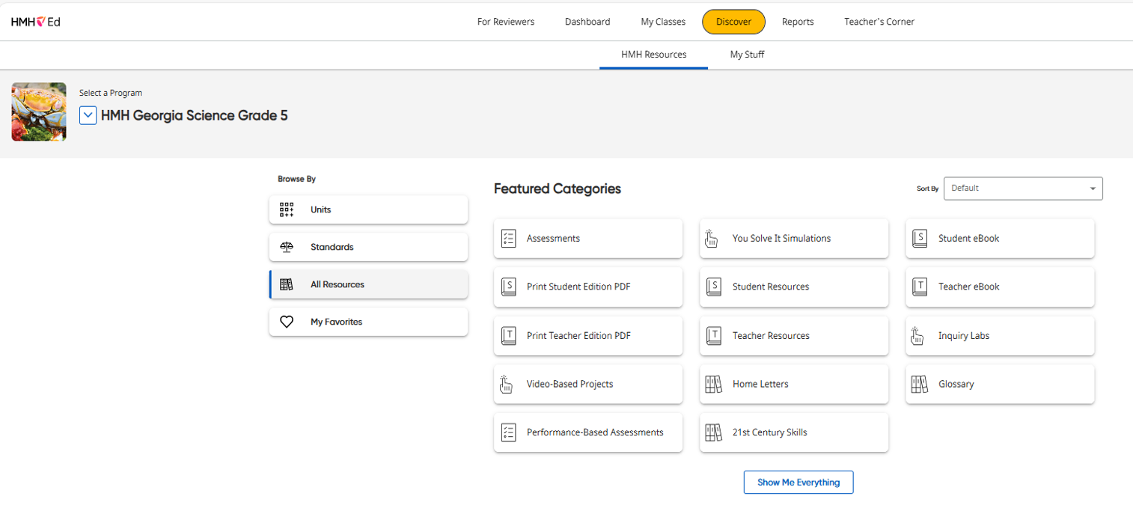
TEXTBOOK RESOURCES
Houghton Mifflin (HMH) Science

Slide 27
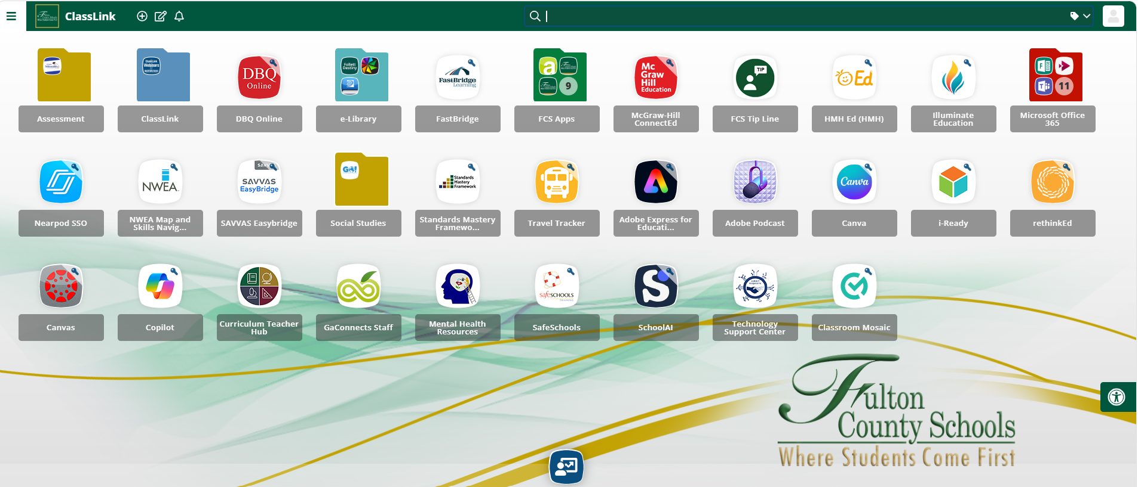
TEXTBOOK RESOURCES

Slide 28
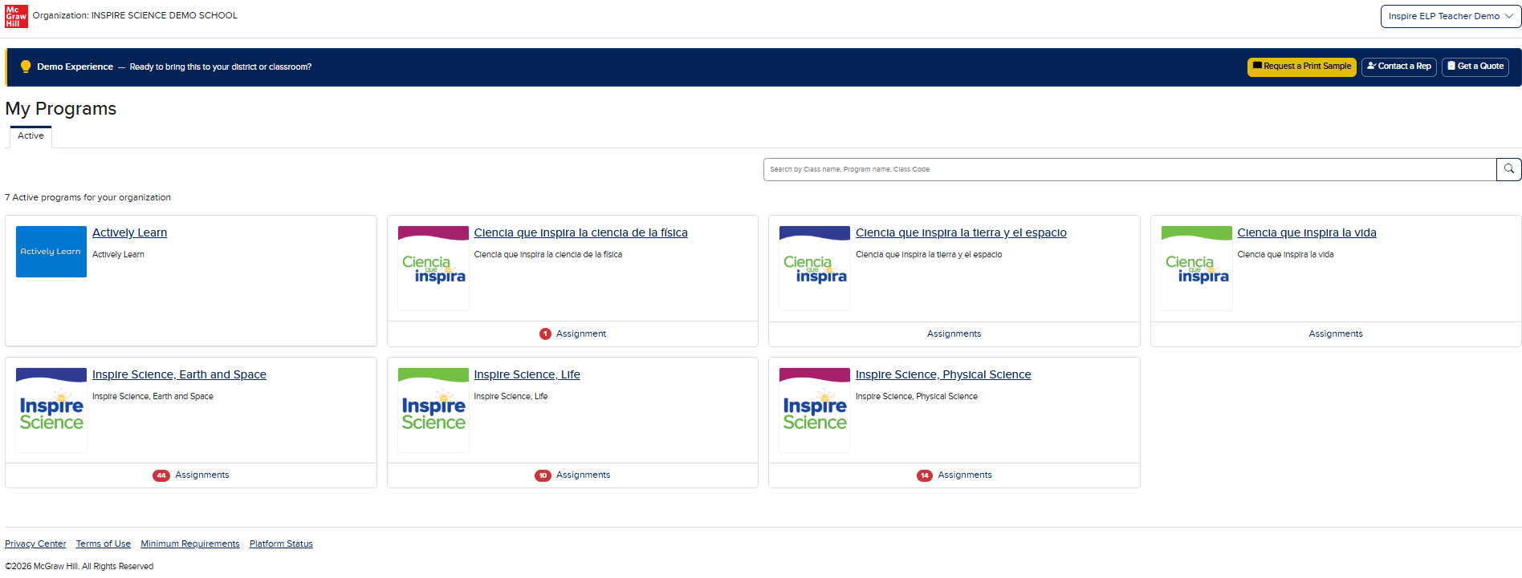
TEXTBOOK RESOURCES (MS)

Slide 29
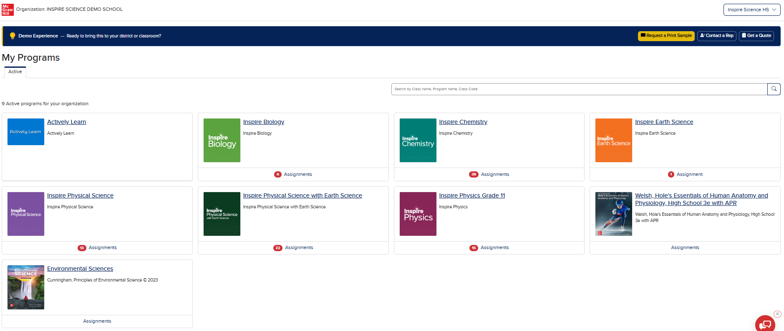
TEXTBOOK RESOURCES (HS)

Slide 30
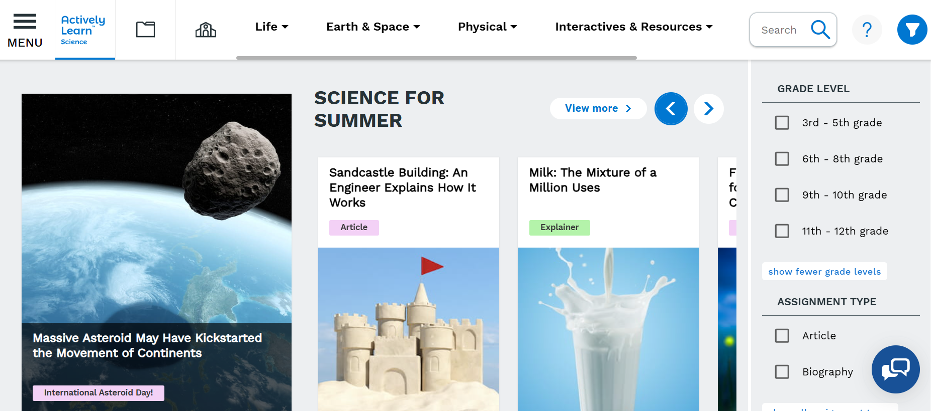
TEXTBOOK RESOURCES – ACTIVELY LEARN

Slide 31
UNIT ASSESSMENTS: CLASSLINK
Illuminate

Slide 32
UNIT ASSESSMENTS: SCHEDULE

Slide 33
UNIT ASSESSMENTS: SCHEDULE
Notes:
LD

Slide 34


SUPPLEMENTAL RESOURCES

Slide 35

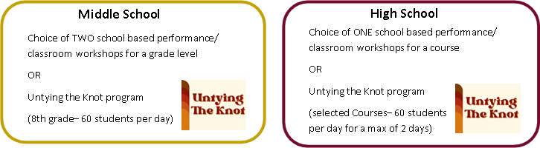

FCS TEACHING MUSEUM
The Teaching Museum provides authentic experiences that support student critical thinking.

Slide 36
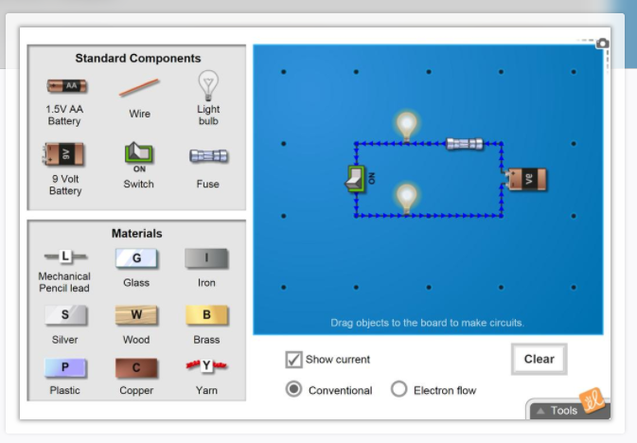
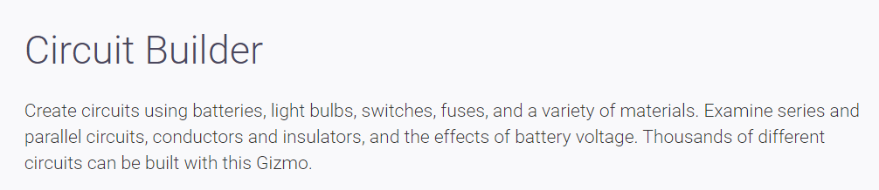
GIZMOS
Online Science and Math simulations
Interactive
Standards-aligned
Promotes inquiry
Helps build conceptual understanding
Easily integrated into instruction
Gizmos correlation found in grade-level resources

Slide 37
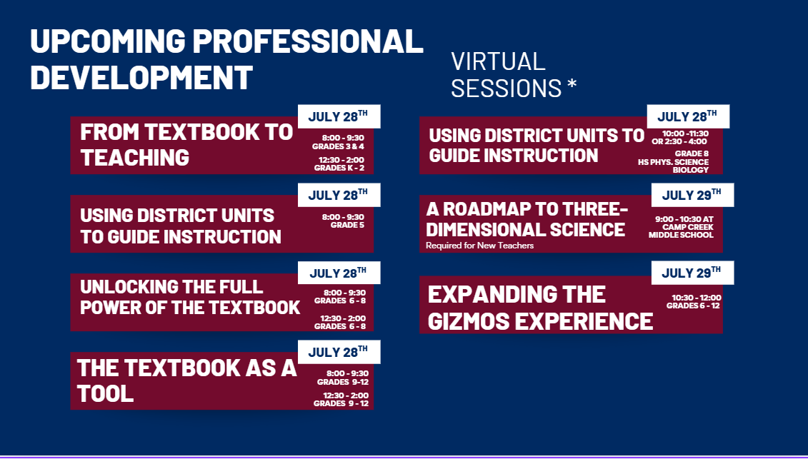
UPCOMING PD DATES

Slide 38
QUESTIONS
& ANSWERS

Slide 39
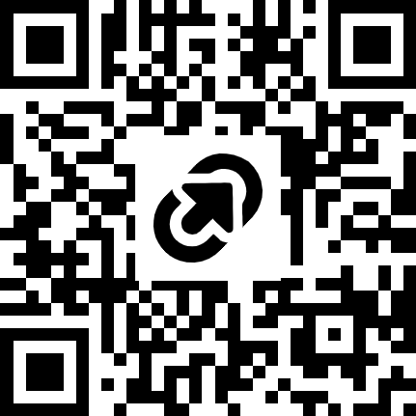
New Teacher Celebration Resources
Access the program and session resources by going to https://tinyurl.com/FCSNTC2026 or scanning the QR code:

