Slide 1

Lower Dauphin School District
2026-27 Budget Presentation #4.
June 8, 2026

Slide 2

2026-2027 Final Budgeted Revenues $81,577,077
Local Sources 63.07%, $51,449,845
State Sources 35.60%, $29,042,244
Federal Sources 1.27%, $1,037,488
Other Sources 0.06%, $47,500

Slide 3

2026-2027 Revenue Categories by Percentage

Slide 4
2026-2027 Real Estate Millage Rate
2026-27 22.0486 Mills, 4.20% Increase (Index)
  CERTIFIED TAXABLE ASSESSED VALUE: $1,934,994,874 (May 2026)
  Multiplied by 2026-2027 Millage Rate X .0220486
  Gross Tax Levy $42,663,927.97
  Less: Act 1 Gaming Revenues ($2,347,970.22)
  Net Tax Levy $40,315,957.75
  Estimated Collection Rate 96.00034%
  Projected Real Estate Revenue $38,685,878.00

Slide 5
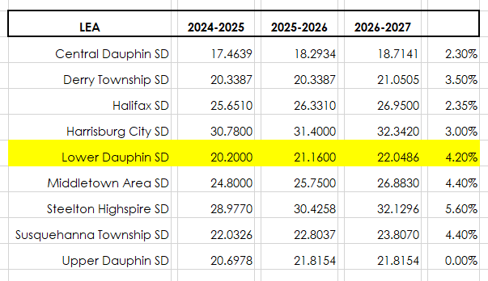
Millage Rate Comparison

Slide 6

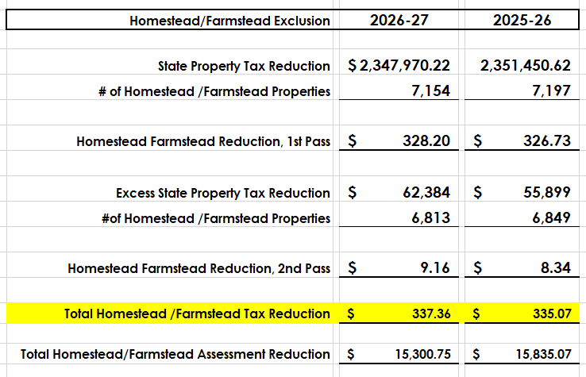
2026-27 Homestead /Farmstead Exclusion

Slide 7
2026-27 Homestead Median Values
2026 Median Assessment Value $128,900
Real Estate Taxes on Median Assessed Property:
    $128,900 X .0224086 Millage Rate: $2,842.06
    Less: 2026 Homestead/Farmstead Exclusion($337.36)
    $2,504.70 Median 2026 Real Estate Tax Notice
2026 High Homestead Value Assessment: $1,338,200
2026 Low Homestead Value Assessment: $1,000

Slide 8
2026-2027 Final Budgeted Expenses $84,108,769
100’s Salaries & Wages, 40.10%, $33,723,435
200’s Employee Benefits, 29.56%, $24,862,429
300’s Purchased Professional & Technical Services, 4.91%, $4,133,701
400’s Purchased Property Services, 1.52%, $1,277,001
500’s Other Purchased Services, 13.75%, $11,567,024
600’s Supplies, 6.63%, $5,578,846
700’s Property, 0.95%, $796,584
800’s Other Objects, 0.14%, $114,078
900’s Other Uses of Funds, 2.44%, $2,055,671

Slide 9
2026-27 Expense Categories by Percentage

Slide 10

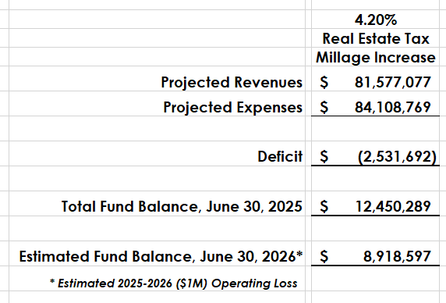
Budget Deficit: ($2,531,692)

Slide 11

Questions ???

