Slide 1
FCS
Assessment
Department
New Teacher Celebration
2026-2027
Overview of Assessment Secondary

Slide 2
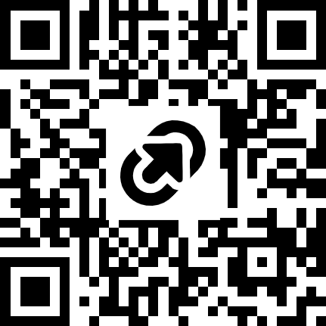
NEW TEACHER RESOURCES
Access the program and session resources by going to https://tinyurl.com/FCSNTC2026 or scanning the QR code:

Slide 3
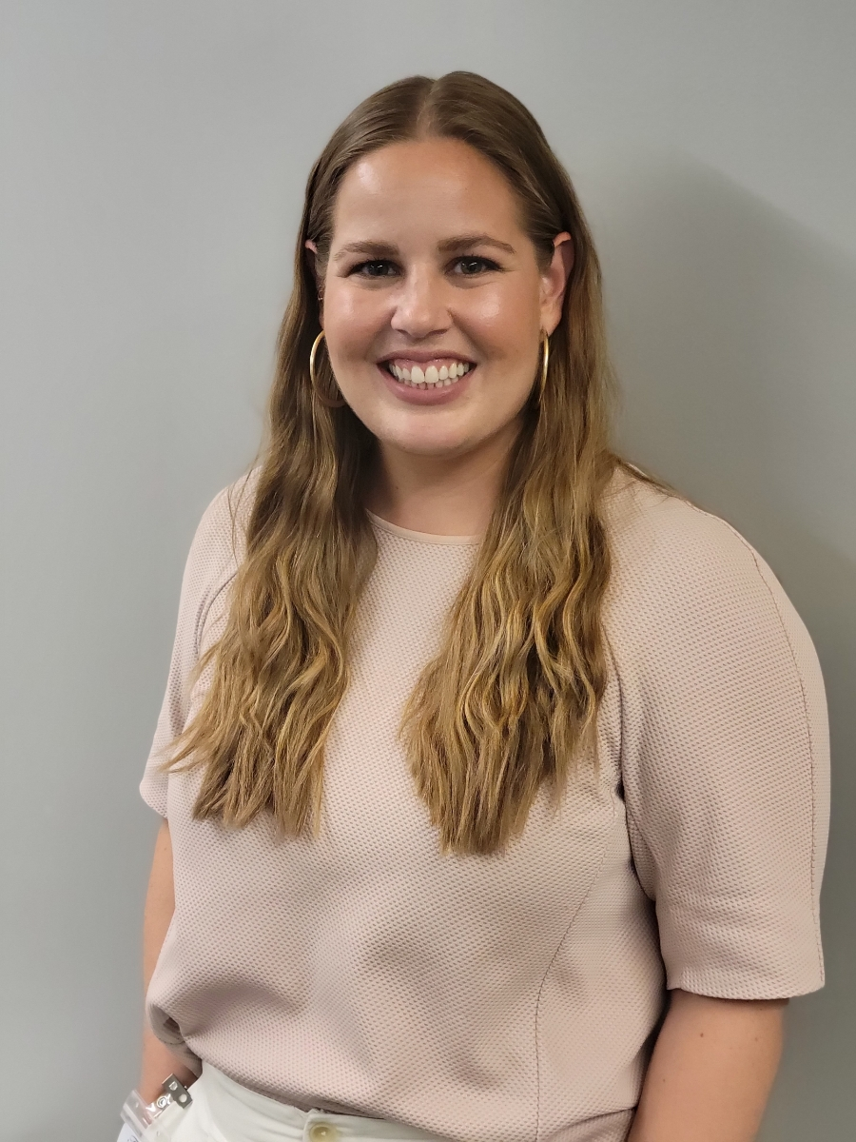
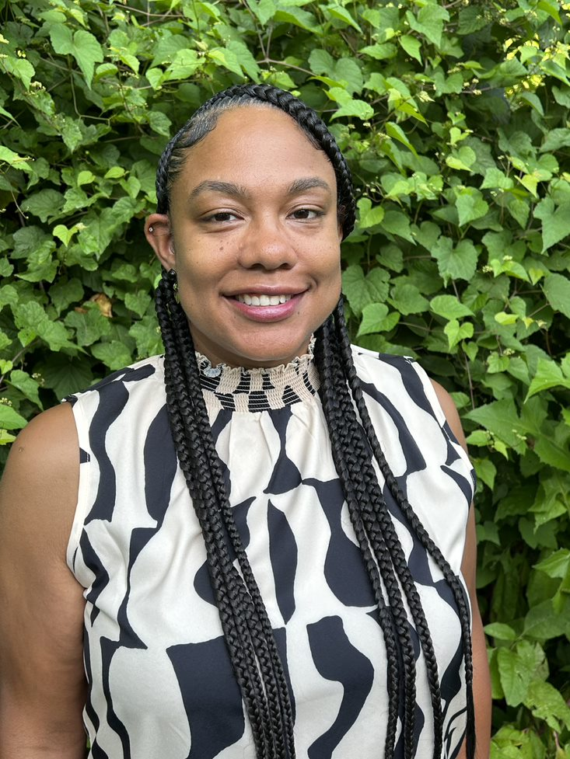
INTRODUCTION TO THE ASSESSMENT TEAM
Sarah Boltz
Assessment Program Specialist
LaWanda Knight
Assessment Program Specialist

Slide 4
GOALS FOR TODAY’S SESSION
Participants will learn about the different assessments administered in Fulton County. We will:
  Share assessment board policy
  Discuss Fulton assessments and purpose
  Show how to access various assessment platforms
  Review Fulton's assessment calendar
  Discuss data-driven instructional practices

Slide 5
GOALS FOR TODAY’S SESSION
Participants will learn about the different assessments administered in Fulton County. We will:
  Share assessment board policy

Slide 6
BOARD POLICY
Board policy II governs assessment administration for FCS.
How does policy define the purpose of each assessment type?
Universal Screening & Diagnostic Assessment
determine a student’s overall academic performance level and their strengths/weaknesses
identify students who may benefit from additional services or supports
pinpoint learning needs to guide curricular and instructional decisions
used at intervals throughout the year to monitor student growth
Standards-based Assessment
used in the classroom before, during, and after instruction
monitor and evaluate student progress towards mastery of grade level standards
inform instruction and respond to students’ needs
teachers reflect on the effectiveness of their instructional strategies
State and National
Assessment
evaluate learning at the end of a long-term instructional period
determine whether each student has achieved proficiency on a set of required skills and concepts
classify or rank students on a continuum of achievement compared to their peers
Notes:
Copies of policy
High level overview
Key takeaway: purpose of assessment

Slide 7

TURN AND TALK
Share a one-minute summary of one of the assessment types (state and national, universal screening and diagnostic, standards-based assessments).

Slide 8
GOALS FOR TODAY’S SESSION
Participants will learn about the different assessments administered in Fulton County. We will:
  Discuss Fulton assessments and purpose

Slide 9
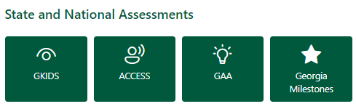
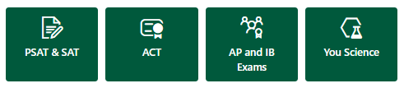
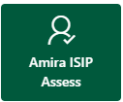

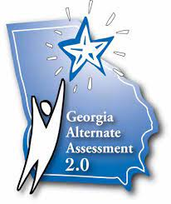

FCS ASSESSMENTS: STATE and NATIONAL
State and National
Assessment
evaluate learning at the end of a long-term instructional period
determine whether each student has achieved proficiency on a set of required skills and concepts
classify or rank students on a continuum of achievement compared to their peers
Notes:
Purpose of standardized assessments is to evaluate learning at the end of the instruction (end of year or program) to determine if a student has achieved proficiency on required skills and concepts

Slide 10
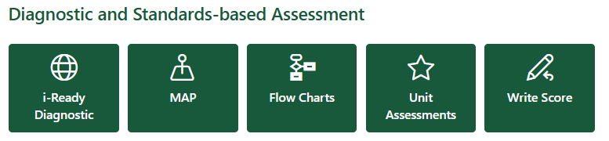

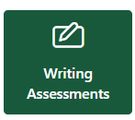




FCS ASSESSMENTS: UNIVERSAL SCREENER & DIAGNOSTIC ASSESSMENT
Universal Screening & Diagnostic Assessment
determine a student’s overall academic performance level and their strengths/weaknesses
identify students who may benefit from additional services or supports
Pinpoint learning needs to guide curricular and instructional decisions
used at intervals throughout the year to monitor student growth
Notes:
Purpose of universal screening and diagnostic assessments is to …..

Slide 11
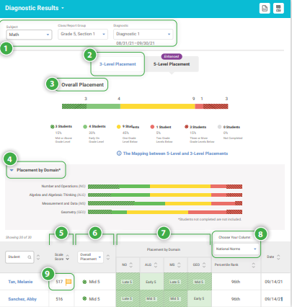
UNIVERSAL SCREENER & DIAGNOSTIC i-READY INFORM
Who? | When? | Why?
Grades 6 - 8 | Fall (BOY) Winter (MOY) Spring (EOY) (optional) | Computer adaptive test that measures skills in Reading and Math Helps determine students' overall academic performance levels Identifies students who may benefit from additional services or supports to meet their learning needs
Read more about i-Ready on the Assessment Hub!
Notes:
Purpose of universal screening and diagnostic assessments is to …..

Slide 12
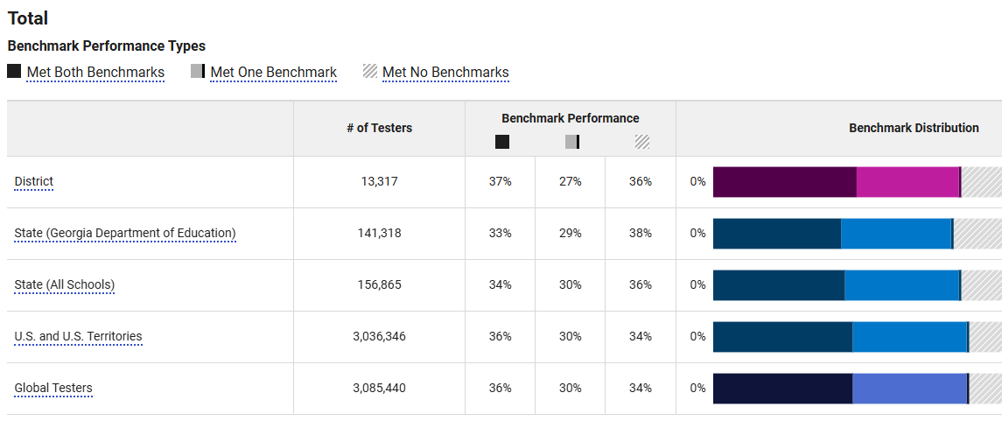
UNIVERSAL SCREENER & DIAGNOSTIC
PSAT 8/9 + PSAT NMSQT
Who? | When? | Why?
Grades 9 - 11 | October 14th | Computer adaptive test that measures skills in Reading and Math Helps determine students' overall academic performance levels Identifies students who may benefit from additional services or supports to meet their learning needs
Read more about PSAT on the Assessment Hub!
Notes:
Purpose of universal screening and diagnostic assessments is to …..

Slide 13
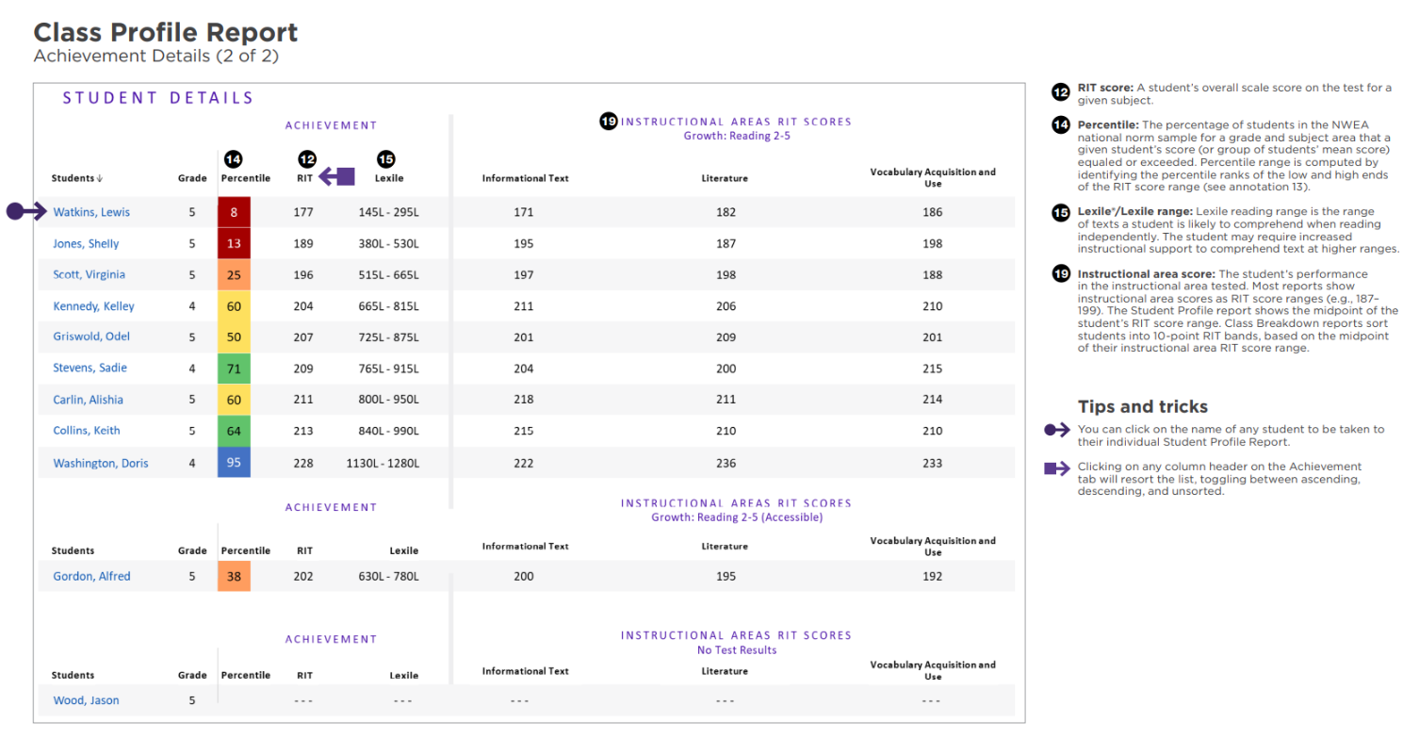
UNIVERSAL SCREENER & DIAGNOSTIC
MAP
Who? | When? | Why?
Grades 9 - 12 (select students based on performance or support programs) | August January May (optional) | Computer adaptive test that measures skills in Reading and Math Helps determine students' overall academic performance levels Identifies students who may benefit from additional services or supports to meet their learning needs Meets the state criteria for MTSS students testing three times a year
Read more about MAP on the Assessment Hub!
Notes:
Some students will continue to be required to take MAP in August. Those students include:
- Students who scored below the 30th percentile on PSAT or MAP during the 2025-26 school year
- Students who scored level 1 "Beginning" on Milestones during the 2025-26 school year. (The state will return ELA GMAS data in Nov/Dec 2026 so this data point is not applicable to determine who to test in the BOY window.)
- Students in basic read/write or algebra support courses
- Students in Tier 2 or Tier 3 MTSS

Slide 14
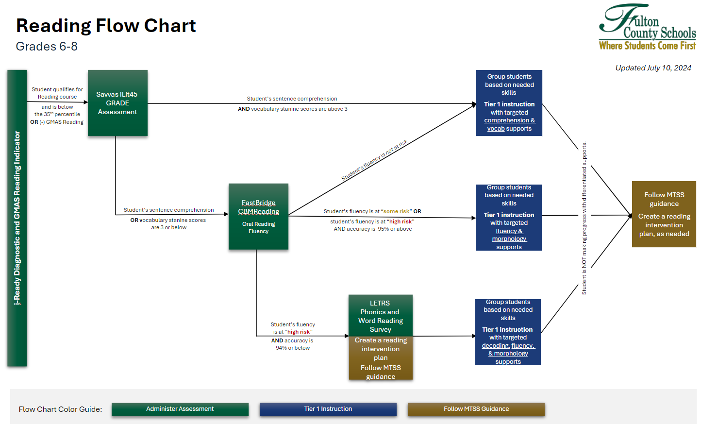
READING FLOWCHART
Who? | When? | Why?
Grades 6-8 (select students based on performance in i-Ready*) | Fall: Grades 6-8 Winter: Grades 6-8 (as needed) | Helps teachers gain additional information on students’ phonics skills Allows teachers to identify specific gaps in phonological awareness, phonics, and oral reading fluency Identifies students who may benefit from additional services or supports to meet their learning needs
Read more about the Reading Flow Chart on the Assessment Hub!

Slide 15

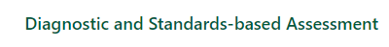
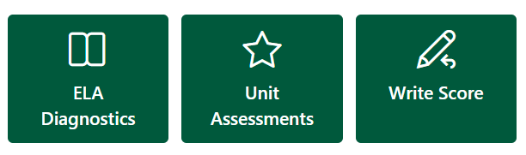

FCS ASSESSMENTS:
STANDARDS-BASED ASSESSMENTS
Standards-based Assessment
used in the classroom before, during, and after instruction
monitor and evaluate student progress towards mastery of grade level standards
inform instruction and respond to students’ needs
teachers reflect on the effectiveness of their instructional strategies

Slide 16
STANDARDS-BASED ASSESSMENTS:
UNIT ASSESSMENTS
When? | Why?
At the end of each instructional unit | Used to monitor student progress towards mastery of grade-level standards Administered at the end of an instructional unit Unpacking assessment items facilitates understanding of student expectations Results should be analyzed and used to inform instruction
Read more about Unit Assessments on the Assessment Hub!
Content | Grade
Math | Grades 6-8, Enhanced Honors Algebra, Algebra CC, Algebra CC Honors (required) Advanced Algebra CC, Advanced Algebra CC Honors, Geometry CC, Geometry CC Honors, Precalculus (optional)
ELA | Grades 6-8, Enhanced Literature & Composition I, Literature & Composition II (required) Literature & Composition I (optional)
Science | Grade 8, HS Physical Science (Grade 8), Biology
Social Studies | Grade 8, U.S. History

Slide 17
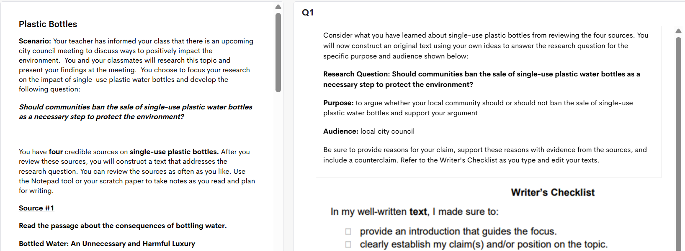
STANDARDS-BASED ASSESSMENTS:
WRITING ASSESSMENTS BENCHMARK 1
Who? | When? | Why?
Grades 6-8, Lit/Comp II | September 14th-18th (Benchmark 1 on the calendar) | Provides district-wide assessment and data point on students’ writing skills so that schools can use the data to tailor further writing instruction Offers data analysis and reporting (needs to be teacher scored using GADOE rubric)
Read more about Writing Assessments on the Assessment Hub!

Slide 18
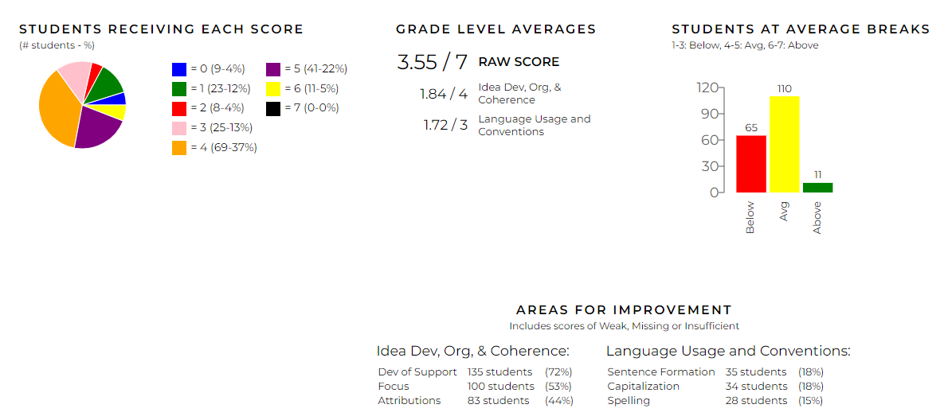
STANDARDS-BASED ASSESSMENTS:
WRITE SCORE BENCHMARK 2
Who? | When? | Why?
Grades 6-8, Lit/Comp II (some schools choose to opt in additional grades) | January 19th-22nd (Benchmark 2 on the calendar) | Provides hand-scored extended writing task and peer revision tasks assessments that are formatted and aligned to Georgia Milestones (ELA Section 1) *G6 and G7 will have a Peer Revision Task Offers data analysis and reporting, as well as lesson plans, professional development, and resources
Read more about Write Score on the Assessment Hub!

Slide 19

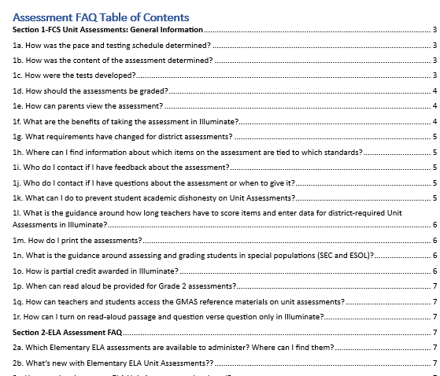
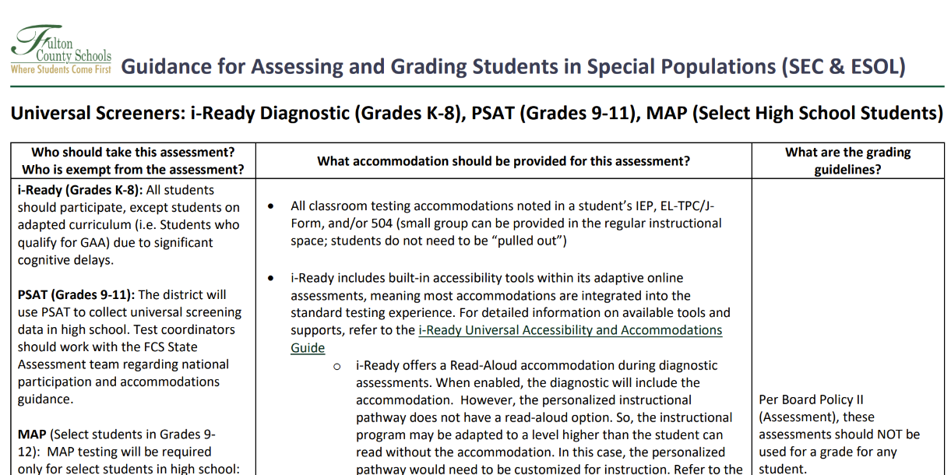
FAQ and SPECIAL POPULATIONS GUIDANCE
Assessment FAQ
Special Populations Guidance

Slide 20
TURN AND TALK
Name one assessment you have learned about in FCS and share its purpose.

Slide 21
GOALS FOR TODAY’S SESSION
Participants will learn about the different assessments administered in Fulton County. We will:
  Show how to access various assessment platforms

Slide 22
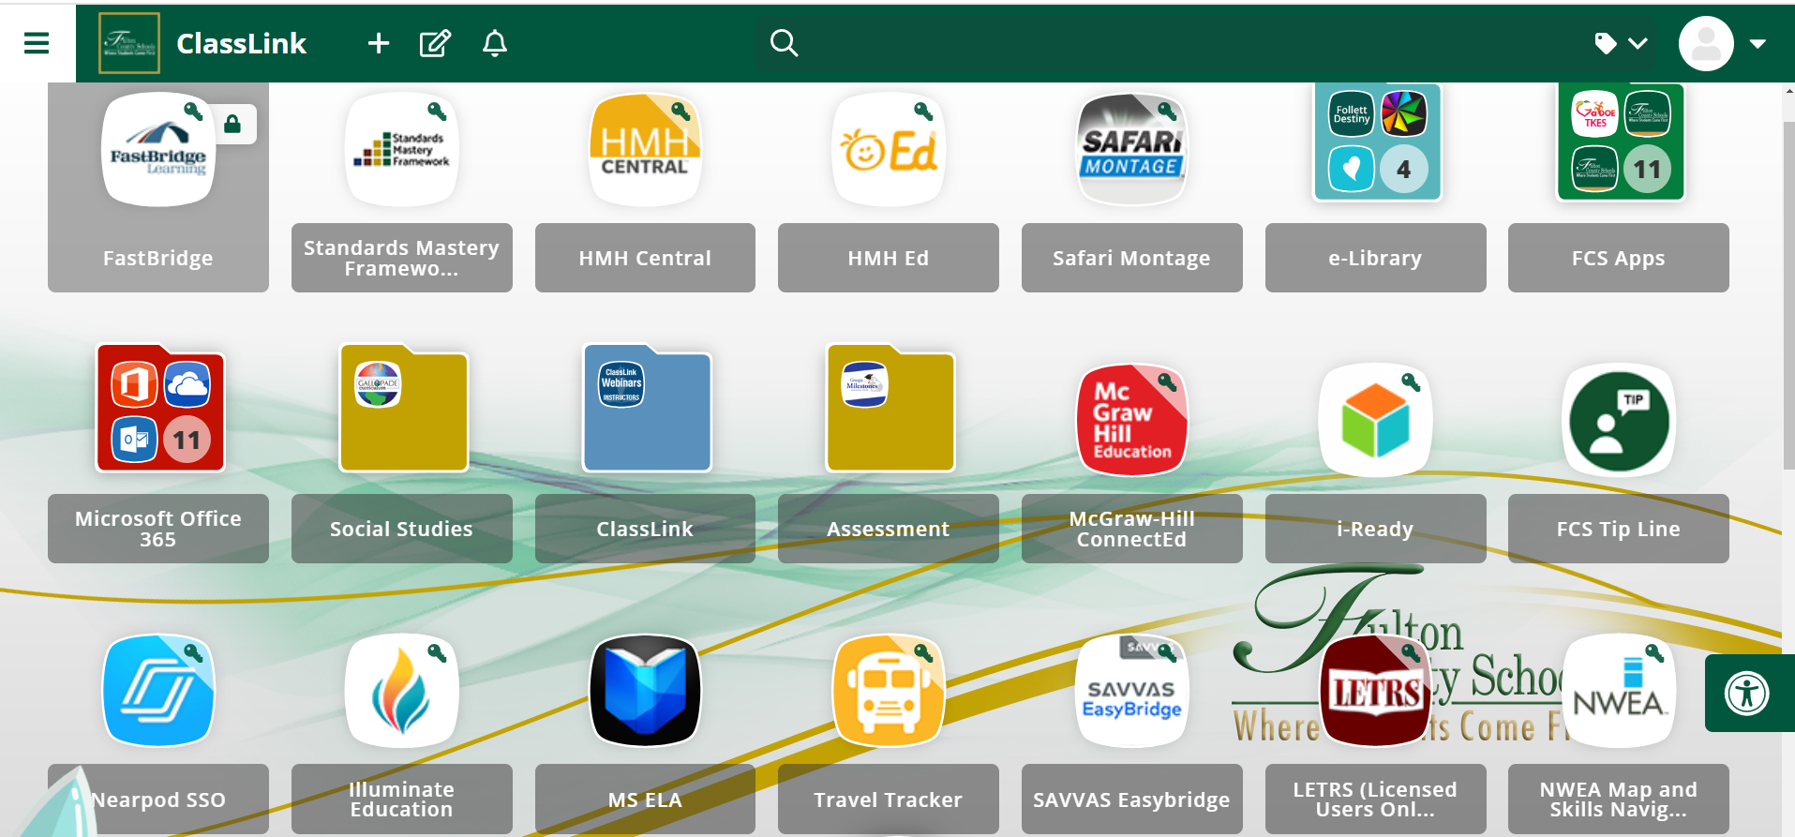
FCS ASSESSMENT PLATFORMS
Notes:
Give one minutes to log in to ClassLink and find/access Illuminate app
Share uses of Illuminate
Access and administer district created unit assessments (summative assessments) for specific grades/contents
Create additional assessments (summatives and formatives) for use throughout the year

Slide 23
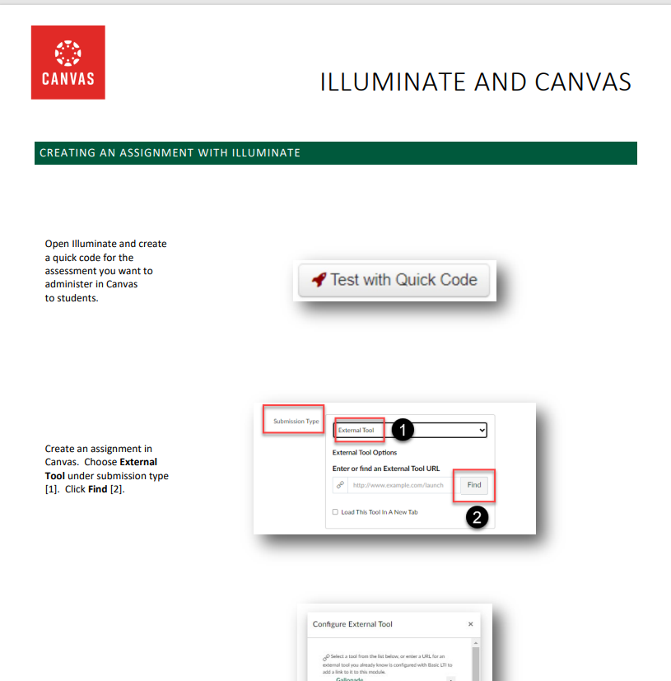

CANVAS
Canvas is a platform for instructors to manage their courses. One feature teachers can use is Creating an Assignment with Illuminate, which links the assessment from Illuminate into Canvas.
NOTE: there are some watchouts when using this feature
Read more about linking Illuminate and Canvas on the Assessment Hub!

Slide 24
GOALS FOR TODAY’S SESSION
Participants will learn about the different assessments administered in Fulton County. We will:
  Review Fulton's assessment calendar

Slide 25
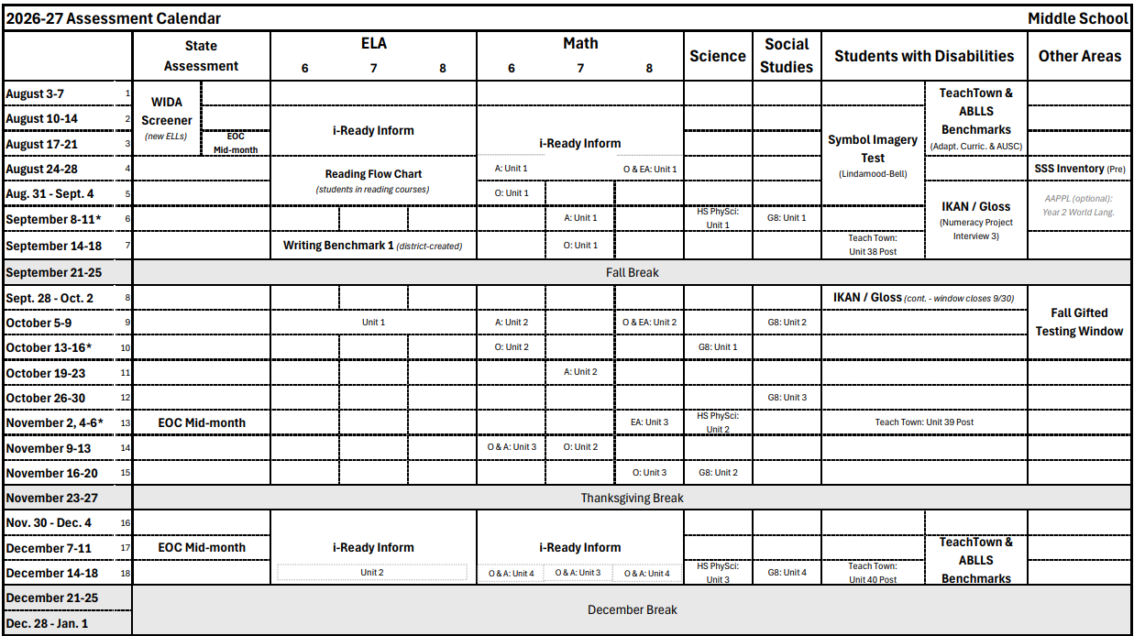
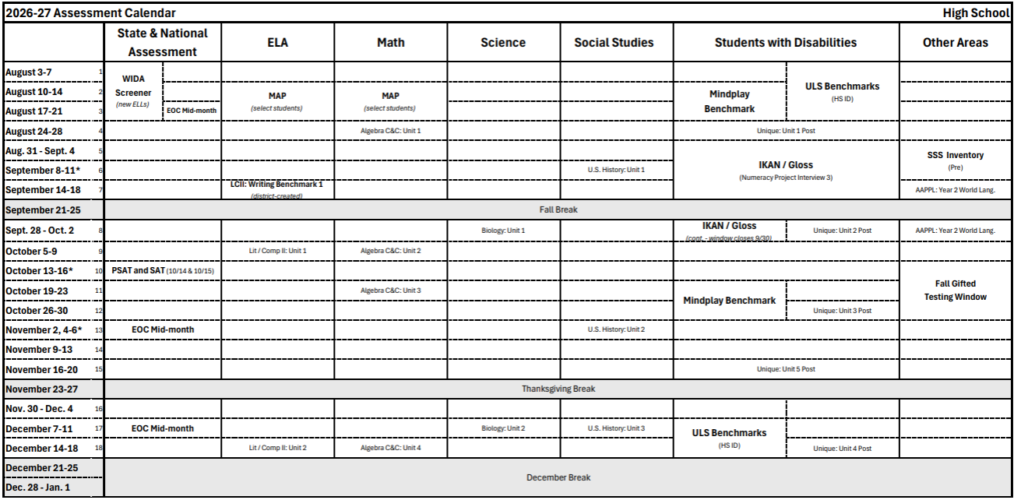
FCS ASSESSMENT CALENDAR
View your assessment calendars on the Assessment Hub!
Notes:
Explain how calendar is divided by content/student groups and organized by weeks
Explain testing window, can administer assessment before window if students are ready, must test by Friday of the assessment window week
Calendar for each content matches the content pacing guides
IF ON THE CALENDAR IT IS REQUIRED. Other assessments that can be given as options but these are REQUIRED

Slide 26
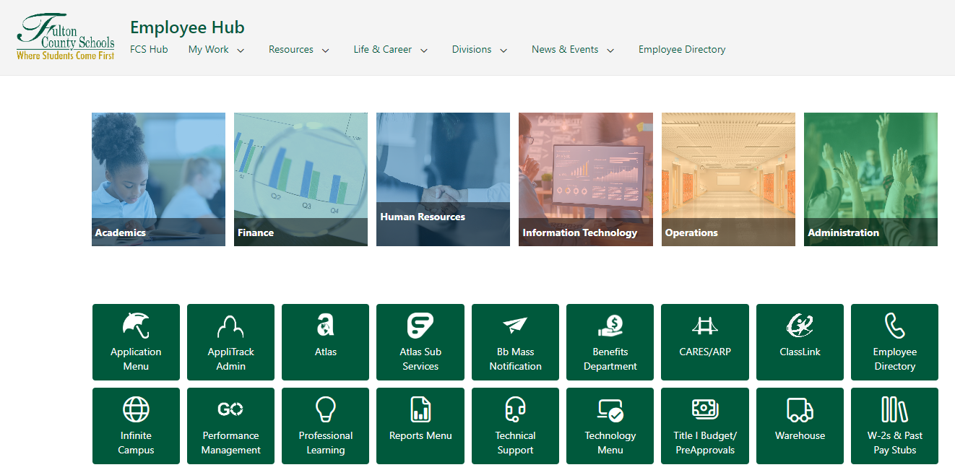

FCS ASSESSMENT CALENDAR: ACCESS
To access the Assessment Hub…
Log into the Employee Hub → Click the Academics app → Choose Assessment
Notes:
Walk through steps and give a minute to navigate to Employee Hub

Slide 27
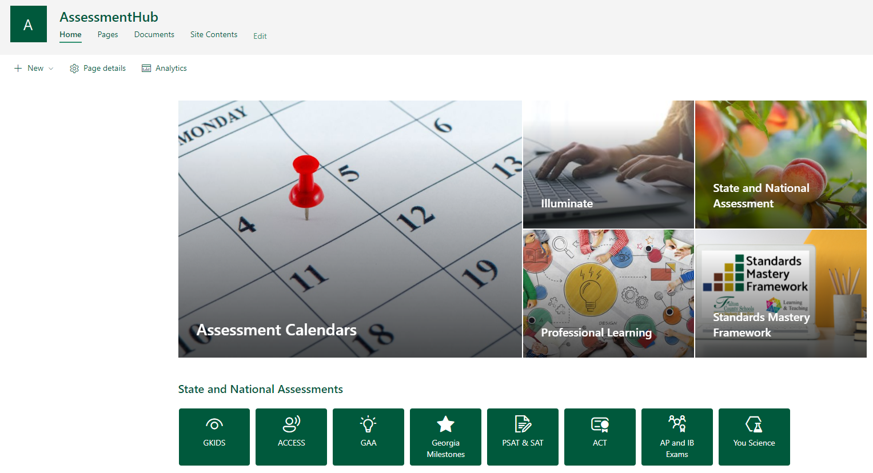
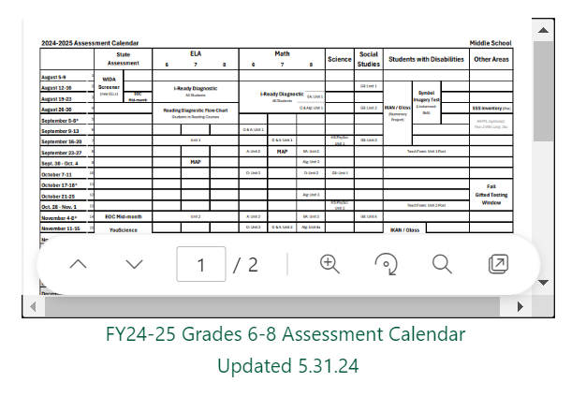
FCS ASSESSMENT CALENDAR: VIEWING
Choose "Assessment Calendars"
Place your clicker over the 6-8 or HS Assessment Calendar-> Click “Open in new window” box
Notes:
Walk through steps and give a minute to navigate to

Slide 28
FCS ASSESSMENT CALENDAR
Share ONE thing you notice on the Assessment Calendar you’re viewing.
Notes:
Give a few minutes to look at the assessment calendar
Share one thing they notice in the chat

Slide 29
GOALS FOR TODAY’S SESSION
Participants will learn about the different assessments administered in Fulton County. We will:
  Discuss data-driven instructional practices

Slide 30
DATA-DRIVEN INSTRUCTION IN FCS
Initial Unit Plan
Unpack summative assessment(s)
Plan for learning
What is the plan for initial learning?
What do students need to know?
Data Analysis & Action (Summative)
Analyze summative assessment data
Plan for reteaching & reassessing
Balanced Assessment Plan (Calendarize)
- Plan and implement common formative assessments & checks for understanding
Data Analysis & Action (Formative)
Analyze formative assessment data
Plan for learning & reteaching (if needed)
What do we do if they don’t know it?
How do we know that they know it?
Resources to support with Data-Driven Instruction on the Assessment Hub!
What do we do if they already know it?

Slide 31
WHO DO I CONTACT FOR SUPPORT?
PLC-Based Support
Grade Level Chair
PLC Team Member or Mentor
School-Based Support
Curriculum Support Teacher (CST)
- Coach(es)
- Department Chair
Administrative Assistant (AA)
SDI Coach
District-Based Support
Assessment Program Specialist

Slide 32

QUESTIONS

Slide 33


And welcome to Fulton County Schools!

