Slide 1

THE BEST WAY TO BE EFFECTIVE
WEARING THE RIGHT PPE

Slide 2
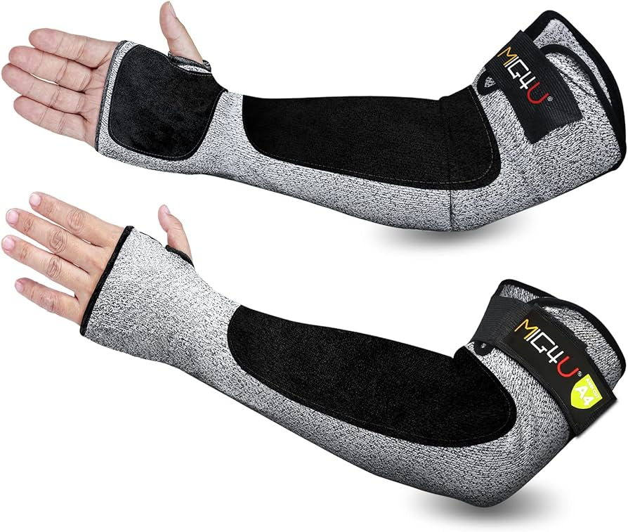
PPE
The right Personal Protective Equipment (PPE) is crucial for workplace safety, as it minimizes the risk of injuries and illnesses caused by hazards.
PPE acts as a barrier, protecting workers from physical, chemical, and biological hazards. Proper selection and use of PPE are essential to ensure adequate protection

Slide 3
Are you Ready for an incident?
Accidents and incidents don’t happen when it’s convenient; they happen when we are or aren’t prepared. Preparation is the most important tool we can have in our tool belt. To be successful in any job, it's crucial to learn the craft and know the ins and outs.
Working with children with special needs is no different. The time you invest in comprehensive training and learning how to protect yourself during behaviors escalation is critical.
Why do we say yourself first? Equipping ourselves with the proper PPE is just as important as the service we give to our students.

Slide 4
PPE VS. No PPE
The use of Personal Protective Equipment (PPE) significantly reduces the risk of workplace injuries. Proper PPE use can prevent 37.6% of occupational injuries and diseases, according to OSHA. Conversely, studies show that a substantial percentage of injuries occur due to the lack of or improper use of PPE, with some studies reporting that up to 34% of occupational accidents are linked to inadequate PPE usage, according to a study published by the National Institutes of Health.

Slide 5
WITHOUT PPE
Scratches and cuts: If a scratch or bite breaks the skin, bloodborne pathogens can enter the bloodstream through these open wounds.
Contact with infected blood or body fluids: If the person or animal that bites or scratches is infected, and their blood or other potentially infectious materials (OPIMs) come into contact with your broken skin or mucous membranes (eyes, nose, mouth), you can be exposed to BBPs.
Saliva: In some cases, such as human bites, saliva can be a concern if it contains blood or other potentially infectious materials.
Animal saliva on claws: Animals that carry diseases like rabies can transmit the virus through scratches because they lick their claws.

Slide 6
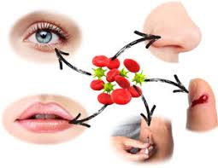
What are BBPs
Examples of BBP
Hepatitis B (HBV): A highly infectious virus that can cause liver damage.
Hepatitis C (HCV): Another virus that affects the liver.
Human Immunodeficiency Virus (HIV): The virus that causes AIDS.
Syphilis: A bacterial infection.

Slide 7
The best way to protect is to cover up
Proper use of personal protective equipment (PPE) is a critical component in minimizing the risk of exposure to bloodborne pathogens (BBPs). By serving as a barrier between potentially infectious materials and the skin, eyes, mouth, and mucous membranes, PPE plays a vital role in safeguarding the health and safety of workers. Consistent adherence to PPE protocols—along with proper training, disposal, and hygiene practices—ensures that individuals are protected and workplace standards for infection control are maintained. Ultimately, PPE is not just a protective measure; it is a fundamental responsibility in preventing the transmission of serious infectious diseases.

Slide 8
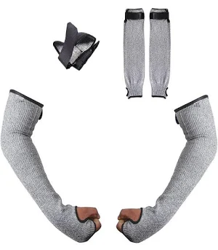
Working with a student who scratches, bites, and hits tool kit

Slide 9

Safety tips for student behavior

Slide 10
Any Question
Was there any new information?
What stood out to you?
Is there anything you could add to this training?

