Slide 1

Safe Lifting for Office Jobs
Prevent injuries and improve workplace safety

Slide 2
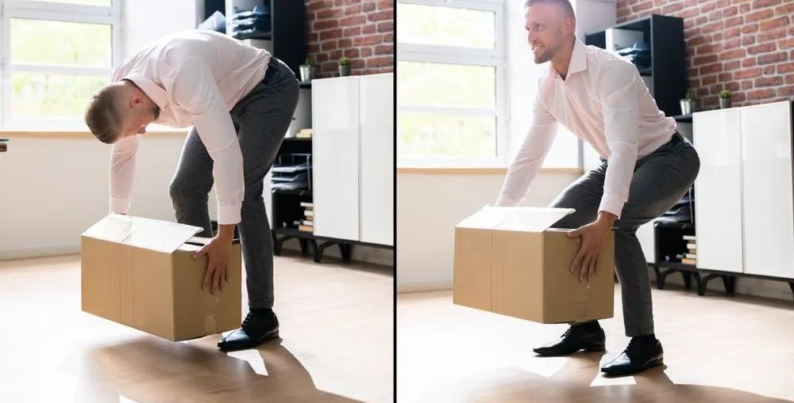
Why Proper Lifting Matters
- Prevent back injuries
- Reduce strain and fatigue
- Improve efficiency
- Promote workplace safety

Slide 3
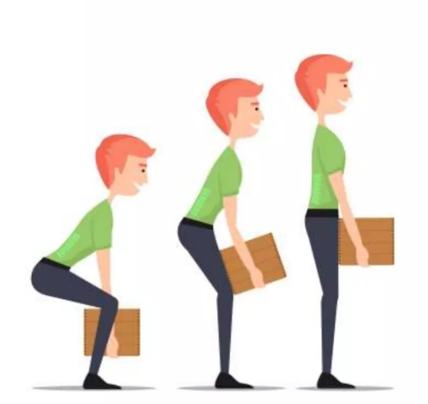
Before You Lift
- Check weight of object
- Plan your path
- Clear obstacles
- Get help if needed

Slide 4
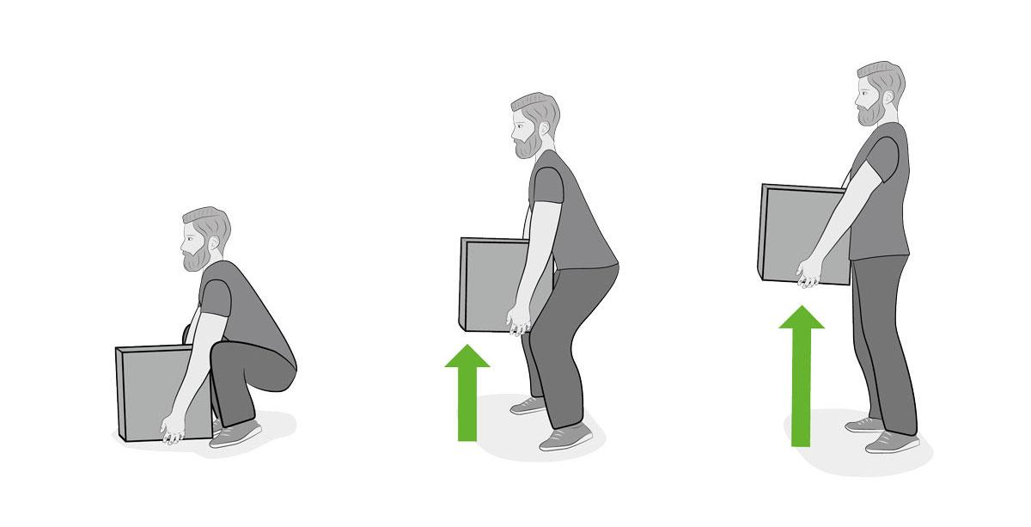
Proper Lifting Technique
- Stand close to object
- Feet shoulder-width apart
- Bend knees, not back
- Keep back straight
- Lift with legs

Slide 5


Slide 6

Carrying the Load
- Keep object close to body
- Maintain good posture
- Move slowly
- Keep eyes forward

Slide 7
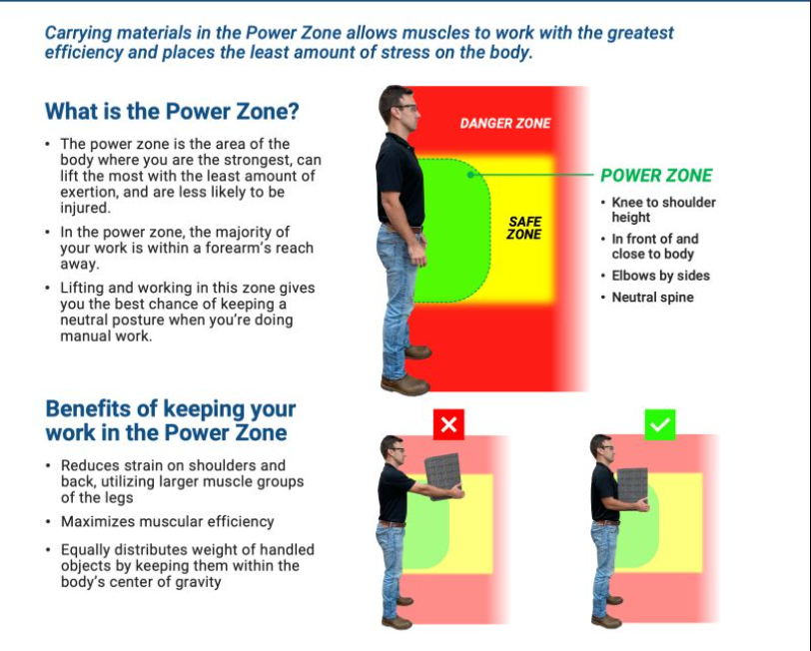
Setting the Load Down
- Bend knees
- Keep back straight
- Lower slowly
- Avoid twisting

Slide 8
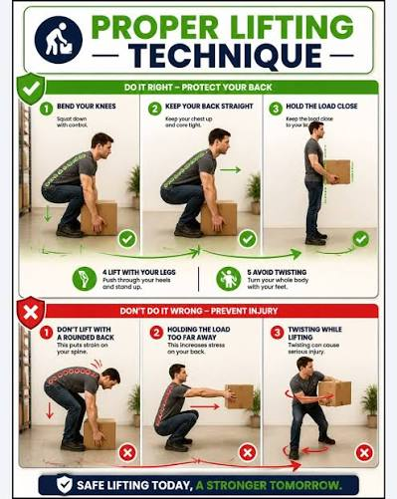
Common Mistakes
- Bending at the waist
- Twisting while lifting
- Lifting too quickly
- Carrying too much

Slide 9
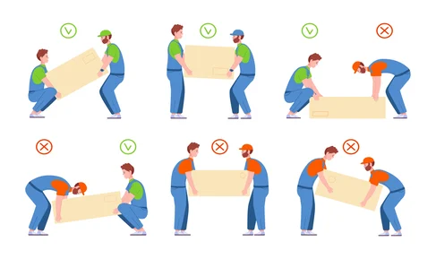
Team Lifting
- Communicate clearly
- Lift together
- Assign a leader
- Coordinate movements

Slide 10

Office Safety Tips
- Use carts/dollies
- Store heavy items properly
- Break loads into smaller parts
- Keep walkways clear

Slide 11
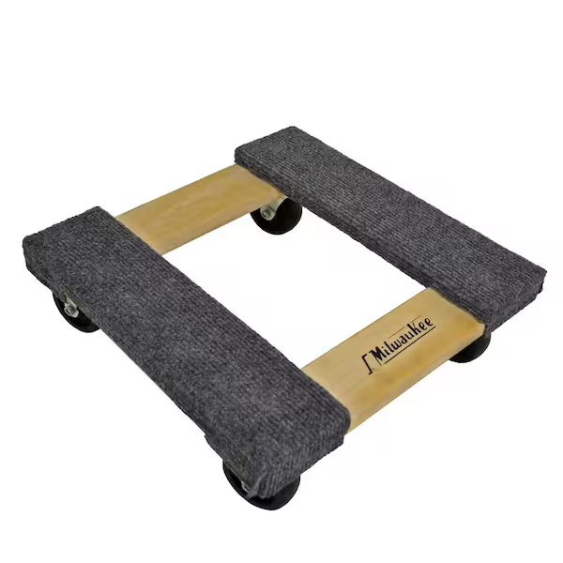
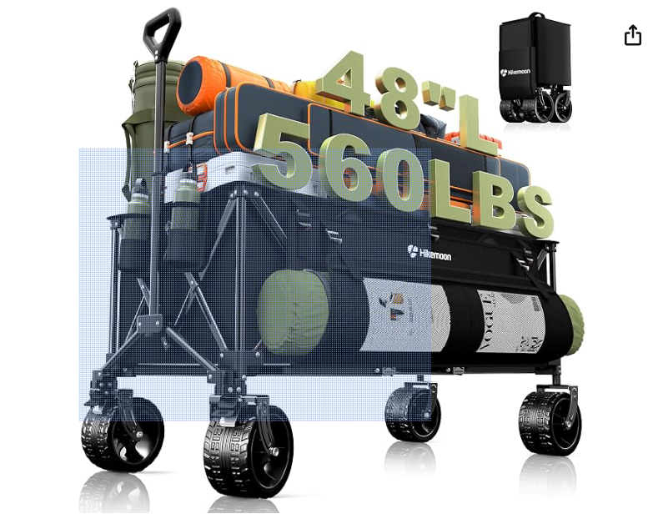
Key Takeaway
If it's too heavy, get help or use equipment
300L Extra Large Wagons Carts Foldable, 560LBS Heavy Duty Collapsible Beach Wagon 48" Long with Big All-Terrain Wheels, Utility Folding Cart for Camping, Grocery, Sports, Garden, Black
https://www.amazon.com/dp/B0F3JD69TB/ref=sspa_dk_detail_right_aax_0?sp_csd=d2lkZ2V0TmFtZT1zcF9kZXRhaWxfcmlnaHRfc2hhcmVk&th=1

