Slide 1

The
History
of
“It’s a GREAT DAY to be a WILDCAT!”

Slide 2
Greetings fellow Wildcat alum! Having graduated from West in 2001 and now teaching there for 21 years, I think I am a good person to provide a “look at West” after 30 + years in business. There are a lot of projects, events, and celebrations that have become part of West’s culture and hopefully this presentation will catch you up on some of it.
Why a presentation and not a newsletter? I hate newsletters and as a visual person – I like to see good pictures of the “what” – not read about it. After spending two hours on a newsletter template without any progress, the choice became obvious. So, enjoy the show and shoot me an email to be on my mailing list when I have time to put together another one. Thanks!
– John Bierbaum (‘01)
bierbauj@unit5.org

Slide 3








Slide 4


Slide 5
Why so many different logos?
Obviously, if you ask that question, you’re not an alum. Haha! We all know that there are (2) logos for Normal West. The original - and in my opinion the best - and the new “W” that is printed / embroidered on shirts, signs, etc. Speaking of logos…

Slide 6
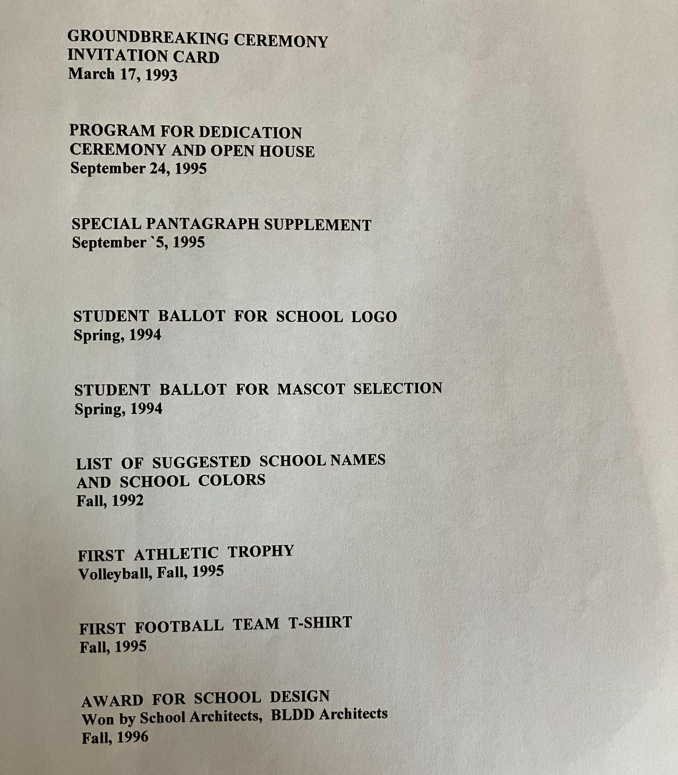
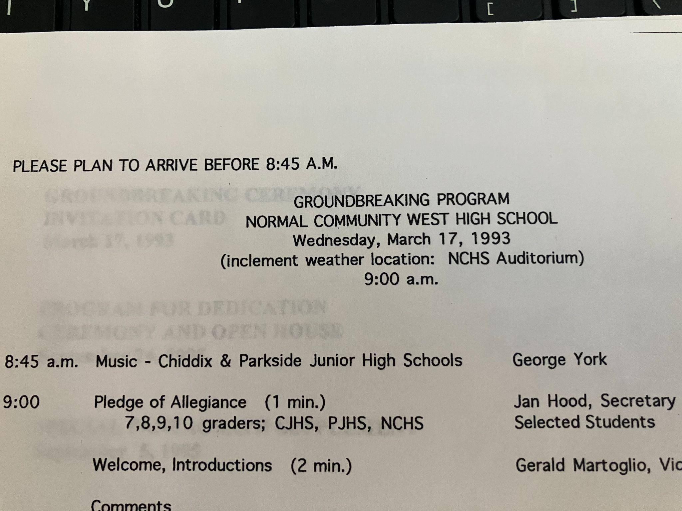
Timeline of Normal West “Founding” events

Slide 7
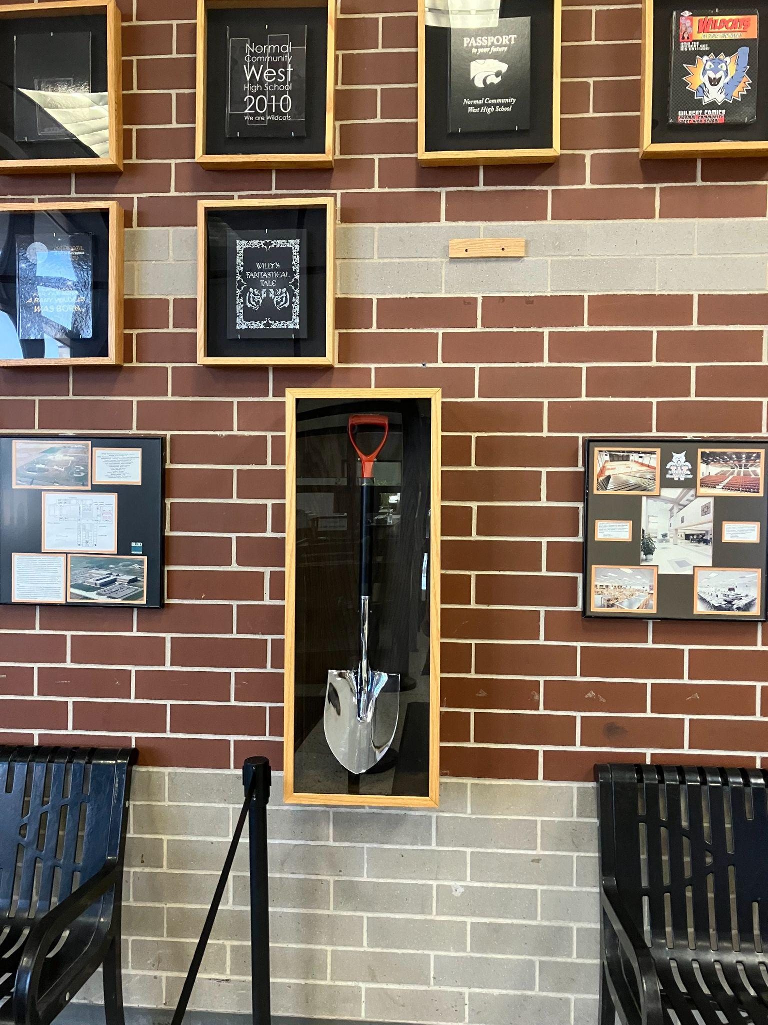
Our Archive Club helped coordinate a project a few years ago to get the original groundbreaking shovel mounted in a shadow box for our lobby.
And funny story: It actually did rain that day and so the “groundbreaking” ceremony did take place at the inclement weather location: the stage at Normal Community High School.

Slide 8
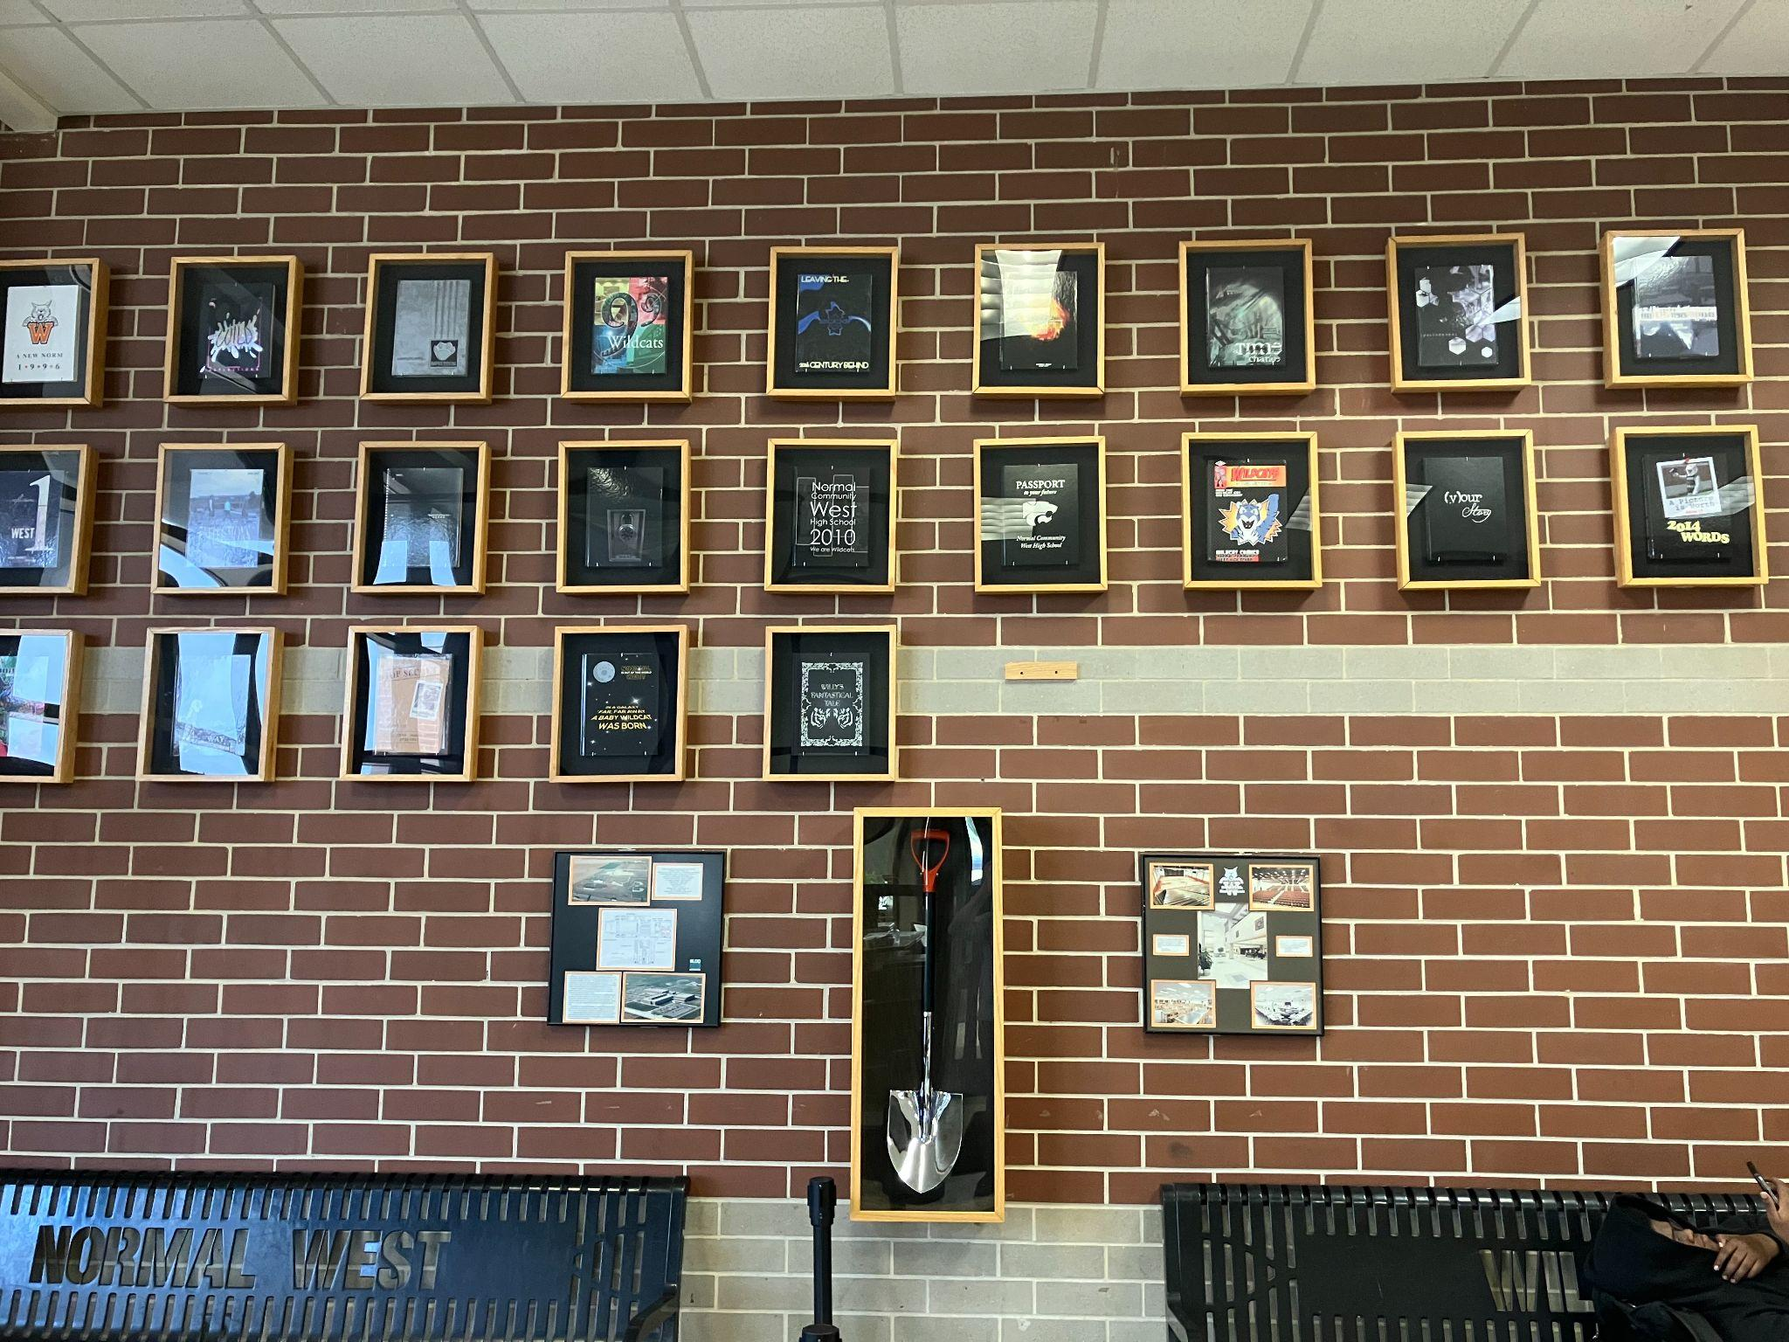

Slide 9
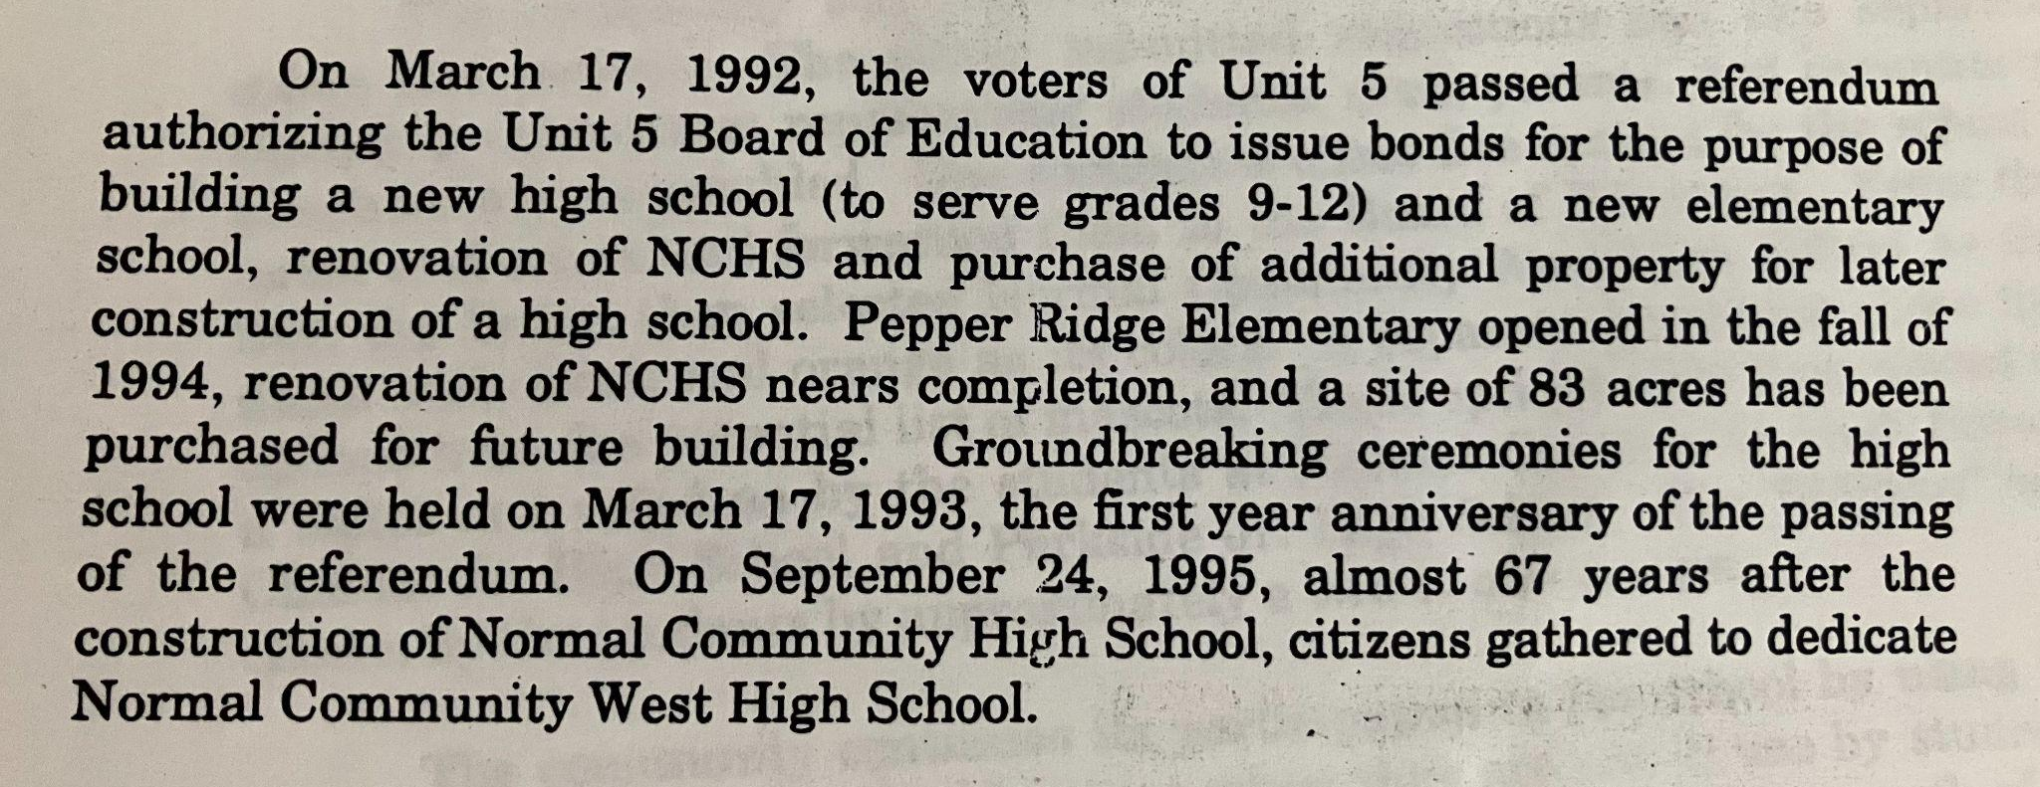

Slide 10
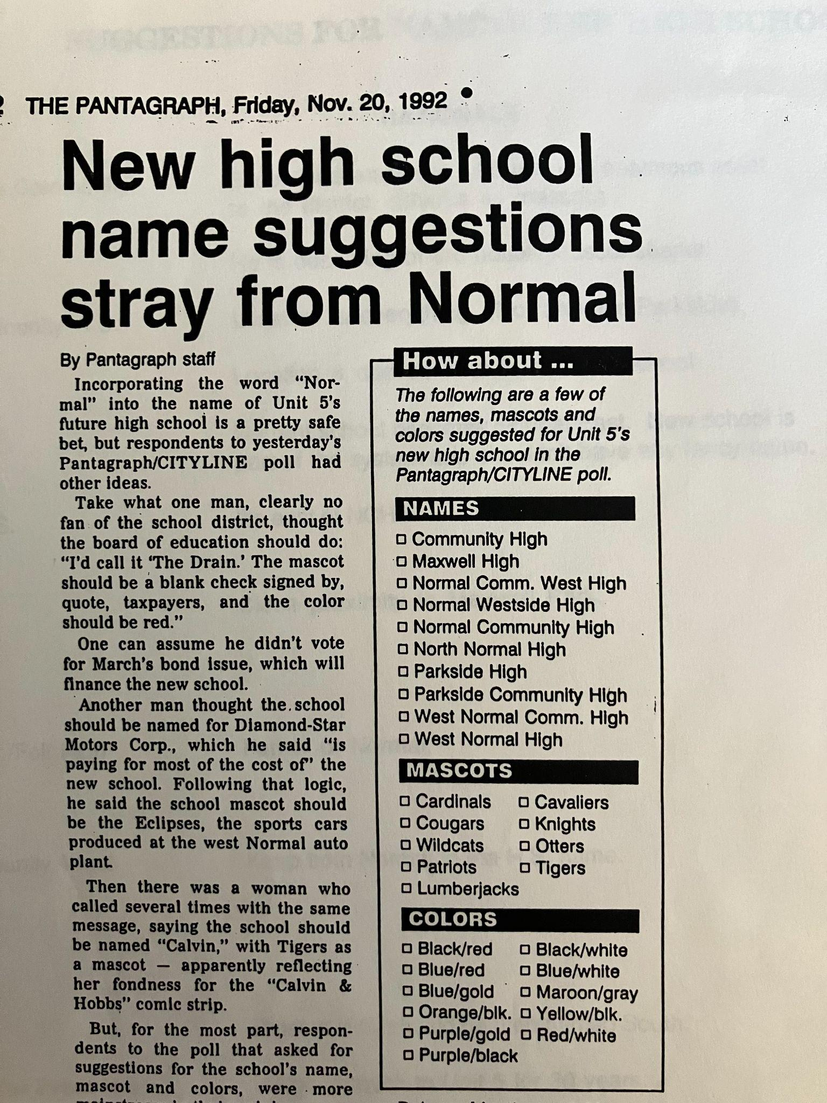
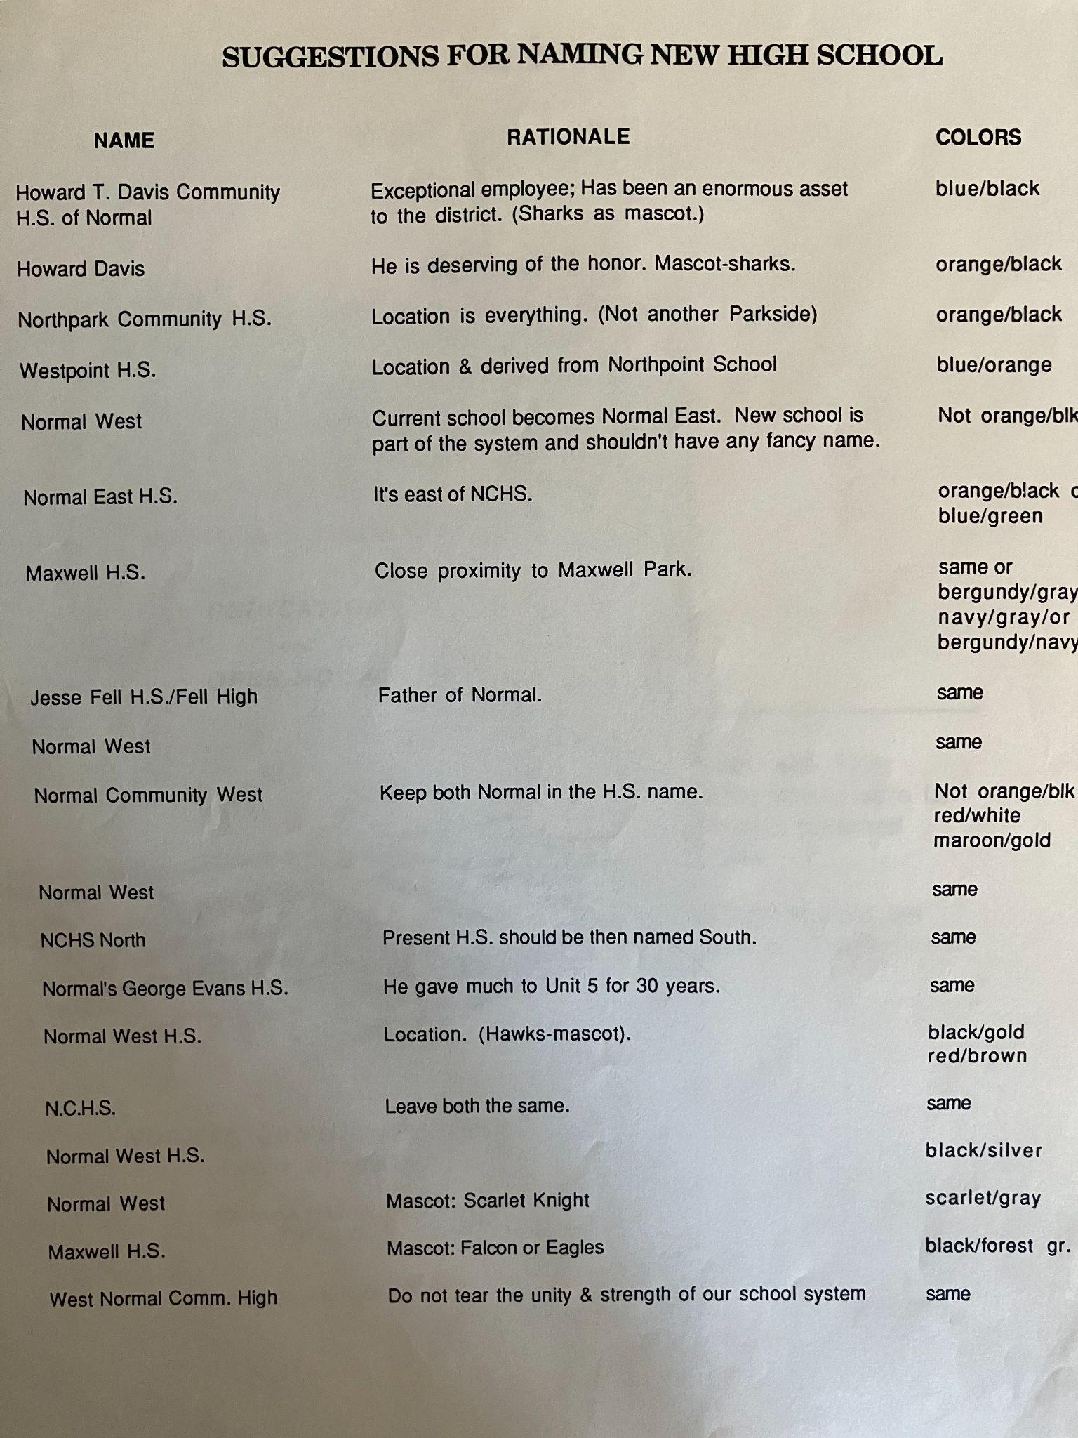

Slide 11
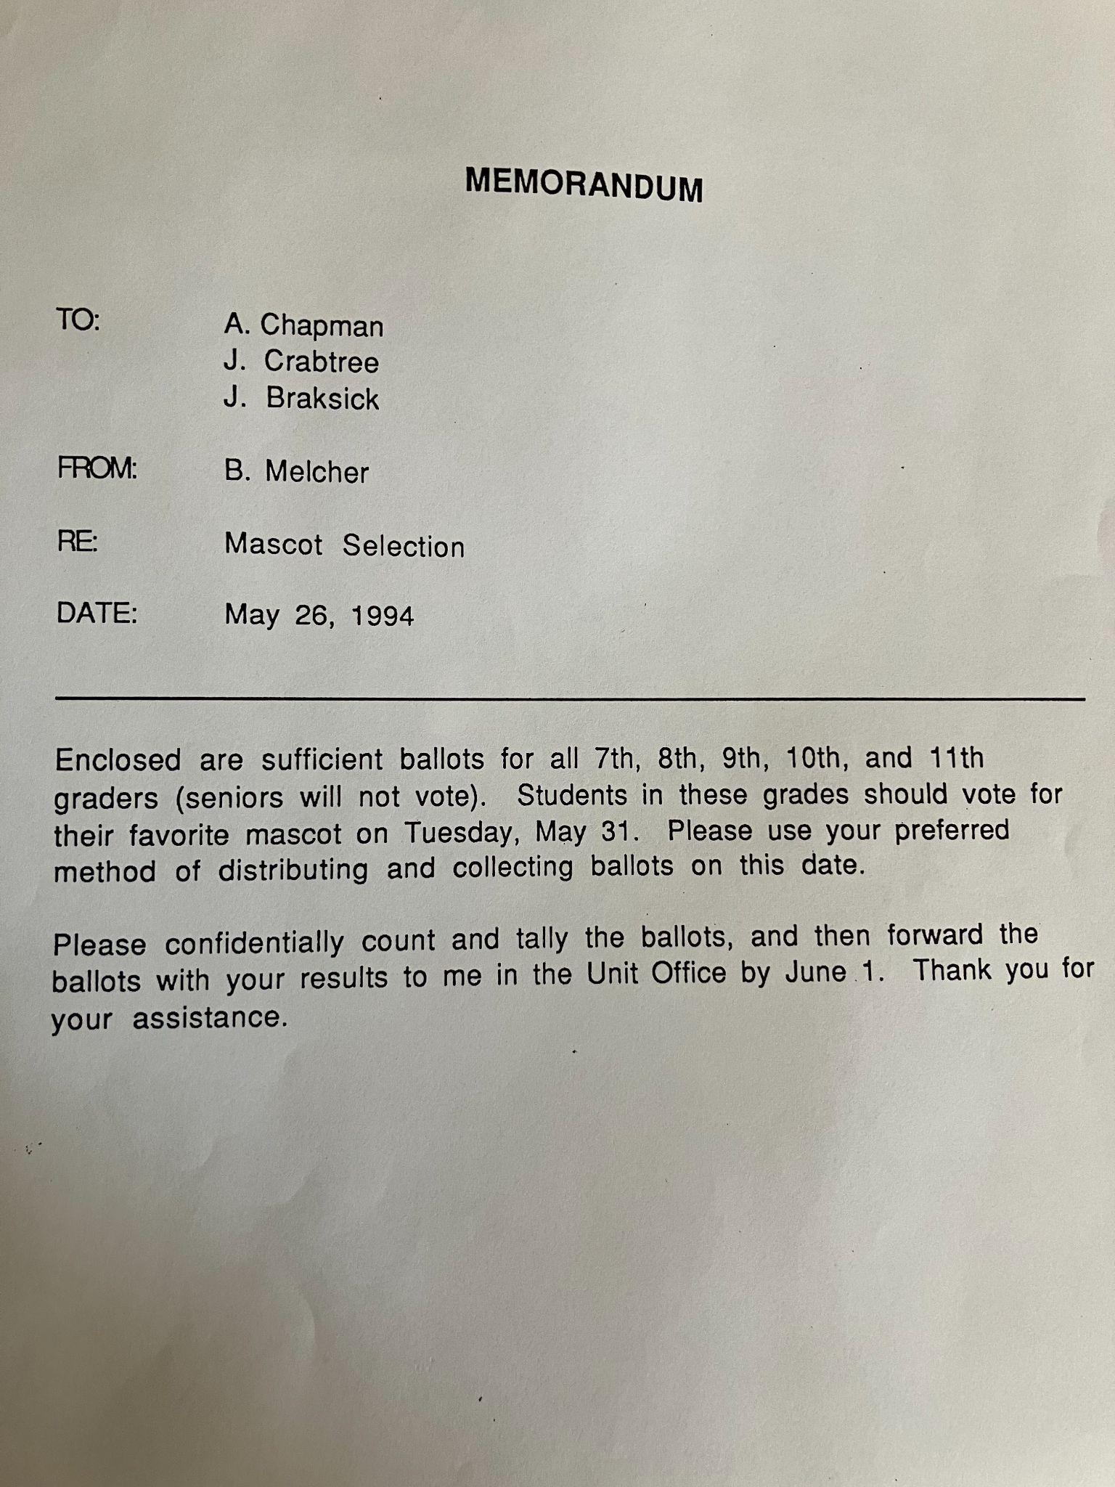
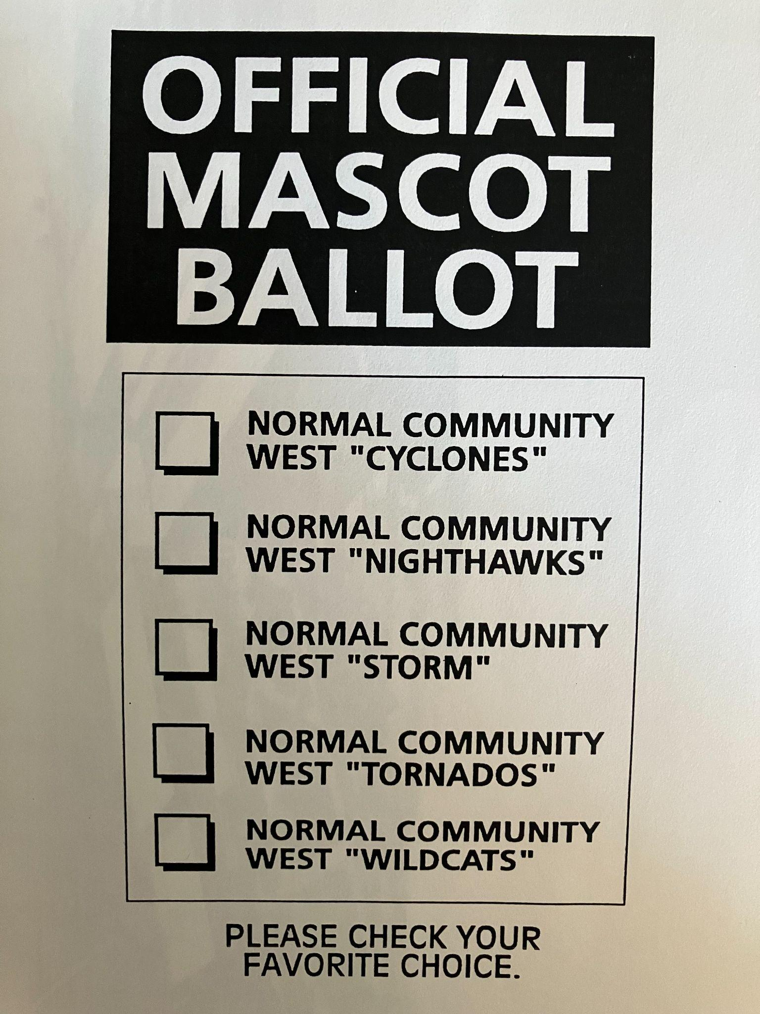
How did we actually pick the mascot?

Slide 12
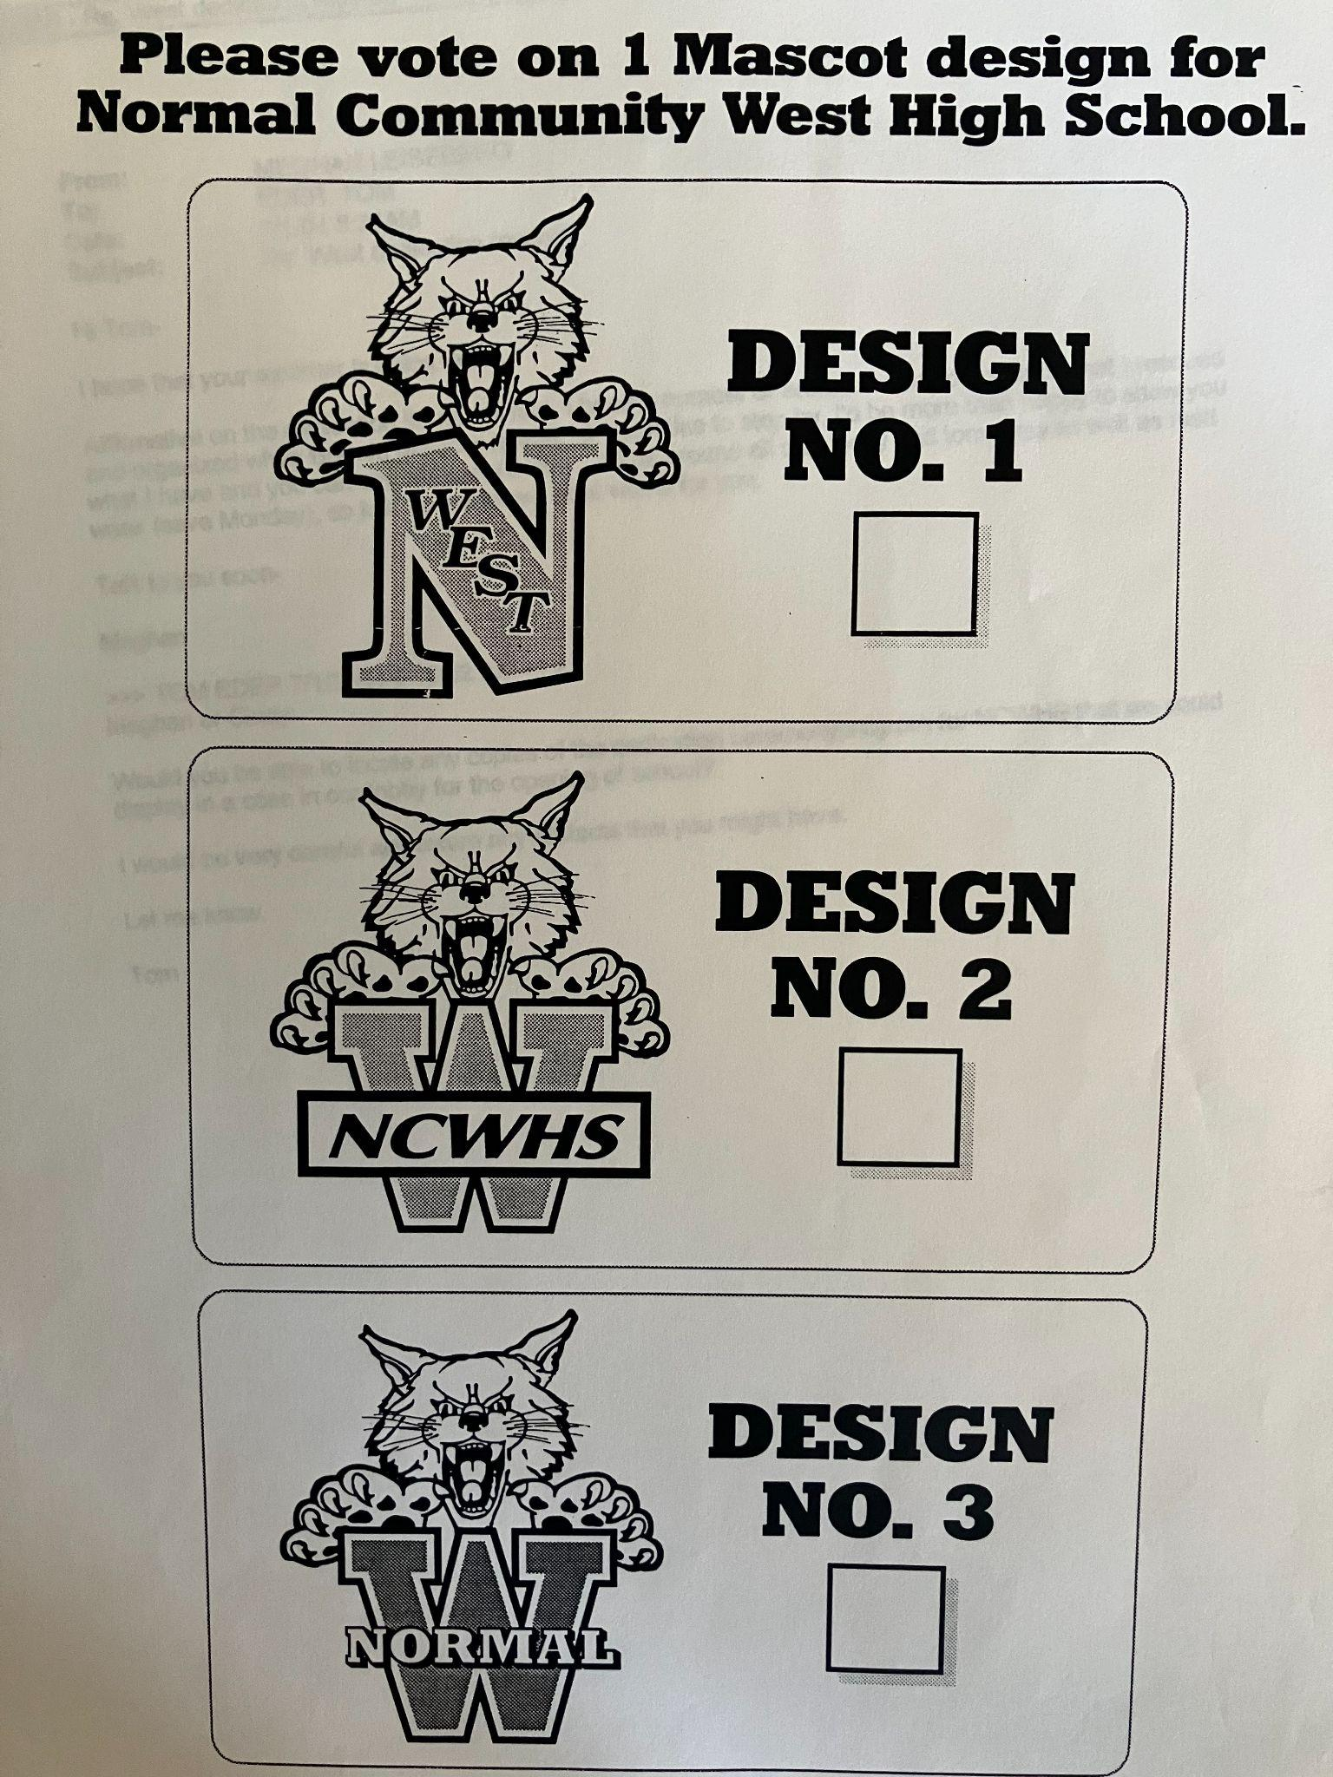

Slide 13
Archive: a collection of historical documents or records providing information about a place, institution, or group of people.
Sometime around 2014, I was teaching sophomore U.S. History and noticed that a bunch of my students had white yearbooks and black yearbooks with reflective art on the front – which of course are the 96’ and 97’ yearbooks. I found out that the fire marshall had gone up to the 3rd floor of N.W. – storage essentially - and ordered all of the “stuff” to be tossed out. This “stuff” was essentially our school’s history: yearbooks, banners, etc. I immediately gathered the class and we went dumpster diving - literally - out back.
Over the years that followed, I organized an “Archive Club” which aims to collect, preserve, and celebrate West’s history.

Slide 14
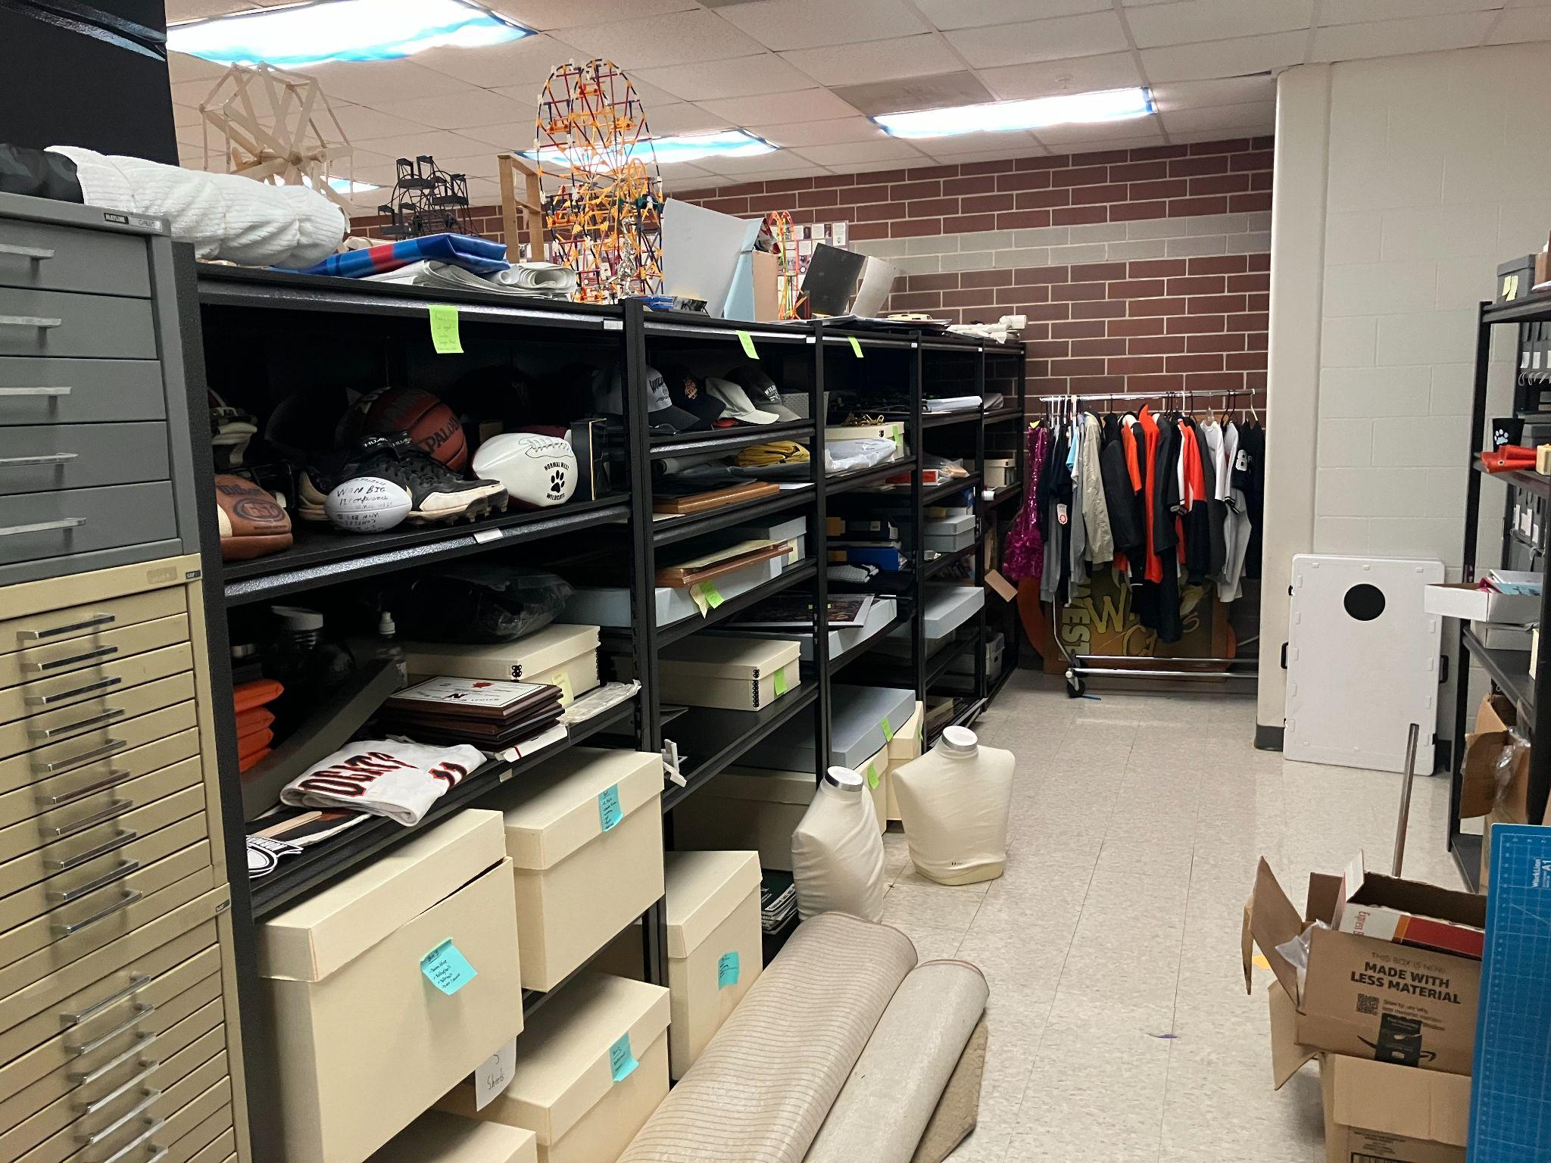
Our “archive” is something between a closet full of really cool things and a functional, professional archive. Each year, a team of students work to organize and inventory all of our amazing treasures.

Slide 15
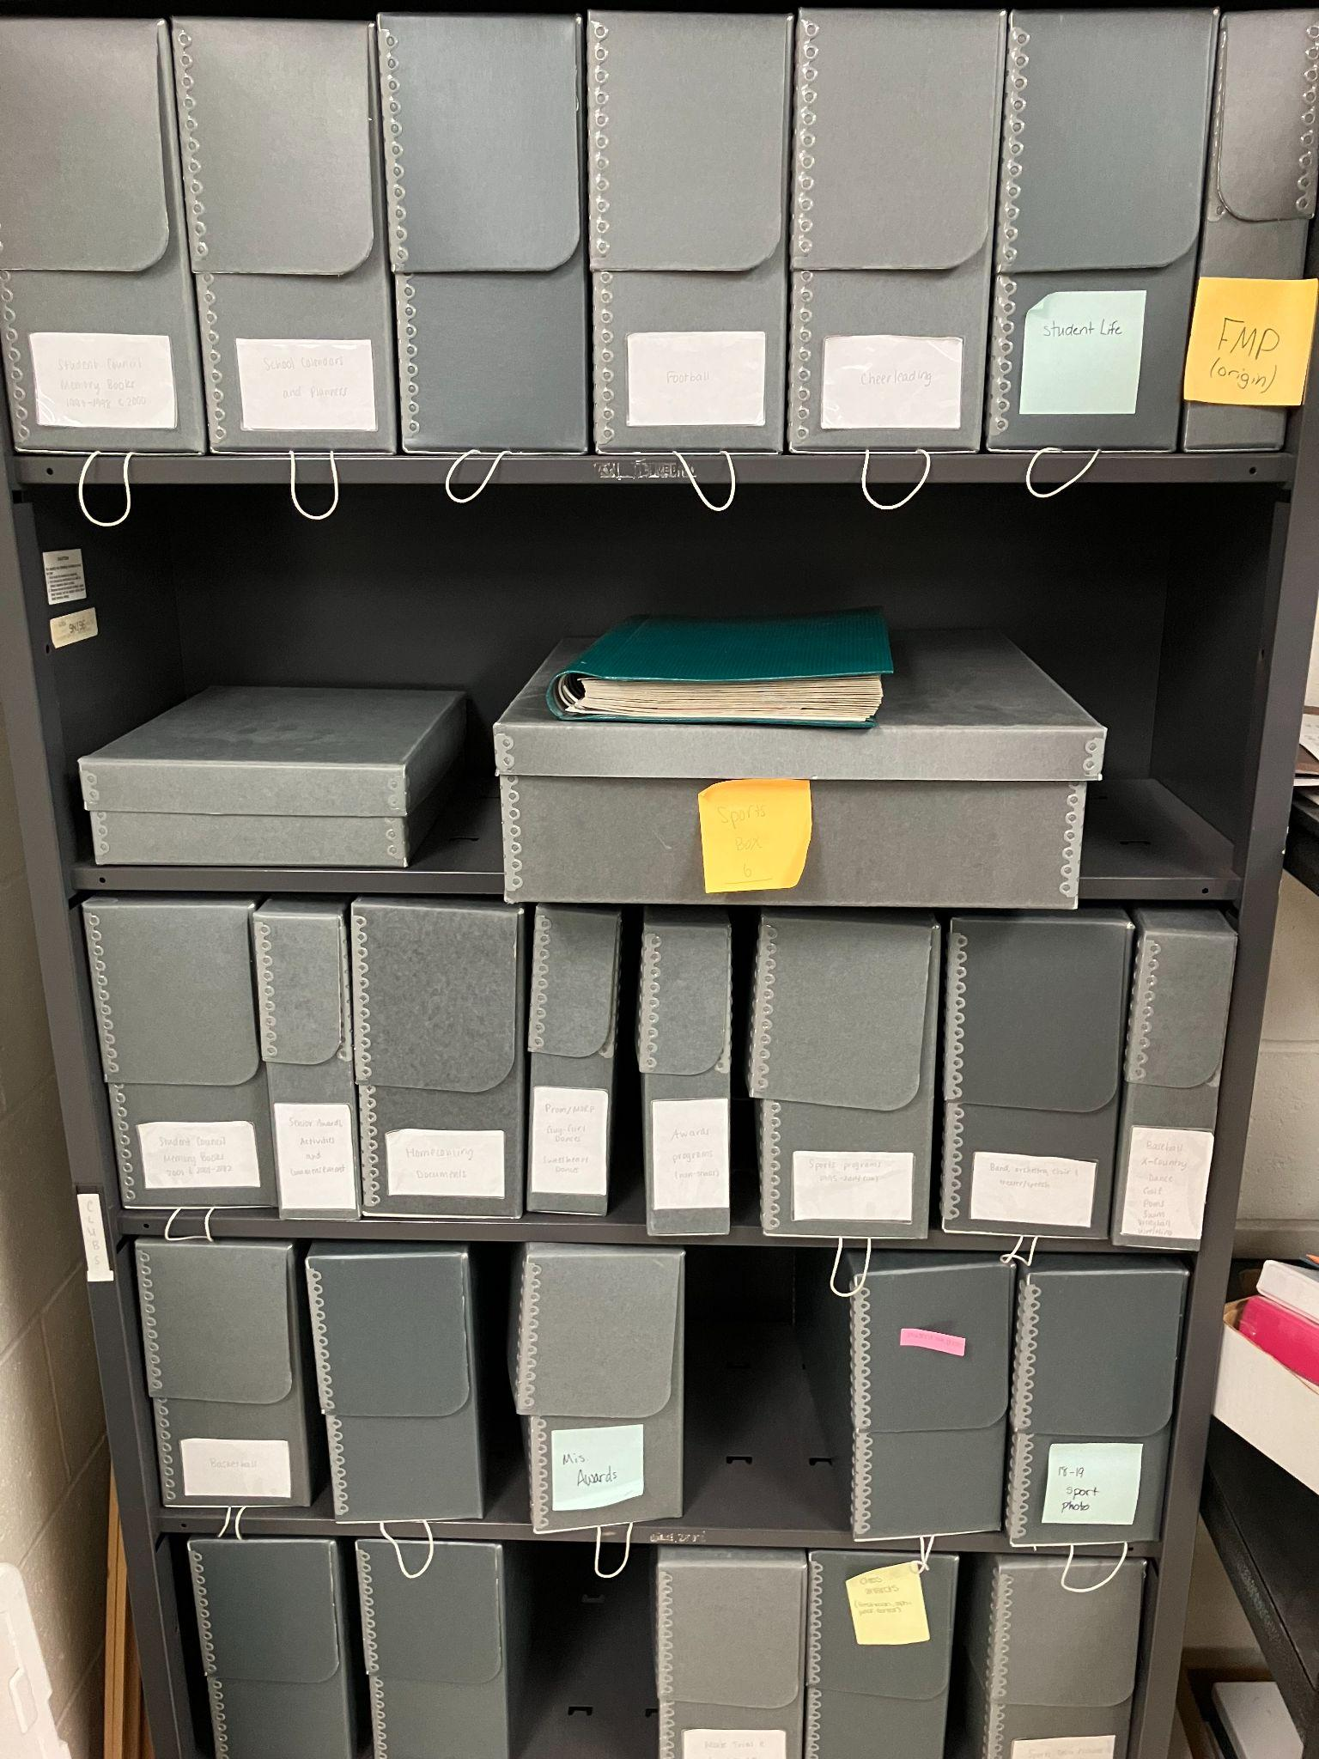
Our archive group has actually taken trips to I.S.U.’s archive (a huge warehouse off Northtown Road, Normal), had presentations from State Farm’s archive, and other educational “outings” to learn how to archive professionally. —---------->
These are acid free boxes which although expensive, keep play/musical pamphlets, pictures, old rosters, certificates, and so many other bits and pieces of West history.

Slide 16
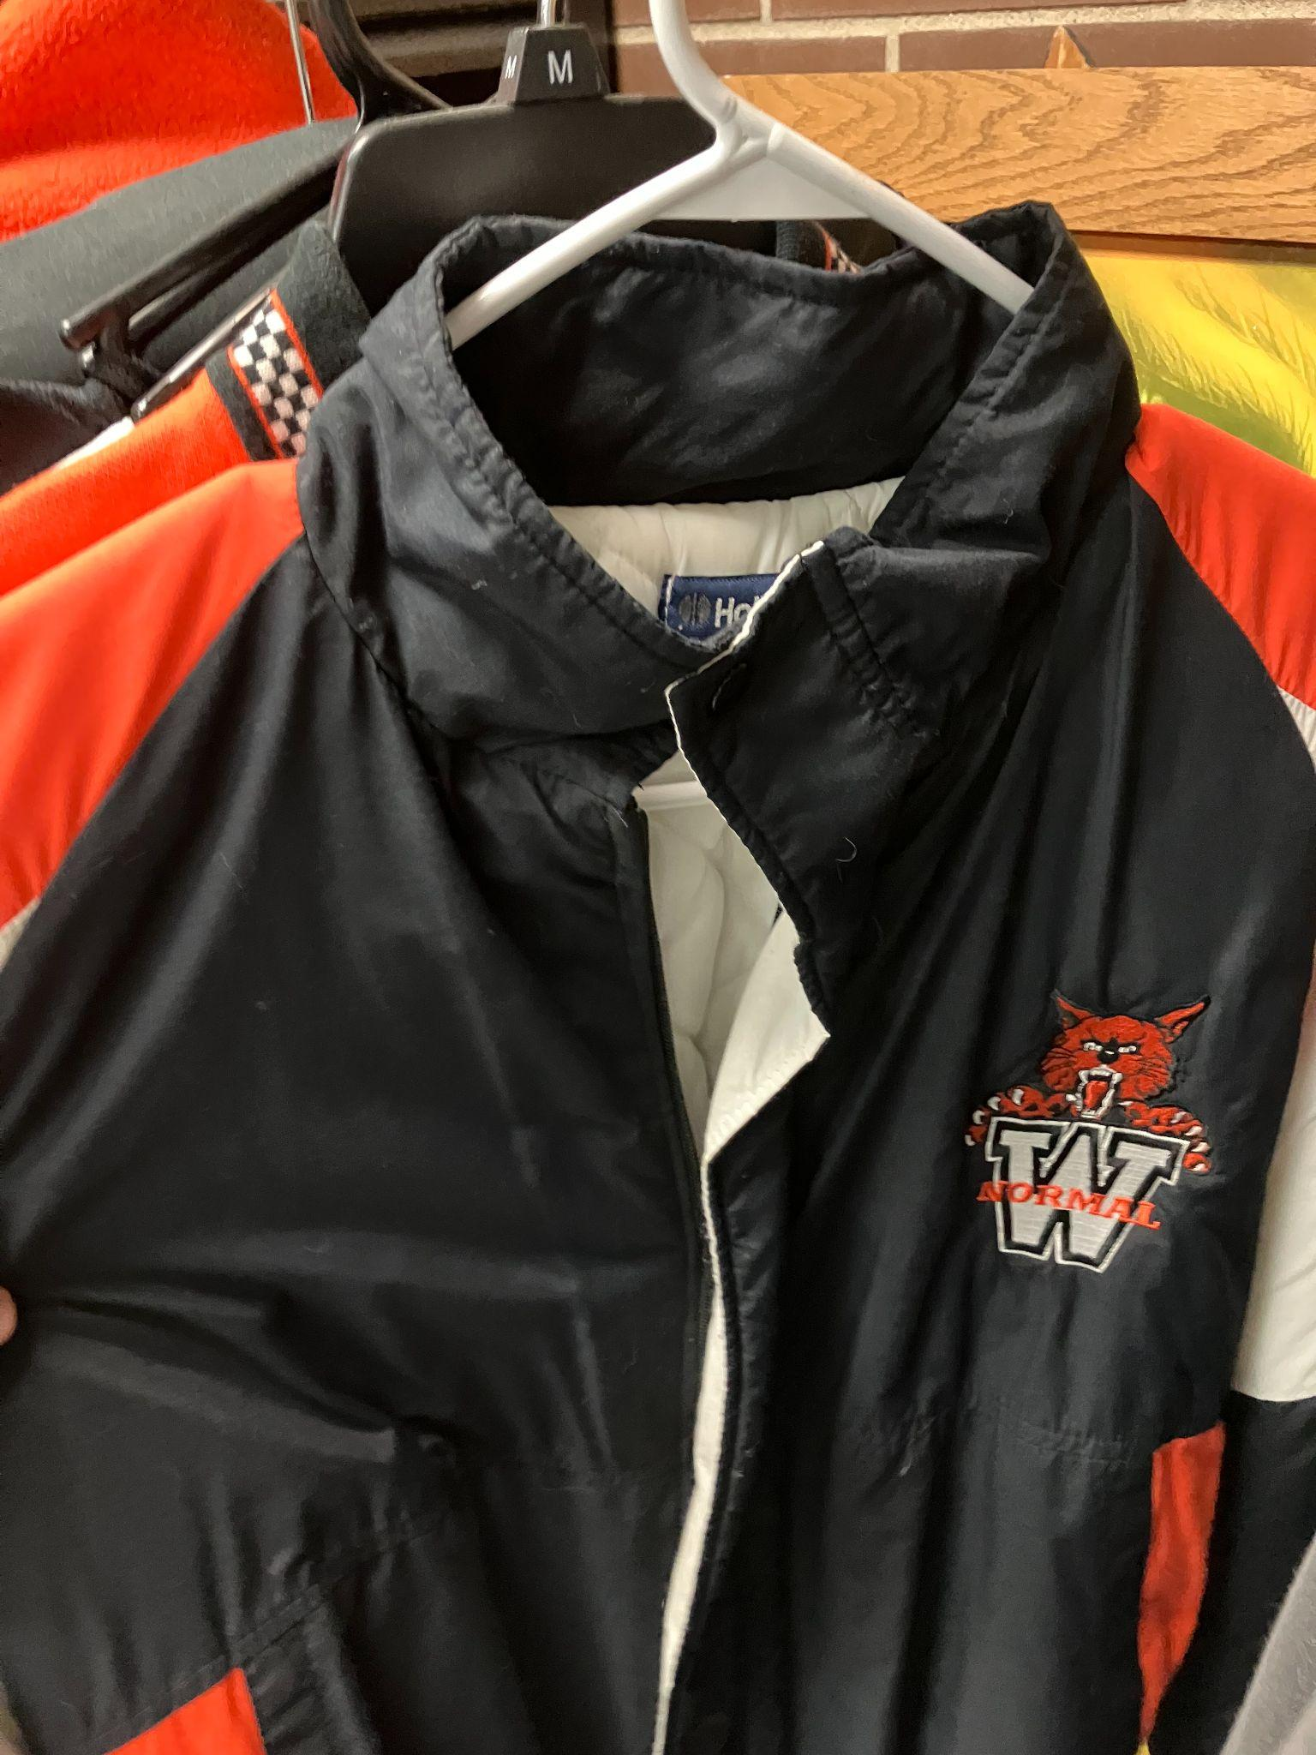
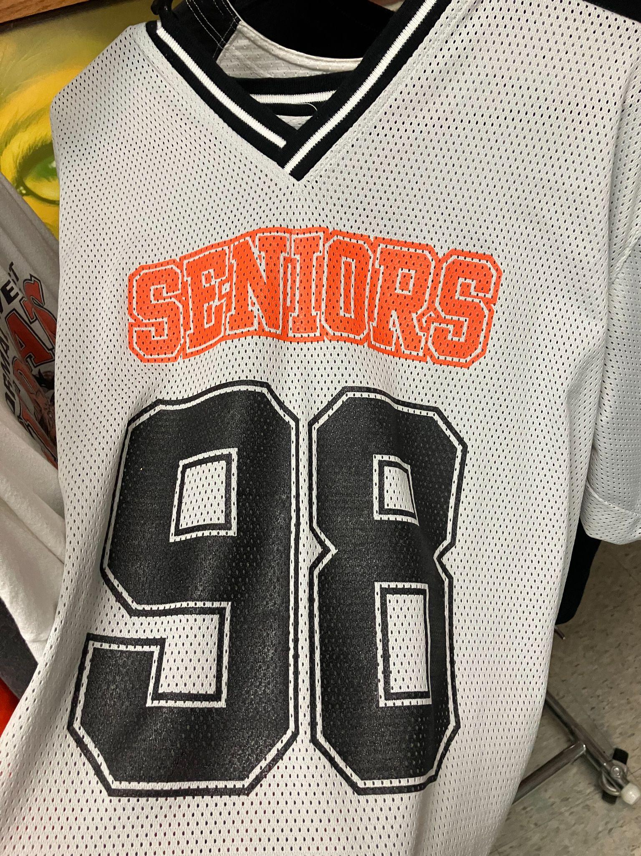
Some things we have collected…

Slide 17
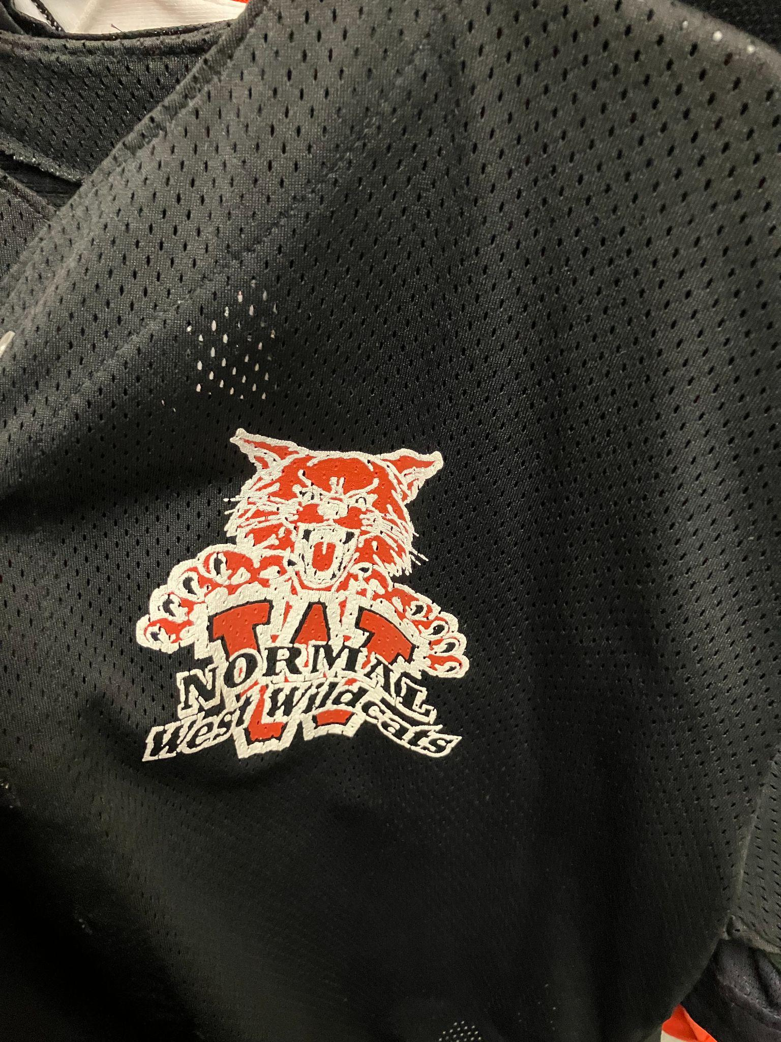
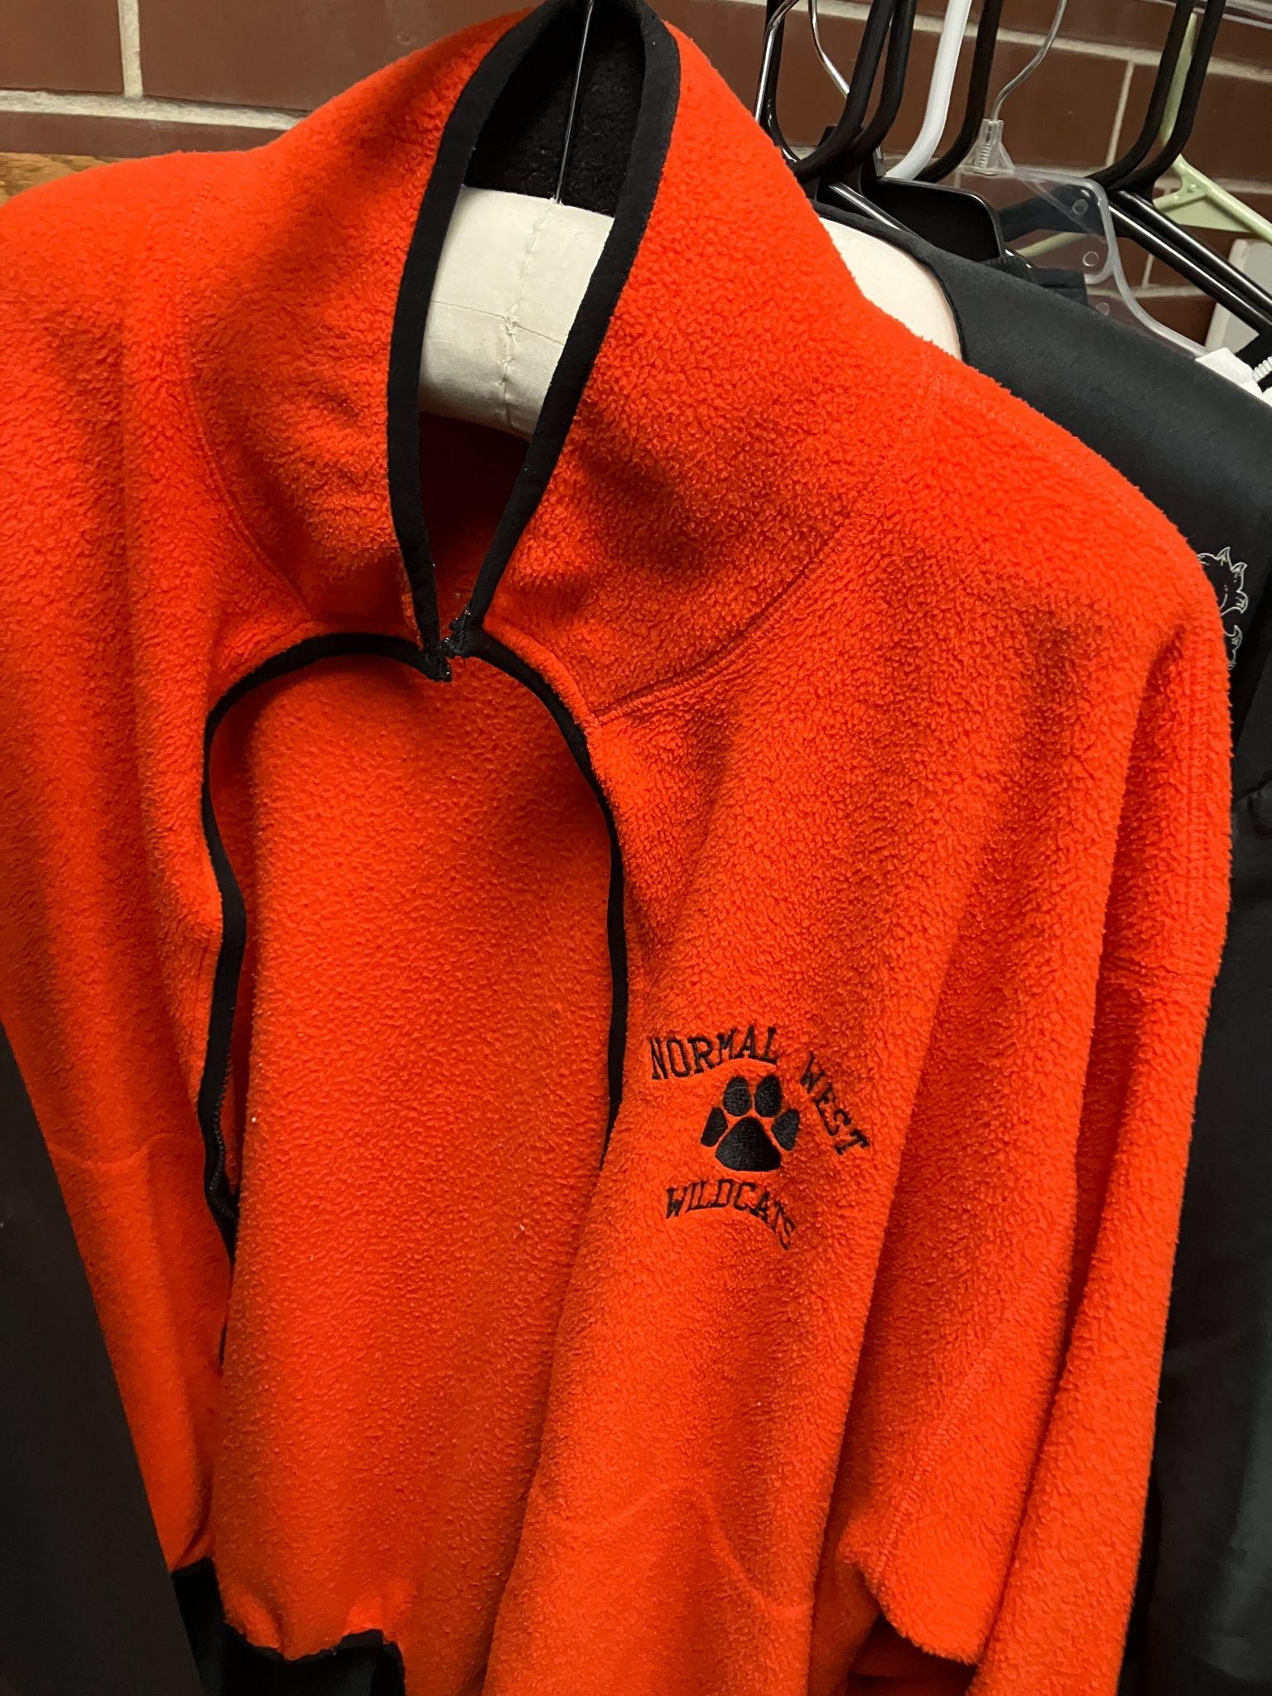
Some more things that we have collected…

Slide 18
- Dr. Crabtree had an “original” West winter coat (think 1990s Starter coats). He passed it to Mr. Eder, who passed it to Mr. Johnson, who didn’t fit into it so he had it stuffed in a box…which is now in the archive.
-Pictures of MORP and an original roll of toilet paper that has fluorescent markings all over it.. If you know, you know…
- Mr. Johnson cleaned out a cabinet in the main office and donated architectural plans, contests to name the school, Unit Five Board notes about the naming the school, etc..
- We have some of the mounted fish that used to hang in Doc’s classroom. We had his deer head until a student asked if he could take it home and hang it in his family’s family room. I couldn’t pass up the adoption opportunity – it is happy and still hanging there.
- A panel of the Integra system from a classroom wall. It works now (as a panel laying on a shelf) as well as it probably ever worked hooked up on the wall.

Slide 19
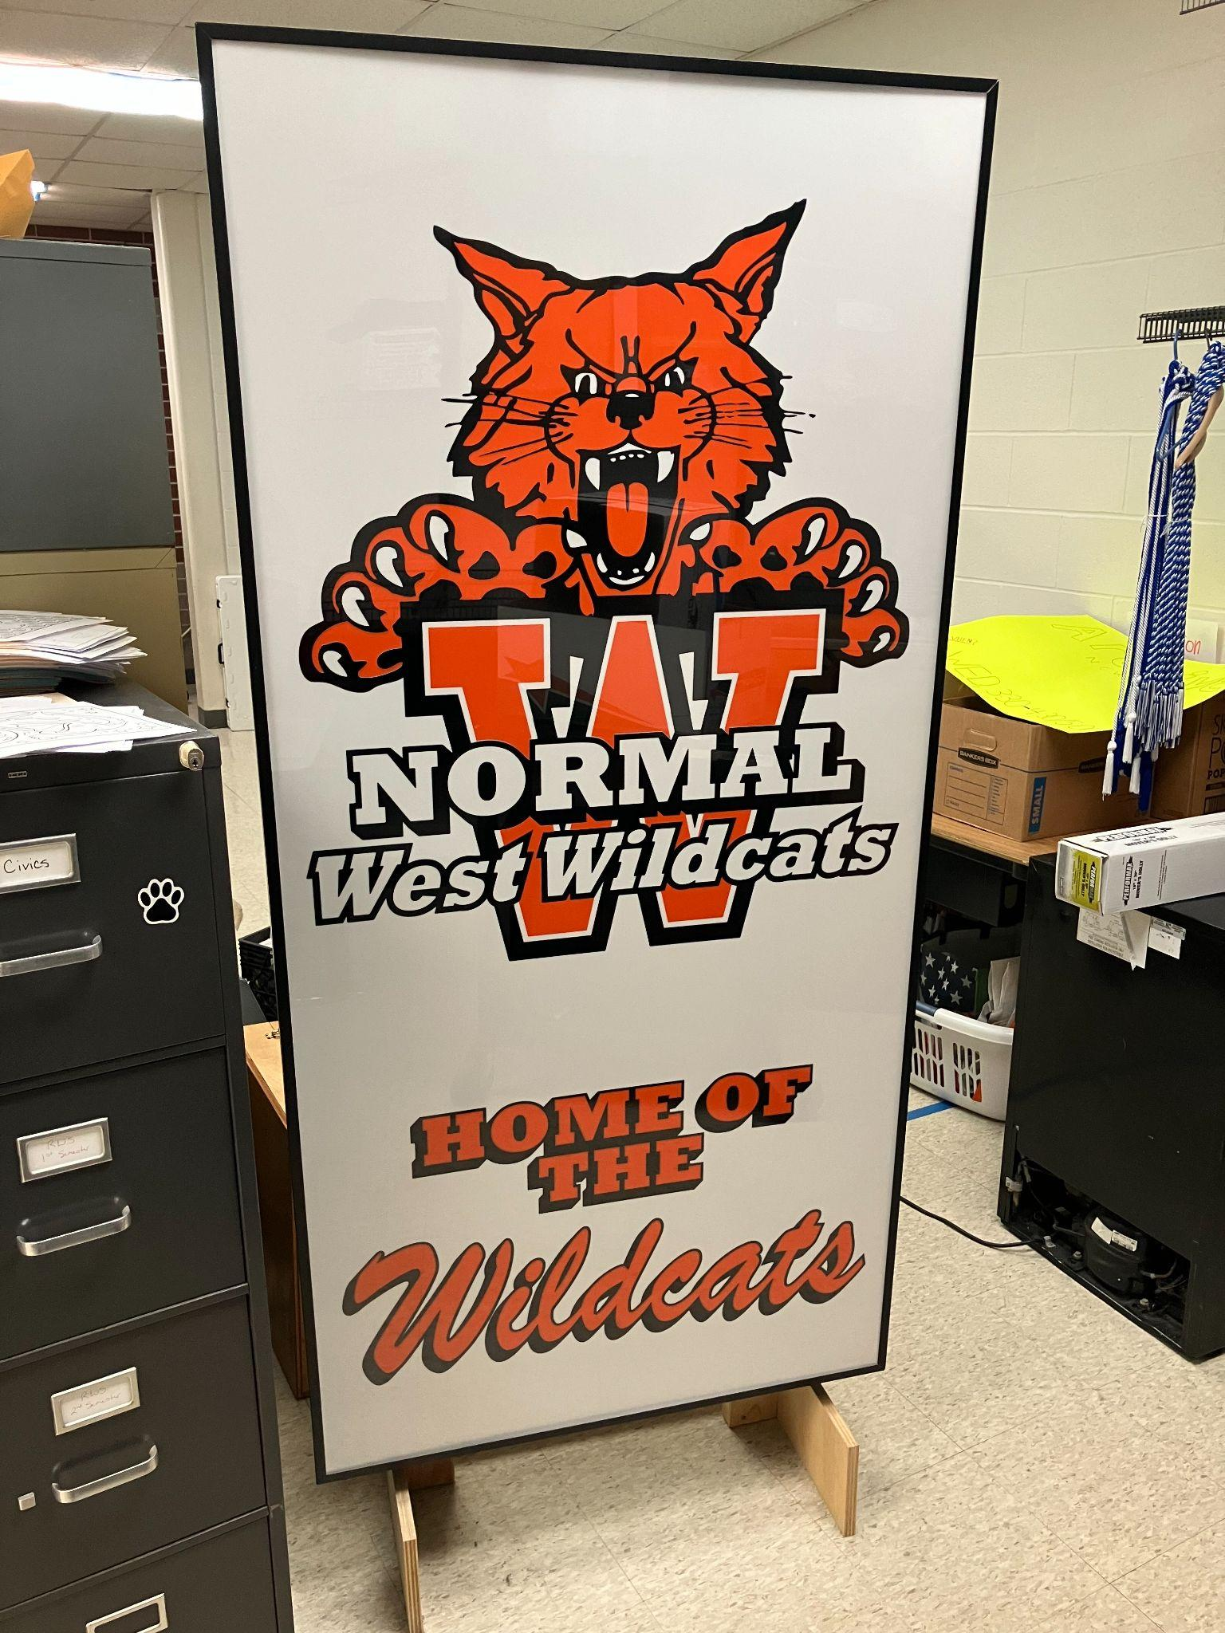
Ok - so you collect stuff. Cool.
Well, we do a lot more than that in the Archive Club. When we replaced the sign out front, there were big panels like this —----------------------> looking for a new home. So, we hired a local handyman to create a few light up signs like this. One is permanently mounted in our school’s lobby and might I say…looks really freaking cool. So we strive to refurbish, repurpose, and again CELEBRATE West history. And that logo has never looked better than when it’s lit up!

Slide 20
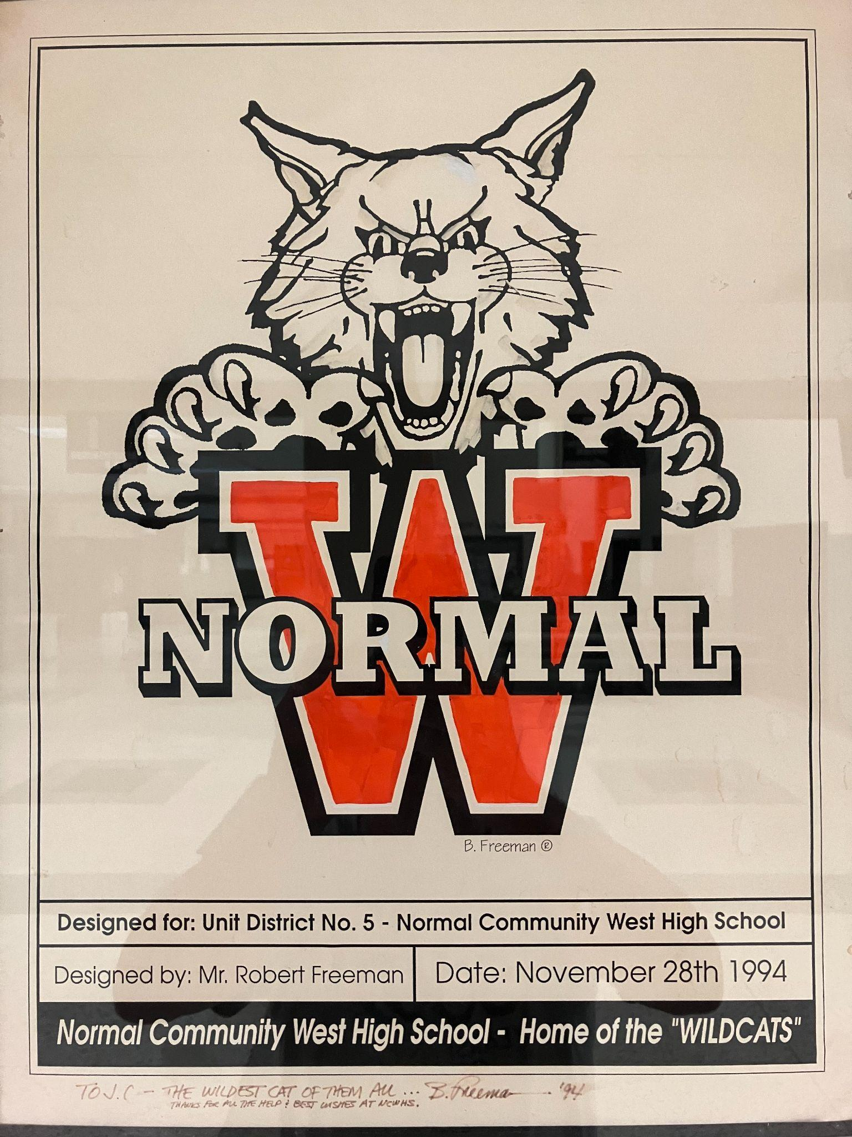
Mr. Johnson (principal #3) donated this to the archive a few years back. It took a minute, but then we realized that it is the ORIGINAL mock up (actual paint and marker) of the 1st (and only…) Wildcat. It had been stored in a cabinet in the main office. So, we had it professionally framed and it now hangs next to a display case in our atrium.

Slide 21
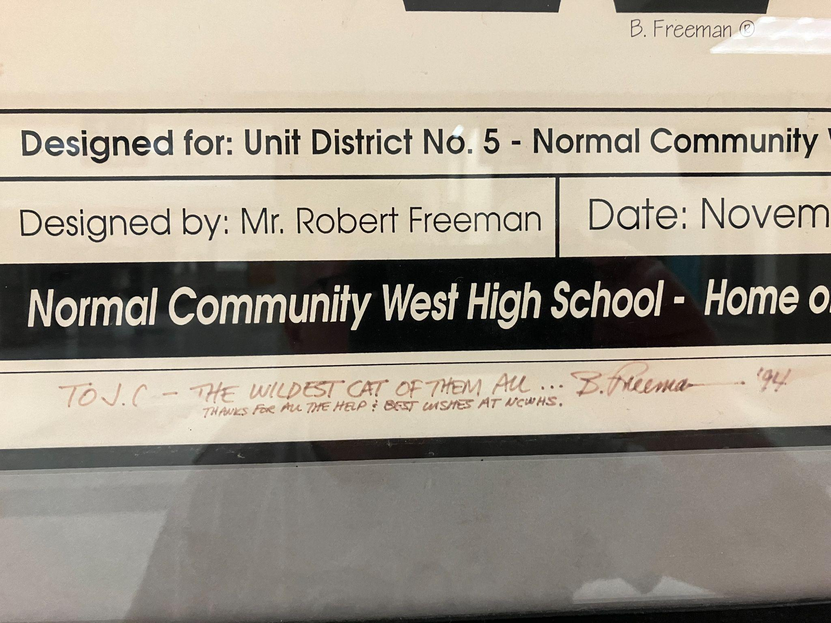

Slide 22
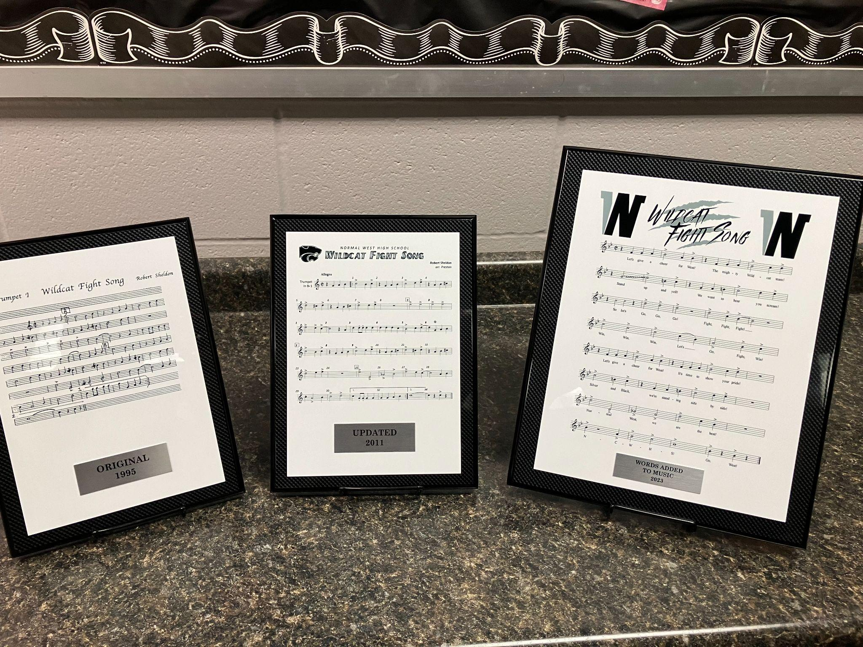

Slide 23
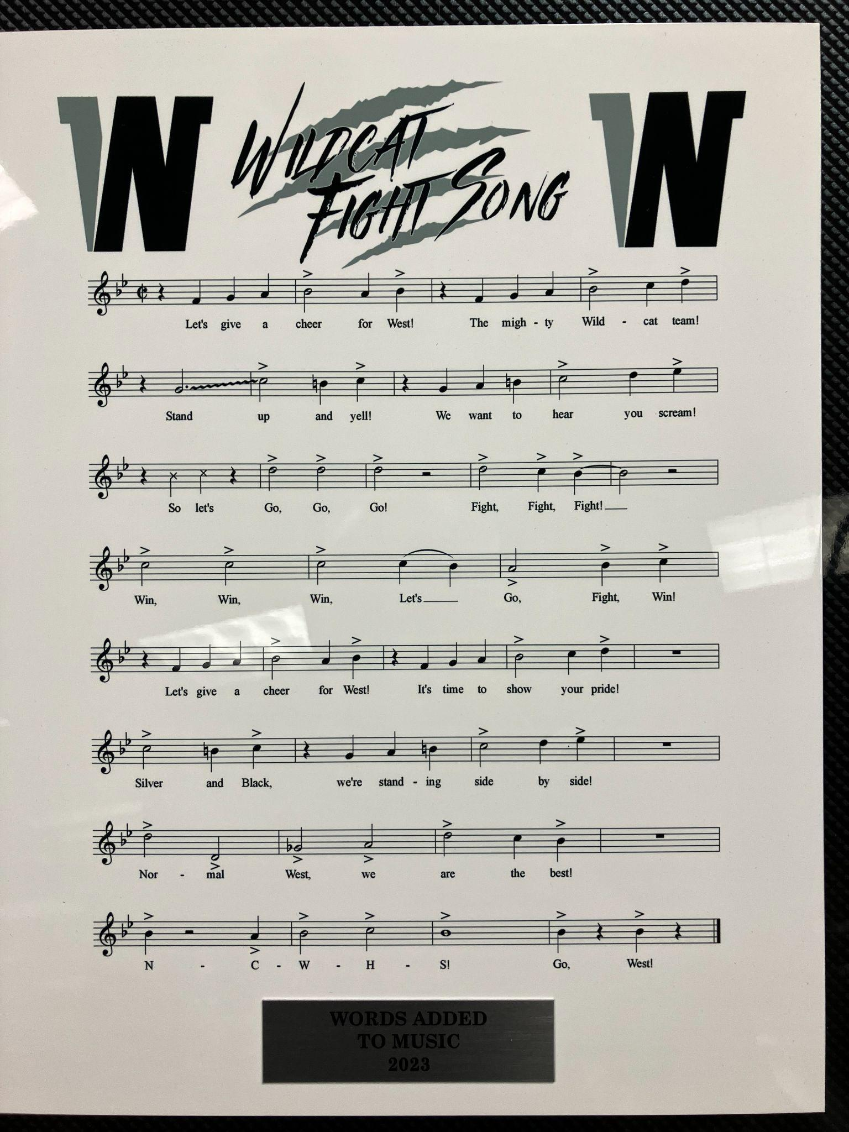
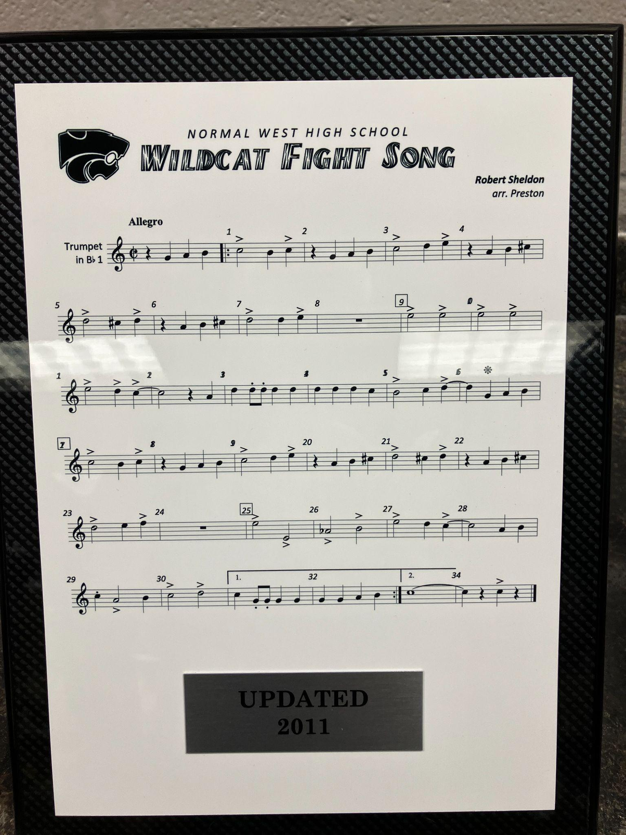

Slide 24
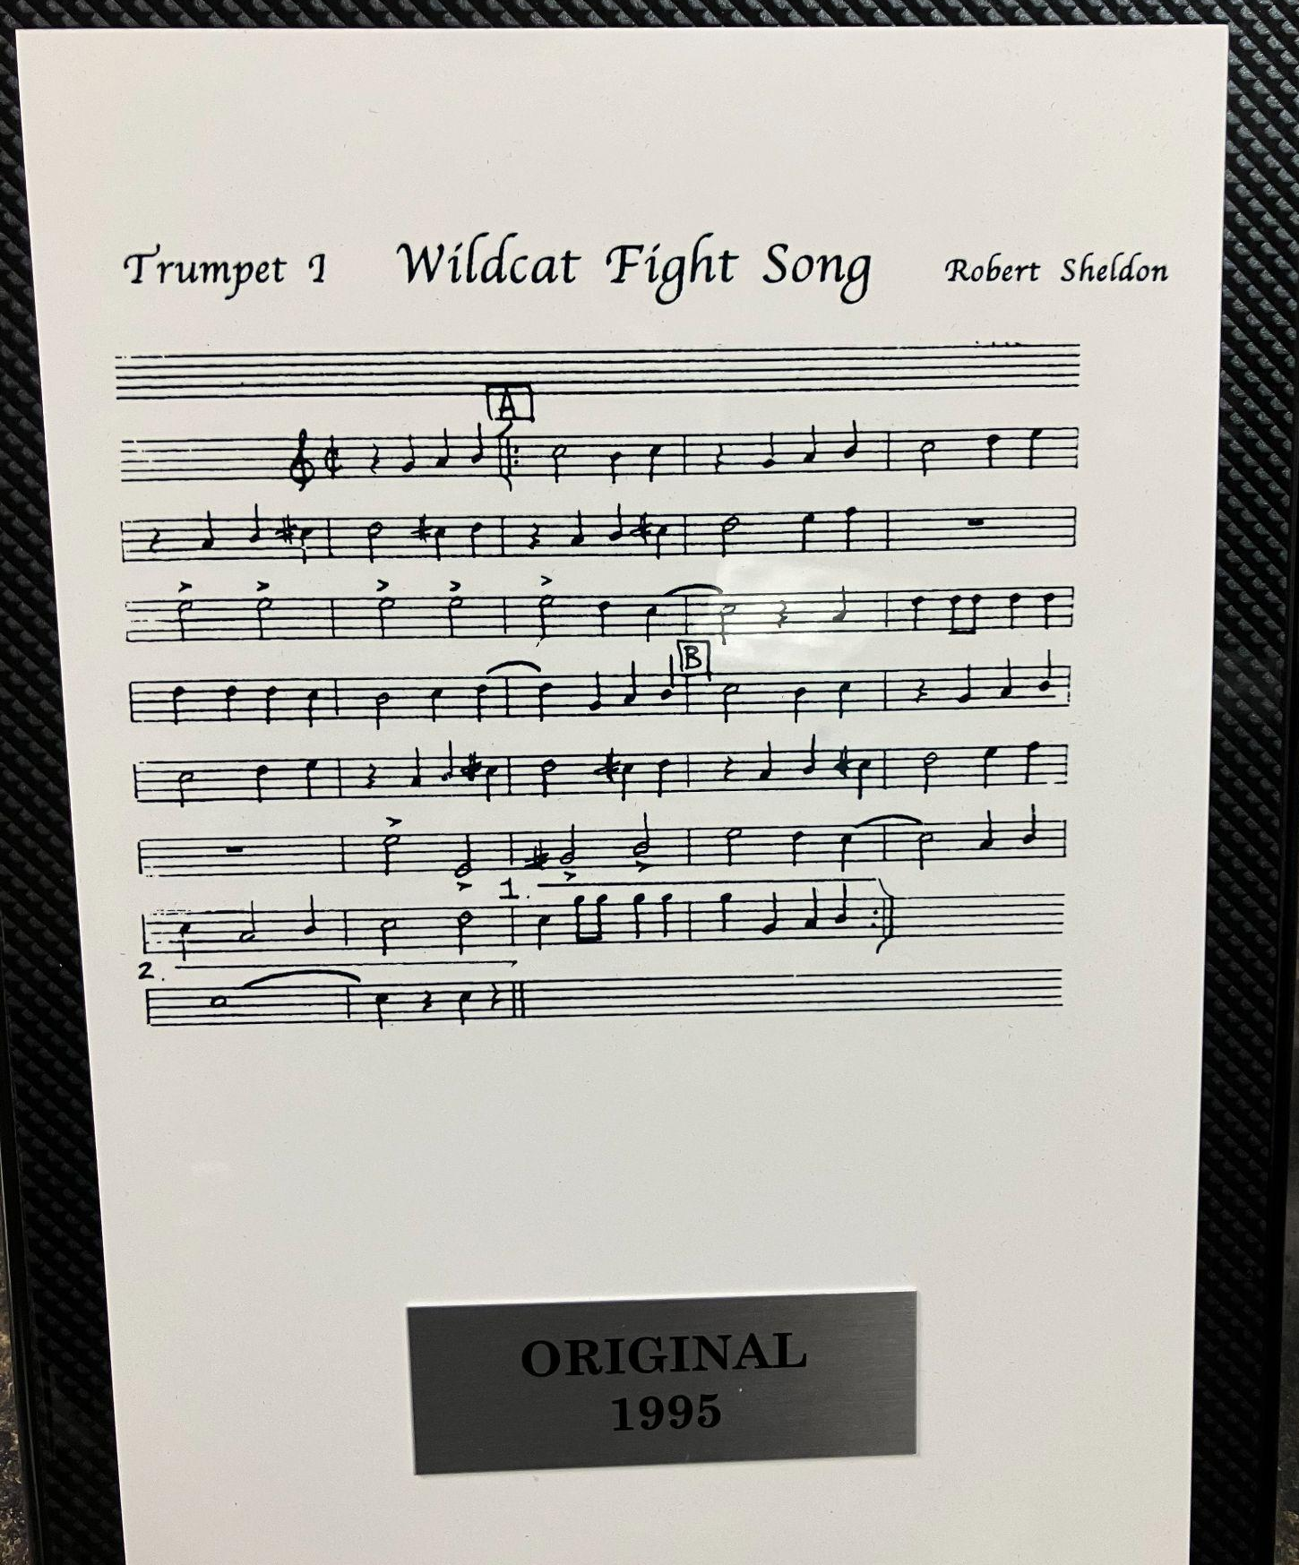

Slide 25
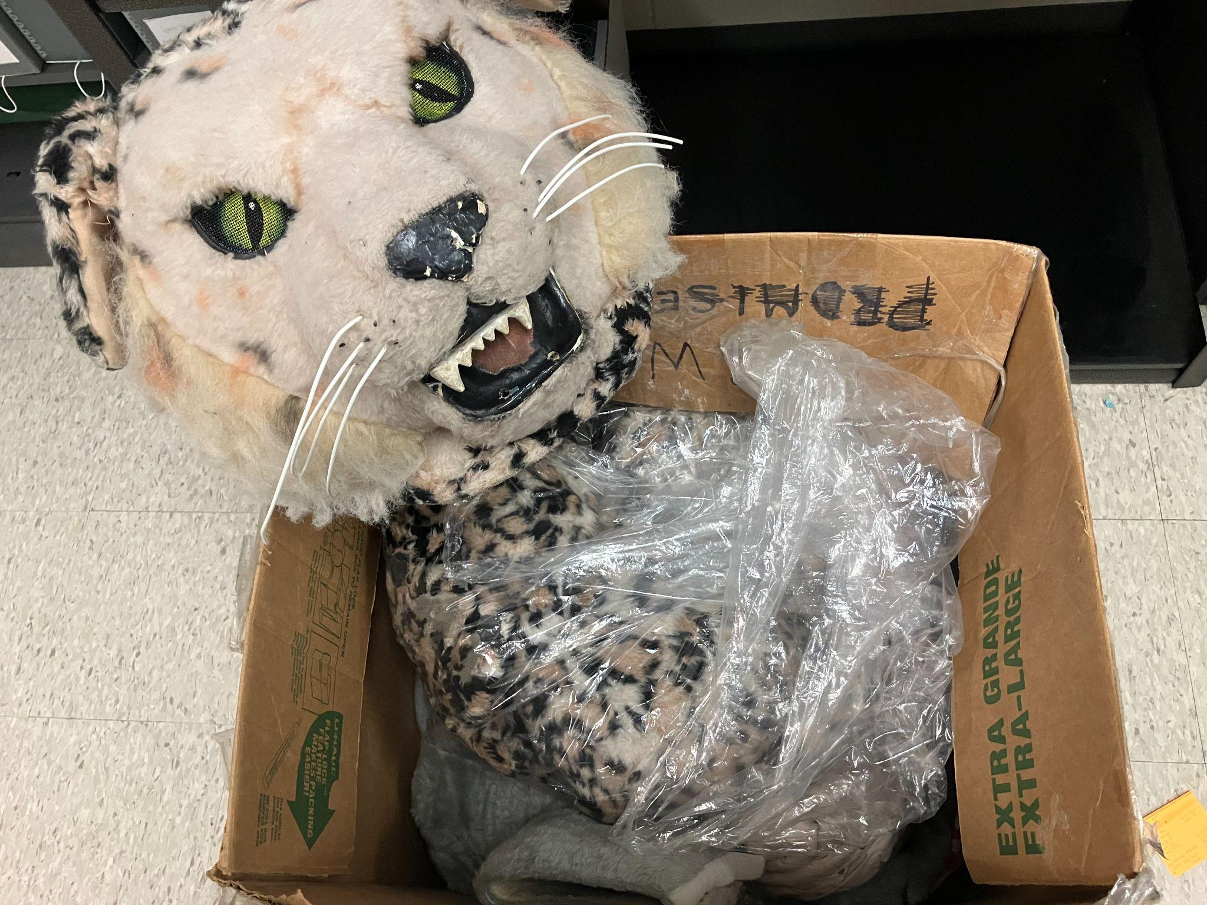
We are on our (3rd) mascot. You can imagine that when we got the original, it was in pretty bad shape. So, we researched where it was originally purchased, sent it back, and paid to have it cleaned and repaired. It is still in a box awaiting us to fundraise the money for a prop up stand, but at least it’s clean and in good condition!

Slide 26
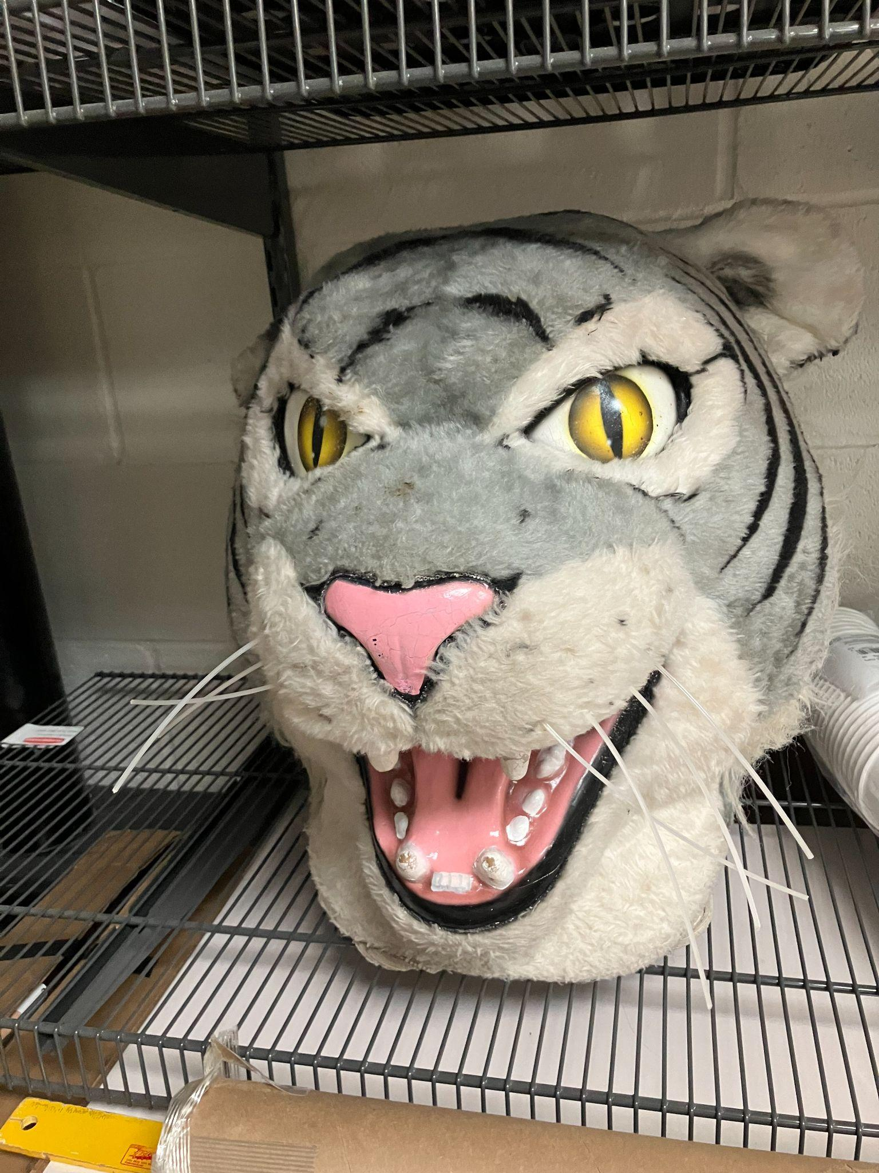
I never really considered this mascot to be MY mascot, but it was Normal West’s nonetheless. Well, it too has been replaced and is now retired on a shelf in our archive.

Slide 27
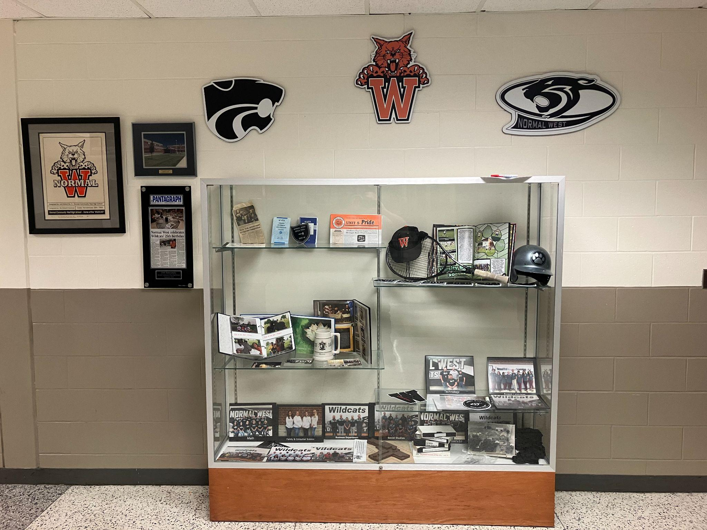
We worked with a Boy Scout looking for an Eagle Scout project to fundraise and install some history display cases. We rotate out these items depending on the season, event happening at school, etc.

Slide 28
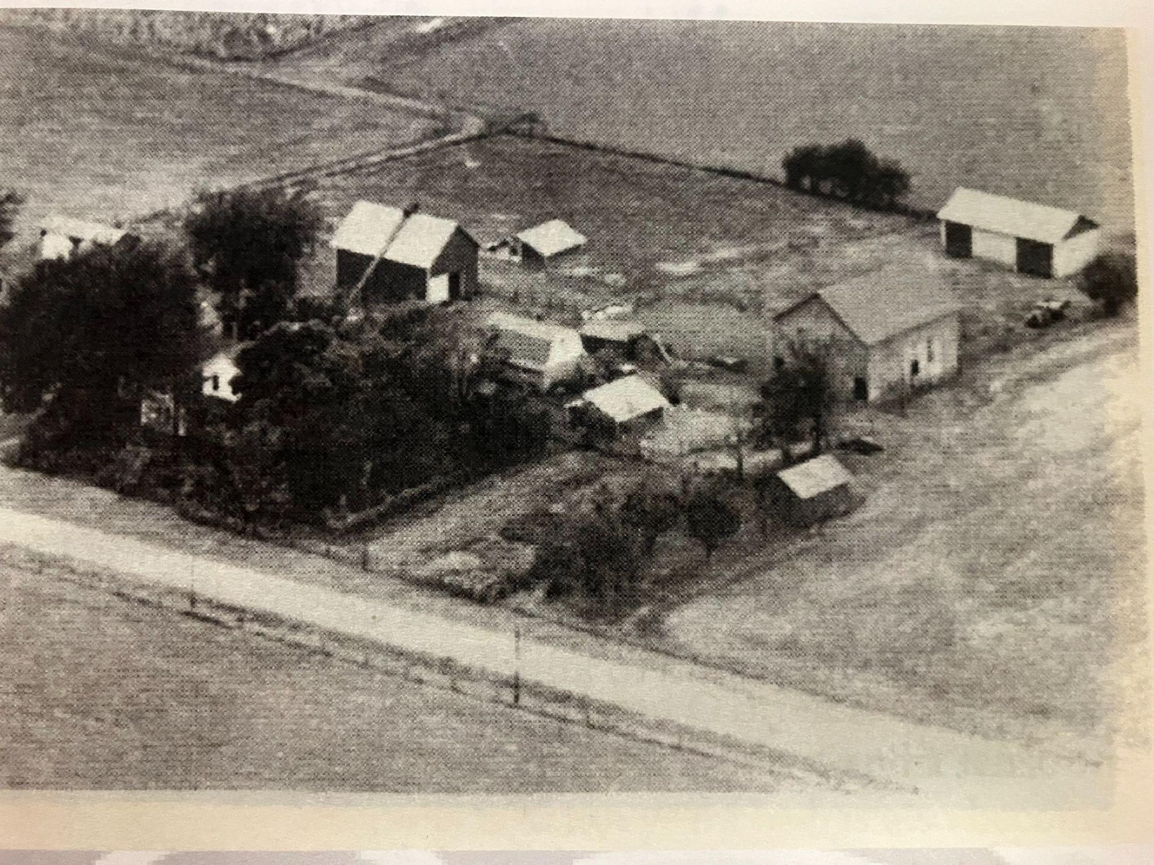
My favorite thing in the archive you ask?
Has to be these (copied) pictures from the McLean County History Museum. This is a 1955 aerial photograph of Henry Becker’s 171 acre farm located on Route 1 in northwest McLean County. If a plane (or drone) were to take the same picture today, they would see Normal West High School located along Parkside Road.

Slide 29
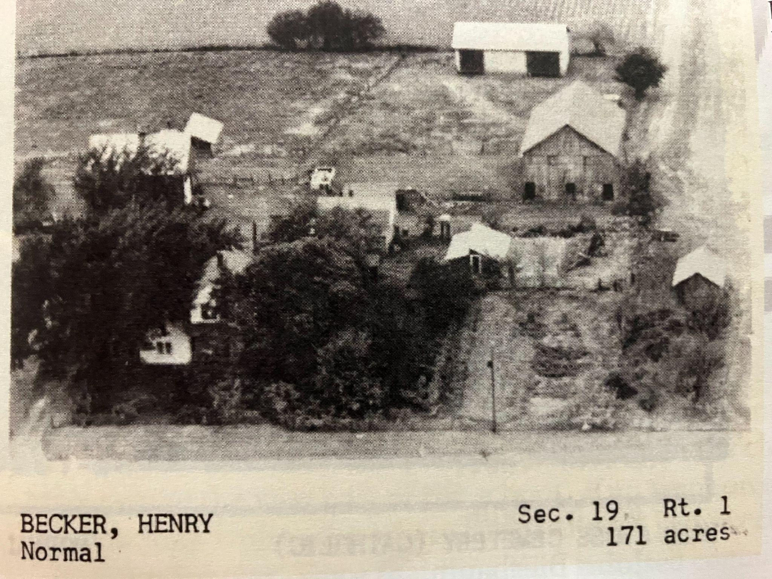
So, one day I took a drive over to Rader’s Pumpkin Patch to see Lynn Rader and he told me that Normal West sits directly in back of where the house was located. Henry rented out the house to Wayne and Bonnie Mohr from about the time of this picture to 1972. During that time, the Mohrs raised four children and had a herd of registered Guernsey cattle. The Mohrs move out of the house in the mid-1970s to a new home on Northtown Road and relocated their dairy herd to the family farm on Ropp Road. The Becker farmhouse was torn down and eventually the property was divided between his kids and farmed by Lynn Rader. Lynn is a long-time area farmer whose kids attended and now grandchildren attend Normal West.

Slide 30
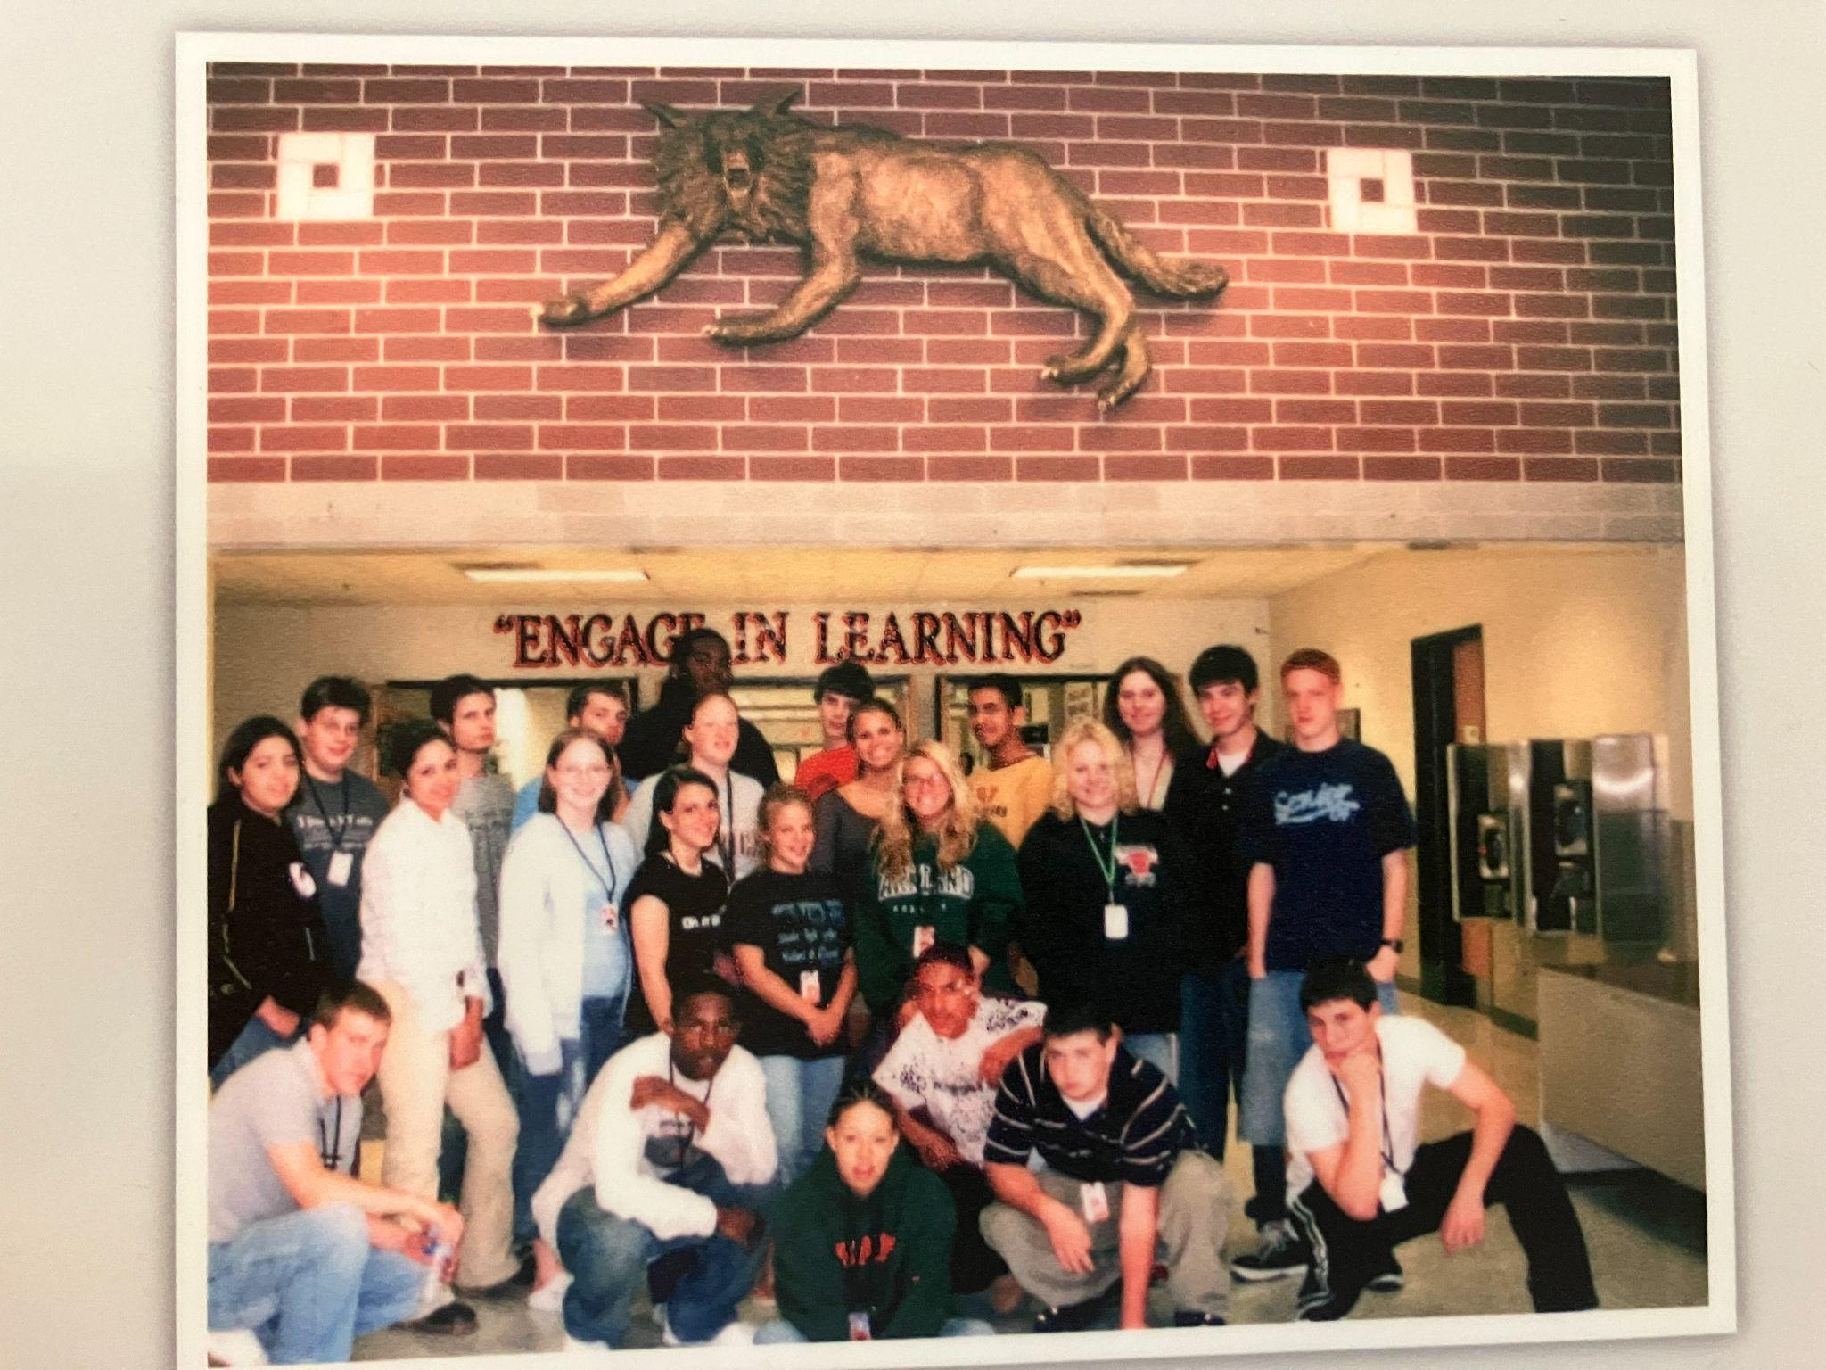

Slide 32
It is cool that now, when anyone wants to change Normal West, they consult the Archive Club for ideas as to how to go about honoring the past and making way for the future. So, when it was time to take this (wildcat) down and put up a new logo in the lobby outside of the main office, we discussed, coordinated, and fundraised for the materials needed for a new home…

Slide 33
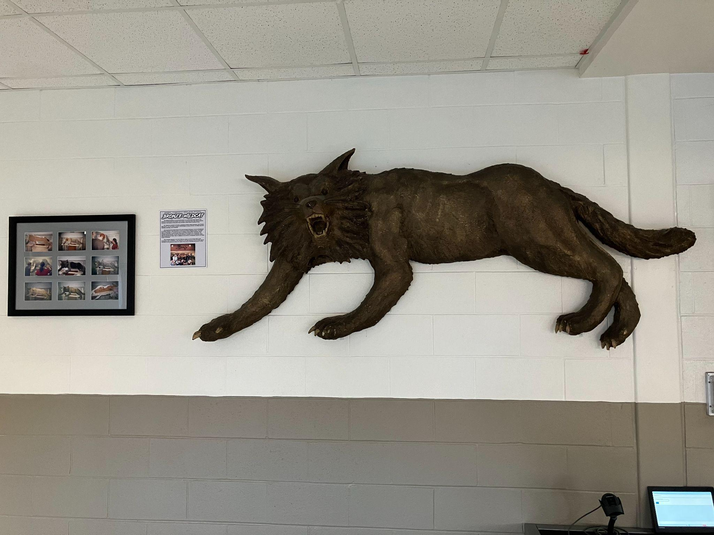
This is now located outside of the auditorium and enjoyed by anyone attending any band, orchestra, choir, or theatrical production. Note the pictures of the students actually creating it. The pictures are from…you got it! The archive!

Slide 35
To take thing up a notch, at about the same time we created the archive, I organized our school’s Wall of Fame. We got a committee together made up of about (15) people including representatives from administration, our school's various departments, our athletic director, and some retired teachers. The committee was initially selected and when someone retires, they choose someone to join that will represent their “view” of West.

Slide 36
I knew you would ask, so here are the current people on the Wall.
Cody White - former I.S.U / N.F.L player
Andrew Jefferson - San Francisco Giants scout
Ying Wu - nuclear physicist
Bob White - Mock Trial volunteer for 25+ years
Charlie Crabtree - longtime basketball volunteer
Nathan Stark - Broadway performer
Jared O’Brien - Mr. Wildcat himself - student manager for several sports, still after graduation
Tyler Ross - I.H.S.A. Speech State Champion
Angie Armenise - award winning chef
Taylor Kirby - Normal West’s 1st State Champion (pole vault)
Adam Kinzinger - former U.S. Congressman, CNN reporter
Berny Chiaro - Founder of West’s Freshmen Mentoring Program, longtime teacher
Kathy Smalley - Counselor, key person in many early West traditions
Dave Caslow - Science teacher, 1st Varsity Basketball coach, Freshman football coach
Kevin “Doc” Enderlin - longtime Agriculture teacher, F.F.A. sponsor
Stan Lewis - Instrumental athletic director during a period of robust growth of West athletic programs and success
Gary Woods - 1st athletic director, was actually a.d. for both N.W. / N.C.H.S. for a while
Tom Eder - 2nd principal, instrumental in many lasting West traditions

Slide 37
I knew you would ask, so here are the current people on the Wall.
Kim Kaufman - Toastmasters International World Champion of Public Speaking
Leah Marlene - American Idol 3rd Place, Nashville recording artist
Brock Stewart - M.L.B. pitcher, Minnesota Twins
Mary Jo Douglas - long time science teacher, current volunteer, instrumental in establishing lasting academic opportunities for students / colleagues
Dr. Jerry Crabtree - 1st Principal, instrumental in many lasting West traditions
Steve Mintus - the epitome of a Wildcat teacher extraordinaire
Tracy Freeman - N.W. teacher (1995 - 2022)
Lisa Tomlin - N.W. teacher (1995 - 2023)
Julie Edmunds Mendez - Class of 1997, Chief Department Counsel for U.S. Department of Defense
April Schermann - N.W. Teacher / Softball Coach (2002 - 2025)
Mandy Garner - Class of 2001, V.P. Digital Brand for Tampa Bay Lightning
Andrew Loy - Class of 2016, record setting swimmer at West, collegiate swimmer at OSU, professional swimmer
Lisa Preston - Director of Bands (1995 - 2022)

Slide 38
I I knew you would ask some questions, so here are some answers…
How do people get on the Wall of Fame? Who should be on the Wall of Fame?
By design, we aim to celebrate excellence in just about any domain of Normal West. Some years, it seems heavier in staff inductees - in others - it’s almost all former students. The key: in 50 years – this will be a snapshot of excellence at Normal West.

Slide 39
Still above the lockers in the Senior hallway.

Slide 40
In the December 13, 1996 issue of the Paw Print, student reporter, Christine Huddleston, introduces the artist behind much of the art still present in the hallways and staircases of Normal West - junior Jenny Riethmaier. Riethmaier had started a small airbrushing business called Sideline, in which she and co-worker/friend Rob Robertson took on many airbrushing projects throughout Unit 5 at various junior highs and elementary schools. Principal Jerry Crabtree had become a fan of their work and gave them almost complete freedom to express the “different variations of the wildcat” throughout the school. In Crabtree’s opinion, these new murals “really spruced up the school.”
This early airbrushed mission statement of Normal West is undoubtedly the work of Riethmaier, likely commissioned by Dr. Crabtree during the 1995-1996 school year. It is part of our school’s time capsule that is being opened / added to this year.

Slide 41
In staircase nearest retirement garden (#1 Cat)

Slide 42
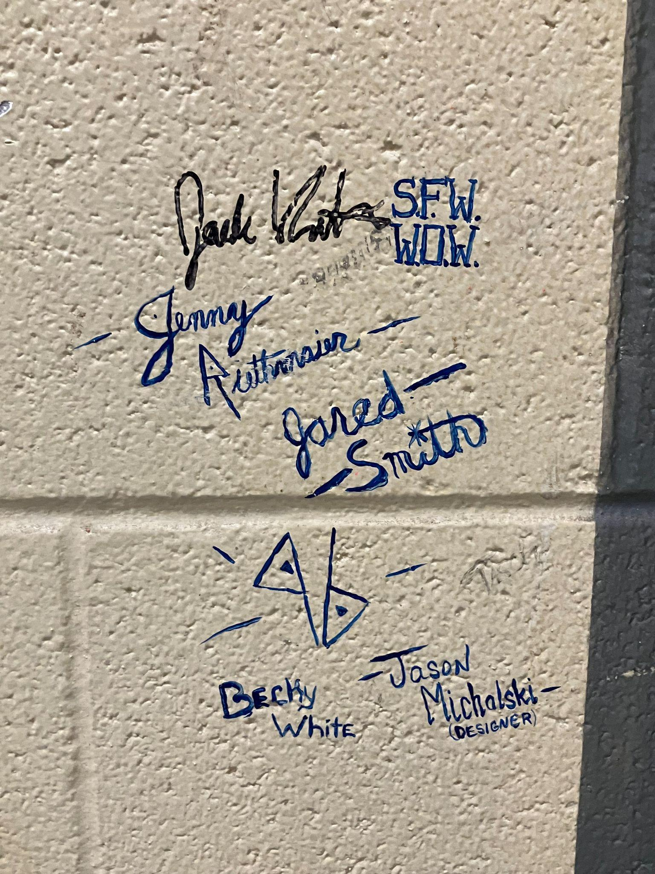
Some yet more friends…
-Jack
-Jenny Reithaier
- Jared Smith
- Becky White
-Jason Michalski

Slide 43
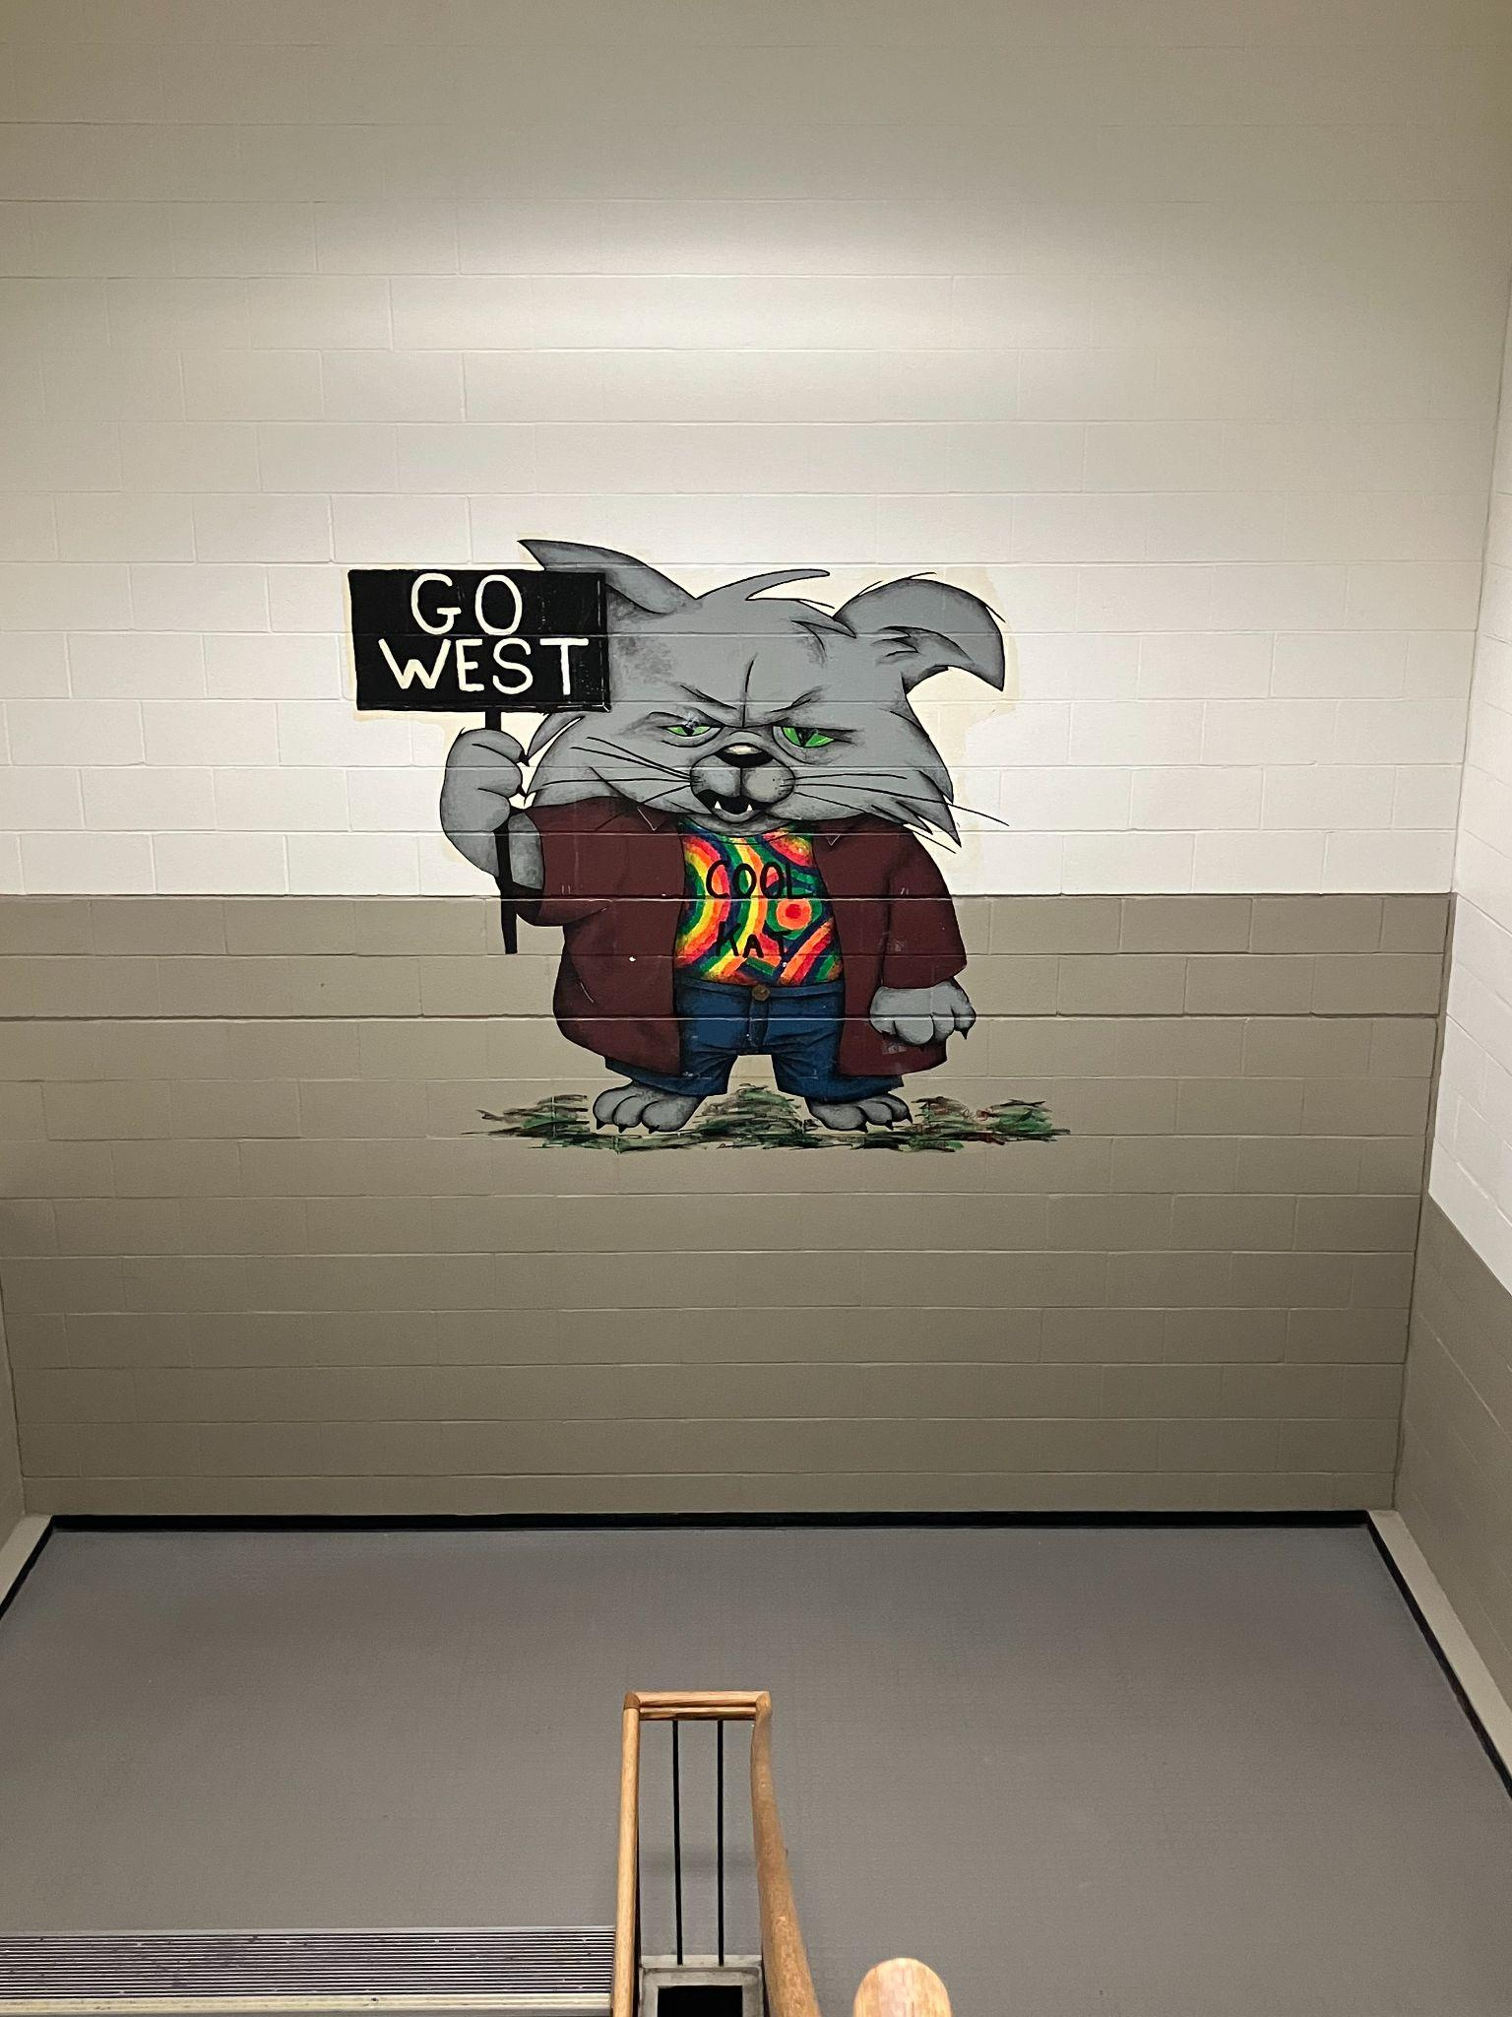
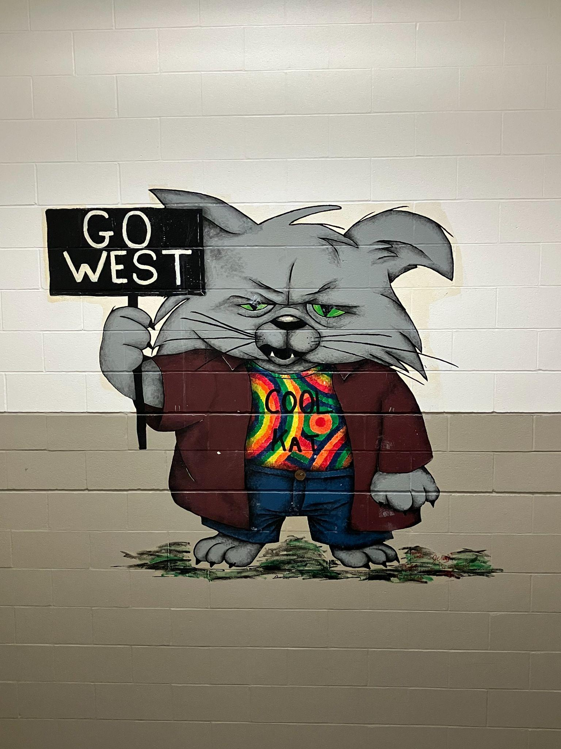
In staircase nearest Social Studies office (#2 Cat)

Slide 44
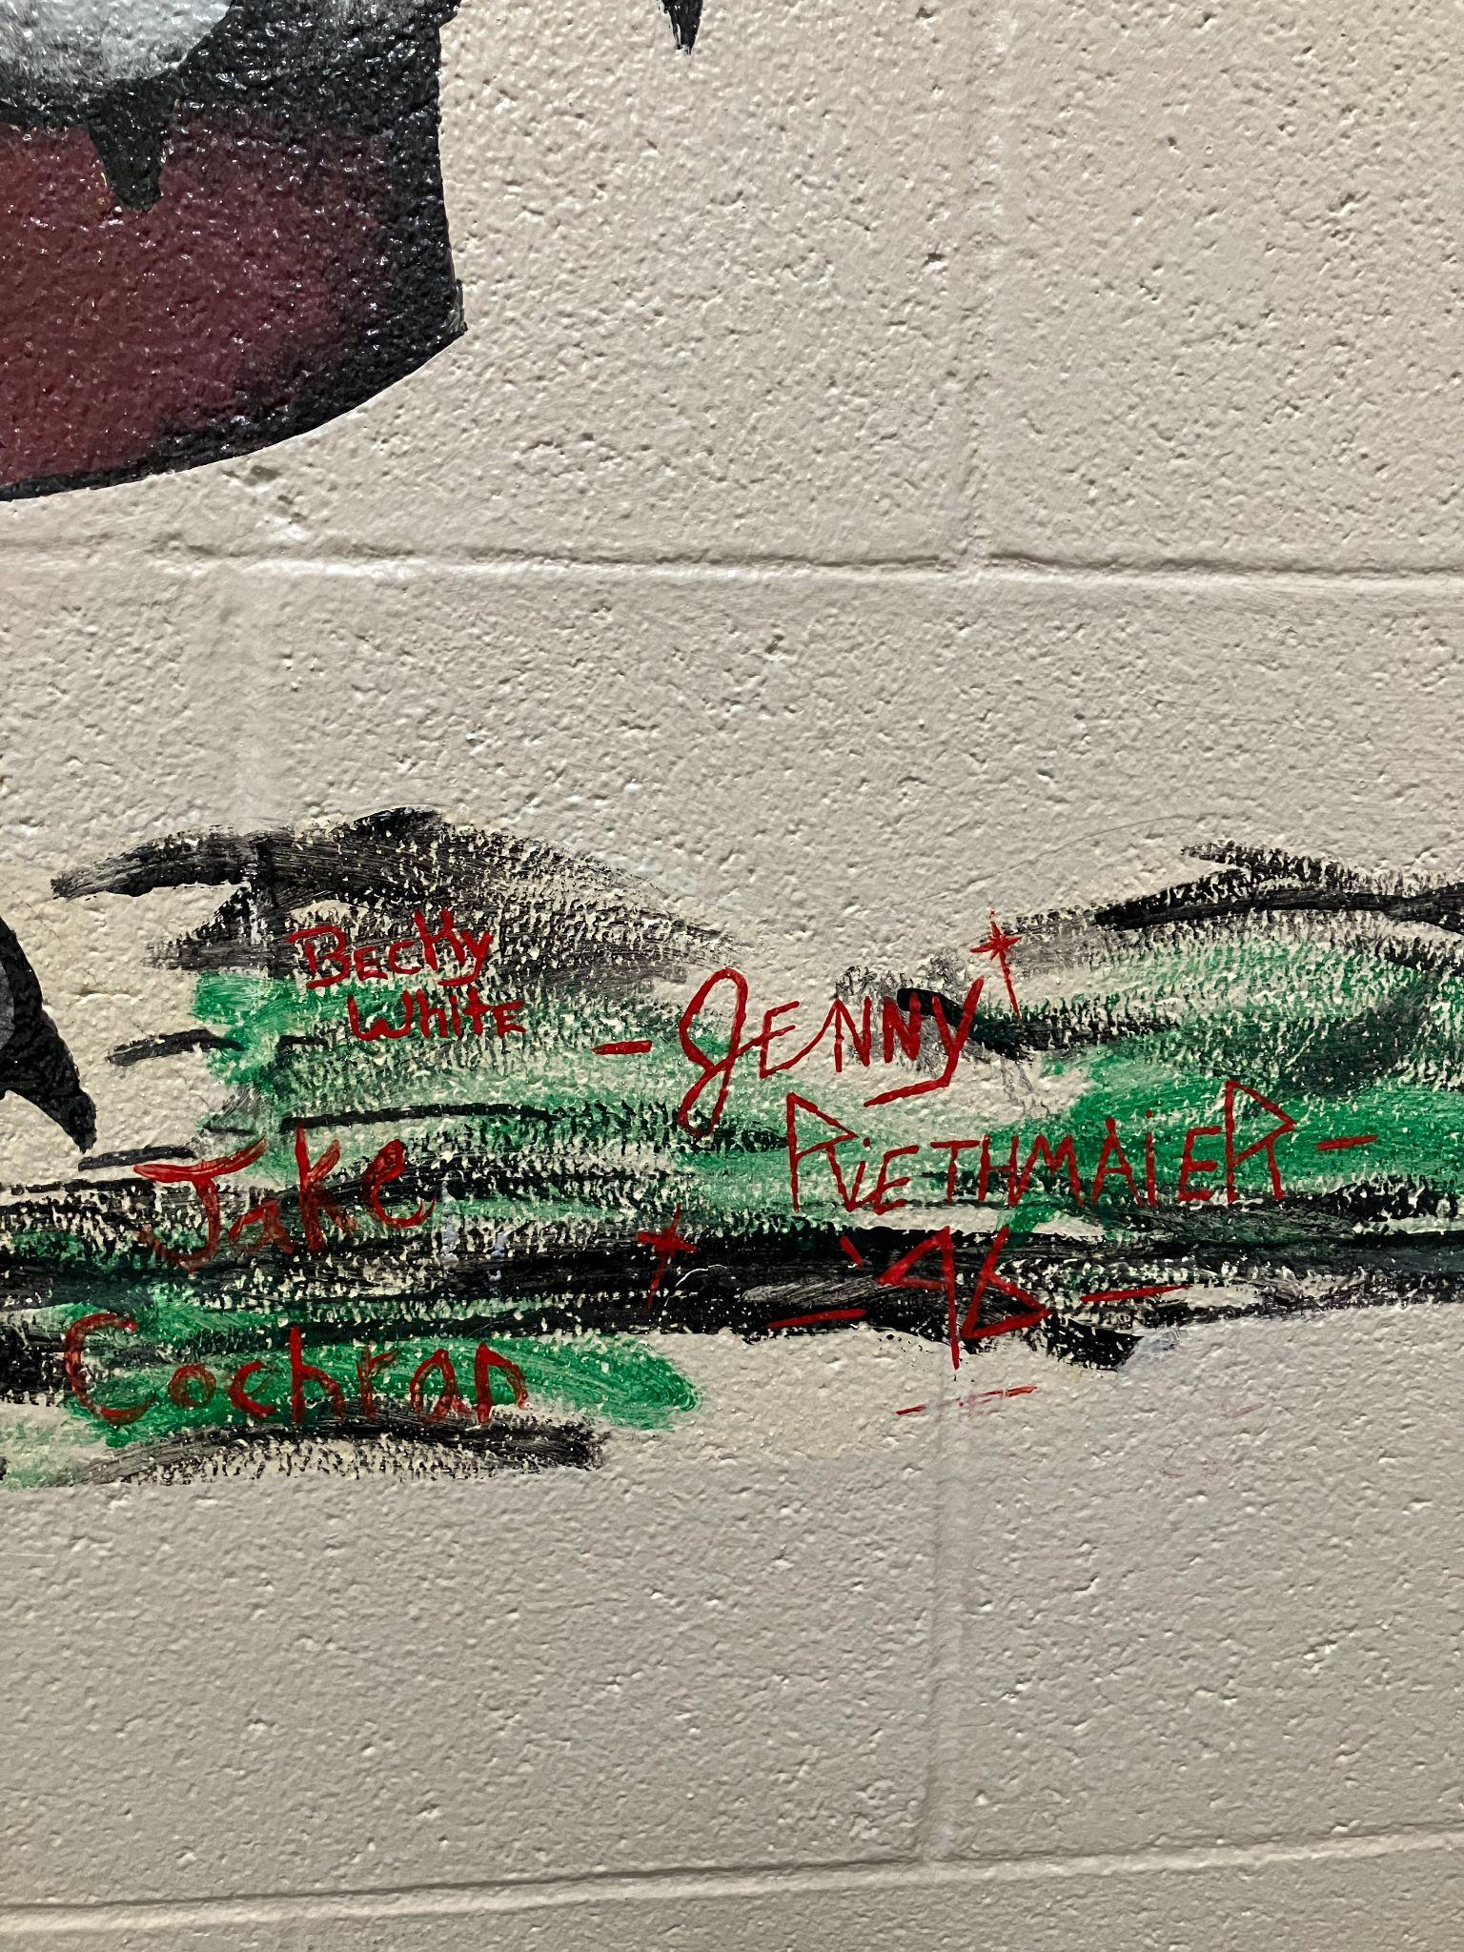
Riethmaier and Robertson had some friends on some of these murals…
Upper left: Becky White
Lower left: Jake Cochran

Slide 45
In staircase nearest teachers’ lounge (#3 Cat)

Slide 46
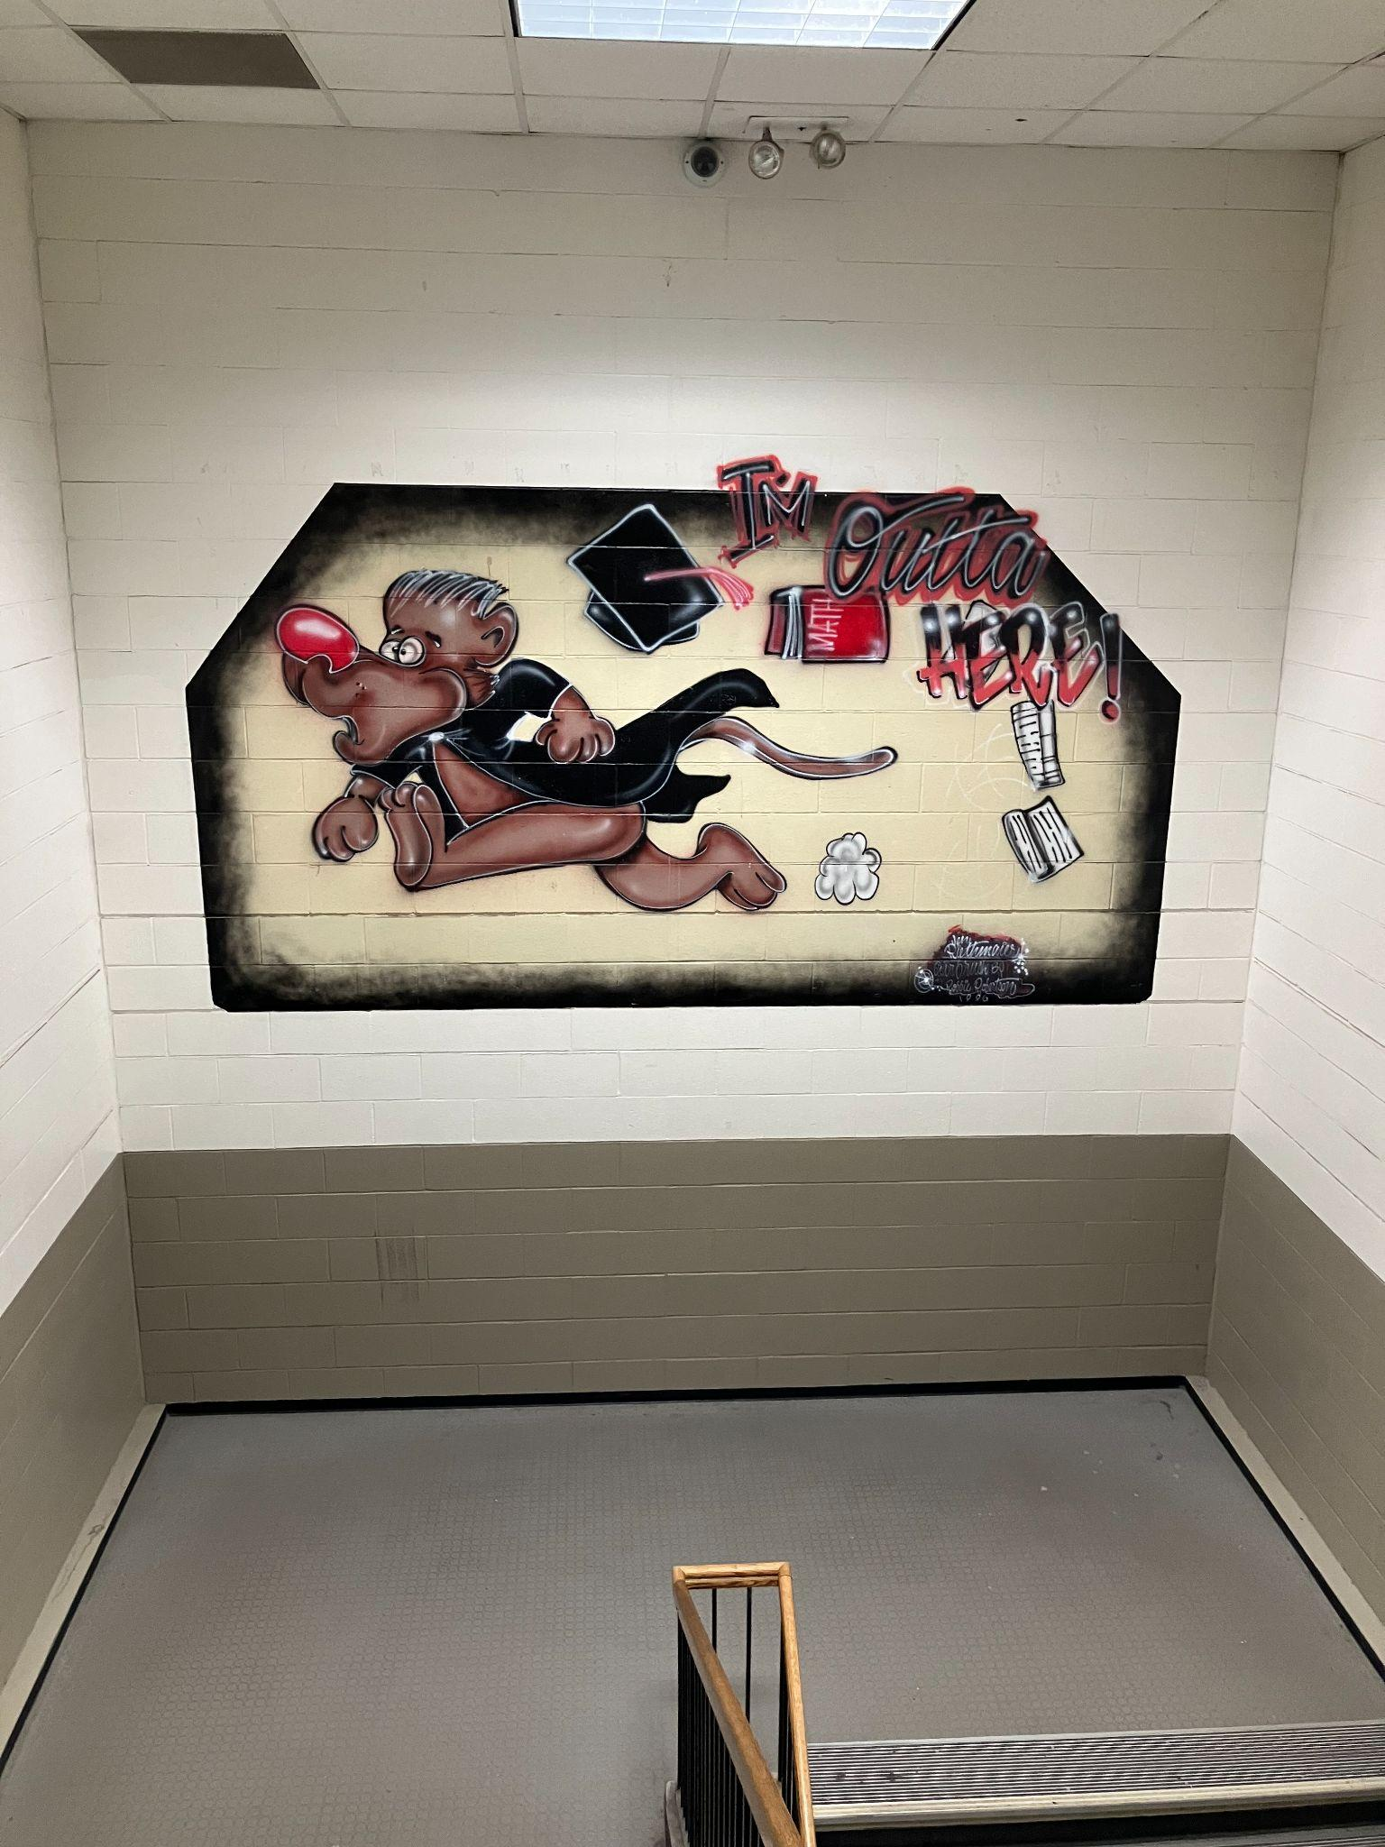
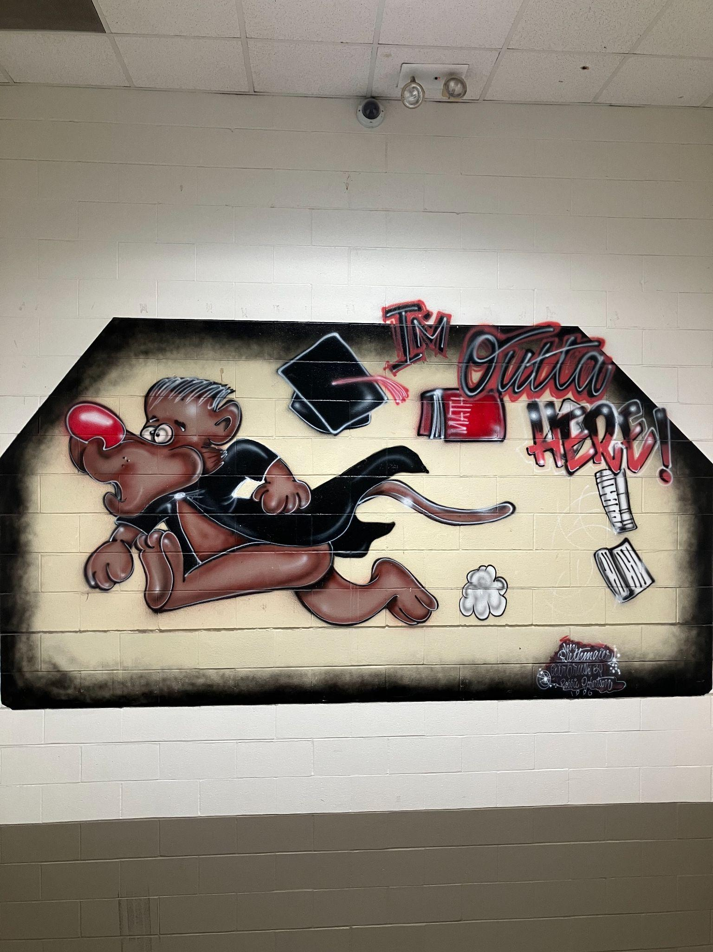
In staircase nearest main office (#4 Cat)

Slide 47
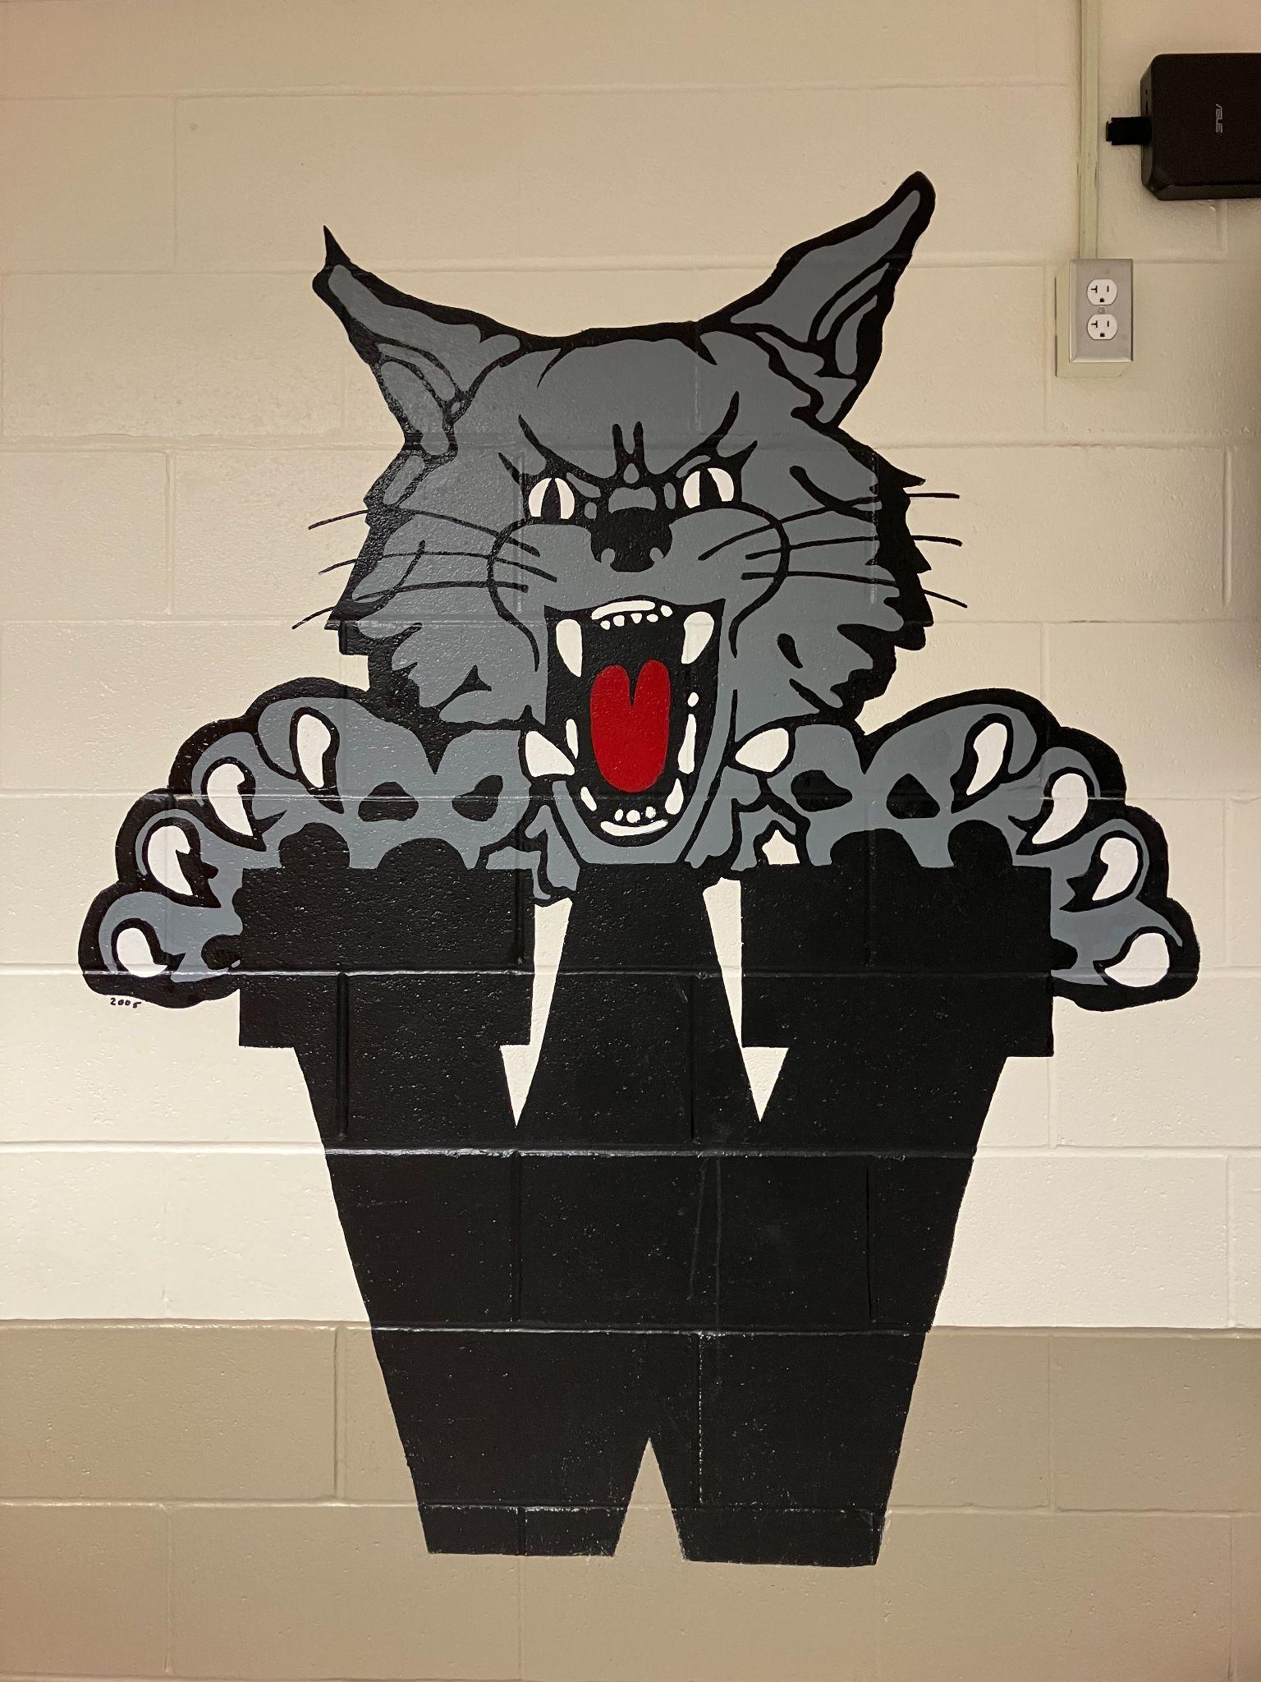
In some cases, we have repainted original logos with our current black/silver school colors.

Slide 48
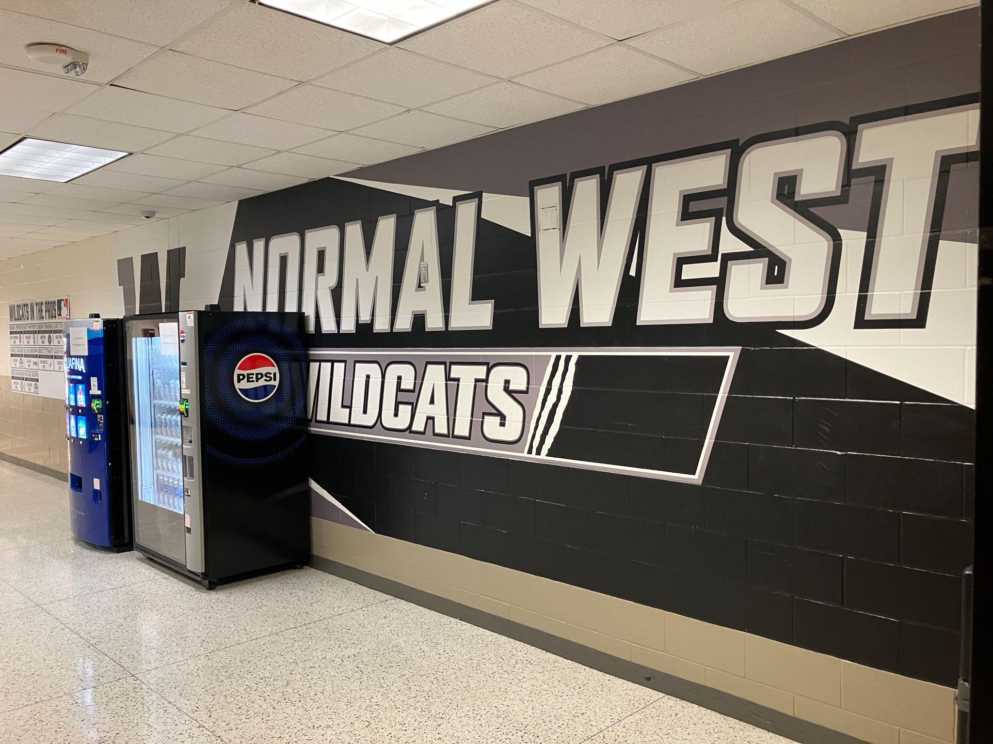
In other cases, we have repainted some walls altogether new. (outside cafeteria, near north gym)

Slide 49
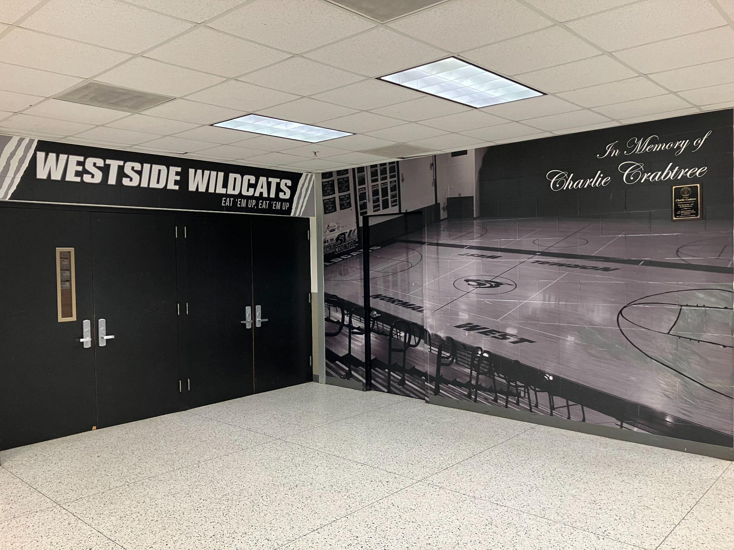
A few years ago, we actually “wrapped” the wall leading into the north gym for a totally cool design.

Slide 50
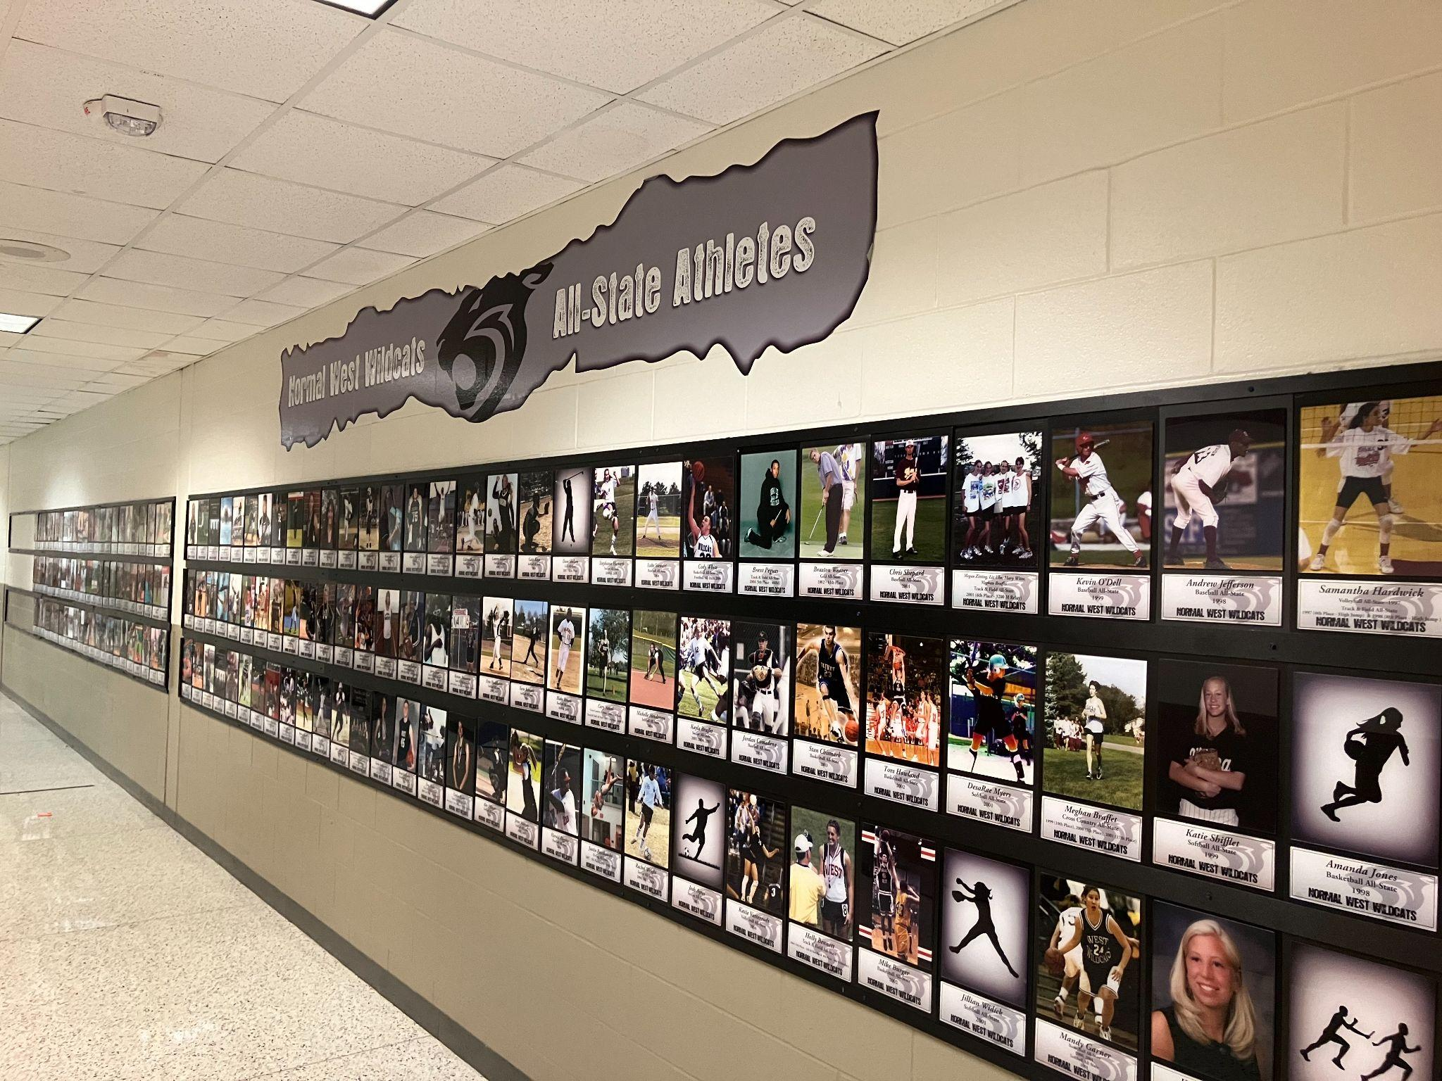
And still we have other new additions that have added a lot to the spirit and celebration of past Wildcats!

Slide 51
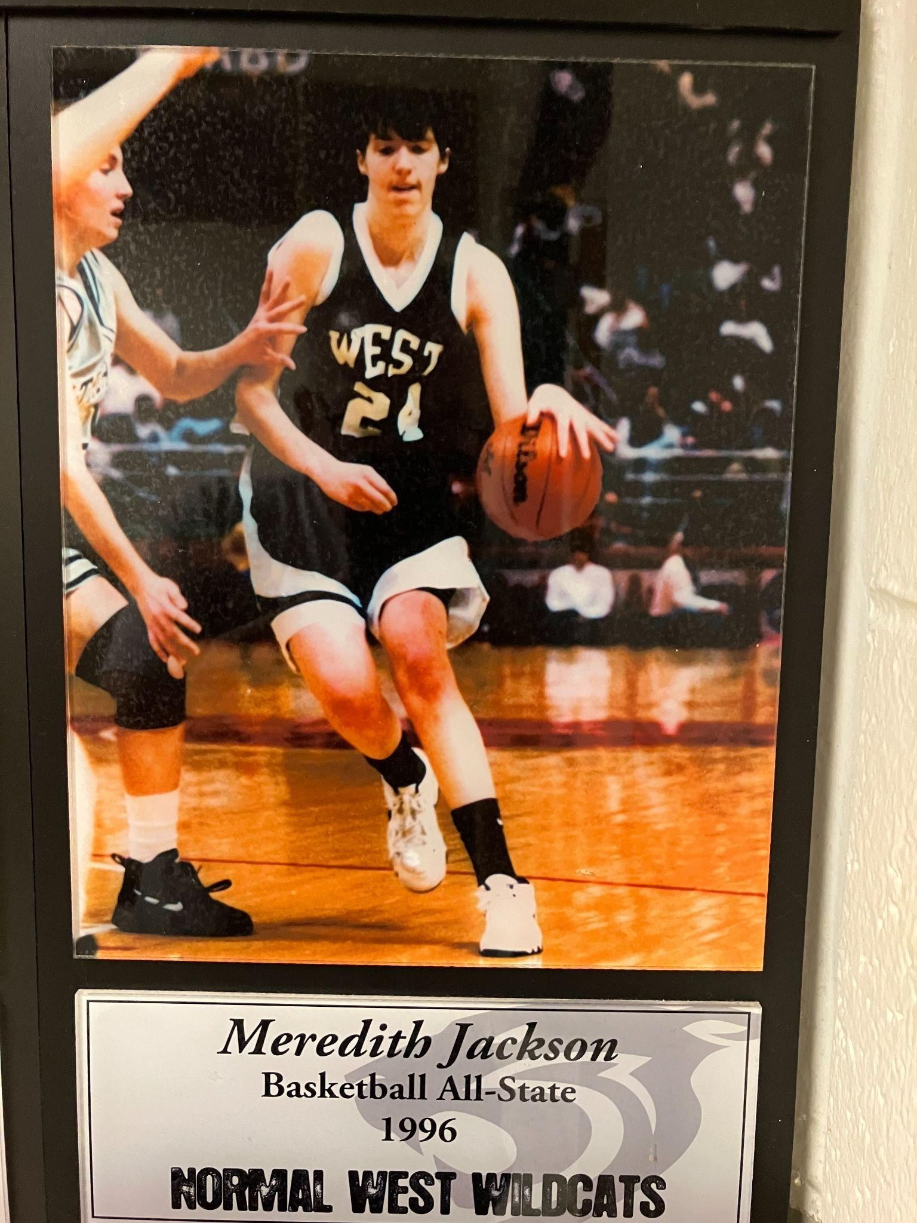
Of course I can zoom up on a few of these early ones!
Some of the first ever All-State Wildcat Athletes

Slide 52
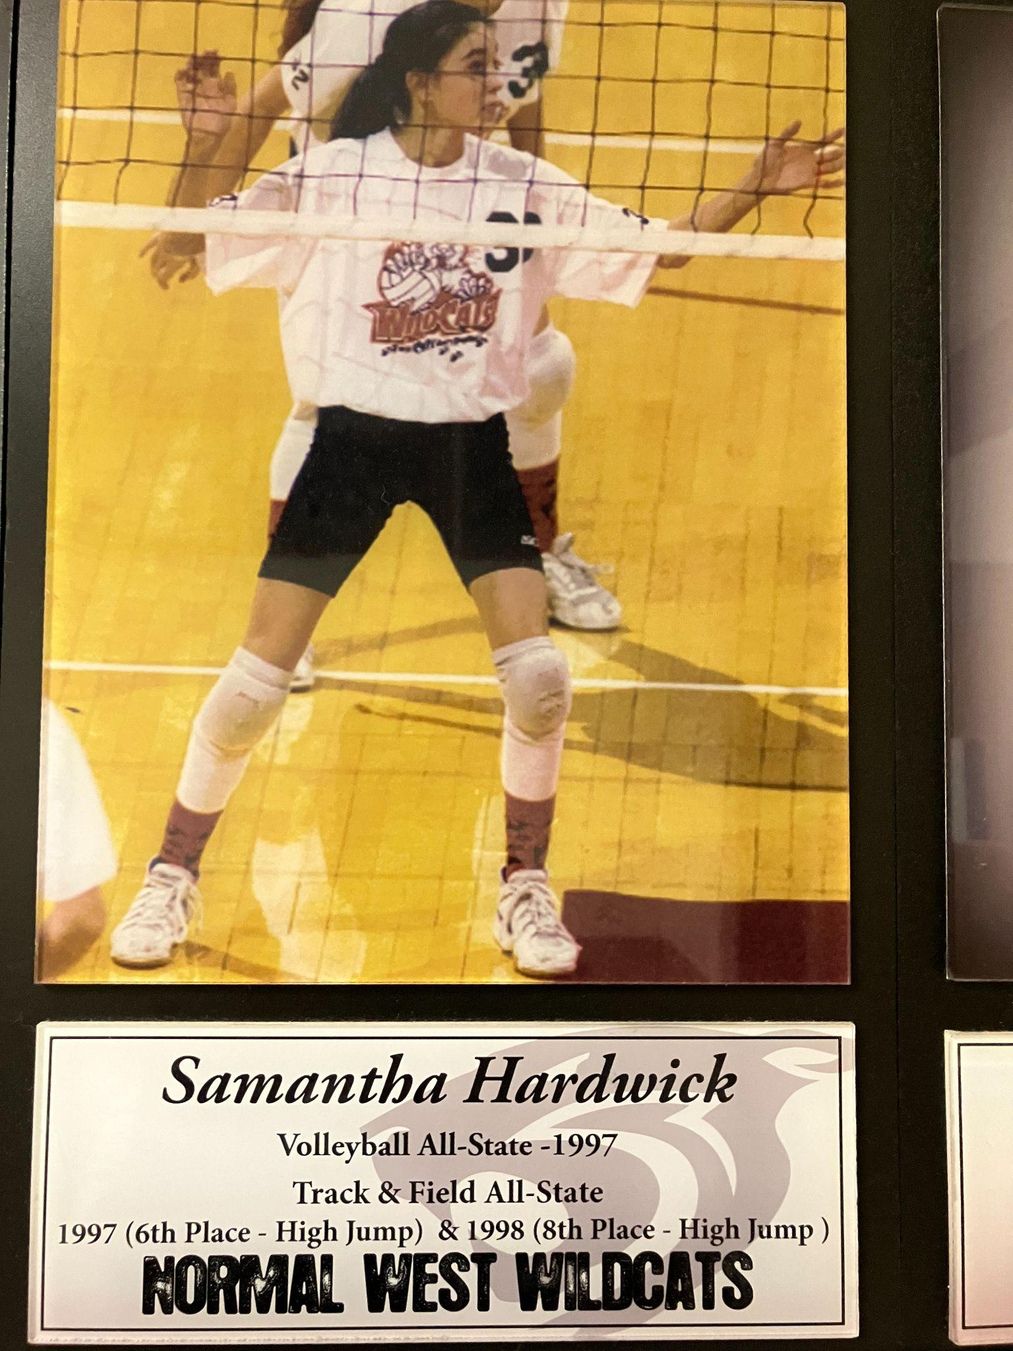
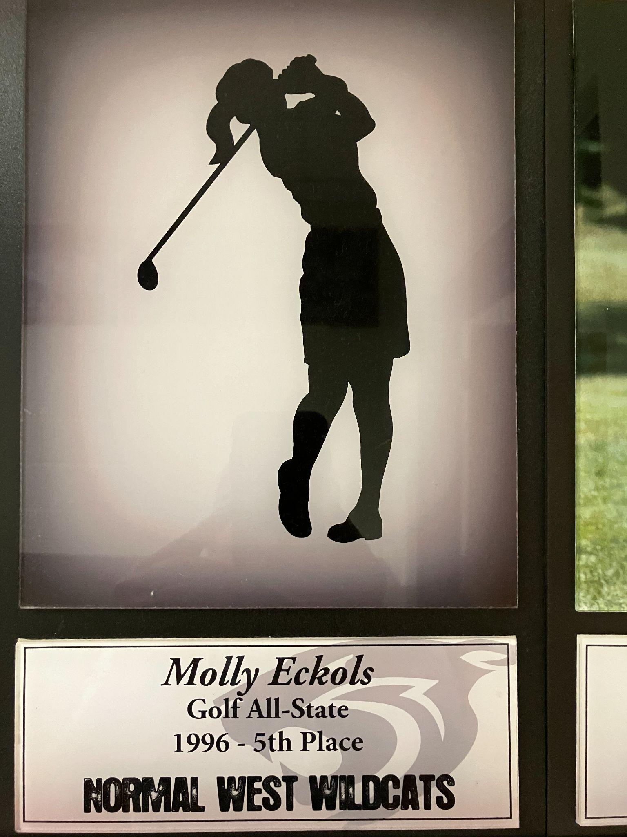

Slide 53
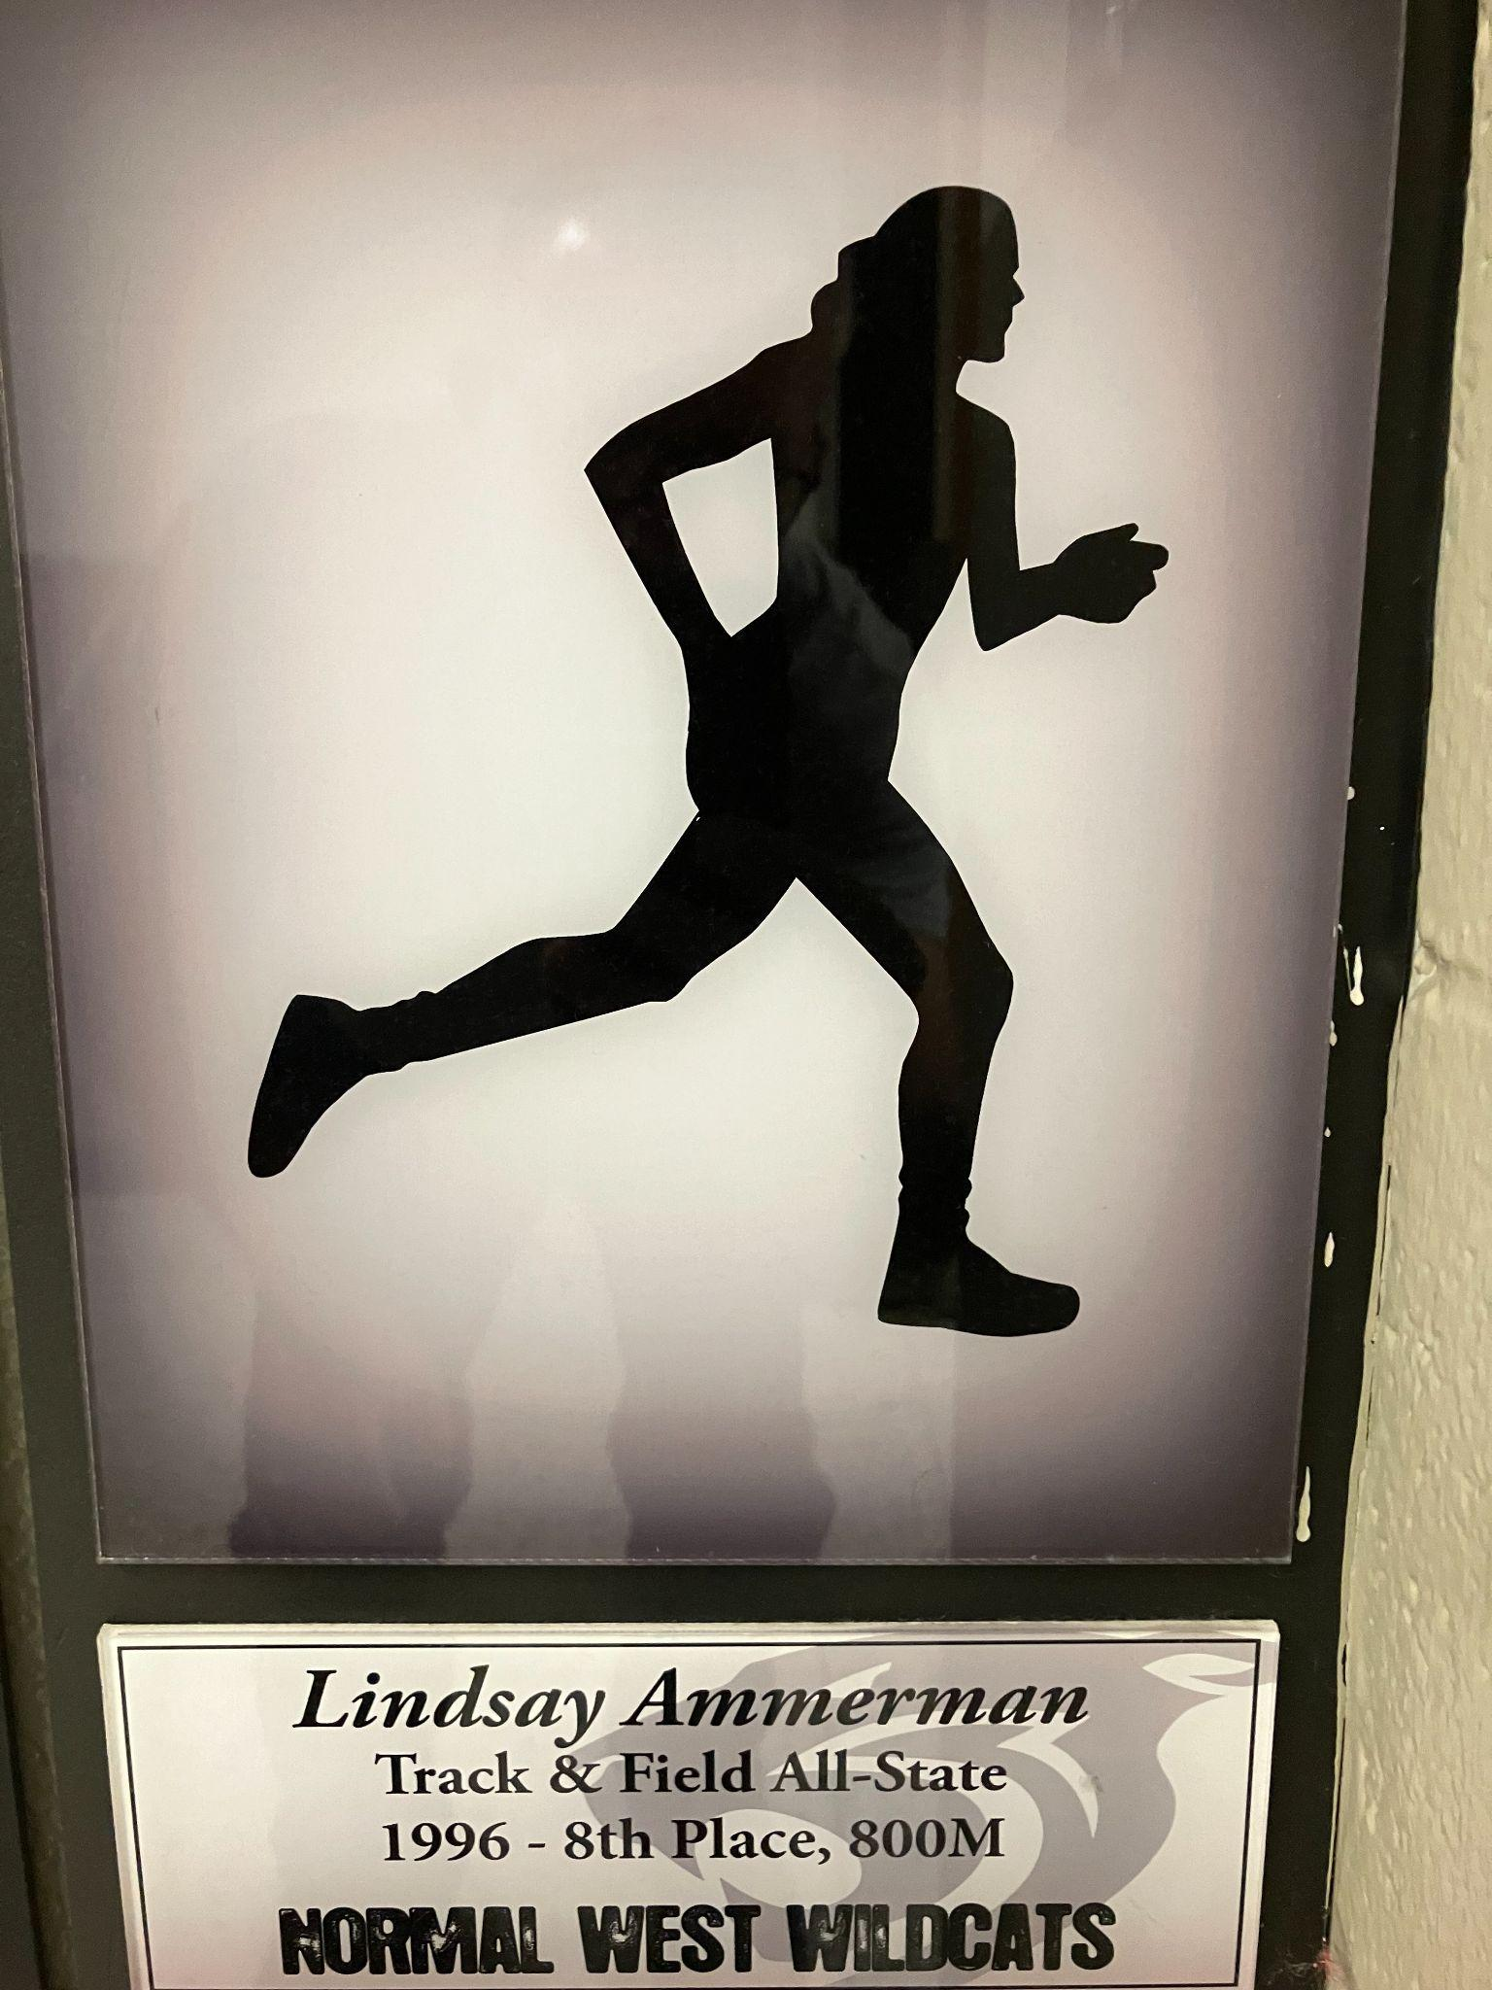
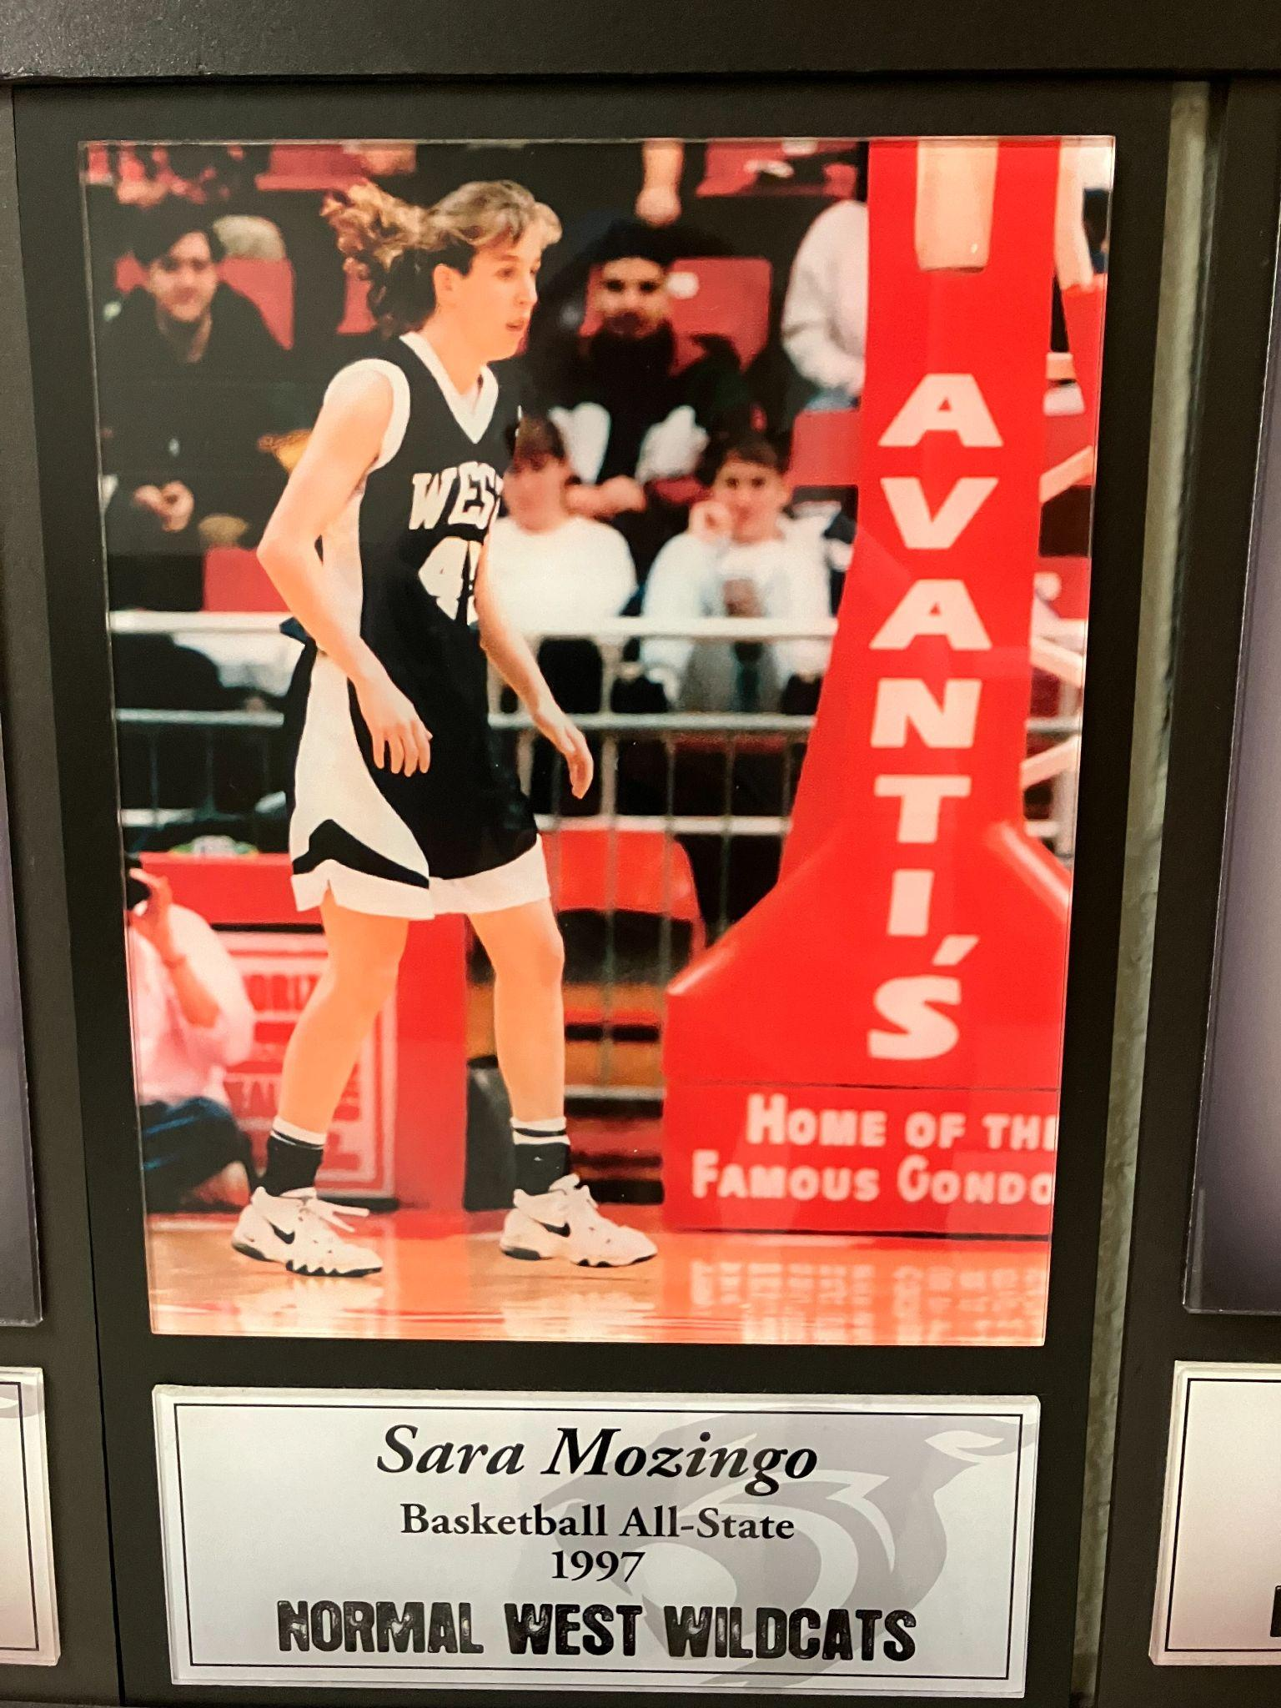

Slide 54
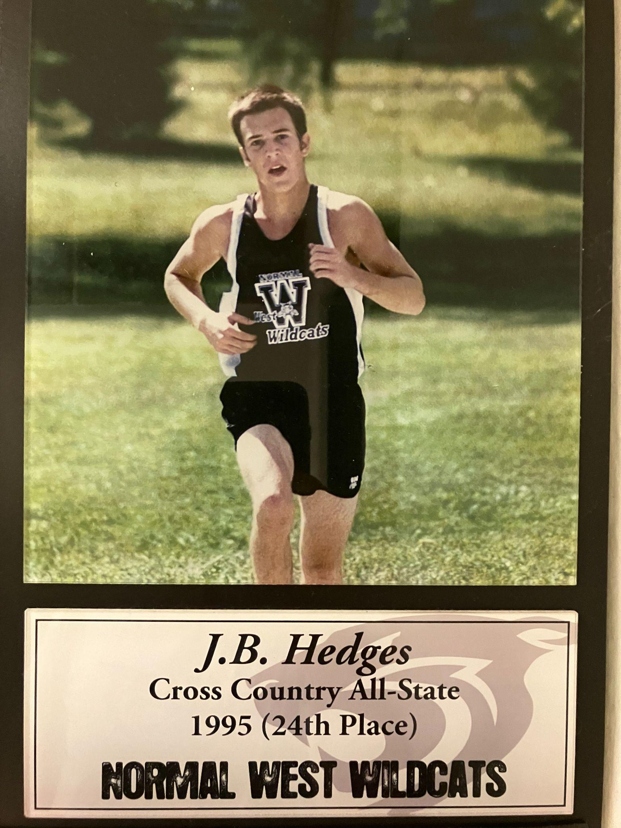
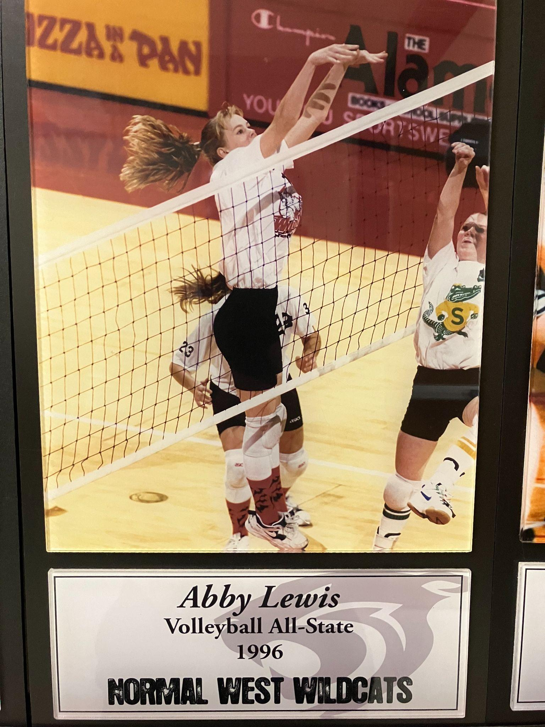

Slide 55
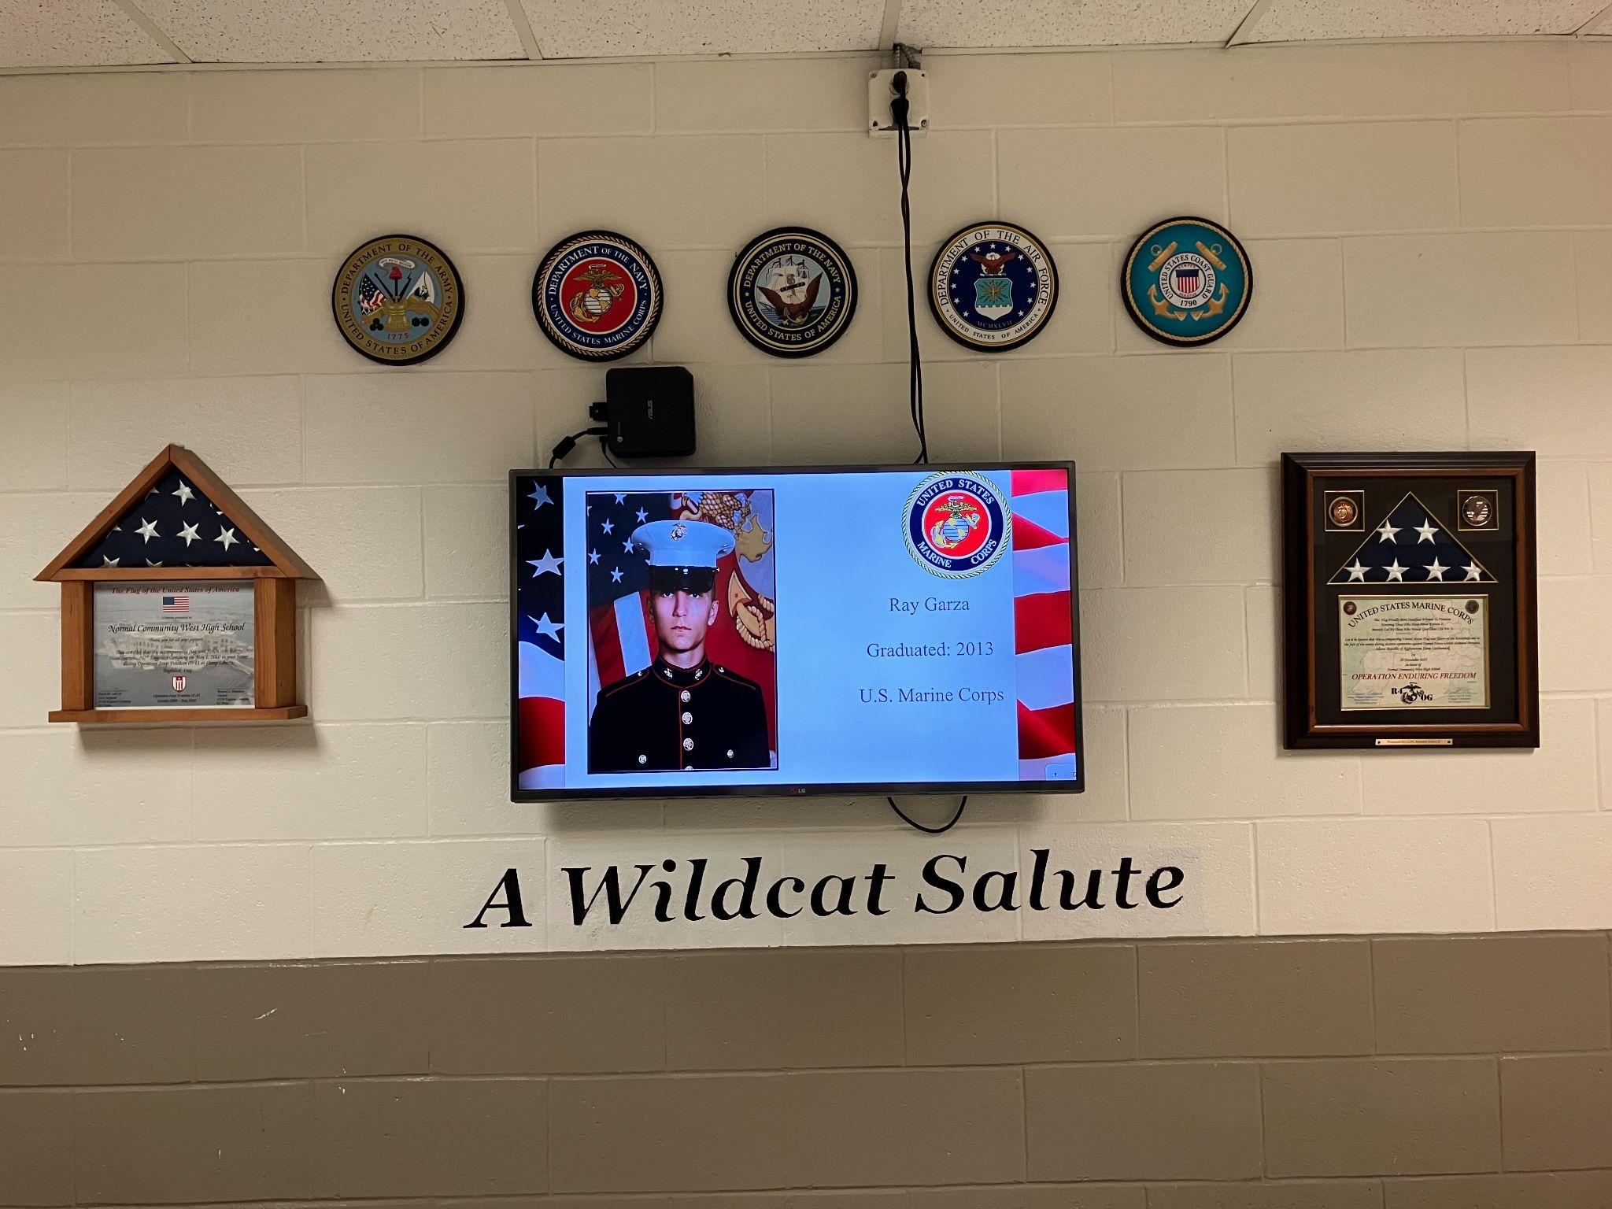
A few years ago, the Archive Club established “A Wildcat Salute” in the atrium. It cycles through all of the past Wildcats (and staff) who have served our country. A few teachers and students have actually dedicated flags flown overseas to Normal West where we proudly display them.

Slide 56
Feel free to check out the presentation
If you know of others who should be added to the presentation, please email John Bierbaum @ bierbauj@unit5.org

Slide 57
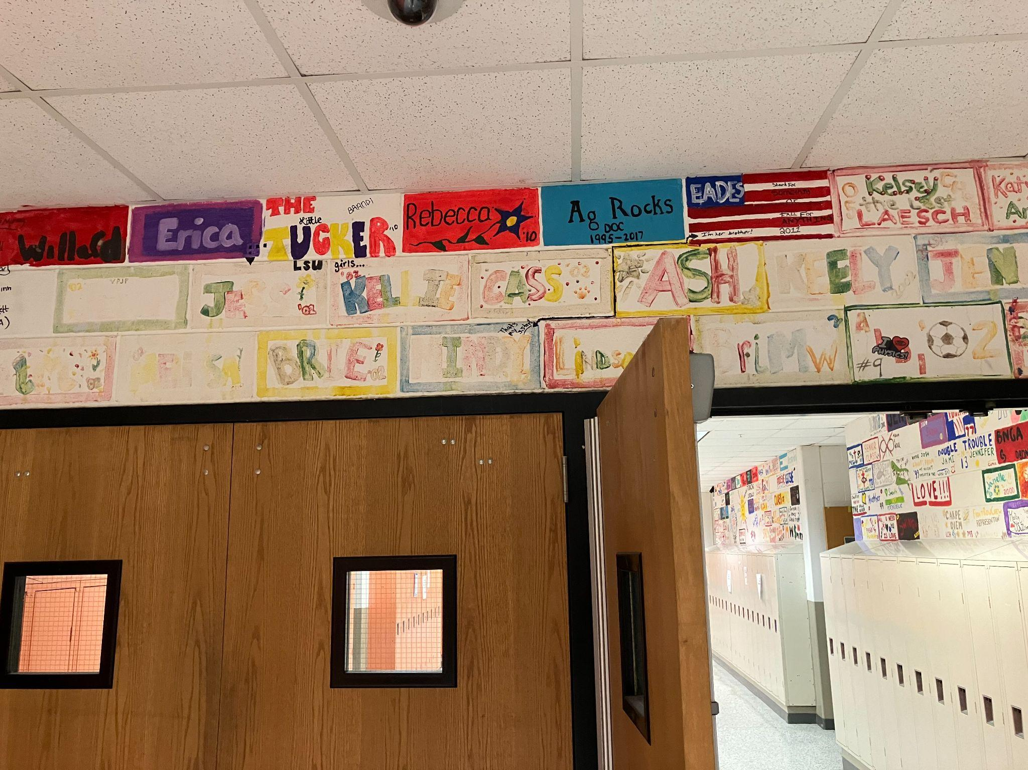
Remember these???

Slide 58
The painted bricks in our Senior hallway continue to add character to our school and celebrate the legacy of Wildcats who have graduated from Normal West. As we are now approaching a point where space for future bricks is at a premium, it’s interesting to think about where that idea came from in the beginning.
The October 21, 1998 Paw Print story, “Brick-painting should be more permanent,” provides some answers. The article quotes Mr. Tim Franz, then Student Council advisor, as saying, “The idea was brought up last year by seniors Ginger Garrett and Sonia Sosa. Its purpose was to generate spirit among seniors. Everyone was saying how sterile the school looks. Maybe this would help. If more people did it, it would look awesome.”
In the spring of 1998, Student Council member had attended the state student council convention and came back to N.W. with the idea for future classes. The original idea for the tradition - as evidenced in the October, 1998 picture of seniors painting bricks - was for the bricks to be completed in the fall, remain up all year, and then be painted over for the next class. As Dr. Crabtree was quoted, “It’s special for the seniors, when they leave they won’t be back and eventually the space would run out.” The Paw Print article later states that he was willing to talk about the possibility of leaving them up longer if that’s what students wanted.
So were the original bricks painted over or did they remain up? Well, kind of both. If you look closely at some of the bricks, you can find a couple painted by the Class of 1999. One example is Heidi Hellman’s (‘99) “BTG” brick. It is hard to know how many were originally painted and how many have been unfortunately damaged due to water or fading and painted over. BTG, BTW, stands for Blue Tone Groove, a group of Normal West students who had formed their own band and create an album that Mr. Franz still has a copy of.

Slide 59
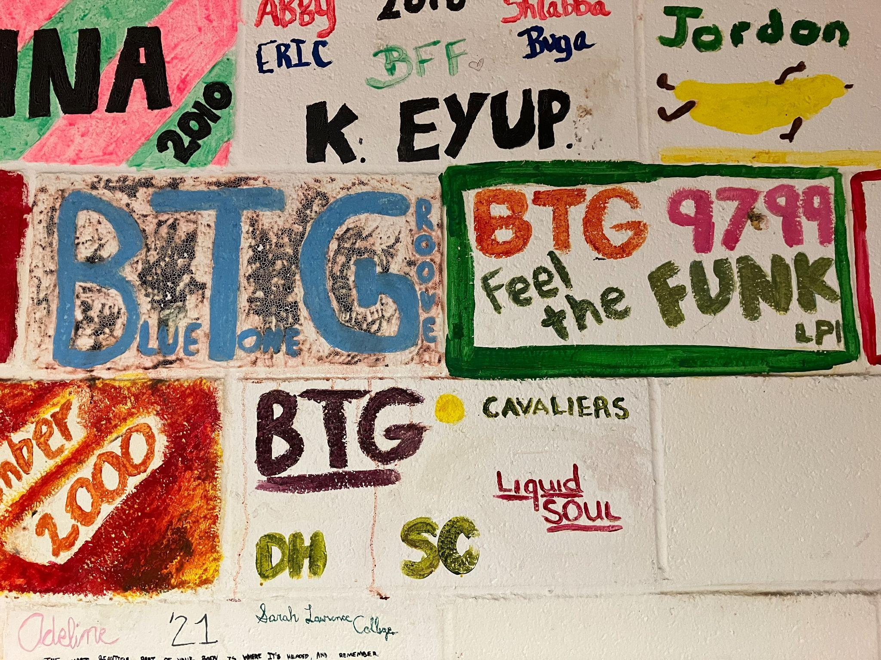

Slide 60
As you may or may not imagine, bricks have over the time faded or been damaged by leaks in the hallway ceiling. So – by now you should have guessed it - the Archive Club started to carefully - using a black light - figure out to the best of our abilities what the original brick said / how they were colored and restored them. To date, there is probably about 10% of the bricks that need to be restored and we are about 1/2 done with the project. Of course, we had to start with any BTG bricks!!! If you know, you know!!!

Slide 61

When this classic shirt arrived in our archive last year, it didn’t mean a whole until this year’s volleyball was undefeated earlier in the season and some comparisons were being made with the 1st volleyball team back in the fall of 1995.
So…the Archive Club decided to have a retro shirt done to honor the 1995 volleyball squad….

Slide 62


Slide 63



Slide 64

And during Homecoming, we set up a history display to celebrate so many of the original team members and their families back at West!
Check out the video
Shout out to Courtney Kalley for providing Halloween socks for the whole 2024 socks…just like the 1995 squad!

Slide 65


Slide 66


We have had so much fun incorporating our history into different aspects of the school year!

Slide 67
Class of 1996 football team for the win!
Through some really wonderful coordination between the West Athletic Department, Gridiron Club, various football alum, and the Class of 1996 football team an ambitious project was launched to raise the funds necessary to upgrade some aspects of the Normal West football complex.

Slide 68

No flags

Slide 69

Worn grass and mud pit

Slide 71

Look! There’s flags!

Slide 72

Look! There’s flags! And more flags!

Slide 73

And an amazing, really cool field tarp! Note: This is where players stand on the sideline instead of creating a huge mud hole.

Slide 74

This project was completed in time for the Wildcats to host in round 1 of playoffs.
Total project coordinated by Class of 1996: $8,500!!!
Amazing!

Slide 75

3’ x 5’!

Slide 76

It was a lot of fun having the original Wildcat football team captains for a team dinner and then be joined with several teammates to be honored before the Homecoming game!

Slide 77
Looking forward…
Teachers, administrators, coaches, and students have brainstormed areas of our school and programs that need some attention to continue to be at the level that Wildcats before them have enjoyed.
So, at the Wall of Fame banquet during Homecoming, we launched our 30th Year WIP campaign and hope you will consider being a part of the effort!

Slide 78
We are kicked off our “WIP”-West Improvement Pledges Campaign to help celebrate our 30th year:
As part of our 30th year celebration, Normal West is kicking off a WEST IMPROVEMENT PLEDGES campaign to “WIP” West into shape. LINK to pdf
—---> opportunity to make a monetary donation to a specific area that you and/or your students have felt personally connected to at West OR more generally related to students' academic and extracurricular experiences here at West
—---> These pledges will be used specifically to impact improvements for specific programs, projects, classroom resources, or enhance aspects of our school to foster a sense of culture, pride, and accomplishment.
—---> Wall of Fame Committee will be reviewing the donor preferences and total amounts to build a plan for several large and small scale long-term improvements for West later this Spring once donations link closes.

Slide 79
We are EXCITED to announce that we have received a $5,000 and a $10,000 anonymous donation at our Wall of Fame Event in 2025 held at the end of September to kick off this campaign! At the time of getting this presentation out, we just received a $500 donation from an alum! It's truly A Great Day to Be a Wildcat!!! Want more information about how you can make a pledge? Click this LINK

Slide 80
So where do we go from here?
Well, the Archive Club is still brainstorming ideas to collect, maintain, and celebrate West history. If you would like to help us out with all of the projects we have going on, use the payment option from the previous option and simply mark your funds as going to the “Normal West Archive Project.”
I hope to send out another update at the end of this year. In the meantime, I appreciate Sean Kerr’s help in getting our digitization project up and running. Enjoy some past West videos that he has uploaded for your viewing pleasure.
https://www.youtube.com/@NormalWestVideoArchive

Slide 81
And of course – feel free to drop me a line. Got a question? Want more information about something or to provide our staff an update about what you are up to? Shoot me an email and I’ll do what I can to continue celebrating West’s history and traditions!
Thanks,
John Bierbaum

