Slide 1


July 23 & 30, 2026
FY27 Millage
Presentation

Slide 2
2027 TENTATIVE MILLAGE RATE
2027 TENTATIVE MILLAGE RATE
M&O Millage Rate Current: 15.208 Proposed: 15.208 Rollback: 15.059
Debt Service Current: 1.418 Proposed: 1.418 Rollback: 1.404
Millage Rate Hearing Dates:
July 23 9:00 a.m. and 7:00 p.m.
July 30 4:00 p.m.

Slide 3
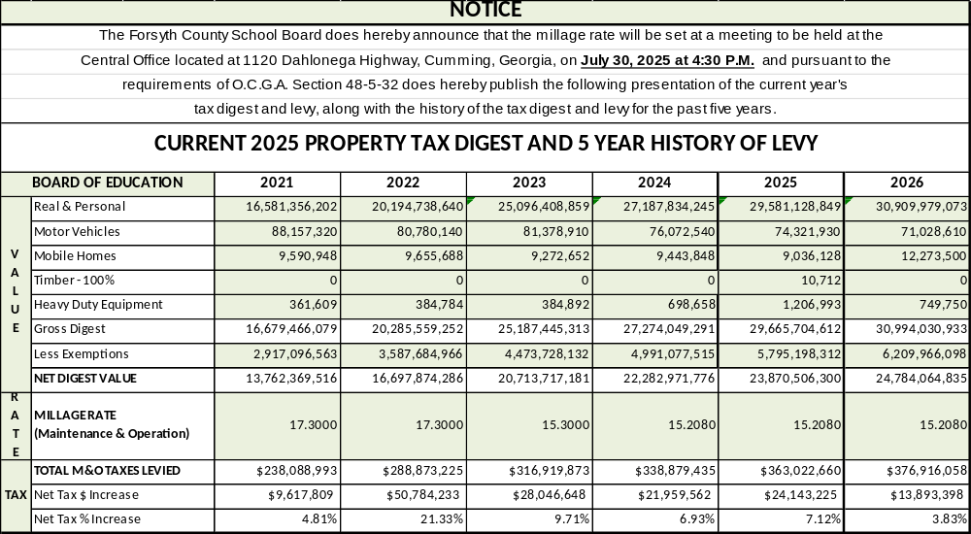
2026 TAX DIGEST & 5 YEAR HISTORY
2026 TAX DIGEST & 5 YEAR HISTORY

Slide 4
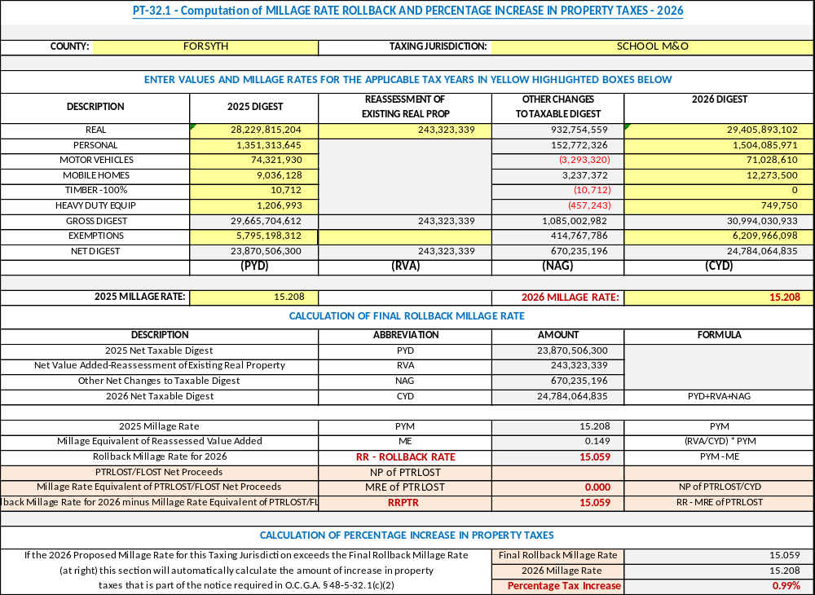
M&O 2026 ROLLBACK COMPUTATION
M&O 2026 ROLLBACK COMPUTATION

Slide 5

DEBT 2026 ROLLBACK COMPUTATION
DEBT 2026 ROLLBACK COMPUTATION

Slide 6
Forsyth County Schools
Safe.
Connected. Thriving.

