Slide 1
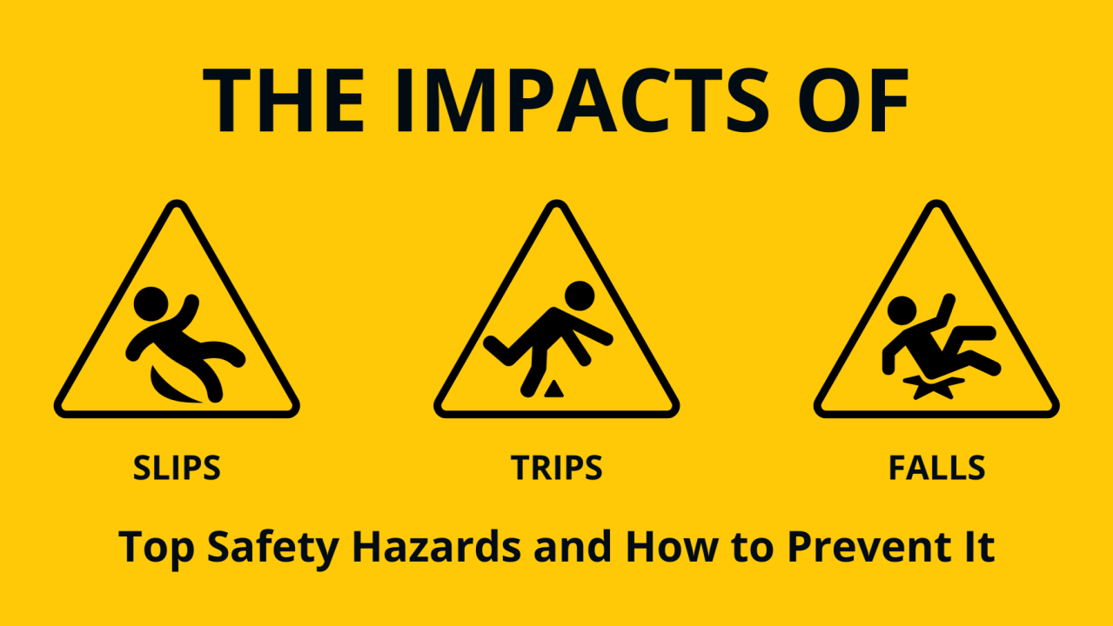
Trips, Slips & Falls
Safer Workplace Starts With You.

Slide 2
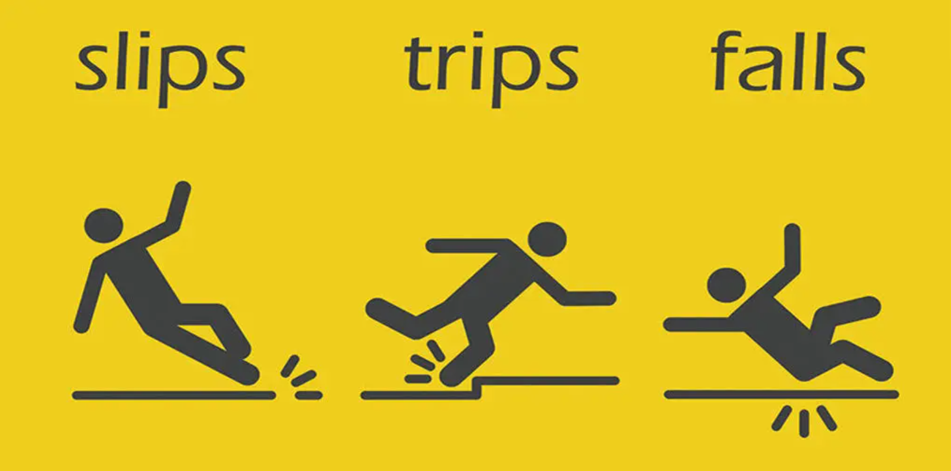
What are trips, slips, and falls
They occur when a person loses balance due to a hazard on or near the walking surface. They are among the leading causes of workplace injuries.

Slide 3
Common Causes
Wet, oily, or slippery floors
Cluttered walkways
Uneven or damaged surfaces
Poor lighting
Loose cords, hoses, or mats
Inadequate footwear
Rushed or distracted walking

Slide 4
Risks & Impact
Injuries: Sprains, Fractures, head injuries, back injuries
Impact: Pain, lost time, reduced productivity
Costs: Medical expenses, workers’ comp, increased insurance costs
Culture: Affect morale and workplace safety reputation

Slide 5
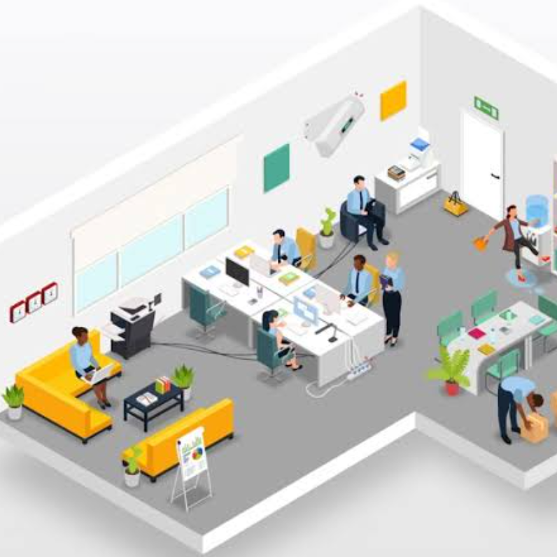
Prevention Strategies
Step 1. Identify
Step 2. Evaluate
Step 3. Correct
Step 4. Control
Step 5. Train

Slide 6
WHAT YOU CAN DO
Keep
Keep walkways and exits clear
Clean up
Clean up spills immediately
Use
Use caution signs
Wear
Wear caution signs
Wear
Wear the appropriate clothing for the job
Stay
Stay Alert- Avoid distractions
Report
Report hazards right away
Take
Take your time –safety first

Slide 7
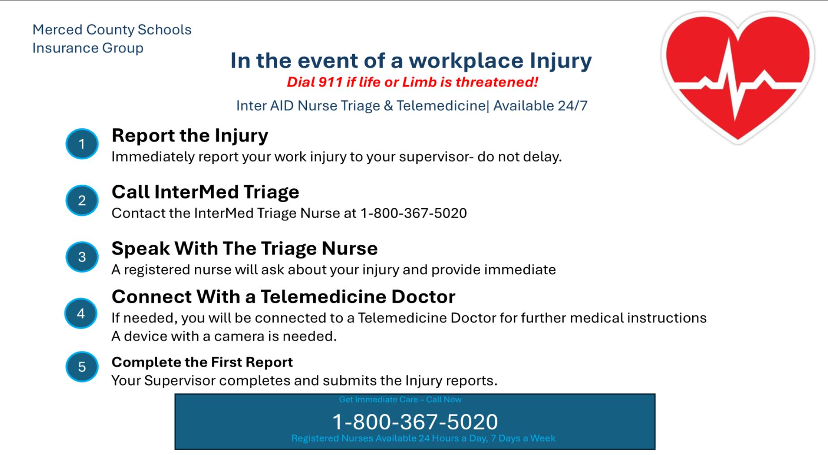

Slide 8

Trips, Slips, And Falls- In the Workplace

Slide 9
