Slide 1
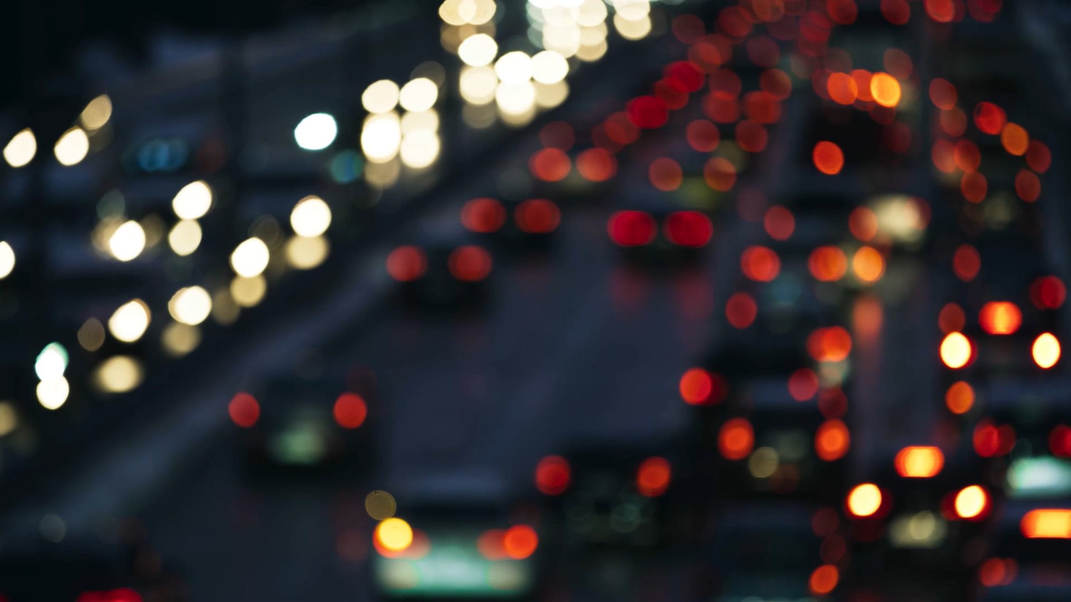
Distracted Driving
Put the phone down

Slide 2
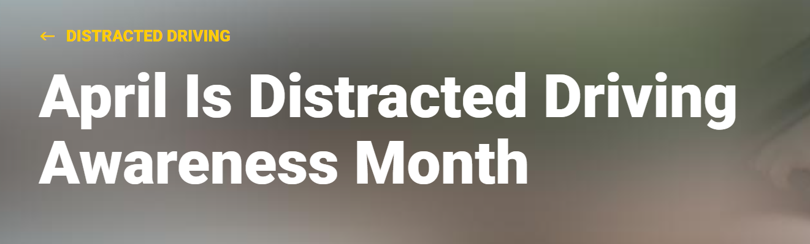
Pay Attention
Because
It’s
Distracted driving has become a deadly epidemic on our roads. Cell phone use — specifically, texting, talking, and social media use — has become the most common distraction. Other risky actions include adjusting the radio or GPS, applying makeup, eating, and drinking. By driving distracted, you’re robbing yourself of seconds that you may need to avoid a close call or deadly crash.

Slide 3
National Highway Traffic Safety Administration
Overview
According to the NHTSA Distracted driving is dangerous, claiming 3,275 lives in 2023. NHTSA leads the national effort to save lives by preventing this dangerous behavior. Get the facts, get involved, and help us keep all roads safe.

Slide 4
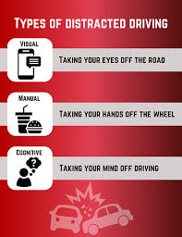
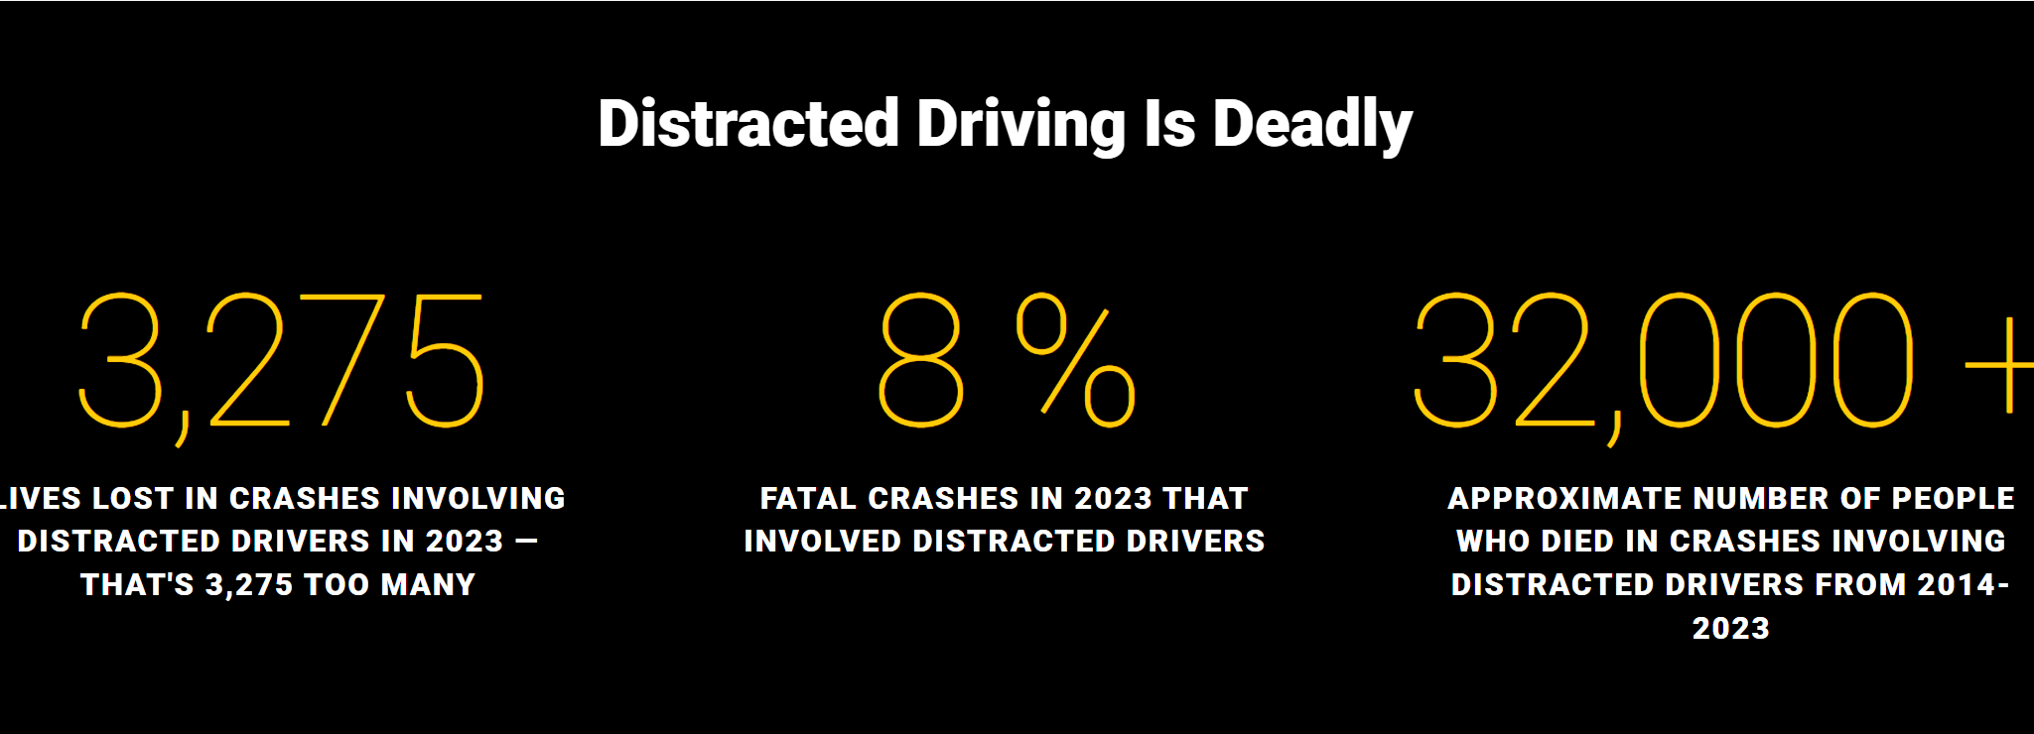
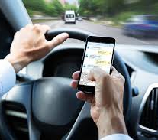
For the past decade, distracted driving has taken U.S. roadways by storm, endangering not only the distracted drivers but their passengers, pedestrians, and others using the road. When we're behind the wheel, we must focus on one task: safe driving. Anytime you shift your attention from driving, you're distracted.
Distracted driving comes in many forms: adjusting the radio or GPS, applying makeup, eating, and drinking. But it’s cell phone use — specifically, texting, talking, and social media use — that is the most common distraction. Texting, which includes messaging, is considered the most dangerous type of distracted driving because it combines visual, manual, and cognitive distraction.

Slide 5
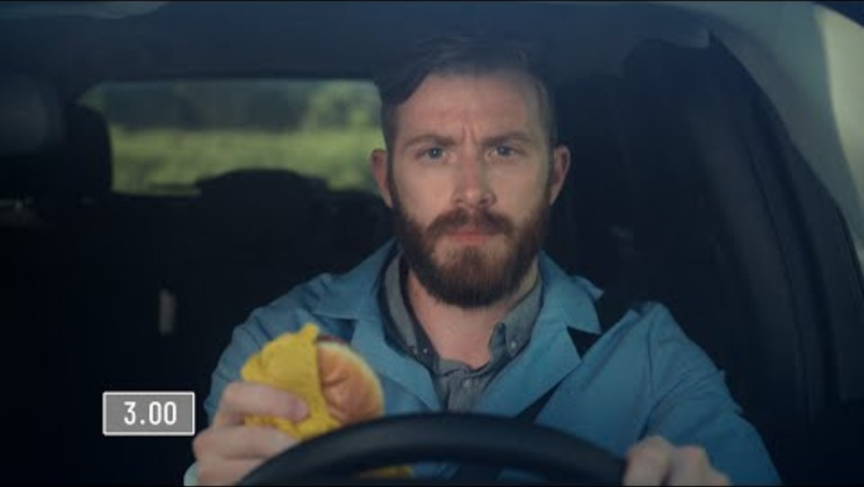
WHAT HAPPENS WITH 3 SECONDS with your eyes OFF THE ROAD

Slide 6
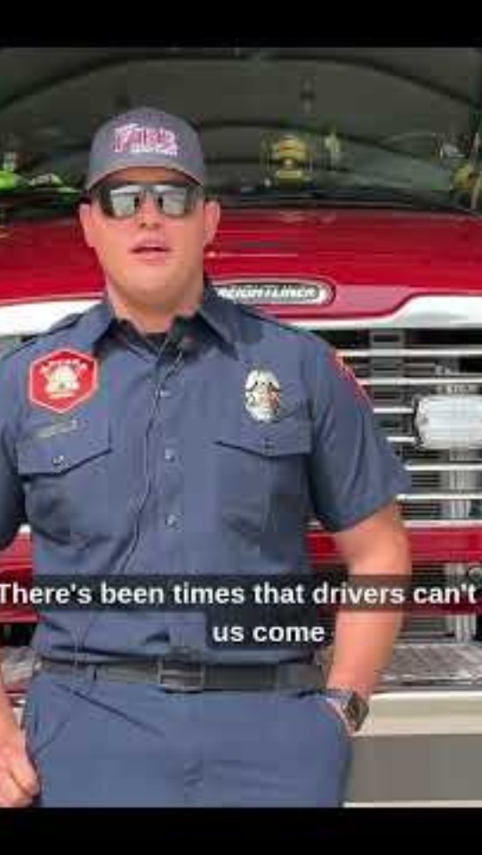
Biggest Distraction

Slide 7
In conclusion
If you have to text, pull over to a safe location and park your car — only then should you read or send the text message.
Distracted driving isn’t just texting, scrolling through social media or messaging while driving is distracted driving too.
Appoint your passenger as the “designated texter” to respond to calls or messages.
Activate your phone’s “Do Not Disturb” feature, silence notifications, or put your phone away in the trunk so you won't be tempted to respond.
Speak up if you see someone texting and driving and ask them to put their phone away.

