Slide 1

Welcome to Helena High Science!
2025-2026

Slide 2
Helena High School Science Team’s Goal
Our goal is to prepare students for college and/or careers and to understand the amazing wonders of science.
We strive to make science interesting and meaningful to your everyday life and we want you to explore as many courses as you can.

Slide 3
Science Graduation Credits
Science Graduation Requirements are 2 years (2 credits) of science
1 Physical Science + 1 Life Science
3 years of science is recommended for most colleges/universities.
HHS Science Teachers believe that more science credits will better prepare you for college and your career.

Slide 4
Science Course Offerings
9th Grade | Earth and Space Science or Honors Earth and Space Science
10th Grade | Biology or AP Biology and Chemistry
11th Grade | Chemistry Physics AP Environmental Science Biology II AP Chemistry
12th Grade | Chemistry Physics AP Environmental Science Biology II AP Chemistry Science Seminar

Slide 5
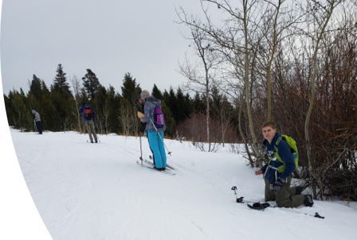
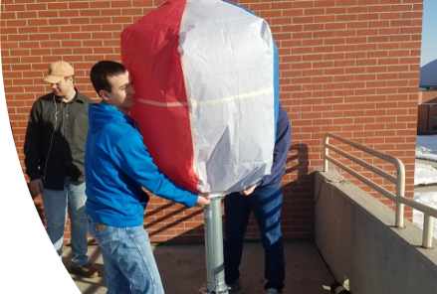
Science Electives
Advanced Placement Electives
AP Environmental Science
AP Chemistry
AP Biology
Physics
Biology II
Chemistry

Slide 6
Health Career Pathway
Year 1
Biomed 1 Principles of Biomedical Science
Year 2-3
Biomed 2- Human Body Systems and/or
Athletic Training
Year 4
Health Career Exploration

Slide 7
Be Involved
Science Club
Envirothon – team science competition in the natural resources.
Science Bowl – team science competition in trivia format.
Science Olympiad – team competition with a variety of events hosted by Montana State University.
Outdoor Club
Green Group

