Slide 1
Welcome to Parents’
Induction Evening
Tuesday, 7th July
Mr Collins
Headteacher

Slide 2
Introductions
Miss Claydon– Head of Year 7
Ms Brabants – Transition Coordinator
Mrs Sandhu – SENDCO
The Senior Leadership Team

Slide 3
The Senior Leadership Team (SLT)
Mr P Collins | Headteacher
Mr A Leane | Senior Deputy Headteacher
Mr M Culkeen | Deputy Headteacher
Mr S Thatcher | Deputy Headteacher
Mrs C Goodyear | Assistant Headteacher
Ms F Shallow | Assistant Headteacher
Dr P Joshi | Assistant Headteacher
Mrs D Lombard | Assistant Headteacher
Mrs S Hind | Assistant Headteacher
Mrs M Davey | Assistant Headteacher
Mrs D England | PA to Headteacher

Slide 4
3 essential things for September
Thursday 3rd September – Day 1 for Year 7
Full school uniform expected every day
Work Hard, Be Nice, No Excuses – our mantra for all that we do

Slide 5

2 things to look for in September:
Online login details for students and parents (ClassCharts, WEDUC, etc.) and signup instructions for after school clubs so your child can take part in all Slough and Eton has to offer.
See It, Hear It, Lose It! Mobile phones are not permitted at school.

Slide 6


1 thing to do if you can:
Summer Reading
Take part in the Summer Book Club by reading Secrets of the Snakestone. Information available on our website, letter, QR code.
(Or read a book on the recommended reading list in the transition booklet. The Slough Library at the Curve is a great place to visit!)
Recommended Reading For Year 7
The Girl Who Drank the Moon by Kelly Barnhill
Refugee by Alan Gibbons
Ghost by Jason Reynolds
The Island at the End of Everything by Kiran Millwood Hargrave
Twitch by M.G. Leonard
Dreadwood by Jennifer Killick
Factopia! By Kate Hale
Outside: A Guide to Discovering Nature by Maria Ana Pexie
Migrants by Eduard Altarriba
A Time Traveller’s Guide to Life, The Universe, and Everything by Dr. Ian Flitcroft
Notes:
Reading and/or paretnetal engagege

Slide 7
Key points for home:
On a Friday we finish at 2.30pm.
We stagger dismissal over a 10-minute period at the end of the day.
Gates are locked morning and evening.
Our morning breakfast service is free.
No break time snack service.
We are a cash-less school; all payments made via thumbprint.
Your child needs to be reading and have a reading book every day.
Every day starts with ten minutes of Tutor Time.
Think of the Form Tutor as their primary school Class Teacher – contact them first.
Let them go – we’ll look after them.
Talk to us when it goes wrong.

Slide 9
Ms Brabants
Transition Coordinator
Whole School Literacy Coordinator

Slide 10

Moving to Slough and Eton
KS1
KS2
KS3
KS4
KS5
So much is different:
  larger school
  faster paced day and lessons
  moving to each lesson
  many new faces, so many students
  many more teachers and staff
  very high expectations
It’s normal for students to feel
  excited, nervous, worried, curious…so many emotions!

Slide 11
Key changes at secondary school
Our expectations are built on those at primary/KS2 but we expect students be able to demonstrate a much higher degree of independence and personal responsibility.
So many changes all at once!
  Structure of the day/lessons
  Pace of the day/lessons
  Population of the school
  Vastly increased responsibility
  Vastly increased independence
  Greater need for personal organisation
  Expectations differ from teacher to teacher and subject to subject
Students need:
  Proper sleep and proper nutrition help students adjust and cope. Screens and devices interfere with sleep so keep mobiles out of bedrooms!
  Support and encouragement from parents is vital: help us help your child.

Slide 12




How to support your child
https://www.slougheton.com/
Have regular conversations about school.
Use WEDUC for notifications and communication.
Read all Slough and Eton communications to students and parents.
Visit the School’s website regularly.
Check ClassCharts for independent study set.
Check that daily independent reading is being done at home.
Discuss what your children are reading with them.
Let us know how we can help.

Slide 13
Medical Conditions
If your child has a medical condition, we will need details.
Please complete an Individual Health Care Plan (IHCP).
Please provide information/instructions for any medications.
Please provide medications.
Medical Lead: Lucy Clark will available in the restaurant after this session.

Slide 14



Know Yourself, Develop Yourself: Preparing to Make the Jump

Slide 15

Transition Booklet and QR codes
Your child has been given a copy of this document today and all the information you and your child needs is included.
All this information and more is also available on our website.
Any questions: Year7transition@slougheton.com

Slide 16

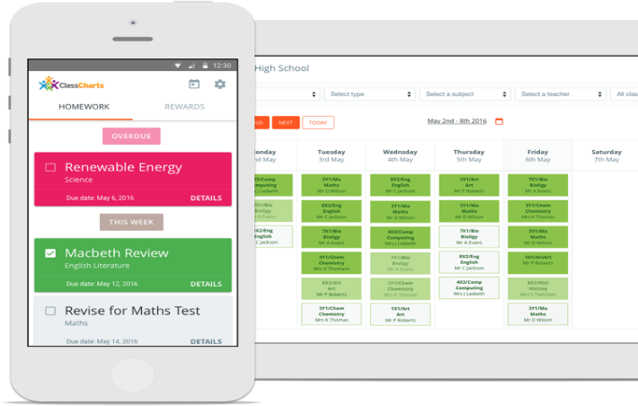
ClassCharts
www.ClassCharts.com
ClassCharts is a simple online homework calendar and platform for positive and negative behaviour points.
It will allow you to see all homework set (including deadlines) and to track your child's progress.
It is also available as an app on mobile devices.
If you have any queries please speak to your child’s Form Tutor.

Slide 17
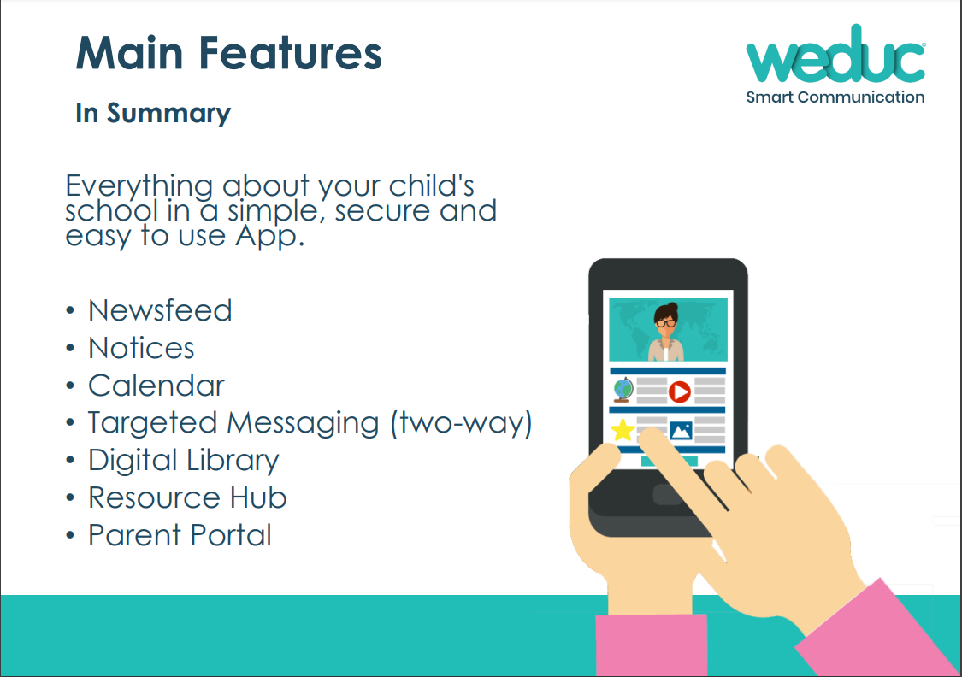
WEDUC
This is our digital platform for parent communication.
Student and Parent Bulletins, other notices, updates, event calendars and other resources are shared via WEDUC.
Report absences via WEDUC.

Slide 18


ParentPay
Online payment system through WEDUC.
Secure payments online for meals and trips
Links directly to our biometric system (thumbprint).
Able to view your child’s balance and what they have spent.
Get balance alerts by text or email and receive notifications about items to pay for.
Integrated with WEDUC.
FSM: Eligibility changes mean that those receiving Universal Credit qualify for FSM. The school will confirm eligibility every year. Any questions, please speak to team in restaurant.

Slide 19
Reading Really Matters
Reading is a skill that needs to be practised.
Reading every day – at least 20 minutes.
Supportive home environment.
Be a role model.
Discuss books and reading. Ask questions about what they’re reading.
‘Never forget that reading gives you knowledge, which gives you choice and opportunity in whatever you want to do in life’ (Andy McNab, Today Everything Changes, p.80).

Slide 20
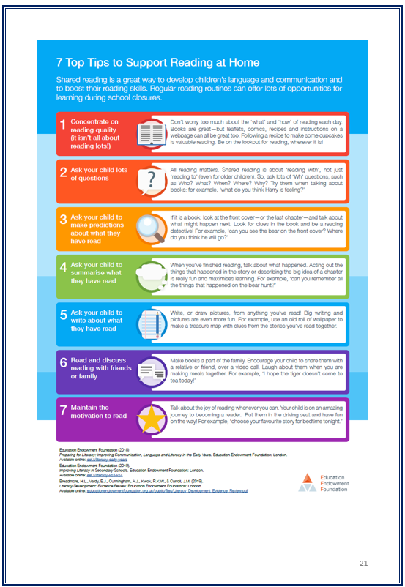
  Reading at Slough and Eton
Reading Plus and Proficiency Scores
Reading for Pleasure
Library: print and digital resources (such as e-platform, Accessit and other platforms)
Newsletters and recommendations sent home.
Book of the Week
Meet the Tutor and Parents’ Evening

Slide 21
Summer Book Club
Take part in the Summer Book Club by reading Secrets of the Snakestone. Information is available on our website with details in a letter and by QR code.
Letters for parents with explanations are available on our website. There is a powerpoint on our website that explains the book club and I have uploaded an individual slide that explains how you can purchase a digital version (e-book) for 99p. There is a QR code that takes you directly to the appropriate page for all the resources, including a sample chapter of the book.
Notes:
Reading and/or paretnetal engagege

Slide 23
Miss Claydon
Head of Year 7
Expectations
Engagement
Enrichment

Slide 24
The Year 7 Team
Miss L Claydon, Head of Year Mrs D Gierlik, Deputy Head of Year
7 Ali | Miss S Austin, Mrs C King
7 Angelou | Mrs S Hashmat, Mrs C King
7 King | Mr Al-Hajjaj
7 Parks | Miss H Ahmed
7 Seacole | Miss N Maximin
7 Winton | Mrs D Gierlik, Mrs C King

Slide 25
Communication with the School
Form Tutor/
Head of Year
A member of the Senior Leadership Team
WEDUC
Student Bulletin
Parent Bulletin
Slough and Eton Review
Text messages
Emails
Postcards
School website

Slide 26
The House System
Ali
House
AngelouHouse
King House
Every Slough and Eton Student belongs to a House.
Students take part in House activities and days, raising money for chosen charities and emulating the qualities of their House namesake.
Students have the opportunity to become 'House Leaders' gaining responsibility within the House System.
Parks
House
SeacoleHouse
Winton House

Slide 27
Wellbeing and Safeguarding
More information available in the Restaurant after this evening’s session.

Slide 28
The School Day: Timings
Students should be here well before the first bell, which rings at 8:25. Each day starts with ten minutes of Form time, beginning at 8:30. Students see their Form Tutor twice each day.
Dismissal is staggered and we have shortened lessons on a Friday for early dismissal at 2:30.
 | Monday to Thursday | Friday
Restaurant and Library | Open from 8:00am | Open from 8:00am
Warning Bell | 8:25am | 8:25am
Registration | 8:30 – 8:40am | 8:30 – 8:40am
Period 1 | 8:40 – 9:30am | 8:40 – 9:25am
Period 2 | 9:30 – 10:20am | 9:25 – 10:10am
Break | 10:20 – 10:35am | 10:10 – 10:25am
Period 3 | 10:35 – 11:25am | 10:25 – 11:10am
Period 4 | 11:25 – 12:15pm | 11:10 – 11:55pm
Lunch 1 (Year 8, 11, 12, 13) | 12:15 – 12:45pm | 11:55 – 12:25pm
Tutor Period (Year 7, 9, 10) | 12:15 – 12:45pm | 11:55 – 12:25pm
Lunch 2 (Year 7, 9, 10) | 12:50 – 1:20pm | 12:30 – 1:00pm
Tutor Period (Year 8,11,12,13) | 12:50 – 1:20pm | 12:30 – 1:00pm
Period 5 | 1:20 – 2:10pm | 1:00 – 1:45pm
Period 6 | 2:10 – 3:00pm | 1:45 – 2:30pm
Period 7 (when used) | 3:00 – 3:50pm
Notes:
Breakfast served from….

Slide 29
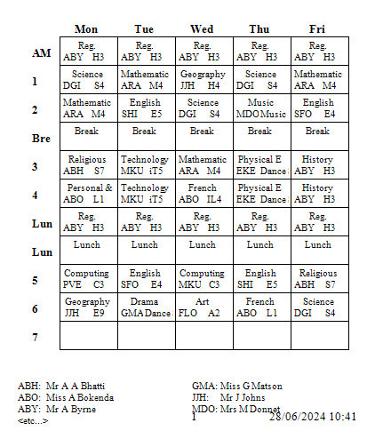
The School Day: Timetable
We follow a one-week timetable.
There are six lessons each day.
Each lesson is 50 minutes (45 minutes on Friday).
Practical lessons are sometimes delivered as a double lesson.
Notes:
Breakfast served from….

Slide 30

Punctuality and Attendance
Students must be in school, in Form Room at 8.30am. (First bell goes at 8:25.)
Students are to arrive on time to every lesson.
Punctuality and attendance is monitored. Attendance target is 96%.
You must contact the school if your child is absent; you can use WEDUC to do this.
Appointments should be scheduled outside of school time. If this is not possible, please notify the school.
Plan ahead, know your route, remember locked carpark.
Notes:
Reiterate breakfast TARGET ATTENDANCE

Slide 31
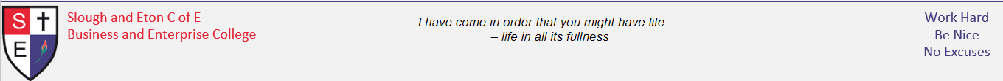
Attendance & Punctuality
Better Attendance = Better Grades (Year 11)
Attendance | Average Grade
90%+ | 5.9
80-90% | 4.9
70-80% | 4.7
60-70% | 2.8
50-60% | 2.4

Slide 32

Mobile Phones: at school and at home
See it, Hear it, Lose it!
Mobiles are NOT permitted in school at any time.
Mobiles will be confiscated if misused and parents will have to pick the phone up from Reception at the end of the school day.
Earpods, headphones, smartwatches are also banned.
Mobiles at home: limit screen time and do not use in the bedroom!

Slide 33
Behaviour
Consistently positive behaviour is rewarded in a variety of ways.
Unacceptable behaviour which breaks the school rules will always be sanctioned.
Notes:
vivos

Slide 34
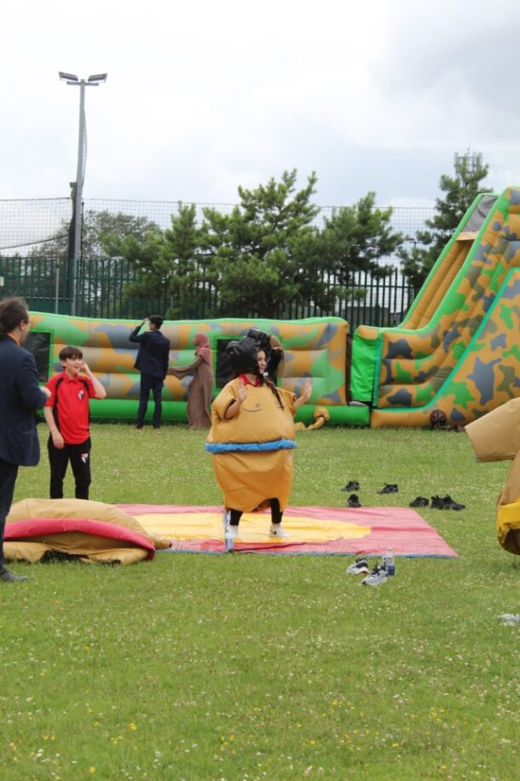
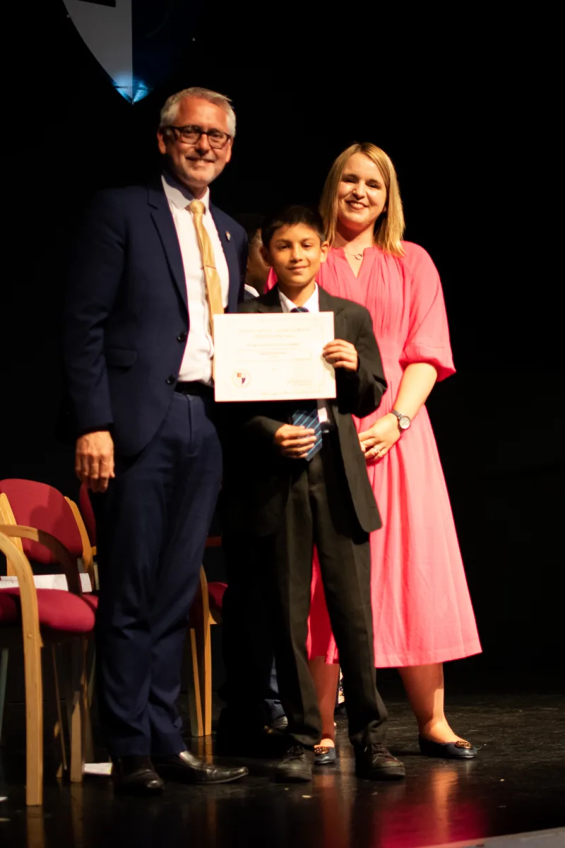
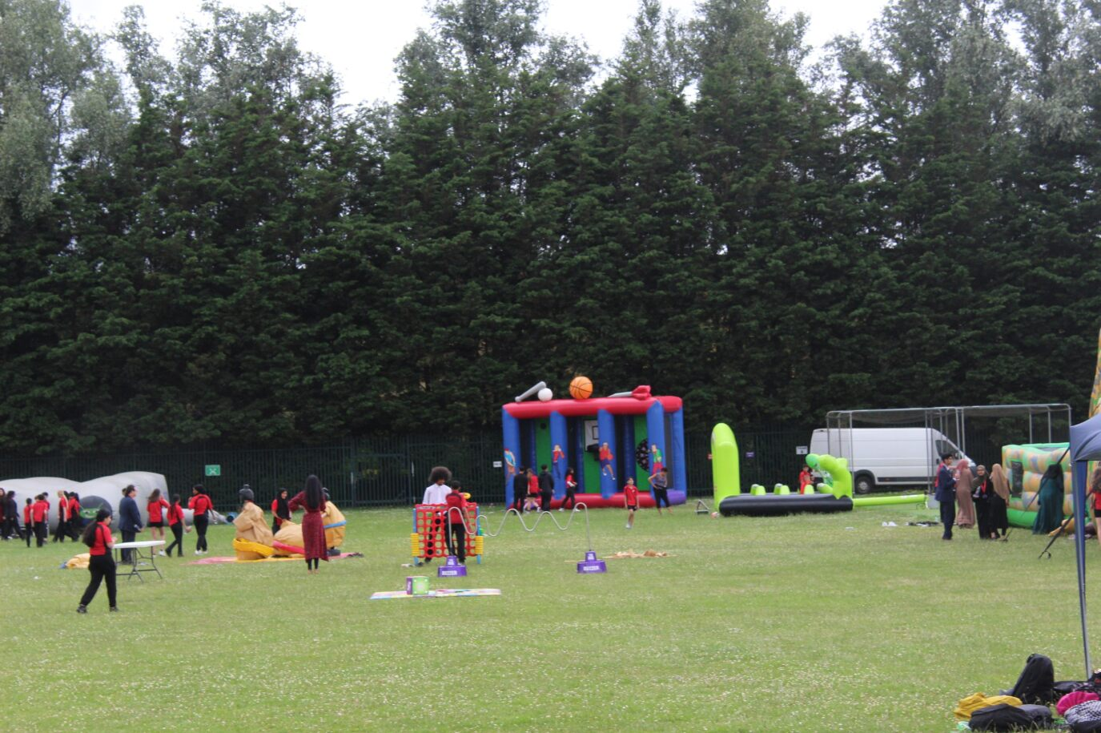
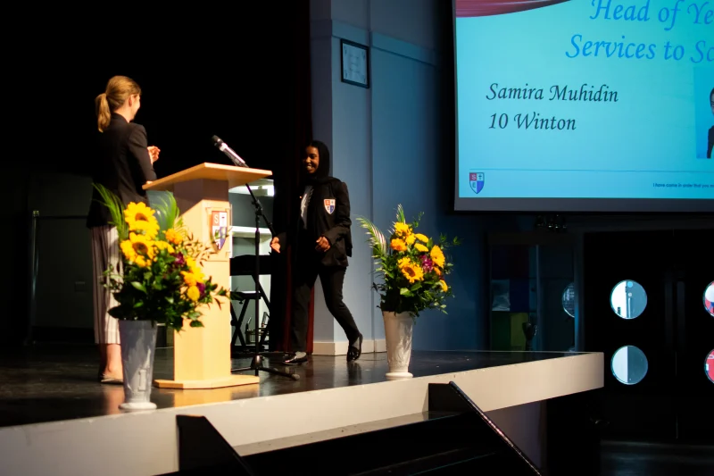
Behaviour
We use ClassCharts for both positive and negative points.
Parent logins for ClassCharts will be provided in September and we encourage you to check your child’s progress as much as possible.
Students can use their balance of positive points to purchase rewards from the ClassCharts reward shop.
There are plenty of rewards to be won including trips, the Big Bash, Achievement badges, certificates and much more.

Slide 35
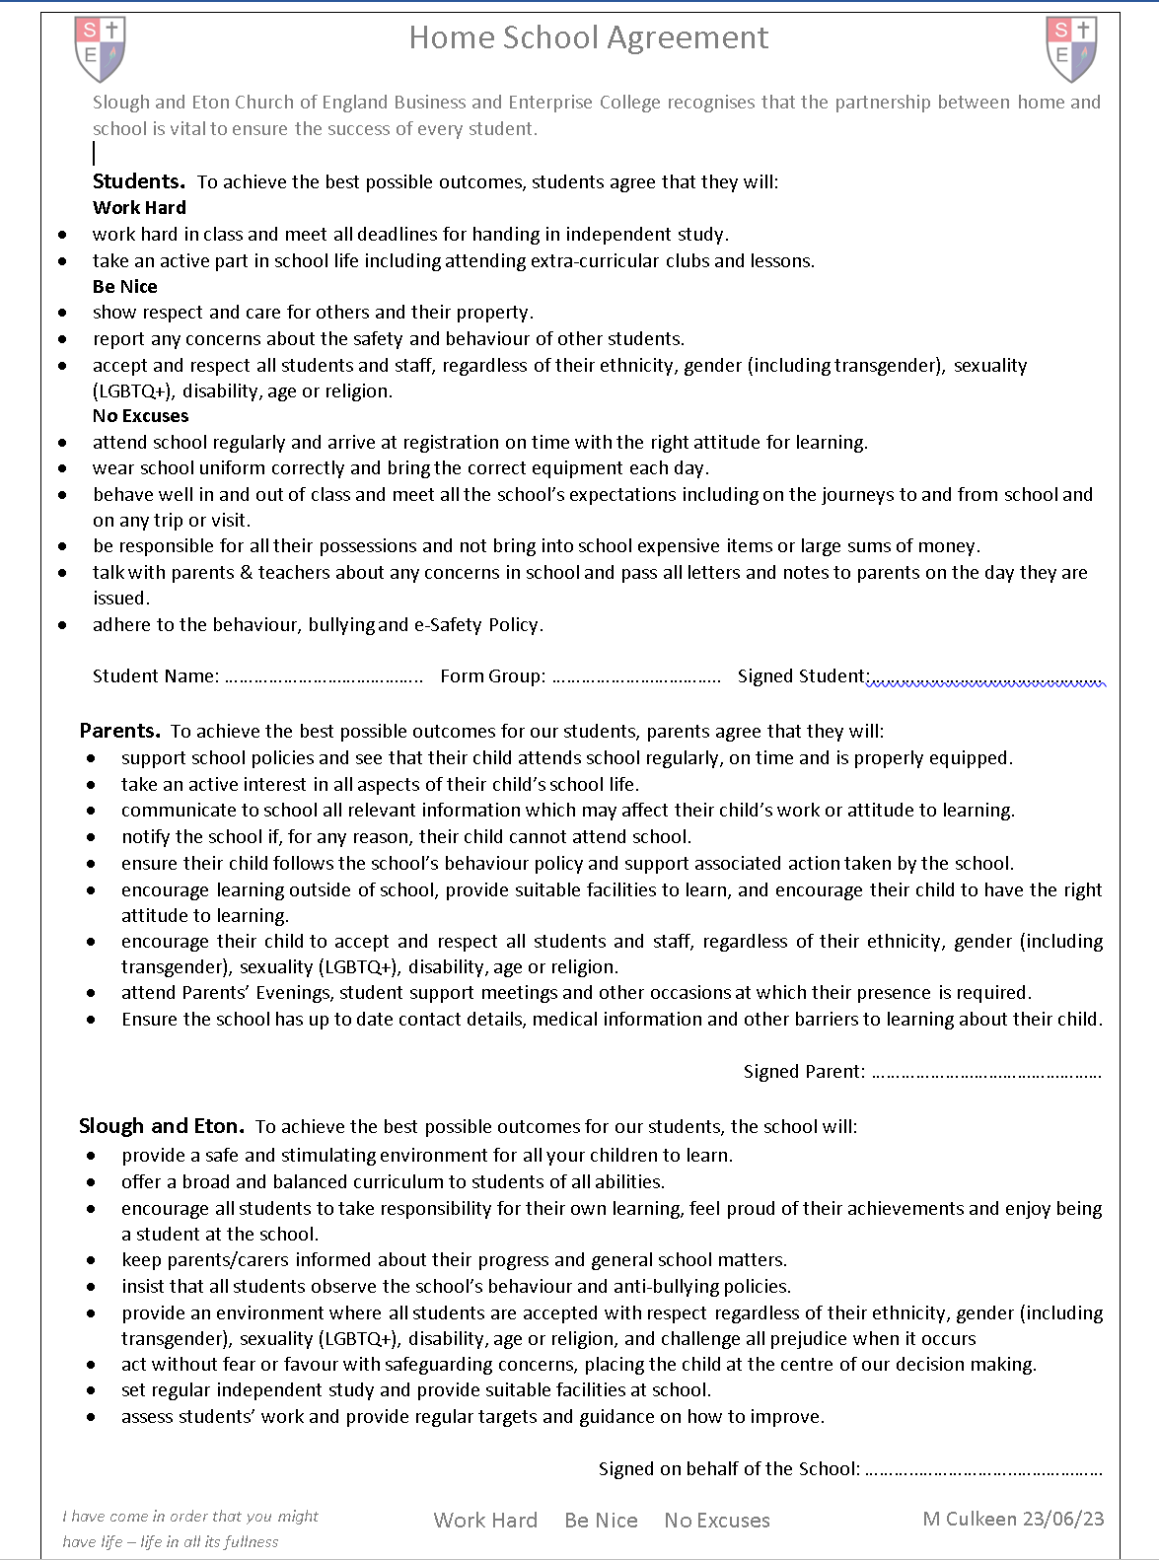
Home School Agreement
This agreement will be distributed in September. The goal to establish positive relationships and ensure that expectations are understood by all so that we can help your child achieve the best possible outcomes.
You can also see a copy in the Transition Booklet or on our website.

Slide 36
Rewards
Positive points accumulate and can be used for rewards.
Certificates
Student positions of responsibility
Text messages and postcards home
Headteacher’s Commendations
Reward Events (in and outside of school) such as the Big Bash
Prizegiving
Notes:
What is the classchart reward bit

Slide 37
Eating at Slough and Eton
We are a healthy eating school.
Wide variety of food available at lunch.
Restaurant opens at 8:00 am, serving a healthy, free breakfast (cereal, toast, tea, coffee).
We are a chewing gum free site. No chewing gum anywhere, anytime at school.

Slide 38
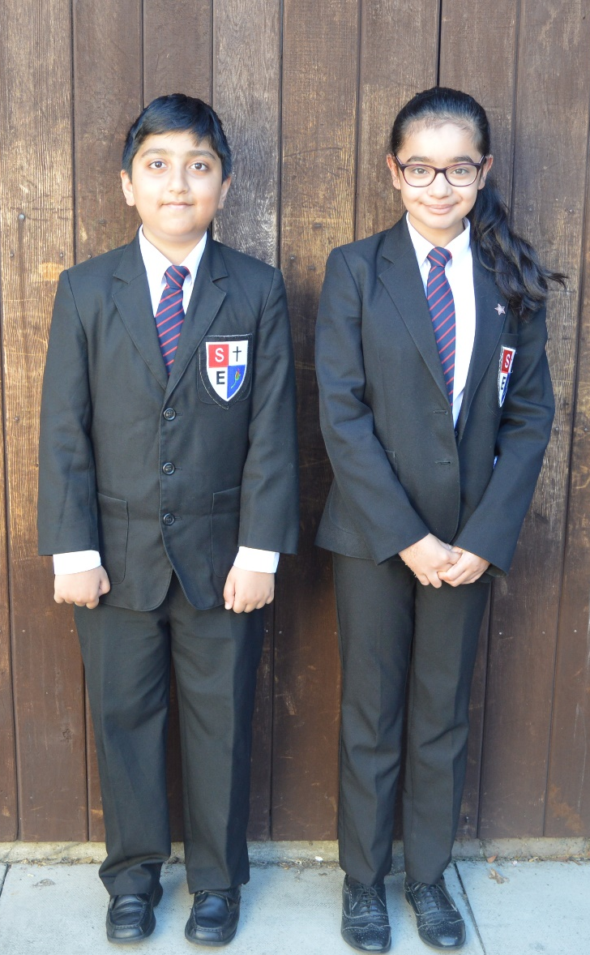
Uniform
Black blazer with School Badge
Black trousers or skirt
White shirt with collar
School House tie
Black V-neck jumper
Black formal shoes
Black or white hijabs
Black or white socks
School Badge £2.00
School Tie £5.25

Slide 39
Uniform/Haircuts/Makeup/Jewellry
We expect all students to maintain a high standard of appearance.
Full school uniform should be worn each day including to and from school. Ties are required and shirts must be tucked in.
Jewellery is not permitted, except for one pair of plain studs or sleepers in ears and an analogue wristwatch.
No nail varnish or makeup is allowed.
Haircuts should be deemed appropriate for school by the Headteacher with no extremes of style (no patterns, lines or unnatural colours).

Slide 40

PE Kit
Available to order this evening in the Small Hall. You can also order from Aqua Uniforms in person or online. The summer polo shirts for hot weather during summer term are also available to order.
Notes:
Check prices

Slide 41
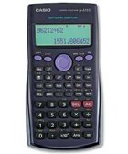



Equipment
Students must make sure that they have all the correct equipment everyday.
Students need to have their pencil case and reading book on the desk at the start of every lesson.
The Library is open for all year groups before and after school and at break and lunchtime.
We require all students to bring the following items to school each day:
Ruler | Rubber
Planner | Pencil
Reading book | Sharpener
Calculator/Maths kit | Pens (black and purple)

Slide 42
Enrichment and Extracurricular Activities
Student Leadership: Form Reps, Student Council, House Leaders
Afterschool clubs and provisions
Fixtures
Trips and visits
In school events
Enrichment day
Looking ahead to future years, Archibishop of York, Duke of Edinburgh, Work Experience…

Slide 43
Important Autumn dates
Monday, 7 September Welcome to Year 7 Parent Meeting
Tuesday, 22 September School photographs
Thursday, 1 October Meet the Tutor Evening from 4PM
Friday, 27 November School closed to students for inset
Friday, 18 December Last day of Autumn Term

Slide 44
Thank you for listening.
Transition
July 2026
Ms Brabants
Information Fayre Locations
Uniform information, purchase and ordering in the Small Hall
Supporting student reading in the Restaurant
Medical conditions/needs in the Restaurant
Attendance in the Restaurant
Wellbeing in the Restaurant
Free School Meals support in the Restaurant
Information on WEDUC in in the Restaurant
SEND/Mrs Sandhu in the Restaurant

