Slide 1

MONTANA ARMY NATIONAL GUARD
STEM/HOP Program
Montana Army National Guard
Sergeant Steve Weber
STEM/HOP Coordinator

Slide 2
STEM OVERVIEW
The Montana Army National Guard STEM program is a NO COST traveling program designed for High School Juniors and Seniors.
The STEM program helps teachers reinforce topics within their curriculum.

Slide 3
HOW IT WORKS
Teachers contact STEM presenter and together they schedule a presentation time for the classroom.
The STEM presenter brings all materials, equipment, and presents the chosen topic to the students.

Slide 4

zSpace
An Augmented Virtual Reality System that allows students to take the subject being viewed “off” the screen into 4D where it can be viewed in 360 as well as dissected in any manner.
This system has multiple subject areas such as Human Biology, Astronomy, Mechanics, Zoology, and Paleontology.
Click here to see our zSpace YouTube video!
https://youtu.be/tqocqNv9AXY

Slide 5
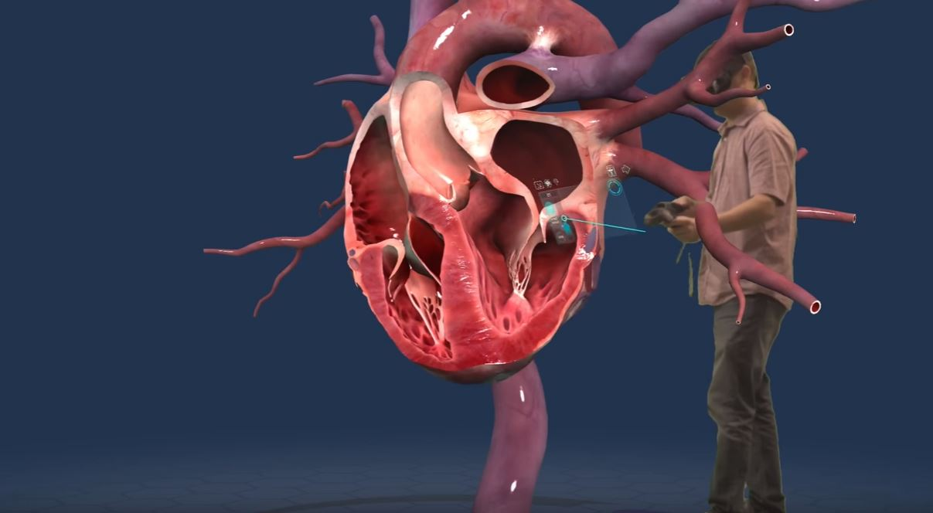
VIRTUAL REALITY
This Virtual Reality system allows students to view all the body systems and then focuses in on the bodies’ organs even allowing the students to see “inside” select organs.
Google Earth and several games allow different classroom options such as geography and computer technology classes..
Click here to see our VR YouTube video!
https://youtu.be/klsO36ZLHqM

Slide 6
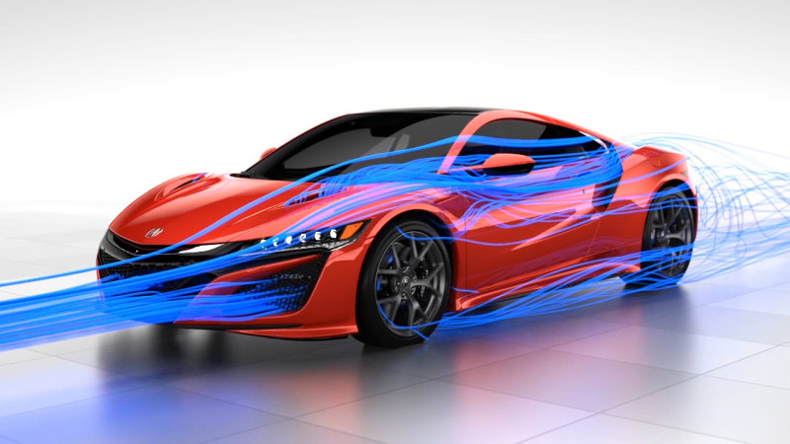
WIND TUNNEL
For Physics and Engineering types of classes, the wind tunnel shows the forces of air on Land and Areal vehicles.
This presentation covers areas of Bernoulli's Principle, Aerodynamics, and Drag Force.
Click here to see our Wind Tunnel YouTube video!
https://youtu.be/M7iEL_sZ3oU

Slide 7
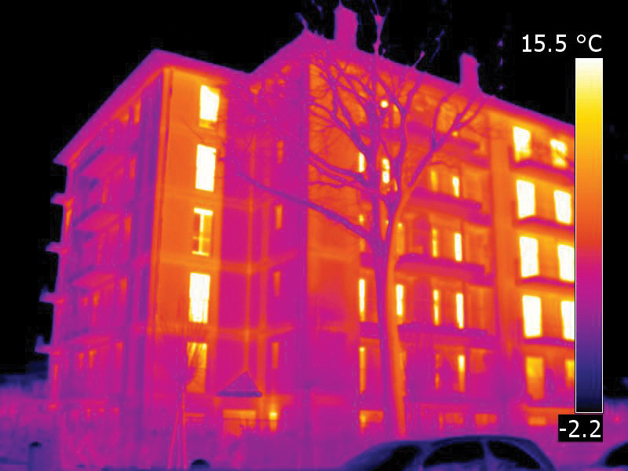
FLIR
The Forward Looking Infra Red, FLIR, Camera is a tool for classes such as Engineering and Physics to explore the world in regards to Temperature.
Discussion in structural issues in buildings as well as being able to “see” and discuss heat loss in building projects.
Click here to see our FLIR YouTube video!
https://youtu.be/8nXyse6y-_s

Slide 8
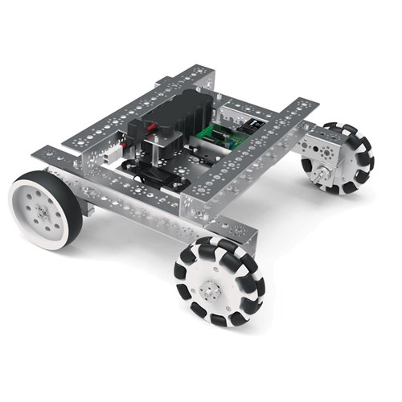
ROBOTICS
Engineering, Shop, and STEM types of classes use the Robots for a variety of different avenues.
Discussion for this presentation cover uses of Robots, building Robots, as well as hands on operation of our Robots.
Click here to see our Robotics YouTube video!
https://youtu.be/YSwbQTYUGjs

Slide 9
HISTORY OUTREACH PROGRAM
(HOP)
The Montana Army National Guard HOP program is another NO COST traveling program designed for High School Juniors and Seniors.
The HOP program helps teachers explore conflicts within our Nations History, with an interactive presentation!

Slide 10
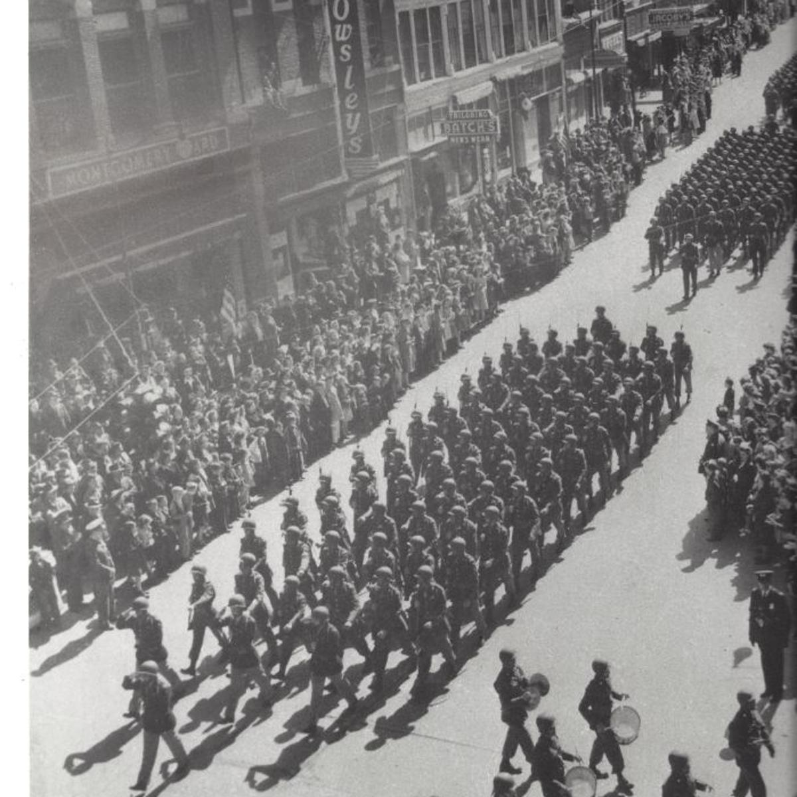
HOP
This program covers 4 of the major conflicts in our Nations History.
  War of 1812
  Civil War
  World War I
  World War II

Slide 11
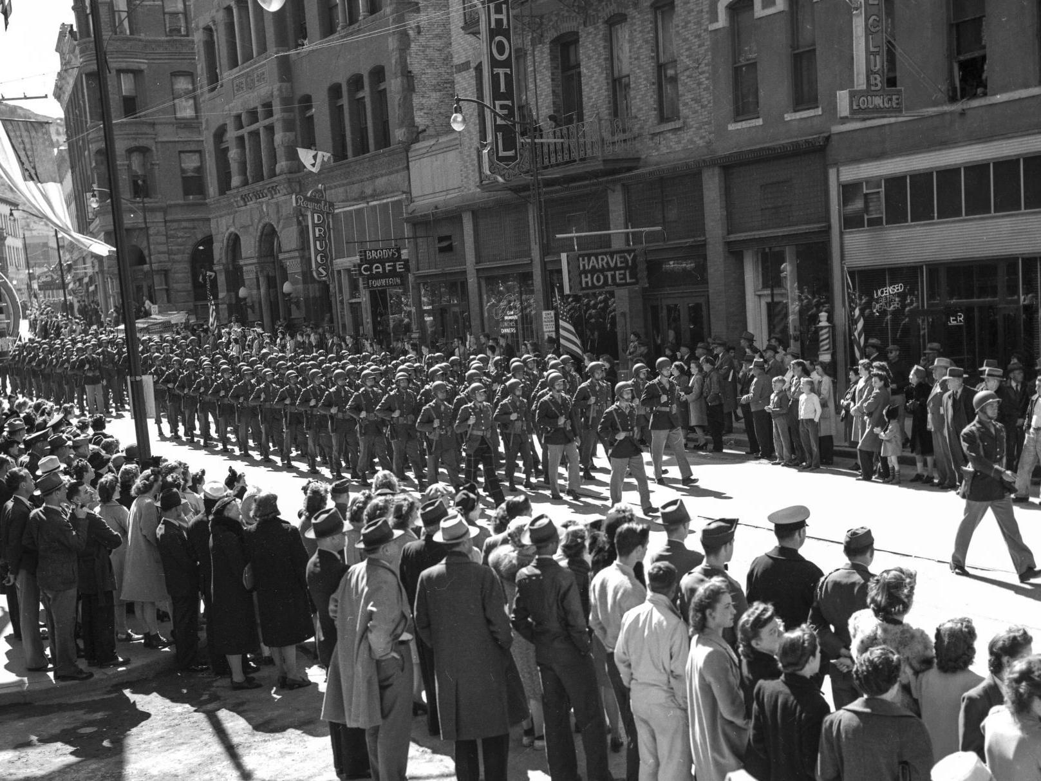
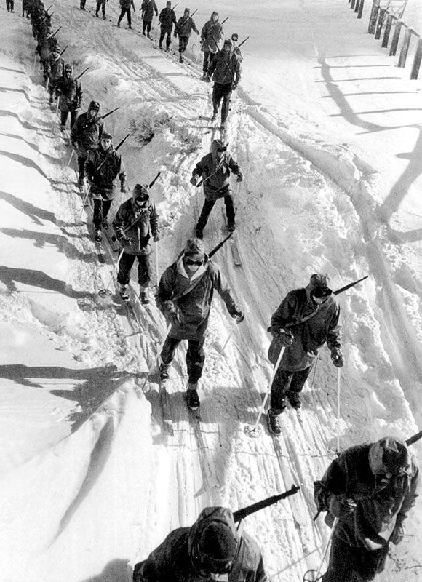
HOP
The presentation can be molded to what the class is covering at the moment.
  Introduction to the Event.
  Covering a specific battle or time within.
  Overview of the Conflict as a whole.
  ENDLESS POSSIBILITIES!

Slide 12
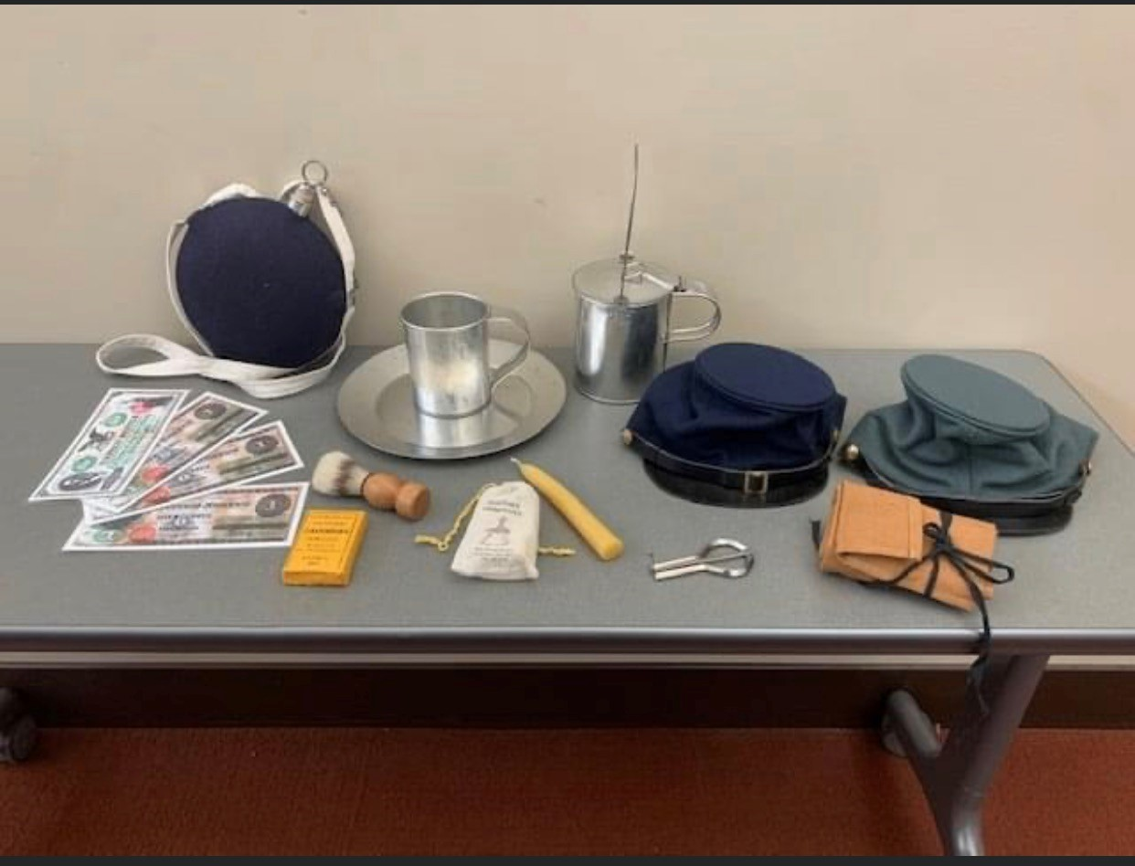
HOP
Each of the presentations has replica items relating to each time in history.
Allows students to hold History in their hands!

Slide 13
Wrap Up
Any one of the presentations can be 100% customized to what the class is working on at the time, making possibilities almost ENDLESS!
For any questions or further explanation into any one of the Presentations please let me know at the contact information below!

Slide 14
CONTACT INFORMATION
Sergeant Stephen Weber
Montana STEM/HOP Coordinator
Phone: 406.431.0603
Email: stephen.j.weber8.mil@army.mil

