Slide 1
Kindergarten School Readiness Assessment Tool Webinar
March 12, 2024

Slide 2
Assessment Review Timeline
Sept. 2022
Part I Letter of Intent to Apply
Oct. 2022
Stakeholder Feedback process on Application
Feb. 2023
Part II Assessment Review
Mar. 2023
Appeal Window
May 2023
Submission to the State Board of Education for approval
June 2023
Approved List of Kindergarten School Readiness Assessments Posted on Website
June 2022
PreK-K Assessment Alignment Project

Slide 3
Kindergarten School Readiness State Board of Education Approved List of Assessments.
Acadience Math K-6
Brigance Early Childhood Screens III
COR for Kindergarten
Desired Results Developmental Profile for Kindergarten (DRDP-K)
DIAL-4 Developmental Indicators for the Assessment of Learning
FastBridge earlyMath
FastBridge earlyReading
FastBridge SAEBRS
Istation's Indicators of Progress (ISIP)
North Carolina Kindergarten Entry Assessment

Slide 4
Responsibilities Identified in the Colorado Revised Statutes
Responsibilities of the State Board of Education
Adopt a description of school readiness,
Adopt one or more assessments,
Adopt a system for reporting population-level results, and
On or before July 1, 2017, and every six years thereafter:
  review the school readiness description and adopt any appropriate revisions, and
  review the school readiness assessments and adopt any appropriate revisions.
Responsibilities of the Local Education Providers
Administer an SBE-approved kindergarten school readiness assessment within the first 60 calendar days of the school year to each student in publicly funded kindergarten,
Ensure data is reported in the statewide Kindergarten School Readiness Data Collection, and
Ensure all children in publicly funded kindergarten receive an Individual Learning Plan with individual student goals informed by assessment data.

Slide 5

Objective
Provide an overview of resources and materials collected through the 2023 KSR Assessment Review Application Process that are available to support local selection of SBE-approved assessment tool(s).

Slide 6
Application Criteria and Submissions

Slide 7
Preschool to Post-Secondary Alignment: Colorado’s Achievement Plan for Kids
Assess developmental and academic domains. (C.R.S. 22-7-1004 (1)).
Assessment tools are to be research-based, reliable instruments and provide data to:
1) determine instruction and intervention (C.R.S. 22-7-1004 (2)(a)).
2) inform individual learning plans (school readiness plan or kindergarten plan) to document individual student needs and growth toward kindergarten standards (C.R.S. 22-7-1014 (1)(a)).
Data may not be used to deny a student admission or progression to kindergarten or first grade (C.R.S. 22-7-1004 (2)(a)).

Slide 8
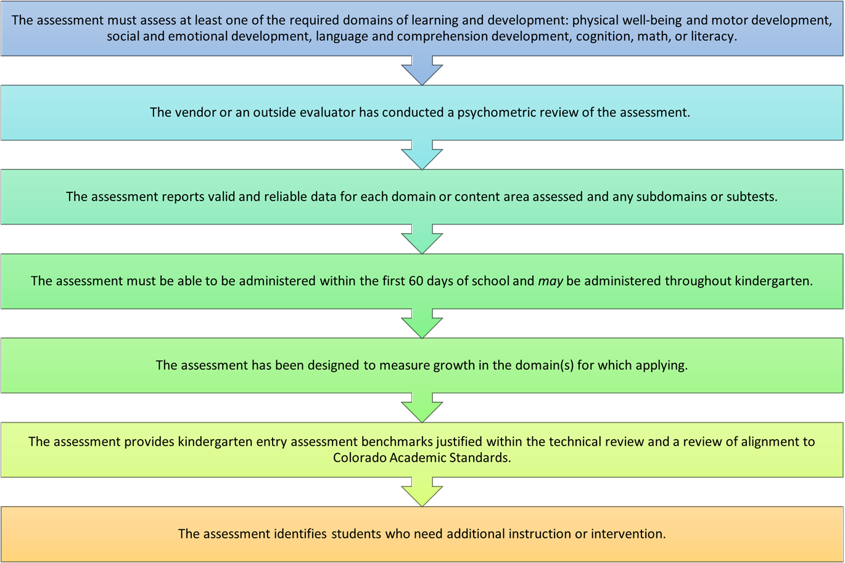
Application: Required Criteria

Slide 9
Application: Evaluation Criteria
Alignment to Colorado State Statute, including purpose of assessment and Colorado Academic Standards.
Comprehensive and accumulated evidence of reliability, scoring, and comparability.
Comprehensive and accumulated evidence of validity.
Comprehensive and accumulated evidence of standardization, feasibility, and efficiency of administration and scoring.
Comprehensive and accumulated evidence of accommodations for students with disabilities, students with special needs, and culturally representative content.

Slide 10
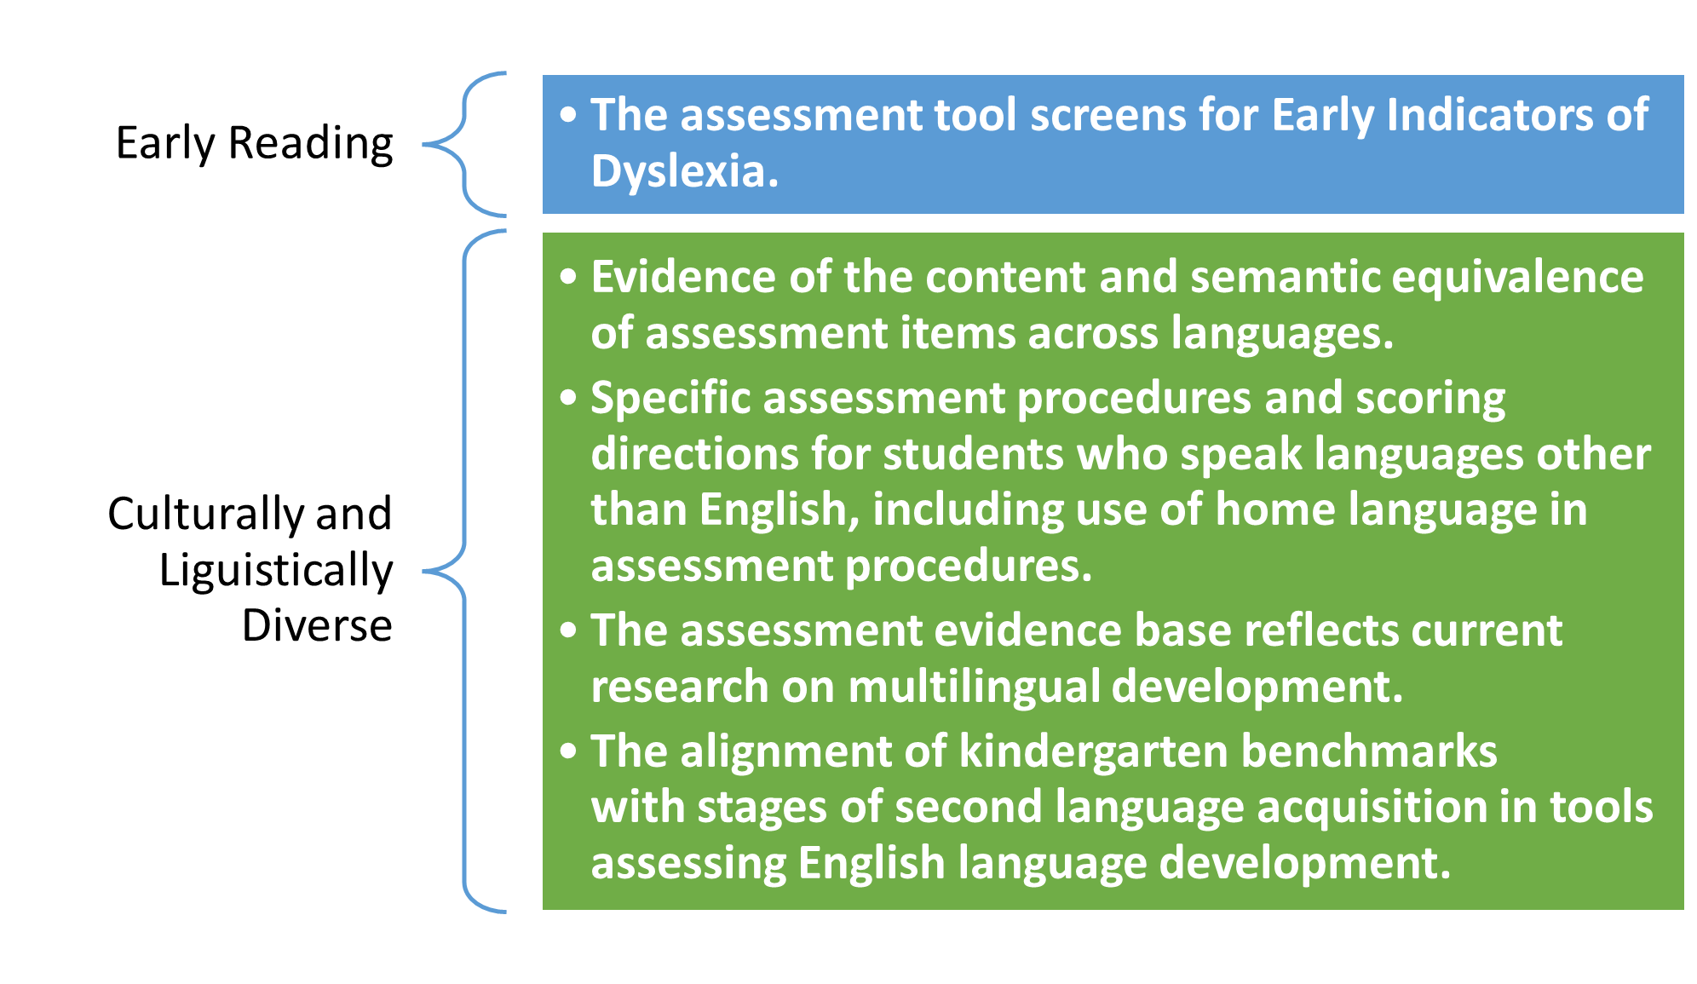
Application: Optional Criteria

Slide 11
11
Updates to the Assessment Review Process | Data Source
Standards-Assessment Correspondence Protocol Collected cost, duration, and frequency of required professional development, including IRR. External evaluation of technical merit. Optional process to demonstrate alignment to stages of second language acquisition | Pre-K to K Assessment Alignment Project Findings: CAS are well-aligned with national research. Consensus on correspondence between standards and assessment measures is difficult to achieve. Training for inter-rater reliability and assessing with fidelity differed by tool. Assessment must be valid and reliable for all students.
All new and currently approved vendors/researchers were required to reapply | The initial review of KSR assessment tools was in 2012.
Assessment tools must assess at minimum one required domain. | Systematic review of charter school waivers and partnership with the Schools of Choice Office.

Slide 12
Assessment Tool Resources
Required
Stated Purpose of Assessment
Assessment Administration Narrative
Assessment Reporting Narrative
Standards Correspondence Worksheet
Technical Evaluation of Assessment
Assessment Materials (not available online)
Optional
Cultural and Linguistic Diversity
Dyslexia Early Indicators of Risk

Slide 13
Resources to Support Selection

Slide 14
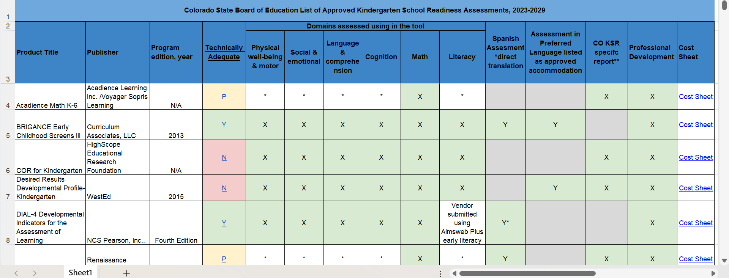
Crosswalk of Assessment Tools
www.cde.state.co.us/schoolreadiness/assessment

Slide 15
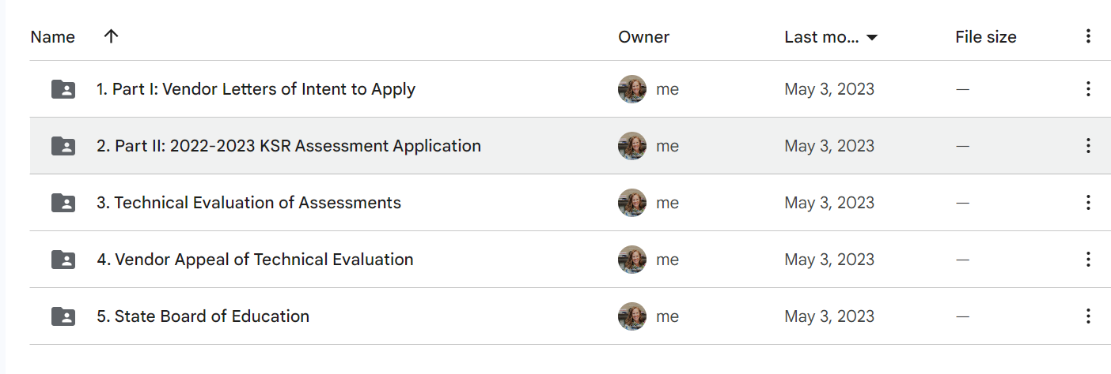
Google Folder
www.cde.state.co.us/schoolreadiness/2022ksrreview
drive.google.com/drive/folders/1qV5bBTl75RDsglgCKCK8S__NLuhLY-Ky?usp=sharing

Slide 16
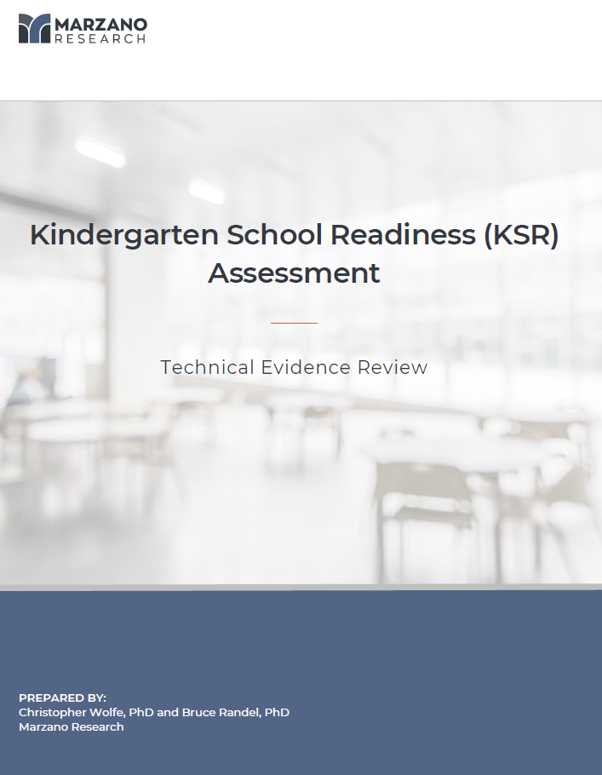
Vendor Application Requirement: Technical Evidence
Purpose: Provide additional rigor to the technical merit review process for each KSR assessment.
Reference the Marzano Research report for information on the technical strengths and weaknesses of each of the 11 assessments submitted to CDE as part of the application process to be reviewed for KSR assessment tools.

Slide 17
Technical review components
The assessments were reviewed against a 19-item technical review rubric.
Each assessment received an overall score for Technical Adequacy (Yes, Partially, No)
Technical Component | Reviewed for evidence of…
Reliability (Items 1-6) | This component examines the assessments normative characteristics, reliability of the items for test-retest and inter-rater reliability.
Validity (Items 7-11) | Does the assessment provide evidence that the items assess different domains? Is there evidence or research for the benchmarks the vendor has set?
Administration (Items 12-16) | Detailed information provided on administration and scoring, efficiency of administration and scoring
Cultural/Accommodations (Items 17-19) | Does the assessment include culturally representative content, accommodations for students with disabilities and special needs and ELLs

Slide 18
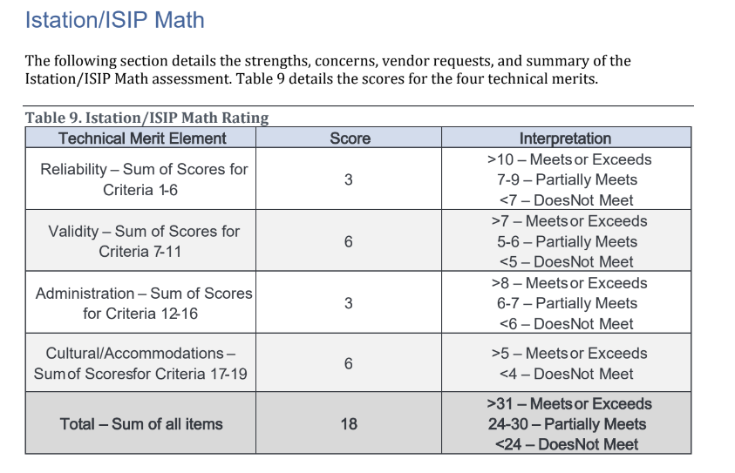
Example technical review: ISIP
Review the assessment’s “Strengths” and “Concerns” in the individual technical review report.
ISIP was found to be
  Low in reliability
  Low in administration
What does this mean?

Slide 19
Vendor Requirement: Item – Standard Correspondence
Step 1.
Review what children should know and do by the end of PK (CAS and CO ELDGs)
Step 2.
Identify BOY item benchmark and corresponding standard expectation/indicators
Step 3.
Identify EOY item benchmark and corresponding standard expectation/indicators
Suggested Guidance: Correspondence is defined by content and cognitive demand.
Content: the assessment item assesses content (what students are expected to know and be able to do) that is substantially like the content expected in the CAS and/or ELDGs.
Cognitive demand: a level of the assessment item substantially aligns to the cognitive expectation of the CAS or ELDG

Slide 20
Why is this important?
Colorado kindergarten school readiness (KSR) assessments
  assess the varying skill levels and knowledge with which students enter kindergarten (C.R.S. 22-7-1002 (2))
  inform individual learning plans for each publicly funded student (C.R.S. 22-7-1014).
KSR assessments measure students’ readiness to engage with the curricula in kindergarten by identifying baseline data to inform systematic intervention and additional layers of instructional support (Jensen, et al., 2021).
Assessments K-12
Assessments K
Assessments pre-K
Standards pre-K
Curriculum pre-K
Standards K
Curriculum K
Standards K-12
Curriculum K-12

Slide 21
Establishing the correspondence process
Based on the work of five State Assessment Review Panels
Language and Literacy
Math
Physical Health and Development
Social Emotional Development
Approaches to Learning
All panels had 7-8 panelists and one national expert advisor (37 panelists)
3 virtual meetings

Slide 22
Finding the correspondence worksheets for each assessment
Part II Applications
Assessment Applications
Choose the assessment
Correspondence Excel

Slide 23
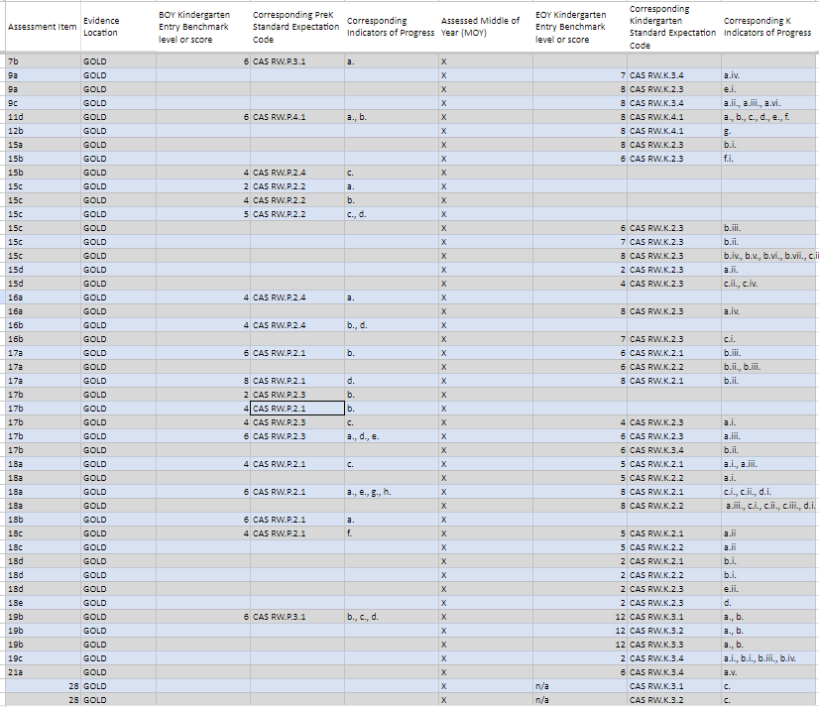
Using the Vendor Correspondence Worksheets
Example: TSG Gold Literacy Items and CAS PK – K Standards
22 Literacy assessment items
BOY
  Gold Literacy Items address 6 PK standard expectations
EOY
  Gold Literacy Items address 8 K standard expectations

Slide 24
Example: Does TS Gold assess phonological awareness?
Worksheet Assessment Item 15c – CAS RW.P.2.2 (a.b.c.d.)
Preschool Learning and Development Expectation:
Phonological awareness is the building block for understanding language.
LDE Code: RW.P.2.2
Indicators of Progress
By the end of the preschool experience (approximately 60 months/5 years old), students may:
Identify and discriminate between words in language.
Identify and discriminate between separate syllables in words.
Identify and discriminate between sounds and phonemes in language, such as attention to beginning and ending sounds of words and recognition that different words begin or end with the same sound.
Recognize patterns of sounds in songs, storytelling, and poetry through interactions and meaningful experiences.

Slide 25
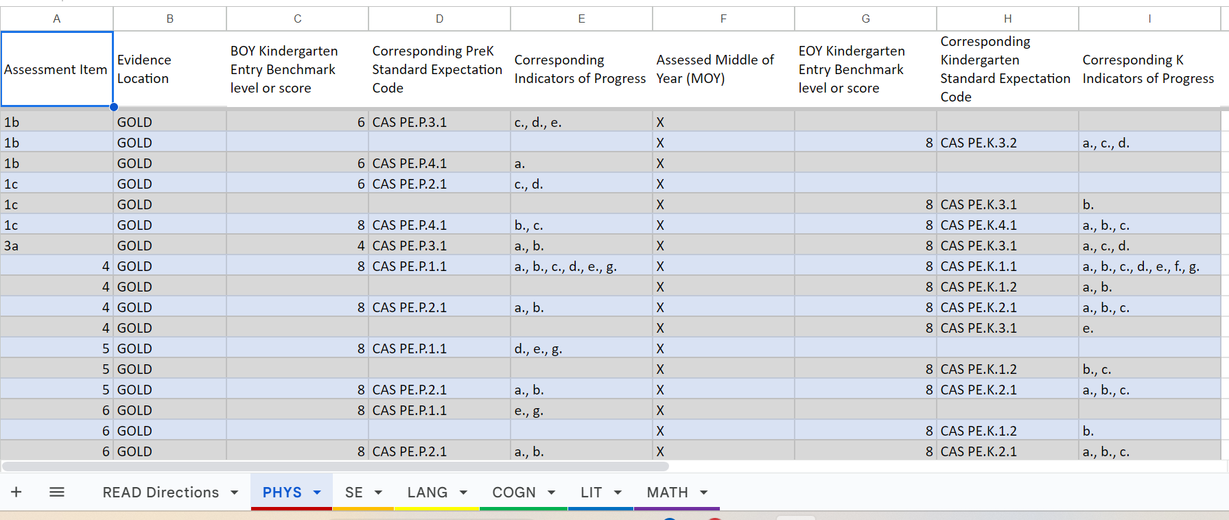
Assessment Correspondence Worksheet

Slide 26
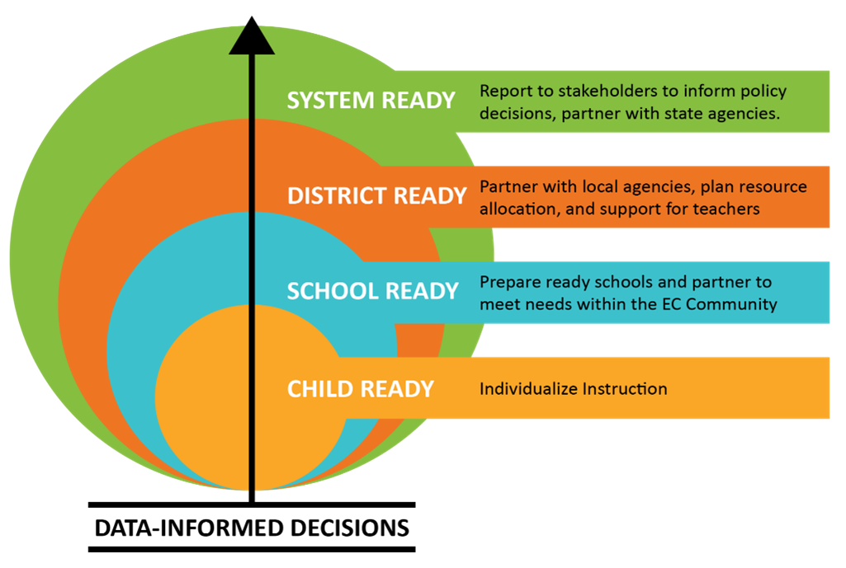
Assessment Data Use
To inform statewide progress toward school readiness, the kindergarten school readiness assessment informs:
individual kindergarten readiness plans and classroom instruction;
families of their child’s progress toward school readiness; and
reporting to the legislature and public through this CAP4K report.
Data may not be used to deny a student admission or progression to kindergarten or first grade (C.R.S. 22-7-1004 (2)(a)).

Slide 27
Q&A

