Slide 1
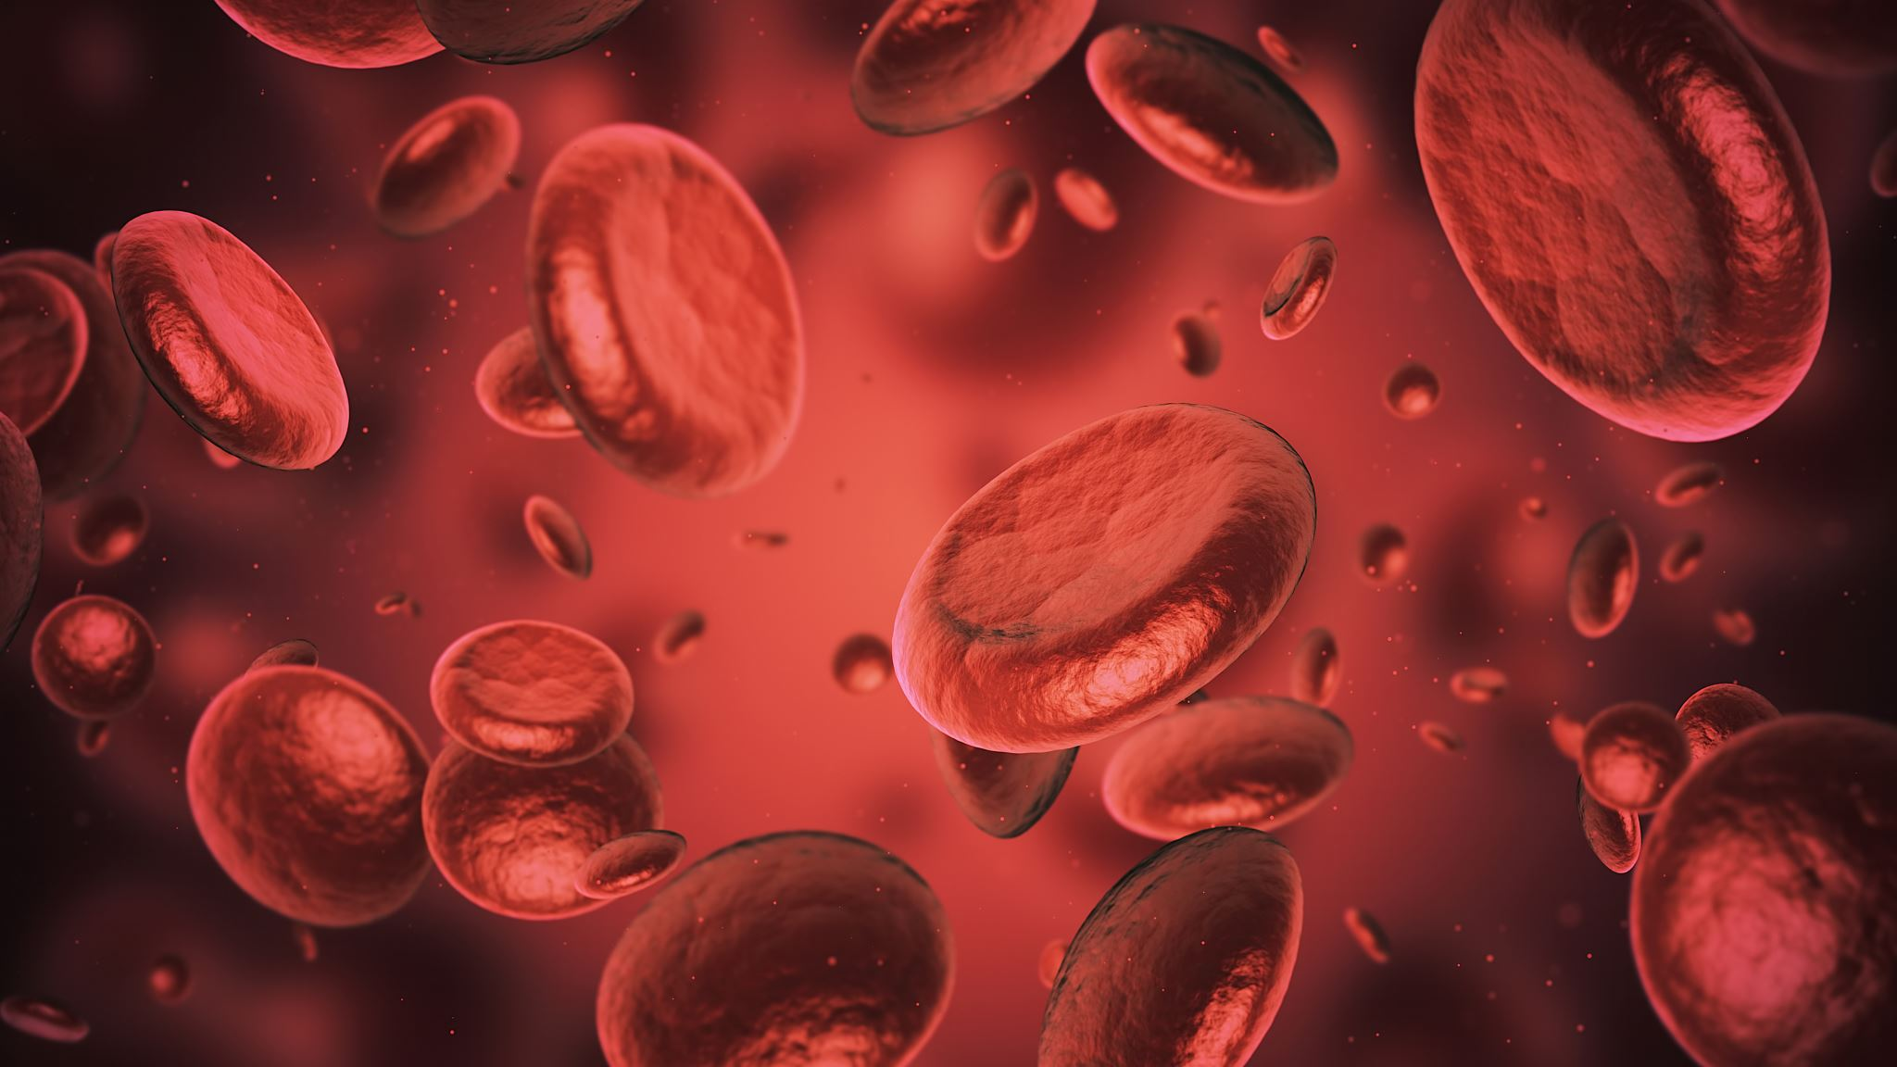
Blood-Born Pathogens
BBP

Slide 2
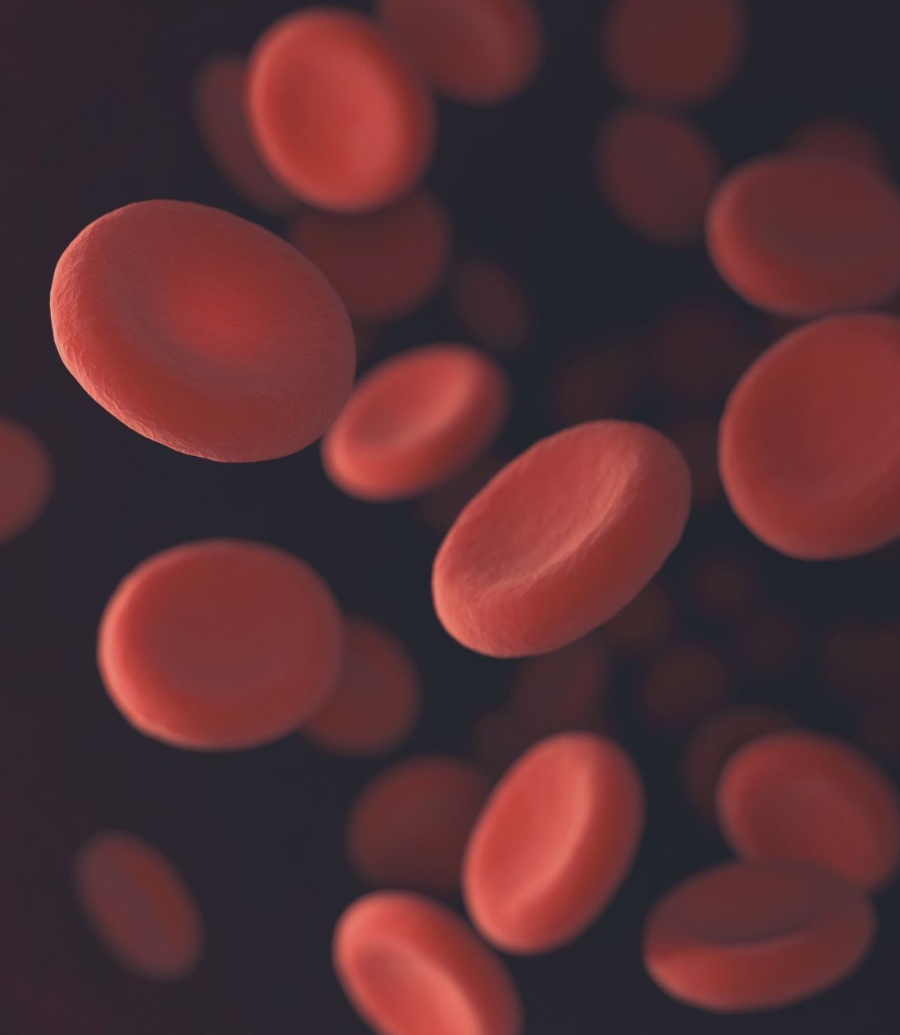
Bloodborne Pathogens
The most common meaning of BBP is Bloodborne Pathogens. It refers to infectious microorganisms in human blood that can cause diseases in humans, such as HIV, Hepatitis B, and Hepatitis C.

Slide 3
What are the symptoms of BBP
Many people with bloodborne pathogens (BBPs) have no symptoms at all for months or even decades. When symptoms do appear, they depend entirely on the specific virus contracted.

Slide 4
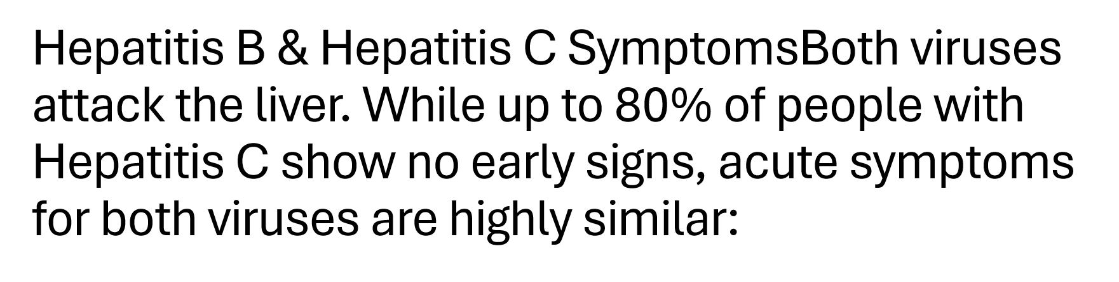

Slide 5
Hepatitis B & C Symptoms when showing
Jaundice: Yellowing of the skin and the whites of the eyes
Gastrointestinal issues: Nausea, vomiting, and loss of appetite
Abdominal pain: Especially in the upper right side near the liver
Altered waste appearance: Dark, tea-colored urine and light, clay-colored stools
Systemic symptoms: Extreme tiredness, low-grade fever, and joint or muscle pain

Slide 6
HIV Symptoms
Early Stage (2 to 4 weeks after exposure): Flu-like symptoms including fever, chills, night sweats, sore throat, severe fatigue, swollen lymph nodes, muscle aches, and a temporary skin rash.
Chronic/Asymptomatic Stage (Can last 10+ years): The virus multiplies quietly; people usually look and feel completely healthy, though they can still transmit the virus.
Late Stage (AIDS): Severe immune deficiency leading to rapid weight loss, chronic diarrhea, mouth or genital ulcers, prolonged fevers, recurring night sweats, and susceptibility to rare, serious infections.

Slide 7
In conclusion
If you have sustained a needlestick injury, or if potentially infected blood has entered an open wound or splashed into your eyes, nose, or mouth, seek immediate medical evaluation. Healthcare providers can administer Post-Exposure Prophylaxis (PEP) to significantly lower the risk of permanent infection.

