Slide 1


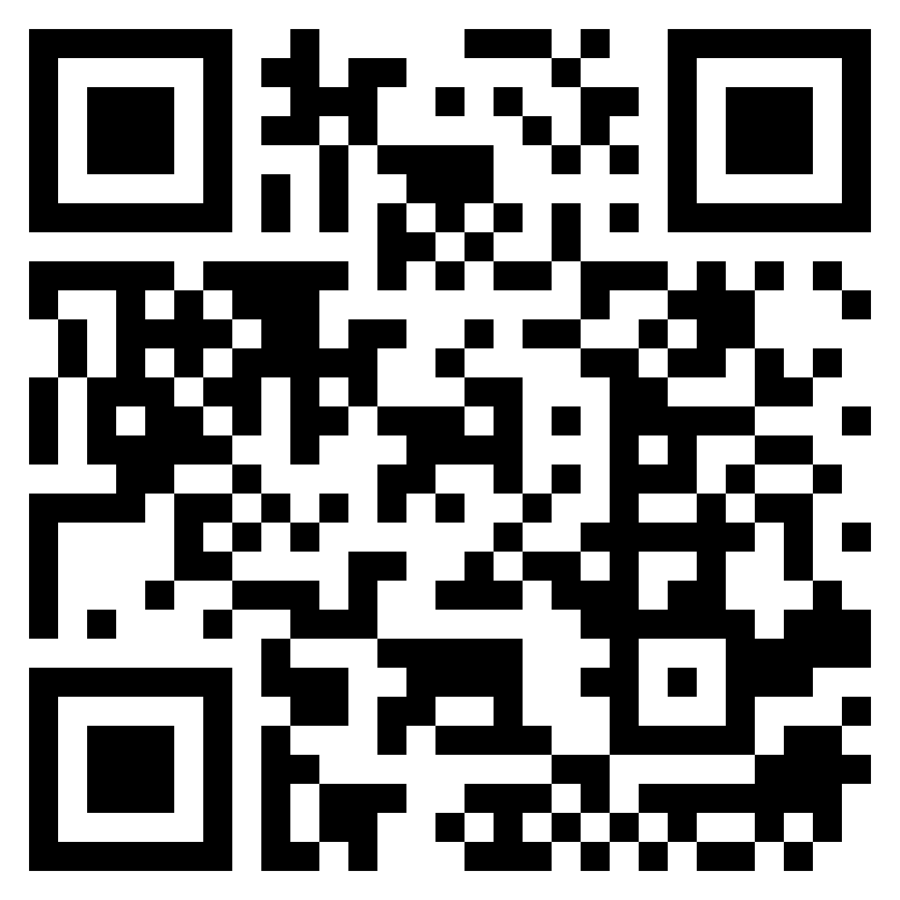
KiDS CHOICE
Kolter elementary
Kids Choice After School Basketball Through Kids Choice basketball, students will learn fundamentals of the game along with increasing dribbling skills and shooting skills that are vital to the game. Students will participate in shooting games and basketball games in the Kolter Gym. But most importantly, students will have fun!
Basketball
Grades 2-5: 3:05-4:00pm
Tuesdays // $250 13 Sessions: August: 25
September: 1, 8, 15, 22, 29
October: 6, 13, 20, 27
November: 3, 10, 17
December: 1 Make up day
Scan for more info & sign up!
KiDS CHOICE
Kolter elementary
Kids Choice After School Basketball Through Kids Choice basketball, students will learn fundamentals of the game along with increasing dribbling skills and shooting skills that are vital to the game. Students will participate in shooting games and basketball games in the Kolter Gym. But most importantly, students will have fun!
Basketball
Grades 2-5: 3:05-4:00
Tuesdays // $250 13 Sessions: August: 25
September: 1, 8, 15, 22, 29
October: 6, 13, 20, 27
November: 3, 10, 17
December: 1 Make up day
Scan for more info & sign up!

