Slide 1

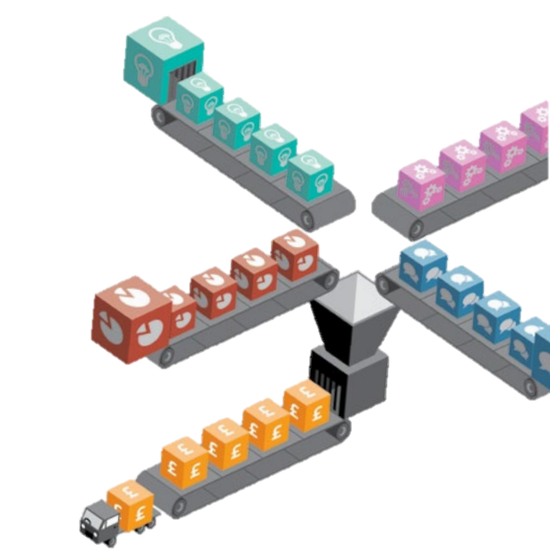
Welcome to
A-level
Business

Slide 2
Why study A-Level Business?
Whatever higher education course or career you go into, the business environment will always have an impact.
We explore current topics from the news and examples from real-life business to help you put the impact of the external environment into context
We touch on many other subjects such as Politics, Economics, Social Sciences, Geography, I.T. and Law when analysing a business’s strategic position, so this course compliments many others!
You will develop real-world knowledge and practical skills to analyse data, think critically about issues and make informed decisions – all of which are essential for higher education and employment.

Slide 3
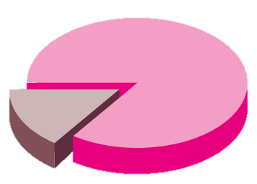




Did you know?
Business qualifications are associated with strong employment rates and earning potential, and many career paths offer clear opportunities for advancement.
Business is in the top ten of A-Level subjects studied in the U.K. and is the most popular university subject, with 20% of all students taking related courses.
Universities often have strong links with businesses, offering opportunities like work placements and challenges that can help students secure jobs after graduation.
Notes:
Figures from 2023

Slide 4
A-Level Business career pathways
Marketing management
Operations management
Human Resources management
Project management
Retail management
Office management
Market analyst
Financial analyst
Accountancy
Banking
Entrepreneurship
Practically anything!

Slide 5

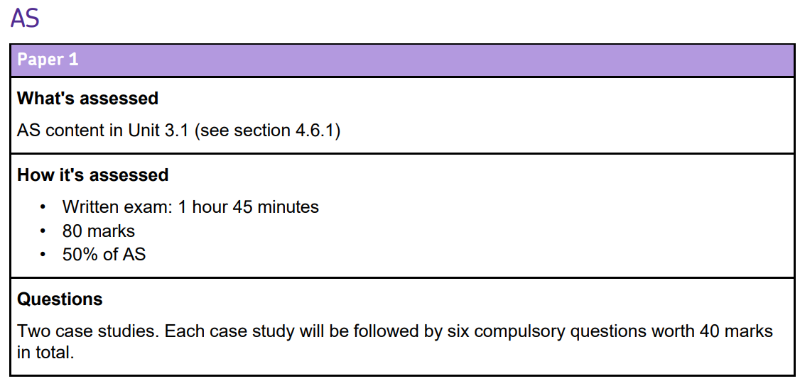
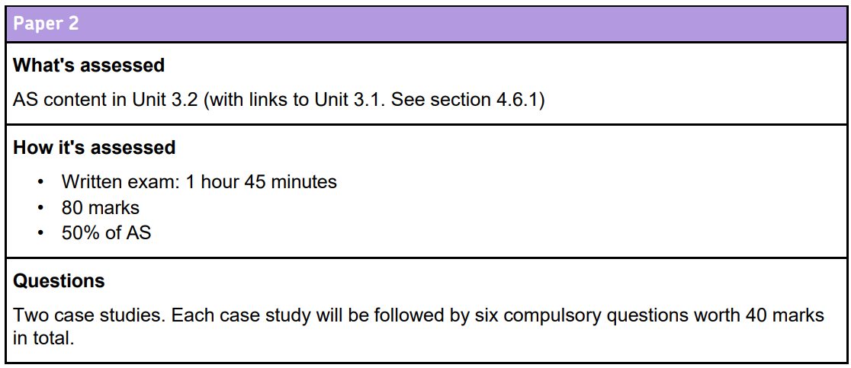

Course assessment – AS
)

Slide 6
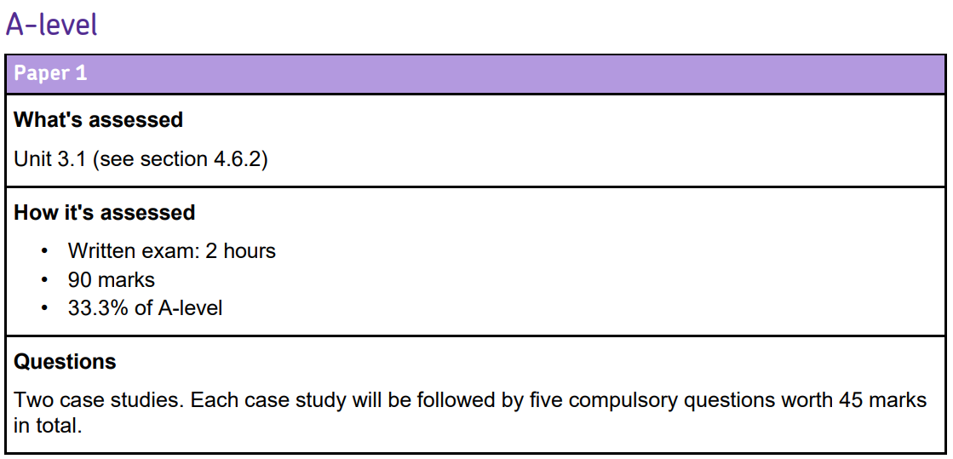
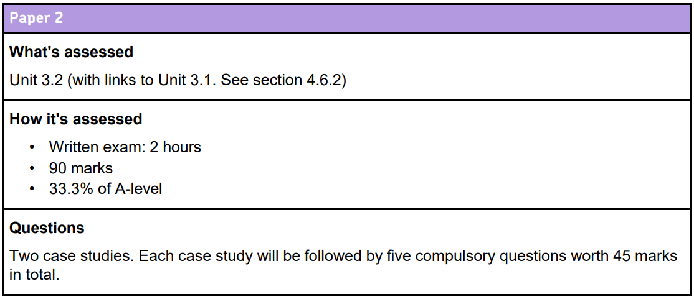
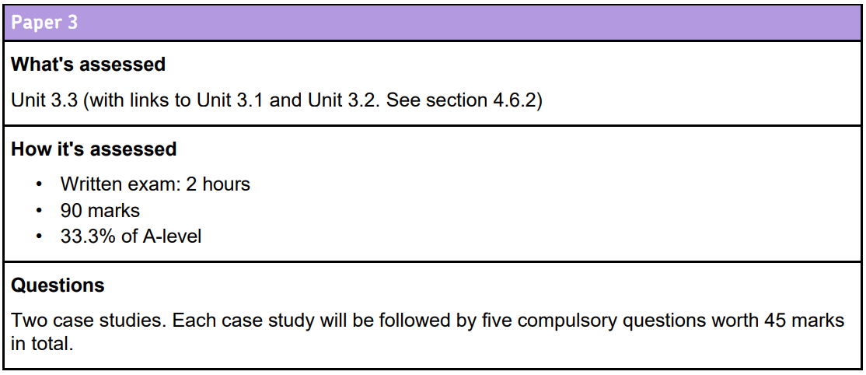
Course assessment – A2
)
)

Slide 7
Course content
AS – Year 12
3.1: What is business? Managing marketing and finance
Business planning, decisions and objectives
Forms of business and stakeholders
Marketing management (incl. digital and AI marketing)
Financial management (incl. accounting & financial analysis)
3.2: Managing people and operations
People management (incl. leadership styles & motivation)
Operations management (incl. efficiency & supply chains)

Slide 8
Course content
A – Year 13
3.1: What is business? Managing marketing and finance
As per year 12 but including ethics in finance
3.2: Managing people and operations
As per year 12 but including managing business culture
3.3: Business and society, business and the external environment, and business strategy
Business and society (incl. sustainability, CSR & ESG)
Business and the external environment (PESTLE & competitive)
Strategy (incl. selection, implementation & digital strategy)
Change (incl. reasons, risks and uncertainties)
Notes:
CSR = corporate social responsibility
ESG = Environmental, Social and Governance

Slide 9

In summary
Entry requirements
Maths and English Grade 6 or above
If you have studied GCSE you must have also gained Grade 6 or above.
The course requires application of theory, critical analysis of complex case studies and financial calculations. Therefore essay writing and mathematical skills are essential.
We cover a wide range of topics including gaining an understanding of the political, social and technological environment in which businesses operate.
Real business examples are used both in class and in the exam, so self-study and reading around the subject are key to success.
We aim to have visiting speakers from businesses to offer real-world examples and experience.
It doesn’t matter if you haven’t studied business before as long as you have an interest to learn. Everything is taught so that all can achieve.

