Slide 1


Welcome to
BTEC level 3
Extended Certificate
in Business

Slide 2
Why study BTEC Business?
Whatever career you go into, the business environment will always have an impact.
This certificate carries the equivalent UCAS points of an A-Level: Distinction* (A*), Distinction (A), Merit (C) and Pass (E)
Students achieving Distinction or above can (and do) go on to study business at university.
We study a range of topics, including key business functions such as marketing, personal and business finance, and innovation.
There are 2 coursework modules and 2 exam modules. We take one of each module in both years, spreading the load more evenly rather than all the pressure being on the big final exams in Year 13.

Slide 3
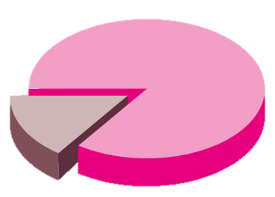




Did you know?
BTECs provide a route into university for one in four student entrants from England.
The majority of Level 3 BTEC students who graduate from university gain at least a 2:1, demonstrating that these qualifications lead to university success.
50% of students with a level 3 BTEC qualification successfully pursue apprenticeships. 81% of level 3 students gain successful employment.
January 2022
October 2023

Slide 4
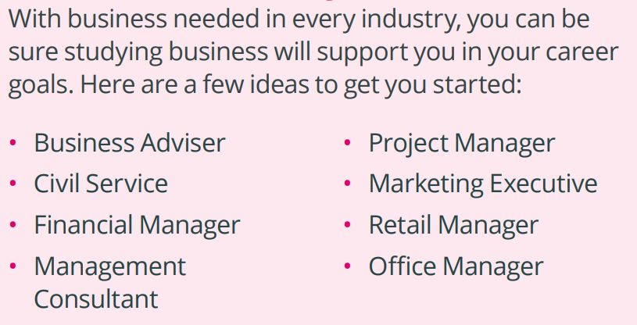
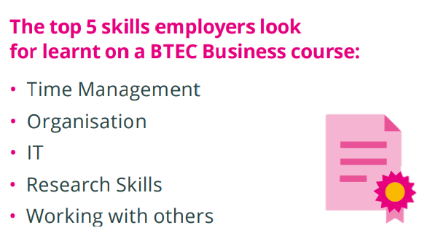
BTEC Business career pathways

Slide 5

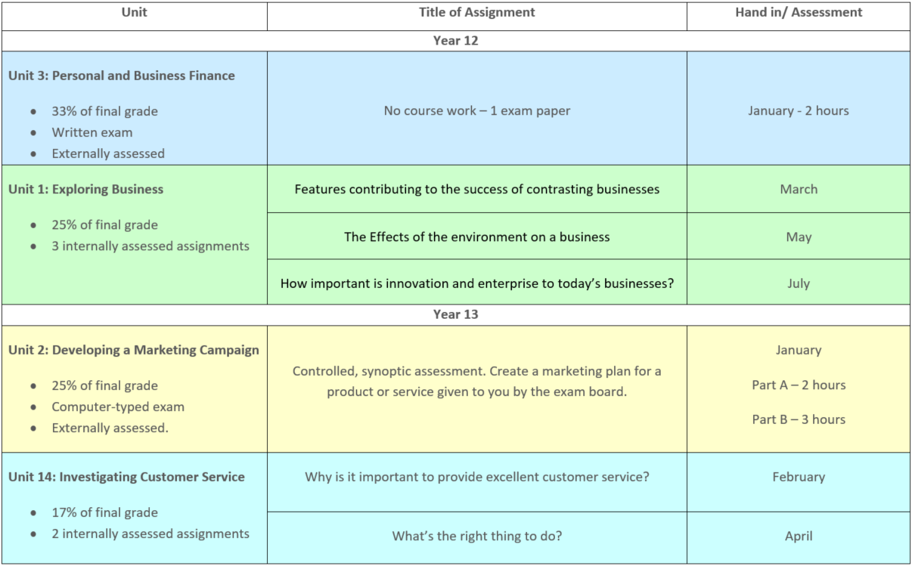
Course outline

Slide 6
Course content
Unit 1: Exploring Business
In this unit, learners study the purposes of different businesses, their structure, the effect of the external environment, and how they need to be dynamic and innovative to survive.
Learning aims
Explore the features of different businesses and analyse what makes them successful
Investigate how businesses are organised
Examine the environment in which businesses operate
Examine business markets
Investigate the role and contribution of innovation and enterprise to business success

Slide 7
Course content
Unit 2: Developing a Marketing Campaign
Learners will gain skills relating to, and an understanding of, how a marketing campaign is developed, from identifying the rationale, to creating a persuasive marketing plan.
Learning aims
Introduction to the principles and purposes of marketing that underpin the creation of a rationale for a marketing campaign
Using information to develop the rationale for a marketing campaign
Planning and developing a marketing campaign

Slide 8
Course content
Unit 3: Personal and Business Finance
Learners study the purpose and importance of personal and business finance. They will develop the skills and knowledge needed to understand, analyse and prepare financial information.
Learning aims
Understand the importance of managing personal finance
Explore the personal finance sector
Understand the purpose of accounting
Select and evaluate different sources of business finance
Break-even and cash flow forecasts
Complete statements of comprehensive income and financial position and evaluate a business's performance

Slide 9
Course content
Unit 14: Investigating Customer Service
Learners will study how excellent customer service contributes to business success. The unit gives learners the opportunity to develop their customer service skills.
Learning aims
Explore how effective customer service contributes to business success
Investigate the methods used to improve customer service in a business
Demonstrate customer service in different situations, using appropriate behaviours to meet expectations

Slide 10
In summary
Entry requirements
5 GCSE’s grade 4 or above.
If you have studied Business at level 2/ GCSE we would expect you have gained a Merit or grade 6.
BTEC Business offers a mix of coursework and exam based assessment.
We use computers to conduct research about real businesses and to write assignments
We also visit real businesses to gain insight and evidence towards assignments
We teach you how to research and reference sources accurately, which develops great skills that are essential for university and valued by employers.
It doesn’t matter if you haven’t studied business before, everything is taught so that all can achieve!

