Slide 1

ED 506 Form Webinar
SY 2021-22
Call In #: 1-844-419-4704
Conference Code #: 1441303097#
This webinar will begin at 2:00pm ET
Office of Elementary and Secondary Education
United States Department of Education
TODAY’S EVENT WILL BEGIN SHORTLY
Notes:
Alec:
Hello everyone, if you are looking to join the ED 506 Form Webinar, you are in the right place. We’re going to wait a few more minutes to allow people to join and then go ahead and get started! If you would like to dial in to today’s webinar and not through your computer, please use the call-in number and conference code displayed on this slide. If you are not calling in to today’s meeting, please ensure your computer speakers are enabled to hear the audio for today’s presentation. If you have any issues while using Adobe Connect please contact PSC.
START PRESENTATION:
Hello everyone, thank you so much for your patience; we are going to go ahead and get started.
Welcome to the ED 506 Form Webinar for SY 2021-22. My name is Alec Walker and I support the Partner Support Center. I also have *Analyst Name* from PSC on the line, as well as some representatives from the Office of Indian Education *Introduce OIE Staff Members Present*, who will assist in answering questions.
The PowerPoint that we will review today, as well as the audio recording of today’s meeting will be available on the EASIE Community website. You can also contact the Partner Support Center to request a copy of these resources or guidance on how to access the Community site.

Slide 2
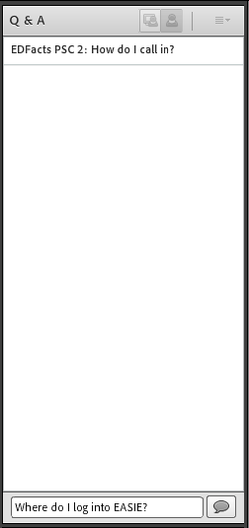
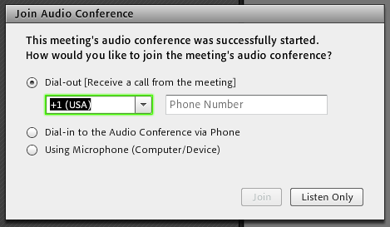
Webinar Housekeeping
1. Audio: Select dial-out and enter your cell phone or desk phone to receive a direct call for the meeting. Users can also dial in or use their computer speakers to hear audio by selecting Listen Only.
2. Submit questions and comments via the “Q&A” panel (see screenshot).
3. Today’s presentation is being recorded and will be posted to the EASIE Community of Practice Website.
U.S. Office of Indian Education (OIE) | ED 506 Form
Notes:
Alec:
To access audio for today’s webinar session, users can select dial-out and enter your cell phone or desk phone to receive a direct call for the meeting. Users can also dial in or use their computer speakers to hear audio by selection Listen Only.
If you would like to submit any questions or comments, please submit these via the “Q&A” panel available on your screen.
Please reference the screenshot provided to see how your chat panel should look when submitting questions or comments.
Please note: Today’s presentation is being recorded and will be posted to the EASIE Community of Practice website after completion.

Slide 3
Webinar Logistics
You are in listen-only mode
This webinar will be recorded
Use the Q&A panel for questions or comments during the presentation
U.S. Office of Indian Education (OIE) | ED 506 Form
Notes:
Alec:
All participants are in listen only mode. As a reminder, some questions sent through the Q&A panel may not be answered in real-time. This helps ensure OIE has proper time to research each individualized policy issue prior to providing a response. If your questions are not addressed during today’s webinar session, please contact PSC.

Slide 4
Agenda
Webinar Housekeeping/Logistics and Introductions
Eligibility for the Indian Education Formula Grants?
What is an ED 506 Indian Student Eligibility Certificate Form?
Locating the ED 506 Indian Student Eligibility Certificate Form
Information Requirements for the ED 506 Form?
When the Tribal Membership or Enrollment Number is Not Available, What Other Document(s) are Acceptable?
Completing Compliant ED 506 Forms
Ensuring Consistency in ED 506 Form Reviews
Questions & Answers
U.S. Office of Indian Education (OIE) | ED 506 Form
Notes:
Alec:
Today we will be reviewing the EASIE 506 Indian Student Eligibility Certificate form. Today we will review Webinar Housekeeping/Logistics and Introductions, Who is Eligible for the Indian Education Formula Grant Program, What is an ED 506 Indian Student Eligibility Certificate Form, Where to Find the ED 506 Indian Student Eligibility Certificate Form, What Information is Required for the ED 506 Form, If the Tribal Membership Enrollment Number is Not Available What Other Document(s) is Accepted, How to Complete ED 506 Forms, How to Ensure Consistency in Reviewing ED 506 Forms, and a Question & Answer. I will now be passing the presentation over to *OIE Analyst Name* from the Office of Indian Education.

Slide 5
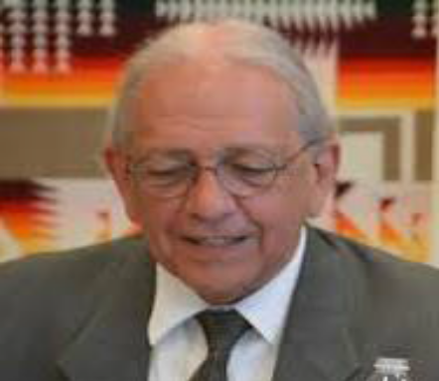
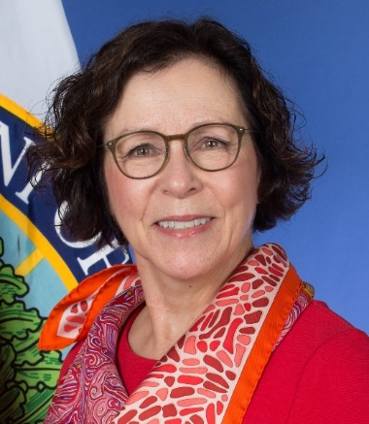
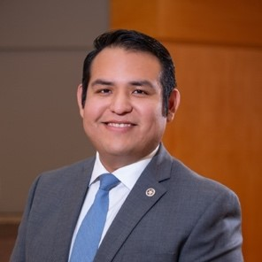

Leadership Staff
Ron Lessard (Mohawk)
Acting Executive Director for the White House Initiative on American Indian and Alaska Native Education
Ruth Ryder
Deputy Assistant Secretary for Formula Grants
Office of Elementary & Secondary Education
Julian Guerrero, Jr. (Comanche/
Kiowa)
Director,
Office of Indian Education, U.S. Department of Education
Dr. Crystal C. Moore (Choctaw)
Supervisory, Group Leader, Formula Team, Office of Indian Education, U.S. Department of Education
U.S. Office of Indian Education (OIE) | ED 506 Form
Notes:
Crystal:
I would first like to highlight the OIE Leadership Staff. We have:
Ron Lessard (Acting Executive Director for the White House Initiative on American Indian and Alaska Native Education),
Ruth Ryder (Deputy Assistant Secretary for Formula Grants Office of Elementary & Secondary Education)
Julian Guerrero, Jr. (Director, Office of Indian Education, U.S. Department of Education)
Dr. Crystal C. Moore (Supervisory, Group Leader, Formula Team, Office of Indian Education, U.S. Department of Education)

Slide 6




Introductions – OIE Formula Program Officers
Tawanda Avery, M.Ed.-SPED, Education Program Specialist
Tawanda.Avery2@ed.gov
Wanda Lee, M.Ed. (Lumbee)
Education Program Specialist
Wanda.Lee@ed.gov
Annabelle Toledo (Jemez Pueblo),
Education Program Specialist
Annabelle.Toledo@ed.gov
Dr. Marie Julienne,
Education Program Specialist
Marie.Julienne@ed.gov
U.S. Office of Indian Education (OIE) | ED 506 Form
Notes:
Crystal:
I would next like to highlight the OIE Formula Program Officers. We have:
Tawanda Avery
Wanda Lee
Annabelle Toledo
Dr. Marie Julienne

Slide 7
Who is Eligible for the Indian Education Formula Grant Program?
Children are eligible to receive services if they meet the definition of “American Indian” as defined in section 6151 of the ESEA and have a completed Indian Student Eligibility Certification Form, “ED 506 form”; or are included in an Indian School Equalization Program (ISEP) count.
American Indian defined in section 6151 of the ESEA is an individual who is:
A member of an Indian Tribe or Band, as membership is defined by the Indian Tribe or Band, including any Tribe or Band terminated since 1940, and any Tribe or Band recognized by the State in which the Tribe or Band resides;
A descendant of a parent or grandparent who meets the requirements described in paragraph (1) of this definition;
Considered by the Secretary of the Interior to be an American Indian for any purpose;
An Eskimo, Aleut, or other Alaska Native; or
A member of an organized Indian group that received a grant under the Indian Education Act of 1988 as it was in effect on October 19, 1994.
U.S. Office of Indian Education (OIE) | ED 506 Form
Notes:
Crystal:
Now we would like to review who is eligible for the Indian Education Formula Grant Program.
Children are eligible to receive services if they meet the definition of “American Indian” as defined in section 6151 of the ESEA and have a completed Indian Student Eligibility Certification Form, “ED 506 form” ; or are included in an Indian School Equalization Program (ISEP) count.
American Indian defined in section 6151 of the ESEA is an individual who is:
A member of an Indian Tribe or Band, as membership is defined by the Indian Tribe or Band, including any Tribe or Band terminated since 1940, and any Tribe or Band recognized by the State in which the Tribe or Band resides;
A descendant of a parent or grandparent who meets the requirements described in paragraph (1) of this definition;
Considered by the Secretary of the Interior to be an American Indian for any purpose;
An Eskimo, Aleut, or other Alaska Native; or
A member of an organized Indian group that received a grant under the Indian Education Act of 1988 as it was in effect on October 19, 1994.

Slide 8
What is an ED 506 Indian Student Eligibility Certificate Form?
An ED 506 [Indian Student Eligibility Certificate] Form is completed by parents or guardians to document eligible Indian students.
It serves as the official record of the eligibility determination for each child included in the student count.
An ED 506 form should be completed for each eligible student unless the student is included in an ISEP count at a Bureau-funded school.
Applicants should keep completed ED 506 forms readily available upon request from ED. Completers of the ED 506 forms should not send completed ED 506 forms to OIE, unless specifically requested.
U.S. Office of Indian Education (OIE) | ED 506 Form
Notes:
Crystal:
What is an ED 506 Indian Student Eligibility Certificate Form?
An ED 506 Form Indian Student Eligibility Certificate Form is a form completed by parents or guardians to document eligible Indian students. This form serves as the official record of the eligibility determination for each individual child included in the student count. An ED 506 form should be completed for each eligible student unless the student is included in an ISEP count at a Bureau-funded school. Applicants should keep completed ED 506 forms readily available upon request from ED. Completers of the ED 506 forms should not send completed ED 506 forms to OIE, unless specifically requested.

Slide 9
What is an ED 506 Indian Student Eligibility Certificate Form? (cont.)
An ED 506 Form must be completed, signed, and dated by the child’s parent to certify an Indian student’s eligibility for the program. A separate form is required for each child.
A new ED 506 Form does NOT have to be completed each year of enrollment in the LEA if a signed, completed form is on file and there is documentation that the student was enrolled during the count period.
Once a child is determined to be eligible to be counted for Title VI program services, the applicant shall maintain a record of such determination and shall not require a new or duplicate determination or form to be made for such child for a subsequent application for this grant.
U.S. Office of Indian Education (OIE) | ED 506 Form
Notes:
Crystal:
An ED 506 Form must be completed in full and signed and dated by the child’s parent to certify a student’s eligibility for the program. A separate ED 506 Form is required for each child.
A new ED 506 Form does NOT have to be completed each year of enrollment in the LEA if a signed, completed form is on file and there is documentation that the student was enrolled during the count period.
Once a child is determined to be eligible to be counted for a grant award, the applicant shall maintain a record of such determination and shall not require a new or duplicate determination or form to be made for such child for a subsequent application for this grant.

Slide 10
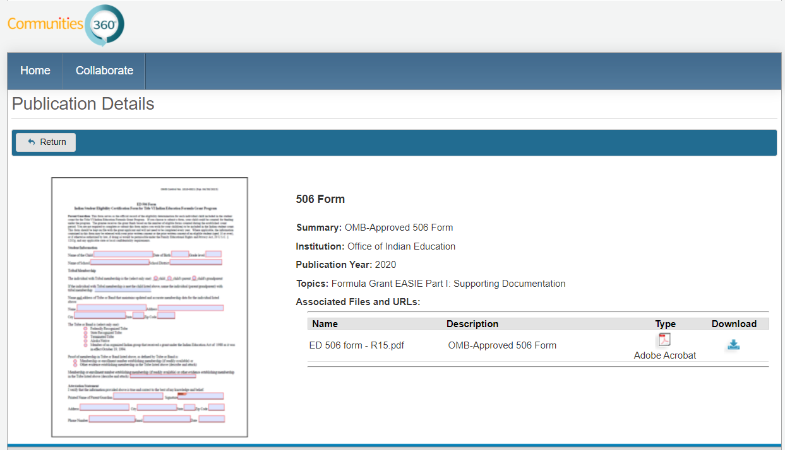
Where to Find the ED 506 Indian Student Eligibility Certificate Form
Can be downloaded on the EASIE Communities of Practice website Part I page: https://easie.grads360.org/#communities/pdc/documents/9670
Note! The ED 506 is a fillable electronic form and may not be altered in any way
U.S. Office of Indian Education (OIE) | ED 506 Form
Notes:
Tawanda:
Where to Find the ED 506 Indian Student Eligibility Certificate Form?
The ED 506 Form can be downloaded on the EASIE Communities of Practice website Part I page. The direct link to the form is present on the slide here.
Note! The ED 506 is a fillable electronic form and may not be altered in any way

Slide 11
Do Applicants Need to Have All ED 506 Forms Collected Before Applying?
Yes. All applicants using ED 506 Forms for Indian student counts are required to have a completed ED 506 Form(s) for students they are counting prior to the count period. The forms can be collected either by the LEA or the applicant.
U.S. Office of Indian Education (OIE) | ED 506 Form
Notes:
Tawanda:
Do Applicants Need to Have All ED 506 Forms Collected Before Applying?
Yes. All applicants using ED 506 Forms for Indian student counts are required to have a completed ED 506 Form(s) for students they are counting prior to the count period. The forms can be collected either by the LEA or the applicant.

Slide 12
Is the ED 506 Form the Only Way to Document Eligibility?
No. Bureau of Indian Education (BIE) schools may use either the Indian School Equalization Program (ISEP) count or the ED 506 Form count to verify their Indian student count. BIE schools that enter an ISEP count must use the most current Indian student count certified by the BIE.
U.S. Office of Indian Education (OIE) | ED 506 Form
Notes:
Tawanda:
Is the ED 506 Form the Only Way to Document Eligibility?
No. Bureau of Indian Education (BIE) schools may use either the Indian School Equalization Program (ISEP) count or the ED 506 Form count to verify their Indian student count. BIE schools that enter an ISEP count must use the most current Indian student count certified by the BIE.

Slide 13
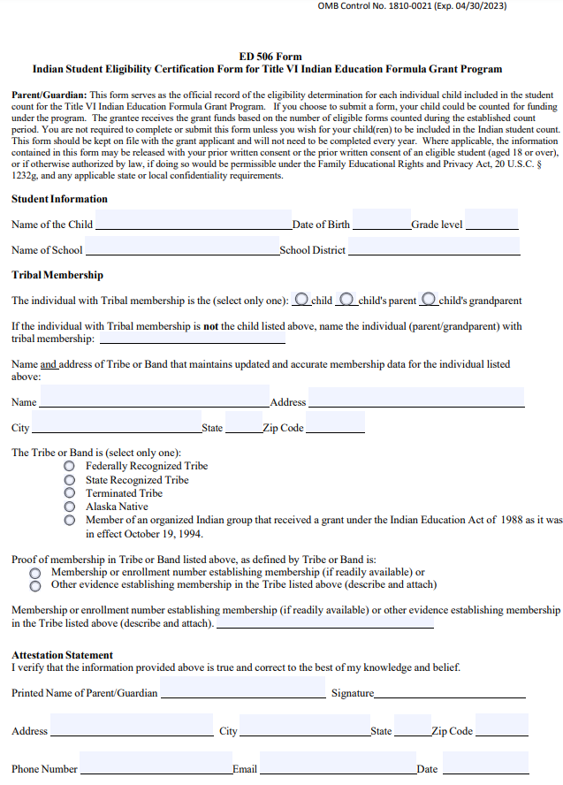
How to Complete ED 506 Forms
The Parent/Guardian must complete the following sections of the ED 506 Form:
Student Information
Tribal Membership
Attestation Statement
U.S. Office of Indian Education (OIE) | ED 506 Form
Notes:
Tawanda:
How to Complete ED 506 Forms?
The Parent/Guardian must complete the below sections of the ED 506 Form:
Student Information
Tribal Membership
Attestation Statement

Slide 14
Can ED 506 Forms be Completed Electronically?
Entities have also asked about obtaining parent signatures electronically; this is permitted.
Applicants should follow State and local laws and procedures concerning electronic signatures to ensure valid and authentic signatures.
U.S. Office of Indian Education (OIE) | ED 506 Form
Notes:
Tawanda:
Can ED 506 Forms be Completed Electronically?
Yes. The ED 506 Form is now electronically fillable. Entities have also asked about obtaining parent signatures electronically; this is permitted. Applicants should follow State and local laws and procedures concerning electronic signatures to ensure valid and authentic signatures.

Slide 15
What Information is Required for the ED 506 Form?
For an ED 506 form to be considered fully complete and compliant, it must contain all the following information:
Name of child and date of birth
School name and grade
Name of the Tribe, band, of Indians
If the Tribe listed is federally recognized, Alaska Native, state recognized, terminated, or an organized Indian group meeting
Name of the individual with tribal membership
If the individual named is the child, the child’s parent, or the child’s grandparent
Proof of membership, as defined by Tribe, which can be either: Membership or enrollment number (if readily available), OR other evidence establishing the membership
Name and address of the organization that maintains updated and accurate membership data for the Tribe, band, of Indians
The name and address of the parent or legal guardian of the child
Signature of the parent or the legal guardian of the child
Date the ED 506 Form was completed; and email address
U.S. Office of Indian Education (OIE) | ED 506 Form
Notes:
Tawanda:
What Information is Required for the ED 506 Form?
For an ED 506 form to be completed in full, it must contain all the following information:
Name of child and date of birth;
School name and grade;
Name of the Tribe, band, of Indians;
Whether the Tribe listed is federally recognized; Alaska Native; state recognized; terminated; or an organized Indian group meeting;
Name of the individual with tribal membership;
Whether the individual named is the child, the child’s parent, or the child’s grandparent;
Proof of membership, as defined by Tribe, which can be either: Membership or enrollment number (if readily available), OR other evidence establishing the membership;
Name and address of the organization that maintains updated and accurate membership data for the Tribe, band, of Indians;
The name and address of the parent or legal guardian of the child;
Signature of the parent or the legal guardian of the child;
Date the ED 506 Form was completed; and email address.

Slide 16
What if the Tribal Membership Enrollment Number is Not Available?
Tribal enrollment criteria are set forth in Tribal constitutions, articles of incorporation or ordinances. The criterion varies from tribe to tribe, so uniform membership requirements do not exist.
Each Tribe determines if an individual is eligible for membership and maintains its own current and historical enrollment records. Some Tribes require conditions such as tribal blood quantum, tribal residency, or continued contact with the tribe.
To obtain information about tribal enrollment documentation, you must contact individual Tribes. More information can be found at https://www.doi.gov/tribes/enrollment
U.S. Office of Indian Education (OIE) | ED 506 Form
Notes:
Tawanda:
What if the Tribal Membership Enrollment Number is Not Available?
Tribal enrollment criteria are set forth in tribal constitutions, articles of incorporation or ordinances. The criterion varies from tribe to tribe, so uniform membership requirements do not exist. Each tribe determines whether an individual is eligible for membership and maintains its own enrollment records and records about past members. Some tribes require conditions such as tribal blood quantum, tribal residency, or continued contact with the tribe; other Tribes require none of those types of items. To obtain information about tribal enrollment documentation, you must contact the specific Tribe. More information can be found at https://www.doi.gov/tribes/enrollment

Slide 17
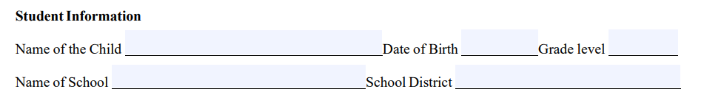
Student Information Section
U.S. Office of Indian Education (OIE) | ED 506 Form
Notes:
Wanda:
The first section on the ED 506 Form is the Student Information Section.
Write the name of the child, date of birth, grade level, name of school and school district. Only name one child per form.

Slide 18
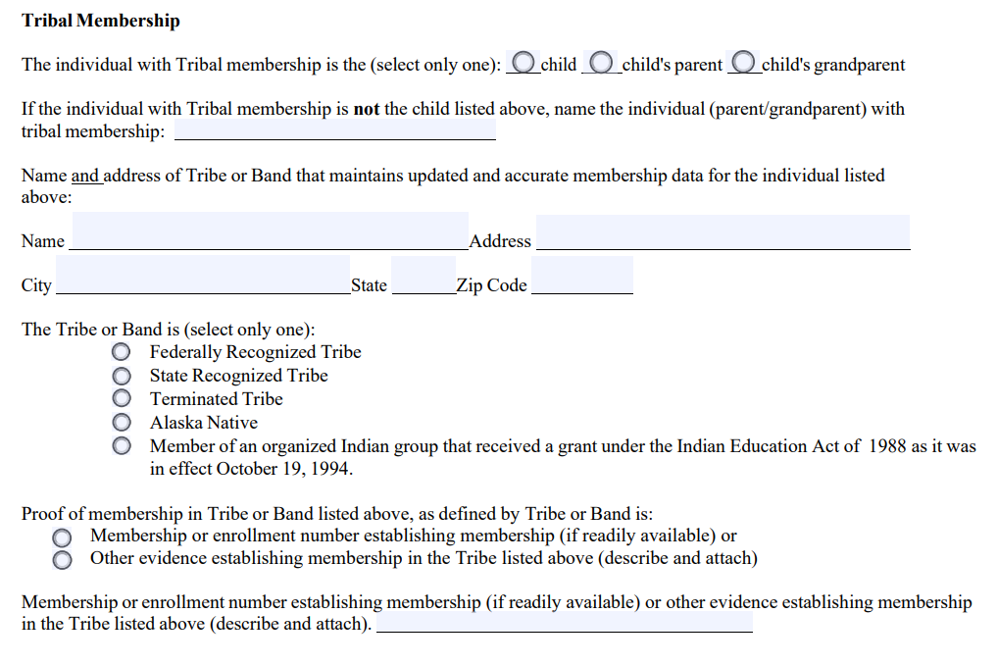
Tribal Membership Section
U.S. Office of Indian Education (OIE) | ED 506 Form
Notes:
Wanda:
The second section on the ED 506 Form is the Tribal Membership Section.
Write the name of the individual with the tribal membership, if it is not the child listed. Only one name is needed for this section, even though multiple persons may have tribal membership. Select only one identifier: the child, child’s parent or grandparent, for whom you can provide membership information.
Write the name and address of the organization that maintains updated and accurate membership data for such Tribe or Band of Indians. The name does not need to be the official name as it appears exactly on the Department of Interior’s list of federally recognized Tribes, but the name must be recognizable and be of sufficient detail to permit verification of the eligibility of the Tribe. Check only one box indicated whether it is a Federally Recognized, State Recognized, Terminated Tribe, Alaska Native, or Organized Indian Group.
Write the enrollment number establishing the membership for the child, parent or grandparent, if readily available, or other evidence of membership. If the enrollment number is not “readily available”, then provide “other evidence” of related Tribal membership – as directed on the form. To confirm, an enrollment number is NOT required to complete and submit this form if some form of “other evidence” of Tribal Membership is provided.

Slide 19
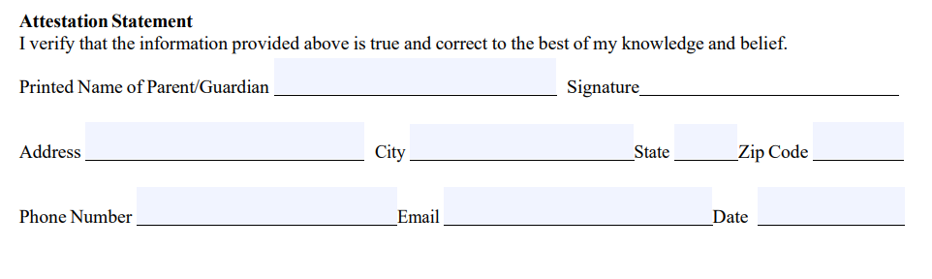
Attestation Statement Section
U.S. Office of Indian Education (OIE) | ED 506 Form
Notes:
Wanda:
The third section on the ED 506 Form is the Attestation Statement Section.
Provide the printed name of parent/guardian and signature, address, phone number and email of the parent or guardian of the child. The signature of the parent or guardian of the child verifies the accuracy of the information supplied.

Slide 20
How to Ensure Consistency in Reviewing ED 506 Forms
An entity should have official policy and procedures and Standard Operating Procedures (SOPs) in place to document how the LEA or the applicant is collecting, reviewing and maintaining ED 506 Forms. This will ensure consistency from year to year.
If you are applying in lieu of an LEA and the LEA was a previous grantee, you may use the previously collected ED 506 Forms for enrolled students. In addition, the ED 506 Form falls under the guidance of Family Educational Rights and Privacy Act, 20 U.S.C. §1232g, and any applicable or local confidentiality requirements.
U.S. Office of Indian Education (OIE) | ED 506 Form
Notes:
Wanda:
How to Ensure Consistency in Reviewing ED 506 Forms?
An entity should have official policy and procedures and Standard Operating Procedures (SOPs) in place to document how the LEA or the applicant is collecting, reviewing and maintaining ED 506 Forms. This will ensure consistency from year to year.
If you are applying in lieu of an LEA and the LEA was a previous grantee, you may use the previously collected ED 506 Forms for enrolled students. In addition, the ED 506 Form falls under the guidance of Family Educational Rights and Privacy Act, 20 U.S.C. §1232g, and any applicable state or local confidentiality requirements.

Slide 21

Important Dates to Remember (1 of 2)
EASIE Part I SY 2021-22 Dates:
Opens Monday, February 8, 2021
Closes Thursday, March 11, 2021 at 11:59 pm ET
EASIE Part I Webinars:
Tuesday, February 9, 2021 from 2:00 – 3:30 pm ET
  (beginning at 1:00 pm CT, 12:00 pm MT, 11:00 am PT)
Thursday, February 11, 2021 from 3:00 pm – 4:30 pm ET
  (beginning at 2:00 pm CT, 1:00 pm MT, 12:00 pm PT)
The EASIE Notice Inviting Applications (NIA) is linked here.
U.S. Office of Indian Education (OIE) | Indian Parent Committee Title VI – Application Process & Addressing Concerns
Notes:
Alec:
For your reference here are important dates to remember.
EASIE Part I for SY 2021-22 will open on Monday, February 8, 2021 and close on Thursday, March 11, 2021 at 11:59 p.m. ET. You can also view the EAIE Part I webinar dates below.
The EASIE Notice Inviting Applications (NIA) is linked here: https://www.federalregister.gov/documents/2021/01/12/2021-00321/applications-for-new-awards-office-of-indian-education-formula-grants-to-local-educational-agencies

Slide 22
Important Dates to Remember (2 of 2)
Additional Technical Assistance Webinars:
Indian Parent Committee: Application Process and Addressing Concerns Webinar
Thursday, February 4, 2021
  from 2:00 p.m. – 3:30 p.m. ET
  (beginning at 1:00 p.m. CT, 12:00 p.m. MT, 11:00 a.m. PT)
Users can access all EASIE Part I webinar registration links via the PSC broadcast sent on 1/25 or on the EASIE Communities of Practice calendar found on the EASIE Announcements page here.
U.S. Office of Indian Education (OIE) | Indian Parent Committee Title VI – Application Process & Addressing Concerns
Notes:
Alec:
Also, OIE/PSC will be presenting another technical assistance webinar this Thursday, February 4, 2021. This webinar is titled Indian Parent Committee: Application Process and Addressing Concerns Webinar.
Users can access all EASIE Part I webinar registration links via the PSC broadcast sent on 1/25 or on the EASIE Communities of Practice calendar found on the EASIE Announcements page here.
Please join us if you can. This webinar will also be recorded and published on the EASIE Communities of Practice website after concluding.

Slide 23

Question and Answer
U.S. Office of Indian Education (OIE) | ED 506 Form
Notes:
Alec:
So, this concludes our presentation for today.
We are going to take a few minutes to see if there are any questions that we can address in the time that remains. As a reminder, questions sent through the Q&A panel may not be answered in real-time. This helps ensure OIE has proper time to research each individualized policy issue prior to providing a response. If your question is not addressed, please contact PSC.
If you would like to ask your question verbally please enter this request in the Q&A panel and PSC will announce your name prior to unmuting you.

Slide 24

Thank you for Participating in Today’s Webinar!
If you have any questions about today’s presentation, please contact the Partner Support Center:
Phone: (877) 457-3336
Email: OIE.EASIE@ed.gov
U.S. Office of Indian Education (OIE) | ED 506 Form
Notes:
Alec:
It appears we have addressed as many of the questions as we could in the time remaining. If your question was not addressed, please contact PSC.
Thank you everyone for joining us today. As always, please feel free to contact the Partner Support Center with any questions or concerns regarding the ED 506 Form and/or the EASIE application process. Again, this PowerPoint as well as the audio recording of today’s webinar will be made available on the community site, or you can always contact PSC to request a copy of these materials.
So, that concludes today’s presentation! Thank you so much for your time and participation today and have a great day!

