Slide 1


Briarcliff
Girls Tennis

Slide 2

AGENDA
About Us:
⚬Karen McCarthy – Varsity Coach
⚬Colin Roller – Varsity Coach
⚬TBD -- JV Coach
  UTR & SportsYou Sign Up
  Expectations
  Schedules
  Team Store

Slide 3
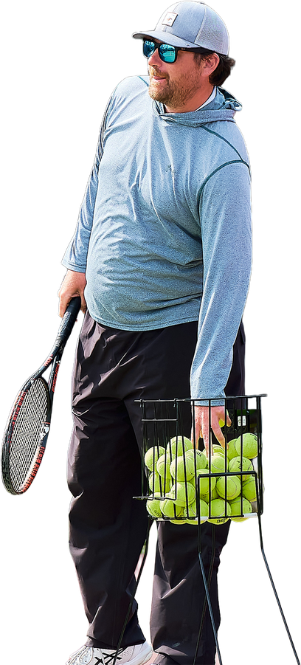
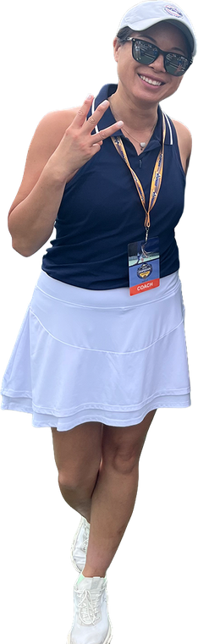
Coaching Staff Contact Info
Karen McCarthy (Varsity Coach)
⚬ O: (914)769-6299 ext. 3710
⚬ kmccarthy@briarcliffschools.org
Colin Roller (Varsity Coach)
⚬ (630) 525-1150
⚬ Croller@sleepyhollowcc.org
TBD (JV Coach)
• SportsYou App: All communications w/ coach via app

Slide 4
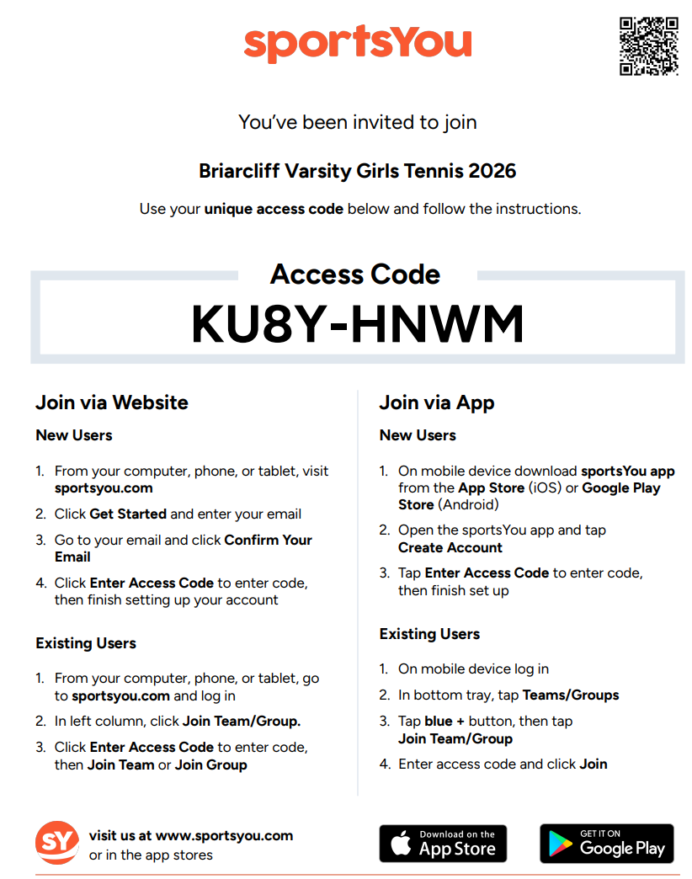
Communication
All communication via SportsYou app

Slide 5

REGISTER: UTR –
Universal Tennis Ranking
•All players rated w/ UTR – used for college recruiting
•All HS matches count toward UTR
•Used to set lineups more accurately
•Scout opposing team matchups; solve stacking issues
•Seed tournaments more accurately and objectively
•Track league standings

Slide 6
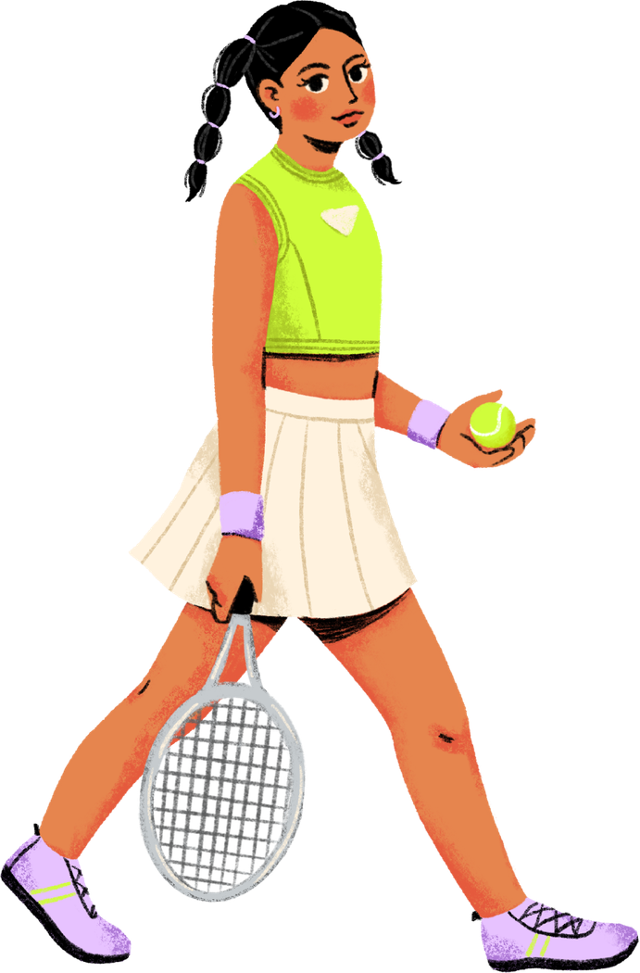
Important Dates and Practice Schedule
Season Start: Monday, 8/24
Try outs: Monday, 8/24 - Friday, 8/28
8 am - 9:30 am
(*Except Thursday, 8/27 - 1pm -2:30 pm*)
Varsity: Monday - Friday 3:30 pm - 5:00 pm
(Saturday practices as needed)
JV: Monday - Friday 5:00 pm - 6:30 pm
*Schedule is subject to change and will be communicated on SportsYou App*

Slide 7

Attendance
• You are expected to attend all practices and games fully prepared with tennis gear
• Excused absences (e.g. illness, religious obligation, testing) will be accepted with advanced notice to coach via email
• Unexcused absences will result in loss of playing time
• COMMUNICATION IS KEY
* All players must attend 6 practices minimum to be eligible to play in matches per NY State regulations*

Slide 8

NYSPHSAA TENNIS Format
•DII League Play = 2/3 Format
⚬2 Singles
⚬3 Doubles
•DI Crossover Matches = 3/4 Format
⚬3 Singles
⚬4 Doubles
  Exhibition matches depending on numbers
  ALL matches are 2 full tiebreak sets with a third set super-tiebreak (10 points)

Slide 9

Line Up Considerations
•8 Players for League Matches
•11 Players per match for some Crossover Matches
*Line ups will be made based on coach evaluations and challenge matches

Slide 10


Match Day Expectations
  HOME MATCHES: Players to be at courts 30 mins before match time
  AWAY MATCHES: 15 mins before the bus departs
All players are expected to travel to away matches by bus
* If players go home with a parent/guardian after an away match, parents must email the coach prior to the match.

Slide 11

Code of Conduct
•Tennis is a Gentlelady’s sport.
•ALL players will be expected to adhere to the Briarcliff Manor UFSD Code of Conduct
•Social media comments should be limited to positive aspects of your team and teammates
•All members of the team are expected to be kind and accepting to each other
Follow the Golden Rule!

Slide 12

Tennis Team Store
BSN
•Team Order: ¼ Zip –$35 personalized and embroidered (REQUIRED)
~ 2 week turnaround. Payment needed ASAP
(Cash or check made out to Briarcliff Boosters Club)
•Team Store: Optional branded merchandise for players and fans
Traditional Shop - 4 week turnaround; pay online
Sprint Shop– 1 week delivery
•DEADLINE for orders: Monday, 9/1 @ 11:59 pm

Slide 13

Questions?
Thank you!
Looking forward to a fun season

