Slide 1

2026 CROSS COUNTRY
Coach Coxen
bcoxen@briarcliffschools.org
Coach Byrnes
bbyrnes@briarcliffschools.org

Slide 2
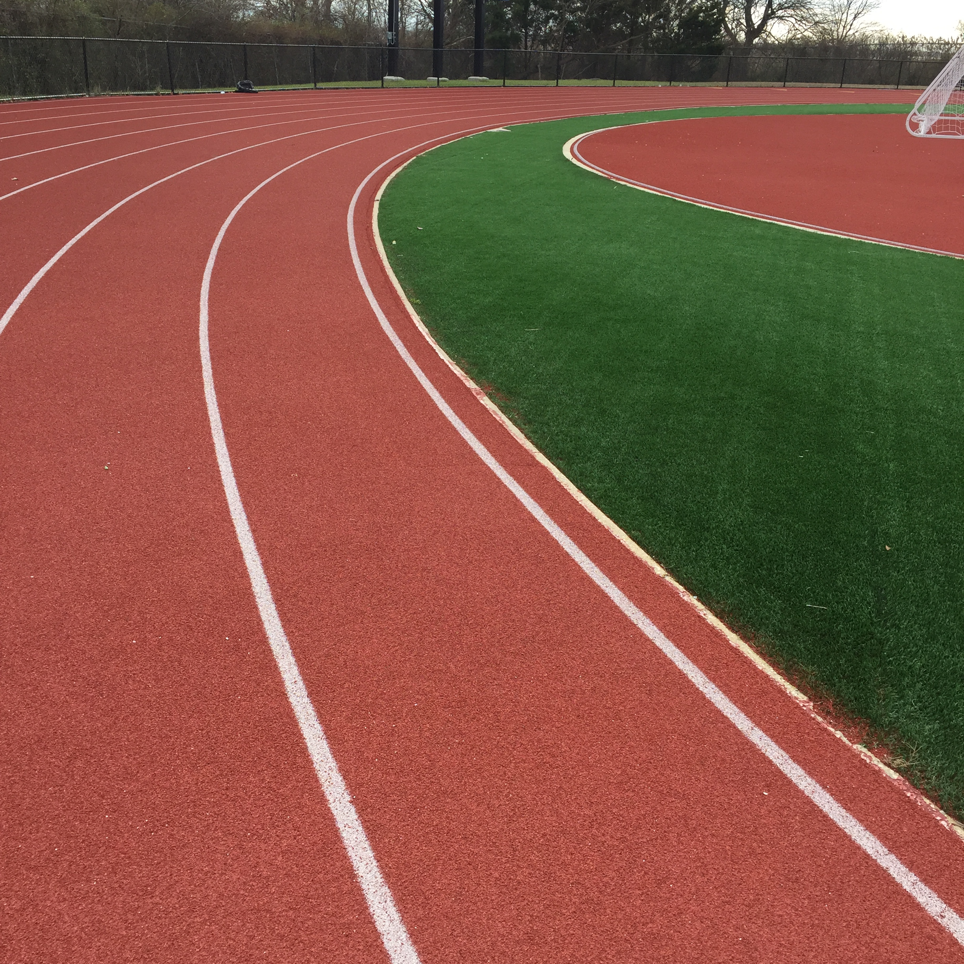
It’s fun to be fit!
The goal of the season is to provide a safe environment for our athletes to exercise and have fun.

Slide 3
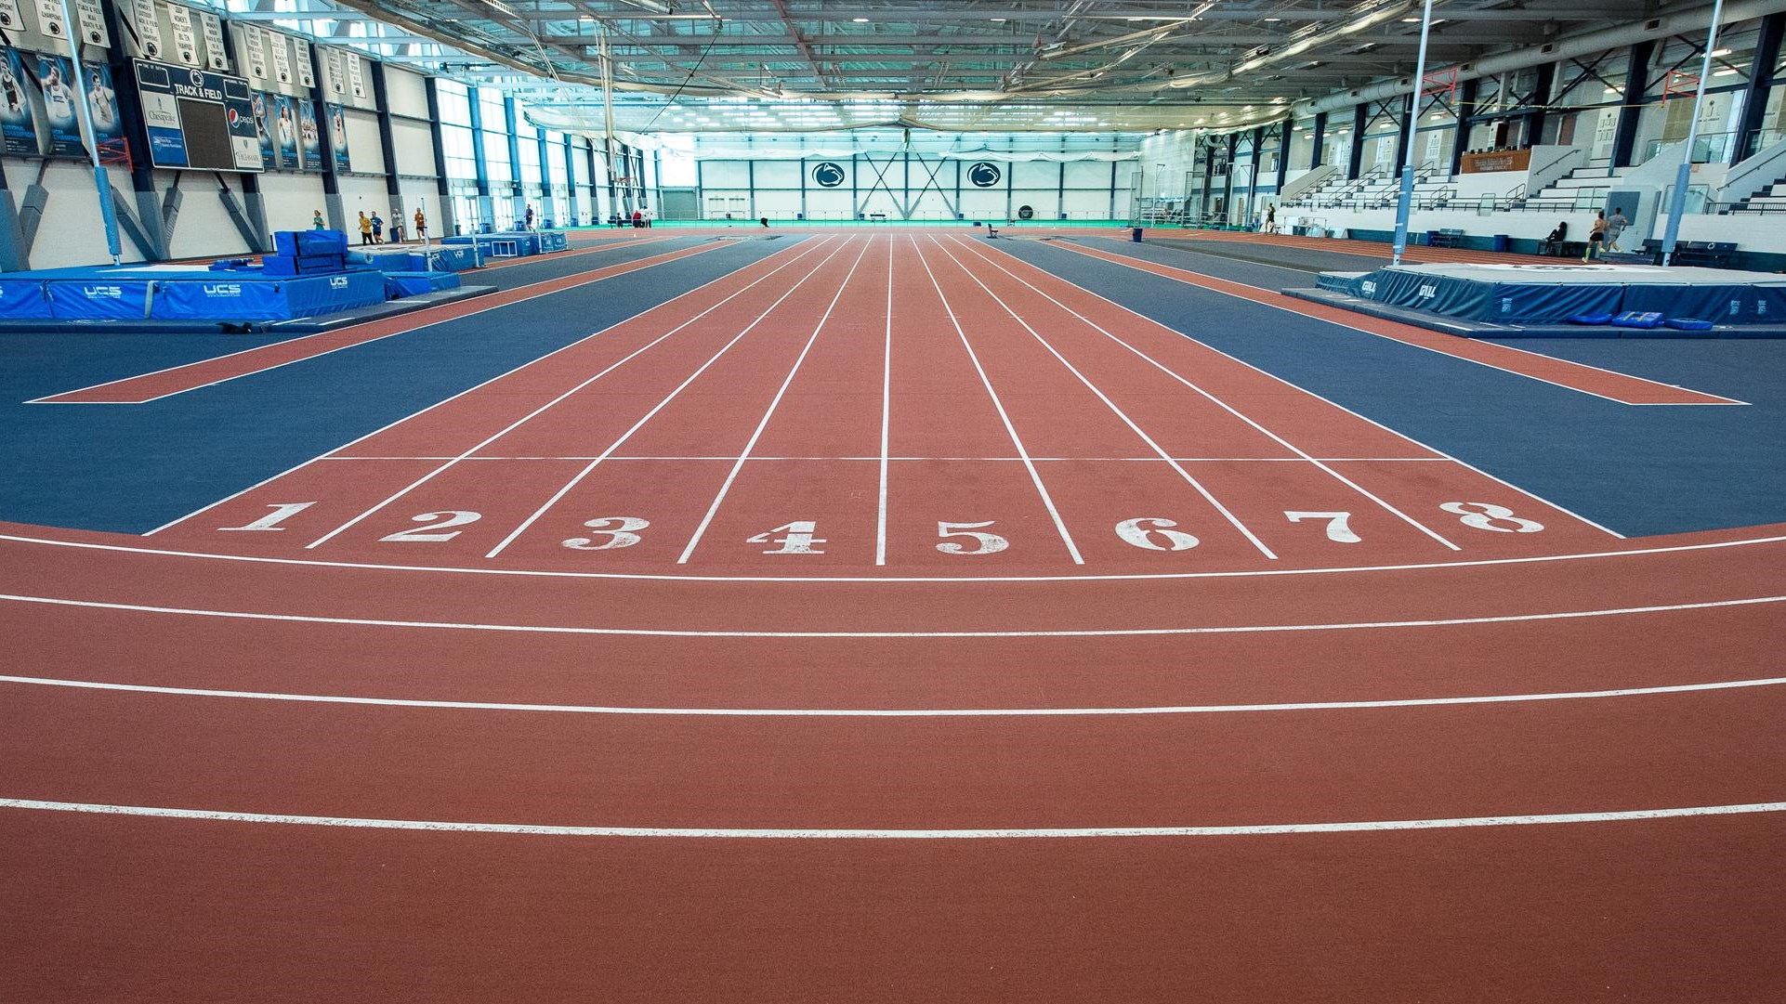
Student-Athletes must:
+ Register in Family ID
+ Be cleared by the District Medical Director
If an updated physical is needed, you will receive an email from the MS Nurse. If your child needs to take a baseline ImPACT test, you will receive an email from the Athletic Trainer.
Please register and submit forms as soon as possible as not to delay clearance.

Slide 4

Starting Date: Monday, September 8th
3:15 pm-4:15 pm
Monday-Friday BMS/BHS Campus

Slide 5
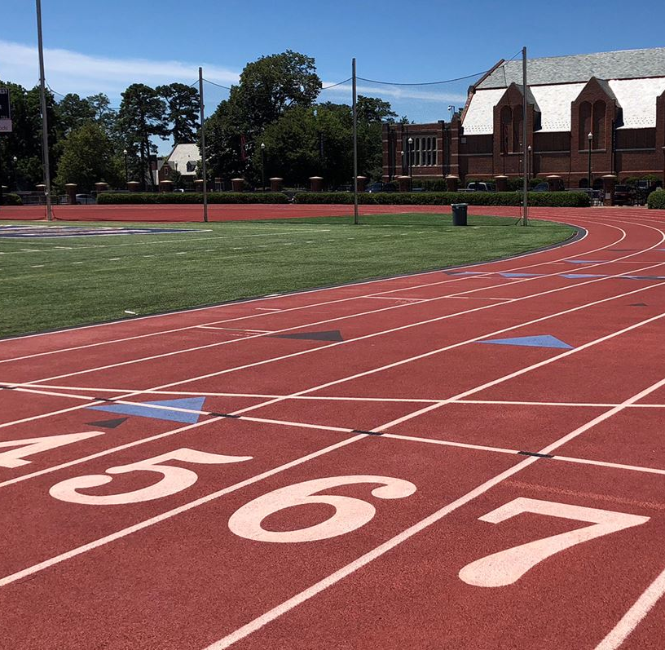
HS/MS Track
The coaches will meet the athletes at 3:15 pm in the Middle School cafeteria. Please be prompt.

Slide 6
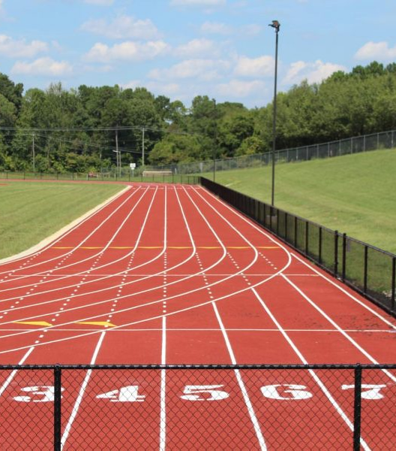
Practice Plan:
3:05pm – Meet Coach in the MS Café for Attendance
3:15pm – 3:30pm Pre-Workout Stretching
3:30pm – 3:45pm Track Work-Out
3:45pm- 4:00pm Cool Down/Core Exercises
4:00pm – 4:15pm Post Work-Out Stretching
4:15pm Parent Pick-Up in Front of Middle School

Slide 7

Team Snap App
To better update you during the season, we will be using the Team Snap App
The App will have the meet schedule with time and location once the season kicks off!
When our roster is complete, the app will send you an email to sign up free of charge
It's recommended that you download the app to your phone so any new alerts about changes of schedule or parent/coach communication will come via an alert on your phone.

